Slide 1

Realizing References
Sean Hardman
March 2011

Slide 2
Definitions
Association
Structure for relating one unique product to another in the registry.
Classification Scheme/Node
Structures for capturing taxonomies in the registry.
A larger topic that isn’t fully covered here.
Logical Identifier (LID)
A string of characters that identifies a product and its multiple versions.
Logical Identifier / Version Identifier (LIDVID)
A string of characters that uniquely identifies a product (single version).
Slot
Structure for capturing additional metadata attributes associated with a product in the registry.

Slide 3
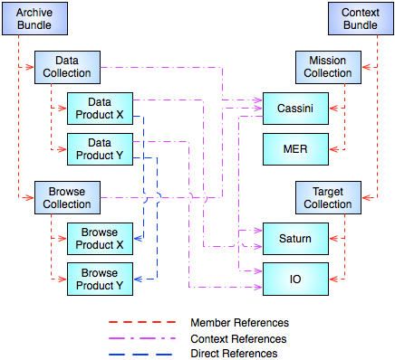
Example References
Member
Represents the logical/physical tree of the archive.
Context
Informational to facilitate search.
Realized at collection or data product level.
Direct
Represents ancillary information.

Slide 4
Reference Types
References between products facilitate search and discovery of data.
Less of a need to rely on keyword correlation.
In a perfect world, references are based on LIDVIDs.
A LIDVID uniquely identifies a product.
Nothing about PDS is perfect, so many of the references are based on LIDs.
A LID identifies a set of products (multiple versions).
LID-based references are resolved at request time.
This presentation focuses on how the Harvest Tool realizes these references in the Registry Service.

Slide 5
LIDVID-Based References
Registered as associations with the Registry Service.
The exception to this rule is if the registry configuration from the model excludes a given reference type.
Associations in the registry require that the source and target references be unique registry objects (products).
Examples include:
A collection referencing its member products.
A data product referencing directly derived products.
The preferred reference type for all member references.

Slide 6
LID-Based References Bundle to Member Collection
These references are currently LID-based and have different reference type values (e.g., has_data_collection) based on the collection referenced.
From the system perspective, LIDVID-based references are preferred.
Harvest creates a slot named according to the reference type and populates it with the LID for the referenced collection.
An example of the slot:
<slot name=‘has_data_collection’ id='800'>
<value>URN:NASA:PDS:PHX_MET:COLLECTION_DATA_RAW</value>
</slot>

Slide 7
LID-Based References Collection to Member Product
These references may be LID-based but have a single reference type (typically has_member) specified in the collection product.
Harvest creates a slot named according to the reference type and populates it with the LIDs for each product that the collection references with just a LID.
An example of the slot:
<slot name=‘has_member’ id='800'>
<value>URN:NASA:PDS:PHX-MET:DATA-RAW:MS000EMH_00896227783_10C6M1</value>
<value>URN:NASA:PDS:PHX-MET:DATA-RAW:MS000EML_00896227783_10C6M1</value>
</slot>

Slide 8
LID-Based References Any Product to Context Product
The model identifies classification schemes for each of the context product types (e.g., investigation, instrument, target, etc.).
The registry is populated with these classification schemes at configuration.
Harvest handles these references as follows:
Identifies a reference to a context product.
Based on the reference type (e.g., has_investigation, has_instrument, has_target, etc.).
Looks up the corresponding classification node.
Adds that classification to the product metadata upon registration.

Slide 9
LID-Based References Any Product to Another Product
These references are handled just like the Bundle to Member Collection references.
Meaning using slot based on the reference type specified.

Slide 10
Wrap Up
Although not all references will result in associations in the registry, they will be captured using other mechanisms.
No matter which mechanism is utilized, these references will be realized in the generated search indexes.
The drawback is that the other mechanisms will not be very useful for direct Registry Service queries.
Applications accessing the registry will need to understand their usefulness.

Slide 11
Questions/Comments

