Slide 1
KRC version 3.4.4 Update
Hugh H. Kieffer
Celestial Reasonings
hkieffer@charter.net
KRC is a thermal model for rotating (day << year) bodies: zero to modest atmosphere.
Mars < Planets, satellites, asteroids, boulders, exoplanets.
Relates IR observation to physical properties.
Continues to evolve. Today discuss new geophysics and a few interface changes
Your first source should be the KRC website: krc.mars.asu.edu
Documentation, quick or custom runs, or download the code-set.
Read the JGR paper, helplist, V34 users guide.
[could binge-watch 7 hours of video in parallel with the 2013 charts.]
2013jan28 @ASU

Slide 2
KRC folks: "Ask Kenny"
Phil: CEO
Hugh Kieffer --> ?: Cognizant programmer
Kenny Rios: IT support, repository and Web site
He has helpers
Robin Fergason: Mentor and validation
Sylvain Piqueux: Manage "Want list" priorities
Christopher Edwards: Davinci interface (next talk)
Your first source should be the KRC website: krc.mars.asu.edu
Two E-mailing lists: for developers and users.
Register, set if you want notices
BTW: 3.4.3 and 3.4.4 KRC are identical; latter has more documentation

Slide 3
Version 34x New geophysics
Closer to reality: see V34 Users guide
May have a condensing gas other than CO2.
Molecular weight, Saturation pressure relation
May invoke some Surface Photometric Models when there is no atmosphere.
Lambertian, Minnaert, Lommel-Seeliger, Keihm Beware, some can yield A>1 at large i, but KRC limits it.
May specify geothermal heat flow at the bottom.
May specify zone Tables of material properties versus depth.
For each zone: Conductivity, density, specific heat, thickness
Two zones may have temperature-dependent properties
Far-field seen by slopes may be temperatures from prior run. Large effect with low sun
Much closer to reality than prior "self-heating"; opens up many possibilities.
E.g., dune fields: run A=lee-face =33 deg east facing slope,
then B=windward side= west facing 15 deg slope with A as the far-field-file.
Or even with off-line step to create far-field-file as mix of lee-slopes and inter-dune flats.
Can do really thin layers! For I=50., minimum top soil layer of 32 micrometers. (But slow)
Test runs indicate differences less than about 0.1K away from frost edge; 1.5 if T-dep; 0 if no atm.

Slide 4
Cartoon of KRC v34 model
IRTM,THEMIS,TES
MiniTES, OTES, ...
No conduction to Atm.
Virtual layer above surface
Planetary
Brightness T
Any star
Any orbit
Any spin
P, any gas, varies
with season
and elevation
Dusty Atm.
IR τ Solar τ
Surface kinetic T
Frost
Slopes and pits
Option for
T-dependent
Conductivity
and
Specific heat
for 2 layers
Far-field surface
Photometric func.
Dry soil
Icy soil
Diurnal variation
Thermal diffusion
Seasonal memory
I~200
I=2290
Any number of custom layers
Insulating or constant temperature or heat flow
2013jan28 @ASU

Slide 5
Other changes
Automatic file extension with keyboard: .inp and same.prt
Slope azimuth sign corrected
Default master file values: Closer to Mars atm.
Improve the numerical accuracy at a modest cost in speed
Ran out of input parameters (~110), a few have multiple meanings!
Can handle up to 3 binary temperature files at once: designation has changed
8 5 x ’<file>’ / Initiate Type 52 multi-case output file
Recommended file extension is .t52
8 21 x ’<file>' / Direct-access output file, only the current case
value of K4OUT -1 to -3 sets how many of Tsurf, Tplanet, Tatm written
Recommended file extensions are .tm1 to .tm3 (type minus)
8 3 x ’<file>' / Far-field input file. Persists until 'off'
if x=1, prints each time a season requested
Auto-detects how many of Ts, Tp, Ta present
If needs Tatm, and it is not there, will fault and go on to next case.

Slide 6
Using KRC
There are several apparent interfaces (real interface is the ASCII input file):
1) Website a: simple i) one day ii) one hour for a year
b: Single point: List of specific time, places and conditions
c: File mode: edit an input file; run on ASU cluster, import resulting file.
2) Davinci: Interface to construct an input file. Christopher or Sylvain.
3) Local: Build KRC at your site (done if at ASU); edit input file
Intimidating: but can model any spinning solid body in the universe larger than a grapefruit
(with only one star, and no eclipses [yet], and not to much hot air)
Start with a master file,
run it changing only the output file location to get familiar with the process
Then edit to your goals.
If problems, can ask Kenny or some other user,
Send an email with description of problem. Always include the input file and the print file.
Helpful to trap what appeared on to the screen.
90% of problems are simple errors (mis-understanding) in the input file.

Slide 7
Typical input file, first part: real and integer
0 0 / KOLD: season to start with; KEEP: continue saving data in same disk file
Version 33 default values. 19 latitudes with mean Mars zonal elevations
ALBEDO EMISS INERTIA COND2 DENS2 PERIOD SPEC_HEAT DENSITY < titles
.25 1.00 200.0 2.77 928.0 1.0275 647. 1600. < values
CABR AMW SatPrA PTOTAL FANON TATM TDEEP SpHeat2
0.11 43.5 27.9546 546.0 .055 200. 180.0 1711.
TAUD/PHT DUSTA TAURAT TWILI ARC2/Pho ARC3=Safe SLOPE SLOAZI
0.3 .90 0.25 0.0 0.5 0.801 0.0 90.
TFROST CFROST AFROST FEMIS AF1 AF2 FROEXT SatPrB
146.0 589944. .65 0.95 0.54 0.0009 50. 3182.48
RLAY FLAY CONVF DEPTH DRSET DDT GGT DTMAX
1.1500 .100 3.0 0.0 0.0 .0020 0.1 0.1
DJUL DELJUL SOLARDEC DAU LsubS SOLCON GRAV AtmCp
-1222.69 17.174822 00.0 1.465 .0 1368. 3.727 735.9
ConUp0 ConUp1 ConUp2 ConUp3 ConLo0 ConLo1 ConLo2 ConLo3 \
0.038640 -0.002145 0.002347 -0.000750 2.766722 -1.298966 0.629224 -0.527291 | T-Dep
SphUp0 SphUp1 SphUp2 SphUp3 SphLo0 SphLo1 SphLo2 SphLo3 | Coeffs
646.6275 246.6678 -49.8216 7.9520 1710.648 721.8740 57.44873 24.37532 /
N1 N2 N3 N4 N5 N24 IIB IC2
38 1536 15 19 120 48 0 7
NRSET NMHA NRUN JDISK IDOWN FlxP14 TUN/Flx15 KPREF
3 24 0 81 0 45 65 1
K4OUT JBARE Notif IDISK2 end
52 0 50 0 0

Slide 8
Input file, lower part: Logical, latitudes, “magic matrix”, change lines
LP1 LP2 LP3 LP4 LP5 LP6 LPGLOB LVFA LVFT LkofT
F T F F F F F F F F
LPORB LKEY LSC LZONE LOCAL Prt76 LPTAVE Prt78 Prt79 L_ONE
T F F F T F F F F F
Latitudes: in 10F7.2 _____7 _____7 _____7 _____7 _____7 _____7 _____7
-87.50 -80.00 -70.00 -60.00 -50.00 -40.00 -30.00 -20.00 -10.00 0.00 Line for each 10
10.00 20.00 30.00 40.00 50.00 60.00 70.00 80.00 87.50 -0.00
_____7 _____7 _____7 Elevations: in 10F7.2 ____7 _____7 _____7 _____7
3.51 2.01 1.39 1.22 0.38 0.48 1.17 1.67 1.26 0.17 match the lats.
-0.94 -1.28 -1.99 -2.51 -3.52 -4.08 -4.51 -4.38 -2.57 -0.00
2013 Jul 24 11:28:09=RUNTIME. IPLAN AND TC= 104.0 0.10000 Mars:Mars \ <- what it is
104.0000 0.1000000 0.8644665 0.3226901E-01 -1.281586 | Cut and paste
0.9340198E-01 1.523712 0.4090926 0.000000 0.9229373 | geometry
5.544402 0.000000 0.000000 686.9929 3397.977 | matrix from
24.62296 0.000000 -1.240317 0.000000 0.000000 | PORB run
0.000000 0.3244965 0.8559126 0.4026359 -0.9458869 |
0.2936298 0.1381285 0.000000 -0.4256703 0.9048783 /
8 5 0 'trial34.t52' / Disk file name for Run 1
0/
2 8 999 'IC2' / homogenous will be case 2
0/
2 8 777 'IC2' / Turn 2-material off. Affects only the values in krccom.
8 25 -7 '/home/hkieffer/krc/zoneX.tab' / Zone table
0/
0/ ======================= end of run

Slide 9
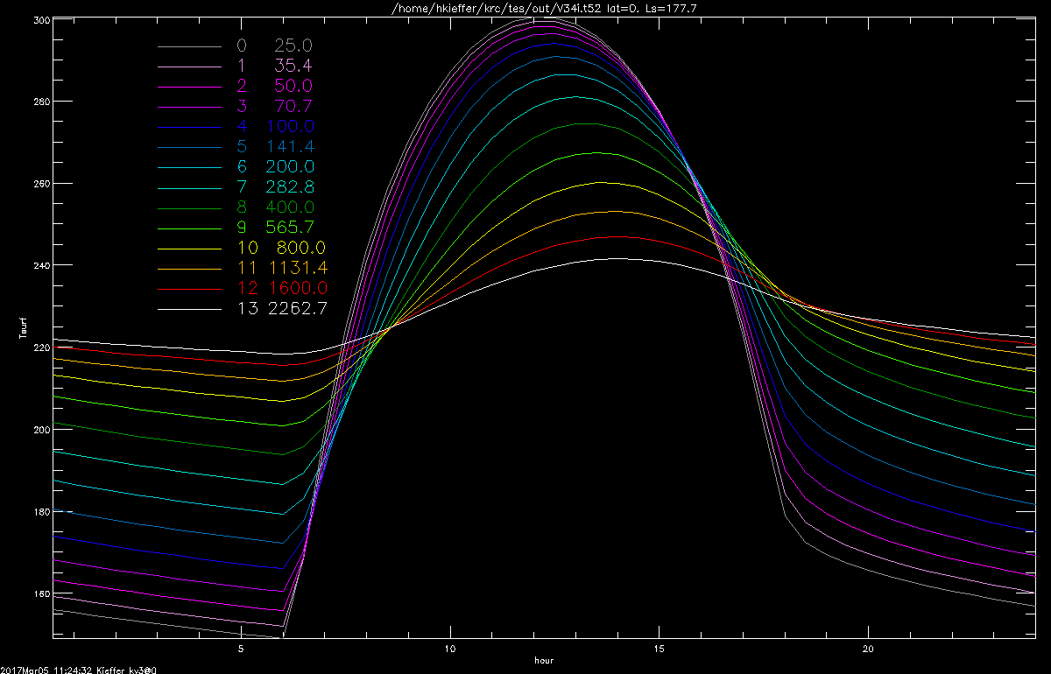
Nominal Mars: √2 Inertia set. Lat.=0, Ls=178

Slide 10
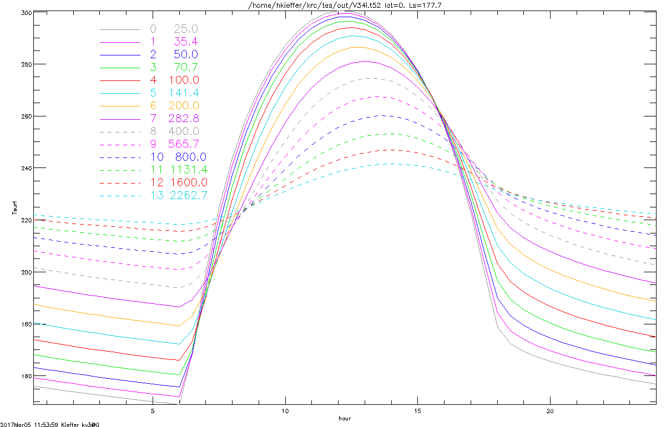
Nominal Mars: √2 Inertia set. Lat.=0, Ls=178

Slide 11
Type 52 output file: (learn to love it) [hours,7,latitudes,x+seasons,cases]
First x seasons contain, for each case:
  Float of 4 integers that define sizes
  Floating point of all input parameters: krccom
  Array(nseas,5): DJU5=date, SUBS=Ls(Mars), PZREF=Surface pressure at 0 elevation,
  TAUD=dust opacity, SUMF=total polar frost
For true seasons, the 7 contain:
  1: TSF, surface kinetic temperature
  2: TPF, planetary bolometric temperature
  3: TAF. Atmosphere kinetic temperature
  4: DOWNVIS: Downward solar flux at the surface
  5: DOWNIR: Downward thermal flux from the atmosphere at surface
  6 and 7 are packed into Hours: Nlay- means as many physical layers from top as fit.
  6: NDJ4=# of convergence days, DTM4=rms temperature change on last day,
  TTA4=predicted final atm. Temp., TIN(Nlay-) = minimum diurnal temperature
  7: FROST4=predicted frost, AFRO4=frost albedo, HEATMM=daily average surface heat flow, TAX(Nlay-) = maximum diurnal temperature of each layer
2013jan28 @ASU

Slide 12
Type 52 use
Type 52 has large capability. Run with one case and look for :
RASE,MASE,MTOT= 37.29 37 9920736
MASE is number of cases that fit in a single run.
Restrictions on multiple cases in one Type 52 file:
Input items that would change any of the bin5 dimensions are not allowed to
increase between cases; i.e., N24 = hours output, N4 = Number of latitudes
and N5-JDISK = number of seasons output.
Dimensions are liberal, defined in krccm8.f , listed in Helplist section 7.2
Type 52 is a “bin5” file: simple format ASCII header that lists sizes
Readers exist in IDL, C++ [?], Davinci
If you prefer another language; write a reader in it and share!

Slide 13
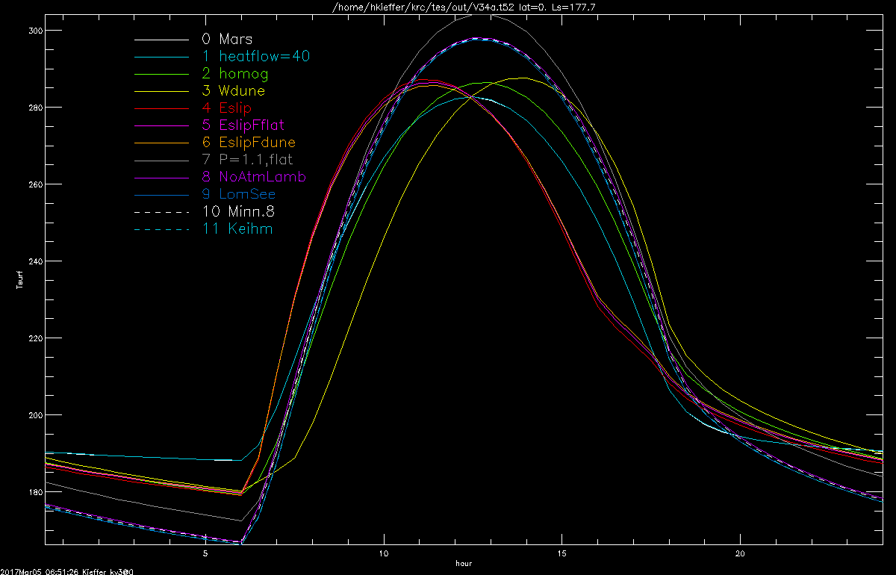
V34 features : Lat. 0, Ls 178

Slide 14
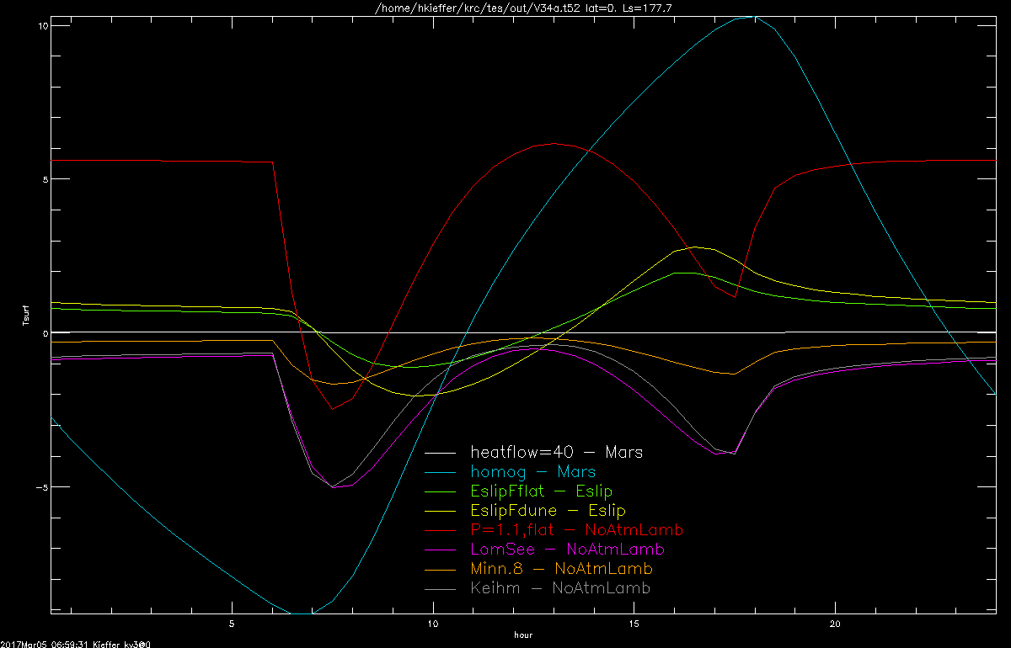
V34: delta Tsurf between models

Slide 15
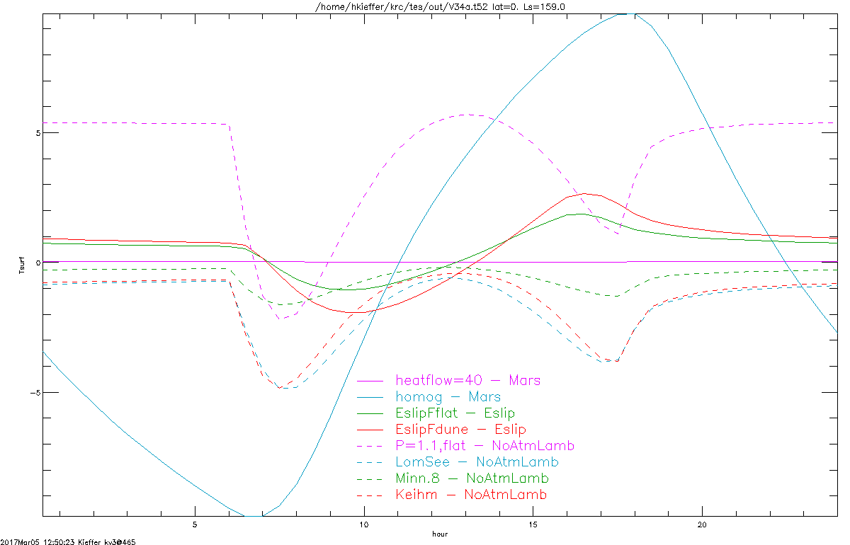
V34: delta Tsurf between models

Slide 16
Reading packed bin5 files
;finame in. String of file name
; ttt out. Fltarr(hour,item,latitude,season,case) Item labels are in itemt
; 0= surface kinetic temperature
; 1= Top-of-atmosphere bolometric temperature
; 2= one-layer atmosphere kinetic temperature
; 3= Down-welling solar radiance
; 4= Down-welling thermal radiance
; uuu out. Fltarr(nlat,item,case) Item labels are in itemu
; 0= Latitude in degrees
; 1= elevation in Km.
; vvv out. Fltarr(season,item,case) I Item labels are in itemv
; 0= Model season julian date relative to J2000.0 = 2000 Jan 1 noon
; 1= L-sub-S computed in KRC
; 2= Global mean pressure: PZREF
; itemt,u,v out. Strarr ID's for the items in ttt, uuu, and vvv
;
; ddd out. Fltarr(layer,item,latitude,season,case) Item labels are in itemd
; Item: 0=Tmin 1=Tmax
; ggg out. Fltarr(item,latitude,season,case) Item labels are in itemg
; Items: NDJ4, DTM4, TTA4, FROST4, AFRO4, HEATMM
; itemd,g out. Strarr ID's for the items in ddd, and ggg
;
; func. out. Fltarr of L-sub-S corresponding to Jul.Day for the first case.
; If an error, returns negative integer
; -1: -4 are from READKRCCOM, -5 = failure here
2013jan28 @ASU

Slide 17
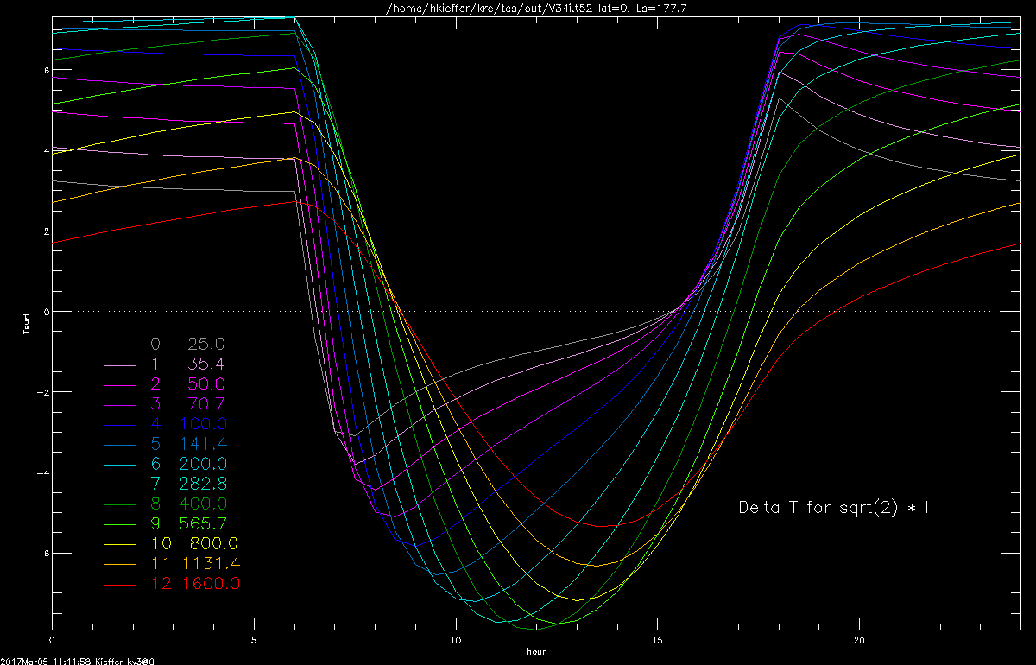
dT/dI/√2 for nominal Mars. Lat.=0, Ls=178

Slide 18
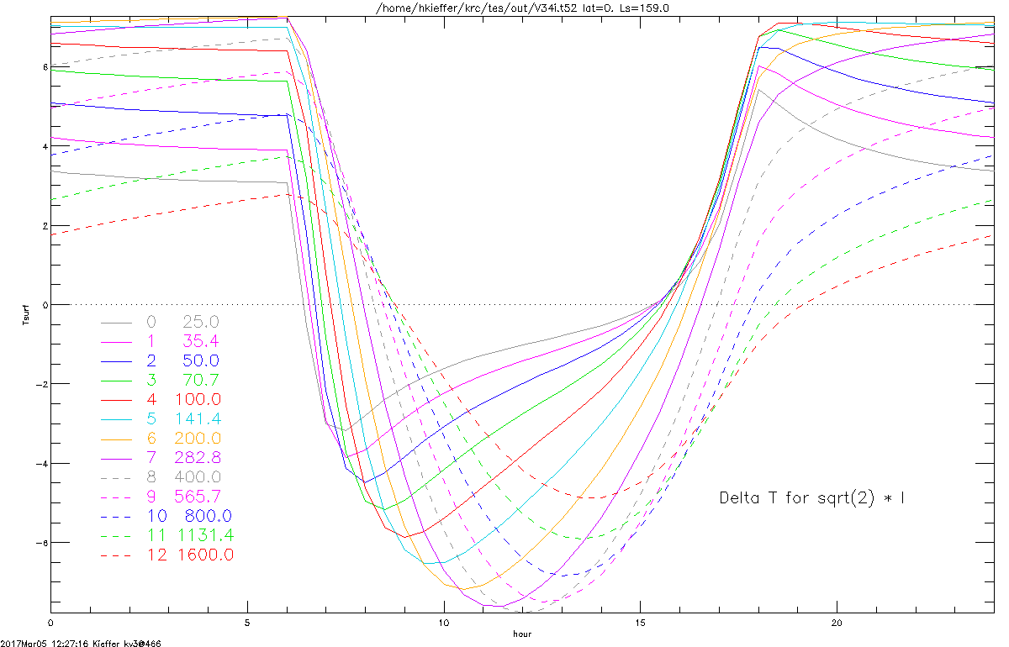
dT/dI/√2 for nominal Mars. Lat.=0, Ls=178

Slide 19
If an error occurs:
Compare your input file to the master.
  Unix: use diff
Check the helplist definition for each item that was modified
If you can not get it to run properly, then ...
Send three files to the mentor: describe your goal.
  Input file
  What appeared on the screen
  Print file
2013jan28 @ASU

Slide 20
Going forward
KRC is probably not faultless. Always check that the results make physical sense.
Minnaert and Lommel-Seeliger photometric functions have bug prior to v3.4.5
Documentation by coder is never a good idea! The digital truth is in the source code.
Odd shapes. If not concave, simply consider latitude and Hour of the local surface.
Rough surfaces and thermal beaming are in development as a post-process
Wishlist: Eclipses and slow rotation. Big change as longitudes will be different,
Will need to add a seventh loop.
You can request new capabilities:

Slide 21
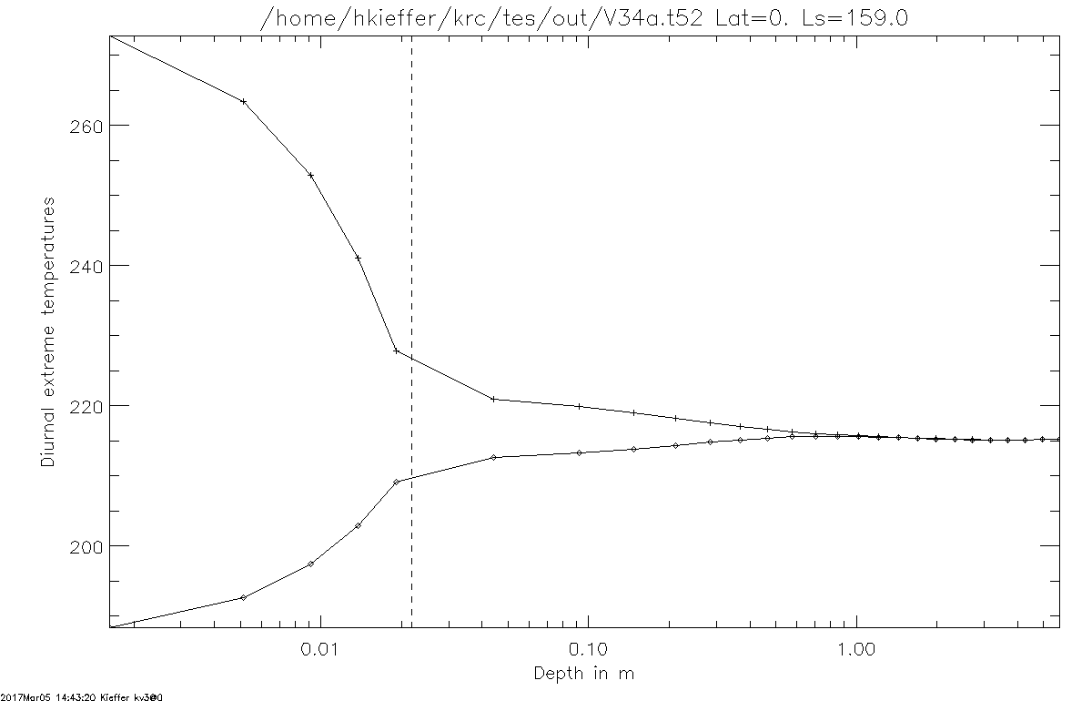
Diurnal Min/Max T after 2.5 years
I=200
I=200
I=2100: dirty ice
Can just see annual wiggle

Slide 22
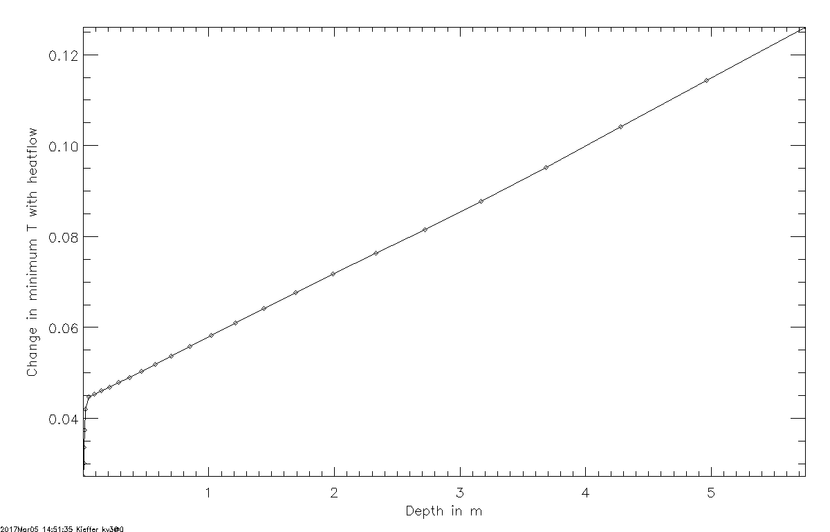
Effect of 40 mW/m2 geothermal heatflow
After 2.7 years, gradient 4% less than theory

Slide 23
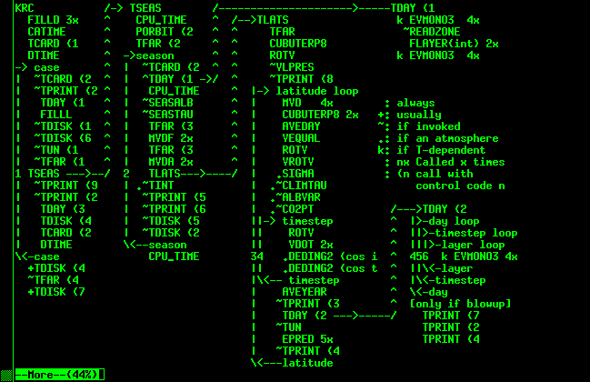
Crude call diagram
From: flow.txt

Slide 24
empty

