Slide 1

Design and Use of the KRC Thermal Model
Hugh H. Kieffer
Celestial Reasonings
hkieffer@charter.net
775-782-0767
Observe temperatures, but commonly want physical properties. Connected by a model. I=√(kρC) = Thermal Inertia
  K=k= conductivity
  R=rho = ρ=density
  C= specific heat
Basic temperature response to a periodic radiation boundary condition
Required reading: JGR-Planets 2013
Thermal model for analysis of Mars infrared mapping
2013jan28 @ASU

Slide 2
Purpose: Transfer knowledge of KRC
A. Users of the maintained version on website: krc.mars.asu.edu
B. Folks wanting their own copy: at ASU or elsewhere
C. People wishing to modify KRC at their site
D. Curation staff:
  Cognizant programmer
  Mentor
  Website master
Documentation is not always reliable. Search the code
2013jan28 @ASU

Slide 3
Outline
A brief history of a long time
Physics included and omitted
Input format: normal and OnePoint
Examples
Architecture
  Run, case, season, latitude, day, time-step, layer
  Call Diagrams: Flow between routines
Use of Commons
Output formats: Print and binary
  Sequential Access: 3 each
  .bin5 packed: 5 each
PORB: Objects other than Mars
Liens: Things yet to be done
[[ Typical Use: Model Sets; detailed studies
2013jan28 @ASU

Slide 4
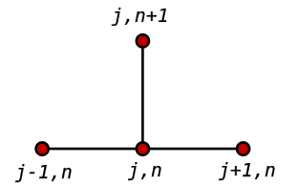
History
Begun in 1968 to support Mariner 6 and 7 infrared radiometers (IRR) and proposal for Viking IRTM
Anticipated need for global/annual models == big runs
Computers were much slower than today
  One case: 18 latitudes, 40 seasons, took an hour on the fastest unclassified computer in the world.
  Now, one second
Choose implicit forward differences
Carefully code for speed
Evolution: step-wise, with occasional bug fixes
  Physics-based one-layer atmosphere
  Additional output formats
  Temperature-dependent thermal conductivity and specific heat
^
T
i
m
e
Depth ->
2013jan28 @ASU

Slide 5
Major physics
Upper and lower materials: separate K, ρ, C
K and C may be temperature-dependent; cubic polynomial in T
Terrain can slope, or be bottom of conical pit
Insulating or fixed T lower boundary
Any orbit, spin axis, rotation period.
One layer atmosphere, gray in solar and thermal regions. Or none
Atmosphere radiation, but not conduction.
Conserves energy
Local seasonal condensation. Atm. condensation falls as snow
If surface reaches CO₂ saturation, starts frost accumulation
Switch to frost properties; gradual for albedo
Total frost may control global pressure, (the only latitude coupling)
or use Viking Lander relation, or constant
Allows table-driven seasonal opacity and albedo
Can use seasonal map of dust and ice opacity
Version derived from Mike Smith THEMIS maps available
Allows twilight
2013jan28 @ASU

Slide 6
Basic Surface and Subsurface Treatment
Surface condition: Radiation Balance
  Specify albedo A , emissivity ε, slope and azimuth.
  Can have frost with different A, ε and scattering thickness scale
  Frost albedo: constant or linear with insolation (two precoded)
  Imbalance of solar and thermal radiation goes into changing
  temperature of the top layer, or into changes of frost amount.
Subsurface: thermal diffusion
  Specify thermal inertia (I), conductivity(k) and density(ρ)
  Lower boundary can be insulating, constant temperature, or fixed constant.
  Can have a different material below a given layer;
  k, ρ and specific heat C_{P}.
2013jan28 @ASU

Slide 7
Atmosphere and multiple scattering
Gray in solar and thermal region, one layer,
  Transmits, absorbs, and scatters solar radiation; Two stream Delta-Eddington
  Transmits, absorbs and emits thermal radiation, Isotropic
  Flux imbalance goes into change of temperature (apart from twilight)
Dust amount and radiative characteristics can be specified
Direct sunlight: Lambertian local surface -> DIRECT
Diffuse Vis. & IR: based on fraction of sky visible -> DIFFUSE
Reflected from surface -> BOUNCE
All three Vis. above normalized to solar flux at Mars -> SOLR
Surface pressure based on elevation. one of:
  constant,
  follow Viking Landers
  based on global integration of frost.
2013jan28 @ASU

Slide 8
2-stream Delta-Eddington for Sunlight
f tp://climate1.gsfc.nasa.gov/wiscombe/Multiple_Scatt/DeltaEddington/DeltaEddingPaper.pdf
Joseph et al, 1976 Delta-Eddington Approximation for radiative flux transfer,J.Atm.Sci vol.33,2453-2459 (1976)
deding2.f See citations therein. Comments tie equations.
Collimated and diffuse beams
Scattering uses Henyey-Greestein function.
  Assymetry set by ARC2 -> G0
    Zero is isotropic, + 1 is pure forward scattering
  Single scattering albedo set by DUSTA -> OMEGA . Maximum 0.999
Runs in double precision (required)
2013jan28 @ASU

Slide 9
Method
Surface thermal inertia, specific heat and density determine the conductivity and diffusivity. Layers scaled with the diurnal skin depth (DSD)
  First layer is 0.18 of DSD, successive ones thicker by factor of 1.2
  As layers become so thick that thermal diffusion through them is small in one time step, time steps are doubled
  Elaborate start-up and convergence techniques; Stability tests
This scheme allows accurate practical treatment of diurnal and seasonal heat flow
Virtually all physical and grid parameters adjustable: ~127 total.
Most you need not touch.
2013jan28 @ASU

Slide 10
Cartoon of KRC model
MGS
ODY
Planetary
Brightness T
P varies with season
and elevation
Dusty Atm.
IR τ Solar τ
No conduction to Atm. Virtual layer above surface
Surface kinetic T
Frost
Slopes and pits
Option for
T-dependent
Conductivity
and
Specific heat
Dry soil
Icy soil
Diurnal variation
Thermal diffusion
Seasonal memory
I~200
I=2290
Insulating or constant temperature
2013jan28 @ASU

Slide 11
What is in KRC
Periodic insolation (sunlight)
  Brightness of the Sun ( or any star)
  Orbit of mars (or any other elliptical orbit)
  Orientation of Mars spin axis ( or any planet/satellite/asteroid)
  Length of a “day” (Sun on the meridian)
  Any number of seasons/year, up to many years
Up to 37 latitudes in a set. All with the same properties
Up to two layered materials; any total depth
  Density (constant), thermal conductivity, specific heat (may vary with T)
Surface albedo; flat, plane slope, or conical depression
Second-order dusty/icy atmosphere, or no atmosphere
What's not included
2013jan28 @ASU

Slide 12
Absent Geophysics. To be included?
Radiative-convective atmosphere (Jakosky-Mellon)
Turbulent mixing (Need wind speed; Vasavada; GCM)
More than 2 materials; fully-flexible layer structure
Vertical transport of sensible and latent heat by gaseous diffusion (Mellon, others ) and regolith breathing (no one?)
Local rocks and shadows: lateral heat conduction
Regional topography with shadows and radiative coupling
Season changes incrementally every SOL
  Now: Planet spins in place for a season
Geothermal heat flow
Solar eclipse (for satellites)
Equation of time (length of solar day varies through a year)
2013jan28 @ASU

Slide 13
Atmosphere model.
One Layer, gray in solar and thermal.
Delta-Eddington, two-stream
Starts at equilibrium with surface based on diurnal average radiation balance.
Solar heating plus any infrared excess or deficit: change the temperature
Affects view-from-space bolometric temperature
Slopes and pits
Considers direct, diffuse, and one-bounce radiation.
Approximation: regional surrounds at same temperature as target.
2013jan28 @ASU

Slide 14
KRC atmosphere
One layer; solar and thermal radiation (later slide)
Gravity and molecular weight: default to Mars
Set the scale height
Surface pressure: 3 options
  Constant, ∝Viking, decreased by global frost mass.
Dust opacity may vary with season: scaled to local pressure
Global table, or zonal climate that allows ice-cloud opacity
  Ice-cloud opacity does not scale to local surface pressure
One-component may condense: snow and accumulated mass
Presence of any frost sets surface T at the local saturation value
  Frost albedo may vary with insolation intensity (Mars' does)
  Frost effect on albedo goes realistically to zero as it thins
2013jan28 @ASU

Slide 15
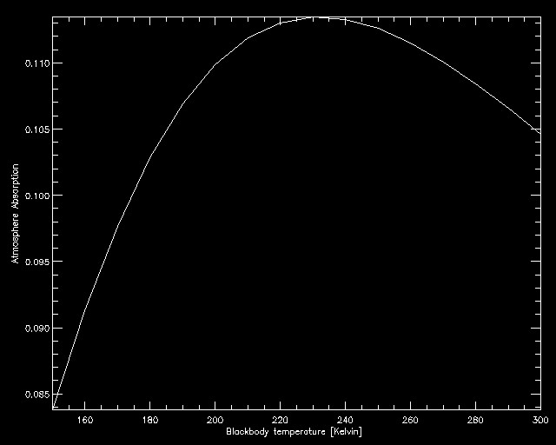
CO2 gas only thermal radiation absorption
2013jan28 @ASU

Slide 16


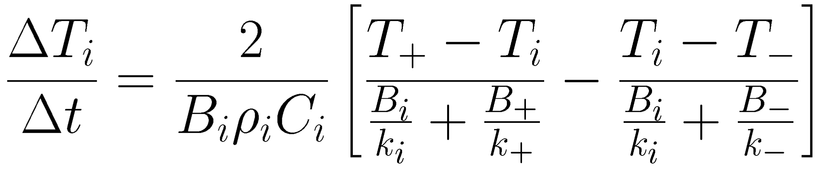
Energy Balance & Heat Diffusion Equations
Surface energy balance; excess/deficit into frost
Last term assumed zero
Subsurface:
Finite
difference
code for grid
T-dependent
properties
Coded for T-ind as: DO J=2,KN with KN a “comb” for time-steps
DTJ(J)=FA1(J)* (TTJ(J+1)+FA2(J)*TTJ(J)+FA3(J)*TTJ(J-1))
Much more code for the T-dep case.
Followed by: DO J=2,KN
TTJ(J)=TTJ(J) + DTJ(J)
2013jan28 @ASU

Slide 17
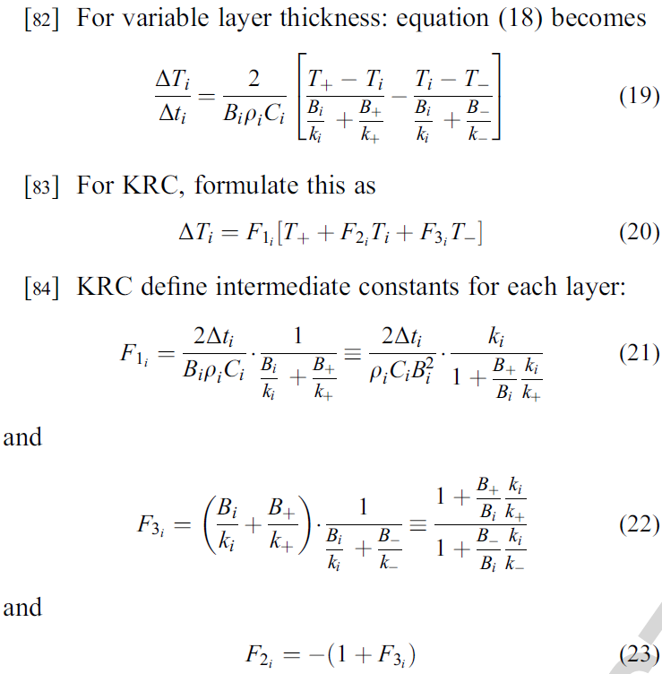
Equations accomodating T-dependence
For T-dependence, must evaluate all k for each time-step.
For T-ind, in each equation the B and k terms reduce to a single constant value for each layer
2013jan28 @ASU

Slide 18
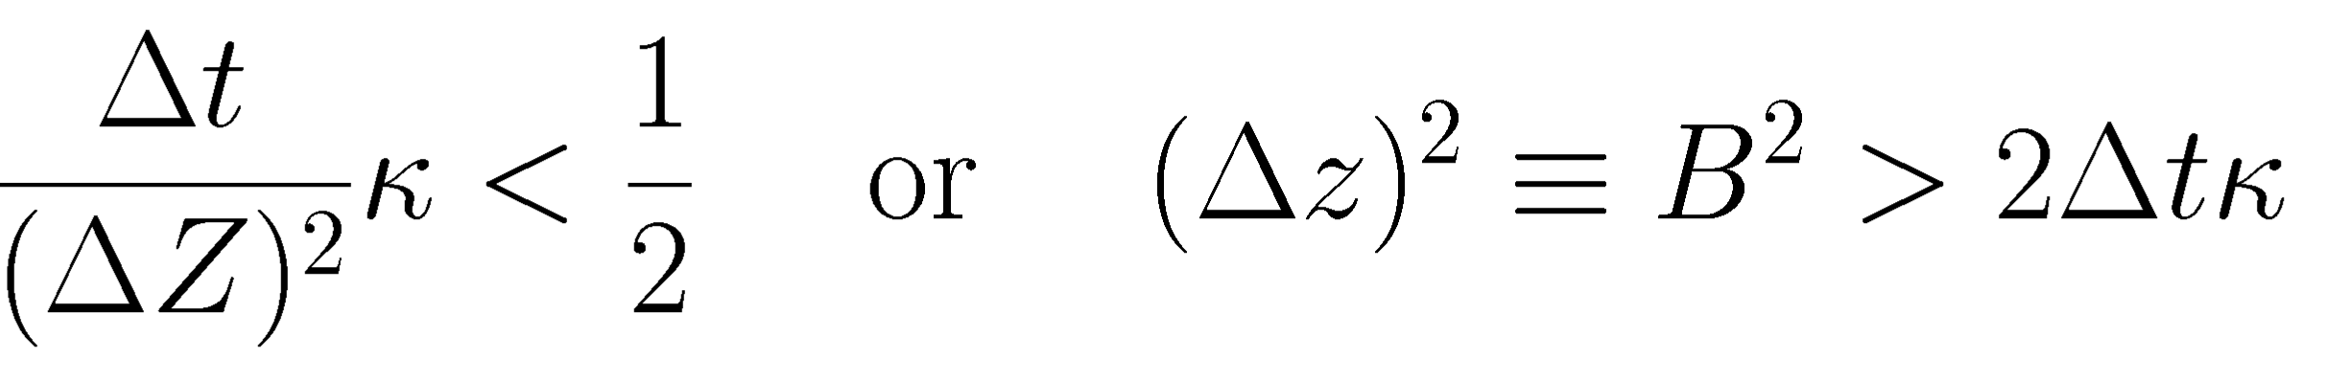
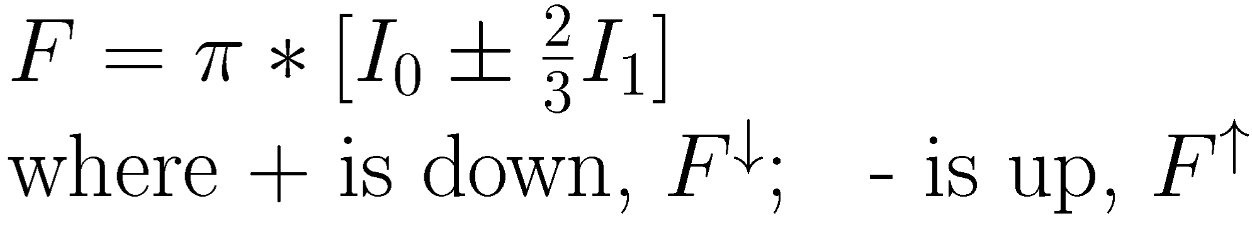
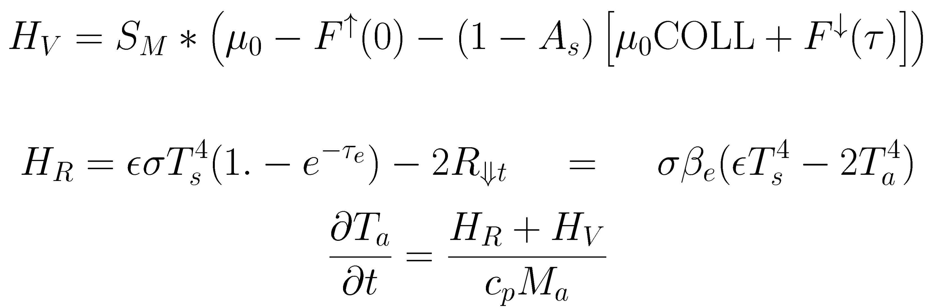
More Equations
Convergence criterion
Two-stream
Delta-Eddington
Atmospheric
heating
Planetary Temperature
2013jan28 @ASU

Slide 19
Numerical Approach
Explicit forward finite differences
Highly optimized code
Basic loop architecture
[Cases]
Seasons
Latitudes
Days
Layers-1
Layers-2
Up to 30 layers, up to 37 latitudes, up to 384*4 time-steps per sol, output at 24 or 48 “hours”/day, up to 16 days to converge., up to 740 seasons.
  All the maximum sizes could be adjusted in krccom.inc
Dynamic dimensioning of .bin5 output files [not FORTRAN-friendly]:
e.g., latitudes*seasons*cases
2013jan28 @ASU

Slide 20
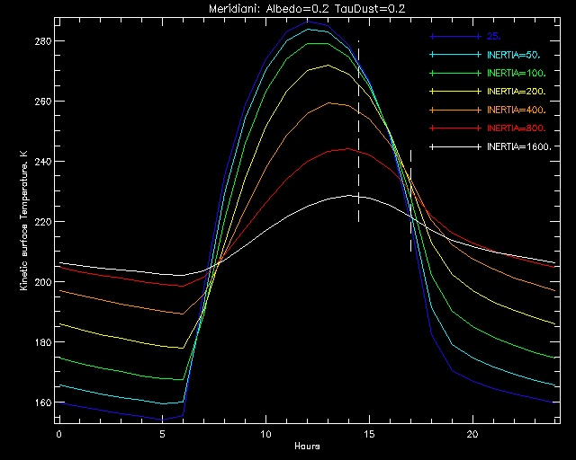
Thermal inertia effect on temperature
THEMIS
2013jan28 @ASU

Slide 21
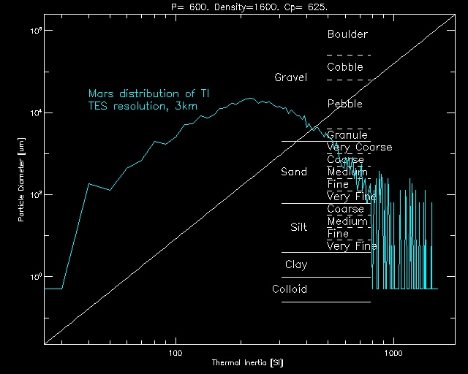
Effective particle size on Mars
Mix of rocks and fines
2013jan28 @ASU

Slide 22
Frost and snow
Local seasonal CO₂ saturation at surface
Super-cooling of atmosphere avoided: energy supplied by CO₂ condensation.
Resulting snow falls to surface (within a day) and adds to surface frost inventory.
Surface frost albedo can follow observed insolation-dependence
  Mars' seasonal frost albedo commonly increases with Sun intensity
Thin frosts are translucent, no discontinuities !
Global integration of solid CO₂ :
  average mass deducted from surface pressure
2013jan28 @ASU

Slide 23
How close is KRC to Mars ???
KRC based on best-estimates of physical parameters
Absence of wind-effect probably the largest shortfall.
Beware working near the edge of the seasonal cap:
  Interpolation commonly not valid between frost and no-frost
2013jan28 @ASU

Slide 24
Everything controlled by input file
# layers, Hours_out/day, latitudes, seasons,…
Start date, Delta season, first to disk, index of major changes
Surface physical properties: two materials
neither/both use T-dependent properties
Atmosphere properties
Frost physical and radiative prop.
  Option: insolation dependant albedo
Planet orientation, day and orbit
  Pre-computer rotation matrices
Layer and time scheme; Convergence criteria
Print output
Output files: 3 direct-read (FORTRAN sequential access)
and 5 compound .bin5
  Most users will be fine with Type 52
2013jan28 @ASU

Slide 25
Meant to be a tool: Many ways to use it
Sets of uniform global models
  E.g., Viking used three
  THEMIS using hundreds
  Global average temperature map used nearly a thousand
Studies of slope effect
Models of rock proportion
Multi-year “spin-up” , then every sol, hour or time step (5 minutes)
The “one-point” mode:
Input list of targets:
Phil ran 1.5 billion points to make thermal movie
There is a “Helplist” users guide
KRC website provides ability to run the maintained version
A distribution includes all source code, sample files, documentation,…
2013jan28 @ASU

Slide 26
What do You want to do?
Several output formats: e.g. Type 52 has:
  Surface kinetic, planetary and atmosphere temperatures every “Hour”,
  minimum and maximum diurnal temperatures for each layer,
  For each latitude:
  Days to convergence, RMS temperature change on last day,
  predicted atmosphere temperature, amount of frost, frost albedo,
  mean upward heat flow into surface
  Global values for every season:
  Julian date (offset from 2,440,000), Ls, Atm pressure at 0 elevation,
  dust opacity, total frost.
  IDL readers provided for every output format.
  Need to generate a common-language (non-IDL) reader
  There is a DeVinci input interface to prior KRC version; could easily be updated
2013jan28 @ASU

Slide 27
Input File: it’s simpler than it looks
master.inp 2013jan22
0 0 / KOLD: season to start with; KEEP: continue saving data in same disk file
Default values for all parameters. 19 latitudes with mean Mars elevations
ALBEDO EMISS INERTIA COND2 DENS2 PERIOD SPEC_HEAT DENSITY
.25 1.00 200.0 2.77 928.0 1.0275 647. 1600.
CABR AMW [ABRPHA PTOTAL FANON TATM TDEEP SpHeat2
0.11 43.5 -0.00 546.0 .055 200. 180.0 1711.
TAUD DUSTA TAURAT TWILI ACR2 [ARC3 SLOPE SLOAZI
0.3 .90 0.5 0.0 0.5 -0.00 0.0 90.
TFROST CFROST AFROST FEMIS AF1 AF2 FROEXT [FD32
146.0 589944. .65 0.95 0.54 0.0009 50. 0.0
RLAY FLAY CONVF DEPTH DRSET DDT GGT DTMAX
1.2000 .1800 2.0000 0.0 0.0 .0020 0.1 0.1
DJUL DELJUL SOLARDEC DAU LsubS SOLCON GRAV AtmCp
10322.33 17.1745 00.0 1.465 .0 1368. 3.727 735.9
ConUp0 ConUp1 ConUp2 ConUp3 ConLo0 ConLo1 ConLo2 ConLo3
0.050087 -0.002145 0.002347 -0.000750 2.766722 -1.298966 0.629224 -0.527291
SphUp0 SphUp1 SphUp2 SphUp3 SphLo0 SphLo1 SphLo2 SphLo3
646.6275 246.6678 -49.8216 7.9520 1710.648 721.8740 57.44873 24.37532
N1 N2 N3 N4 N5 N24 IB IC
20 384 15 19 120 24 0 7
NRSET NMHA NRUN JDISK IDOWN FlxP14 FlxP15 KPREF
3 24 1 81 0 45 65 1
K4OUT JBARE Notif [IDISK2 end
52 0 20 -0 0
LP1 LP2 LP3 LP4 LP5 LP6 LPGLOB LVFA LVFT LkofT
F T F F F F F F F F
LPORB LKEY LSC spare LOCAL Prt76 LPTAVE Prt78 Prt79 L_ONE
T F F F T F F F F F
2013jan28 @ASU

Slide 28
Input file, continued
Latitudes: in 10F7.2 _____7 _____7 _____7 _____7 _____7 _____7 _____7
-87.50 -80.00 -70.00 -60.00 -50.00 -40.00 -30.00 -20.00 -10.00 0.00
10.00 20.00 30.00 40.00 50.00 60.00 70.00 80.00 87.50 -0.00
Elevations: in 10F7.2 _____7 _____7 _____7 _____7 _____7 _____7 _____7
3.51 2.01 1.39 1.22 0.38 0.48 1.17 1.67 1.26 0.17
-0.94 -1.28 -1.99 -2.51 -3.52 -4.08 -4.51 -4.38 -2.57 -0.00
08 Sep 29 10:41:33 =RUNTIME. IPLAN AND TC= 4.0 0.55000
4.000000 0.5500000 0.8650615 0.3229325E-01 5.000821
0.9340634E-01 1.523671 12882.95 686.9650 0.9229904
5.544495 24.62280 0.000000 0.4093198 0.000000
0.000000 0.000000 0.000000 6.159676 0.4662921
0.4172604E-01 0.6197483 4.381073 0.000000 1.228627
0.6619807 0.000000 1.391099 0.1075499 -0.3195100E-01
0.2263214 -1.246176 -0.5861457 -0.8611114E-01 0.8908045
0.4461527 -0.9063585 0.1158813 -0.4063075 -0.4136413
-0.4393618 0.7974096 0.9138050 -0.4049719 -0.3095386E-01
0.4054090 0.9140893 0.9184200E-02 0.2457525E-01 -0.2094154E-01
0.9994786 -0.3252879 -0.8556869 -0.4024770 0.9456150
-0.2943530 -0.1384504 0.7823110E-07 0.4256245 -0.9048999
8 0 0 '/work1/krc/mars/masterA.t52' / Disk file name
1 12 540. 'PTOTAL set to yield 7 mb at VL1 @ Ls=100' /
1 4 0.22 'COND2'/ to match lower k(T)
1 35 4. 'CONVF' / push time doubling start deeper
0/ a zero ends a case
3 10 1 'LkofT' / Temperature-dependant conductivity
0/
0/ two zeros end a run
Locations
Orbit and
Pole
matrix.
Mars
2005
Change Cards,
See Helplist
2013jan28 @ASU

Slide 29
Input Changes
8 0 0 '/work1/krc/mars/master.t52' / Disk file name
1 12 540. 'PTOTAL set to yield 7 mb at VL1 @ Ls=100'
1 35 4. 'CONVF' / push time doubling start deeper
0/ <<< end of a case
0/ <<< 2nd consecutive 0 is end of the run
Next is an example of an elaborate set of change cards that looks in detail at the temperatures through the first 40 sols of ice freshly exposed at the bottom of a conical pit. It uses 3 latitudes and does 5 cases; the first is ice freshly exposed to a full hemisphere of sky, followed by pits with slopes of 45 and 25 degrees, then these two pits with a different initial ice temperature
2 integers, 1 real/integer/logical, one text [/] free comments
2013jan28 @ASU

Slide 30
Complex Input
7 7 7 'Pit dug to ice by Phoenix' / New title
8 0 0 '../output/phx4.t52' / Disk file name/
1 1 .20 'Albedo'
1 3 2025.3 'Inertia for ice' /
1 7 1300. 'Spec heat' / for ice
1 8 928. 'Density' / for ice
1 15 185. 'TDEEP' /
1 17 0.2 'TAUD'
1 39 .001 'GGT: set to avoid ending early' / set for daily output
1 41 11920.2 'DJUL' / starting date
1 42 1.0275 'DELJUL 1 sol' / set for daily output
2 1 19 'Num Layers' /
2 3 1 'N3: set to run each day' / set for daily output
2 4 3 'N4' / number of latitudes
2 5 40 'N5' / total number of seasons = sols
2 7 2 'IB start all =TDEEP' /
2 12 1 'JDISK start immediately' /
2 17 52 'K4OUT’ /
4 77 77 'New Latitudes' / Must be N4 of them in 10F7.2
65.00 70.00 72.00 -10.00 0.00 10.00 25.00 45.00 70.00 22.00
5 77 77 'New Elevations' / Must be N4 of them in 10F7.2
-3.5 -3.5 -3.5 00.0 00.0 00.0 00.0 00.0 00.0 -3.1
0/
1 24 -400. 'Azimuth. Set flag to indicate a pit' /
1 23 45. 'Slope' / slope of pit wall
0/
1 23 65. 'Slope' /
0/
1 23 45. ’reset Slope' /
1 15 220. ' TDEEP' /
0/
1 23 65. 'Slope' /
0/
0/
2013jan28 @ASU

Slide 31
Layer Table: I=200 Cp=630 Density=1600
Conductiv.= 3.968E-02 Dens*Cp= 1.008E+06 Diffu.= 3.937E-08 Scale= 3.335E-02
___THICKNESS____ _______CENTER_DEPTH_____ CONVERGENCE
LAYER scale meter scale meter kg/m^2 factor
1 0.1800 0.0060 -0.0900 -0.0030 0.000 0.000
2 0.2160 0.0072 0.1080 0.0036 11.527 2.851
3 0.2592 0.0086 0.3456 0.0115 25.359 2.053
4 0.3110 0.0104 0.6307 0.0210 41.958 2.956
5 0.3732 0.0124 0.9729 0.0324 61.877 2.129
6 0.4479 0.0149 1.3834 0.0461 85.779 3.065
7 0.5375 0.0179 1.8761 0.0626 114.462 2.207
8 0.6450 0.0215 2.4673 0.0823 148.882 3.178
9 0.7740 0.0258 3.1768 0.1060 190.185 2.288
10 0.9288 0.0310 4.0282 0.1344 239.749 3.295
11 1.1145 0.0372 5.0498 0.1684 299.226 2.372
12 1.3374 0.0446 6.2758 0.2093 370.598 3.416
13 1.6049 0.0535 7.7469 0.2584 456.244 2.460
14 1.9259 0.0642 9.5123 0.3173 559.020 3.542
15 2.3111 0.0771 11.6308 0.3879 682.351 2.550
16 2.7733 0.0925 14.1730 0.4727 830.348 3.672
17 3.3279 0.1110 17.2235 0.5745 1007.945 5.288
18 3.9935 0.1332 20.8843 0.6966 1221.061 7.615
19 4.7922 0.1598 25.2771 0.8431 1476.800 10.965
20 5.7506 0.1918 30.5485 1.0189 1783.687 15.790
21 6.9008 0.2302 36.8742 1.2299 2151.951 22.737
22 8.2809 0.2762 44.4651 1.4831 2593.868 32.742
23 9.9371 0.3314 53.5741 1.7869 3124.169 47.148
24 11.9245 0.3977 64.5049 2.1515 3760.530 67.893
25 14.3094 0.4773 77.6219 2.5890 4524.163 97.766
Bottom layers for time doubling: 2 4 6 8 10 12 14 25
2013jan28 @ASU

Slide 32
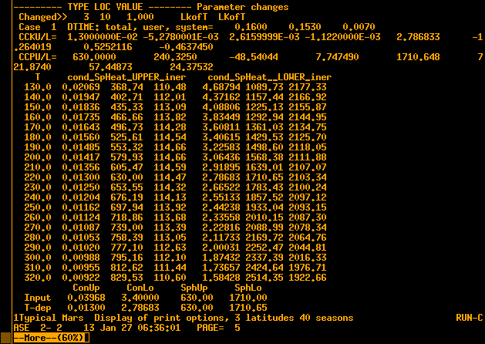
T-dependent Table
← Check for similarity

Slide 33
The one-point mode
Input file points to ‘one.inp’ list of “targets”.
Interactive, or provide a text-file of rows with
  Ls = season
  Latitude
  Hour of day
  Surface elevation
  Albedo
  Thermal Inertia
  Solar opacity
  Surface slope
  Slope azimuth
Any other non-default values can be specified in the formatted input parameter file
Outputs:
  Surface kinetic temperature
  Top-of-atmosphere bolometric brightness temperature
2013jan28 @ASU

Slide 34
KRC-lite. The “one-point” interface
You build a table of “points” of interest:
  Ls
  Latitude
  Hour
  Elevation (km)
  Bolometric Albedo
  Thermal Inertia (SI units)
  Atmosphere Visual opacity
  Regional slope (degrees)
  Azimuth of down-slope (degrees Eastward of North)
Output file has these, plus columns of:
  Surface kinetic temperature, Tsurf
  Top-of-Atmosphere bolometric temperature,Tplan==Tbolo
2013jan28 @ASU

Slide 35
One-point details
Copy one.inp Edit it; rigid format. Keep name the same
  Title Line, Text transfered to output. This & next line must be present
  11 Ls Lat Hour Elev Alb Inerti Opac Slop_Azim <Align each field
  11 123.1 4.1 9.4 22.22 0.17 100.0 0.10 0 0
  11 320.1 -33.1 15.5 -3.12 0.15 500.1 0.55 0.0 123.
  11 180. -10.1 13.5 0. 0.20 200.0 0.50 0.0 123.
Run krc. Input file is: krcone_master.inp
  This file sets KRC into 13 layer, 1 latitude, short season mode, and points to one.inp.
Underneath the one-point mode is the full KRC model
You can copy krcone_master.inp and edit it to do [almost] whatever you like, including point to a different one-point file
2013jan28 @ASU

Slide 36
Production Mode
Pre-compute hundreds of models on a grid of albedo, dust opacity,
thermal inertia, surface elevation, latitude, hour, season.
  Traditionally output direct-access files, a record for each season
Interpolation scheme: mostly quadratic
Extract surface and nadir-view temperatures for target.
Select results for albedo and dust opacity based on observations
Logarithmic interpolate at observed temperature to derive thermal inertia
Time is not an issue. Can do entire TES or THEMIS model set* in an hour.
  Mellon models took a week.
* 48 times of day, 37 latitudes, [168+] 84 seasons,
3 albedos, 3 opacities, 3 elevations, 10 inertias.
2013jan28 @ASU

Slide 37
Output
Default print file (krc.prt) lists all changes, then the full input list, then the layer table, which should usually be contemplated.
Options to turn on many kinds of printout.
  Beware: file can get huge.
Binary output files: 7 kinds in two sets: controlled by K4OUT
Fortran direct access. [Allows restart at any recorded season]
-1: Used for major model runs. Outputs KRCCOM, which contains all the input parameters, then arrays of Surface kinetic temperature and Planetary Bolometric Temperature for each season.
0: LATCOM. Arrays of several variables versus latitude and depth
+1: DAYCOM for the last latitude for each season. Arrays of variables versus time-step or Hour or convergence-day.
2013jan28 @ASU

Slide 38
Bin5 Binary output arrays
+51: Minimum and Maximum temperature for all layers, 5 latitudes, 40 seasons, 5 cases
  Layers 29,30 contain Tp_min, Tp_max, L_sub_s, Julian Day
+52: 24 hours, 6 items, 5:10 lats, 1+<=80 seasons, <=5 cases)
  Items are: Tsurf, Tplan, Tatm, DownVis, DownIR, spare
  First "season" contains: KRCCOM and 3 season variables
+53: Combo at 1 lat, 2+80 seasons, 10 cases
  Combo: Tsurf & Tplan @ 24 hours; Tmin & Tmax @ 30 layers,
  Asol @ 24 hours. The first 2 "seasons" contain KRCCOM
+54: 68:740 seasons, 3 items, 1+<= 5 lats, <=10 cases
  3 items are: heat flow, surface temperature, frost amount
  Store KRCCOM in the first latitude
2013jan28 @ASU

Slide 39
Model sets and Determination of Thermal Inertia
Two large set of models have been pre-computed.
  Both have: Two year run-up, 3 albedos, 3 opacities, 3 elevations,
  logrithmic inertia. Tsur and Tplan output at 24 Hour points:
Mellon: Used for TES production.
  84 seasons, 39 latitudes, 10 Inertias (25:800)
KRC: recent run, plan to extend to I>=2000
  84 seasons, 37 latitudes, 15 Inertias (25:800), 3 albedos, 3 pressures, climate odust and ice opacities, 9 slopes [K4OUT=-1]
Interpolation: described in Mellon,Jakosky, Kieffer and Christensen (2000): Icarus, 148, on page 441.4a
  Season: linear
  Albedo, opacity, elevation: quadratic
  Hour and Latitude: bilinear
Yields a set of 10 temperatures. Finds set between Tmin and Tmax
  Inertia: linear in logarithm, And dT/dI for final interval
2013jan28 @ASU

Slide 40
Installation and Supporting documentation
KRC installed at ASU
Helplist.tex Guide to running KRC
/mars/u/hkieffer/cop/krcCorP2.pdf Corrected version of JGR article
HeatOft.pdf Temperature dependence of rock thermal properties
Cement.pdf Particulate thermal conduction
newKRC.ppt 2008 powerpoint with some more details
mkrc.pdf making thermal movies
Have a look at ~/phil/ls09_32_full_5_part_movie.mov
Expect all this to be in Team-access area.
Will become public upon publication of the KRC paper
2013jan28 @ASU

Slide 41
Coding Philosophy
Place the large-loop actions (seasons, latitude) in separate routines
Communicate via commons
All dimensions set in the main common: krccom
Minimize operations in the inner-most loop
Implicit none in all routines that use commons
tday.f: top section sets up the layer and time system
Called once per case
2013jan28 @ASU

Slide 42
A few aspects of FORTRAN
One of the earliest languages (FORmula TRANslator) and still widely used for heavy-duty computing (large scientific models)
Language has evolved, but largely backward compatible.
1-based indexing
  Default typing based on first letter of name
  I,J,K,L,M,N: default-length (4-byte) integers
  A-H,O-Z: single-precision floating-ping (REAL)
However, KRC mostly uses IMPLICIT NONE (contained in krccom.inc), which requires that each variable be explicitly typed.
Subroutine values NOT remembered by default, but can be SAVED or placed in (named) COMMON block
EQUIVALENCE puts items in the same place in memory, including all related to it
2013jan28 @ASU

Slide 43
Some bad habits (speedy treachery) in KRC
Pitiful excuse: 8 Mbyte took half a floor!
Overloading: use the same variable for different things at different times
Equivalence: can place different things in the same place in memory
Use of REAL vectors to hold strings
DO LOOP indices placed in COMMON.
Allows reporting just where program was at an error
Use of COMMON simply to ensure remembrance
Use of subroutines to move things in memory.
  E.g., r2r: (from,to,number(of 4-byte words)) N negative ⇨ from is a constant
  Does not care about actual types ! A seductive tool.
  The C version checks for physical location, and runs backwards if needed.
2013jan28 @ASU

Slide 44
Mixed-dimension Cartoon
One-Layer
Grey Delta-Eddington
Atmosphere
Frost
Surface
_x0003_
Geometrically thicker layers
Binary time division
Thermal diffusion
Insulating or fixed T
Bottom Layer
2013jan28 @ASU

Slide 45
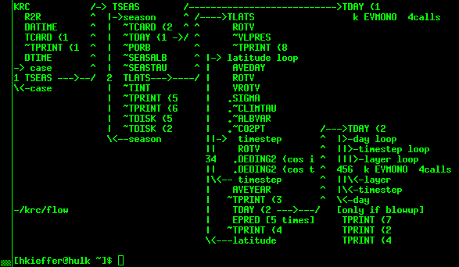
Flow: Loops and Calls
~: optional
. : only if atmosphere
K: only if T-dependent
2013jan28 @ASU

Slide 46
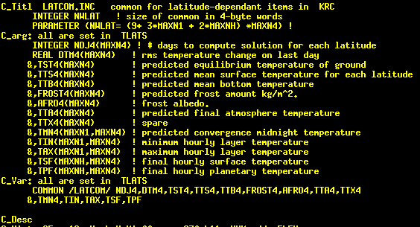
Latitude Common: latcom.inc
2013jan28 @ASU

Slide 47
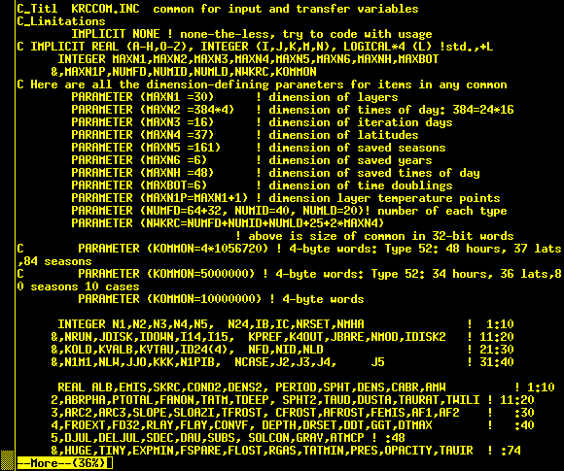
krccom.inc top part
2013jan28 @ASU

Slide 48
krccom.inc Part 1
C Here are all the dimension-defining parameters for items in any common
PARAMETER (MAXN1 =30) ! dimension of layers
PARAMETER (MAXN2 =384*4) ! dimension of times of day: 384=24*16
PARAMETER (MAXN3 =16) ! dimension of iteration days
PARAMETER (MAXN4 =37) ! dimension of latitudes
PARAMETER (MAXN5 =161) ! dimension of saved seasons
PARAMETER (MAXN6 =6) ! dimension of saved years
PARAMETER (MAXNH =48) ! dimension of saved times of day
PARAMETER (MAXBOT=6) ! dimension of time doublings
PARAMETER (MAXN1P=MAXN1+1) ! dimension layer temperature points
PARAMETER (NUMFD=64+32, NUMID=40, NUMLD=20)! number of each type
PARAMETER (NWKRC=NUMFD+NUMID+NUMLD+25+2*MAXN4)
! above is size of common in 32-bit words
C PARAMETER (KOMMON=4*1056720) ! 4-byte words: Type 52: 48 hours, 37 lats,84 seasons
C PARAMETER (KOMMON=5000000) ! 4-byte words: Type 52: 34 hours, 36 lats,80 seasons 10 cases
PARAMETER (KOMMON=10000000) ! 4-byte words
INTEGER N1,N2,N3,N4,N5, N24,IB,IC,NRSET,NMHA ! 1:10
&,NRUN,JDISK,IDOWN,I14,I15, KPREF,K4OUT,JBARE,NMOD,IDISK2 ! 11:20
&,KOLD,KVALB,KVTAU,ID24(4), NFD,NID,NLD ! 21:30
&,N1M1,NLW,JJO,KKK,N1PIB, NCASE,J2,J3,J4, J5 ! 31:40
2013jan28 @ASU

Slide 49
Inclusion of commons
Copy from re-arranged Makefile
krc.o: krc.f krccom.inc latcom.inc daycom.inc units.inc filcom.inc
tseas.o: tseas.f krccom.inc latcom.inc hatcom.inc units.inc
tlats.o: tlats.f krccom.inc latcom.inc daycom.inc hatcom.inc units.inc
mlats.o: mlats.f krccom.inc latcom.inc daycom.inc hatcom.inc units.inc
tday.o: tday.f krccom.inc daycom.inc hatcom.inc units.inc
tcard.o: tcard.f krccom.inc latcom.inc daycom.inc units.inc filcom.inc
tprint.o: tprint.f krccom.inc latcom.inc daycom.inc units.inc filcom.inc
tdisk.o: tdisk.f krccom.inc latcom.inc daycom.inc hatcom.inc units.inc filcom.inc
tint.o: tint.f krccom.inc
seasalb.o: seasalb.f units.inc filcom.inc
seastau.o: seastau.f units.inc filcom.inc
climtau.o: climtau.f units.inc filcom.inc
porb0.o: porb0.f units.inc porbcm.inc
albvar.o: albvar.f krccom.inc
alsubs.o: alsubs.f krccom.inc
2013jan28 @ASU

Slide 50
krccom.inc Lower part
COMMON /KRCCOM/
1 ALB,EMIS,SKRC,COND2,DENS2, PERIOD,SPHT,DENS,CABR,AMW ! 1:10
2,ABRPHA,PTOTAL,FANON,TATM,TDEEP, SPHT2,TAUD,DUSTA,TAURAT,TWILI ! 11:20
3,ARC2,ARC3,SLOPE,SLOAZI,TFROST, CFROST,AFROST,FEMIS,AF1,AF2 ! :30
4,FROEXT,FD32,RLAY,FLAY,CONVF, DEPTH,DRSET,DDT,GGT,DTMAX ! :40
Cset *day1
5,DJUL,DELJUL,SDEC,DAU,SUBS, SOLCON,GRAV,ATMCP ! :48
Cset v total of 56 input
5,CCKU,CCKL,CCPU,CCPL,HUGE,TINY ! :66
&,EXPMIN,FSPARE,FLOST,RGAS,TATMIN,PRES,OPACITY,TAUIR,TAUEFF,TATMJ ! :76
Cset *seas ----seas-------
6,SKYFAC,TFNOW,AFNOW,PZREF,SUMF, TEQUIL,TBLOW, HOURO,SCALEH,BETA ! :86
Cset -----------lats--------- tint ---lats------- ---lats----
6,DJU5,DAM,EFROST,DLAT,COND, DIFFU,SCALE,PIVAL,SIGSB,RADC ! :96
Cset seas lat day2 lats -------day1------- --main------
7,N1,N2,N3,N4,N5, N24,IB,IC,NRSET,NMHA ! 1:10
8,NRUN,JDISK,IDOWN,I14,I15, KPREF,K4OUT,JBARE,NMOD,IDISK2 ! 11:20
9,KOLD,KVALB,KVTAU,ID24, NFD,NID,NLD ! 21:30
Cset ----card---
A,N1M1,NLW,JJO,KKK,N1PIB, NCASE,J2,J3,J4, J5 ! 31:40
Cset ---day1- lat ----day1- main -day2- lats seas
B,LP1,LP2,LP3,LP4,LP5, LP6,LPGLOB,LVFA,LVFT,LKOFT ! 1:10
C,LPORB,LKEY,LSC,LNOTIF,LOCAL, LD16,LD17,LD18,LD19,LONE ! 11:20
D,TITLE,DAYTIM,ALAT,ELEV !
Cset tcard tprint tcard tcard
C
EQUIVALENCE (FD(1),ALB), (ID(1),N1), (LD(1),LP1)
2013jan28 @ASU

Slide 51
What makes it fast
Geometrically increasing layer thickness with depth
Progressive time-step doubling as layer thickness allows for numerical stability
Jump perturbations to equalize average temperature with depth in the first season
Asymptotic predictor after convergence to the end of a season
Pre-calculate frequently-used terms (Modern optimizer would do this)
Major Limitations
Can not do really thin surface layers
2013jan28 @ASU

Slide 52
Some Details
TBLOW: stops if this is exceeded by surface kinetic temperture
  Twice the temperature of black plate facing the Sun
  TBLOW=2.*√√[(Solar constant/distance^2)/(Emissivity*σ)]
Heliocentric distance, Solar declination, Ls
PORB returns, for a modified Julian Date (JD-2 440 000),
  DAU=heliocentric distance in AU( distance for which Solar Constant is defined)
  PEA,PEB=latitude,longitude(radians) of planet in heliocentric ecliptic coord.
  HFA,HFB=latitude,longitude(radians) of Sun in planetocentric fixed coordinates
2013jan28 @ASU

Slide 53
Packing of bin5 files
All done and remembered in TDISK (tdisk.f)
When called with a 1: sets up 10-element JJJ with sizes that will go into the bin5 header
1) the number of dimensions to the array
2:N+1) size of those dimensions
2013jan28 @ASU

Slide 54
Type 52: (hours,7,latitudes,x+seasons,cases)
First x seasons contain, for each case:
  Float of 4 integers that define sixes
  Total size of krccom transfered
  1-based index of the dimension with extra values
  Number of those extra dimensions
  spare
  Floating point of krccom
  Array(nseas,5) DJU5,SUBS,PZREF,TAUD,SUMF
For true seasons, the 7 contain:
  1: TSF, surface kinetic temperature
  2: TPF, planetary bolometric temperature
  3: TAF. Atmosphere kinitec temperature
  4: DOWNVIS:
  5: DOWNIR
  6: packed: float(NDJ4)+ DTM4 + TTA4+ Tmin(Nlay-) || Omitting the virtual
  7: packed: FROST4+ AFRO4+ HEATMM+ Tmax(Nlay-) || first layer
2013jan28 @ASU

Slide 55
Reading packed bin5 files
readk52.pro, finame,ttt,uuu,vvv,itemt,itemu,itemv, ddd,ggg,itemd,itemg ,t51=t51
;finame in. String of file name
; ttt out. Fltarr(hour,item,latitude,season,case) Item labels are in itemt
; 0= surface kinetic temperature
; 1= Top-of-atmosphere bolometric temperature
; t52 2= one-layer atmosphere kinetic temperature
; t52 3= Down-welling solar radiance
; t52 4= Down-welling thermal radiance
; uuu out. Fltarr(nlat,item,case) Item labels are in itemu
; 0= Latitude in degrees
; 1= elevation in Km.
; vvv out. Fltarr(season,item,case) Item labels are in itemv
; 0= Model season julian date - 2,440,000
; 1= L-sub-S computed in KRC
; 2= Global mean pressure: PZREF
; itemt,u,v out. Strarr ID's for the items in ttt, uuu, and vvv
; Following 4 outputs not valid for Type 51
; ddd out. Fltarr(layer,item,latitude,season,case) Item labels are in itemd
; Item: 0=Tmin 1=Tmax
; ggg out. Fltarr(item,latitude,season,case) Item labels are in itemg
; Items: 'NDJ4','DTM4','TTA4','FROST4','AFRO4','HEATMM'
; itemd,g out. Strarr ID's for the items in ddd, and ggg
; t51 in_ Flag. If set, presumes input file is type 51
; func. out. Fltarr of L-sub-S corresponding to Jul.Day for the first case.
; If an error, returns negative integer
; -1: -4 are from READKRCCOM, -5 = failure here
2013jan28 @ASU

Slide 56
Readkrc52: lower calls
bin5.pro: BIN5,'R',finame,head,aaa,/verb
  reads the bin5 packed array
readkrccom.pro:
;Use: Call initially, q=READKRCCOM('filename',hold) where hold may be undefined
; To get a case kcom=READKRCCOM(Icase,hold) where hold is unchanged
; When done with file: READKRCCOM(-1,hold) or free_lun,hold[0]
;_Calls DEFINEKRC
Hold is 4 words: [lun, size-of-case, # cases, nwkrc]
definekrc.pro: Define structures in IDL that correspond for Fortran commons
Basically a translation of krccom.inc, latcom, daycom or filcom into IDL, with default or fake values. Therefor MUST AGREE with the krccom used to write the file.
2013jan28 @ASU

Slide 57
PORB: Planetary ORBit calculator
PORBMN Main program. Includes 'porbcm.inc'
DATIME Returns current date and time
may call the following in any order. All INCLUDE 'porbcm.inc'
PORB1 Read orbital elements, compute matrices
PORBEL Read any of 4 orbital element files, compute basic constants
YMD2JD Convert year, month, day to Julian date offset from 2,440,000
OBLIQ Compute Planets poles in ecliptic coord and nodes
OBLIP Compute obliquity of a planet
ROTDIA 2x
ROTAX 10x
PORBIO Read/write Common to file as text or binary
EPHEMR Print ephemeris == geometry versus time
PORB Computes planetary angles and location for specific time
ORBIT Compute location of body in its orbital plane
ROTVEC Apply rotation matrix to rotate a vector
CALDATE
SPCREV
ANG360
PORBQQ Test computation of matrices
ROTDIA 2x
ROTAX 4x
MPRINT 3x
MPROD3 2x
2013jan28 @ASU

Slide 58
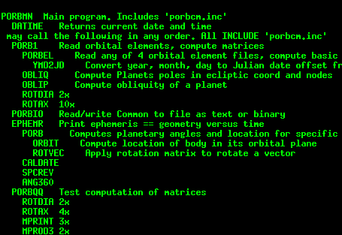
PORB: Planetary ORBit calculator
Runs as stand-alone program porbmn.f
Subroutine PORB used by KRC
Key input are the [four] elements formatted-text files
Users guide: PORBguide.txt
2013jan28 @ASU

Slide 59
Debug print options
If first input line has third non-zero integer, then will read a an extra 2nd line of six integers: IDB1,IDB2,IDB3,IDB4,IDB5,IDB6
These control optional WRITE statements as listed in helplist section on DEBUG OPTIONS
2013jan28 @ASU

Slide 60
Restart for prior run. Powerful & delicate
First input line: KOLD & KEEP [& KDB]
KOLD: record of prior run to start with. Will fill KRCCOM and Latitudes and elevations from prior run, and use the kinetic tempertures of the layers at the end of the specified season.
Must not change the layering scheme.
KEEP: Flag, 0=do not write to this file. Else, leaves the file open,
And will start writing based on JDISK
Not sure this still works:
2013jan28 @ASU

Slide 61
If an error occurs:
Compare your input file to the master.
  Unix: use diff
Check the helplist definition for each item that was modified
If can not get it to run properly ---
Send three files to the mentor:
  Input file
  What appeared on the screen
  Print file
2013jan28 @ASU

Slide 62
Liens
binf5.F Detecting hardware architecture. Near line 122.
  Currently does not detect, so swap might no happen.
  Bastion : uname -p = i686 -i = i386
  Hulk2: x86_64 for both
Add version: to print, monitor and bin5. Here are all the steps:
  transfer through filcom.inc: CHARACTER*12 VERDAT
  krc.f VERDAT='KRC2013jan27'
  WRITE (IOPM,*)'This is:',VERDAT
  tdisk.f HEADER --> HEADTX ( header appears in many commens)
  CHARACTER*3 CSTAT ! File status and string version of KODE
  CHARACTER*25 HEADTX
  write(cstat,*)kode ! converts file type to string
  HEADTX=VERDAT//' tdisk Type'//CSTAT ! 12+10+3
  tprint.f at 800, replace ' RUN-CASE' with VERDAT as A12
2013jan28 @ASU

Slide 63
Liens: 2
Decide how to handle “master” version of code during transition
Automate processing of a new Distribution
Helplist:
  Rename .tex to .txt
  Make html version with index
  Make pdf version with index
Remove the alternate input options (not used for a long time)
?? Remove the debug options
Resolve the extra-word issue between FORTRAN and IDL
Make a re-ordered entry form for input: output the current input file
  Real time limit checks (some are linked)
  Put expert-only items last
  May be a challenge to retain flexability
2013jan28 @ASU

Slide 64
Extras
2013jan28 @ASU

Slide 65
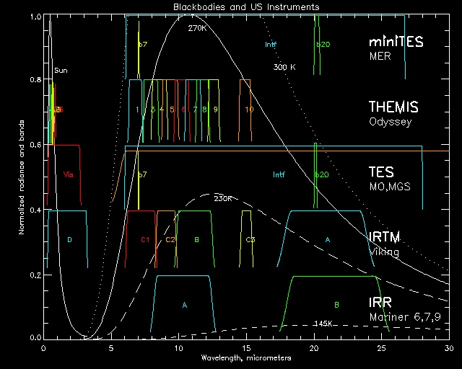
Evolution of Mars’ thermal instruments
Phil’s
All
Uncooled
!!
2013jan28 @ASU

Slide 66
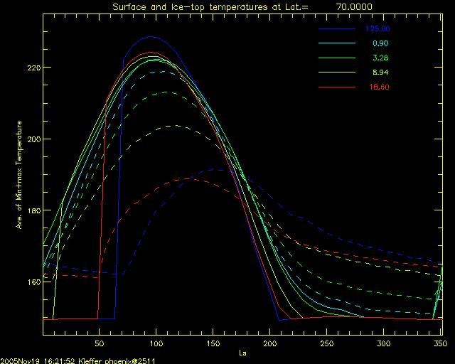
KRC: Effect of depth to ice
2013jan28 @ASU

Slide 67
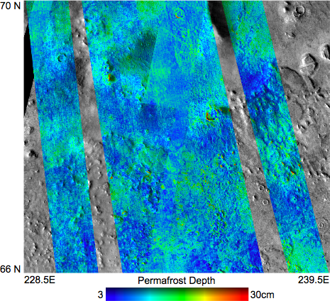
Bandfield et al. THEMIS mapping of landing region
Phoenix Landing site
Regional:
TES:
I=258, Z=4.5cm
THEMIS:
I=283
Z=6.2cm
2013jan28 @ASU

Slide 68
Mix of Rocks and fines is common
Rocks dominate at night
  Anything larger than ~10 cm
Fine particles dominate in day
Using day and night observations allow determination of rock fraction and drift particle size.
Good predictions for landing sites
With spectral information, need to weight radiances, not temperatures
KRC is for one vertical situation at a time.
Linear addition of models represent scenes of mixed rocks and fines
Mixed scenes do not look like blackbodies; brightness temperature increases toward shorter wavelengths
Day+night observations [or spectral analysis] allow separation of rocks from fines.
Rock fraction is a major criterion for landing sites.
2013jan28 @ASU

Slide 69
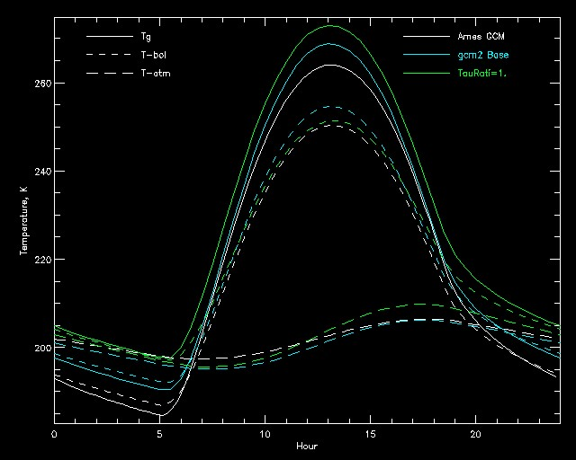
Comparison to Ames GCM model: temperatures
2013jan28 @ASU

Slide 70
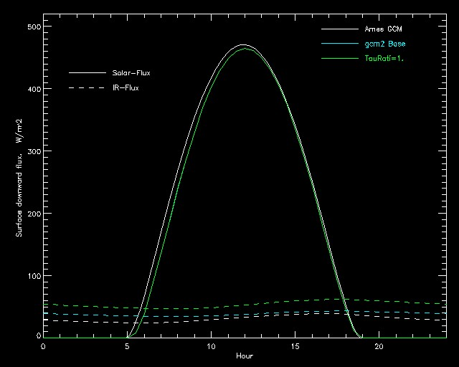
Comparison to Ames GCM model: downward flux
2013jan28 @ASU

Slide 71
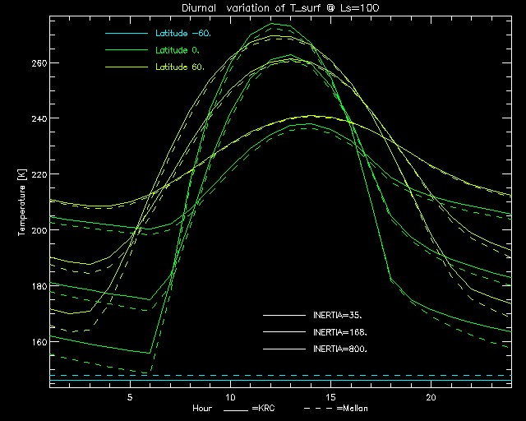
Comparison to Mellon Models (TES default): diurnal
2013jan28 @ASU

Slide 72
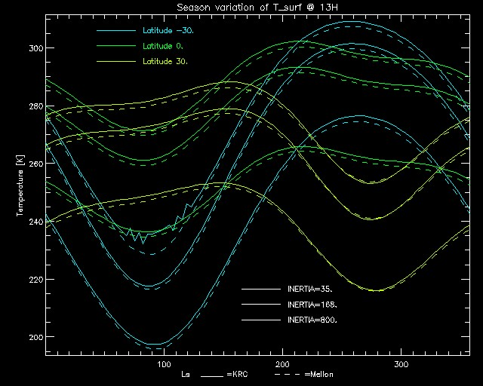
Comparison to Mellon Models: seasonal
Night frost
30S I=35
2013jan28 @ASU

Slide 73
Uncertainty of Thermal Inertia
Deal with the uncertainty of measured temperature, as well as all of the parameters that go into the model.
For simplicity, assume the “errors” are uncorrelated
U_{I} = RSS [ UT_{b}, UA⋅∂ T_{m}/ ∂A, U τ ⋅∂ T_{m}/ ∂ τ, U ⇓ ⋅∂ T_{m}/ ∂ ⇓,…] / ( ∂ T_{m}/ ∂I ) at proper I
U = uncertainty A=Albedo τ =Opacity ⇓=slope and azimuth
All the partial derivatives are available from a thermal model!
Run models with each U parameter individually perturbed
Or, subtract pairs of models in the large sets.
You have to assess the magnitude of the input Uncertainties
2013jan28 @ASU

