Slide 1
The KRC Thermal Model System
Hugh H. Kieffer USGS Emeritus
THEMIS Team Meeting. Kona 2004 Oct 26-28
And onto ASU server as first-order Guide
  Basics & equations
  Input
  Example results
  Output Files
  KRC-lite
  How to get help
  The future What do you need?

Slide 2
Basic Surface and Subsurface Treatment
Surface condition: Radiation Balance
  Specify albedo A , emissivity ε, slope and azimuth.
  Can have frost with different A, ε and scattering thickness scale
  Frost albedo: constant or linear with insolation (two precoded)
  Imbalance of solar and thermal radiation goes into changing
  temperature of the top layer, or into changes of frost amount.
Subsurface: thermal diffusion
  Specify thermal inertia (I), conductivity(k) and density(ρ)
  Lower boundary can be insulating, constant temperature, or fixed constant.
  Can have a different material below a given layer;
  k, ρ and specific heat C_{P}.

Slide 3
Atmosphere: Two stream Delta-Eddington
Gray in solar and thermal region, one layer,
  Transmits, absorbs, and scatters solar radiation
  Transmits, absorbs and emits thermal radiation
  Flux imbalance goes into change of temperature (apart from twilight)
Dust amount and radiative characteristics can be specified
Direct sunlight: Lambert on local surface
Diffuse sunlight: based on fraction of sky visible
Surface pressure based on elevation. one of:
  constant,
  follow Viking Landers
  based on global integration of frost.

Slide 4
Method
Surface thermal inertia, specific heat and density determine the conductivity and diffusivity. Layers scaled with the diurnal skin depth (DSD)
  First layer is 0.18 of DSD, successive ones thicker by factor of 1.2
  As layers become so thick that thermal diffusion through them is small in one time step, time steps are doubled
  Elaborate start-up and convergence techniques; Stability tests
This scheme allows accurate practical treatment of diurnal and seasonal heat flow
Virtually all physical and grid parameters adjustable: ~127 total. Most you need not touch.

Slide 5
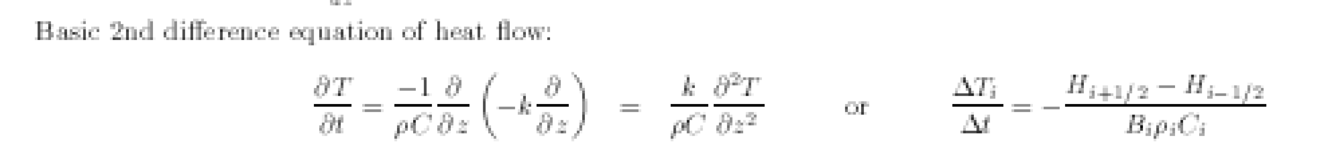
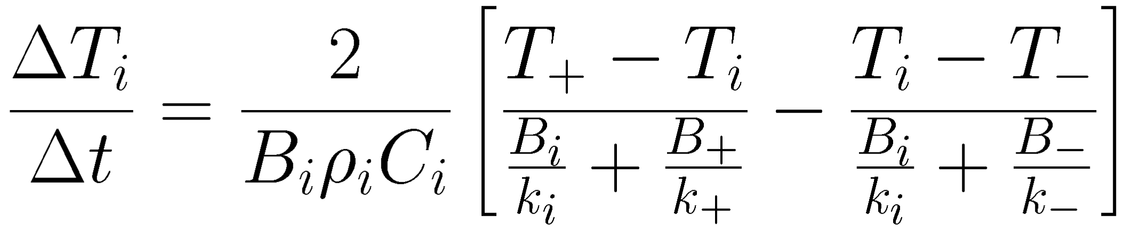
Energy Balance & Heat Diffusion Equations
Into Frost :
W=
Subsurface:
Finite
difference
code for grid

Slide 6
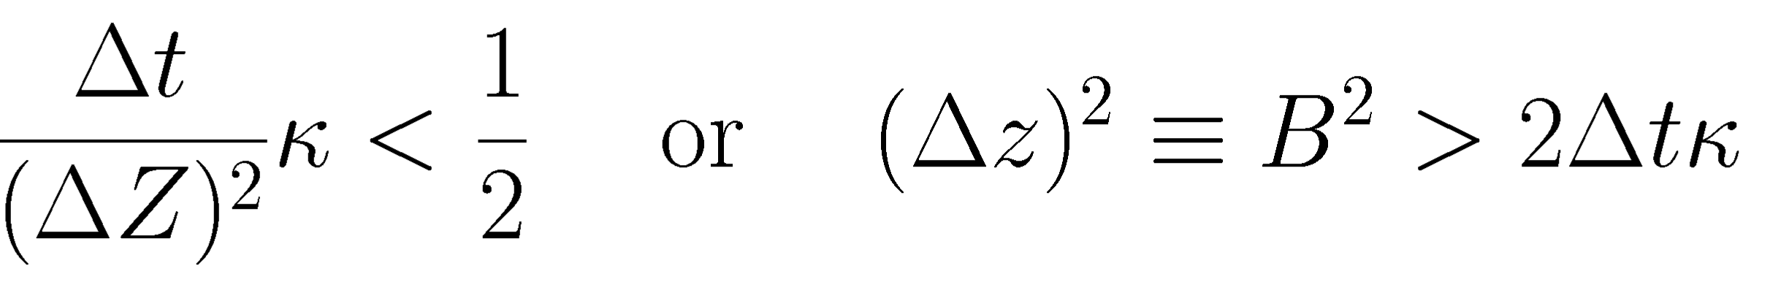
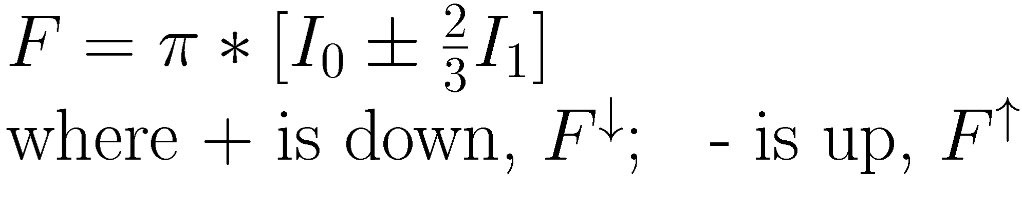
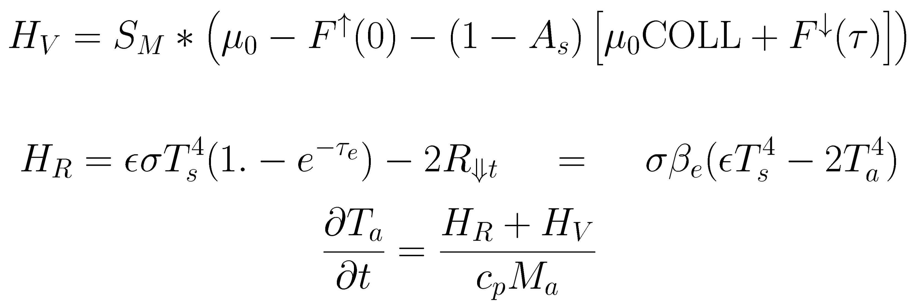
More Equations
Convergence criterion
Two-stream
Delta-Eddington
Atmospheric
heating
Planetary Temperature

Slide 7
Mixed-dimension Cartoon
One-Layer
Grey Delta-Eddington
Atmosphere
Frost
Surface
_x0003_
Geometrically thicker layers
Binary time division
Thermal diffusion
Insulating or fixed T
Bottom Layer

Slide 8
Input: pure ASCII. Upper part
0 0 / KOLD: season to start with; KEEP: continue saving data in same disk file
Test case to compare with Ames GCM at VL1
ALBEDO EMISS INERTIA COND2 DENS2 PERIOD SPEC_HEAT DENSITY
.25 1.00 270.0 3.4 928.0 1.0275 630. 1600.
CABR -ABRAMP -ABRPHA PTOTAL FANON TATM TDEEP SpHeat2
0.18 -0.00 -0.00 689.7 .055 200. 150.0 1300.
TAUD DUSTA TAURAT TWILI ACR2 -ARC3 SLOPE SLOAZI
0.3 .90 .5 1.0 0.5 -0.00 0.0 90.
TFROST CFROST AFROST FEMIS AF1 AF2 FROEXT ARC6
146.0 589944. .65 0.95 0.54 0.0009 50. 0.0
RLAY FLAY CONVF DEPTH DRSET DDT GGT -FDOWN
1.2000 .1800 2.0000 0.0 0.0 .0020 .1 -00.0
DJUL DELJUL SOLARDEC DAU HLON SOLCON GRAV Atm_Cp
10320.138 17.1745 00.0 1.465 .0 1368. 3.727 860.
N1 N2 N3 N4 N5 N24 IB IC
19 384 10 1 120 24 0 0
NRSET NMHA NRUN JDISK -IDOWN I14 I15 KPREF
999 24 1 81 0 45 65 1
K4OUT JBARE NMOD IDISK2 end
54 0 5 0 0
LP1 LP2 LP3 LP4 LP5 LP6 LPGLOB LVFA LVFT debug
F T F F F F F T T F
LPORB LKEY LSC LNOTIF LOCAL LD16 LPTAVE Prt.78 Prt.79 LONE
T F F T T F F F F F

Slide 9
Input file: lower part
Orange part makes it Mars. DO NOT TOUCH
LATITUDES: in 10F7.2 _____7 _____7 _____7 _____7 _____7 _____7 _____7
22.00 -80.00 -75.00 -70.00 -65.00 -60.00 -55.00 -50.00 -45.00 0.0
Elevations: in 10F7.2 _____7 _____7 _____7 _____7 _____7 _____7 _____7
-3.1 4.55 4.16 4.09 4.10 4.01 3.76 3.60 3.04 0.0
97-JAN-30 15:37:58 =RUNTIME. IPLAN AND TC= 4.0 0.49000
4.000000 0.4900000 0.8556749 0.3221672E-01 4.997373
0.9339862E-01 1.523693 10820.59 686.9796 0.9204510
5.539492 24.62278 0. 0.4093198 0.
0. 0. 0. 6.150894 0.4662405
0.4166342E-01 0.6202968 4.377076 0. 0.
0. 0. 0. 0. 0.
0. 0. 0. -0.9491031E-01 0.8901852
0.4456034 -0.9056373 0.1086292 -0.4099036 -0.4132956
-0.4424591 0.7958748 0.9085325 -0.4166692 -0.3091195E-01
0.4171058 0.9088128 0.9055913E-02 0.2431985E-01 -0.2112114E-01
0.9994811 -0.3290646 -0.8544949 -0.4019393 0.9443074
-0.2977673 -0.1400645 0.3352761E-07 0.4256445 -0.9048904
2 17 52 'K4OUT: ts,downvis,downIR' /
8 0 0 '/work1/mars/tes/KRC/gcm1.t52' / Disk file name
0/
1 19 1.0 'VIS/IR tau ratio'/
0/
0/
0/

Slide 10
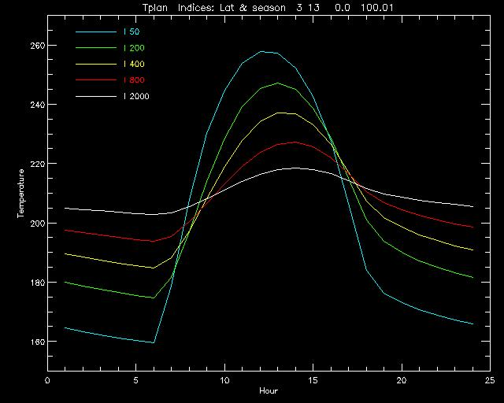
Example: Range of thermal inertia
Note
the
overlap
near
ends of
daylight

Slide 11
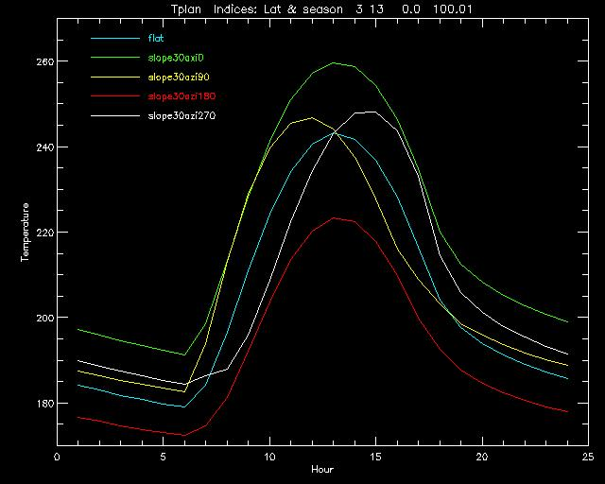
Example: 30 degree slopes

Slide 12
Uncertainty of Thermal Inertia
Deal with the uncertainty of measured temperature, as well as all of the parameters that go into the model.
For simplicity, assume the “errors” are uncorrelated
U_{I} = RSS [ UT_{b}, UA⋅∂ T_{m}/ ∂A, U τ ⋅∂ T_{m}/ ∂ τ, U ⇓ ⋅∂ T_{m}/ ∂ ⇓,…]
∂ T_{m}/ ∂I
U = uncertainty A=Albedo τ =Opacity ⇓=slope and azimuth
All the partial derivatives are available from a thermal model!
Run models with each U parameter individually perturbed
Or, subtract pairs of models in the large sets.
You have to assess the magnitude of the input Uncertainties

Slide 13
Output
Default print file (krc.prt) lists all changes, then the full input list, then the layer table, which should usually be contemplated.
Options to turn on many kinds of printout.
  Beware: file can get huge.
Binary output files: 7 kinds in two sets: controlled by K4OUT
Fortran direct access. [Allows restart at any recorded season]
-1: Used for major model runs. Outputs KRCCOM, which contains all the input parameters, then arrays of Surface kinetic temperature and Planetary Bolometric Temperature for each season.
0: LATCOM. Arrays of several variables versus latitude and depth
+1: DAYCOM for the last latitude for each season. Arrays of variables versus time-step or Hour or convergence-day.

Slide 14
Bin5 Binary output arrays
+51: Minimum and Maximum temperature for all layers, 5 latitudes, 40 seasons, 5 cases
  Layers 29,30 contain Tp_min, Tp_max, L_sub_s, Julian Day
+52: 24 hours, 6 items, 5:10 lats, 1+<=80 seasons, <=5 cases)
  Items are: Tsurf, Tplan, Tatm, DownVis, DownIR, spare
  First "season" contains: KRCCOM and 3 season variables
+53: Combo at 1 lat, 2+80 seasons, 10 cases
  Combo: Tsurf & Tplan @ 24 hours; Tmin & Tmax @ 30 layers,
  Asol @ 24 hours. The first 2 "seasons" contain KRCCOM
+54: 68:740 seasons, 3 items, 1+<= 5 lats, <=10 cases
  3 items are: heat flow, surface temperature, frost amount
  Store KRCCOM in the first latitude

Slide 15
KRC-lite. The “one-point” interface
You build a table of “points” of interest:
  Ls
  Latitude
  Hour
  Elevation (km)
  Bolometric Albedo
  Thermal Inertia (SI units)
  Atmosphere Visual opacity
  Regional slope (degrees)
  Azimuth of down-slope (degrees Eastward of North)
Output file has these, plus columns of:
  Surface kinetic temperature, Tsurf
  Top-of-Atmosphere bolometric temperature,Tplan==Tbolo

Slide 16
One-point details
Copy one.inp Edit it; rigid format. Keep name the same
  Title Line, Text transfered to output. This & next line must be present
  11 Ls Lat Hour Elev Alb Inerti Opac Slop_Azim <Align each field
  11 123.1 4.1 9.4 22.22 0.17 100.0 0.10 0 0
  11 320.1 -33.1 15.5 -3.12 0.15 500.1 0.55 0.0 123.
  11 180. -10.1 13.5 0. 0.20 200.0 0.50 0.0 123.
Run krc. Input file is: krcone_master.inp
  This file sets KRC into 13 layer, 1 latitude, short season mode, and points to one.inp.
Underneath the one-point mode is the full KRC model
You can copy krcone_master.inp and edit it to do [almost] whatever you like, including point to a different one-point file

Slide 17
Help and Guides
Primary documentation: LaTeX file krc.tex and postscript derivative.
Guide to running KRC: ASCII file helplist.txt describes all the input parameters and output file options.
An FAQ has been started: FAQ.txt
Will publish this model in some form, perhaps attach to some science results paper.
All the code and documentation and sample input and output files are ASU. Robin Fergason is the expert and curator.

Slide 18
Thermal Inertia
Two large set of models have been pre-computed.
  Both have: Two year run-up, 3 albedos, 3 opacities, 3 elevations,
  logrithmic inertia. Tsur and Tplan output at 24 Hour points:
Mellon: Used for TES production.
  84 seasons, 39 latitudes, 10 Inertias (25:800)
KRC: recent run, plan to extend to I>=2000
  40 seasons, 19 latitudes, 10 Inertias (25:800), [K4OUT=-1]
Interpolation: described in Mellon,Jakosky, Kieffer and Christensen (2000): Icarus, 148, on page 441.4a
  Season: linear
  Albedo, opacity, elevation: quadratic
  Hour and Latitude: bilinear
Yields a set of 10 temperatures. Finds set between Tmin and Tmax
  Inertia: linear in logarithm, And dT/dI for final interval

Slide 19
How close is KRC to Mars ???
KRC based on best-estimates of physical parameters
Expect that a little “tuning” of the atmosphere parameters would get close to the results for a full convective-radiative multi-layer atmosphere
  KRC is 2 orders of magnitude faster.
Difficult to find a basis for such tuning; something closer to the “truth”. Looking at full Ames GCM (Bob Haberle).
Robin is comparing KRC to the TES Production runs
( Mellon-Jakosky-Haberle-Pollack model)
Beware working near the edge of the seasonal cap:
  Interpolation commonly not valid between frost and no-frost

Slide 20
Absent Geophysics. To be included?
Radiative-convective atmosphere (Jakosky-Mellon)
Turbulent mixing (Need wind speed; GCM)
Temperature-dependant conductivity
More than 2 materials; fully-flexible layer structure
Vertical transport of sensible and latent heat by gaseous diffusion (Mellon, others? ) and regolith breathing (no one?)
Local rocks and shadows: lateral heat conduction
Regional topography with shadows and radiative coupling
  2-D ( topo profile) and 3-D (TOTEM ? )
Season changes incrementally every SOL
  Now: Planet spins in place for a season
Geothermal heat flow

Slide 21
Final Words
Your are driving a Ferrari. Don’t be scared; you can choose how curvy a road to follow.
Access issues: Propose that the Guru Team provide/support interfaces in some “favorite” analysis environments:
  e.g., C, IDL(done), DaVinci (some exists), Fortran (native)
Scientific issues: Robin can bail you out (for now).
If you see a useful change or addition, please ask.
  Some things would be easy to change.

