Slide 1

Michael Mommert,
M. Kelley, M. de Val-Borro, Jian-Yang Li, G. Guzman,
J. Ďurech, M. Granvik, W. Grundy, N. Moskovitz, A. Penttilä, N. Samarasinha
EPSC 2018 workshop, 18. September 2018

Slide 2

What is this workshop about?
sbpy!
  What is it, how can it help you, how can you use it?
  sbpy is for you: what would you like to see?
This workshop is not:
  An introduction to Python programming
  An attempt to convert you into a Python programmer

Slide 3
What is sbpy?
A Python package for small-body planetary astronomy (asteroid and comet observers/researchers)
A collection of basic functions and methods
Compatible with astropy, numpy, scipy methods
Tested against published results
Well-documented (sbpy.readthedocs.io)
sbpy.org

Slide 4

Motivation
Imagine… you need some code to solve a problem...
  Write the code from scratch (time intensive)
  Use somebody else’s code (is it reliable?)
  Re-write somebody else’s FORTRAN code (ewww…)
  Use a well-tested and documented existing code
Astropy (astropy.org)
Provide especially young
researchers with a code base
to kick-start their research

Slide 5
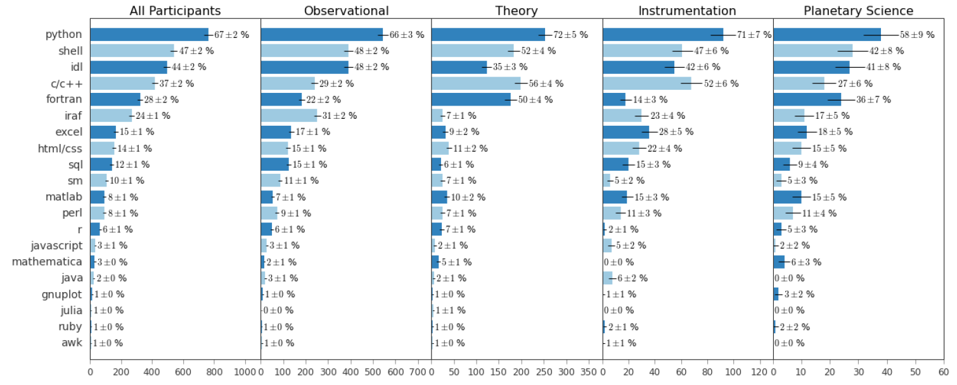
Why Python?
“Which of these programming languages do you frequently use in your research?”
Momcheva and Tollerud (2015)

Slide 6
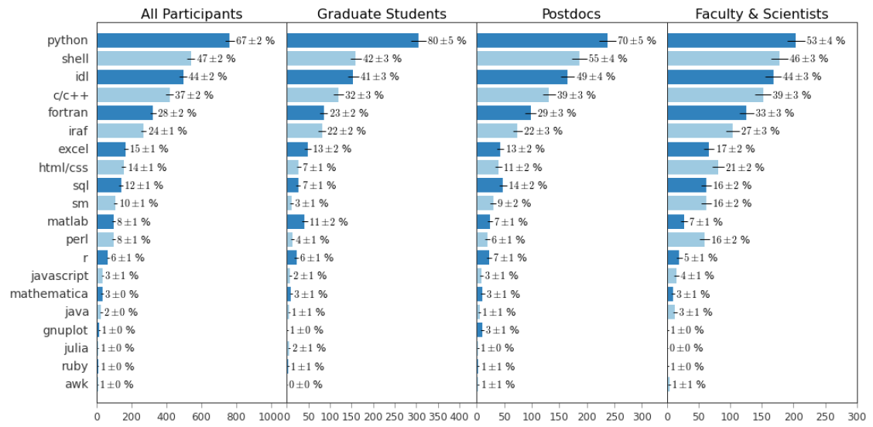
Why Python?
“Which of these programming languages do you frequently use in your research?”
Momcheva and Tollerud (2015)

Slide 7
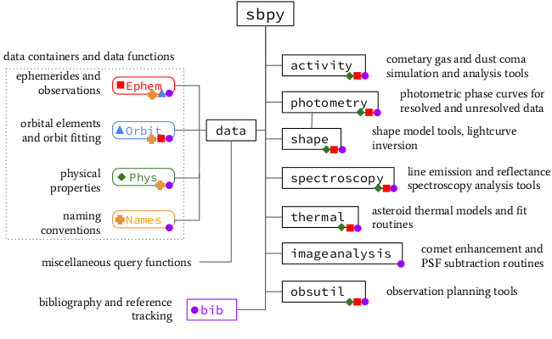
sbpy – Inventory

Slide 8
sbpy.data
A collection of data containers:
  Orbit: orbital elements
  Ephem: ephemerides and observational data
  Phys: physical properties
  Names: asteroid and comet name/number/designation
Common functionality (use the same base class) utilizing astropy.table
Data input/output of all sbpy functions uses sbpy.data
Aimed at convenience and flexibility

Slide 9
sbpy.data - Examples
Different ways to generate
data objects:
  from a list or array:
  from a dictionary:
  from an online resource:
>>> eph = Ephem.from_array([[10.2234, 10.233453]*u.deg,
... [-12.42123, -12.42562]*u.deg,
... [2451234.1234,2451234.2345]*u.d],
... names=['ra', 'dec', 't'])
>>> ceres = Phys.from_dict({'d':986*u.km, 'pv':0.09})
>>> eph = Ephem.from_horizons('ceres')

Slide 10
sbpy.data - Examples
Using sbpy.data objects:
>>> eph.column_names
<TableColumns names=('targetname','RA','DEC', … )>
>>> eph['ra', 'dec']
<QTable length=10>
RA DEC
deg deg
--------- --------
139.60684 26.72378
140.20138 26.46513
142.0532 25.66408
... ...
>>> eph['RA_rate'].to('arcsec/s')
<Quantity [0.01218538, 0.01244878, ...] arcsec / s>

Slide 11
sbpy.data
Home to query functions:
  JPLHorizons: ephemerides, orbital elements, and state vectors (using astroquery.jplhorizons)
  JPLSBDB: physical properties (using astroquery.jplsbdb)
Future query functions (mostly as part of astroquery):
  Minor Planet Center (orbits, ephemerides, observations)
  IMCCE (orbits, ephemerides)
  Lowell Observatory (ephemerides, physical properties)
Ephem.from_horizons('ceres')

Slide 12
sbpy.data
Interoperability with other Python
modules:
  Pyoorb: a Python interface to OpenOrb
    implemented: element transformations, orbit propagation, ephemeris computation
    Future functions: ranging, orbit fitting
    See jupyter notebook for examples
  PyEphem (tbd): ephemeris calculation
  Rebound (tbd): n-body simulation
  SpiceyPy (tbd): SPICE interface

Slide 13
sbpy.data
Name resolving functionality
>>> from sbpy.data import Names
>>> Names.parse_asteroid('3552 Don Quixote (1983 SA)')
{'number': 3552, 'name': 'Don Quixote', 'desig': '1983 SA'}
>>> Names.parse_comet('72P/Denning-Fujikawa')
{'type': 'P', 'number': 72, 'name': 'Denning-Fujikawa'}
>>> Names.asteroid_or_comet('72P/Denning-Fujikawa')
'comet'

Slide 14
sbpy.activity
Using sbpy.data objects:
>>> eph.column_names
<TableColumns names=('targetname','RA','DEC', … )>
>>> eph[‘ra’, ‘dec’]
<QTable length=10>
RA DEC
deg deg
--------- --------
139.60684 26.72378
140.20138 26.46513
142.0532 25.66408
... ...
>>> eph[‘RA_rate’].to(‘arcsec/s’)
<Quantity [0.01218538, 0.01244878, ...] arcsec / s>

Slide 15
sbpy.photometry
Using sbpy.data objects:
>>> eph.column_names
<TableColumns names=('targetname','RA','DEC', … )>
>>> eph[‘ra’, ‘dec’]
<QTable length=10>
RA DEC
deg deg
--------- --------
139.60684 26.72378
140.20138 26.46513
142.0532 25.66408
... ...
>>> eph[‘RA_rate’].to(‘arcsec/s’)
<Quantity [0.01218538, 0.01244878, ...] arcsec / s>

Slide 16
sbpy.shape
Using sbpy.data objects:
>>> eph.column_names
<TableColumns names=('targetname','RA','DEC', … )>
>>> eph[‘ra’, ‘dec’]
<QTable length=10>
RA DEC
deg deg
--------- --------
139.60684 26.72378
140.20138 26.46513
142.0532 25.66408
... ...
>>> eph[‘RA_rate’].to(‘arcsec/s’)
<Quantity [0.01218538, 0.01244878, ...] arcsec / s>

Slide 17
sbpy.spectroscopy
Using sbpy.data objects:
>>> eph.column_names
<TableColumns names=('targetname','RA','DEC', … )>
>>> eph[‘ra’, ‘dec’]
<QTable length=10>
RA DEC
deg deg
--------- --------
139.60684 26.72378
140.20138 26.46513
142.0532 25.66408
... ...
>>> eph[‘RA_rate’].to(‘arcsec/s’)
<Quantity [0.01218538, 0.01244878, ...] arcsec / s>

Slide 18
sbpy.thermal
Using sbpy.data objects:
>>> eph.column_names
<TableColumns names=('targetname','RA','DEC', … )>
>>> eph[‘ra’, ‘dec’]
<QTable length=10>
RA DEC
deg deg
--------- --------
139.60684 26.72378
140.20138 26.46513
142.0532 25.66408
... ...
>>> eph[‘RA_rate’].to(‘arcsec/s’)
<Quantity [0.01218538, 0.01244878, ...] arcsec / s>

Slide 19
sbpy.imageanalysis
Using sbpy.data objects:
>>> eph.column_names
<TableColumns names=('targetname','RA','DEC', … )>
>>> eph[‘ra’, ‘dec’]
<QTable length=10>
RA DEC
deg deg
--------- --------
139.60684 26.72378
140.20138 26.46513
142.0532 25.66408
... ...
>>> eph[‘RA_rate’].to(‘arcsec/s’)
<Quantity [0.01218538, 0.01244878, ...] arcsec / s>

Slide 20
sbpy.obsutil
Using sbpy.data objects:
>>> eph.column_names
<TableColumns names=('targetname','RA','DEC', … )>
>>> eph[‘ra’, ‘dec’]
<QTable length=10>
RA DEC
deg deg
--------- --------
139.60684 26.72378
140.20138 26.46513
142.0532 25.66408
... ...
>>> eph[‘RA_rate’].to(‘arcsec/s’)
<Quantity [0.01218538, 0.01244878, ...] arcsec / s>

Slide 21
sbpy.bib
Using sbpy.data objects:
>>> eph.column_names
<TableColumns names=('targetname','RA','DEC', … )>
>>> eph[‘ra’, ‘dec’]
<QTable length=10>
RA DEC
deg deg
--------- --------
139.60684 26.72378
140.20138 26.46513
142.0532 25.66408
... ...
>>> eph[‘RA_rate’].to(‘arcsec/s’)
<Quantity [0.01218538, 0.01244878, ...] arcsec / s>

Slide 22
sbpy – Current Status
sbpy.data: mostly functional, more query functions to be implemented in the future
sbpy.spectroscopy: some functionality implemented
sbpy.activity: some functionality implemented
sbpy.photometry: some phase function models implemented
All other modules currently only skeletons

Slide 23
sbpy – How can I help?
Give us your feedback! (create issues)
What would you like to see/have?
Do you have code that might be useful to others? Consider donating it!
Spread the word!
Use it!

Slide 24






Resources
sbpy.org github.com/NASA-Planetary-Science/sbpy
sbpy.readthedocs.io
github.com/NASA-Planetary-Science/sbpy-tutorial
sbpy is supported by NASA PDART
Grant No. 80NSSC18K0987.

