Slide 1
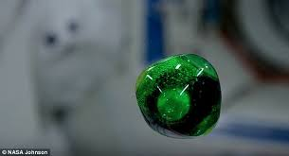
BUBBLOUR
TO SAVE THE SPACE COLONIES FROM STRESS........................

Slide 2


THE CHALLENGE
YOU WILL LIVE ON MARS REAL SOON.....
THERE, WHAT DO YOU DO WHEN YOU GET BORED............

Slide 3
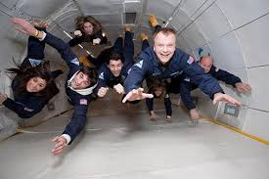
The issue
MICRO-GRAVITY..........

Slide 4

Gravity of the problem
OVER STRESS RUINS TALENTS.......

Slide 5
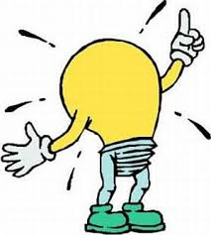
DID I FORGET SOMETHING?????
OH GOD!!!!!!! MY THINKING CAP.....

Slide 6
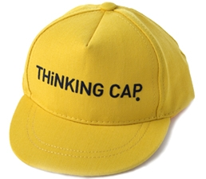
THERE YOU ARE...........☺
THE MISSION
A COOL GAME, WHICH CAN PLAYED EASILY IN MICROGRAVITY, WITH MINIMUM REQUIREMENTS.......

Slide 7
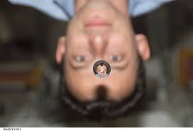
AND DONE.........
A GAME OF WATER BUBBLES AND COLOR ............

Slide 8
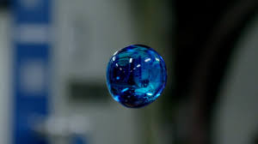
WHY.....
EASILY AVAILABLE...
GETS COLOURED BY PIGMENTS...
GETS REPELLED BY SILICA.....
AFTER ALL ....ITS COOL....!

Slide 9
THE GAME
2 TEAMS.....3 PLAYERS EACH.....
EACH PLAYER HAS A SYRINGE WITH COLOURING PIGMENT AND A DISC COATED WITH SILICA....
TEAM 1- RED, GREEN, BLUE.....
TEAM 2- CYAN, MAGENTA, YELLOW.....
PIGMENTS ARE FIRED USING THE SYRINGE TO COLOUR BUBBLES.......

Slide 10
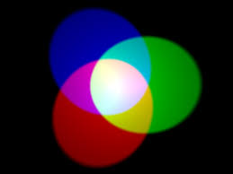

THE COLOURS

Slide 11
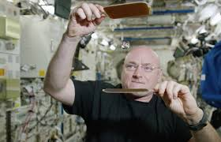
So...lets play.....
PLAYERS SURROUNDED BY WATER BUBBLES OF SAME SIZE.......
MOVEMENT OF BUBBLES CONTROLLED BY SILICA DISC....
THE BUBBLES GET COLOURED AND JOIN.........
THE BUBBLES ARE IN A BOUNDARY AND PLAYERS STAND ARROUND.....

Slide 12
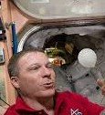
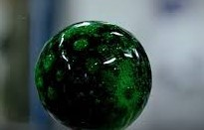
GOAL.....
RGB TEAM MUST MAKE A WHITE BUBBLE TO WIN......
FOR CMY TEAM.....A BLACK BUBBLE......
TEAMS TRY TO MAKE THEIR BUBBLE AT THE SAME TIME PREVENTENTING THE OTHER TEAM FROM DOING SO............

Slide 13
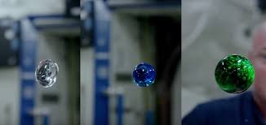
RULES......
DIRECTION CONTROL WITH SILICA DISC ONLY NEAR THE BOUNDARY....
BUBBLES SHOULDN’T HIT PLAYERS BODY.......
SO SIMPLE...............

Slide 14

worth
No chance for any physical injuries......
Very less requirements......
Strategic game.........
COOL............

Slide 15

wishes
LET COLONIES IN MARS PLAY BUBBLOUR IN THEIR OLIMBICS GAMES THERE.

Slide 16

That’s all

