Slide 1
WIFI OUTLET
A Project proposed by
6941.Mohammed dilshad p k
6944.Muhammed naseef m k
6958.Saigadha s
6959.Sanjoob ismail

Slide 2
ABSTRACT
Popularity of home automation devices has increased greatly in recent years due to higher affordability and simplicity through smartphone connectivity.
In this project we will be developing the Smart Outlet : a stand-alone communication unit, used to connect home outlets to the internet.
We could control simple appliances throughout the home, remotely , using wireless commands from the web.

Slide 3
INTRODUCTION
In the field of home automation, our focus is to integrate electrical devices in the home.
We introduces another possible solution of centralized control and a possible future direction for home automation.
Presently the devices available in the market are limited to their cost and incompatibility.
We advocate the possibility of achieving integration and interoperation of existing applications at a high level.

Slide 4
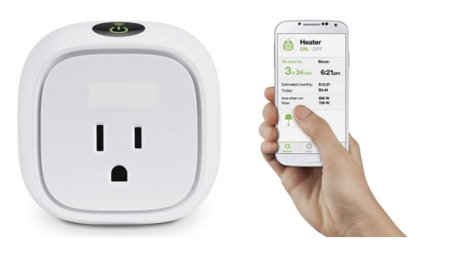
Model

Slide 5
COMPONENTS REQUIRED
Wi-Fi Module + MCU(ESP8266)
Relay
Socket
Power supply(AC-DC Convertor & DC-DC Convertor)

Slide 6
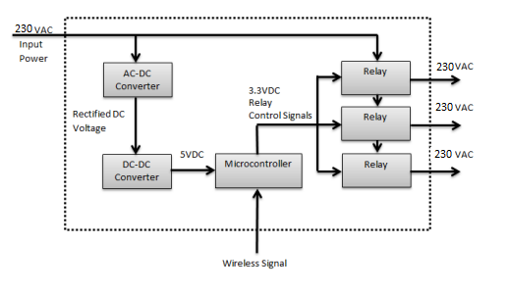
BLOCK DIAGRAM

Slide 7
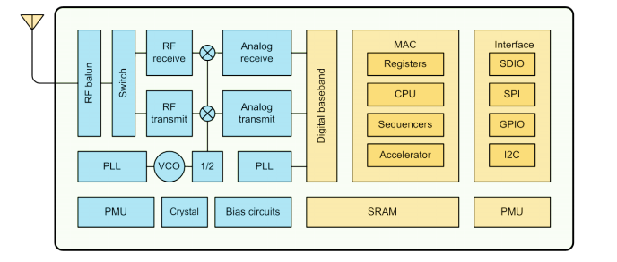
Block Diagram of ESP8266EX

Slide 8
About ESP8266EX
Espressif Systems Smart Connectivity Platform (ESCP) is a set of high performance, high integration wireless SOCs, designed for space and power constrained mobile platform designers.
It provides unsurpassed ability to embed Wi-Fi capabilities within other systems, or to function as a standalone application, with the lowest cost, and minimal space requirement.
ESP8266EX offers a complete and self-contained Wi-Fi networking solution; it can be used to host the application or to offload Wi-Fi networking functions from another application processor.
When ESP8266EX hosts the application, it boots up directly from an external flash. In has integrated cache to improve the performance of the system in such applications. Alternately, serving as a Wi-Fi adapter, wireless internet access can be added to any micro controller based design with simple connectivity (SPI/SDIO or I2C/UART interface).

Slide 9
ESP8266EX is among the most integrated Wi-Fi chip in the industry; it integrates the antenna switches, RF balun, power amplifier, low noise receive amplifier, filters, power management modules, it requires minimal external circuitry, and the entire solution, including front-end module, is designed to occupy minimal PCB area.
Espressif Systems Smart Connectivity Platform (ESCP) demonstrates sophisticated system-level features include fast sleep/wake context switching for energy-efficient VoIP, adaptive radio biasing for low-power operation, advance signal processing, and spur cancellation and radio co-existence features for common cellular, Bluetooth, DDR, LVDS, LCD interference mitigation.

Slide 10
Architecture of ESP8266EX
802.11 b/g/n
Integrated low power 32-bit MCU
Integrated 10-bit ADC
Integrated TCP/IP protocol stack
Integrated TR switch, balun, LNA, power amplifier and matching network
Integrated PLL, regulators, and power management units
Supports antenna diversity
Wi-Fi 2.4 GHz, support WPA/WPA2
Support STA/AP/STA+AP operation modes
Support Smart Link Function for both Android and iOS devices

Slide 11
SDIO 2.0, (H) SPI, UART, I2C, I2S, IR Remote Control, PWM, GPIO
STBC, 1x1 MIMO, 2x1 MIMO
A-MPDU & A-MSDU aggregation & 0.4s guard interval
Deep sleep power < 5uA
Wake up and transmit packets in < 2ms
Standby power consumption of < 1.0mW (DTIM3)
+20 dBm output power in 802.11b mode
Operating temperature range -40C ~ 125C • FCC, CE, TELEC, Wi-Fi Alliance, and SRRC certified

Slide 12
ADVANTAGES
These devices include monitoring energy usage, and controlling appliances.
These devices are intended for plug-and-play use, with no complicated setup required so consumers can install them into their own homes with minimal knowledge of home networking or electrical wiring.
Most of these devices function at any time and any location with Wi-Fi or cell service. They also come with dedicated smartphone apps, and all offer a manual override. With smartphones, users can receive notifications right to their phones. This provides a convenient way to check on the status of your home.
Portability.

Slide 13
Need of Home Automation
Home automation is a key to have effective energy efficiency in our home.
Adds safety through appliance and lighting control.
Increases awareness through smart phones.
Saves money and increase convenience.

Slide 14
THANK YOU

