Slide 1
FiB – Fitness Buddy (AI-Powered Health & Wellness Coach)
AICTE Edunet Foundation IBM SkillsBuild Internship on AI & Cloud
Presented By:
Student Name- Vivek Kumar Yadav
College Name- Banarsidas Chandiwala Institute of Information Technology
Department- MCA

Slide 2
OUTLINE
Problem Statement
Proposed Solution
System Development Approach (Technology Used)
Wow Factor
End User
Algorithm & Deployment
Result (Output Image)
Conclusion
Git-hub Link
Future Scope
References
IBM Certificates

Slide 3
Problem Statement
In today’s fast-paced world, many individuals struggle to maintain a healthy lifestyle due to lack of personalized guidance, time constraints, and inconsistent motivation. Traditional fitness solutions are often rigid, expensive, or inaccessible. There is a growing need for an intelligent virtual assistant that can provide on-demand fitness advice, meal suggestions, and motivational support — tailored to each individual’s goals and preferences.

Slide 4
Proposed Solution
The proposed system, FiB (Fitness Buddy), is an AI-powered virtual health coach built using IBM Agentic Lab and Granite LLM. It provides personalized fitness, nutrition, and motivation guidance through natural conversations — grounded in real knowledge.
🧠 Agent Design with IBM Granite & Instructions
FiB is created using IBM Agentic Lab, where instructions define the agent’s personality, role, and boundaries.
The assistant is guided to act like a friendly fitness coach, focusing on: Home workout routines, Simple and nutritious meals, Motivational advice, Habit-building techniques
📘 Document Grounding via Vector Indexing
A fitness knowledge document (text-based) is uploaded and vectorized inside Agentic Lab.
This allows FiB to retrieve and reference specific, grounded information when answering queries.
💬 LLM-Powered Reasoning (IBM Granite)
The assistant uses IBM Granite, an enterprise-grade LLM, to generate smart, human-like responses.
Granite combines: Agent instructions (how to behave), Vectorized document segments (what to say), User queries (context)
🔄 Conversation Flow
User enters a query (e.g., “Suggest a 10-min morning workout”) → Agentic Lab retrieves document context →Granite LLM generates grounded reply →FiB responds conversationally and guides the user
🚫 No Traditional ML or Deployment
No model training or prediction algorithm is required
Deployment is currently limited to IBM Agentic Lab interface
Future scope includes static website or mobile app integration for public access

Slide 5
System DEVELOPMENT Approach
🧰 Development Environment
IBM Cloud Agentic Lab – for building the AI agent
IBM Granite LLM – large language model powering FiB's understanding and responses
Jupyter Notebook on IBM Watson Studio – for testing prompt logic, model grounding, and experimentation
Vector Store (In-Memory) – used for document grounding in Agentic Lab
Text-Based Knowledge Document – uploaded and indexed for accurate answers
⚙️ Libraries/Tools Used
IBM Granite LLM
IBM Agentic Lab Studio (agent + grounding pipeline)
OpenAI-style prompt template logic (used internally)
PDF-to-text preprocessing (external/local)
IBM Cloud resources (Lite tier)

Slide 6
Wow factor
✅ 100% Built on IBM Cloud
FiB is developed entirely within IBM’s AI ecosystem, using Granite LLM, Agentic Lab, and vectorized document grounding — no external tools, no backend code.
🧠 Grounded Intelligence
Unlike chatbots trained on random web data, FiB uses a curated fitness knowledge base, ensuring every answer is:
Accurate 💡, Safe 🛡️ , Context-aware 📄
🤯 Zero Code, Enterprise-Grade AI
No ML models, no code — just prompt engineering, vector indexing, and smart design. It’s a low-code, high-impact solution that demonstrates:
Practical GenAI usage 🚀
Scalable architecture 🏗️
Real-world application value ✅
🔮 Future-Ready AI Agent
FiB isn’t a chatbot. It’s a multi-skill AI agent ready to:
Integrate with wearables
Give dynamic fitness plans
Scale into web/mobile platforms
And eventually support voice, video, and personalization

Slide 7
END USER
🧍‍Students & Working Professionals: Busy individuals who want quick, reliable fitness guidance without needing a gym or coach.
🧘‍ Health-Conscious Beginners: People new to fitness who need motivation, easy meal ideas, and non-intimidating workouts.
👨‍👩‍👧‍👦 General Public & Homemakers: Anyone interested in forming healthy habits, staying active at home, and improving wellness.

Slide 8
Algorithm & Deployment
🔎 Query Flow Using LLM Grounding
User Input → A natural language question about workouts, nutrition, or habits
Instruction Layer → Agent behavior instructions tell Granite to act as a fitness coach
Vector Search → Grounding module fetches relevant chunks from the embedded knowledge base
LLM Response → IBM Granite generates a context-aware answer using both document data and instructions
🧠 Model Logic (No Traditional ML)
No training or prediction algorithms required
FiB leverages IBM Granite for zero-shot, retrieval-augmented generation (RAG)
All "intelligence" is controlled through:
Agent Instructions (system behavior)
Document Grounding (PDF vector embedding)
Prompt flow logic
🚀 Deployment
Currently running within IBM Agentic Lab interface
Future deployment planned via:
Static website with embedded chatbot (HTML + IBM web components)
Optional cloud API gateway for third-party integrations

Slide 9
Result
✅ Achievements
AI agent successfully responds to fitness, meal, and motivation queries
All responses are grounded in uploaded fitness knowledge content
Tone remains friendly, beginner-safe, and helpful

Slide 10
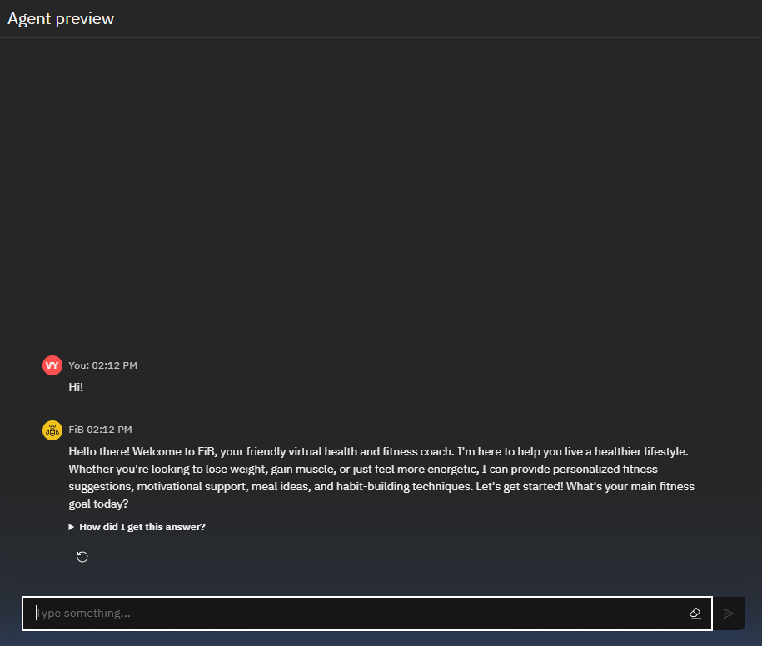
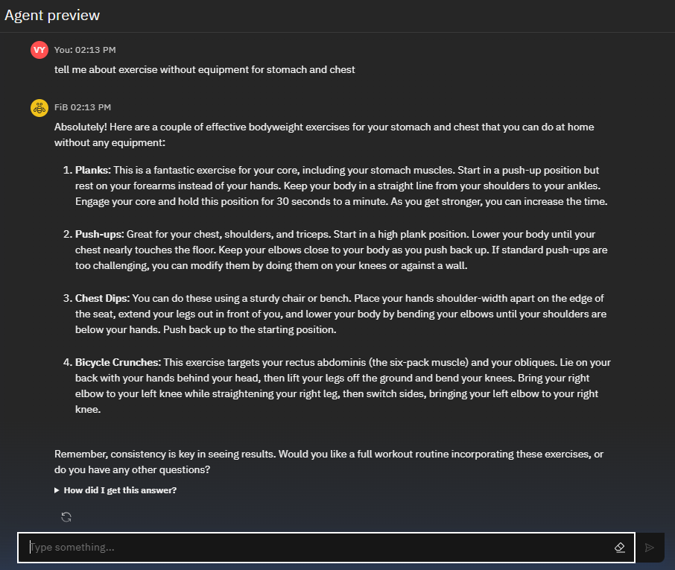
📸 Screenshots:

Slide 11
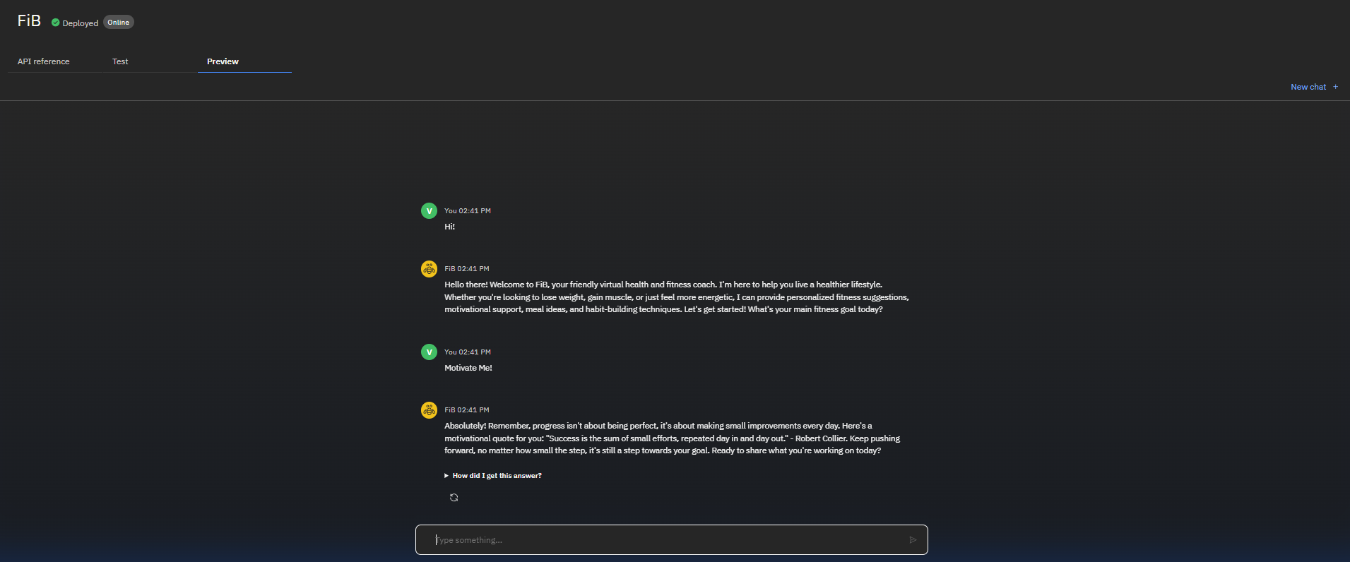

Slide 12
Conclusion
FiB proves that a lightweight, grounded AI fitness assistant can be built with zero custom code
Using IBM Granite, Agentic Lab, and knowledge vectorization, the assistant gives smart, reliable advice
No ML training, no model tuning — just intelligent use of modern LLM architecture
The assistant is designed with user-friendliness and low barrier-to-use in mind
This project reflects the future of scalable, intelligent wellness tools for the general public

Slide 13

GIT-HUB LINK
https://github.com/NASTOV03/FiB-Agentic-AI-RAG-AICTE_Edunet_IBM_Project.git

Slide 14
Future scope
🔊 Add voice input with Speech-to-Text integration
📱 Deploy FiB as a mobile-first web chatbot
🧠 Connect to live APIs for step tracking, meal databases, or reminders
📈 Introduce user profiling with personalization memory
🏥 Expand to mental wellness coaching, lifestyle FAQs, or medical triage (with proper disclaimers)

Slide 15
References
IBM Agentic Lab https://agentic-lab.ai.cloud.ibm.com
IBM Granite LLM (Watsonx) https://www.ibm.com/products/watsonx-granite
IBM Cloud Documentation https://cloud.ibm.com/docs
Health & Fitness Content (used in grounding PDF)
World Health Organization (WHO) – https://www.who.int
Mayo Clinic – https://www.mayoclinic.org
Healthline – https://www.healthline.com
AICTE-Edunet Internship Portal Resources

Slide 16
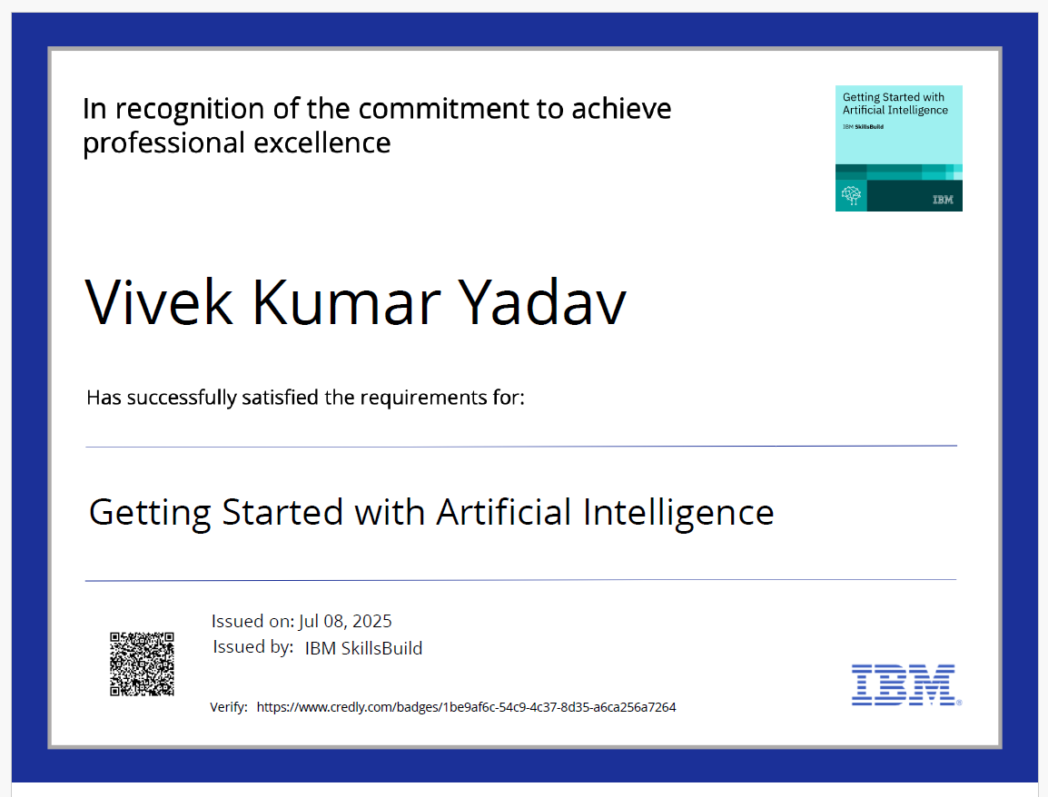
IBM Certifications

Slide 17
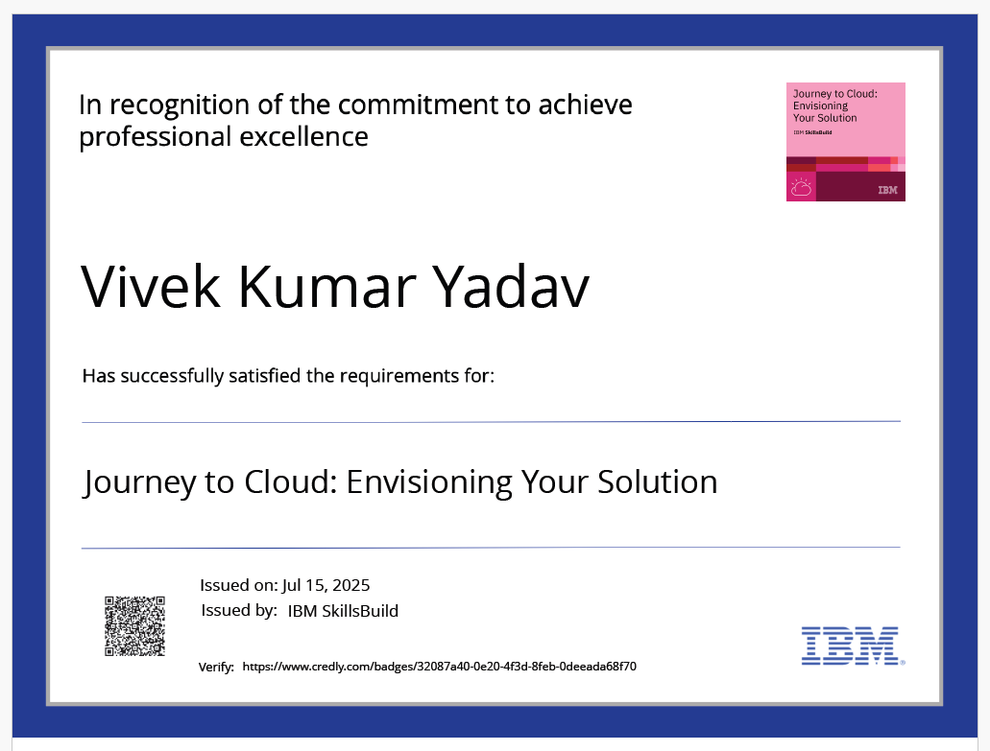
IBM Certifications

Slide 18
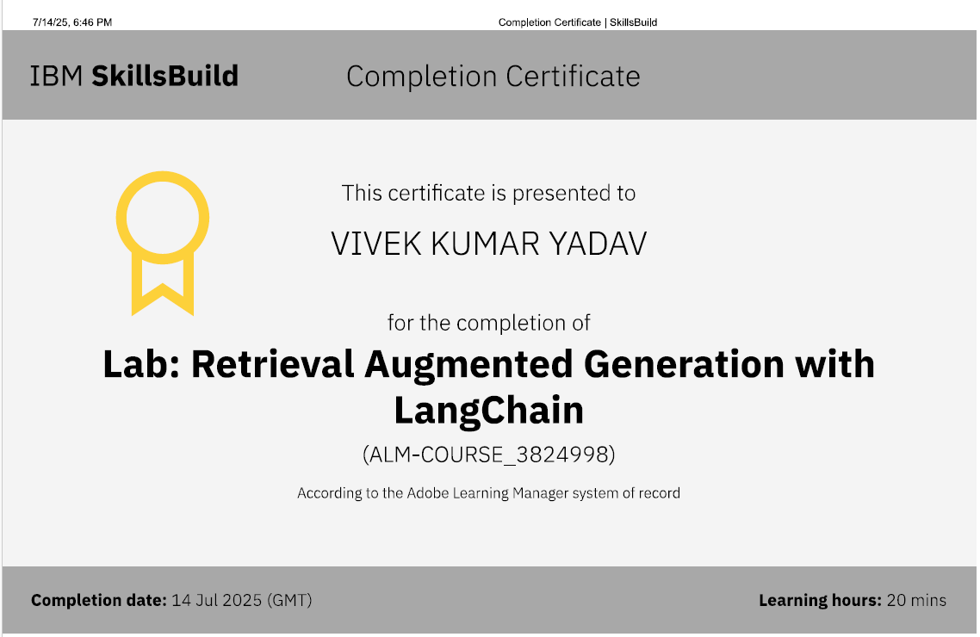
IBM Certifications

Slide 19
THANK YOU

