Slide 1


INSIGHTIQ
IBM SKILLSBUILD AI SUMMER CERTIFICATION
InsightIQ- Empowering students through AI
PRESENTED BY:- 4-bit coders
MEMBER 1- DEEPAK KUMAR YADAV,DR.AKHILESH DAS GUPTA INSTITUTE OF PROFESSIONAL STUDIES
MEMBER 2- ADITYA KUMAR JHA,DR.AKHILESH DAS GUPTA INSTITUTE OF PROFESSIONAL STUDIES
MEMBER 3- VIVEK KUMAR YADAV,BANARSIDAS CHANDIWALA INSTITUTE OF INFORMATION TECHNOLOGY
MEMBER 4- ARYAN JHA,DRONACHARYA GROUP OF INSTITUTIONS

Slide 2

Lack of Personalized Academic Support
Many students, especially in rural and under-resourced areas don’t have access to teachers and mentors outside of school hours
Learning Gaps
Problem
Statement
According ASER 2023 report , over 50% of Grade-5 student cannot read Grade-2 level text
One-Size-Fits-All Learning
Traditional teaching method fail to adopt to each student’s own learning pace and style

Slide 3

Limited Access to Qualified Teachers Rural and low-income areas often face teacher shortages and lack subject specialists.
Inadequate Learning Resources Outdated textbooks, no access to digital content, and limited library facilities.
Time Constraints for Teachers High student-to-teacher ratios mean teachers can’t address every student’s doubts.
Lack of Personalization Classroom teaching often uses a one-size-fits-all approach, ignoring individual pace and learning needs.
Causes of Problem

Slide 4

AI-Powered Doubt Solver Instantly answers students’ academic questions with clear, age-appropriate explanations.
Personalized Quiz Generator Creates quizzes tailored to the student’s subject, difficulty level, and learning progress.
Available Anytime, Anywhere Works 24/7 on web and mobile, reducing dependency on physical classroom hours.
Lightweight & Accessible Designed to work even on low-end devices and slow internet connections.
Proposed Solution

Slide 5
How it works
InsightIQ is an AI-powered assistant built on IBM Watsonx and LLaMA 3 Vision-Instruct (11B), designed for education and knowledge enhancement. It delivers high-context, intelligent answers and remains always available for students and learners.
Step 1
Step 2
Step 3
Step 4
Ask
Process
Deliver
Assess
Students write a doubt or request a quiz
AI understands the request using IBM Watsonx and LLM
Provides a clear answer or personalized quiz
Student check answer using answer keys

Slide 6

Unique Value Proposition
“InsightIQ – Your 24/7 AI tutor that adapts to you.”
Personalized Learning at Scale – Adapts explanations and quizzes to each student’s level and pace.
Instant Doubt Resolution – Answers academic questions within seconds, anytime, anywhere.
Accessible for All – Optimized for low-bandwidth and basic devices, ensuring no student is left out.
Self-Assessment Driven – Separate answer keys encourage independent learning and critical thinking.

Slide 7


SDG Alignment
SDG 4 – Quality Education
Ensures inclusive and equitable access to quality learning resources.
Promotes lifelong learning through personalized and adaptive education tools.
SDG Alignment and Scope
Scope
Educational Reach: From primary to higher education, adaptable for multiple subjects.
Scalability: Can be expanded to include voice support, multilingual explanations, and advanced analytics.

Slide 8
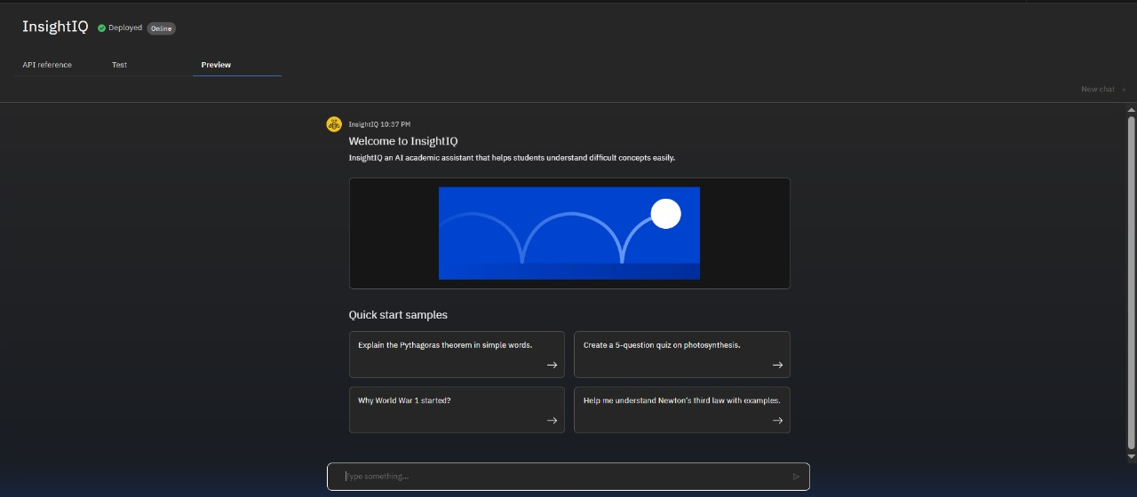
Result

Slide 9
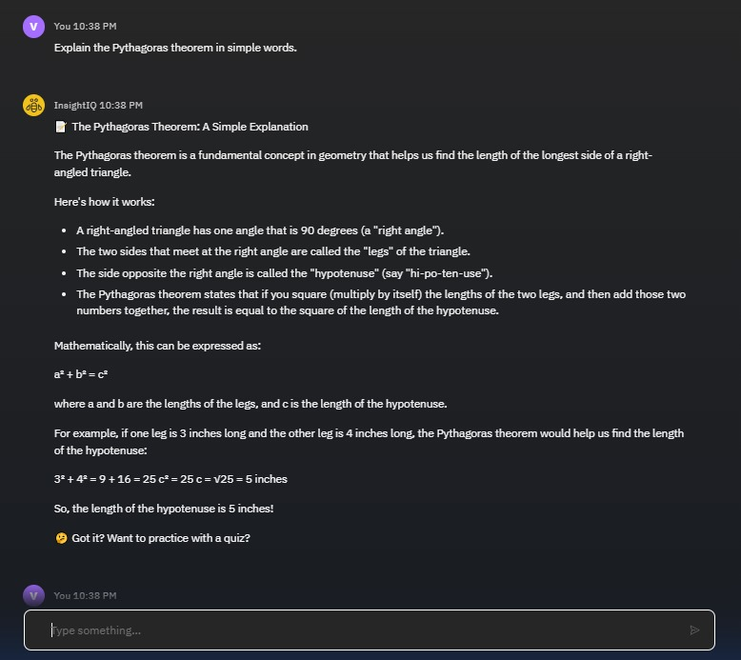
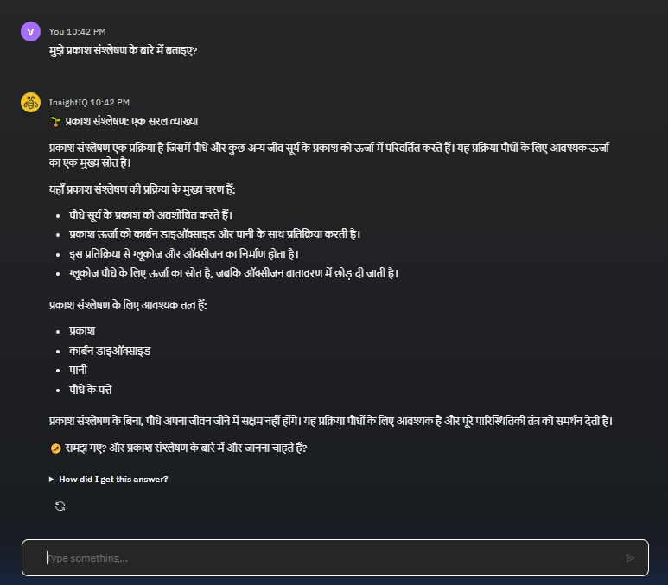

Slide 10

GIT-HUB LINK
https://github.com/NASTOV03/InsightIQ_AI-Agent_4-bit-coders.git

Slide 11

References
United Nations Sustainable Development Goals – SDG 4: Quality Education https://sdgs.un.org/goals/goal4
IBM Watsonx – AI & Machine Learning Platform https://www.ibm.com/watsonx
LLaMA 3 – Meta AI Language Model Overview https://ai.meta.com/llama
ASER 2023 Annual Status of Education Report – Learning Levels in India http://asercentre.org

