Slide 1

Midterm Warp-up
Shan Wang
Lingnan College, Sun Yat-sen University
2020 Data Mining and Machine Learning LN3119
https://wangshan731.github.io/DM-ML/

Slide 2
Course outline
Supervised learning
Linear regression
Logistic regression
SVM and kernel
Tree models
Deep learning
Neural networks
Convolutional NN
Recurrent NN
Unsupervised learning
Clustering
PCA
EM
Reinforcement learning
MDP
ADP
Deep Q-Network

Slide 3
ML THREE elements
Model

Slide 4
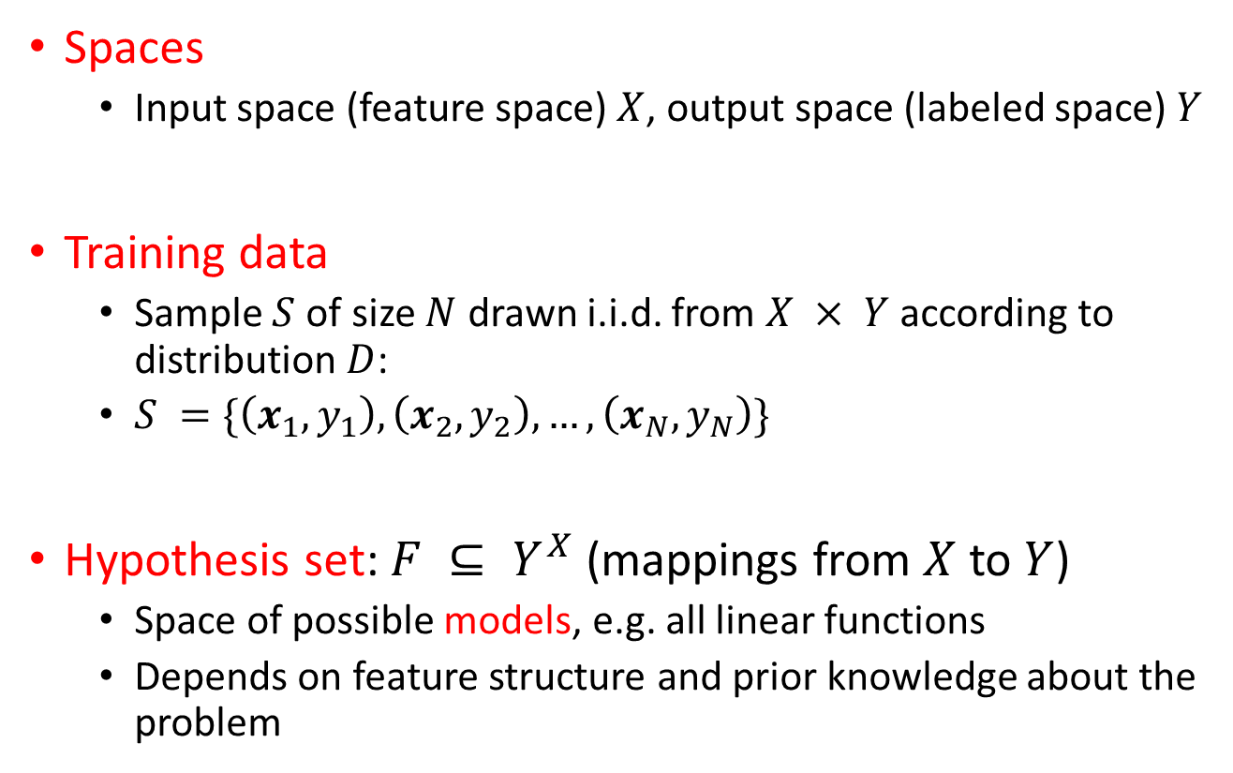
Model
ML THREE elements – Model
Spaces
Input space (feature space) $X$, output space (labeled space) $Y$
Training data
Sample $S$ of size $N$ drawn i.i.d. from $X × Y$according to distribution $D$:
$S =\{\left(x_{1},y_{1}\right),\left(x_{2},y_{2}\right),…,\left(x_{N},y_{N}\right)\}$
Hypothesis set: $F ⊆ Y^{X}$ (mappings from $X$ to $Y$)
Space of possible models, e.g. all linear functions
Depends on feature structure and prior knowledge about the problem

Slide 5
ML THREE elements
Strategy

Slide 6
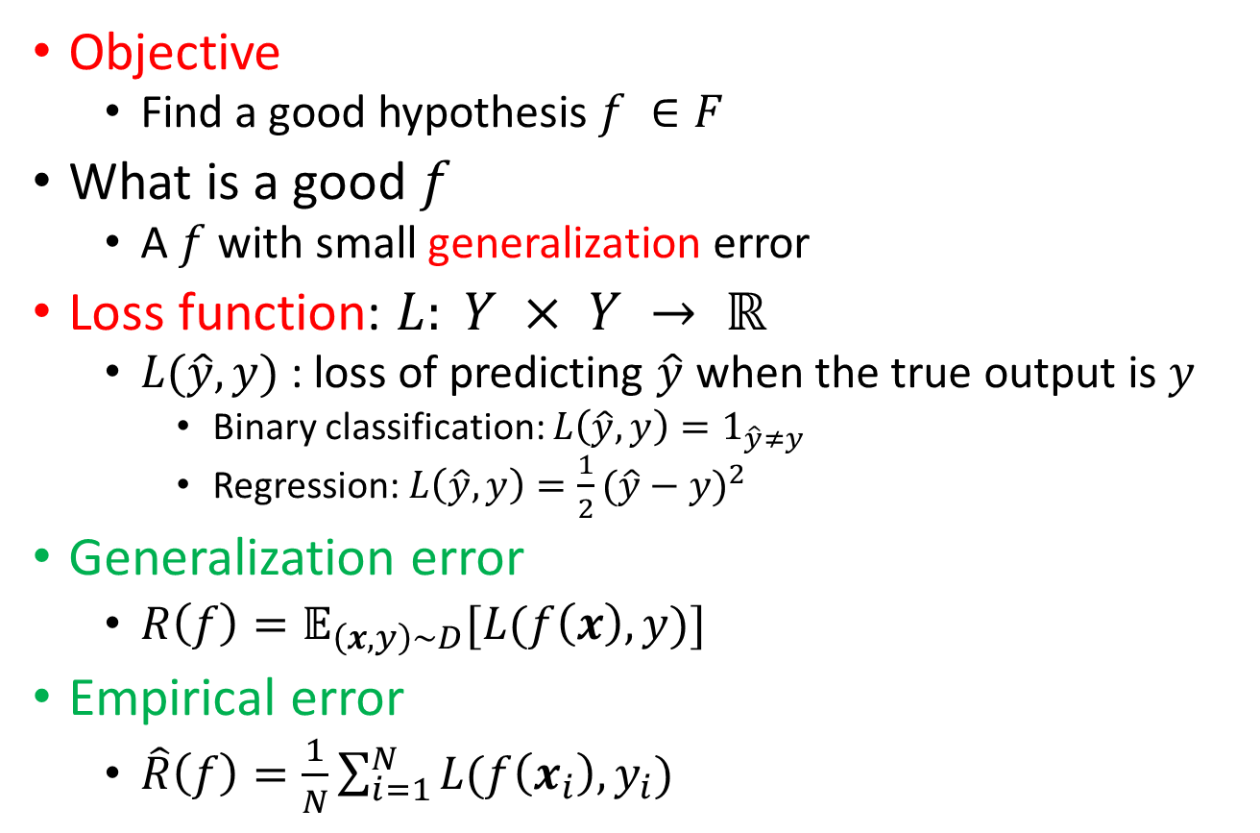
Strategy
ML THREE elements - Strategy
Objective
Find a good hypothesis $f ∈F$
What is a good $f$
A $f$ with small generalization error
Loss function: $L: Y × Y → ℝ$
$L(\hat{y}, y)$: loss of predicting $\hat{y}$ when the true output is $y$
Binary classification: $L\left(\hat{y}, y\right)=1_{\hat{y}≠y}$
Regression: $L\left(\hat{y}, y\right)=\frac{1}{2}{(\hat{y}−y)}^{2}$
Generalization error
$R\left(f\right)=𝔼_{\left(x,y\right)\sim D}[L(f\left(x\right),y)]$
Empirical error
$\hat{R}\left(f\right)=\frac{1}{N}\sum_{i=1}^{N}{L(f\left(x_{i}\right),y_{i})}$

Slide 7
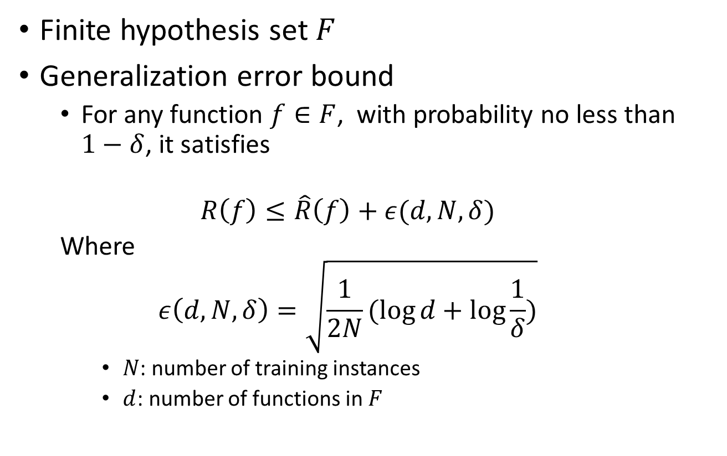
Generalization error bound
ML THREE elements - Strategy
Finite hypothesis set $F$
Generalization error bound
For any function $f∈F$, with probability no less than $1−δ$, it satisfies
$$R\left(f\right)≤\hat{R}\left(f\right)+ε(d,N,δ)$$
Where
$$ε\left(d,N,δ\right)=\sqrt{\frac{1}{2N}(\log{d}+\log{\frac{1}{δ}})}$$
$N$: number of training instances
$d$: number of functions in $F$
Bonus question: How to prove it?
Hint: Hoeffding Inequality

Slide 8
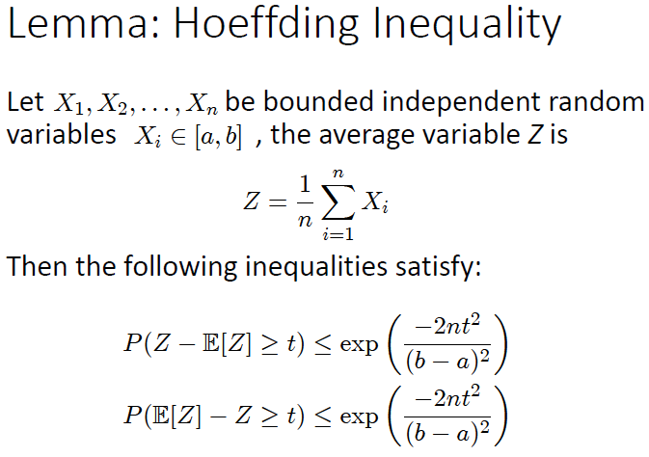
Generalization error bound - Hint
ML THREE elements - Strategy

Slide 9
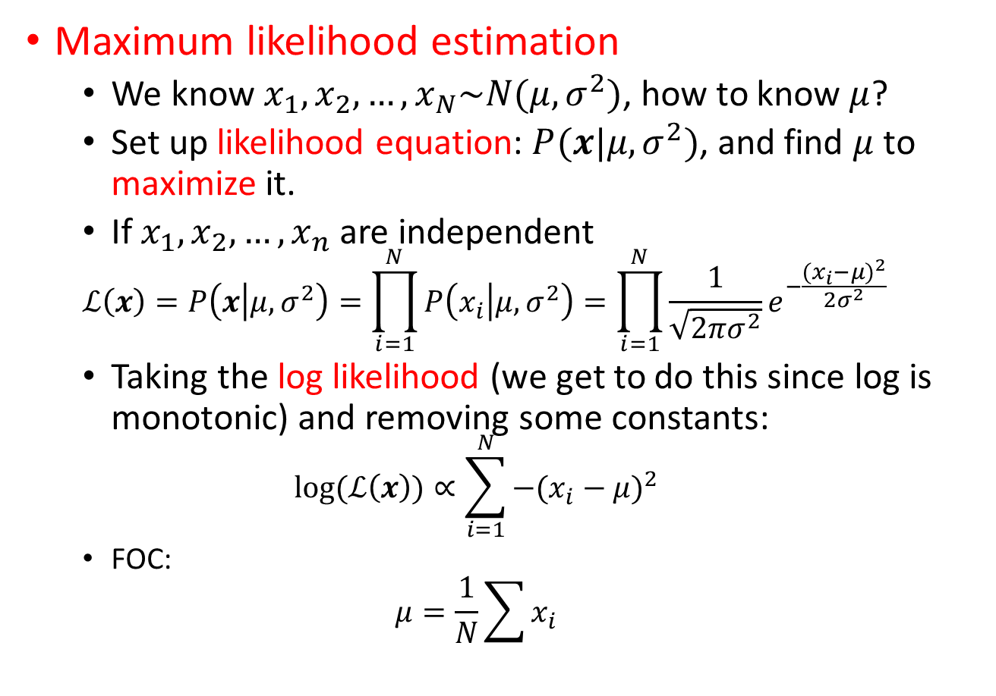
Maximum likelihood estimation
ML THREE elements - Strategy
Maximum likelihood estimation
We know $x_{1},x_{2},…,x_{N}\sim N(μ,σ^{2})$, how to know $μ$?
Set up likelihood equation: $P(x|μ,σ^{2})$, and find $μ$ to maximize it.
If $x_{1},x_{2},…,x_{n}$ are independent
$$ℒ\left(x\right)=P\left(x | μ,σ^{2}\right)=\prod_{i=1}^{N}{P\left(x_{i} | μ,σ^{2}\right)}=\prod_{i=1}^{N}{\frac{1}{\sqrt{2πσ^{2}}}}e^{−\frac{{(x_{i}−μ)}^{2}}{2σ^{2}}}$$
Taking the log likelihood (we get to do this since log is monotonic) and removing some constants:
$$log⁡(ℒ\left(x\right))∝\sum_{i=1}^{N}{−{(x_{i}−μ)}^{2}}$$
FOC:
$$μ=\frac{1}{N}\sum{x_{i}}$$

Slide 10
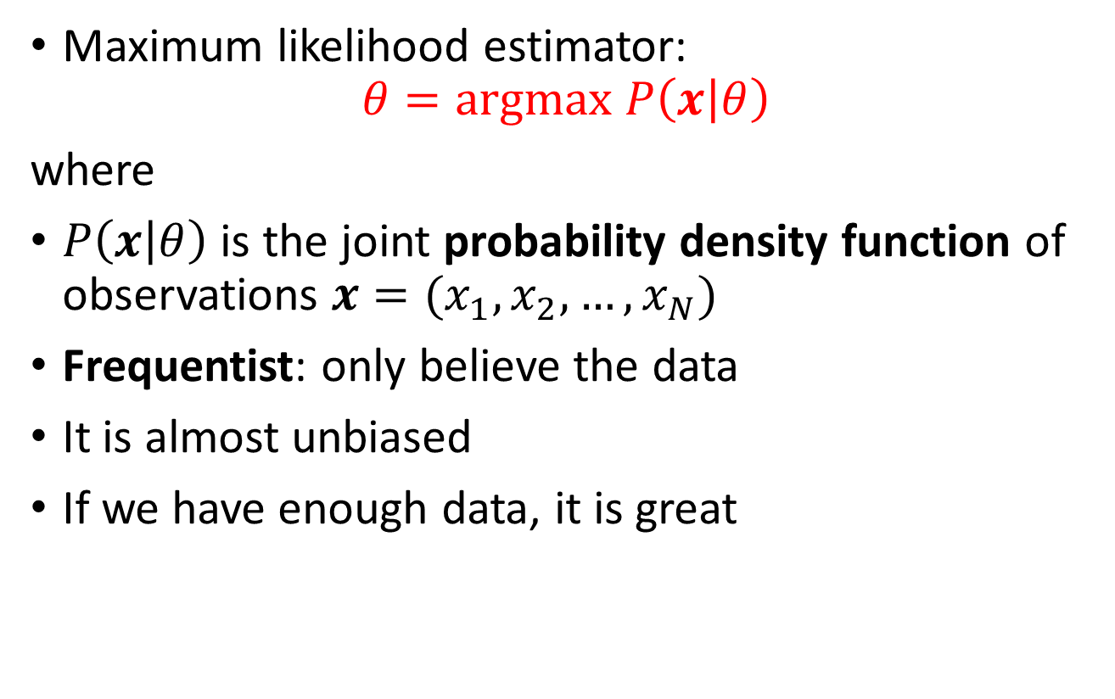
About MLE
ML THREE elements - Strategy
Maximum likelihood estimator:
$$θ=argmax P\left(x | θ\right)$$
where
$P\left(x | θ\right)$ is the joint probability density function of observations $x=(x_{1},x_{2},…,x_{N})$
Frequentist: only believe the data
It is almost unbiased
If we have enough data, it is great

Slide 11
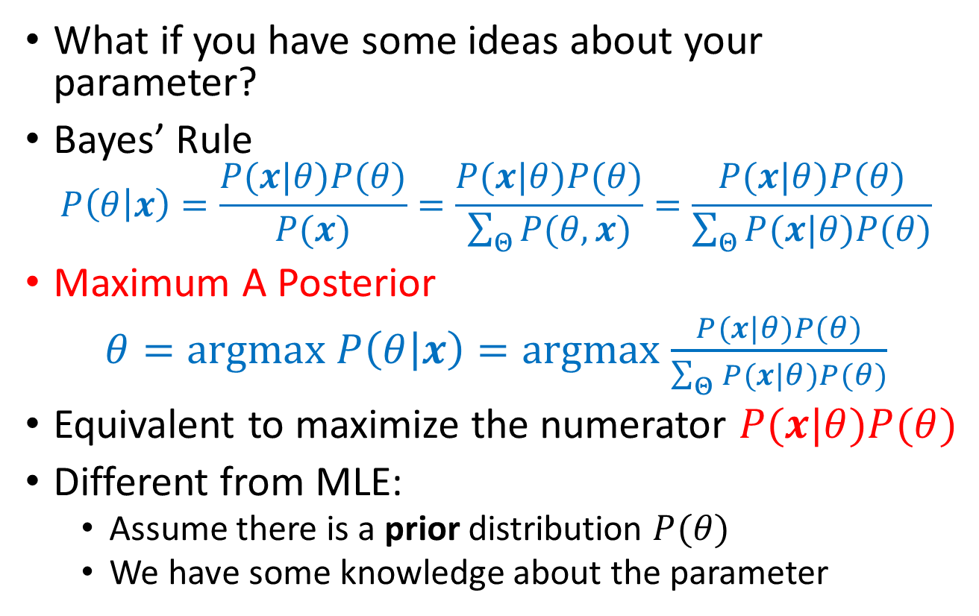
Maximum A Posterior
ML THREE elements - Strategy
What if you have some ideas about your parameter?
Bayes’ Rule
$$P\left(θ | x\right)=\frac{P(x|θ)P(θ)}{P(x)}=\frac{P(x|θ)P(θ)}{\sum_{Θ}{P(θ,x)}}=\frac{P(x|θ)P(θ)}{\sum_{Θ}{P(x|θ)P(θ)}}$$
Maximum A Posterior
$θ=argmax$ $P\left(θ | x\right)=argmax$ $\frac{P(x|θ)P(θ)}{\sum_{Θ}{P(x|θ)P(θ)}}$
Equivalent to maximize the numerator $P(x|θ)P(θ)$
Different from MLE:
Assume there is a prior distribution $P(θ)$
We have some knowledge about the parameter

Slide 12
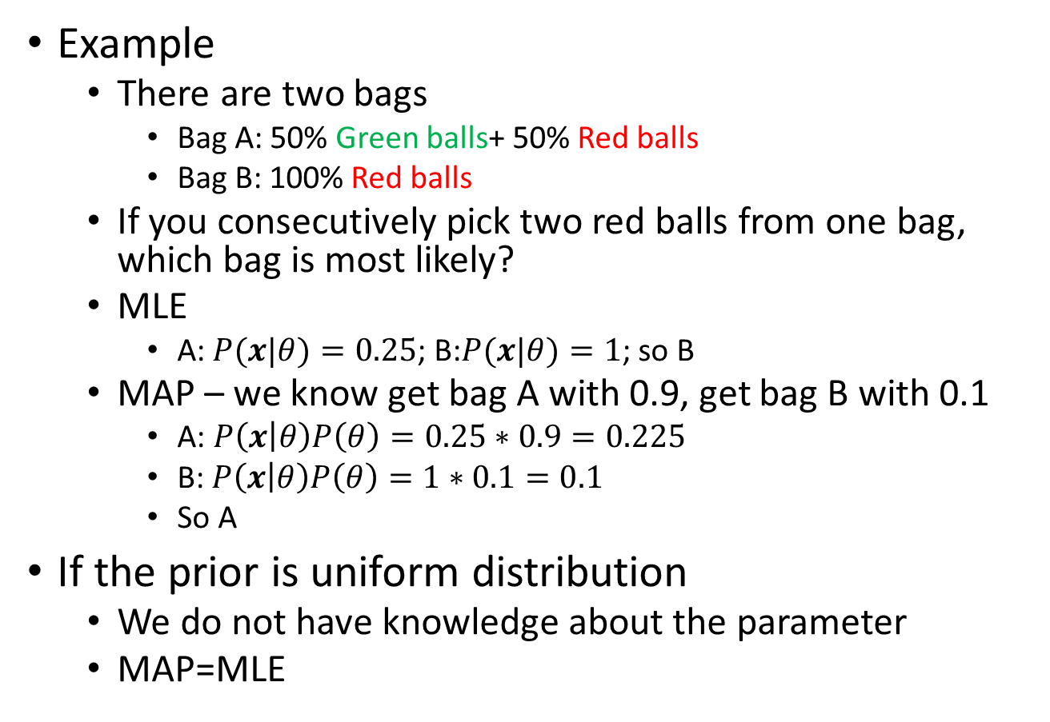
About MAP
ML THREE elements - Strategy
Example
There are two bags
Bag A: 50% Green balls+ 50% Red balls
Bag B: 100% Red balls
If you consecutively pick two red balls from one bag, which bag is most likely?
MLE
A:$P(x|θ)=0.25$; B:$P(x|θ)=1$; so B
MAP – we know get bag A with 0.9, get bag B with 0.1
A: $P\left(x | θ\right)P\left(θ\right)=0.25∗0.9=0.225$
B: $P\left(x | θ\right)P\left(θ\right)=1∗0.1=0.1$
So A
If the prior is uniform distribution
We do not have knowledge about the parameter
MAP=MLE

Slide 13
ML THREE elements
Algorithm

Slide 14
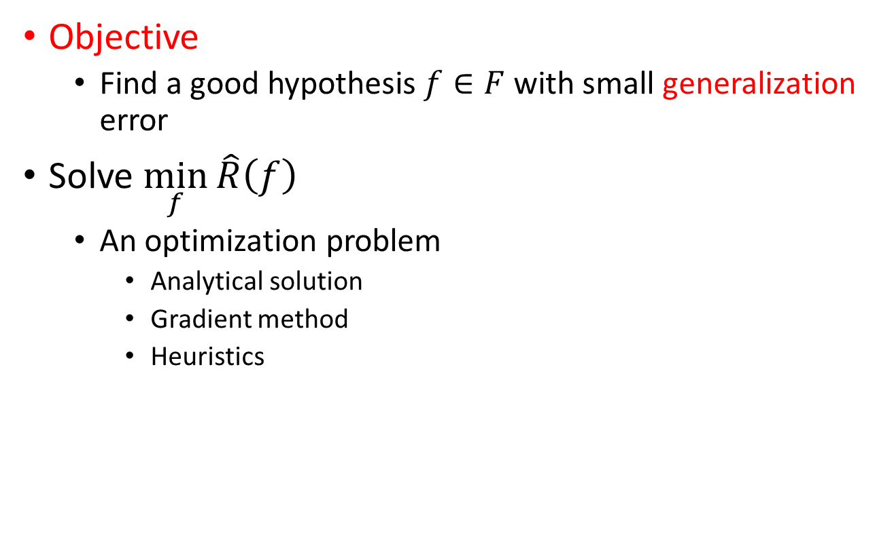
Algorithm
ML THREE elements - Algorithm
Objective
Find a good hypothesis $f∈F$ with small generalization error
Solve $\min_{f}{\hat{R}\left(f\right)}$
An optimization problem
Analytical solution
Gradient method
Heuristics

Slide 15
Model evaluation

Slide 16

Confusion matrix
Model evaluation – For classification problem
Confusion Matrix
TP – True Positive ; FP – False Positive
FN – False Negative; TN – True Negative
Any limitation?
 | Predicted class
Actual class |  | Class=yes | Class=no
 | Class=yes | TP | FN
 | Class=no | FP | TN
$$Accuracy=\frac{TP+TN}{TP+FN+FP+TN}$$

Slide 17

Other measures
Model evaluation – For classification problem
Cost-sensitive measures
F1 measure is best if there is some sort of balance between precision (p) & recall (r)
 | Predicted class
Actual class |  | Class=yes | Class=no
 | Class=yes | TP | FN
 | Class=no | FP | TN
$$Precision (p)=\frac{TP}{TP+FP}$$
$$Recall \left(r\right)=\frac{TP}{TP+FN}$$
$$F1−measure \left(F\right)=\frac{2rp}{r+p}=\frac{2TP}{2TP+FP+FN}$$

Slide 18
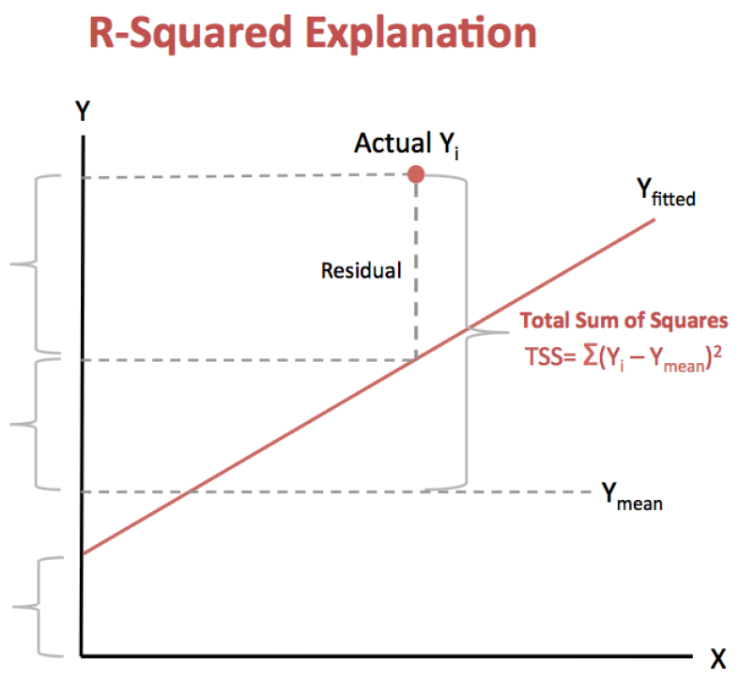












R-squared
Model evaluation – For regression problem
Coefficient of determination ($R^{2}$)
measures how much of the residue can be explained by the regression line
Total Sum of Squares $TSS=\sum{{(y_{i}^{}−\overline{y})}^{2}}$
(Total variance )
Explained Sum of Squares $ESS=\sum{{(f_{i}^{}−\overline{y})}^{2}}$
(Explained variance)
Residual Sum of Squares $RSS=\sum{{(f_{i}^{}−y_{i}^{})}^{2}}$
(Unexplained variance )
$$R^{2}=\frac{explained variance}{total variance}=\frac{ESS}{TSS}=1−\frac{RSS}{TSS}$$
$$y$$
$$\overline{y}$$
$$y_{i}^{}$$
$$f$$
$$f(x)$$
RSS
TSS
$$f_{i}^{}$$
ESS
$$\overline{y}$$
$$\overline{y}$$
intercept
$$x$$
$$\overline{y}$$

Slide 19
Model selection and regularization

Slide 20
Bias vs. Variance
Model selection & regularization
Bias – variance decomposition
Bias – variance trade-off
Model complexity

Slide 21
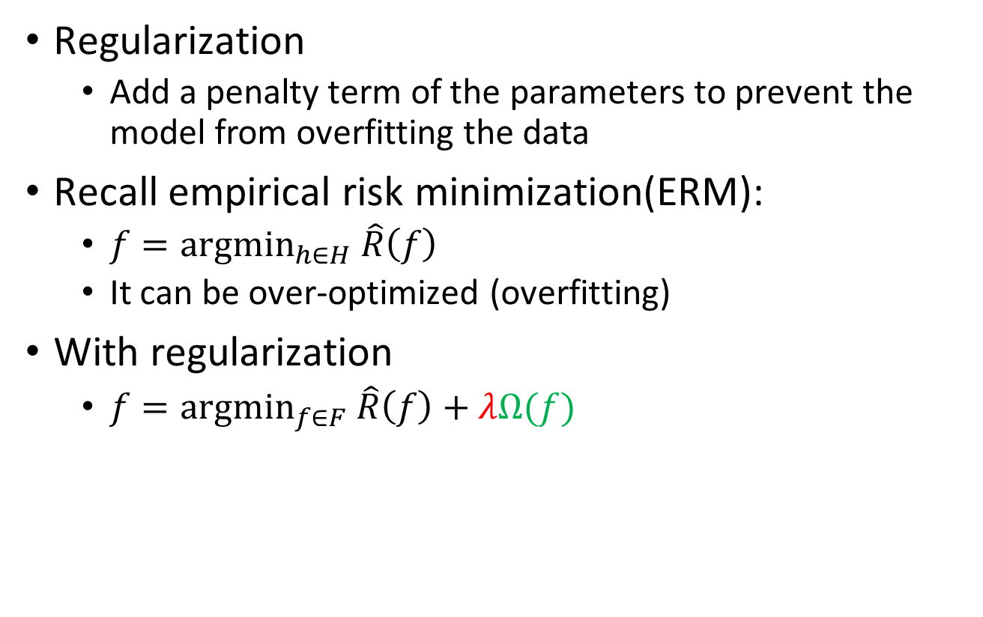

How regularization works
Model selection & regularization
Regularization
Add a penalty term of the parameters to prevent the model from overfitting the data
Recall empirical risk minimization(ERM):
$f={argmin}_{h∈H} \hat{R}\left(f\right)$
It can be over-optimized (overfitting)
With regularization
$f={argmin}_{f∈F} \hat{R}\left(f\right)+λΩ(f)$
Complexity of $f$
Regularization
parameter

Slide 22

L1-norm and L2-norm regularization
Model selection & regularization
L2-norm (Ridge):
$Ω\left(f=ax+b\right)=a^{2}+b^{2}$
L1-norm (Lasso):
$Ω\left(f=ax+b\right)=\left|a\right|+\left|b\right|$

Slide 23
Cross validation

Slide 24
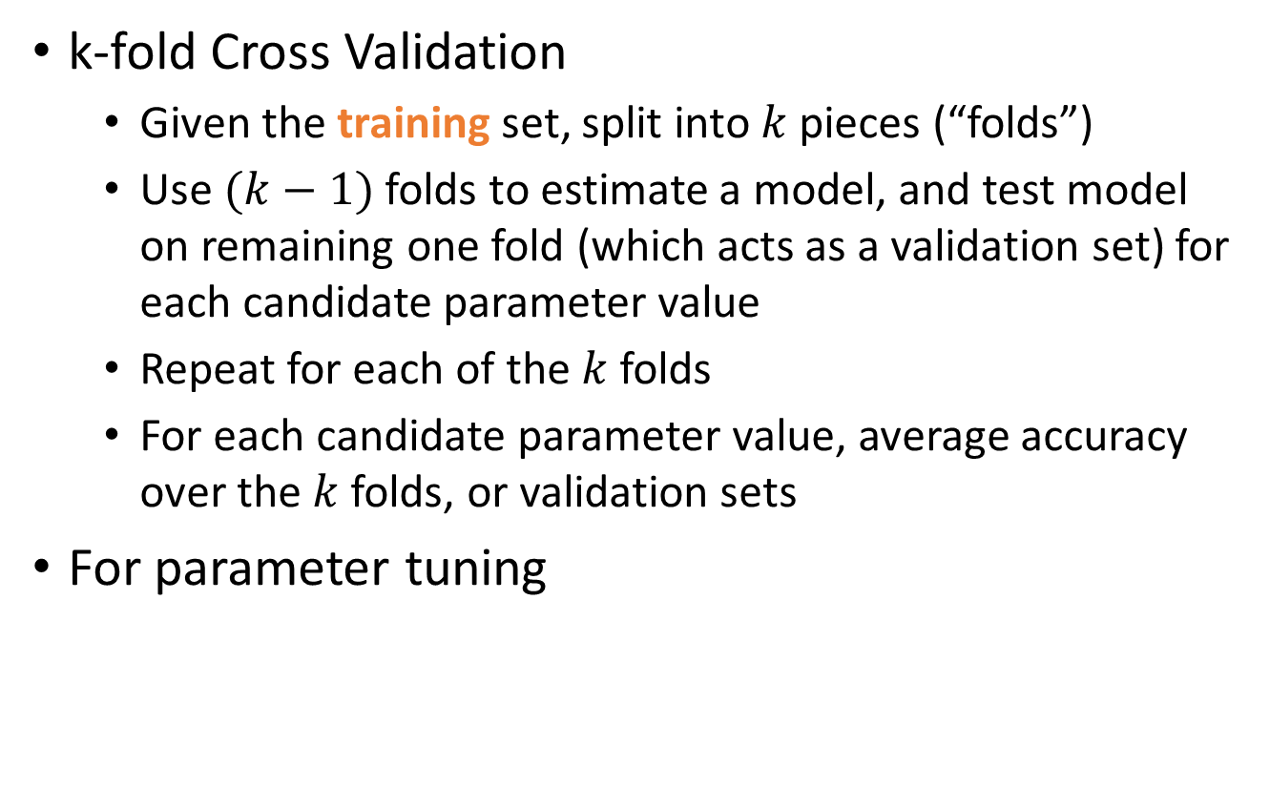
k-fold Cross Validation
Cross validation
k-fold Cross Validation
Given the training set, split into $k$ pieces (“folds”)
Use $(k−1)$ folds to estimate a model, and test model on remaining one fold (which acts as a validation set) for each candidate parameter value
Repeat for each of the $k$ folds
For each candidate parameter value, average accuracy over the $k$ folds, or validation sets
For parameter tuning

Slide 25
Regression Problem
Linear Regression
Classification Problem
Logistic Regression
SVM
Decision Tree
Neural Network

Slide 26

Linear Regression
$y=θ′x$
Minimize squared error $⇔$ Maximize likelihood

Slide 27
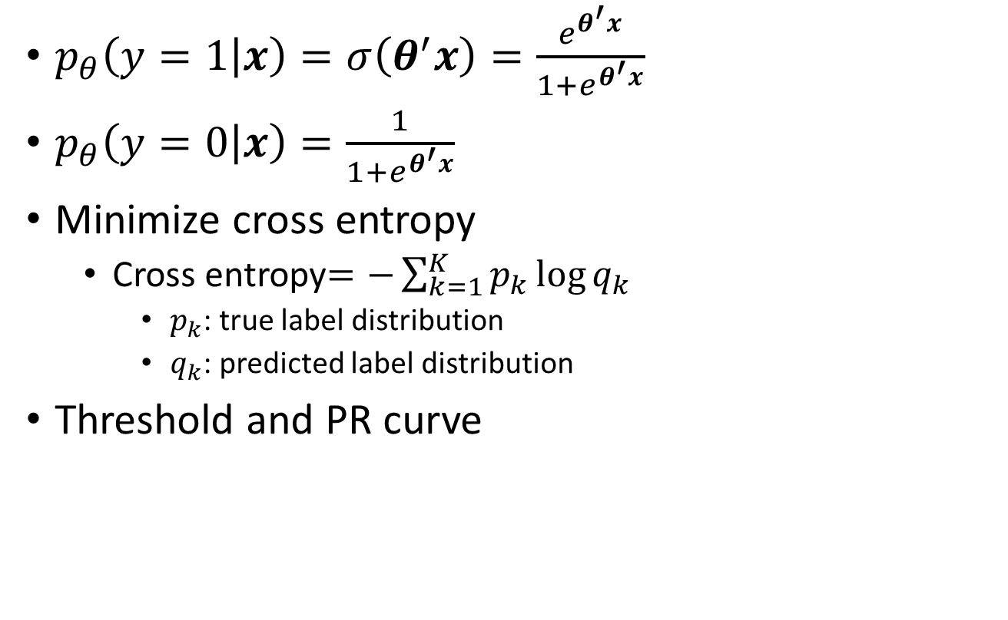
Logistic Regression
$p_{θ}\left(y=1 | x\right)=σ\left(θ^{′}x\right)=\frac{e^{θ^{′}x}}{1+e^{θ^{′}x}}$
$p_{θ}\left(y=0 | x\right)=\frac{1}{1+e^{θ^{′}x}}$
Minimize cross entropy
Cross entropy$=−\sum_{k=1}^{K}{p_{k}\log{q_{k}}}$
$p_{k}$: true label distribution
$q_{k}$: predicted label distribution
Threshold and PR curve

Slide 28



SVM
$y=f_{θ}\left(x\right)=\left\{\begin{aligned}+1, if θ^{′}x+θ_{0}≥\text{0} \\ −1, if { θ}^{′}x+θ_{0}<\text{0}\end{aligned}\right.$
Maximize margin
Soft margin $C\sum_{i=1}^{N}{ξ_{i}}$
Kernel$φ\left(x\right)$
SMO algorithm
Prim
Dual
$$\min_{θ{,θ}_{0}}{{\frac{1}{2}\left\|θ\right\|}^{2}}$$
$$s.t. y_{i}\left(θ^{′}x_{i}+θ_{0}\right)≥1, i=1,…,N$$
$$\max_{α≥0}{\sum_{i=1}^{N}{α_{i}}}−\frac{1}{2}\sum_{i=1}^{N}{\sum_{j=1}^{N}{α_{i}{α_{j}y_{i}y}_{j}{x_{j}′x}_{i}}}$$
$$s.t. \sum_{i=1}^{N}{α_{i}y_{i}}=0$$

Slide 29
Decision Tree
12 Blue 12 Black X < 55
Yes
No
Strategy & Algorithm
ID.3: information gain
C4.5: information gain ratio
CART
Classification: Gini index
Regression: Squared error
Regularization: pruning
Random forest: bagging
combining the results of multiple parallel models
Bootstrapping the data sets
6 Blue 1 Black Blue
6 Blue 11 Black Y < 20
Yes
No
6 Blue 4 Black X < 85
0 Blue 7 Black Black
Yes
No
6 Blue 1 Black Blue
0 Blue 3 Black Black
Information gain: with the 𝑋, how much the uncertainty of 𝑌 decreases
Information gain ration: Information gain divided by uncertainty of 𝑋

Slide 30
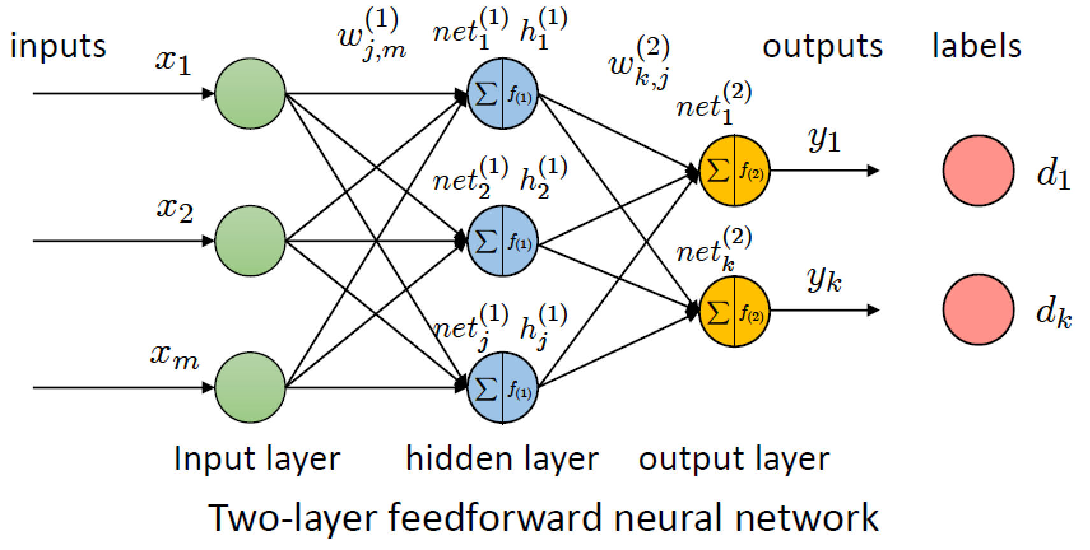






Neural Network
Update the parameters:
$$w_{k,j}^{(2)}′=w_{k,j}^{(2)}−ηΔw_{k,j}^{(2)}=w_{k,j}^{(2)}−ηε_{k}h_{j}^{\left(1\right)}$$
$$w_{j,m}^{(1)}′=w_{j,m}^{(1)}−ηΔw_{j,m}^{(1)}=w_{j,m}^{(1)}−ηε_{j}x_{m}$$
Error of $k$
Output of $j$
Learning rate
Output of $m$
Error of $j$
If node $i$ is in output layer
$ε_{i}=$ $\left(o_{i}−y_{i}\right)f_{}^{′i}$
If node $i$ is in hidden layer
$$ε_{i}=\sum_{k=1}^{K}{ε_{k}}w_{k,i}^{}f_{}^{′i}$$

Slide 31
Questions?
2020 Data Mining and Machine Learning LN3119
https://wangshan731.github.io/DM-ML/
Shan Wang (王杉）
https://wangshan731.github.io/

