Slide 1
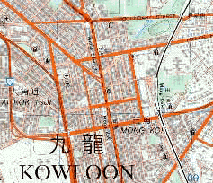
DNG Data Structure
Detail
Hashtable
Arc id detail list
Node
Net.txt
id type ….
-- ----- ----
-- ----- ----
Node.txt
id type ….
-- ----- ----
-- ----- ----
Arc
Detail List
Arc.txt
id type ….
-- ----- ----
-- ----- ----
Database
--- ---- -----
--- ---- -----

Slide 2
Network Structure
MyNetwork
GenericNetwork
Net
Hashtable
InArc
Hashtable
MyNet
BasicNet
Net id Net
Arc id Arc
Node
Hashtable
OutArc
Hashtable
MyNode
BasicNode
Node id Node
Arc id Arc
MyArc
BasicArc
Arc
Hashtable
Arc id Arc

Slide 3
Full Network Structure
Net Hash
Node Hash
InArc Hash
InArc
Net List
Net
Object
Node
Object
Arc
Object
Node List
OutArc
OutArc Hash
Arc List
Arc Hash

Slide 4
Network Structure 2
Node1
Node2
Node3
Node4
Net1
Node List
Arc List
Net2
Node List
Arc List
Arc1
Arc2
Arc3
Arc4
Arc5
Arc6
Arc7
Arc8

Slide 5
Network Structure 3
Arc1
Arc2
Arc3
Arc4
Arc5
Arc6
Arc7
Arc8
Node1
InArc List
OutArc List
Node2
InArc List
OutArc List

Slide 6
Useful Function
Please refer to the HTML files

