Slide 1

NAUPA-3 XML Schema Overview

Slide 2
XML Schema Basics
Three basic schema constructs:
Complex Types: define the structure of “container elements”
Simple Types: constrain the values of “value elements”
Enumerated Types: special case of simple types
There’s a bit more to it than that, but this should suffice for our purposes
Let’s look at some examples of each type…

Slide 3
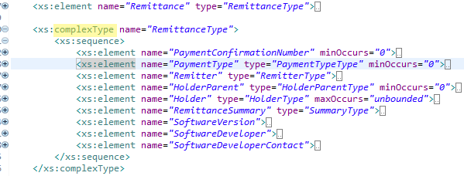
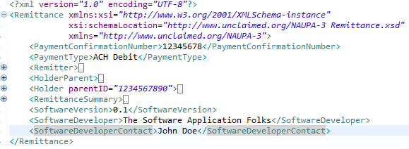
Complex Type Example: Remittance
Schema
Valid XML
Defines
Notes:
This is a complete NAUPA-3 report, just like the spreadsheet! In these screen shots, the important bits are collapsed by the XML editor, which understands the hierarchical structure.

Slide 4
Things to Note About complexType
Defines the order of sub-elements
sequence: Order defined top-to-bottom
choice: One and only one element from the set of potential sub-elements listed
Defines the type of sub-elements
Sub-element types can be complex, simple, or enumerated
Defines the multiplicity of sub-elements
Default is a single “required” element
Can change multiplicity using minOccurs and maxOccurs
minOccurs=“0” means the element is optional
maxOccurs can be a number or “unbounded”
Can be named if desired, or if needed for re-usability

Slide 5
RemittanceType Example Revisited
Schema
Meaning
The Remittance element contains several sub-elements (at least 6)
PaymentConfirmationNumber is optional, but appears first if present, and only once
PaymentType is also optional, and may appear only once if present
Remitter is required, and appears exactly once
HolderParent is optional, and appears only once if present
Notes:
Whether the above is correct is the subject of another meeting, but this is what the schema says at the moment.

Slide 6
RemittanceType Example
Schema
Meaning
Holder must appear at least once, and may appear many times (no maximum)
RemittanceSummary, SoftwareVersion, SoftwareDeveloper, and SoftwareDeveloperContact are required, and appear only once
Notes:
Whether the above is correct is the subject of another meeting, but this is what the schema says at the moment.

Slide 7
Simple Types
Used for elements that contain values only, not other elements
May be defined in-line
Useful for “one-offs” like defining the length of a particular string
Can be defined as a “named type” if used in more than one place in the XML document (e.g. a Social Security Number)
Usually extend an XML schema intrinsic type, e.g. “string” or “decimal”
Can also extend another simpleType that is already defined elsewhere
Can constrain values, e.g. number range, string length, string patterns

Slide 8
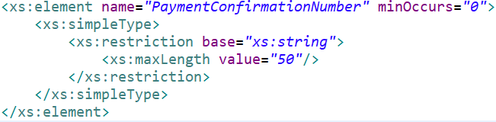
In-Line simpleType Example
Defines PaymentConfirmationNumber as a string value whose maximum length is 50 characters

Slide 9
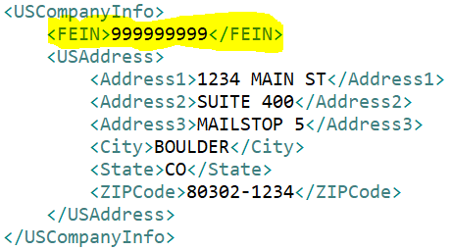
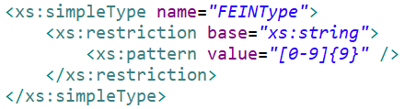
Named simpleType Example: FEINType
Federal Employer Identification Number (FEIN), used in many places
String pattern: exactly nine numeric characters

Slide 10
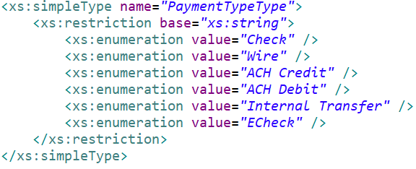
Enumerated Types
A special kind of string-based simpleType in which all possible values are enumerated.
Example: PaymentTypeType
Any value not matching one of the listed values would cause a validation error.

Slide 11
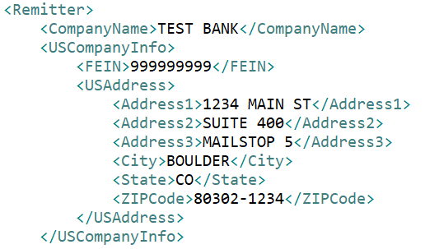
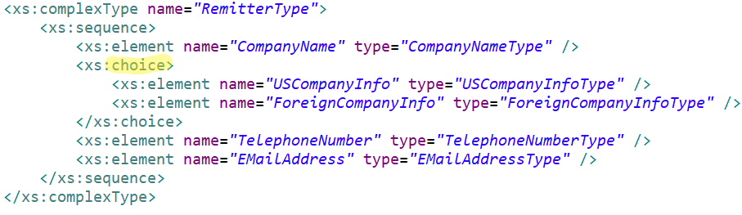
Choices
Choices allow you to say: “this sub-element can be either ElementA or ElementB”
Example: company information for a Remitter: can be either US company info or foreign company info:

Slide 12
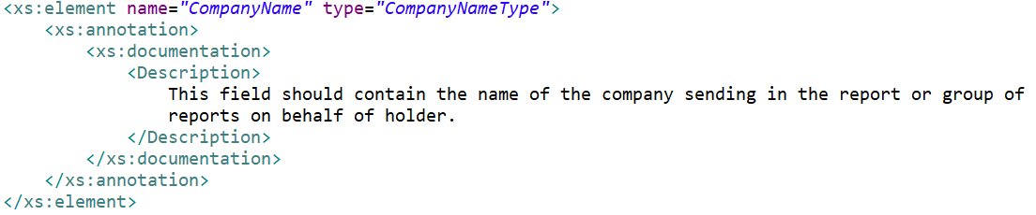
Documentation
Appears only in the schema document, not the actual XML document.
Allows us to match things up with the spreadsheet.
Adds significantly to the schema line count!

Slide 13
Work to Be Done
Go through each complexType and determine:
Sub-element naming (match with spreadsheet)
Sub-element type (complex or simple)
Sub-element cardinality with respect to parent element (minOccurs, maxOccurs)
Documentation (match with spreadsheet)
Go through each named or in-line simpleType and determine:
Base type
Restrictions (number range, string length, etc.)
Enumerations
Documentation

Slide 14
Work to Be Done
33 complexTypes
21 named simpleTypes
25 enumerated simpleTypes
Doesn’t sound too bad, but will probably take a while!

