Slide 1





Reverse Prompt.
GDGoC - GTA
A team game: we show an AI-generated image, you write the prompt that recreates it.
100 points up for grabs.
Three difficulties, five rounds. The team with the highest total takes the win.
Notes:
Welcome everyone. Reverse Prompt is a team game: we show an AI-generated image, you write the prompt that recreates it.

Slide 2


Overview.
How the game works
3 Difficulties
Match the Image
Most Points Wins
Easy, Medium and Hard. The less help you get, the harder the round.
Points are awarded on how similar your generated image is to the one shown.
The team with the highest total across all rounds takes the win.
Reverse Prompt | GDGoC - GTA
2
Notes:
Three things to know: there are three difficulty levels, you are scored on how closely your image matches the target, and the team with the most points wins.

Slide 3
How a Round Works.
Four steps, every round
1
2
3
4
See
Write
Generate
Score
The target image is revealed on screen.
Your team writes a prompt to recreate it.
Run the prompt in your AI image tool.
Judges score how similar your image is.
The timer starts as soon as the image appears.
Reverse Prompt | GDGoC - GTA
3
Notes:
Every round follows the same four steps. Remind teams: the clock starts the moment the image appears.

Slide 4

Rules Per Difficulty.
More time, less help as you go up
EASY
MEDIUM
HARD
3 min/img
5 min/img
8 min
Time limit
Time limit
Time limit
Overview provided in depth.
Little overview provided.
No instructions for the image.
Reverse Prompt | GDGoC - GTA
4
Notes:
Easy: 3 minutes per image with the overview in depth. Medium: 5 minutes per image with little overview. Hard: 8 minutes and no instructions.

Slide 5

Scoring.
100 points across three difficulty levels
EASY
MEDIUM
HARD
20 points
50 points
30 points
Round 1
10 pts
Round 1
25 pts
Single round
30 pts
Round 2
10 pts
Round 2
25 pts
EASY 20 · MEDIUM 50 · HARD 30
100 pts total
Reverse Prompt | GDGoC - GTA
5
Notes:
100 points in total. Easy is worth 20 (10 per round), Medium is worth 50 (25 per round) and the single Hard round is worth 30.

Slide 6
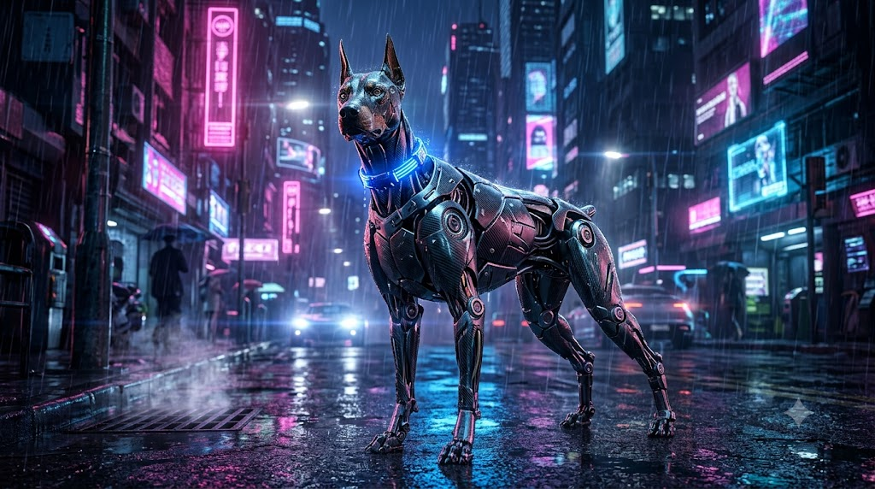
Easy · Round 1.
TIME LIMIT
3:00
PROMPT HINT
Robotic Doberman dog, glowing blue collar, standing in a rainy cyberpunk city street, neon pink and blue lights, highly detailed 3D render.
Reverse Prompt | GDGoC - GTA
Overview provided in depth
6
Notes:
Easy round. Time limit 3:00. Overview provided in depth.

Slide 7
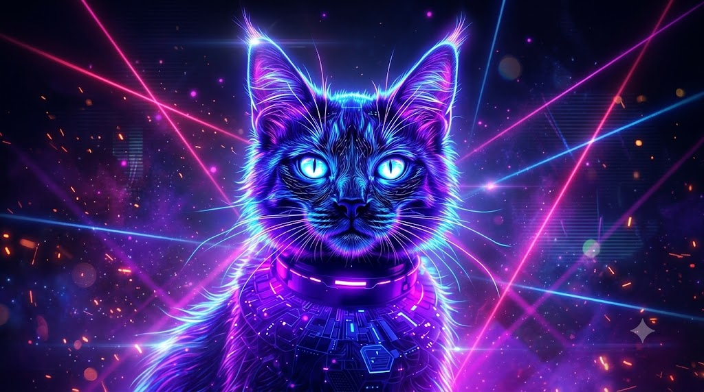
Easy · Round 2.
TIME LIMIT
3:00
PROMPT HINT
Portrait of a cat made of glowing purple and blue neon lights, bright cyan glowing eyes, dark background with laser beams, synthwave style.
Reverse Prompt | GDGoC - GTA
Overview provided in depth
7
Notes:
Easy round. Time limit 3:00. Overview provided in depth.

Slide 8
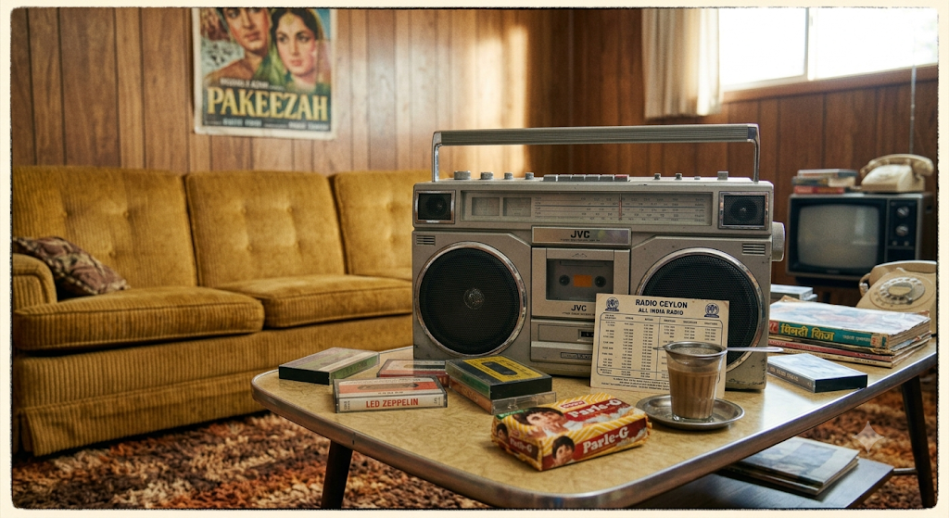
Medium · Round 1.
TIME LIMIT
5:00
PROMPT HINT
Vintage 1980s boombox radio sitting on a surface
Reverse Prompt | GDGoC - GTA
Little overview provided
8
Notes:
Medium round. Time limit 5:00. Little overview provided.

Slide 9
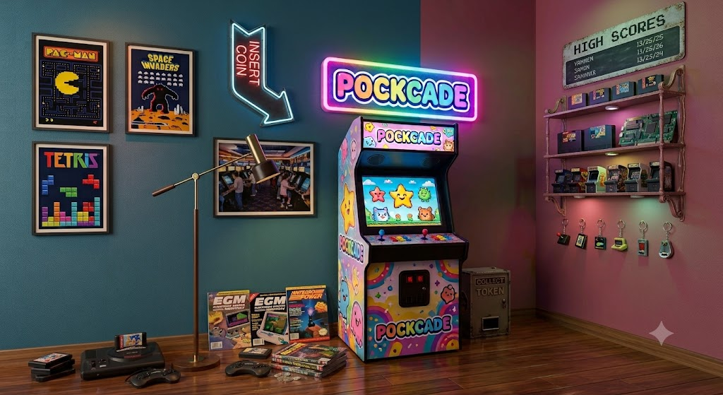
Medium · Round 2.
TIME LIMIT
5:00
PROMPT HINT
Vintage decaying POCKCADE arcade cabinet in a dark derelict gothic hallway
Reverse Prompt | GDGoC - GTA
Little overview provided
9
Notes:
Medium round. Time limit 5:00. Little overview provided.

Slide 10

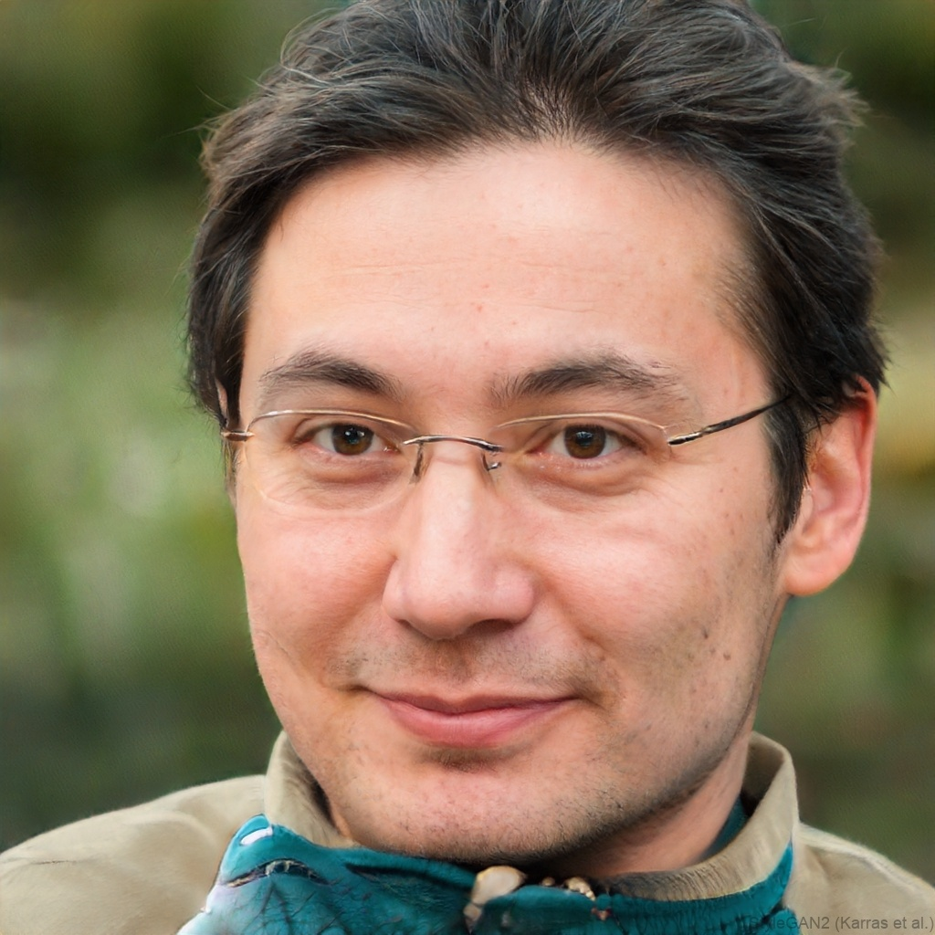
Hard.
TIME LIMIT
8:00
HINT
No prompt. No description. Study the image and work it out from what you see.
Reverse Prompt | GDGoC - GTA
No instructions
10
Notes:
Hard round. Time limit 8:00. No instructions.

Slide 11


Thank you for playing.
GDGoC - GTA
Time to tally the scores and crown the winning team.
Notes:
Thank the teams, then tally the scores and announce the winners.

