Slide 1

Remote sensing Image scene Classification on LULC using ML
Remote sensing Image scene Classification on LULC using ML
by
J.GOWRI
Roll No. 224G1A0521
P.NAVADEEP
Roll No. 234G5A0509
T.JAGAN
Roll No. 224G1A0531
Under the guidance of
Ms. G. Lokeswari _{M.Tech.,} _{(Ph.D)}
_{Assistant Professor}
Department of Computer Science and Engineering
Srinivasa Ramanujan Institute of Technology
Autonomous
Rotarypuram Village, B K Samudram Mandal, Ananthapuramu – 515701.
2025-2026
A-19
DEPT. OF COMPUTER SCIENCE AND ENGINEERING
Srinivasa Ramanujan Institute of Technology
` 1

Slide 2
Contents
Remote sensing Image scene Classification on LULC using ML
Title Justification
Abstract
Problem statement
Objectives of Project
Literature survey for objectives
Proposed Work -(Methods to be followed for proposed system)
References
GitHub Link
Queries
Srinivasa Ramanujan Institute of Technology

Slide 3
Title Justification
Remote sensing Image scene Classification on LULC using ML
Project Title:
Remote Sensing Image Scene Classification on LULC Using ML
Justification:
The title “Remote Sensing Image Scene Classification” represents a machine learning–based system designed to identify and analyze land use and land cover patterns from satellite images.
The word “Remote Sensing” signifies the use of satellite or aerial imagery for observing and collecting Earth surface information.
“Scene Classification” reflects the process of categorizing images into different land scenes such as urban, vegetation, water bodies, forest, and barren land.
The subtitle “on LULC Using ML” clearly states the project’s main purpose—classifying land use and land cover using machine learning techniques.
It conveys technological innovation, environmental importance, and the role of ML in supporting accurate land monitoring and sustainable planning for real-world applications.
Srinivasa Ramanujan Institute of Technology

Slide 4
Abstract
Remote sensing Image scene Classification on LULC using ML
Remote sensing images play a vital role in monitoring land use and land cover (LULC) changes, but traditional classification methods rely heavily on manual interpretation or limited feature-based techniques, leading to low accuracy and inefficiency. To address this challenge, this research focuses on “Remote Sensing Image Scene Classification on LULC using Machine Learning (ML)”, where image scenes are automatically classified into different land use and land cover categories using intelligent algorithms. The main objective of the study is to develop an efficient ML-based classification model that can accurately identify various land scenes such as urban areas, vegetation, water bodies, forests, and barren land from satellite images.
The proposed model is trained using a well-structured dataset of remote sensing images, and machine learning techniques are applied for feature extraction and classification to improve accuracy and reliability. Experimental results show that the ML-based approach performs better than traditional classification methods by reducing manual effort and improving consistency. Overall, the proposed system provides a scalable and effective solution for environmental monitoring, urban planning, and sustainable resource management, highlighting the importance of machine learning in remote sensing–based LULC analysis.
Srinivasa Ramanujan Institute of Technology

Slide 5
Problem Statement
Remote sensing Image scene Classification on LULC using ML
Land use and land cover (LULC) classification using remote sensing images is important for environmental monitoring and planning. However, existing methods rely on manual interpretation or traditional feature-based techniques, which often produce low accuracy and inconsistent results. These approaches are time-consuming and inefficient for large satellite datasets.
Therefore, there is a need for an automated and intelligent machine learning–based image scene classification system that can accurately classify LULC categories from remote sensing images with improved reliability and efficiency. Such a system should handle large-scale data and capture complex spatial patterns effectively to support real-world applications.
Srinivasa Ramanujan Institute of Technology

Slide 6
Objectives of Project
Remote sensing Image scene Classification on LULC using ML
1. Research Objective
To develop a machine learning–based model that classifies remote sensing images into different land use and land cover (LULC) categories by analyzing image features such as texture, color, spatial patterns, and spectral information.
2. Objectives of the ML-Based LULC Classification
To design a user-friendly system that allows users to upload remote sensing images and obtain accurate LULC scene classification results. To build an efficient ML model that improves classification accuracy and processes large datasets smoothly for practical and real-world applications.
Srinivasa Ramanujan Institute of Technology

Slide 7
Remote sensing Image scene Classification on LULC using ML
Literature survey for objectives
Afchar et al. (2018) proposed a CNN-based approach for image classification, showing that convolutional neural networks are effective in learning spatial and texture-based features from images. Their work demonstrates how image feature extraction can improve classification accuracy, which supports the objective of using image features for remote sensing image scene classification on LULC. Source: IEEE Xplore
Zhu et al. (2017) discussed the use of deep learning and machine learning techniques for land use and land cover classification using remote sensing data. Their study showed that learning-based models outperform traditional methods, supporting the objective of applying ML techniques for accurate LULC classification.
Source: IEEE Xplore
Cheng et al. (2017) highlighted that combining multiple feature representations such as spectral, spatial, and texture features improves scene classification performance in remote sensing images. This supports the objective of building an efficient and accurate ML-based system for LULC scene classification. Source: IEEE Access
Srinivasa Ramanujan Institute of Technology

Slide 8
Proposed System
Remote sensing Image scene Classification on LULC using ML
The proposed system uses a machine learning model that analyzes remote sensing images to classify land use and land cover (LULC) scenes accurately.
A feature extraction or CNN-based model extracts important visual features such as texture, color, shape, patterns, and spectral information from the uploaded satellite image.
A preprocessing module improves the quality of input images by performing operations like resizing, normalization, and noise reduction to make feature extraction and classification more effective.
The extracted features are fed to an ML classifier to assign each image or image patch to the appropriate LULC class with improved accuracy.
The system provides a simple and user-friendly interface, allowing users to upload remote sensing images and select the required area or tile for LULC classification.
The backend processes the input images and returns predicted LULC classes with confidence scores to support analysis and decision-making.
Srinivasa Ramanujan Institute of Technology

Slide 9
References
Remote sensing Image scene Classification on LULC using ML
J. A. Richards and X. Jia, Remote Sensing Digital Image Analysis: An Introduction, Springer, 5th Edition, 2013.
G. Mountrakis, J. Im, and C. Ogole, “Support Vector Machines in Remote Sensing: A Review,” ISPRS Journal of Photogrammetry and Remote Sensing, vol. 66, no. 3, pp. 247–259, 2011.
G. Cheng, C. Yang, X. Yao, L. Guo, and J. Han, “Remote Sensing Image Scene Classification via Learning Discriminative CNNs,” IEEE Transactions on Geoscience and Remote Sensing, vol. 56, no. 5, pp. 2811–2821, 2018.
Srinivasa Ramanujan Institute of Technology

Slide 10
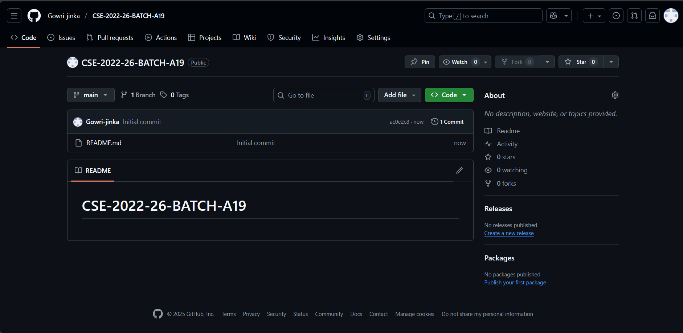
Git Hub Dashboards of each student
Remote sensing Image scene Classification on LULC using ML
LINK:- Gowri-jinka/CSE-2022-26-BATCH-A19
Srinivasa Ramanujan Institute of Technology

Slide 11
Any Queries?
Remote sensing Image scene Classification on LULC using ML
Srinivasa Ramanujan Institute of Technology

