Slide 1

Remote Sensing Image Classification Of Land Use Land Cover Using Deep Learning
Remote sensing Image Classification on LULC using DL
by
J.GOWRI
Roll No. 224G1A0521
P.NAVADEEP
Roll No. 234G5A0509
T.JAGAN
Roll No. 224G1A0531
Under the guidance of
Ms. G. Lokeswari _{M.Tech., (Ph.D)}
Assistant Professor
Department of Computer Science and Engineering
Srinivasa Ramanujan Institute of Technology
Autonomous
Rotarypuram Village, B K Samudram Mandal, Ananthapuramu – 515701.
2025-2026
A-19
1

Slide 2
Comments
Remote sensing Image Classification on LULC using DL
What problem does the Remote sensing Image classification of land use land cover System aims to Solve?
Who are the Intended end users of this Project, and how will they benefit from it?
What are main algorithms and DataSet used in this Project, and why were they used?
A-19
DEPT. OF COMPUTER SCIENCEAND ENGINEERING
Srinivasa Ramanujan Institute of Technology Technology
2

Slide 3
Title Justification
Remote sensing Image Classification on LULC using DL
Project Title:
Remote Sensing Image Classification of Land Use Land Cover using Deep Learning.
Justification:
The title “Remote Sensing Image Scene Classification” represents a deep learning–based system designed to identify and analyze land use and land cover (LULC) patterns from satellite images.
The term “Remote Sensing” refers to the use of satellite or aerial imagery to observe and collect information about the Earth’s surface without direct contact.
“Scene Classification” describes the process of categorizing satellite images into different land scenes such as urban areas, vegetation, water bodies, forests, and barren land.
The subtitle “on LULC Using DL” clearly highlights the main objective of the project, which is to classify land use and land cover using deep learning techniques.
This project emphasizes advanced technology, environmental significance, and the role of deep learning in achieving accurate land monitoring and supporting sustainable planning in real-world applications.
DEPT. OF COMPUTER SCIENCEAND ENGINEERING
2

Slide 4
Contents
Remote sensing Image Classification on LULC using DL
Abstract
Introduction
Literature Survey
Existing System
Proposed System
Planning
Design
Implementation
Research Paper
References
Github Link
DEPT. OF COMPUTER SCIENCEAND ENGINEERING
2

Slide 5
Remote sensing Image Classification on LULC using DL
Abstract
Accurate land use and land cover (LULC) classification from remote sensing imagery plays a critical role in environmental monitoring, urban planning, and sustainable resource management. Recent advances in deep learning have significantly improved the capability of automated feature extraction from high-resolution satellite images, enabling robust and scalable geospatial analysis.
This study presents a deep learning–based framework for LULC classification using the EuroSAT RGB dataset. The workflow includes systematic dataset exploration, image preprocessing with Image Data Generator–based rescaling, geometric transformations, horizontal flipping, and image reshaping to enhance generalization. Multiple deep convolutional architectures—ResNet50, ResNet18, DenseNet121, VGG19, ResNet152, and ConvNeXt-Tiny—are implemented and trained with early stopping to mitigate overfitting and underfitting.
Model evaluation is performed using precision, recall, F1-score, and accuracy metrics, computed through a dedicated performance assessment function. Grad-CAM visualization is applied to interpret model predictions by highlighting salient regions of satellite images that influence classification decisions. Among the evaluated models, ConvNeXt-Tiny achieves superior performance with an accuracy of 98.49%, precision of 98.48%, recall of 98.46%, and F1-score of 98.47%, demonstrating its effectiveness for complex LULC discrimination.

Slide 6
Remote sensing Image Classification on LULC using DL
Introduction
Remote sensing plays a critical role in monitoring the Earth's surface, enabling the observation and analysis of land use and land cover patterns over time. The increasing availability of high-resolution satellite imagery has created opportunities to understand environmental changes, urban expansion, deforestation, agricultural development, and natural resource management with unprecedented accuracy.
Accurate classification of land cover types is essential for informed decision-making in urban planning, environmental conservation, and sustainable resource allocation. Manual interpretation of these images is labor-intensive, time-consuming, and prone to human error, making automated solutions highly valuable.
Advances in Deep learning and image analysis have enabled automated systems to process vast amounts of satellite imagery efficiently, identifying meaningful patterns and classifying regions based on their spectral and spatial characteristics. These systems enhance the precision and scalability of land cover mapping while reducing dependency on manual efforts. By incorporating automated processing pipelines.
The integration of interactive applications further improves accessibility, allowing users to upload satellite imagery and obtain classification results quickly. Such systems provide immediate insights and visualization of land use categories, facilitating easy interpretation and supporting actionable decisions. This approach bridges the gap between large-scale geospatial data and end-user requirements, promoting more informed management of environmental and urban resources

Slide 7
Literature Survey
Remote sensing Image Classification on LULC using DL
TITLE | AUTHORS | METHODOLOGY | DRAWBACKS | RESULTS | LINK
Land Use and | Xiaoyu Li, Yifan Zhang, Wei Liu, et al. | A dual-branch neural | Challenges include | Early Fusion | https://www.md
Land Cover Classification with Deep |  | network was employed to fuse SAR and optical imagery for LULC | handling intrinsic differences between SAR and optical data, | achieved 88% accuracy and an F1 score of 87%, | pi.com/2072- 4292/17/7/1298
Learning-Based |  | classification. Two | such as speckle noise | outperforming Late
Fusion of SAR |  | fusion strategies—Early | in SAR and cloud | Fusion (84%
and Optical Data |  | Fusion and Late | obstruction in optical | accuracy, F1 score
 |  | Fusion—were compared. | images. Multimodal | 82%). The fusion of
 |  | Early Fusion integrates | fusion increases | SAR and optical
 |  | low-level features from | computational | data improved
 |  | both modalities, while | complexity and | LULC classification,
 |  | Late Fusion combines | requires large | capturing both
 |  | high-level features after | annotated datasets for | spectral and
 |  | independent processing. | effective training, | structural features,
 |  |  | limiting scalability to | and mitigated
 |  |  | resource-constrained | limitations of single-
 |  |  | environments. | sensor approaches.
Srinivasa Ramanujan Institute of Technology

Slide 8
Literature Survey
Remote sensing Image Classification on LULC using DL
TITLE | AUTHORS | METHODOLOGY | DRAWBACKS | RESULTS | LINK
Comprehensive | Rohit Sharma, | Optical satellite imagery | The methodology is | CART classifier | https://link.spri nger.com/articl e/10.1007/s125 24-024-01997- w
Approach | Priya Deshmukh, | from LISS IV sensor | limited by moderate | achieved the highest
Towards | Anil Patil, et al. | was analyzed using | classification | accuracy at 75.2%,
Enhancing Land |  | Object-Based Image | accuracy, high | followed by Sigmoid
Use Land Cover |  | Analysis (OBIA). Four | computational | (73.7%) and
Classification |  | machine learning | complexity for some | Perceptron (53.6%).
Through |  | classifiers—Perceptron, | classifiers, and | Agricultural land
Machine |  | Sigmoid, MP Neuron, | sensitivity to small- | was estimated at
Learning and |  | and CART—were | area analysis. OBIA | 84.97 km². OBIA
Object-Based |  | integrated with OBIA to | requires careful | combined with
Image Analysis |  | classify LULC. | parameter tuning, and | machine learning
 |  | Classification leveraged | results may vary | improved LULC
 |  | spatial context and | across regions, | understanding,
 |  | semantic information of | reducing | offering better
 |  | image objects for | generalizability | spatial and semantic
 |  | improved accuracy. | without extensive | discrimination than
 |  |  | preprocessing and | traditional pixel-
 |  |  | iterative calibration. | based approaches.
Srinivasa Ramanujan Institute of Technology

Slide 9
Literature Survey
Remote sensing Image Classification on LULC using DL
TITLE | AUTHORS | METHODOLOGY | DRAWBACKS | RESULTS | LINK
Advancements | Samuel Taye, | Machine learning | High computational | XGBoost achieved | https://www.fro ntiersin.org/jour nals/environme ntal- science/articles/ 10.3389/fenvs.2 025.1584485/fu ll
in land cover | Mekdes Abebe, | models, including | requirements limit | the highest accuracy
classification | Daniel Bekele, et | XGBoost, Random | scalability for | of 95.17% and an
and machine | al. | Forest, SVM, and ANN, | extremely large | IoU of 90.18%. The
learning |  | were applied to remote | datasets. Model | methodology
techniques for |  | sensing big data for | performance may | effectively extracted
Urban areas |  | urban land cover | vary with input data | urban building
using remote |  | classification. The | quality, sensor | features and
sensing big data |  | approach enhanced | resolution, and urban | predicted gully
 |  | building feature | complexity. | erosion
 |  | extraction at multiple | preprocessing time | susceptibility,
 |  | scales, integrating | and reduces | enabling precise land
 |  | geospatial analysis to | transferability across | cover classification,
 |  | identify patterns and | regions without | supporting urban
 |  | predict urban land cover | recalibration. | planning, and
 |  | and erosion |  | facilitating
 |  | susceptibility with high |  | sustainable.
 |  | spatial precision.
Srinivasa Ramanujan Institute of Technology

Slide 10
Literature Survey
Remote sensing Image Classification on LULC using DL
TITLE | AUTHORS | METHODOLOGY | DRAWBACKS | RESULTS | LINK
Land use and | Ramesh Kumar, | LISS-III satellite | CNN models require | Overall | https://www.sci encedirect.com/ science/article/p ii/S2590197425 000096
land cover | Priyanka Sharma, | imagery from 2010 and | large labeled datasets | classification
classification for | V. S. Raju, et al. | 2020 was processed | and substantial | accuracy reached
change detection |  | using a CNN-based deep | computational | 94.08% (2010) and
studies using |  | learning model for | resources. Accuracy | 95.30% (2020).
convolutional |  | LULC classification. | may be affected by | Change detection
neural network |  | GIS tools were used for | seasonal variations, | showed built-up
 |  | change detection | sensor limitations, | areas increased by
 |  | analysis. The approach | and mixed land cover | 0.83%, agricultural
 |  | replaced manual | pixels. The model | land by 0.23%,
 |  | interpretation, extracting | may not generalize | water bodies by
 |  | spatial and temporal | well to other regions | 0.35%, while forest
 |  | patterns to detect land | without retraining or | cover decreased by
 |  | cover changes efficiently | fine-tuning, limiting | 0.15% and other
 |  | over a decade. | broader applicability. | land uses by 1.22%
 |  |  |  | over ten years.
Srinivasa Ramanujan Institute of Technology

Slide 11
Literature Survey
Remote sensing Image Classification on LULC using DL
TITLE | AUTHORS | METHODOLOGY | DRAWBACKS | RESULTS | LINK
A Remote | Mohammad | Google Earth Engine | The approach | CNN achieved | https://link.spri
Sensing Approach to Spatiotemporal Analysis of Land | Rezaei, Ali Karimi, Zahra Hosseini, et al. | (GEE) was used to generate LULC maps and calculate land surface temperature | requires extensive historical satellite data and high computational | 92.03% accuracy, outperforming SVM (85.4%), RF (86.3%), and linear regression | nger.com/articl e/10.1007/s417 42-025-00752-4
Surface |  | (LST) over 1985–2020. | resources. Model | (69.8%). Urban
Temperature in |  | A CNN model, | performance may be | areas expanded from
Response to |  | incorporating LULC | affected by cloud | 24.61% to 53.4%,
Land Use/Land |  | indices like NDVI, | cover, data gaps, or | while forest cover
Cover Change |  | NDBI, and NDWI, was | seasonal variability. | decreased from
via Cloud Base |  | applied to predict LST | CNN models need | 48.78% to 9.29%,
and Machine |  | changes. Performance | careful tuning and | leading to a 2 °C
Learning |  | was benchmarked | may not generalize to | maximum LST
Methods, Case |  | against SVM, Random | other cities without | increase,
Study: Sari |  | Forest, and linear | retraining, limiting | highlighting urban
Metropolis, Iran |  | regression models. | broader applicability. | heat island effects.
Srinivasa Ramanujan Institute of Technology

Slide 12
Existing System
Remote sensing Image Classification on LULC using DL
The existing system for land use and land cover classification primarily relies on remote sensing imagery from individual sensors, such as optical or Synthetic Aperture Radar (SAR) data. Optical imagery provides rich spectral information useful for identifying vegetation, water bodies, and urban structures, whereas SAR imagery offers structural and textural details and is resilient to weather conditions.
Traditional approaches often process these modalities separately, limiting the ability to capture complementary information. Deep learning models such as ResNet, VGGNet, and GoogleNet have been applied to extract hierarchical features from each sensor type, enabling automated classification of land cover categories.
These models process input images to learn both low-level and high-level patterns, with ResNet focusing on residual learning, VGGNet using deep stacked convolutional layers, and GoogleNet employing inception modules for multi-scale feature extraction.
While effective on single-sensor data, these systems face challenges in integrating multimodal imagery for more robust and comprehensive classification.
Srinivasa Ramanujan Institute of Technology

Slide 13
Proposed System
Remote sensing Image scene Classification on LULC using DL
The system aims to develop an automated framework for land use and land cover classification using deep learning on high-resolution satellite images. It focuses on leveraging advanced convolutional neural networks to extract hierarchical spatial features from input images, enabling accurate identification of diverse land cover categories.
The framework incorporates multiple proposed deep learning models including ResNet50, ResNet18 to evaluate their effectiveness in capturing both low-level and high-level spatial patterns.
Input images undergo preprocessing steps such as rescaling, geometric transformations, horizontal flipping, and reshaping to ensure consistency and improve feature learning. Early stopping mechanisms are applied during model training to prevent underfitting or overfitting and optimize generalization performance.
The system is designed to provide a robust and scalable solution capable of handling complex satellite imagery, supporting efficient classification, and serving as a reliable tool for environmental monitoring, urban planning, and land management analysis.
Srinivasa Ramanujan Institute of Technology

Slide 14
Advantages of Proposed System
Remote sensing Image Classification on LULC using DL
Incorporates multiple advanced deep learning models, including ResNet50, ResNet18, ResNet152, enabling extraction of hierarchical low-level and high-level spatial features for improved land cover classification.
Employs comprehensive preprocessing including rescaling, geometric transformations, horizontal flipping, and reshaping to ensure uniform input quality and enhance model learning efficiency and generalization performance.
Integrates early stopping during model training to prevent underfitting and overfitting, maintaining stable convergence and reliable performance across diverse high-resolution satellite images.
Provides a scalable and robust framework capable of handling complex satellite imagery, supporting efficient classification, accurate land cover identification, and facilitating environmental monitoring and urban planning applications.
Srinivasa Ramanujan Institute of Technology

Slide 15
Planning
Remote sensing Image Classification on LULC using DL
Requirement Analysis:
Identify the need for automated satellite image analysis.
Detect Land Use / Land Cover categories from satellite images.
Provide object detection and AI-based insights.
Dataset & Model Planning
Use EuroSAT Dataset for training. Plan deep learning models:
ResNet18 for land cover classification.
YOLOv8 for detecting objects in satellite images.
System Architecture Planning
Three-tier system design:
Frontend Layer: React web interface for users.
Backend Layer: Node.js + Express API for processing requests.
AI Layer: Python FastAPI service running ML models.
Srinivasa Ramanujan Institute of Technology

Slide 16
Planning
Remote sensing Image Classification on LULC using DL
Feature Planning
Image upload (single & batch)
Land cover classification
Object detection
AI chatbot explanation
Results visualization
Export reports (JSON, CSV, PDF)
User Interface Planning
Home page
Image upload & analysis
Results dashboard
Analysis history
AI chatbot
Admin dashboard
Srinivasa Ramanujan Institute of Technology

Slide 17
Planning
Remote sensing Image Classification on LULC using DL
Technology Stack Planning
Frontend: React, Vite, Recharts
Backend: Node.js, Express
AI Models: PyTorch, ResNet18, YOLOv8
APIs: OpenAI API for chatbot
Deployment Planning
AI Service → Port 8000
Backend API → Port 5000
Frontend App → Port 5173
Srinivasa Ramanujan Institute of Technology

Slide 18
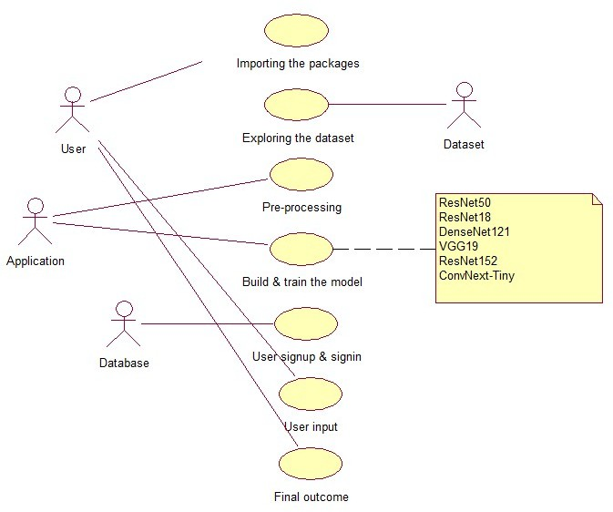
Design – Use Case Diagram
Remote sensing Image Classification on LULC using DL
fig-1: Use case diagram for the User and Admin
Srinivasa Ramanujan Institute of Technology

Slide 19
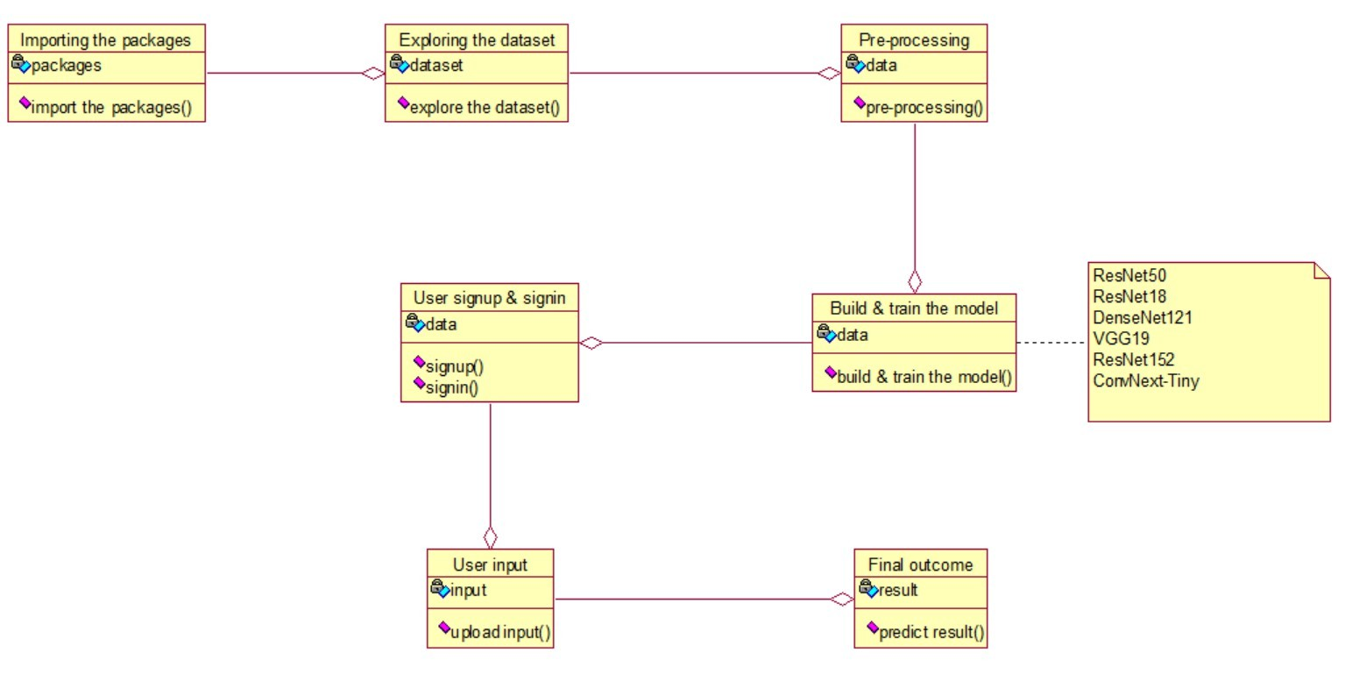
Design – Class Diagram
Remote sensing Image Classification on LULC using DL
fig-2: Class diagram
Srinivasa Ramanujan Institute of Technology

Slide 20
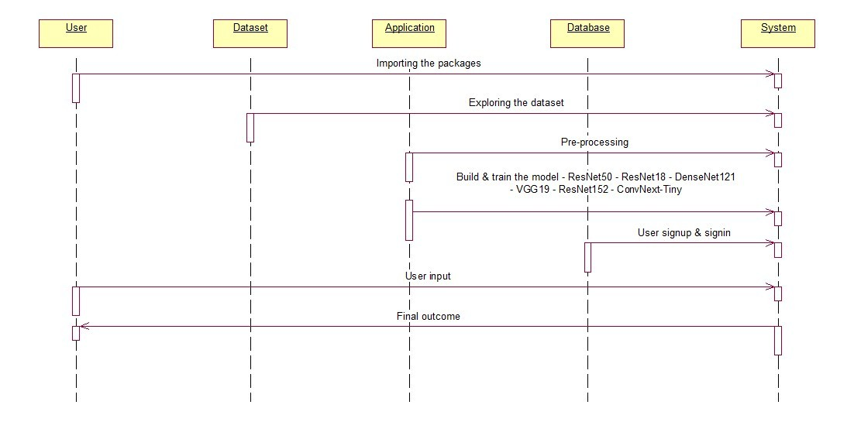
Design – Sequence Diagram
Remote sensing Image Classification on LULC using DL
fig-3: Sequence diagram
Srinivasa Ramanujan Institute of Technology

Slide 21
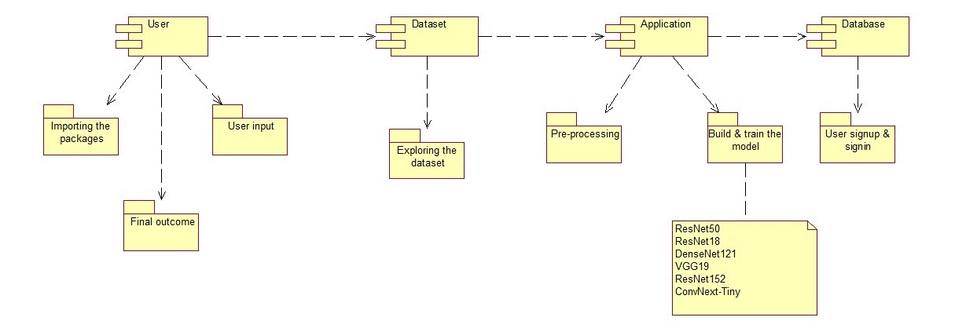
Design – Component Diagram
Remote sensing Image Classification on LULC using DL
fig-4: Component Diagram
Srinivasa Ramanujan Institute of Technology

Slide 22
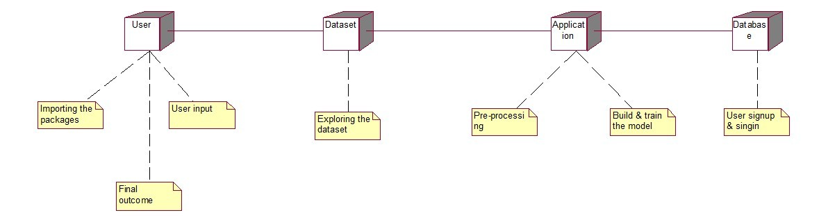
Design – Development Diagram
Remote sensing Image Classification on LULC using DL
fig-5: Development diagram
Srinivasa Ramanujan Institute of Technology

Slide 23
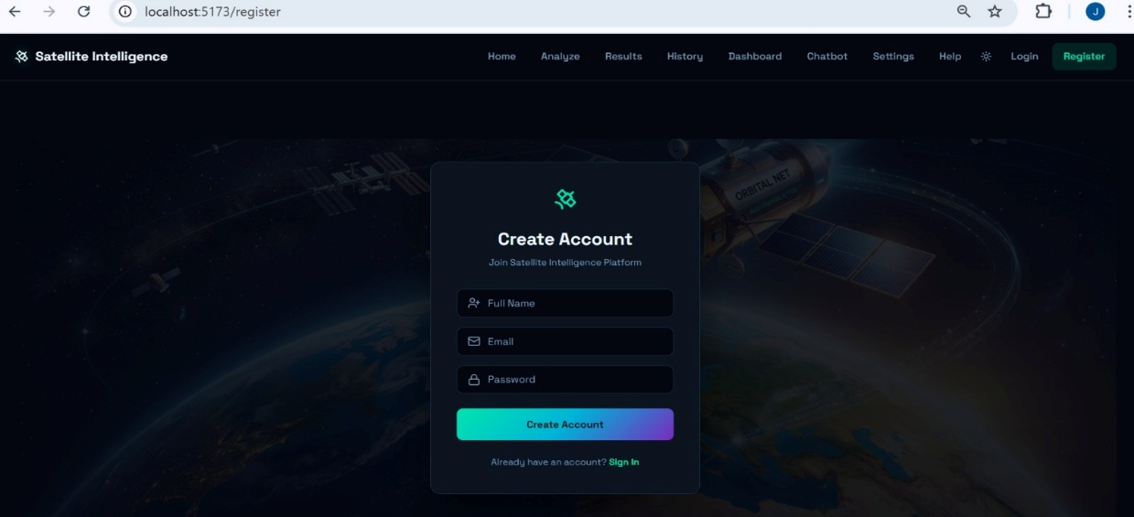
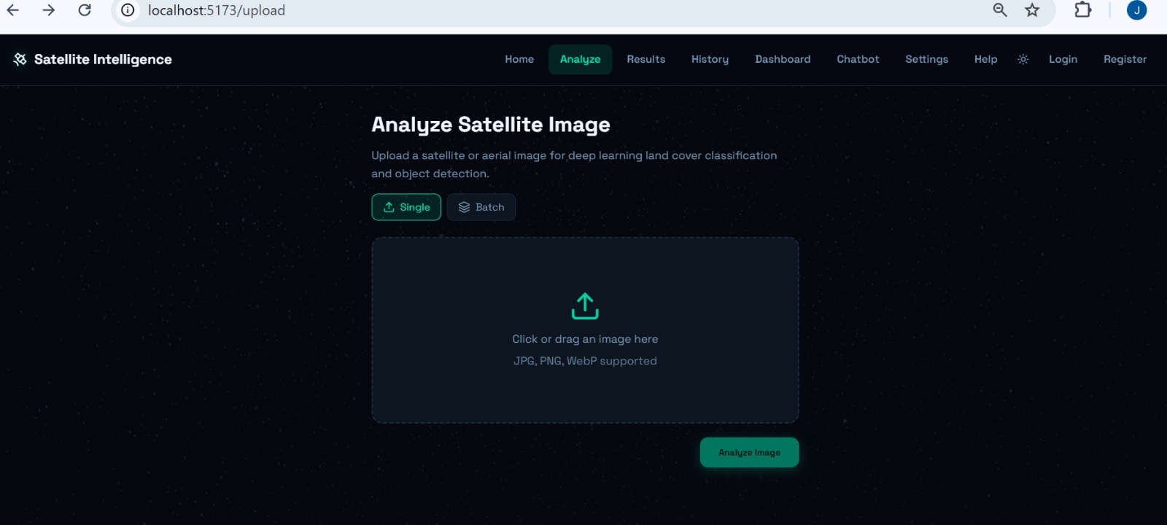
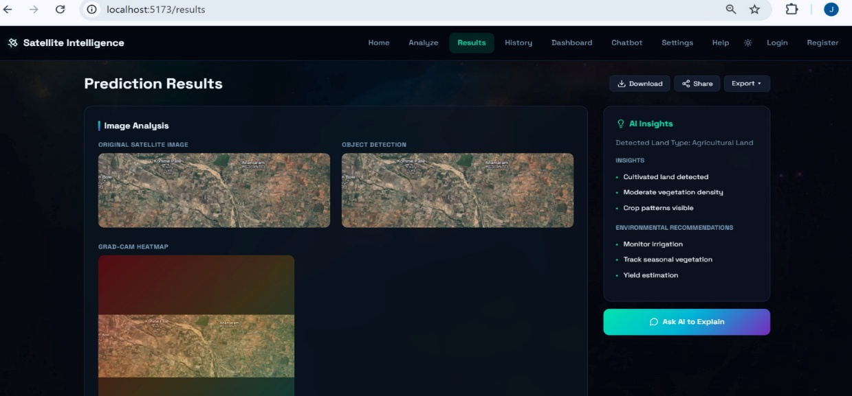
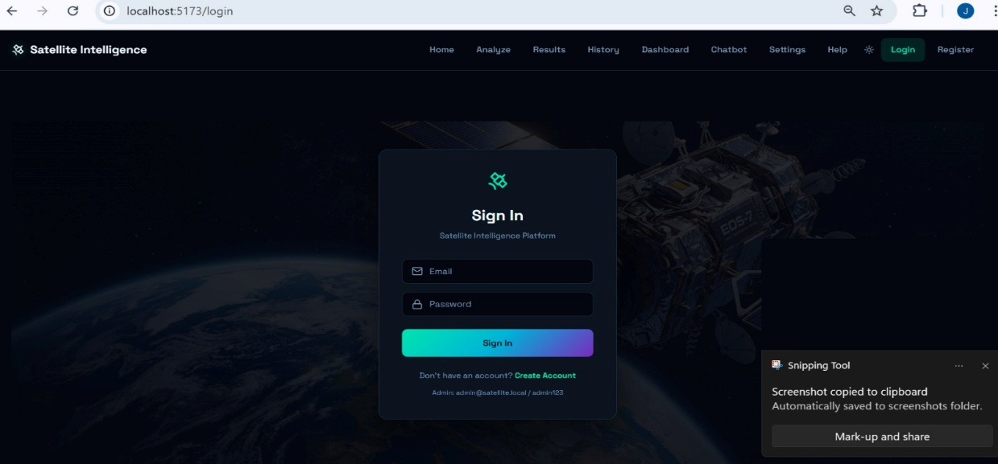
Implementation
Remote sensing Image Classification on LULC using DL
Srinivasa Ramanujan Institute of Technology

Slide 24
Research Paper
Remote sensing Image Classification on LULC using DL
Srinivasa Ramanujan Institute of Technology

Slide 25
Reference
Remote sensing Image Classification on LULC using DL
[1] Irfan, A., Li, Y., E, X., & Sun, G. (2025). Land Use and Land Cover classification with deep learning-based fusion of SAR and optical data. Remote Sensing, 17(7), 1298
[2] Behera, D. K., Pujar, G. S., Kumar, R., & Singh, S. K. (2025). A comprehensive approach towards enhancing land use land cover classification through machine learning and object-based image analysis. Journal of the Indian Society of Remote Sensing, 53(3), 731-749.
[3] Al-Najjar, H., Kalantar, B., & Abdul Halin, A. (2025). Advancements in land cover classification and machine learning techniques for Urban areas using remote sensing big data. Frontiers in Environmental Science, 13, 1584485.
[4] Pushpalatha, V., Mallikarjuna, P. B., Mahendra, H. N., Subramoniam, S. R., & Mallikarjunaswamy, S. (2025). Land use and land cover classification for change detection studies using convolutional neural network. Applied Computing and Geosciences, 25, 100227.
[5] Komeh, Z., Hamzeh, S., Memarian, H., Attarchi, S., & Alavipanah, S. K. (2025). A Remote Sensing Approach to Spatiotemporal Analysis of Land Surface Temperature in Response to Land Use/Land Cover Change via Cloud Base and Machine Learning Methods, Case Study: Sari Metropolis, Iran. International Journal of Environmental Research, 19(3), 98.
Srinivasa Ramanujan Institute of Technology

Slide 26
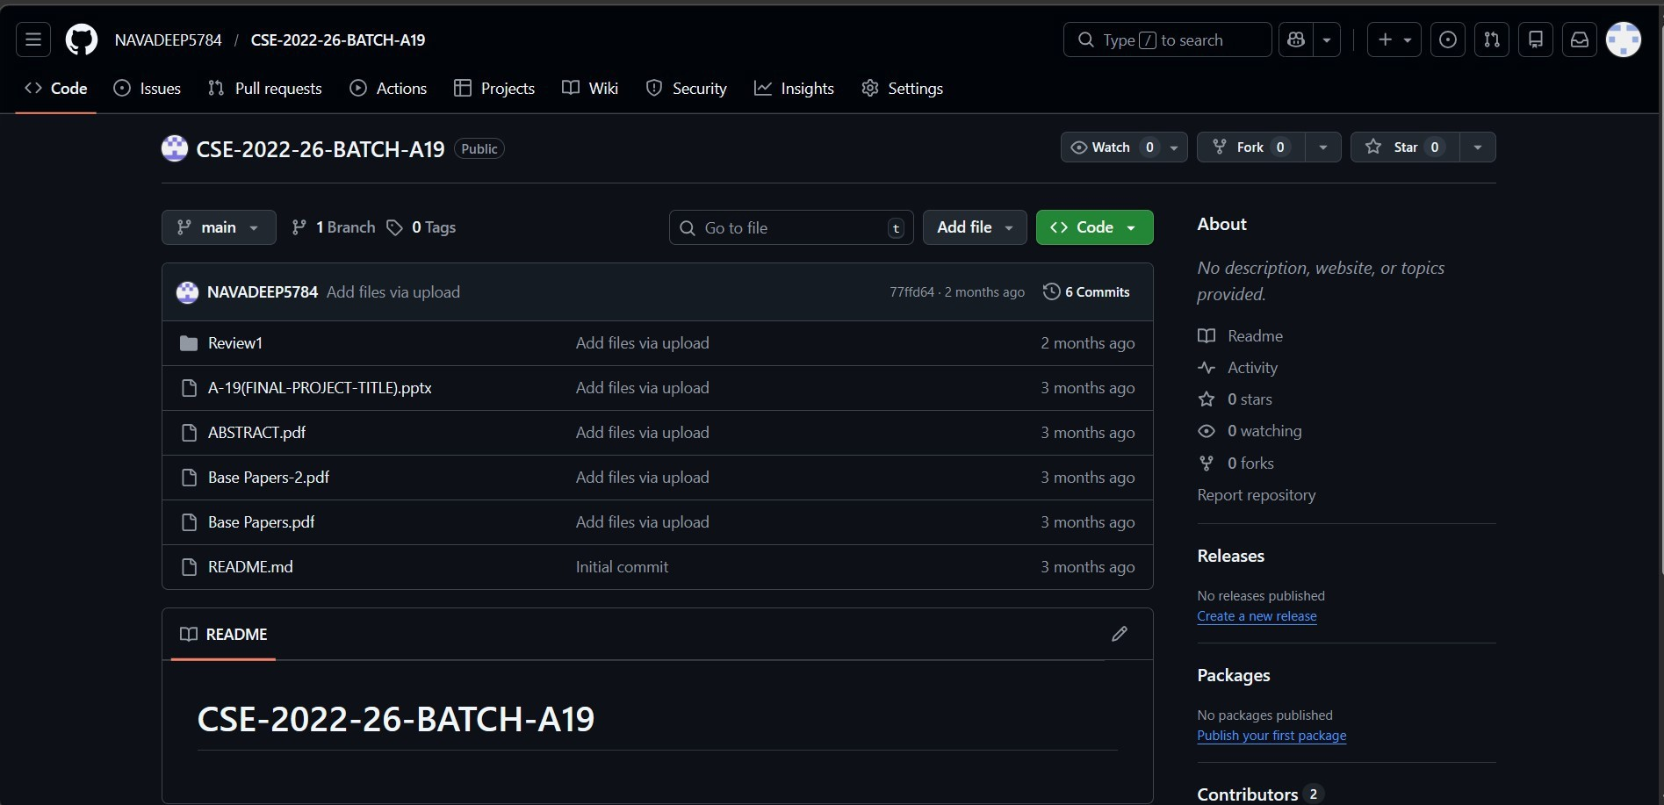
Github Link
Remote sensing Image Classification on LULC using DL
https://github.com/Gowri-jinka/CSE-2022-26-BATCH-A19
Srinivasa Ramanujan Institute of Technology

Slide 27
Remote Sensing Image Classification Of LULC Using DL
Thank You!
Srinivasa Ramanujan Institute of Technology

Slide 28
Remote Sensing Image Classification Of Land Use Land Cover Using DL
Any Queries?
Srinivasa Ramanujan Institute of Technology

