Slide 1

Remote Sensing Image Classification Of Land Use Land Cover Using Deep Learning
Remote sensing Image scene Classification on LULC using DL
by
J.GOWRI
Roll No. 224G1A0521
P.NAVADEEP
Roll No. 234G5A0509
T.JAGAN
Roll No. 224G1A0531
Under the guidance of
Ms. G. Lokeswari _{M.Tech.,} _{(Ph.D)}
_{Assistant Professor}
Department of Computer Science and Engineering
Srinivasa Ramanujan Institute of Technology
Autonomous
Rotarypuram Village, B K Samudram Mandal, Ananthapuramu – 515701.
2025-2026
A-19
DEPT. OF COMPUTER SCIENCE AND ENGINEERING
Srinivasa Ramanujan Institute of Technology
1

Slide 2
Queries From Review-0
Remote sensing Image scene Classification on LULC using DL
What is the main objective of your project?
Who are the intended end users of this project, and how will they benefit from it?
What are the main algorithms used in this project, and why were they chosen?
Can you explain how this project works step by step from input to output?
Srinivasa Ramanujan Institute of Technology

Slide 3
Contents
Remote sensing Image scene Classification on LULC using DL
Title Justification
Abstract
Introduction
Software Requirements
Datasets/Modules
Implementation
Outputs
Conclusion
References
Srinivasa Ramanujan Institute of Technology

Slide 4
Title Justification
Remote sensing Image scene Classification on LULC using DL ML
Project Title:
Remote Sensing Image Scene Classification on LULC Using DL
Justification:
The title “Remote Sensing Image Scene Classification” represents a deep learning–based system designed to identify and analyze land use and land cover (LULC) patterns from satellite images.
The term “Remote Sensing” refers to the use of satellite or aerial imagery to observe and collect information about the Earth’s surface without direct contact.
“Scene Classification” describes the process of categorizing satellite images into different land scenes such as urban areas, vegetation, water bodies, forests, and barren land.
The subtitle “on LULC Using DL” clearly highlights the main objective of the project, which is to classify land use and land cover using deep learning techniques.
This project emphasizes advanced technology, environmental significance, and the role of deep learning in achieving accurate land monitoring and supporting sustainable planning in real-world applications.
Srinivasa Ramanujan Institute of Technology

Slide 5
Abstract
Remote sensing Image scene Classification on LULC using DL
Accurate land use and land cover (LULC) classification from remote sensing imagery plays a critical role in environmental monitoring, urban planning, and sustainable resource management. Recent advances in deep learning have significantly improved the capability of automated feature extraction from high-resolution satellite images, enabling robust and scalable geospatial analysis.
This study presents a deep learning–based framework for LULC classification using the EuroSAT RGB dataset. The workflow includes systematic dataset exploration, image preprocessing with Image Data Generator–based rescaling, geometric transformations, horizontal flipping, and image reshaping to enhance generalization. Multiple deep convolutional architectures—ResNet50, ResNet18, DenseNet121, VGG19, ResNet152, and ConvNeXt-Tiny—are implemented and trained with early stopping to mitigate overfitting and underfitting.
Model evaluation is performed using precision, recall, F1-score, and accuracy metrics, computed through a dedicated performance assessment function. Grad-CAM visualization is applied to interpret model predictions by highlighting salient regions of satellite images that influence classification decisions. Among the evaluated models, ConvNeXt-Tiny achieves superior performance with an accuracy of 98.49%, precision of 98.48%, recall of 98.46%, and F1-score of 98.47%, demonstrating its effectiveness for complex LULC discrimination.
The best-performing model is serialized and integrated into a Flask-based web framework with SQLite-backed user authentication, enabling end-user image upload, preprocessing, inference, Grad-CAM visualization, and result display through a lightweight frontend interface.
Srinivasa Ramanujan Institute of Technology

Slide 6
Introduction
Remote sensing Image scene Classification on LULC using DL
Remote sensing plays a critical role in monitoring the Earth's surface, enabling the observation and analysis of land use and land cover patterns over time. The increasing availability of high-resolution satellite imagery has created opportunities to understand environmental changes, urban expansion, deforestation, agricultural development, and natural resource management with unprecedented accuracy.
Accurate classification of land cover types is essential for informed decision-making in urban planning, environmental conservation, and sustainable resource allocation. Manual interpretation of these images is labor-intensive, time-consuming, and prone to human error, making automated solutions highly valuable.
Advances in machine learning and image analysis have enabled automated systems to process vast amounts of satellite imagery efficiently, identifying meaningful patterns and classifying regions based on their spectral and spatial characteristics. These systems enhance the precision and scalability of land cover mapping while reducing dependency on manual efforts. By incorporating automated processing pipelines, users can analyze temporal and spatial changes, supporting monitoring of ecological impacts and infrastructure development.
The integration of interactive applications further improves accessibility, allowing users to upload satellite imagery and obtain classification results quickly. Such systems provide immediate insights and visualization of land use categories, facilitating easy interpretation and supporting actionable decisions. This approach bridges the gap between large-scale geospatial data and end-user requirements, promoting more informed management of environmental and urban resources. Overall, automated land use and land cover classification empowers stakeholders with reliable, timely, and scalable tools for environmental analysis and spatial planning.
Srinivasa Ramanujan Institute of Technology

Slide 7
Software Requirements
Remote sensing Image scene Classification on LULC using DL
Software: Anaconda (2023.03-1)
Primary Language: Python (3.10.9)
Web Framework: Flask
Development Environment: Jupyter Notebook
Database: Sqlite3
Front-End Technologies: HTML, CSS, JavaScript and Bootstrap4
Srinivasa Ramanujan Institute of Technology

Slide 8
Datasets/Modules
Remote sensing Image scene Classification on LULC using DL
Importing the Packages: Essential libraries are imported to support image handling, numerical computation, deep learning operations, performance evaluation, and web integration. These packages enable data preprocessing, model construction, training control, metric computation, and seamless interaction between backend processing and user-facing functionalities.
Exploring the Dataset: The dataset is examined to understand class distribution, image resolution, and category diversity. Sample visualization and directory inspection help verify data integrity and balance, ensuring that images are correctly organized and suitable for effective land use and land cover classification tasks.
Image Processing: Image preprocessing is performed using an image data generator to rescale pixel values, apply geometric transformations, perform horizontal flipping, and reshape inputs. These operations enhance feature learning, reduce overfitting, and ensure uniform input dimensions for efficient model training.
Model Training: The training phase involves building and fitting deep learning models including ResNet50, ResNet18, DenseNet121, VGG19, ResNet152, and ConvNeXt-Tiny. Early stopping is applied to monitor validation performance, ensuring stable convergence and preventing underfitting or overfitting during learning.
Final Outcome: The system displays the predicted land use and land cover category through the frontend interface. Clear visualization of results enables users to interpret classification outcomes effectively, supporting informed analysis and decision-making based on remote sensing imagery.
Srinivasa Ramanujan Institute of Technology

Slide 9
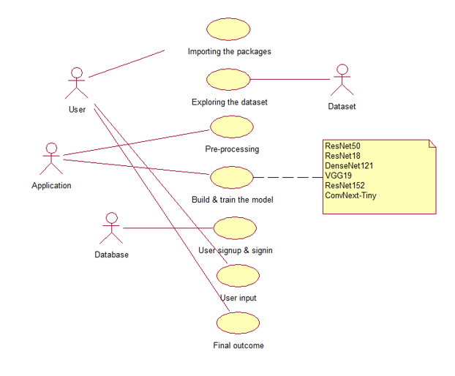
Remote sensing Image scene Classification on LULC using DL
Implementation – Use Case Diagram
The use case diagram represents the functional flow of the system by illustrating interactions between the User, Application, Dataset, and Database. It shows key use cases such as importing packages, exploring and preprocessing the dataset, building and training deep learning models (ResNet, DenseNet, VGG, ConvNeXt), user signup and signin, user input submission, and generation of the final outcome, thereby explaining the complete EcoVision system workflow.
Srinivasa Ramanujan Institute of Technology

Slide 10
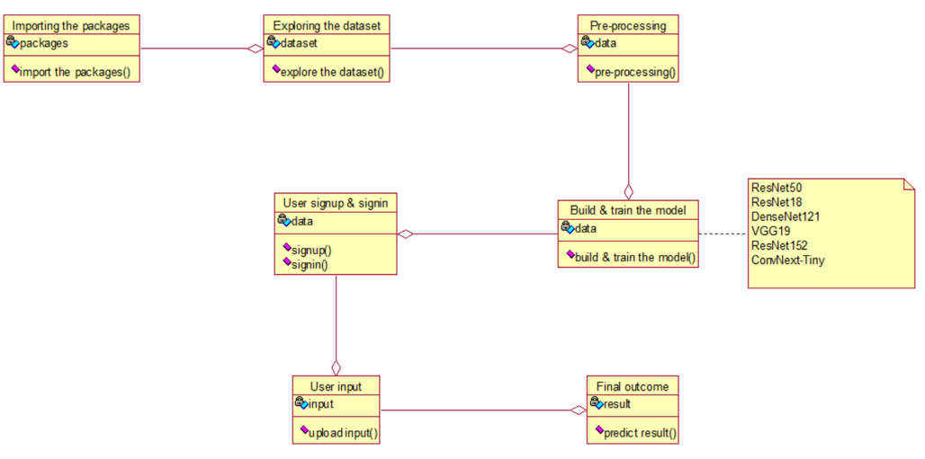
Remote sensing Image scene Classification on LULC using DL
Implementation – Class Diagram
The class diagram illustrates the structural design of the system by representing classes, their attributes, and operations, and the relationships between them. It describes the workflow starting from importing packages, exploring and preprocessing the dataset, user signup and signin, building and training deep learning models (ResNet, DenseNet, VGG, ConvNeXt), accepting user input, and generating the final prediction result, thereby defining the complete system architecture of the EcoVision application.
Srinivasa Ramanujan Institute of Technology

Slide 11
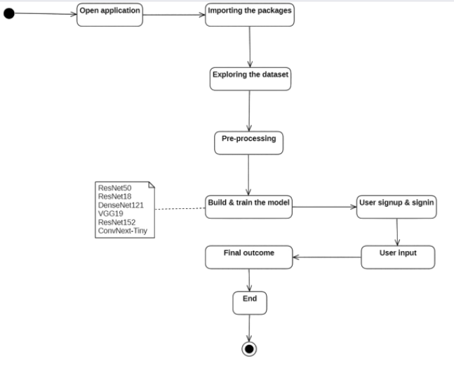
Remote sensing Image scene Classification on LULC using DL
Implementation – Activity Diagram
The activity diagram represents the workflow of Remote Sensing Image Classification of Land Use and Land Cover using Deep Learning, starting from application launch, data preprocessing, and model training using deep learning architectures. User authentication and input of satellite images lead to land use and land cover classification, generating the final outcome.
Srinivasa Ramanujan Institute of Technology

Slide 12
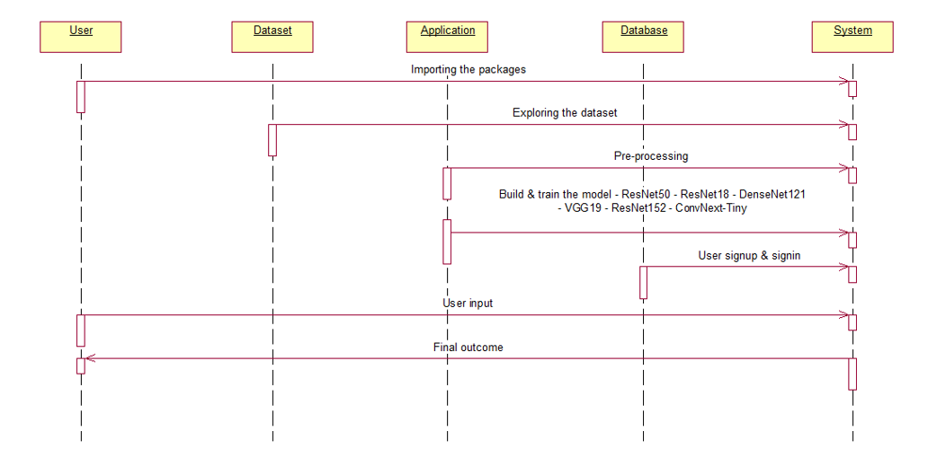
Remote sensing Image scene Classification on LULC using DL
Implementation – Sequence Diagram
The sequence diagram illustrates the interaction flow of Remote Sensing Image Classification of Land Use and Land Cover Using Deep Learning among the User, Dataset, Application, Database, and System. It shows the sequence of operations including importing packages, exploring and preprocessing remote sensing datasets, building and training deep learning, user signup and signin, user input submission, and generation of the final land use and land cover classification result.
Srinivasa Ramanujan Institute of Technology

Slide 13
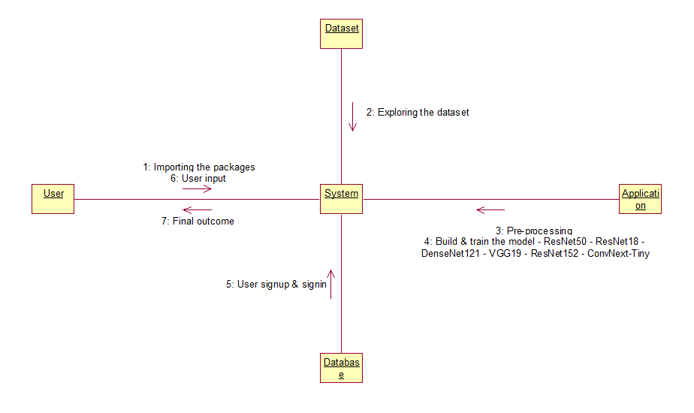
Remote sensing Image scene Classification on LULC using DL
Implementation – Collaboration Diagram
The diagram illustrates the system interaction flow for Remote Sensing Image Classification of Land Use and Land Cover Using Deep Learning. It shows how the user interacts with the system to import required packages and provide input satellite images, while the system explores the remote sensing dataset and performs preprocessing. The application builds and trains deep learning models such as ResNet, DenseNet, VGG, and ConvNeXt, user authentication is managed through the database, and the trained system generates the final land use and land cover classification outcome.
Srinivasa Ramanujan Institute of Technology

Slide 14
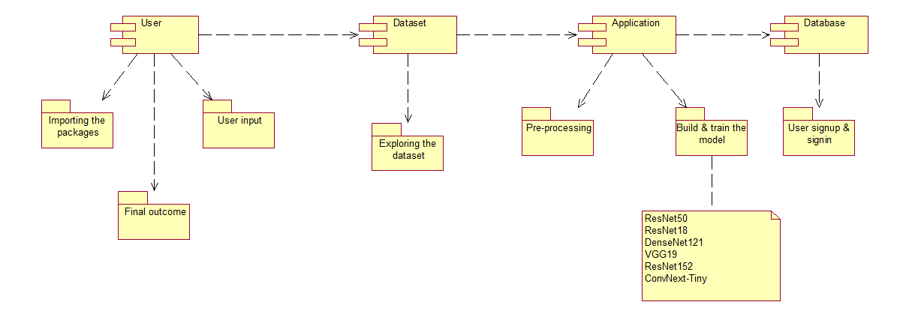
Remote sensing Image scene Classification on LULC using DL
Implementation – Component Diagram
The diagram represents an end-to-end machine learning application workflow starting from user interaction. The user provides input to the system after necessary packages are imported, and the dataset is explored to understand its structure and quality. The application performs data pre-processing before building and training deep learning models such as ResNet, DenseNet, VGG, and ConvNeXt. A database module manages user signup and signin to ensure secure access. Finally, the trained model processes the user input and delivers the final outcome.
Srinivasa Ramanujan Institute of Technology

Slide 15
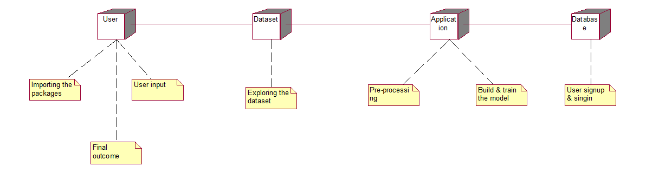
Remote sensing Image scene Classification on LULC using DL
Implementation – Deployment Diagram
This diagram illustrates the overall architecture of a machine learning–based system involving the user, dataset, application, and database. The process starts with the user, where required packages are imported and user input is provided to the system. The dataset is then explored to understand its characteristics before being used in the application. The application performs data pre-processing followed by building and training the machine learning models. The database manages user signup and signin, and the system finally generates the output for the user.
Srinivasa Ramanujan Institute of Technology

Slide 16
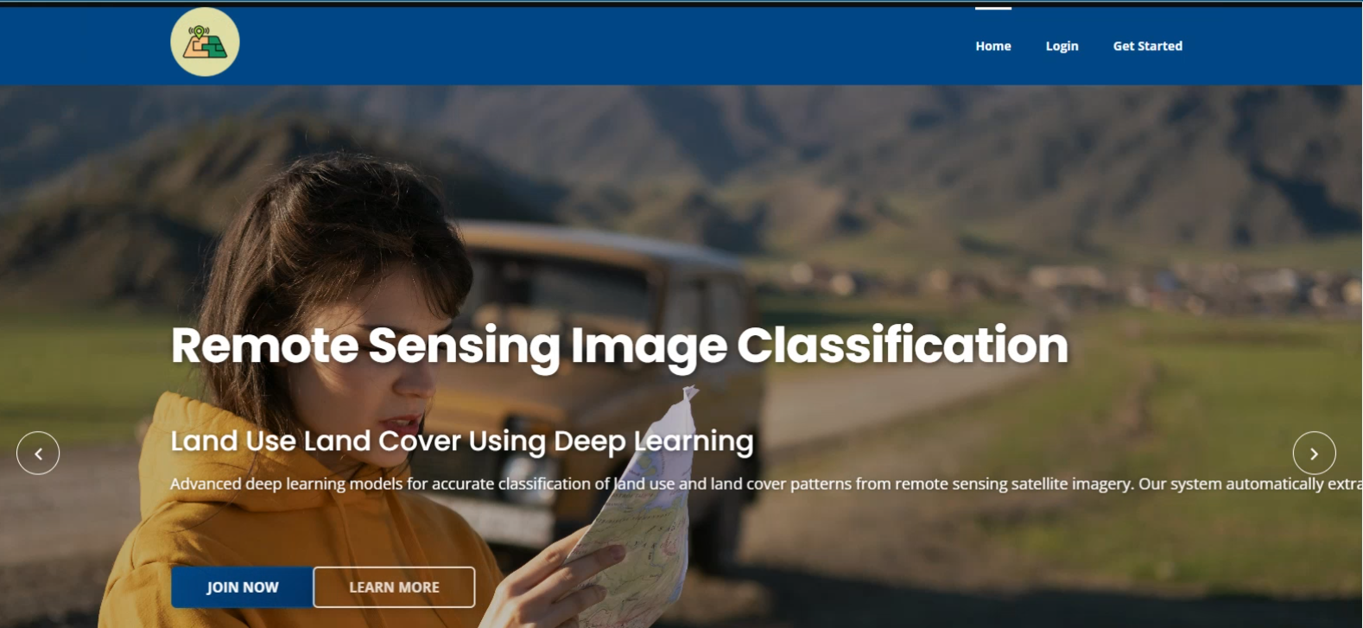
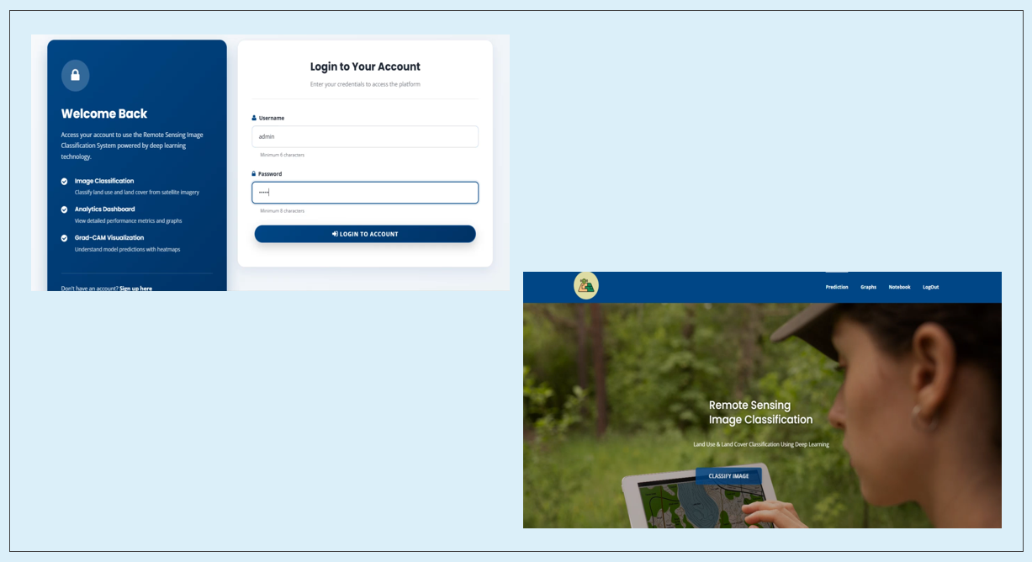
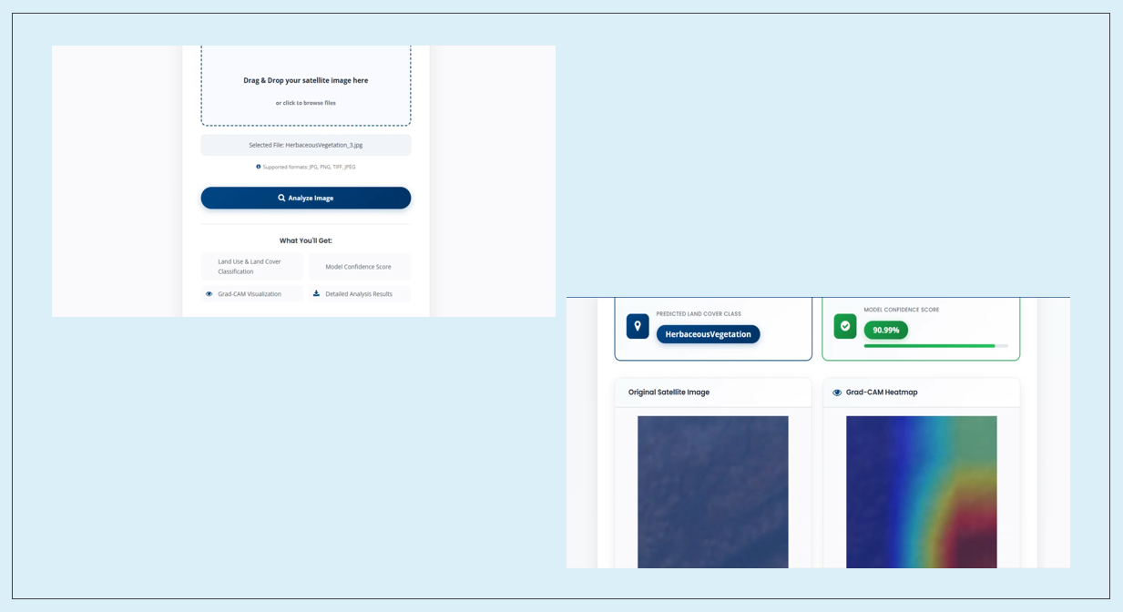
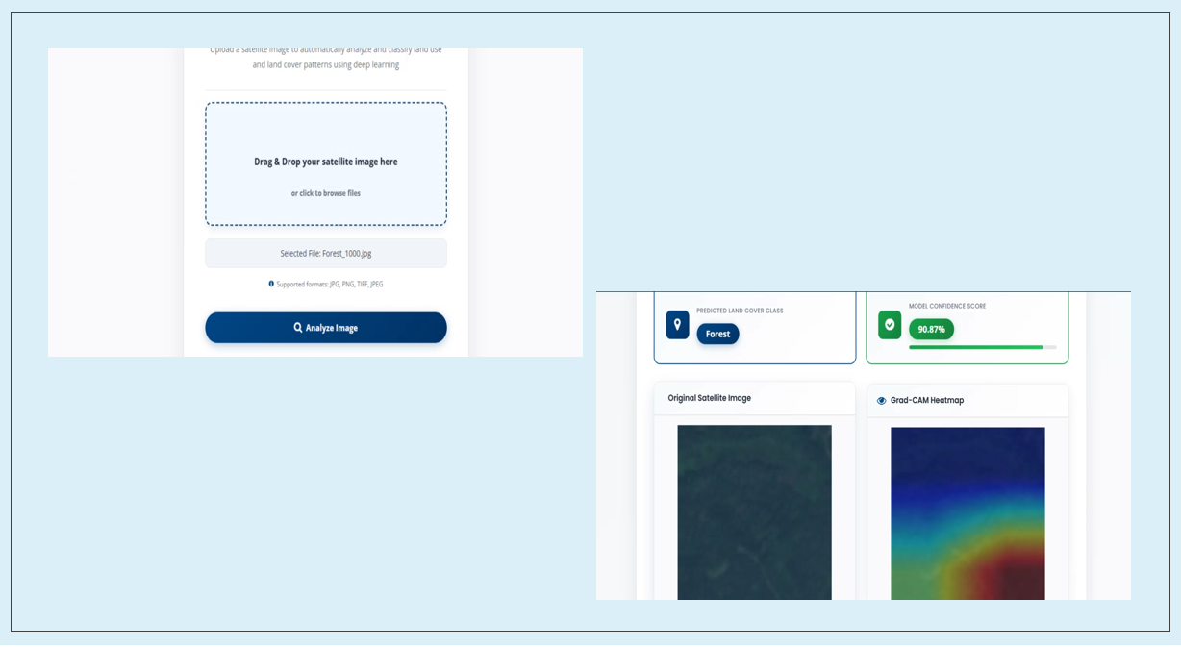
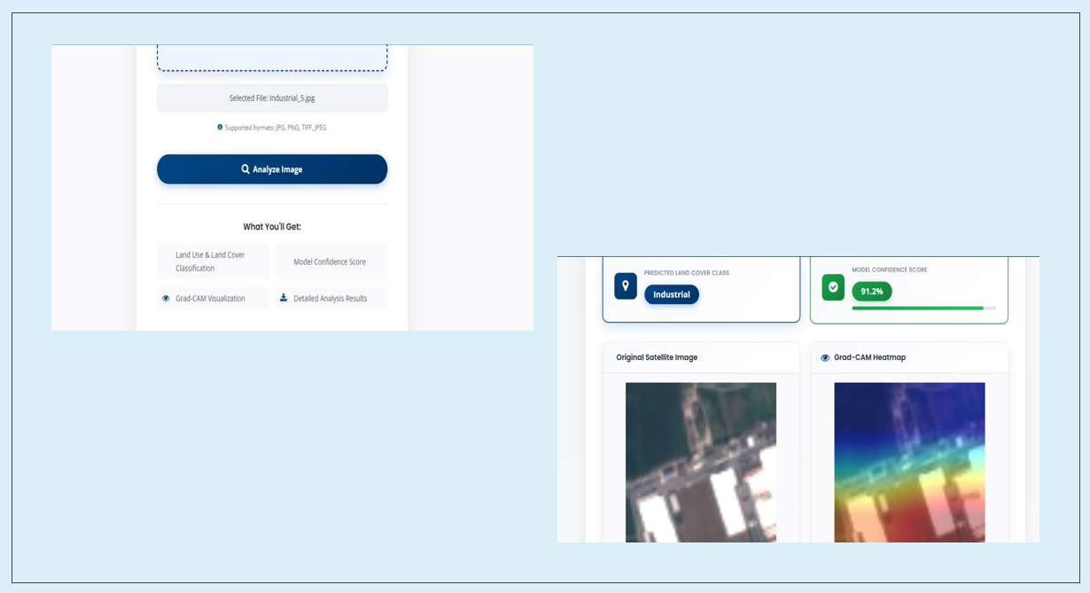
Remote sensing Image scene Classification on LULC using DL
Outputs
Srinivasa Ramanujan Institute of Technology

Slide 17
Remote sensing Image scene Classification on LULC using DL
Conclusion
The developed deep learning–driven land use and land cover classification framework demonstrates strong capability in extracting discriminative spatial features from high-resolution remote sensing imagery. Comprehensive preprocessing, including normalization, geometric augmentation, and reshaping, contributes to improved model generalization and robustness across diverse land cover categories. Performance evaluation using standard metrics confirms the effectiveness of deep convolutional representations for multi-class LULC recognition.
Experimental results highlight ConvNeXt-Tiny as the most effective architecture, achieving an accuracy of 98.49%, precision of 98.48%, recall of 98.46%, and an F1-score of 98.47%, indicating reliable and balanced classification performance. Grad-CAM visualization is applied to interpret model predictions by highlighting the most influential regions of satellite images, providing insights into the spatial features driving classification decisions.
The trained high-performing model is preserved and reused for efficient inference, ensuring consistency and reproducibility in classification outcomes. Practical applicability is enhanced through integration with a Flask-based web interface supported by an SQLite database for secure user authentication.
Srinivasa Ramanujan Institute of Technology

Slide 18
References
Remote Sensing Image Classification Of Land Use Land Cover Using DL
[1] Irfan, A., Li, Y., E, X., & Sun, G. (2025). Land Use and Land Cover classification with deep learning-based fusion of SAR and optical data. Remote Sensing, 17(7), 1298.
[2] Behera, D. K., Pujar, G. S., Kumar, R., & Singh, S. K. (2025). A comprehensive approach towards enhancing land use land cover classification through machine learning and object-based image analysis. Journal of the Indian Society of Remote Sensing, 53(3), 731-749.
[3] Al-Najjar, H., Kalantar, B., & Abdul Halin, A. (2025). Advancements in land cover classification and machine learning techniques for Urban areas using remote sensing big data. Frontiers in Environmental Science, 13, 1584485.
[4] Pushpalatha, V., Mallikarjuna, P. B., Mahendra, H. N., Subramoniam, S. R., & Mallikarjunaswamy, S. (2025). Land use and land cover classification for change detection studies using convolutional neural network. Applied Computing and Geosciences, 25, 100227.
[5] Komeh, Z., Hamzeh, S., Memarian, H., Attarchi, S., & Alavipanah, S. K. (2025). A Remote Sensing Approach to Spatiotemporal Analysis of Land Surface Temperature in Response to Land Use/Land Cover Change via Cloud Base and Machine Learning Methods, Case Study: Sari Metropolis, Iran. International Journal of Environmental Research, 19(3), 98.
Srinivasa Ramanujan Institute of Technology

Slide 19
Thank You!
Remote Sensing Image Classification Of Land Use Land Cover Using DL
Srinivasa Ramanujan Institute of Technology

Slide 20
Any Queries?
Remote Sensing Image Classification Of Land Use Land Cover Using DL
Srinivasa Ramanujan Institute of Technology

