Slide 1
Parameter Development
Introduction to Epidemiologic Simulation Modeling
August 6-10, 2007
Fort Collins, Colorado, USA

Slide 2
Outline
Description
Getting started
Basic characteristics of parameters
Sources of data for parameters
Assigning values to parameters
Concluding thoughts

Slide 3
Input Parameters
Input parameters in NAADSM are values or ranges of values that characterize or describe biological events
Six types of parameters are used throughout NAADSM:
  Yes/no values
  Integer values
  Floating point numbers
  Probabilities
  Probability density functions
  Relational functions

Slide 4
Where do you start?
Define the problem
Use your model to identify data needs
  Research the topic
  Identify the data you have
  Identify gaps in knowledge
  Collect data to fill in the blanks

Slide 5
Basic Considerations
Parameters should make biological sense
Parameters should represent real life
  Real life is variable, subject to chance, and contains uncertainty
Sensitivity analysis should be carried out to assess the influence of uncertain parameters on the model outcome

Slide 6
Sources of data
Field data or ‘veterinary intelligence’
Analysis of past outbreaks
Subject matter experts
Scientific literature
With respect to most diseases, all the data required for comprehensive models are not available

Slide 7
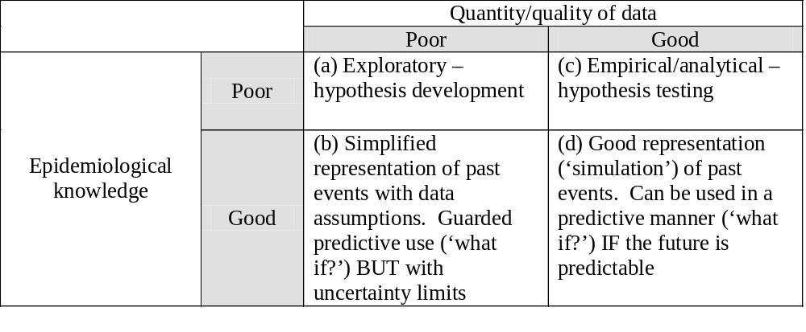
Field data or ‘veterinary intelligence’
Good data are available
but epidemiolgical
knowledge is lacking
Lack of data or
unpredictable
behavior
Good data and
knowledge
=
High quality
parameters and models
Source: Taylor N (2003). Review of the use of models in informing disease control policy development and adjustment.

Slide 8
Analysis of past outbreaks
Past outbreaks are a potential source of data
  Identify important epidemiological determinants of that particular epidemic
    Foot-and-mouth disease outbreak in the UK, 2001
    Foot-and-mouth disease outbreak in the UK, 2007
    Pseudorabies virus outbreak in Wisconsin, 2007
    Highly pathogenic avian influenza outbreak in British Columbia, 2004

Slide 9
Subject matter experts
Lack of data and/or knowledge about the population of interest
  What is the probability of the animal straying?
    The value of parameters have to be assigned when there is no objective evidence
      Assign values based on best guess (assumption)
        Minimum, maximum, most likely
      Distribution reflects uncertainty, resulting from a lack of precise knowledge
‘Sometimes animals stray from one farm to another’

Slide 10
Scientific Literature
Etiologic Agent
  Survival of agent in different conditions
  Infectious doses by different routes to different species
  Incubation period
    Parameter based on assumption that the incubation period in the modeled population will be the same as measured in different populations.
  Exposure
    Exposure to a source of infection may or may not result in a unit becoming infected.

Slide 11
Utilizing information to develop parameters
Collate, analyze, and interpret all information
Parameters must be given a quantitative value

Slide 12
Assigning values to model parameters
Values assigned to model parameters are often uncertain due to lack of good quality data
Parameters must be given as quantitative values
  Some values are more easily knowable than others
    Number of farms and animals in a given county
  Other values are difficult to measure in real life
    Who bumps into whom and how often?
Simplifications and assumptions are made to over come this issue

Slide 13
Concluding thoughts
The simplifications, assumptions, and limitations must be fully appreciated by all users
The process of developing parameters can be viewed as an aid to understanding the systems being modeled
Modeling is a mixture of science and art, but because modeling is a quantitative discipline it can appear entirely scientific and ‘real’.

