Slide 1
HP
Health Passport
Your Life in Your Hand

Slide 2





Our Team
Xiaochen Zhang
Tom Nguyen
Bernard Lin
Travis Thayer
Ed

Slide 3






Problem Statement
The cost of poor patient data sharing is LIFE

Slide 4
Our Solution- Health Passport
I
INDIVIDUALS
Data autonomy
C
CLINICS
Fast response
I
INSURANCE COMPANIES
Smart decision
G
GOVERNMENT AGENCIES
Improved public health

Slide 5
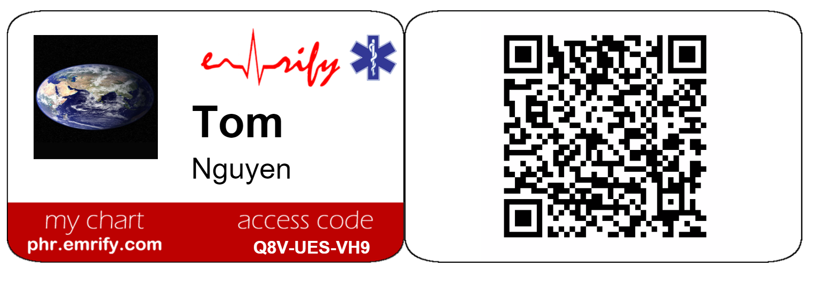
Our Hack
Use of blockchain technology to securely aggregate, link and share patient data to the destination of their choice
Hack Focus
Novelty
Aggregate individual health data providing a patient-centric solution
Architecture
Impact
Technologies used uPort, Ethereum, NodeJS, FIHR, IPFS
EMT improved service quality
Individual: xxxx

Slide 6
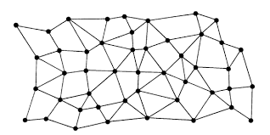
Architecture in a Glance
Care Providers
uPort
Health
Passport
Insurers
Pharmacies
Ethereum
ipfs

Slide 7
DEMO Working Code
2 min.

Slide 8
Questions

