Slide 1
COMPUTER SCIENCE AND ENGINEERING • S5 MINI PROJECT
ACADEMIC PORTFOLIO PRESENTATION
GREEN CAMPUS KPI DASHBOARD
An AI-Driven Sustainability Performance Management System
M Sanjai
Roll: 7376241CS256
Navaneth N D
Roll: 7376241CS292
Ezhil Kumaran
Roll: 7376241CS176
SOUNDHIRI S
PROJECT GUIDE

Slide 2
01
Project Abstract
The Challenge
• Data Silos: Water, waste, and solar stats exist independently.
• Manual Logging: Leads to errors and latency in audit reporting.
• Reactive Policies: Lack of warnings locks campus into high utility costs.
Our Methodology
• Automated Ingestion: Structured pipelines sync with Google Sheets API.
• Z-Score Analysis: Highlights spikes/drops in near real-time.
• Holt-Winters Models: Predicts next-month energy needs.
Accreditation Impact
• NAAC Criteria 7: Ready compliance data for Green Audits.
• Actionable ROI: Simulator projects savings in ₹ and carbon offsets.
• Unified Scorecard: A composite Green Score out of 100.
Green Campus KPI Dashboard • CSE S5 MINI Project • Page 2 of 15

Slide 3
02
Gap Analysis: The 'BEFORE' State
TRADITIONAL SILO LIMITATIONS
✗ Information in Silos
• Separate Offices: Water and solar logs held in disparate sheets.
• No Central Access: Impedes immediate visibility of overall campus health.
✗ No Predictive Foresight
• Reactive Budgets: Run purely on historical invoices.
• Static Projections: Fail to model daily variations or reserve margins.
✗ Invisible Anomaly Events
• High Losses: Minor leaks and line spikes remain unnoticed.
• Cost Accumulation: Faulty panel circuits run unfixed for weeks.
✗ No Standardized Scoring
• Hard Compliance: NAAC/NBA reviews require weeks of compiling.
• Unclear ROI: Hard to map green upgrades directly to performance index.
Green Campus KPI Dashboard • CSE S5 MINI Project • Page 3 of 15

Slide 4
03
Gap Analysis: The 'AFTER' State
INTELLIGENT GREEN CONTROL
✓ Unified Command Center
• Unified view: All streams integrated into a glassmorphic dashboard.
• Streamlined monitoring: Direct visibility of campus-wide resources.
✓ ML-Based Demand Forecasting
• Proactive scheduling: Holt-Winters algorithm models future loads.
• Grid matching: Enables proactive grid management and peak offsets.
✓ Automated Defect Diagnostics
• Near real-time alert: Z-score equations detect spikes instantly.
• Pinpoint warning: Diagnostic tags isolate target faulty blocks.
✓ Instant Accreditation Auditing
• Green Score: Generates composite index score (84/100) automatically.
• Fast reports: Outputs print-ready NAAC-aligned audit PDFs.
Green Campus KPI Dashboard • CSE S5 MINI Project • Page 4 of 15

Slide 5
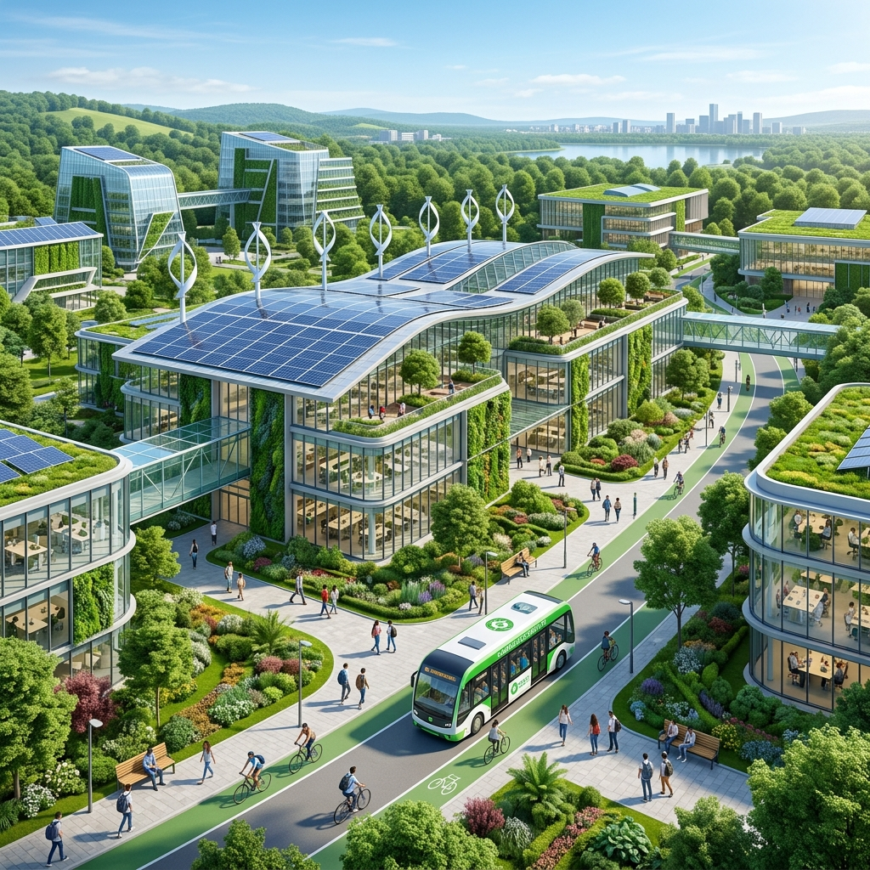
04
Project Objectives & Scope
Primary Objectives
• Develop an automated ingestion model to scrape and deduplicate multi-source campus utility logs.
• Implement Z-score logic to systematically flag anomaly consumption spikes.
• Integrate statistical and neural predictive models to forecast electricity & water usage.
• Design sliders projecting bill and CO2 feedback based on operational dimming options.
Project Scope
• Focused on 8 primary institutional buildings and main feeders.
• Tracks 8 key green domains including energy, water, waste, carbon, green cover, transport, and student participation.
Concept: Integrating physical smart-grid resources with digital KPI monitoring dashboards.
Green Campus KPI Dashboard • CSE S5 MINI Project • Page 5 of 15

Slide 6
05
System Architecture & Detailed Data Flow
1. Data Sources
• Utility Invoices
• Solar Meter Logs
• Water Meters
• Manual Waste Entry
2. Backend Ingestion
• FastAPI API Endpoints
• Google Sheets Scraper
• SQLAlchemy ORM Core
• JSON Validator
3. Relational DB
• PostgreSQL Core Schema
• IndexDB browser cache
• Anomaly Registers
• Historical baseline data
4. Dashboard Logic
• Next.js 14 Web UI
• Z-Score and HW models
• Recharts UI Widgets
• jsPDF Client Exporter
Green Campus KPI Dashboard • CSE S5 MINI Project • Page 6 of 15

Slide 7
06
Technical Stack Breakdown
Frontend UI Architecture
• Next.js 14 (App Router) & React
• Vanilla CSS with responsive CSS grid layout
• Framer-motion for smooth UI transitions
• Lucide-react for sharp iconography
Backend Services
• Python FastAPI for high-throughput REST APIs
• NumPy for forecasting and statistical diagnostics
• Built-in CORS securing client requests
• Direct integration with Google Sheets API v4
Data Flow & Caching
• TanStack React-Query: Auto-updates and background synchronization
• In-browser local storage cache for absolute offline resilience
• Modular settings management for sheet syncing periods
Analytics & Reporting Tools
• Recharts for high-fidelity interactive curves and gauges
• jsPDF for compiling accreditation reports directly in the client
• Custom CSV parser parsing heterogeneous time formats
Green Campus KPI Dashboard • CSE S5 MINI Project • Page 7 of 15

Slide 8
07
Core Dashboard Views
Live Grid Overview
• Near real-time health indicator
• Solar injection monitoring
• Dynamic alerts warning feed
AI Grid Diagnostics
• Monthly Carbon footprint logs
• Equivalent tree requirements
• Outlier anomaly register
AI Predictive Forecasting
• Holt-Winters predicted load
• Shaded confidence margins
• Peak reserve calculations
Solar Microgrid Analytics
• Generation KPI statistics
• Grid Dependency Index bar
• Weather irradiance tracking
Building Operations & Audits
• Efficiency leaderboards
• Diurnal demand allocation
• Diurnal HVAC/lighting charts
Raw Ledger & Exporter
• Multi-row TanStack table
• Filtered CSV spreadsheet download
• jsPDF dynamic auditor preview
Green Campus KPI Dashboard • CSE S5 MINI Project • Page 8 of 15

Slide 9
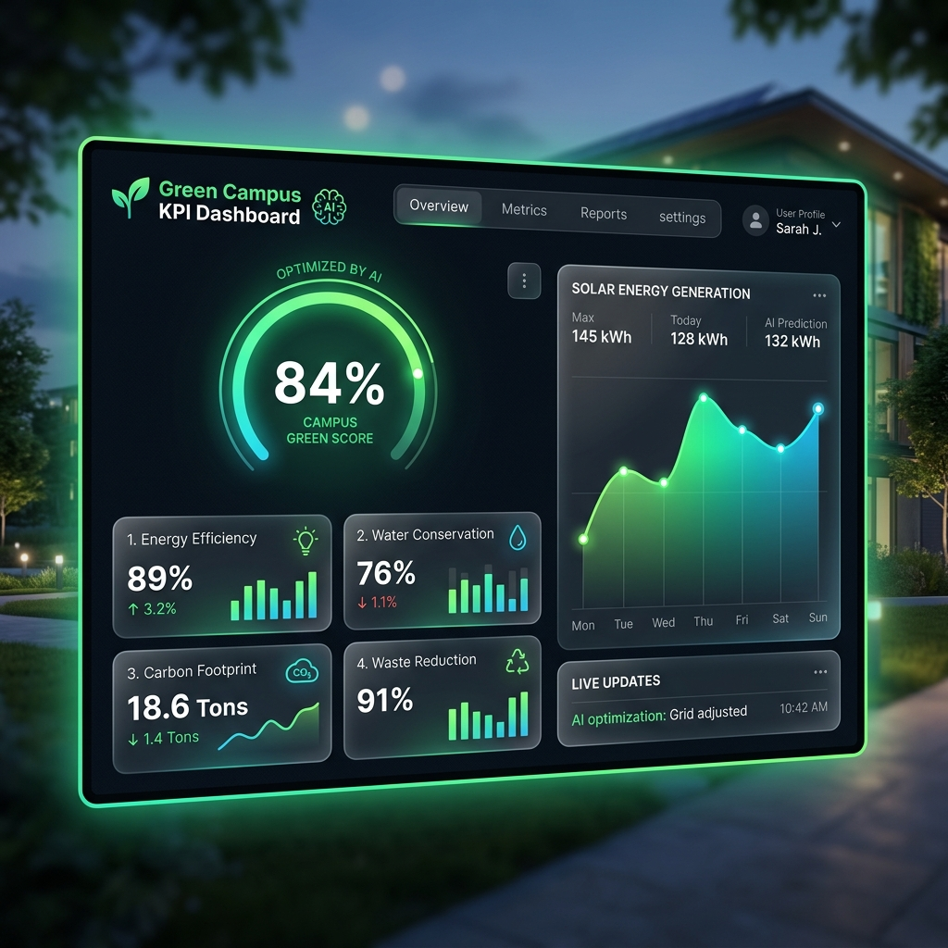
08
UI Design & Layout Showcase
Modern Dashboards
• Design System:
Deep slate dark theme with frost-glass containers, neon borders, and dynamic motion states.
• Real-time HUD:
Key gauges rendering Green Score (84%), dependency ratios, and grid active loads.
• Component Design:
Floating card metrics displaying real-time power metrics, temperatures, and solar irradiance indexes.
• Action Center:
AI recommended alerts prioritizing direct conservation guidelines and diagnostic feedback.
Green Campus KPI Dashboard • CSE S5 MINI Project • Page 9 of 15

Slide 10
09
AI Predictions & Diagnostics
Mathematical Forecasting Core
• Double-Seasonal Holt-Winters Smoothing
Models energy logs by tracking overlapping daily and weekly seasonal cycles with triple exponential alpha/beta/gamma smoothing coefficients.
• Random Forest Regression Core
Evaluates decision trees over historical parameter matrices (temperature, hour, day type) to output baseline hourly demands.
• Linear Trend Fallback Script
A lightweight client-side regression line script running locally in-browser if backend model APIs are unreachable.
Grid Anomaly Registers
• Z-Score Deviation (Threshold = 2.5)
Models historical standard deviations to tag incoming load spikes/drops exceeding 2.5 standard deviations from the hourly average.
• Outlier Diagnostic Solver
Categorizes usage incidents: off-peak leakage (night hours), consumption spikes (chillers), and hardware sensor errors.
• Root Cause Allocation
Maps anomaly events directly to physical panels and structures to isolate exact load leakage nodes.
Green Campus KPI Dashboard • CSE S5 MINI Project • Page 10 of 15

Slide 11
10
Green Campus Score & KPI Weights
KPI Category | Weight (%)
Energy Efficiency | 25%
Carbon Footprint Offset | 20%
Water Conservation | 15%
Waste Segregation & Recycling | 15%
Renewable Energy Integration | 10%
Paperless Administrative Score | 5%
Biodiversity & Green Cover | 5%
Student Green Participation | 5%
84%
🟢 EXCELLENT
Campus Green Score Formulation
GS = (Energy×0.25) + (Carbon×0.20) + (Water×0.15) + (Waste×0.15) + (Renewable×0.10) + (Paperless×0.05) + (Biodiversity×0.05) + (Participation×0.05)
• Dynamically computed indices directly formatting NBA / NAAC reviews.
Green Campus KPI Dashboard • CSE S5 MINI Project • Page 11 of 15

Slide 12
11
Smart Simulator & Chatbot Utilities
AI What-If Simulation Engine
Simulating real-time billing and carbon offsets:
Smart NLP Chatbot Core
Interactive dialog engine demo:
• HVAC Power Dimming (Set to: 30%)
User: 'Which department has the highest energy consumption this week?'
• Solar Capacity Upgrades (Set to: +80%)
Bot: 'Mechanical Lab Block consumed 1,840 kWh, which is 12% higher than average. Z-Score flags anomaly spike.'
Simulated Offset Projections:
• Estimated Billing Savings: ₹1,48,200 / Month (14.2% reduction) • Carbon Savings: 2,420 kg CO2 Offset / Month • Environmental Impact: Equivalent to 84 mature trees planted
• Processing Core: Local keyword parsing with backend RegExp routing.
• Preset Suggestions: Renders dynamic response tables and Markdown summary grids comparing active panel parameters.
Green Campus KPI Dashboard • CSE S5 MINI Project • Page 12 of 15

Slide 13
12
Implementation Roadmap (12-Week Schedule)
Design & Requirements (Weeks 1-2)
DB & Ingestion Core (Weeks 3-5)
UI & ML Integration (Weeks 6-9)
System Testing (Weeks 10-12)
Phase | Duration | Key Activities & Deliverables
Phase 1 & 2: Req. Analysis & Design | Weeks 1–2 | Define sustainability KPIs, system architecture, database schema, and UI prototype. Deliverable: SRS & Design Mockups.
Phase 3 & 4: Data Ingestion & Backend | Weeks 3–5 | Initialize PostgreSQL database, program CSV pipeline parsers, and write REST APIs. Deliverable: Functional backend API.
Phase 5 & 6: Frontend UI & AI Models | Weeks 6–9 | Build glassmorphic Next.js pages, integrate Holt-Winters forecasting, and construct anomaly registers. Deliverable: Prediction core.
Phase 7 & 8: Testing & Deployment | Weeks 10–12 | Perform unit & integration audits, run UAT, prepare documentation, and deploy production containers. Deliverable: Fully working app.
Green Campus KPI Dashboard • CSE S5 MINI Project • Page 13 of 15

Slide 14
13
Risk Management & Mitigations
Risk Description | Probability | Impact | Mitigation & Contingency Strategy
R1: Incomplete or missing sustainability records from departments | High | High | Integrate automated fallback states using representative historical baseline records.
R2: Noisy sensor logs leading to skewed KPI calculations | High | High | Build clean validation parsers to catch cumulative meter resets and out-of-bound errors.
R3: Statistical AI models yielding high forecasting error rates | Medium | High | Retrain models continuously and run a fallback lightweight browser-based regression model.
R4: UI latency when rendering large historical spreadsheets | Medium | Medium | Optimize database indexing and cache calculations using React-Query query cache.
R5: Unauthorized access to campus grid controls and dashboard settings | Low | High | Enforce Role-Based Access Control (RBAC), hash passwords, and require secure HTTPS/TLS.
Green Campus KPI Dashboard • CSE S5 MINI Project • Page 14 of 15

Slide 15
14
Expected Outcomes & Conclusion
Key Project Deliverables
• Centralized Web Application:
Production Next.js 14 frontend and high-throughput Python FastAPI backend microservice.
• Aggregated Campus Database:
Relational PostgreSQL database schema holding historical grid, solar, and water records.
• Technical Reports Generator:
Client-side PDF compiler (jsPDF) producing accredited sustainability logs.
Institutional Value & ESG Impact
• Evidence-Based Accreditations:
Supports NBA and NAAC audits by producing transparent, continuous audit files.
• Resource & Cost Savings:
Drives a projected 10–15% operational utility billing drop through proactive alarm routines.
• Proactive Campus Governance:
Transitions management structures from retrospective bills to data-driven ML insights.
Green Campus KPI Dashboard • CSE S5 MINI Project • Page 15 of 15

