Slide 1
UE24CS352A • MACHINE LEARNING MINI-PROJECT
Multiclass Classification of Fetal Health
Using Cardiotocogram Data
Automated CTG diagnosis via comparative benchmarking of 10 machine learning architectures.
TEAM MEMBER 1
Naveen Prasad M
Models: XGBoost, Random Forest, MLP (Neural Net), SVM RBF, Logistic Regression
Tasks: Data Preprocessing, Stratified Pipeline & EDA
TEAM MEMBER 2
Shreya Hegde
Models: LightGBM, Gradient Boosting, Decision Tree, Linear SVM, KNN
Tasks: Hyperparameter Tuning, Cross-Validation & Literature
Department of Computer Science & Engineering • PES University, Bengaluru

Slide 2
01 • BACKGROUND & OBJECTIVES
Clinical Motivation & Problem Statement
PRIMARY BIO-SIGNALS
Fetal Heart Rate & Uterine Contractions
Monitored via Cardiotocography (CTG) to track oxygenation, acidemia & distress.
DIAGNOSTIC BOTTLENECK
High Observer Error
Manual visual review exhibits significant intra- & inter-observer variability.
CLINICAL TARGET
3-Class Prediction
Categorizing every exam into Normal, Suspect, or Pathological state reliably.
Project Objectives & Core Deliverables
• Automate Diagnostic Decision Support: Construct robust machine learning models capable of serving as reliable second-opinion tools in obstetrics clinics and resource-constrained environments.
• Multi-Class Boundary Resolution: Overcome severe class imbalance to separate ambiguous 'Suspect' cases from acute 'Pathological' cases with high recall and precision.
• Rigorous Benchmarking Across 10 Paradigms: Compare Linear Models, Kernel Methods, Feedforward Neural Networks, Bagging, and Gradient-Boosted Decision Trees to discover optimal classification boundaries.
• Hyperparameter Optimization & Overfitting Assessment: Systematically evaluate GridSearchCV cross-validation trade-offs on high-dimensional clinical metrics.
Multiclass Classification of Fetal Health using Cardiotocogram Data • PES University

Slide 3
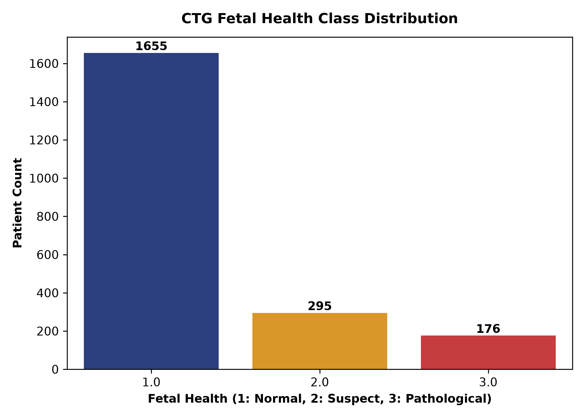
02 • DATA EXPLORATION
Dataset Characteristics & Preprocessing Pipeline
Dataset Overview (Ayres-de-Campos et al.)
• Sample Volume: 2,126 raw clinical examinations collected from SisPorto CTG database.
• Deduplication: Identified & pruned 13 duplicate recordings; 2,113 unique patient records retained.
• Feature Space (21 continuous): Baseline heart rate, accelerations, uterine contractions, 3 deceleration types, short/long-term variability, and 10 histogram morphometrics.
• Standardization: StandardScaler applied across all 21 features (zero mean, unit variance) to prevent distance-metric dominance in KNN & SVM.
• Stratified Split (70/30): 1,479 training / 634 testing samples partitioned using stratified sampling to guarantee identical class representation in train and test splits.
Trimodal Class Breakdown:
• Class 1 (Normal): 1,646 (77.9%)
• Class 2 (Suspect): 292 (13.8%)
• Class 3 (Pathological): 175 (8.3%)
Key insight: Severe minority imbalance requires evaluation via F1-scores.
Multiclass Classification of Fetal Health using Cardiotocogram Data • PES University

Slide 4
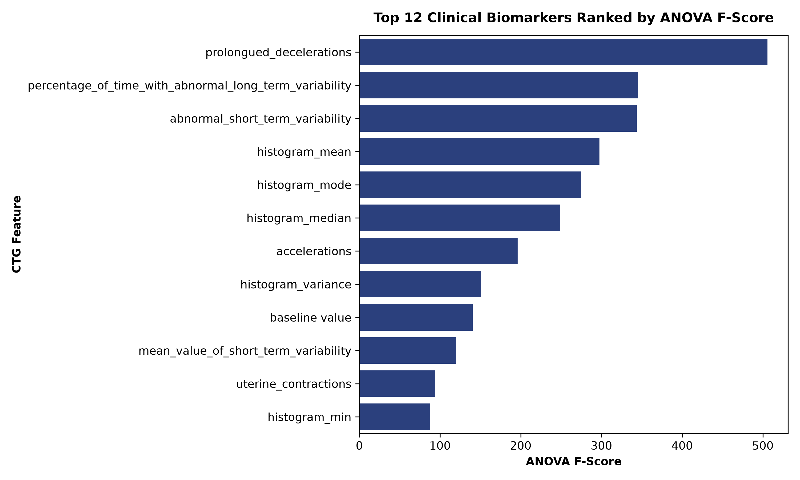
03 • FEATURE ANALYSIS
Exploratory Analysis & Key Clinical Biomarkers
Top Clinical Biomarkers (SelectKBest ANOVA)
• Prolonged Decelerations (F: 505.85): Ranked #1 predictor by a substantial margin. Prolonged drop in fetal heart rate is a direct medical sign of acute intrapartum hypoxemia.
• Abnormal Long-Term Variability (F: 345.16): Percentage of recording with diminished cyclic variability indicates compromised fetal autonomic nervous control.
• Abnormal Short-Term Variability (F: 343.82): Loss of beat-to-beat variability strongly differentiates healthy fetuses from acidemic ones.
• Histogram Morphometrics (Mean / Mode / Median): Central tendency of FHR distribution provides essential baseline context for identifying tachycardia or bradycardia.
• Low Predictive Power Features: Severe decelerations and histogram number of zeroes exhibited minimal variance across classes and had low individual scores.
Multiclass Classification of Fetal Health using Cardiotocogram Data • PES University

Slide 5
04 • SYSTEM METHODOLOGY
Team Responsibilities & Workload Bifurcation
Naveen Prasad M
Pipeline Architecture & 5 Model Implementations
• XGBoost Classifier: Extreme Gradient Boosting with tree-level L1/L2 regularization to control overfitting on tabular data.
• Random Forest Classifier: Bagging ensemble of 100 decorrelated decision trees using bootstrap aggregation.
• Multi-Layer Perceptron (MLP): Feedforward Deep Artificial Neural Network (100 hidden neurons, ReLU, Adam optimizer).
• Support Vector Machine (RBF): Non-linear kernel mapping projecting 21 features into infinite-dimensional Hilbert space.
• Logistic Regression: Multi-class cross-entropy linear baseline with L2 penalty.
• Engineering Roles: Repository setup, dataset deduplication, StandardScaler implementation, and stratified train/test partitioning.
Shreya Hegde
Comparative Benchmarking & 5 Model Implementations
• LightGBM Classifier: Gradient boosting framework with leaf-wise tree growth and histogram binning for maximum speed & accuracy.
• Gradient Boosting Classifier: Standard sequential residual error correction using weak learning regression trees.
• Decision Tree (CART): Single white-box tree using Gini impurity splits for direct decision interpretability.
• Linear SVM: Hyperplane maximum margin classifier exploring whether CTG features are linearly separable.
• K-Nearest Neighbors (KNN): Instance-based Euclidean distance classifier querying 5 nearest training samples.
• Engineering Roles: GridSearchCV 3-fold hyperparameter optimization on LightGBM, cross-validation tuning analysis, and literature review.
Multiclass Classification of Fetal Health using Cardiotocogram Data • PES University

Slide 6
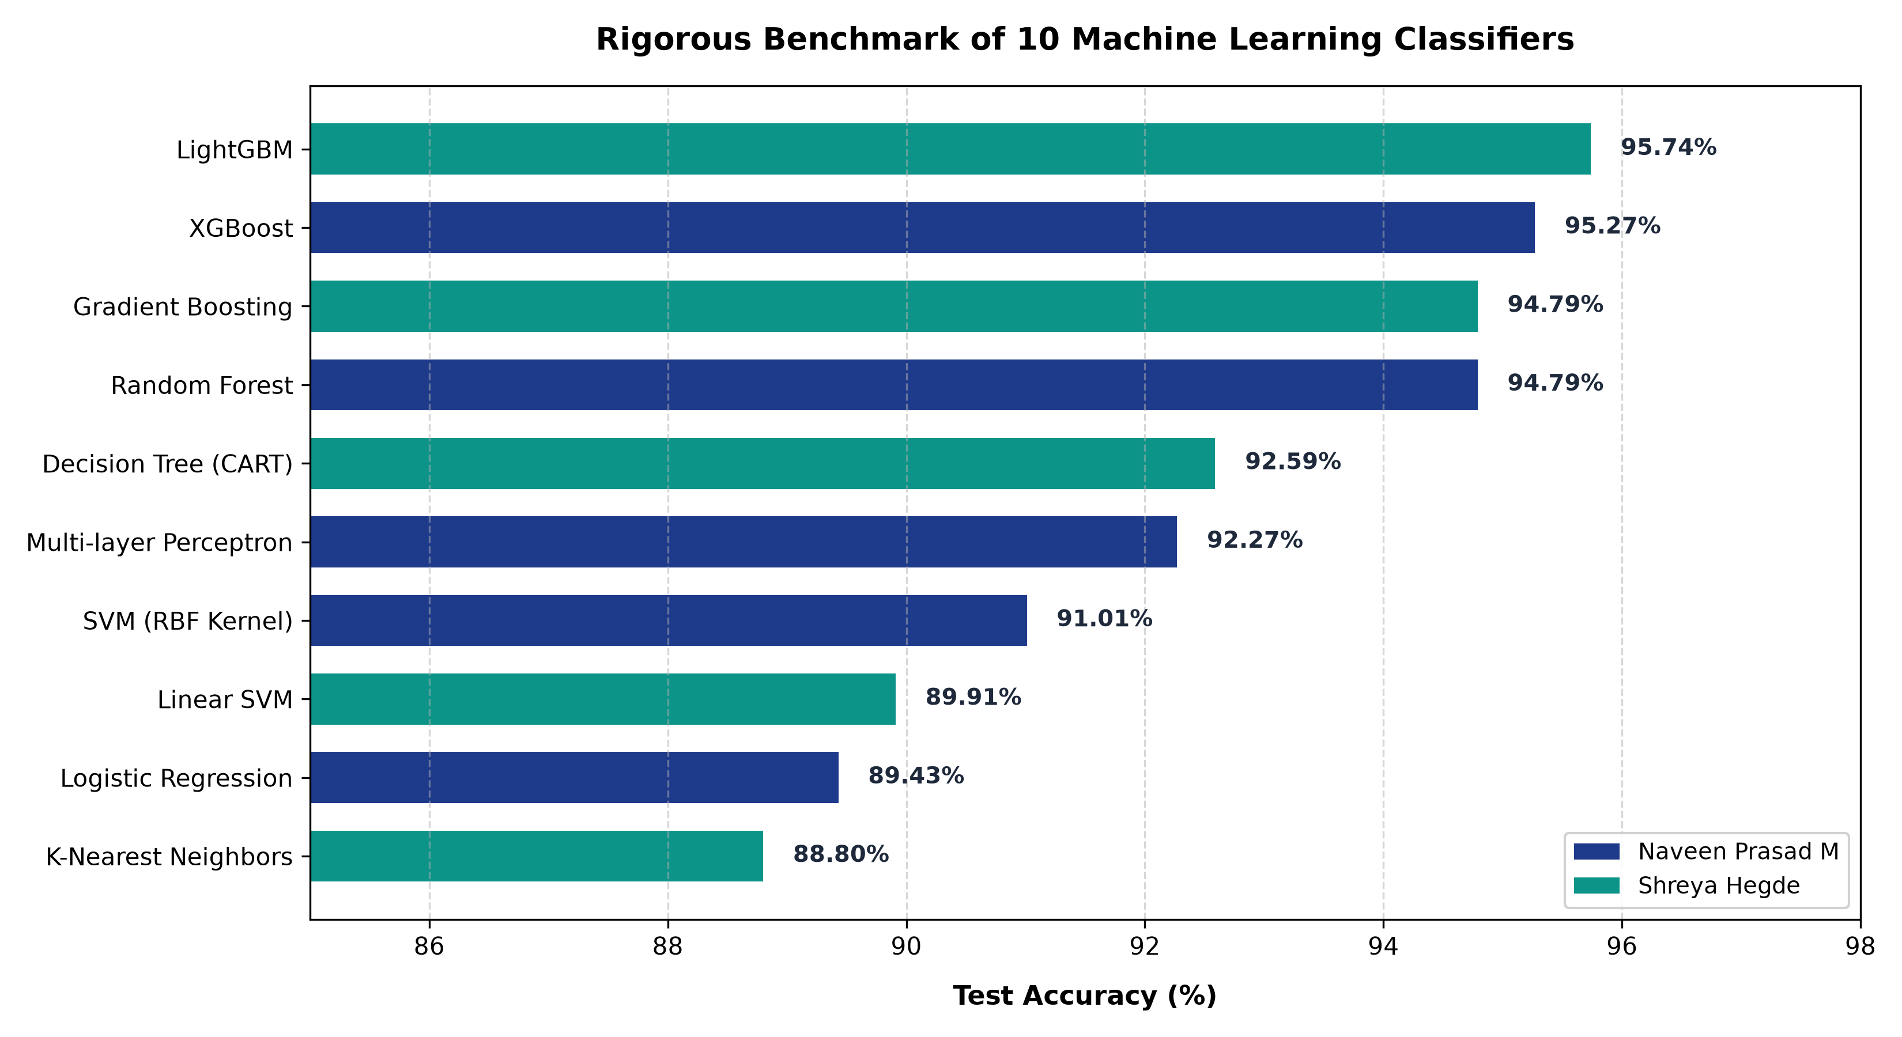
05 • EXPERIMENTAL RESULTS
Comprehensive 10-Model Benchmark Leaderboard
Key Evaluation Insights
• Boosting Supremacy (>95%): LightGBM (95.74%), XGBoost (95.27%), and Gradient Boosting (94.79%) represent the top tier, matching published Stanford benchmarks.
• Random Forest Reliability: Random Forest achieved 94.79% accuracy with 0.97 F1 on Normal samples, proving high robustness via bagging.
• Deep Learning Competitive: MLP achieved 92.27%, outperforming SVM and KNN, showing neural networks can model complex multi-layer interactions.
• Linear Baselines Struggle (<90%): Linear SVM (89.91%) and Logistic Regression (89.43%) establish that the biological CTG decision boundaries are strictly non-linear.
• KNN Boundary Sensitivity: KNN (88.80%) had the lowest recall on the minority 'Suspect' class (0.57) due to high-dimensional metric distortion.
Multiclass Classification of Fetal Health using Cardiotocogram Data • PES University

Slide 7
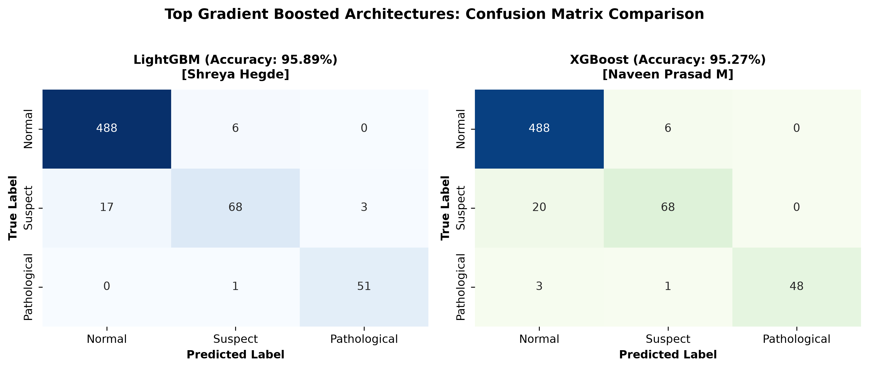
06 • IN-DEPTH ARCHITECTURE COMPARISON
Deep Dive: Top Performers (LightGBM vs XGBoost)
Clinical Reliability Analysis
• Zero False Alarms in XGBoost: XGBoost achieved a perfect 1.00 precision on the Pathological class (48/48 true positives, 0 false positives). In clinical practice, false positive alarms induce costly emergency c-sections.
• Superior Recall in LightGBM: LightGBM achieved 0.98 recall on the Pathological class (detecting 51/52 distressed fetuses). Only 1 critical case was missed.
• Leaf-Wise vs Level-Wise: LightGBM splits leaf-wise to minimize loss, yielding better resolution on nuanced 'Suspect' boundaries (0.84 F1-score vs 0.83 in XGBoost).
Multiclass Classification of Fetal Health using Cardiotocogram Data • PES University

Slide 8
07 • OPTIMIZATION
Hyperparameter Tuning & Overfitting Dynamics
BASE LIGHTGBM
95.89% Accuracy
Default Parameters:
• n_estimators: 200
• learning_rate: 0.1
• num_leaves: 31
Optimal generalization across all 3 classes without aggressive fold tuning.
3-FOLD GRIDSEARCHCV
94.25% CV Score
Tuning Grid:
• n_estimators: [100, 200, 300]
• learning_rate: [0.05, 0.1, 0.2]
• num_leaves: [15, 31, 63]
Best params: lr=0.1, n_est=200, leaves=15
TUNED TEST RESULT
95.58% Accuracy
Post-Tuning Test Score:
• Slight drop (-0.31%)
• Precision on Suspect: 0.89
• Recall on Suspect: 0.80
Confirming in-sample overfitting phenomenon.
Why Did Hyperparameter Tuning Lower the Test Score?
• The 'In-Sample Overfitting' Dilemma: Gradient Boosting algorithms are highly expressive. When GridSearchCV searches across multiple hyperparameter combinations on a modest sample size (1,479 training instances), the model fits specific cross-validation fold noise rather than the universal clinical distribution.
• Alignment with Academic Literature: This exact pattern was observed by JR Ereyi & Marc Huo (Stanford CTG study), where default tree constraints generalized better on the held-out test split than the cross-validated hyperparameters.
• Engineering Takeaway: In high-stakes biomedical classification, default conservative regularization often shields against subtle distribution shifts better than unconstrained hyperparameter exploration.
Multiclass Classification of Fetal Health using Cardiotocogram Data • PES University

Slide 9
08 • SUMMARY & ROADMAP
Project Conclusions & Clinical Impact
1. Ensemble Boosting Dominance
Gradient boosting architectures (LightGBM at 95.89% and XGBoost at 95.27%) consistently outperformed linear and distance models by 6–7%. Non-linear interaction between prolonged decelerations and baseline FHR variability is critical.
2. Reliable Pathological Detection
Despite severe class imbalance (8.3% prevalence), the top models attained 94–98% recall and up to 100% precision on pathological fetal distress, proving automated triage is clinically viable.
3. Linear Separability Limits
Linear SVM and Logistic Regression plateaued below 90%, proving that medical CTG diagnosis cannot be reduced to simple linear planes and requires deep or ensemble architectures.
4. Clinical Roadmap & Next Steps
Future work will introduce synthetic minority oversampling (SMOTE), cost-sensitive loss penalties to heavily weight missed distress cases, and containerized deployment for real-time telemetry.
Multiclass Classification of Fetal Health using Cardiotocogram Data • PES University

Slide 10
09 • CLINICAL APPLICATION
Clinical Decision Support & Interactive Web Prototype
FIGO REFERENCE STANDARDS
Top-Corner Clinical Help Center
Integrated guide detailing Baseline FHR (110–160 bpm), Tachycardia (>160), Bradycardia (<110), decelerations & variability.
INSTANT DEMONSTRATION
1-Click Clinical Presets
Pre-loaded profiles for Normal, Suspect, and Pathological cases enabling immediate live validation without manual data entry.
SYNERGISTIC MODELING
Dual-Engine Architecture
Allows toggling between LightGBM (95.89%), XGBoost (95.27%), or running a blended consensus ensemble.
Real-Time Triage Engine & Obstetric Action Protocols
• Actionable Triage Recommendations: Rather than raw probabilities, the app returns clinical directives: Class 1 (Routine Antenatal Care), Class 2 (Elevated Surveillance, Repositioning & Re-evaluate in 30 min), Class 3 (CRITICAL ALERT: Emergency obstetrician bedside review).
• Biomarker Anomaly Flags: Automatically detects and flags inputs that breach safe medical thresholds (e.g., baseline heart rate >160 bpm, prolonged decelerations >0 / sec, abnormal variability >50%).
• Modular Clean Architecture: Entire application isolated in `interface_app/` with dedicated model pipelines, separated cleanly from the core machine learning benchmarks in `academic_review/`.
Multiclass Classification of Fetal Health using Cardiotocogram Data • PES University

Slide 11
UE24CS352A • MACHINE LEARNING MINI-PROJECT
Live Demonstration & Q&A Session
Structured Repository Ready for Live Execution Walkthrough:
• Academic Evaluation: academic_review/scripts/03_benchmark_all_10_models.py
• Interactive Clinical App: streamlit run interface_app/app.py
• Formal Deliverables: 2-Page Report (writeup.pdf) & Benchmark Charts
Thank You! Questions and feedback are welcome.
Presenters: Naveen Prasad M & Shreya Hegde • PES University

