Slide 1
PIRATE HUNTER
LabelGuard
Packaged Food Label
Compliance Check Service
Mini Project 10
ML System Design & AgentOps
PES University / 28 October 2026
Notes:
Project report for UE24AM342AA5. Sources: README.md, docs/REPORT.md and the supplied MiniProject_10_Food_Label_Compliance.pdf. The demonstration uses a deterministic planner fixture, not a live external LLM.

Slide 2
Project team
Team member | SRN
Naveen Prasad M | PES1UG24AM379
Nishanth Nag | PES1UG24AM381
Sateesh | PES1UG24AM397
Team: Pirate Hunter. Course: UE24AM342AA5.
02
Notes:
Team identities follow the user correction and supplied roster. No historical individual contribution claims are assigned. Source: docs/TEAM.md.

Slide 3
Problem and supported scope
Problem
Label declarations and nutrition claims depend on different FSSAI regulations.
Input
Structured label and package data for domestic retail processed breakfast cereals.
Output
Cited findings with a supported-checks, revision or regulatory-review route.
Human decision
A regulatory professional decides print readiness. The service never authorises printing.
03
Notes:
Source: docs/REPORT.md sections 1 and 2, docs/REQUIREMENTS.md. The route clear-for-print is retained only to meet the assignment interface. Every response has print_authorized:false.

Slide 4
Asynchronous service workflow
01 Submit
FastAPI validates the request and returns a run ID with HTTP 202.
02 Research
A separate worker selects tools and retrieves applicable regulatory evidence.
03 Verify
Another worker re-resolves citations and recomputes the proposed findings.
04 Review
The browser polls for the verified result, exact citations and trace.
Durable leases and atomic hand-off preserve work across worker restarts.
04
Notes:
Source: labelguard/api.py, store.py, agents.py and worker.py. See docs/ARCHITECTURE.md for the deployment diagram. SQLite WAL provides the durable leased queue.

Slide 5
Two agents with separate responsibilities
Responsibility | Research agent | Verification agent
Execution | LangGraph tool loop | Separate LangGraph graph
Evidence | Search and exact clause lookup | Re-resolve against pinned corpus
Decision | Build a candidate with citations | Recompute policy and arithmetic
Failure path | Bounded retry or escalation | One repair pass, then escalation
Research tools: request_fields, corpus_search and clause_lookup.
05
Notes:
Source: labelguard/agents.py, provider.py, rules.py, prompts/v1.md, prompts/v2.md and prompts/verifier-v1.md. Research uses an HTTP planner. The verifier is deterministic and independent of the planner.

Slide 6
Pinned regulatory corpus
Source | Pinned version | Use
Labelling and Display 2020 | VIII, 9 Sep 2025 | Mandatory declarations
Advertising and Claims 2018 | IV, 14 Dec 2022 | Nutrition-claim conditions
First Amendment 2026 | 24 Mar 2026 | Commences 1 Jul 2027
146 chunks / 19 curated clauses
LangChain + FAISS with local lexical hashing embeddings. Dates from 1 July 2027 escalate.
06
Notes:
Official source URLs and SHA256 hashes are in data/sources.json. Labelling: https://www.fssai.gov.in/upload/uploadfiles/files/Comp_Labelling%20Display_Version%20VIII_09_09_2025.pdf . Claims: https://www.fssai.gov.in/upload/uploadfiles/files/Compendium_Advertising_Claims_Regulations_14_12_2022.pdf . Amendment: https://www.fssai.gov.in/docs/food-law/regulations/amendments/labelling-display/Notification%20dt%2024_03_2026_NRC.pdf . Gazette notifications prevail over compendia.

Slide 7
Protein claim: evidence across regulations
For the illustrative 54 g/day benchmark, any one branch can qualify:
Source-of-protein branch | Required protein
Per 100 g of solid food | 5.4 g
Per 100 kcal | 2.7 g
Per serving | 5.4 g
Example: 6 g/100 g passes the mass branch. At 3 g/100 g, 376 kcal/100 g and 40 g/serve, all fail.
07
Notes:
Sources: docs/DEMO.md, docs/REPORT.md section 2, data/clause_map.json and examples/valid-protein.json. Citations: LD 5(3)(b), pp10–11; AC 5(3), p4; AC Schedule I item11, p9; AC 2(1)(n), p2. The 54g/day benchmark is an illustrative supplied, reviewer-confirmed value, not a universal recommendation.

Slide 8
Guardrails and execution limits
Before execution
Strict types, ranges, cross-field checks and text screening. Invalid inputs enter quarantine.
Tool boundary
Allowlisted tools and read-only field paths. Every citation must match a stored passage.
Research budget
24 steps, 12 tool calls, 5 s/tool and 8 s/provider attempt.
Recovery
Two provider retries, circuit breaker and a 45 s total run budget.
08
Notes:
Source: labelguard/models.py, guardrails.py, config.py, provider.py and docs/CONTRACTS.md. Injection/toxicity screening is pattern based and limited. It does not establish complete resistance to adversarial inputs.

Slide 9
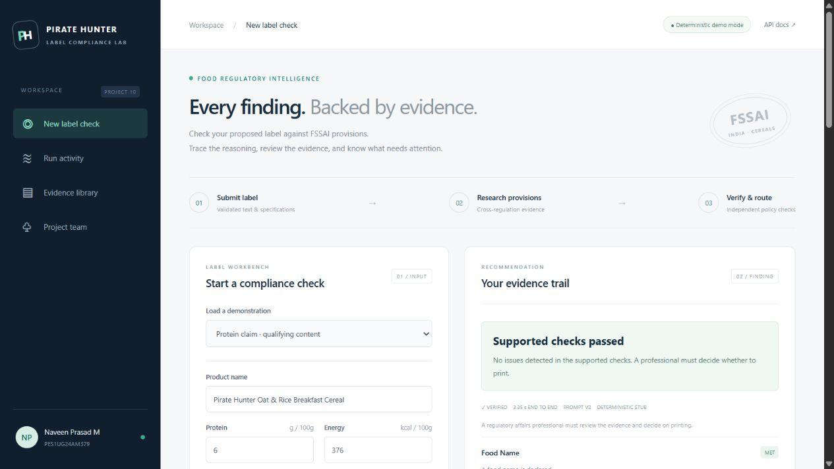
Workbench and cited findings
The interface shows the recommendation, requirement findings and exact source passages.
09
Notes:
Actual current viewport screenshot: output/demo/result-viewport.png. Sources: web/app.js and output/demo/rehearsal.json.

Slide 10
Prompt v2 matches all 32 fixed scenarios
Metric | v1 | v2
Outcome matches | 14 / 32 | 32 / 32
Groundedness | 1.0000 | 1.0000
Context relevance | 0.8522 | 1.0000
Faithfulness | 1.0000 | 1.0000
Hallucination rate | 0.0000 | 0.0000
Context recall | 0.7541 | 1.0000
v2 follows claim dependencies. Results use a deterministic fixture and shared policy-based metrics.
10
Notes:
Sources: output/evaluation/final-container-results.json and docs/REPORT.md section 5. The 32 cases include 27 answer scenarios and 5 rejects. Metrics measure citation provenance and consistency with the implemented policy. They do not establish independent legal truth or live-model generalisation.

Slide 11
Scaling meets the 15-second SLO at 8 users
Workers | Users | Runs | Runs/s | p95 (s) | SLO
1 | 2 | 11 | 0.332 | 6.2 | Met
1 | 4 | 13 | 0.333 | 12.0 | Met
1 | 8 | 17 | 0.321 | 24.0 | Missed
3 | 4 | 31 | 0.963 | 5.5 | Met
3 | 8 | 36 | 0.966 | 8.9 | Met
3 | 20 | 46 | 0.993 | 20.0 | Missed
At 8 users, three research workers deliver 3.01× observed throughput. These are short local tests.
11
Notes:
Sources: docs/SLO.md, output/load/results.json and saved Locust CSVs. Target declared before measurement: p95 submission-to-final-result <=15s. Cache disabled, provider stub delay350ms, 30s arrival periods and up to50s drain. Small samples and rounded Locust histograms limit capacity conclusions.

Slide 12
Warm caching removes repeat planner calls
Measure | Cache disabled | Warm cache
p95 complete run | 4.421 s | 0.047 s
Planner calls/run | 7 | 0
Actual provider cost | 0 | 0
Both conditions use the demo stub. Paid-model cost savings have not been measured.
12
Notes:
Sources: output/load/cache/results.json, docs/REPORT.md section7 and labelguard/store.py. Ten sequential runs per condition, prewarmed cache, priming excluded. p95 is the nearest-rank maximum with n=10. Cache TTL1h. Cache keys include request, corpus, prompt, verifier policy and provider configuration.

Slide 13
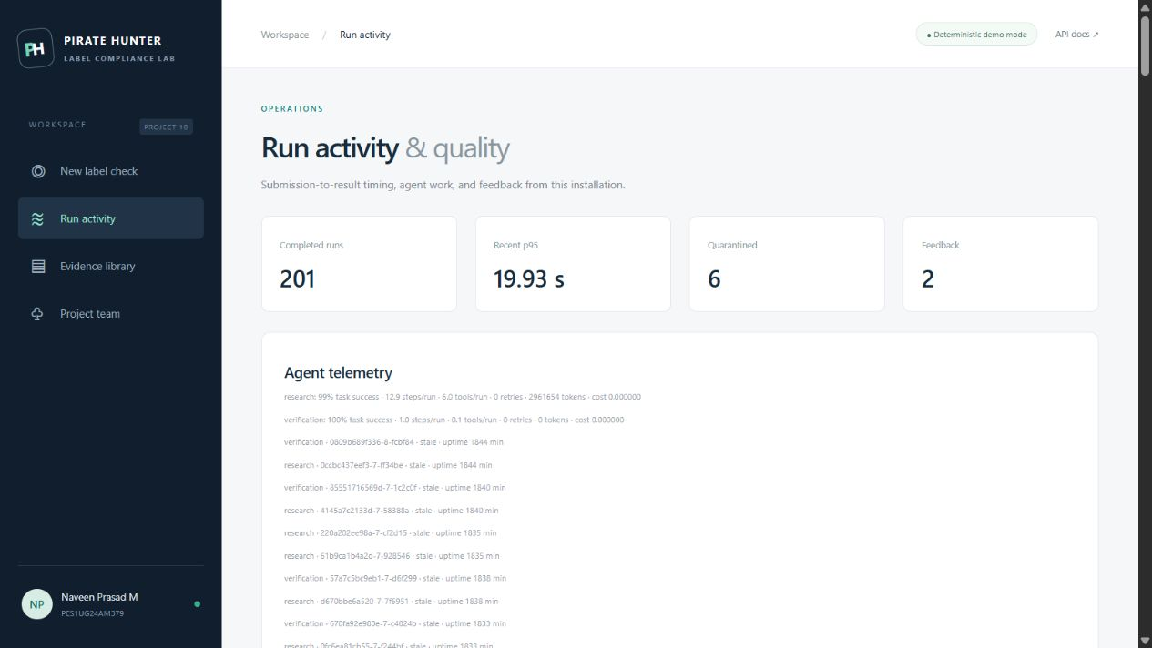
Operations and observability
Prometheus
Service metrics
Grafana
16 dashboard panels
Jaeger
Connected service traces
Seven long-running Compose services, plus one initialiser. Research workers scale independently.
13
Notes:
Sources: infra/prometheus.yml, infra/grafana, labelguard/telemetry.py and output/verification/monitoring.json. The saved Jaeger trace connects API, research, provider stub and verification. Screenshot: output/demo/activity-viewport.png. Historical stale worker records and aggregate latency include earlier load/fault exercises. Current readiness is checked separately.

Slide 14
Tests and failure handling
Check | Observed result
Automated tests | 21 passed
Browser acceptance | Submit, poll, citations, feedback and mobile passed
Tampered candidate | Verifier rejected it and repair succeeded
Provider outage | Circuit opened and the run escalated safely
Malformed or injected input | 422 + quarantine, with no agent job created
Actual incidents: registry pull retry recovered, and installed Edge resolved a missing test browser.
14
Notes:
Sources: output/verification/final-tests.xml, service-results.json, browser-results.json, fault-results.json, docs/INCIDENTS.md and docs/VERIFICATION.md. 21 tests passed in the Linux container. The external-provider adapter used MockTransport, not a paid live call.

Slide 15
Repository organisation
Path | Contents
labelguard/ and web/ | Service, agents, policies and browser client
data/ and prompts/ | Pinned regulations, clause map and versioned prompts
tests/, eval/ and loadtests/ | Unit tests, fixed scenarios and Locust workload
infra/ and compose.yaml | Container orchestration and observability
docs/ and output/ | Report, runbook, measured evidence and presentation
README.md is the entry point. docs/DEMO.md contains the demonstration and viva guide.
15
Notes:
Sources: docs/REPOSITORY_GUIDE.md and README.md. GitHub repository: https://github.com/NAVEEN4516/pirate-hunter-labelguard . Source and verification commits were pushed and the first Actions workflow passed. Commits organise the delivery and do not claim historical individual contributions.

Slide 16
Demonstration and remaining work
Run the service
docker compose up --build -d
Open http://localhost:8000
Demonstrate
Compare the protein pass/fail examples, then inspect citations and the agent trace.
Current limitation
Demonstration uses a deterministic HTTP planner stub. Live LLM quality is unmeasured.
Next work
Validate a real provider, expand expert-reviewed rules and run longer capacity tests.
16
Notes:
Sources: docs/DEMO.md, docs/REQUIREMENTS.md and docs/REPORT.md. The live external-model adapter needs target-provider evaluation. Professional review remains required for product eligibility, exemptions, lab substantiation, licence authenticity, layout and Legal Metrology. No faculty approval is asserted.

Slide 17
Report evidence and references
Regulations
FSSAI Labelling and Display 2020, version VIII
FSSAI Advertising and Claims 2018, version IV
Effective-date boundary
Labelling and Display First Amendment 2026
Notified 24 March 2026, commences 1 July 2027
Measured evidence
Fixed evaluation results, raw Locust CSVs, browser screenshots and connected traces.
Companion documents
Final PDF report, requirement matrix, runbook, incident log and viva guide.
17
Notes:
Official sources: data/sources.json (three FSSAI PDFs with URL, version and SHA256). Local sources: MiniProject_10_Food_Label_Compliance.pdf, docs/REPORT.md, docs/REQUIREMENTS.md, output/evaluation/final-container-results.json, output/load/results.json and output/verification/. All external facts and screenshots are cited in the relevant slide notes.

