Slide 1


Student Details
Name: D.NAVEENKUMAR
Skills Build Email ID: naveenkumard17294@gmail.com
College Name: IIIT, RK Valley. RGUKT University
College State: Andhra Pradesh
Internship Domain: AI and ML
Internship Start And End Date: 15-05-2024 TO 19-06-2024

Slide 2

Project title – “Sentiment Analysis For Restaurant Reviews”
The problem statement is to find whether the Review of the Restaurant is positive or Negative.
There are different types of reviews given by the customers after completing eating food. It might be either positive and negative. so we need to predict the how much percentage of good review of Entire dataset .

Slide 3

AGENDA
As the influence of the social media and internet is increasing in ones life there arises a need to analyse the valuable insights from the data scattered over the internet in various forms. Business like restaurants can use this data to find out how they are performing and find out what are the reviews of their customers and know what their customers are really thinking of them. Our goal is to create a AI algorithm that finds the sentiment of a user from its review and distinguish it between two categories either positive or negative. This can be really beneficial for the restaurants to gain insights and also to recognise which dish is performing best, what are the areas to work on, what are the negative points. Using this knowledge they can upgrade themselves so that they can perform well on their customers.

Slide 4








PROJECT OVERVIEW
Purpose:
The primary objective is to develop a model or system that can analyze text data (reviews) and determine the sentiment associated with them.
The project aims to develop a system that automatically evaluates and categorizes customer reviews of restaurants based on their sentiments.
The project uses Natural Language Processing (NLP) techniques and machine learning models to analyze text data and provide insights into customer satisfaction levels.
Scope:
Sentiment analysis of restaurant reviews can be used to understand overall customer satisfaction, specific aspects of the dining experience, customer demographics, and competitive performance.
The project aims to deliver sentiment analysis system that can accurately classify restaurant reviews into positive or negative categories.
Once a satisfactory model is trained, it can be deployed as a service or integrated into a larger application. This could be a web application, mobile app, or any other platform where users can input reviews and receive sentiment predictions.

Slide 5
Objectives:
Data Collection and Preprocessing
Model Selection and Training
Evaluation and Performance Metrics
Classify reviews as positive or negative
PROJECT OVERVIEW
Understand customer satisfaction
Identify areas for improvement
Make better business decisions
Identify specific aspects of the dining experience that customers are most and least satisfied with
Understand how different groups of customers (e.g., age groups, nationalities, etc.) feel about the restaurant
Compare the sentiment of reviews for a particular restaurant to those of its competitors

Slide 6




Future scope
Restaurant owners and managers: They can use the sentiment analysis tool to gain insights into customer feedback and make informed decisions to improve their services, menu offerings, and overall customer experience.
Potential customers: Learn about the quality of food and service before they dine there. Positive changes in response to feedback contribute to better overall dining experiences.
Market researchers and analysts: Data analysts and researchers in the restaurant industry can use the sentiment analysis results for deeper insights into customer preferences, trends, and areas of improvement.
Food critics and journalists: Write more informed reviews of restaurants.

Slide 7
Solution:
My solution provides restaurant owners and managers with powerful tools to derive actionable insights from customer reviews, ultimately leading to enhanced customer satisfaction, improved business operations, and a competitive edge in the market. Leveraging my expertise in language and contextual analysis, I have developed a method to analyze and classify restaurant reviews as positive or negative.
Additionally, my solution identifies specific aspects of the dining experience that customers are most and least satisfied with. Restaurants can use this information to enhance customer satisfaction and overall performance. I am confident that my solution will be valuable for restaurants of all sizes. By understanding customer sentiment, restaurants can make informed decisions regarding their food, service, marketing, and operations, resulting in higher customer satisfaction and increased profitability.
My SOLUTION AND ITS VALUE PROPOSITION

Slide 8





Automated Insight Generation:The system provides automated analysis of restaurant reviews, saving time and effort that would otherwise be spent manually sorting through large volumes of feedback.
VALUE PROPOSITION
Improved Decision-Making:Restaurant owners and managers can make more informed decisions based on the insights provided by the sentiment analysis tool.
Scalability and Adaptability:The system is designed to handle large volumes of reviews, ensuring scalability as a restaurant's customer base grows.
Customization and Integration:The system can be customized to suit specific business needs and integrated into various platforms.
Additionally, my solution is easy to use and deploy. Restaurants can simply provide me with a set of restaurant reviews, and I will return the sentiment of each review. This information can then be used to improve the restaurant experience for customers.

Slide 9

MODELLING
Multinomial Naive Bayes algorithm:
A probabilistic classification algorithm well-suited for text classification tasks, such as sentiment analysis.
Assumes that the features of the data are independent of each other.
Learns the probabilities of each word in the dataset belonging to each sentiment class (positive or negative).
Apply the probability to data by treating the problem as a binary classification task, where the classes are positive and negative sentiments.
Predicts the sentiment of a new review by calculating the probability of the review belonging to each sentiment class and then predicting the class with the highest probability.
Multinomial Naive
Bayes algorithm

Slide 10
MODELLING
Benefits of using the MNB algorithm for restaurant sentiment analysis:
Simple Implementation and Training:Able to learn from even a relatively small dataset of labeled reviews. Its simplicity makes it a good choice for tasks like sentiment analysis.
Effective for text classification tasks: It efficiently handles the high dimensionality of text data, making it an effective choice for analyzing restaurant reviews.
Effective with Limited Labeled Data: MNB can perform well even with a relatively small dataset of labeled reviews.
Well-Suited for Categorical Data: MNB is designed to work with categorical features like word counts or term frequencies.
Multinomial Naive
Bayes algorithm

Slide 11
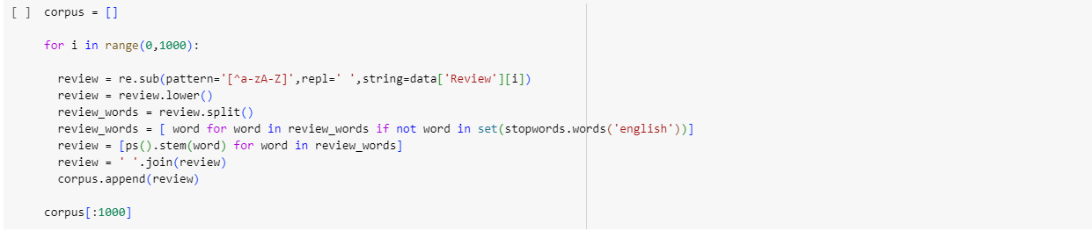
Results
Data Cleaning : Before using data for model training its essential to clean the data. Cleaning data involves steps like making data into correct format for used for training, removing blanks, and removing unwanted data. In this case we have stopwords (the words that doesn’t contribute in meaning of sentence) so we will remove them first before training the model.

Slide 12
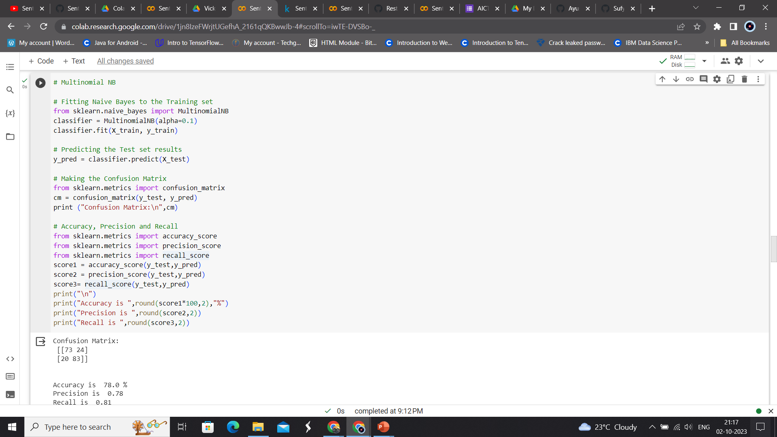
Multinomial naive bayes Algorithm

Slide 13
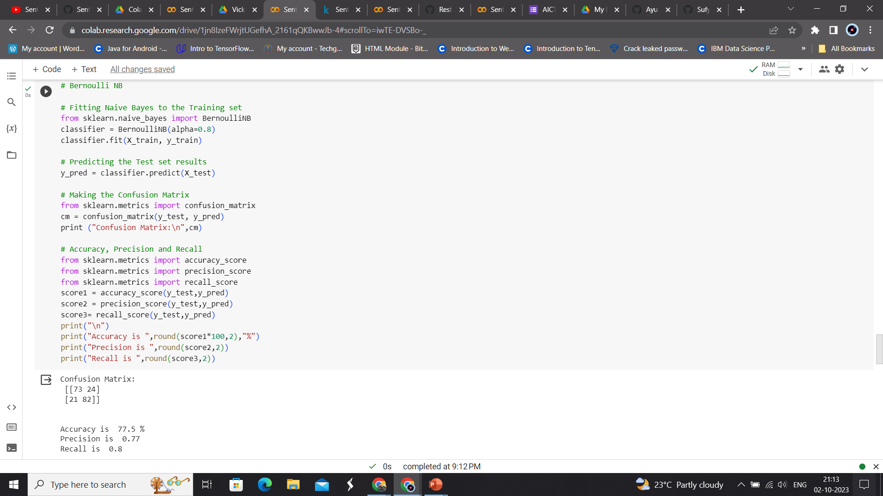
Bernoulli Naive Bayes Algorithm

Slide 14
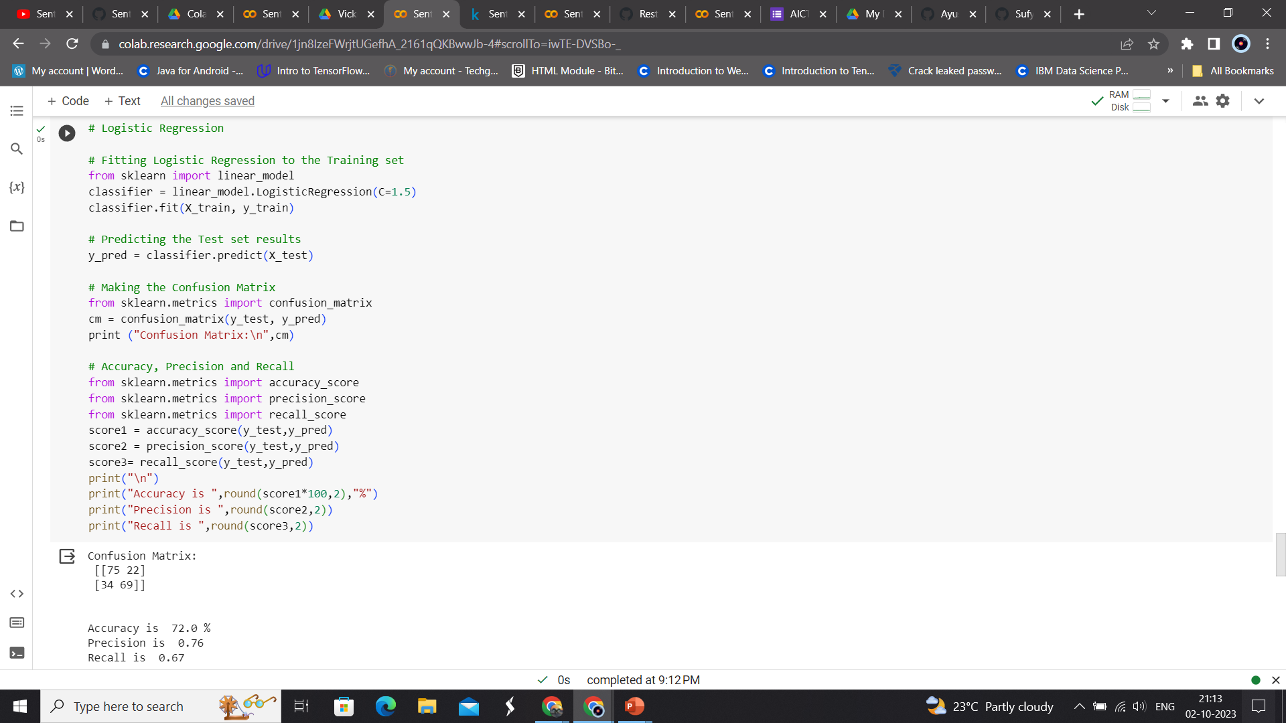
Logistic Regression

Slide 15
Results
Using Multinomial Naive Bayes,
Recall of prediction is 0.78.
Using Logistic Regression,
From the results, Multinomial Naive Bayes is slightly better method compared to Bernoulli Naive Bayes and Logistic Regression, with 77.67% accuracy which means the model built for the prediction of sentiment of the restaurant review gives 77.67% right prediction.
Accuracy of prediction is 77.67%.
Precision of prediction is 0.76.
Accuracy of prediction is 76.67%.
Precision of prediction is 0.78.
Accuracy of prediction is 77.0%.
Precision of prediction is 0.8.
Recall of prediction is 0.77.
Using Bernoulli Naive Bayes,
Recall of prediction is 0.71.

Slide 16
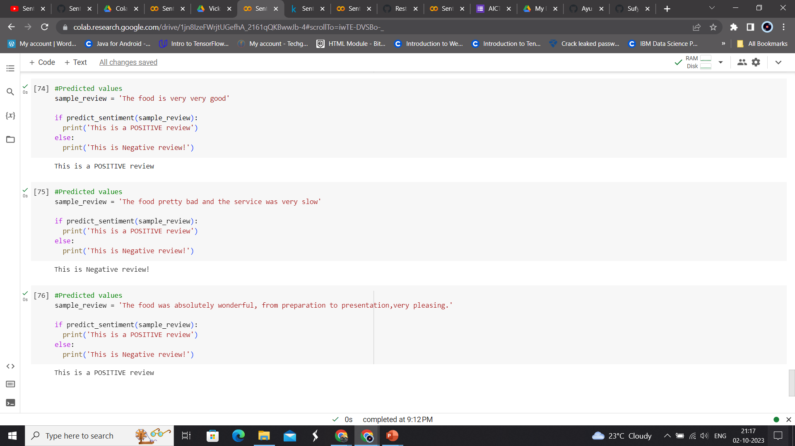
Final Outcome on reviews

Slide 17


links
Google Collab
Click on shape to open link
Click on shape to open link

