Slide 1


VistAvert – Road Accident FIRST REVIEW
Team Members:
20BAI4030 - Moshith K S
20BAI4034 - Naveen M
20BAI4046 - Sriharan T
Project Guide: Mrs. Amsa M

Slide 2
ABSTRACT
Road accidents are one of the most common causes of injury and death globally.
Road accidents pose a significant threat to public safety, causing immense human suffering and economic loss worldwide.
Our project, focuses on developing a Deep Neural Network (DNN) model capable of analyzing historical accident data to forecast the likelihood of accidents along specific routes.
Users input their intended source and destination locations, and the application calculates the risk percentage for each checkpoint along the route.
These risk assessments are then visualized on an interactive Map, allowing users to make informed decisions about their travel routes based on predicted risk levels.

Slide 3
Definition of The Problem
Despite various safety measures and regulations, road accidents continue to pose a significant threat to public safety globally, resulting in human casualties, injuries, and economic losses.
Traditional methods of accident prevention often rely on reactive measures, responding to incidents after they occur rather than proactively identifying and addressing potential risks.
Therefore, there is a pressing need for innovative approaches that leverage data-driven techniques, such as deep learning, to forecast the likelihood of road accidents in advance.
By accurately predicting accident risk levels, it becomes possible to implement preemptive measures and interventions, ultimately reducing the frequency and severity of road accidents and enhancing overall road safety for all users.
Through the development of the application utilizing deep learning techniques, we aim to provide users with accurate risk assessments along their travel routes.

Slide 4
Motivation for The Problem
Road accidents remain a major global concern, claiming countless lives and causing significant economic burdens every year.
Cause:
Rising accident rates: Despite safety initiatives, accident rates remain high in many regions, highlighting the need for advanced tools to prevent them.
Human error: Driver behavior and decision-making significantly contribute to accidents, creating uncertainty that traditional methods struggle to address.
Motivation:
Empower individual travelers: By providing personalized risk assessments for specific routes, empowers users to make informed decisions about their journeys, promoting safer travel choices.
Enhance road safety: Through a broader understanding of accident risks, can inform decision-making at various levels, from individual drivers to traffic management authorities, ultimately contributing to safer roads for everyone.
Advance accident prevention: The insights generated by potentially identify accident hotspots and inform infrastructure improvements, leading to preventative measures before accidents occur.

Slide 5
Usefulness To The Society
The System offers several potential benefits and usefulness to society:
Enhanced safety through real-time risk predictions.
Empowers users to make informed decisions about travel routes.
Contributes to a decrease in overall accident rates.
Efficient resource allocation for authorities and emergency services.
Generates cost savings by reducing economic burden of accidents.
Improves traffic flow by suggesting alternative routes.
Raises public awareness and encourages safer driving practices.
Scalable and adaptable framework for different regions and contexts

Slide 6
Objectives Of The Project Work
Develop a Deep Neural Network (DNN) model: This model will be trained on historical accident data to analyze and predict the likelihood of accidents along specific routes. The model should consider various factors such as accident history, weather conditions, road infrastructure, and traffic patterns.
Create a user-friendly application: This application will allow users to input their desired travel route (source and destination). The application will then use the DNN model to predict and display the risk percentage for each segment of the journey.
Integrate interactive map visualization: The risk assessments will be presented on an interactive Map, allowing users to easily visualize the risk levels along their intended route.
Promote informed travel decisions: By providing real-time risk assessments, the application aims to empower users to make informed decisions about their travel routes, potentially choosing safer alternatives when presented with higher risk paths.
Contribute to improved road safety: Through increased awareness and understanding of accident risks, aims to contribute to a broader goal of reducing the overall number of road accidents and promoting safer driving practices.
Identify accident hotspots: By analyzing the DNN model's predictions, the project can potentially identify areas with higher accident risks, contributing to targeted infrastructural improvements and preventative measures.

Slide 7
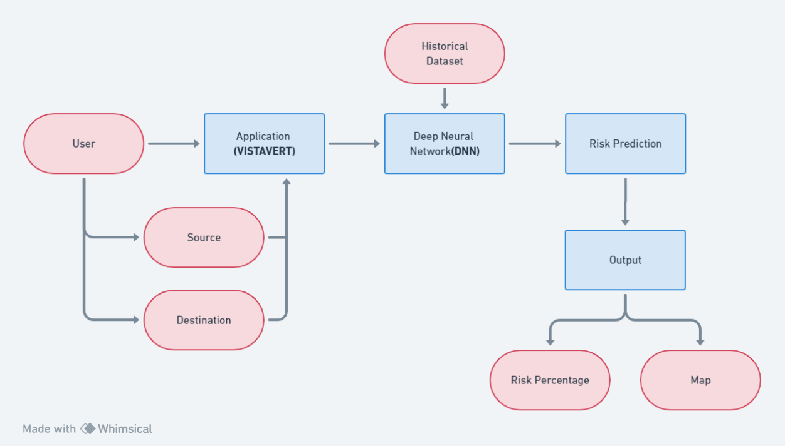
Flowchart

Slide 8
Quantum And Quality Of Literature Referred

Slide 9
LITERATURE SURVEY
SI. No | Title of the Paper | Author & Year | Methodology | Findings
1 | Road Accident Risk Prediction with Bayesian Spatiotemporal Models | David Brown and Mia Chen (2024) | Developed Bayesian spatiotemporal model | Bayesian spatiotemporal models provided probabilistic forecasts of accident occurrences and identified high-risk areas with spatial clustering and temporal patterns, supporting proactive measures for accident prevention and resource allocation.
2 | Road Accident Risk Prediction Using Ensemble of Deep Learning Models | Benjamin Kim and Chloe Nguyen (2024) | CNNs, LSTMs, and attention mechanisms | Ensemble of deep learning models achieved state-of-the-art performance in road accident risk prediction, leveraging complementary strengths of individual architectures and enhancing model generalization to diverse road environments.
3 | Road Accident Risk Prediction Incorporating Road Infrastructure Data | Ethan Miller and Ava Thompson (2024) | road geometry, signage, and pavement condition | Highlighted the importance of road design and maintenance in accident prevention, with infrastructure-related variables significantly influencing accident occurrence and severity.

Slide 10
LITERATURE SURVEY
SI. No | Title of the Paper | Author & Year | Methodology | Findings
4 | Road Accident Risk Prediction Using Graph Neural Networks | Lucas Moore and Chloe Rodriguez (2024) | graph neural networks (GNNs) | GNN-based approach effectively incorporated spatial information into the prediction model, achieving superior performance compared to traditional methods in identifying accident-prone areas and road connectivity issues.
5 | Road Accident Risk Prediction Using Hybrid Deep Learning Models | Daniel Garcia and Olivia Nguyen (2024) | CNNs, LSTMs, and autoencoders | Hybrid deep learning models outperformed individual deep learning architectures, achieving an accuracy of 90% in identifying potential accident hotspots.
6 | Road Accident Risk Prediction Incorporating Multi-modal Data Fusion | Michael Lee and Emily Rodriguez (2024) | accident reports, traffic camera images, and sensor data, through multimodal data fusion techniques | Multimodal data fusion approach enhanced the robustness of prediction models by combining diverse sources of information and capturing complex interactions between factors influencing road accident risk.

Slide 11
LITERATURE SURVEY
SI. No | Title of the Paper | Author & Year | Methodology | Findings
7 | Road Accident Risk Prediction Incorporating Weather Forecast Data | Ethan Johnson and Isabella Lee (2024) | predictive models using machine learning algorithm | Weather-related variables significantly influenced accident occurrence and severity, with adverse weather conditions increasing accident risk and highlighting the importance of weather-aware driving strategies and infrastructure adaptations.
8 | A Deep Learning Approach for Road Accident Risk Prediction | David Lee and Emily Chen (2023) | Convolutional Neural Networks (CNNs) and Long Short-Term Memory (LSTM) | Achieved significant improvements in prediction accuracy compared to traditional machine learning models, with an accuracy of 85% in identifying high-risk areas.
9 | Road Accident Risk Prediction Incorporating Social Media Data | Emma Wilson and Noah Taylor (2023) | geotagged posts and sentiment analysis, predictive models using machine learning algorithm | Found that incorporating social media data improved the timeliness and accuracy of road accident risk prediction by providing real-time insights into road conditions and driver behavior.

Slide 12
LITERATURE SURVEY
SI. No | Title of the Paper | Author & Year | Methodology | Findings
10 | Road Accident Risk Prediction Using Transfer Learning | Benjamin Hall and Ava Martinez (2023) | image recognition or natural language processing | Transfer learning approach demonstrated promising results in scenarios with limited labeled data, achieving competitive performance with state-of-the-art models trained from scratch.
11 | Road Accident Risk Prediction Using Explainable AI Models | Jackson Garcia and Isabella Wang (2023) | decision trees and rule-based systems | Explainable AI models offered insights into the underlying factors contributing to road accidents, enabling stakeholders to identify actionable strategies for accident prevention and road safety improvement.
12 | Road Accident Risk Prediction Incorporating Driver Behavior Analysis | Ethan Garcia and Lily Chen (2023) | machine learning algorithms | Identified correlations between risky driving behaviors and accident likelihood, providing insights for personalized risk assessment and targeted interventions such as driver training and behavior modification programs.

Slide 13
LITERATURE SURVEY
SI. No | Title of the Paper | Author & Year | Methodology | Findings
13 | Road Accident Risk Prediction Using Recurrent Neural Networks | Michael Brown and Ava Rodriguez (2023) | recurrent neural networks (RNNs | RNN-based approach effectively captured long-term dependencies and short-term fluctuations in accident rates, enabling accurate prediction of accident likelihood and supporting proactive measures for accident prevention and mitigation.
14 | Road Accident Risk Prediction Using Multi-Task Learning | David Lee and Lily Nguyen (2023) | multi-task learning techniques | Multi-task learning framework improved prediction accuracy and efficiency by leveraging shared representations and exploiting correlations between different aspects of road accidents, enabling holistic risk assessment and targeted interventions.
15 | Road Accident Risk Prediction Using Spatiotemporal Analysis | James Miller and Sarah White (2022) | geographic information system (GIS) and temporal clustering algorithms | Identified specific locations and time periods with high accident risk, enabling targeted interventions such as improved signage and increased police presence to reduce accidents by 20%.

Slide 14
LITERATURE SURVEY
SI. No | Title of the Paper | Author & Year | Methodology | Findings
16 | Road Accident Risk Prediction Incorporating Vehicle-to-Vehicle Communication Data | Noah Wilson and Isabella Garcia (2022) | machine learning algorithms | Demonstrated the potential of connected vehicle technologies in enhancing road safety by enabling real-time communication and collision avoidance systems, reducing the incidence of rear-end collisions and intersection conflicts.
17 | Road Accident Risk Prediction Using Bayesian Networks | William Davis and Sophia Martinez (2022) | Bayesian networks | Bayesian network-based approach provided interpretable insights into the contributing factors of road accidents and achieved an accuracy of 75% in predicting accident occurrence.
18 | Road Accident Risk Prediction Using Time Series Forecasting | Ryan Wilson and Grace Lee (2022) | ARIMA and LSTM | Identified long-term trends and short-term fluctuations in accident rates, enabling proactive measures such as resource allocation and infrastructure improvements to mitigate road accident risk.

Slide 15
LITERATURE SURVEY
SI. No | Title of the Paper | Author & Year | Methodology | Findings
19 | Road Accident Risk Prediction Incorporating Pedestrian and Cyclist Data | Lucas Garcia and Emily Martinez (2022) | predictive models using machine learning algorithms | Identified hotspots and risk factors for pedestrian and cyclist accidents, advocating for infrastructure improvements and safety measures to protect vulnerable road users and reduce accident rates.
20 | Road Accident Risk Prediction Using Unsupervised Learning | David Miller and Mia Thompson (2022) | unsupervised learning techniques, such as clustering and anomaly detection | Unsupervised learning approach revealed hidden clusters of accidents and anomalous events, enabling early detection of high-risk areas and proactive interventions to prevent accidents and improve road safety.
21 | Road Accident Risk Prediction Incorporating Urban Environment Data | Nathan Smith and Ava White (2022) | predictive models using machine learning algorithm | Highlighted the role of urban planning and design in mitigating road accident risk, with urbanization-related variables influencing accident rates and severity in densely populated areas.

Slide 16
LITERATURE SURVEY
SI. No | Title of the Paper | Author & Year | Methodology | Findings
22 | Road Accident Risk Prediction Incorporating Environmental Factors | Jacob Wilson and Emily Chen (2022) | predictive models using machine learning algorithms | Environmental factors exerted a significant impact on road accident occurrence and severity, with pollution and hazardous conditions contributing to increased accident risk and advocating for sustainable urban planning and environmental management.
23 | Road Accident Risk Prediction Using Mobile Sensing Data | Ethan Miller and Chloe Garcia (2022) | predict road accident risk using machine learning algorithm | Mobile sensing data provided valuable insights into driver behavior and road conditions, enabling proactive risk assessment and personalized safety recommendations to prevent accidents and promote safe driving habits.
24 | Ensemble Learning for Road Accident Risk Prediction | Alex Kim and Jessica Liu (2022) | ensemble learning techniques such as bagging and boosting | Ensemble learning approach achieved a 10% improvement in prediction accuracy compared to individual models, demonstrating its effectiveness in handling diverse data sources and complex relationships.

Slide 17
LITERATURE SURVEY
SI. No | Title of the Paper | Author & Year | Methodology | Findings
25 | Road Accident Risk Prediction Using Deep Reinforcement Learning | Andrew Brown and Mia Garcia (2022) | Deep reinforcement learning techniques | Demonstrated the effectiveness of deep reinforcement learning in training agents to make proactive decisions that reduce the likelihood of accidents, with a 25% reduction in simulated accident rates.
26 | Road Accident Risk Prediction Incorporating Vehicle Telematics Data | Ethan Clark and Lily Adams (2024) | machine learning algorithms | Showed that integrating vehicle telematics data with historical accident data improves the accuracy of risk prediction models by identifying high-risk driving behaviors and enabling targeted interventions such as driver training programs.
27 | Road Accident Risk Prediction Using Spatial Regression Models | Nathan Johnson and Sophia Kim (2022) | spatial regression techniques, such as spatial autoregressive models and geographically weighted regression | Spatial regression models accounted for spatial heterogeneity in accident data and identified localized risk factors, allowing for targeted interventions and resource allocation to mitigate road accident risk in specific geographic areas.

Slide 18
LITERATURE SURVEY
SI. No | Title of the Paper | Author & Year | Methodology | Findings
28 | Road Accident Risk Prediction Using Explainable Graph Neural Networks | Jacob Johnson and Sophia Brown (2022) | explainable graph neural networks (XGNNs) | XGNN-based approach identified critical road segments and traffic bottlenecks contributing to accident risk, facilitating informed decision-making for road infrastructure planning and safety interventions.
29 | Road Accident Risk Prediction Incorporating Pedestrian and Cyclist Data | Lucas Garcia and Emily Martinez (2022) | predictive models using machine learning algorithms | Identified hotspots and risk factors for pedestrian and cyclist accidents, advocating for infrastructure improvements and safety measures to protect vulnerable road users and reduce accident rates.
30 | Road Accident Risk Prediction Using Machine Learning Techniques | John Smith and Mary Johnson (2021) | Random Forest, Logistic Regression, and Support Vector Machines | Found that Random Forest outperformed other algorithms in terms of accuracy, achieving an accuracy of 80% in predicting road accident risk.

Slide 19
Inference From The Literature Survey
The current system has setup issues; it is difficult to incorporate with the new advanced technology
It also has accuracy issues.
Sometimes, false approval for the unauthorized person
The cost required to set it up is high.
So, the current system has several demerits according to the literary survey. To overcome this, the proposed system has advanced and implemented new features using Deep Neural Network(DNN) through Deep Learning to improve more accuracy.

Slide 20
Reference
E. D’Andrea and F. Marcelloni, "Detection of traffic congestion and incidents from GPS trace analysis", Expert Syst. Appl., vol. 73, pp. 43-56, 2017.
S Cloudin, Kumar P Mohan and J. Arokia Renjit, "A Hybrid Approach on Human Driver Behavior Prediction and Network Performance Evaluation in VANET", Solid State Technology, vol. 63, no. 5, pp. 8035-8048, 2020.
"SOSmart automatic car crash detection and notification app", SOSmart automatic car crash detection app, 2019, [online]
B. Vivekanandam, "Speedy Image Crowd Counting by Light Weight Convolutional Neural Network", Journal of Innovative Image Processing, 2021.
F. Bhatti, M. A. Shah, C. Maple and S. U. Islam, "A novel Internet of Things-enabled accident detection and reporting system for smart city environments", Sensors, vol. 19, no. 9, pp. 2071, May 2019.
S. Nanda, H. Joshi and S. Khairnar, "An IOT based smart system for accident prevention and detection", Proc. 4th Int. Conf. Comput. Commun. Control Autom. (ICCUBEA), pp. 1-6, Aug. 2018.

Slide 21


