Slide 1
International Regulation for Preventing Collision at Sea, 1972
（COLREG 72 ）
1972年国际海上避碰规则

Slide 2
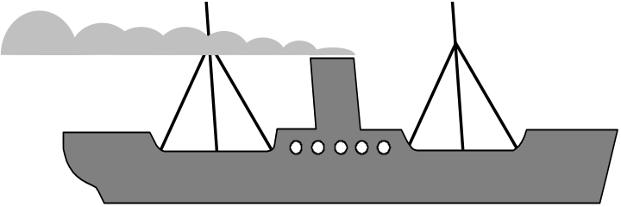
Structure of COLREG 72
5 Parts （章）
38 Rules （条）
4 Annex （附录）

Slide 3
Part A: General (总则）
Part B: Steering and Sailing Rules
（驾驶与航行规则）
Part C: Lights and Shapes
（号灯与号型）
Part D: Sound and Lights Signals
（灯光与声响信号）
Part E: Exemptions （豁免）

Slide 4
PART A GENERAL
第一章 总 则
（Three Rules Rule 1-3)
（共有三条规则 第1-3条）
RULE１： Application
第一条：适用范围
RULE２： Responsibilities
第二条：责任
RULE３： General Definitions
第三条：一般定义

Slide 5
PART B - STEERING AND SAILING RULES
第二章 驾驶与航行规则
SECTION 1: 第一节 任何能见度情况下的行动
Conduct of Vessels in any Condition of Visibility
SECTION II: 第二节 船舶在互见中的行动
Conduct of Vessels in Sight of One Another
SECTION III: 第三节 能见度不良时的行动
Conduct of Vessels in Restricted Visibility

Slide 6
SECTION I - Conduct of Vessels in any Condition of Visibility
第一节 船舶在任何能见度情况下的行动
Rule 4 : Application 适用范围
Rule 5 : Look-out 了望
Rule 6 : Safe Speed 安全航速.
Rule 7 : Risk of Collision 碰撞危险.
Rule 8 : Action to avoid Collision 避免碰撞的行动.
Rule 9 : Narrow Channels 狭水道
Rule 10 : Traffic Separation Schemes 分道通航制.

Slide 7
SECTION II - Conduct of Vessels in Sight of One Another
第二节 船舶在互见中的行动
Rule 11 : Application 适用范围
Rule 12 : Sailing Vessels 帆船
Rule 13 : Overtaking 追越
Rule 14 : Head-on Situation 对遇局面
Rule 15 : Crossing Situation 交叉局面
Rule 16 : Action by Give-way Vessel 让路船的行动
Rule 17 : Action by Stand-on Vessel 直航船的行动
Rule 18 : Responsibilities between Vessels
船舶之间的责任

Slide 8
SECTION III - Conduct of Vessels in Restricted Visibility
第三节 能见度不良时的行动
Rule 19 : Conduct of Vessels in Restricted Visibility.
船舶在能见度不良时的行动

Slide 9
PART C - LIGHTS AND SHAPES
Rule 20 : Application 适用范围
Rule 21 : Definitions 定义
Rule 22 : Visibility of Lights 号灯可见距离
Rule 23 : Power-driven Vessels underway
在航机动船
Rule 24 : Towing and Pushing.拖带和顶推
Rule 25 : Sailing Vessels underway and Vessels
under Oars.在航帆船和划桨船

Slide 10
Rule 26 : Fishing Vessels 渔船
Rule 27 : Vessels not under Command or Restricted in their Ability to Manoeuvre
失控船和操纵能力受到限制的船
Rule 28 : Vessels constrained by their Draught
限于吃水的船舶
Rule 29 : Pilot Vessels. 引航船
Rule 30 : Anchored Vessels and Vessels aground
锚泊船和搁浅船
Rule 31 : Seaplanes 水上飞机

Slide 11
PART D :
Sound and Light Signals
Rule 32: Definitions 定义
Rule 33: Equipment for Sound Signals声响设备
Rule 34 : Manoeuvring and Warning Signals
操纵与警告信号
Rule 35 : Sound Signals in Restricted Visibility
能见度不良时的声响信号
Rule 36 : Signals to Attract Attention招引注意的信号
Rule 37 : Distress Signals 遇险信号

Slide 12
PART E:
EXEMPTIONS
Rule 38
Exemptions

Slide 13
Rule１ Application
( Including Five Items)
第一条 适用范围
( 共有5 款)

Slide 14
Applied vessels and waters
适用的船舶与水域
（a）These rules shall apply to all vessels upon the high seas and in all waters connected therewith navigable by seagoing vessels.
(本规则适用于在公海和连接公海而可供海船航行的一切水域中的一切船舶)

Slide 15
Special rules made by authority
主管机构指定的特殊规则
(b) Nothing in these Rules shall interfere with the operation of special rules made by an appropriate authority for roadsteads, harbour, river, lakes and inland waterways connected with the high seas and navigable by seagoing vessel. Such special rules shall conform as closely as possible to these Rules. 本规则各条，不妨碍有关主管机关为连接公海而可供海船航行的一切水域的任何港外锚地、港口、江河、湖泊及内陆水道制定的特殊规定的实施。这些特殊规定，应尽可能符合本规则各条

Slide 16
Special rules made by Government
政府指定的特殊规则
(c) Nothing in these Rules shall interfere with the operation of special rules made by the with respect to additional station or signal lights, shapes or whistle signals for ships of war and vessels proceeding under convoy, or with respect with to additional station or signal lights, shapes for fishing vessels engaged in fishing as a fleet. These additional station or signal lights, shapes or whistle signals shall, as far as possible, be such that they cannot be mistaken for any light, shape or signal authorized elsewhere under these Rules.

Slide 17
本规则各条，不妨碍各国政府为军舰及护航下的船舶所制定的关于额外的队形灯、信号灯、号型或笛号、或者为结对从事捕鱼的渔船所制定的关于额外的队形灯、信号灯或号型的任何特殊规定的实施。这些额外的队形灯、信号灯、号型及号笛，尽可能不致被误认为本规则其他条文所规定的任何号灯、号型或信号。

Slide 18
TSS Adopted by IMO
IMO 采纳的TSS
(d) Traffic Separation Schemes may be adopted by the Organization for the purpose of these Rules.
（为了实施本规则，本组织可以采纳分道通航制）

Slide 19
Special Structure and Purpose Vessel
特殊结构 和用途的船舶
(e) Whenever the Government concerned shall have determined that a vessel of special construction or purpose cannot comply fully with the provisions of any of these Rules with respect to the number, position, range or arc of visibility of lights or shapes, as well as to the disposition and characteristics of sound-signaling appliances(to be continued),

Slide 20
such vessel shall comply with such other provisions in regard to the number, position, range or arc of visibility of lights or shapes, as well as to the disposition and characteristics of sound-signaling appliances, as her Government shall have determined to be the closest possible compliance with these Rules in respect of that vessel.

Slide 21
凡经有关政府确定，某种特殊结构或用途的船舶，如不能完全遵守本规则任何一条关于号灯或号型的数量、位置、能见距离或弧度以及声号设备的配置和特性的规定时，则应遵守其政府在号灯或号型的数量、位置、能见距离或弧度以及声号设备的配置和特性方面为之另行确定的尽可能符合本规则的规定。

Slide 22
Rule 2 Responsibility
(Including 2 items)
第二条 责任
(共有2款)

Slide 23
Neglect Clause 过失条款
(a) Nothing in these Rules shall exonerate any vessel, or the owner, master or crew thereof, from the consequences of any neglect to comply with these Rules or of the neglect of any precaution which may be required by the ordinary practice of seamen, or by the special circumstances of the case.
１. 本规各条则并不免除任何船舶或其所有人、船长或是船员由于对遵守本规则各条的任何疏忽,或者对海员通常做法或当时特殊情况可能要求的任何戒备上的疏忽而产生的各种后果的责任。

Slide 24
Neglect Clause 过失条款
(b) In construing and complying with these Rules due regard shall be had to all dangers of navigation and collision and to any special circumstances，including the limitations of the vessels involved, which may make a departure from these Rules necessary to avoid immediate danger.
２. 在解释和遵行本规则各条规定时, 应充分考虑 一切航行和碰撞的危险以及包括当时船舶条件限制在内的任何特殊情况，这些危险和特殊情况可能需要背离本规则条款以避免紧迫危险。

Slide 25
Rule 3
第三条
General Definitions
一般定义

Slide 26
(a) The word “vessel” includes every description of water craft, including non-displacement craft, WIG craft and seaplane, used or capable of being used as a means of transportation on water
1.“船舶”一词指用作或能够用作水上运输工具的船筏, 包括非排水船舶、地效翼船和水上飞机。

Slide 27
(b) The term “power-driven vessel ” means any vessel propelled by machinery.
 “机动船”是指用机器推进的任何船舶, 包括装有机器并正在使用机器作推进动力的帆船。

Slide 28
(c)The term “sailing vessel” means any vessel under sail provided that propelling machinery,if fitted, is not being used.
“帆船” 是指任何驶帆的船舶，包括装有推进器而不在使用者。

Slide 29
(d) The term “vessel engaged in fishing ” means any vessel fishing with nets, lines,trawler or other fishing apparatus which restrict maneuverability, but does not include a vessel fishing with trolling lines or other fishing apparatus which do not restrict manoevurability.
“从事捕鱼的船舶”是指使用网具、绳钓、拖网或其他使其操纵性能受到限制的任何船舶,但并不包括使用曳绳钓或其他并不使其操纵性能受到限制的渔具捕渔的船舶。

Slide 30
(e) The word “seaplane” includes any aircraft designed to manoeuvre on the water . 
“水上飞机”是指为能在水面操纵而设计的任何航空器（飞机、飞艇、水陆两栖型）

Slide 31
(f) The term “vessel not under command” means a vessel which through some exceptional circumstance is unable to manoevure as required by these rules and is therefore unable to keep out of way of another vessel.
“失去控制的船舶”是指由于某种异常的情况，不能按规则各条的要求进行操纵，因而不能给他船让路的船舶。

Slide 32
(g) The term “vessel restricted in her ability to manoeuvre” means a vessel which from the nature of her work is restricted in her ability to manoeuvre as requires by these rules and is therefore unable to keep out of way of another vessel.
 “操纵能力受到限制的船舶” 是指由于工作性质，使其按规则要求进行操纵的能力受到限制, 因而不能给他船让路的船舶。

Slide 33
(h)The term “vessel constrained by her draught” means a power-driven vessel which because of her draught in relation to the available depth and width of navigable water is severely restricted in her ability to deviate from the course she is following.
“限于吃水的船舶”是指由于吃水与可航水域的深度和宽度的关系，致使其驶离所驶航向的能力严重受到限制的机动船

Slide 34
(i) The word “underway ” means that vessel is not at anchor, or made fast to the shore, or aground.
“在航” 是指船舶不在锚泊、系岸和搁浅。

Slide 35
(j) The word “length” and “Breadth” of a vessel mean her length overall and greatest breadth.
船舶的“长度” 和“宽度” 是指船舶的总长度和最大宽度。

Slide 36
(k) Vessel shall be deemed to be “in sight of one another ” only when one can be observed visually from the other.
“互见”是指只有当一船能自他船以视觉看到时，才认为两船是在互见中。

Slide 37
(l) The term “restricted visibility ” means any condition in which visibility is restricted by fog, mist, falling snow, heavy rainstorms, sandstorms or any other similar causes.
“能见度不良”指任何由于雾、下雪、暴风雨、霾、沙暴或其他原因而使能见度受到限制的情况.其他原因包括：城市的烟雾与尘埃。

Slide 38
(m) The term " Wing-In-Ground craft" means a multi-modal craft which, in its main operational mode, files in close proximity to surface by utilizing surface-effect action.
13．“地效翼船”一词系指多式船艇，其主要操作方式是利用表面效应贴近水面飞行。

Slide 39

Part B (第二章）
Steering and Sailing Rules
驾驶和航行规则

Slide 40
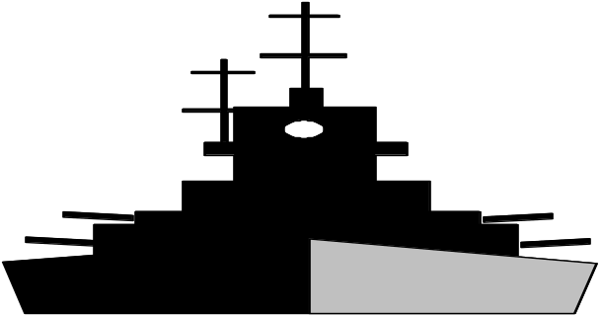
SECTION 1
( 第一节）
Conduct of Vessel in Any
Condition of Visibility
（船舶在任何能见度情况下的行动规则)

Slide 41
Rule 4 Application
(第四条 适用范围）
Rules in this section apply in any condition of visibility.
本节各条适用于任何能见度的情况

Slide 42
Rule Five
Look-out
(第五条 了望）

Slide 43
Every vessel shall at all times maintain a proper look-out by sight and hearing as well as by all available means appropriate in the prevailing circumstances and conditions so as to make a full appraisal of the situation and of the risk of collision.
每一船舶任何时侯应采用视觉、听见以及适合当时环境和情况下一切有效的手段保持正规的了望，以便对局面和碰撞危险做出充分的估计。

Slide 44

Rule Five
Safe Speed
(第五条 安全航速）

Slide 45
Every vessel shall at all times proceed at a safe speed so that she can take proper and effective action to avoid collision and be stopped within a distance appropriate to the prevailing circumstances and conditions.
每一船舶在任何时侯均应用安全航速，以便能采取适当而有效的避碰让行动，并能在适合当时环境和条件的距离内把船停住。

Slide 46
Factors in determining a safe speed （决定安全航速因素）
１. By all vessels ：
(1) the state of visibility 能见度
(2) the traffic density including concentrations of fishing vessels or any other vessels 通航密度
(3) the manoeuvrability of the vessels with special reference to stopping distance and turning ability in the prevailing conditions）
本船操纵性能

Slide 47
(4) at night the presence of background light such as from shore lights or from the back scatter of her own lights 灯光背景
(5) the state of wind, sea and current and proximity of navigation hazards
风、海浪和障航物
(6) the draught in relation to the available depth of water
船舶吃水

Slide 48
2. By vessels with operational radar
(1) the characteristics, efficiency and limitations of radar equipment 雷达特性效率与局限性
(2) any constraints imposed by the radar range scale in use 雷达量程限制
（3) the effects on radar detection of the sea state, weather and other sources of interference 海况气象和其他影响源

Slide 49
(4) the possibility that small vessels, ice and other floating objects, may be not detected by radar at an adequate range 在适当的距离内可能探测不到的小船、浮冰和其他漂浮物
(5) the number, location and movement of vessels detected by radar 雷达探测到的船舶数量、位置和动态
(6) the more exact assessment of visibility that may be possible when radar is used to determine the range of vessels or other objects in the vicinity 通过刚看到和突然消失物标来判断可见距离

Slide 50
Rule Seven
Risk of Collision
（碰撞危险）
（Rule 7 including 4 items）
（第七条共包括4款）

Slide 51
(a) Every vessel shall use all available means appropriate to the prevailing circumstances and condition to determine if risk of collision exists. If there is any doubt such risk shall be deemed to exist.
１. 每一船舶应用适合当时环境和条件的一切手段断定是否存在碰撞危险, 如有怀疑则应认为存在这种危险。

Slide 52
(b) Proper use shall be made of radar equipment if fitted and operational, including long-range scanning to obtain early warning of risk of collision and radar plotting or equivalent systematic observation of detected objects.
２. 如装有雷达设备并可使用的话，则应正确予以使用，包括远距离扫瞄，以便获得碰撞危险的早期警报，并对探测到的物标进行雷达标绘或与其相当的系统观察。

Slide 53
(c) Assumptions shall not be made on the basis of scanty information, especially scanty radar information.
３.不应当根据不充分的资料,特别是不充分的雷达观测资料做出推断
(d) In determining if risk of collision exists the following consideration shall be among those taken into account:
4. 在断定是否存在碰撞危险时, 考虑的因素应包括以下各点:

Slide 54
(i) such risk shall be deemed to exist if the compass bearing of an approaching vessel does not appreciably change;
1)如果来船的罗经方位没有什么变化, 则应认为存在这种危险;
(ii) such risk may sometimes exist even when an appreciable bearing change is evident, particularly when approaching a very large vessel or a tow or when approaching a vessel at a close range.
2)即使有明显的方位变化, 有时也存在这种危险, 特别是在驶近一艘很大的船舶或拖带船组时,或是近距离驶近它船时。

Slide 55
Rule Eight
Action to avoid collision
避免碰撞危险的行动
（Rule 8 including 6 items）
(第七条共包括6款)

Slide 56
(a) Any action taken to avoid collision shall be taken in accordance with the Rules of this part and shall, if the circumstances of the case admit, be positive, made in ample time and with due regard to the observance of good seamanship.
1. 应根据本章各条采取避免碰撞所采取的任何行动，如当时环境许可，应是积极地、并应及早地进行和注意运用良好的船艺。

Slide 57
(b) Any alteration of course and/or speed to avoid collision shall, if the circumstances of the case admit, be large enough to be readily apparent to another vessel observing visually or by radar; a succession of small alteration of course and/or speed should be avoided.
2. 为避免碰撞而作的航向和（或）航速的任何变动，如当时环境许可，应大得足以使他船用视觉和雷达观察时容易察觉到，应避免对航向和（或）航速作一连串的小变动。

Slide 58
.
(c) If there is sufficient sea room, alteration of course alone may be the most effective action to avoid a close-quarters situation provided that it is made in good time, is substantial and does not result in another close-quarters situation.
3.如有足够的水域，则单用转向可能是避免紧迫局面的最有效行动，倘若这种行动是及时的、大幅度的并且不致造成另一紧迫局面。

Slide 59
(d) Action taken to avoid collision with another vessel shall be such as to result in passing at a safe distance. The effectiveness of the action shall be carefully checked until the other vessel is finally pass and clear.
4. 为避免与他船碰撞而所采取的行动，应能导致在安全距离驶过。应细心查核避让行动的有效性，直到最后驶过让清为止。

Slide 60
(e) If necessary to avoid collision or allow more time to assess the situation, a vessel shall slacken her speed or take all her way off by stopping or reversing her means of propulsion.
5. 如须避免碰撞或须留有更多时间来估计局面，船舶应当减速或者停止或倒转推进器把船停住。

Slide 61
(f) (i) A vessel which, by any of these rules, is required not to impede the passage or safe passage of another vessel shall, when required by the circumstances of the case, take early action to allow sufficient sea room for the passage of the other vessel.
6.(1) 据本规则的任何规定，要求不得妨碍另一艘船舶的通过或安全通过的船舶应根据当时环境的需要及早采取行动以留出足够的水域供其他船舶安全通过。

Slide 62
(ii) A vessel required not to impede the passage or safe passage of another vessel is not relieved of his obligation if approaching the other vessel so as to involve risk of collision and shall, when taking action, have full regard to the action which may be required by the rules of this part.
(2) 如果在接近其他船舶致有碰撞危险时，被要求不得妨碍另一艘船舶的通过或安全通过的船舶并不解除这一责任，在采取行动时，应充分考虑到本章各条可能要求的行动。

Slide 63
(iii) A vessel the passage of which is not to be impeded remains fully obliged to comply with the rules of this part when two vessels are approaching one another so as to involve risk of collision.
(3) 当两船相互接致有碰撞危险时，其通过不得被妨碍的船舶仍有完全遵守本章各条规定的责任。

Slide 64
Unit Six
Narrow Channel
狭水道

Slide 65
(a) A vessel proceeding along the course of narrow channel or fairway shall keep as near to the outer limit of the channel of fairway which lies on her starboard side as is safe and practicable.
1. 船舶沿狭水道或航道行使时，只要安全可行，应尽量靠近本船右舷的该水道或航道的外缘行驶。

Slide 66
(b) A vessel of less than 20 meters in length or a sailing vessel shall not impede the passage of a vessel which can safely navigate only within a narrow channel or fairway.
2.帆船或者长度小于20米的船舶，不应妨碍只能在狭水道和航道内安全航行的船舶通行。

Slide 67
(c) A vessel engaged in fishing shall not impede the passage of any other vessel in navigating only within a narrow channel or fairway.
3.从事捕鱼的船舶，不应妨碍任何其他在狭水道或航道以内航行的船舶通行。

Slide 68
(d) A vessel shall not cross a narrow channel or fairway if such crossing impedes the passage of a vessel which can safely navigate only within such channel or fairway. The latter vessel may use the sound signal prescribed in Rule 34(d) if in doubt as to the intention of the crossing vessel.
4.船舶不应穿越狭水道或航道，如果这种穿越会妨碍只能在这种水道或航道以内航行的船舶通行。后者若对穿越船的意图有怀疑时，可以使用第三十四条4款所规定的相应声号。

Slide 69
(e) (i) In a narrow channel or fairway when overtaking can take place only if the vessel to be overtaken has to take action to permit safe passing, the vessel intending to overtaking shall indicate her intention by sounding the appropriate signal prescribed in Rule 34(C)(i).
5.(1) 在狭水道或航道内，如只有在被追越船必须采取行动以允许安全通过才能追越时，则企图追越的船，应鸣放第三十四条第3款(1)项所规定的相应声号，以表示本船的意图

Slide 70
The vessel to be overtaken shall, if in agreement sound the appropriate signal prescribed in Rule 34(C)(ii) and take steps to permit safe pass. If in doubt she may sound the signals prescribed in Rule 34(d).
被追越船如果同意，应鸣放第三十四条3款(2)项所规定的相应声号、并采取使之能安全通过的措施。如有怀疑，则可以鸣放第三十四条4款所规定的声号。

Slide 71
(e) (ii) This Rule does not relieve the overtaking vessel of her obligation under Rule 13.
5.(2) 本条并不解除追越船根据第十三条所负的义务。

Slide 72
(f) A vessel nearing a bend or an area of a narrow channel or fairway where other vessels may be obscured by an intervening obstruction shall navigate with particular alertness and caution and shall sound the appropriate signal prescribed in Rule 34(e).
6.船舶在驶近可能被居间障碍物遮蔽他船的狭水道或航道的弯头或地段时，应特别机警和谨慎地驾驶，并应鸣放第三十四条5款所规定的相应声号。

Slide 73
(g) Any vessel shall, if the circumstances of the case admit, avoid anchoring in a narrow channel.
7. 任何船舶，如当时环境许可，都应避免在狭水道内锚泊。

Slide 74
Unit Seven
Traffic Separation
Schemes (TSS)
分道通航制
(Rule 10 Including 12 Items)

Slide 75
(a) This Rule applies to traffic separation schemes adopted by the Organization and does not relieve any vessel of her obligation under any other rule.
1. 本条适用于本组织所采纳的分道通航制，但并不解除任何船舶遵守任何其他各条规定的责任。

Slide 76
(b) A vessel using a traffic separation scheme shall: (使用分道通航制区域的船舶应)
(i) proceed in the appropriate traffic lane in the general direction of traffic flow for that lane;
(1)在相应的通航分道内顺着该分道的船舶总流向行驶
(ii) so far as practicable keep clear of a traffic separation line and separation zone;
(2)尽可能让开通航分隔线或分隔带

Slide 77
(iii) normally join or leave at traffic lane at the termination of the lane, but when joining or leaving from either side shall do so at as smaller angle to the general direction of traffic flow as practicable.
(3)通常在通航分道的端部驶进或驶出，但从分道的任何一侧驶过或驶出时，应与分道的船舶总流向形成尽可能小的角度。

Slide 78
(c) A vessel shall so far as practicable avoid crossing traffic lanes, but if obliged to do so shall cross on a heading as nearly as practicable at right angle to the general direction of traffic flow.
3.船舶应尽可能避免穿越通航分道，但如不得不穿越时，则应尽可能与分道的船舶总流向成直角的航向穿越。

Slide 79
(d) (i) A vessel shall not use an inshore traffic zone when she can safely use the appropriate traffic lane within the adjacent traffic separation scheme. However, vessels of less than 20 meters in length, sailing vessels and vessels engaged in fishing may use the inshore traffic zone.
4.(1)当船舶可安全使用邻近分道通航制区域中相应通航分道时,不应使用沿岸通航带，但长度小20米的船舶、帆船和从事捕鱼的船舶可使用沿岸通航带；

Slide 80
(e) A vessel other than a crossing vessel or a vessel joining or leaving a lane shall not normally enter a separation zone or cross a separation line except:
(i) in cases of emergency to avoid immediate danger; (ii) to engage in fishing within a separation zone.
5. 除穿越船或者驶近或驶出通航分道的船舶外,船舶通常不应进入分隔带或穿越崐分隔线，除非：(1)在紧急情况下避免紧迫危险；(2)在分隔带内从事捕鱼。

Slide 81
(f) A vessel navigating in areas near the termination of traffic separation schemes shall do so with particular caution.
6.船舶在分道通航制区域端部附近行驶时，应特别谨慎。

Slide 82
(g) A vessel shall as far as practical avoid anchoring in a traffic separation scheme or in areas near its terminations.
7. 船舶应尽可能避免在分道通航制区域内或其端部附近锚泊；

Slide 83
(h) A vessel not using a traffic separation scheme shall avoid it by as wide a margin as is practicable.
8.不使用分道通航制区域的船舶，应尽可能远离该区；

Slide 84
(i) A vessel engaged in fishing shall not impede the passage of any vessel following a traffic separation lane.
9. 从事捕鱼的船舶，不应妨碍按分道通航行驶的任何船舶的通行；

Slide 85
(j) A vessel of less than 20 meters in length or a sailing vessel shall not impede the safe passage of a power-driven vessel following a traffic lane.
10.帆船或长度小于20米的船舶，不应妨碍按分道通航行驶的机动船舶的安全通行；

Slide 86
(k) A vessel restricted in her ability to manoeuvre when engaged in an operation for the maintenance of safety of navigation in a traffic separation scheme is exempted from complying with this Rule to the extent necessary to carry out the operation.
11.操纵能力受到限制的船舶，当在分道通航制区域内从事维护航行安全的作业时，在执行该作业所必需的限度内，可免受本条规定的约束；

Slide 87
(i) A vessel restricted in her ability to manoeuvre when engaged in an operation for the laying, servicing or picking up of a submarine cable, within a traffic separation scheme, is exempted from complying with this Rule to the extent necessary to carry out the operation.
12. 操纵能力受到限制的船舶，当在分道通航制区域内从事敷设、维修或起捞海底电缆时，在执行该作业所必需的限度内，可免受本条规定的约束

Slide 88
Section Two
Conduct of vessels
in sight of one another
船舶在互见中的行动规则
（Rule 11 - 18 )

Slide 89
Rule 11 - Application
Rules in this section apply to vessels in sight of one another.
本节各条适用于互见中的船舶

Slide 90
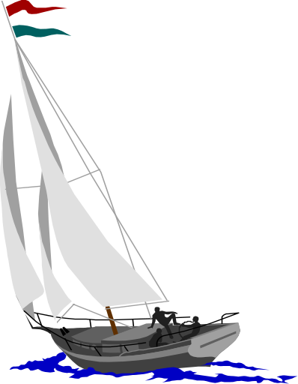

Rule 12
Sailing vessel
帆 船
(Rule 12 including 2 items)

Slide 91
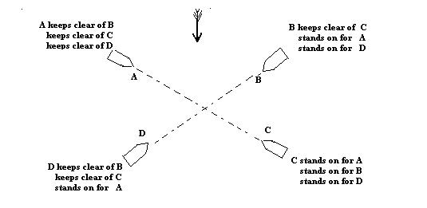

Slide 92
(a) When two sailing vessels are approaching one another, so as to involve risk of collision, one of them shall keep out of the way of the other as follows:
两艘帆相互使近致有构成碰撞危险时，其中一船应按下列规定给他船让路：
(i) when each has the wind on a different side, the vessel which has the wind on the port side shall keep out of way of the other; 两船在不同舷受风时, 左舷受风的船应给右舷受风船让路

Slide 93
(ii)when both have the wind on the same side, the vessel which is windward shall keep out of way of the vessel which is to leeward;
两舷在同舷受风时,上风船应给下风船让路。
(iii) If the vessel with the wind on the port side sees a vessel windward and cannot determine with certainty whether the other vessel has the wind on the port or the starboard side, she shall keep out of the way of the other;
如左舷受风的船看到在上风的船而不能断定究竟该船是左舷还是右舷受风,则应给该船让路。

Slide 94
(b) For the purpose of this rule the windward side shall be deemed to be the side opposes to that on which the mainsail is carried or, in the case of a square-rigged vessel, the side opposite to that on which the largest fore-and-aft sail is carried.
就本条规定而言，船舶的受风舷侧应认为是主帆被吹向的一舷的对面舷侧，对于方帆船，则应认为是最大纵帆被吹向的一舷的对面舷侧。

Slide 95
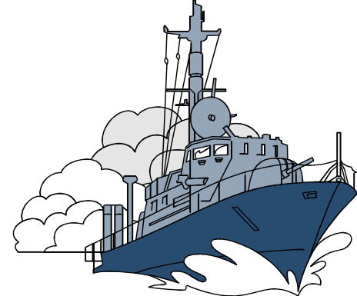
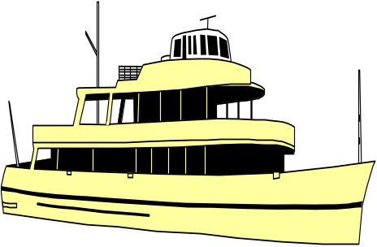
Rule 13
Overtaking
追 越
(Rule 13 including 4 Items)

Slide 96
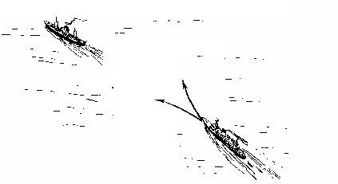


Slide 97
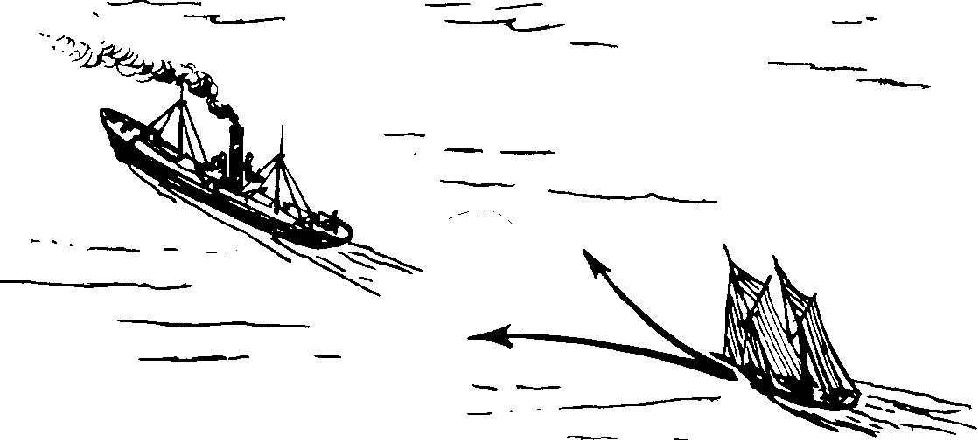

Slide 98
(a) Notwithstanding anything contained in the Rule of the part B, Section I and II, any vessel overtaking any other shall keep out of way of the vessel being overtaken.
1. 不论第二章第一节和第二节的各条规定如何, 任何船舶在追越任何他船时, 均应给被追越船让路。

Slide 99
(b) A vessel shall be deemed to be overtaking when coming up with another vessel from a direction more than 22.5 °abaft her beam, that is, in such a position with reference to the vessel; she is overtaking, that at night she would be able to see only the stern light of that vessel but neither of her sidelights.
2. 一船正从他船正横后大于22.5°的某一方向赶上他船时，即该船对其所追越的船所处位置，在夜间只能看见被追越船的尾灯而看不见他的任一舷灯时，应认为在追越中。

Slide 100
(c) When a vessel is in any doubt as to whether she is overtaking another, she shall assume that is the case and act accordingly.
3.当一船对其是否在追越他船任何怀疑时, 该船应假定是在追越,并应采取相应行动。

Slide 101
(d) Any subsequent alteration of the bearing between the two vessels shall not make the overtaking vessel a crossing vessel within the meaning of these Rules or relieve her of the duty of keep clear of the overtaken vessel until she is finally past and clear.
4.随后两船间方位的任何改变, 都不应把追越船作为本规则各条含义中所指的交叉船, 或者免除其让开被追越船的责任, 直到最后驶过让清为止。

Slide 102
Rule 14
Head-on Situation
对遇局面

Slide 103
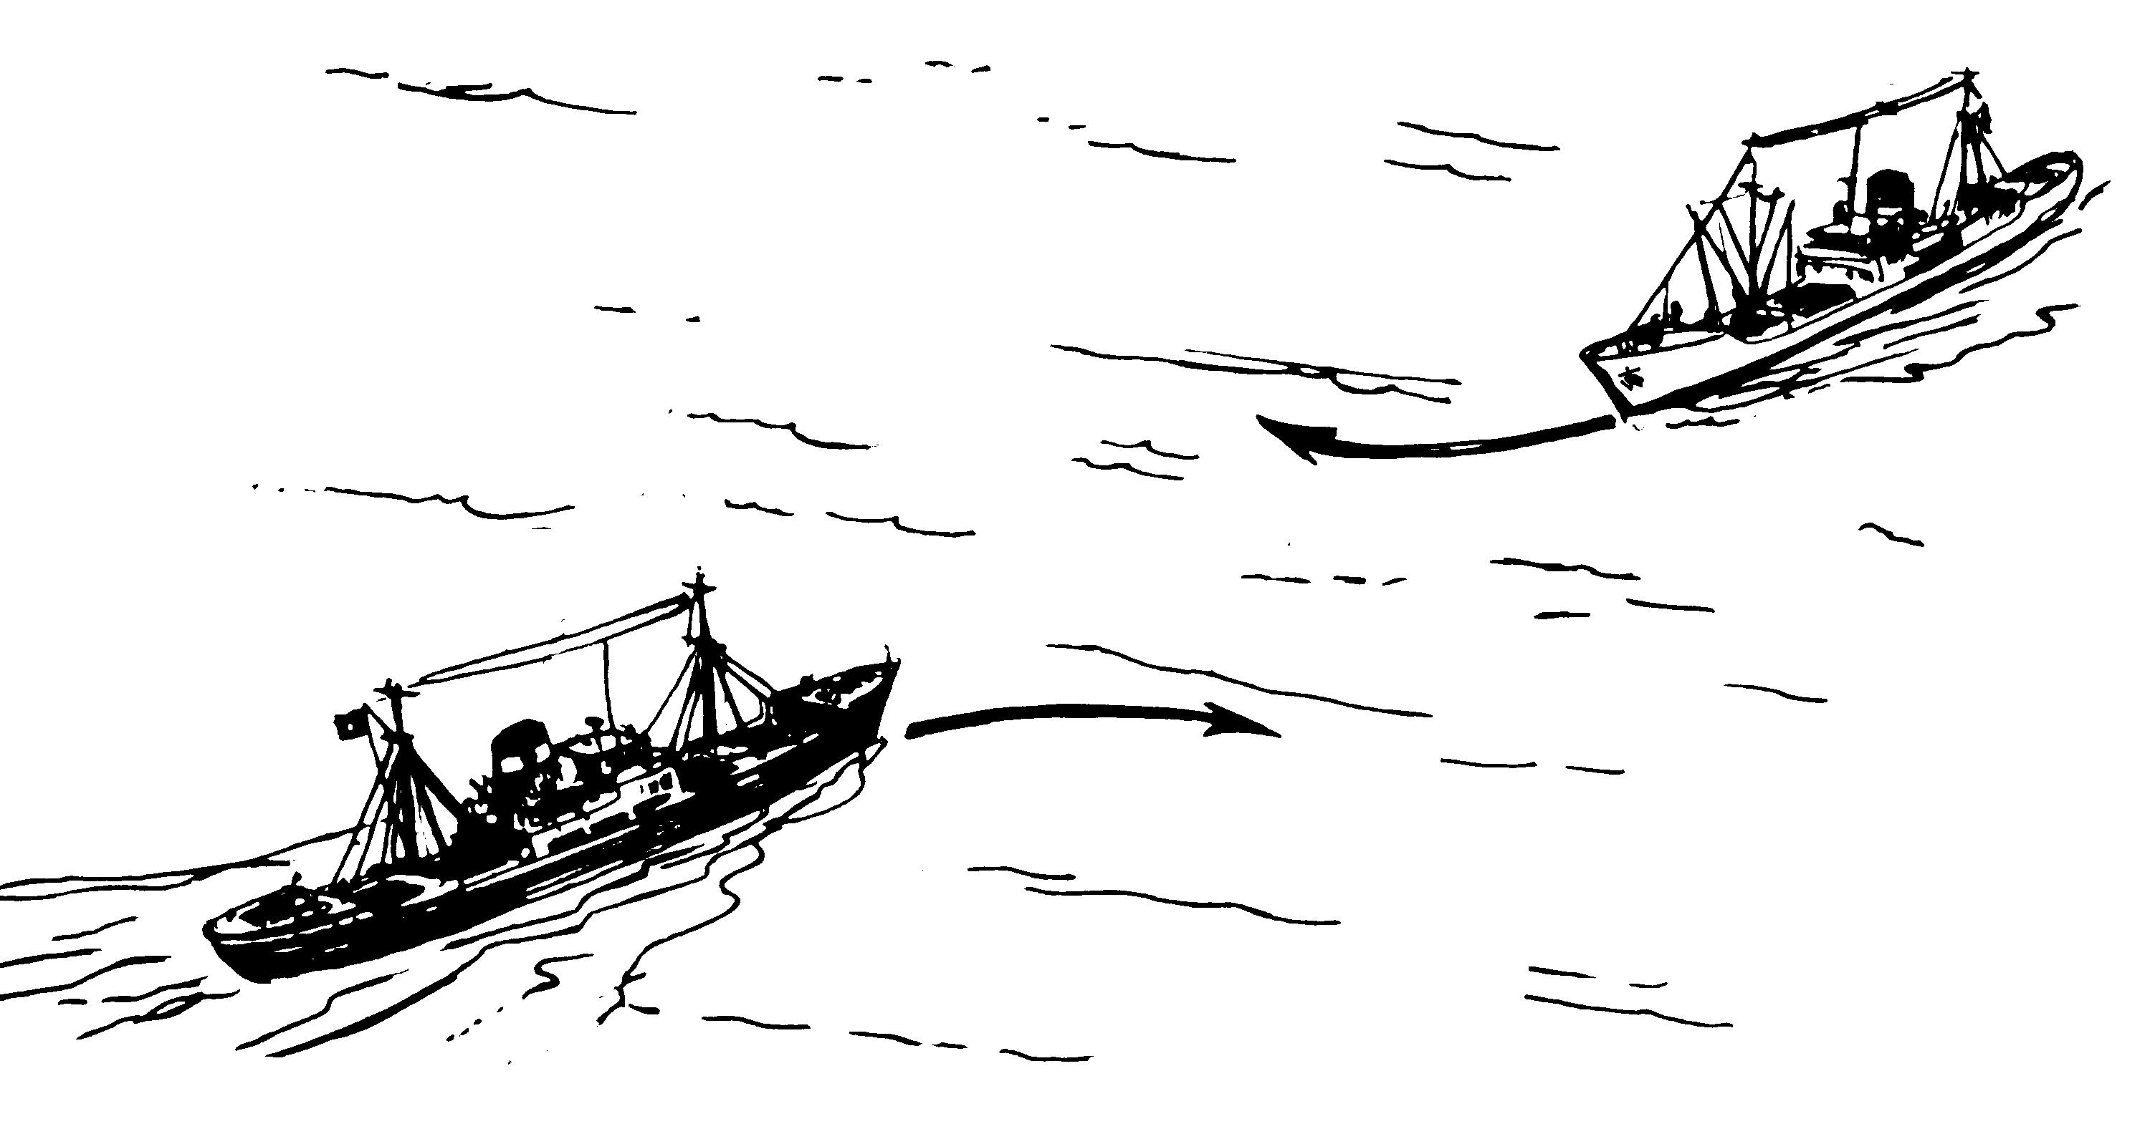

Slide 104
(a) When two power-driven vessels are meeting on reciprocal or nearly reciprocal course so as involve the risk of collision each shall alter her course to starboard so that each shall pass on the port side of the other.
1.当两机动船在相反或接近相反的航向上相遇致有构成碰撞危险时, 各应向右转向, 从而各从他船的左船舷通过。

Slide 105
(b) Such a situation shall be deemed to exist when a vessel sees the other ahead or nearly ahead and by night she could see the masthead lights of the other in a line or nearly in a line and/or both sidelights and by day she observes the corresponding aspect of the other vessel.
2.当一船看见他船在正前方或接近正前方; 即在夜间, 能看见他船的前后桅灯成一直线或接近一直线, 和（或）两盏舷灯, 在日间, 看到他船的上述相应形态时, 则应认为存在这样的局面。

Slide 106
(c) When a vessel is in any doubt as to whether such a situation exists she shall assume that it does exist and act accordingly.
3.当一艘船对是否存在这样的局面有任何怀疑时，该船应假定确实存在这种局面，并采取相应的行动。

Slide 107
Rule 15
Crossing Situation
交叉相遇局面
(Rule 15 only including 1 items)

Slide 108
When two power-driven vessels are crossing so as to involve risk of collision, the vessel which has the other on her own starboard side shall keep out of way and shall, if the circumstances of the case admit, avoid crossing ahead of the other vessel.
当两机动船交叉相遇致有构成碰撞危险时, 有他船在本船右舷的船应给他船让路, 如当时环境许可，还应避免横越他船的前方。

Slide 109
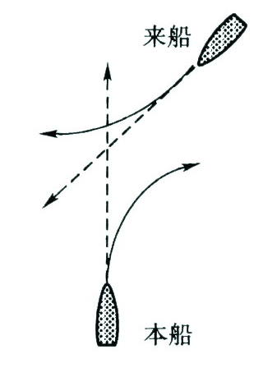
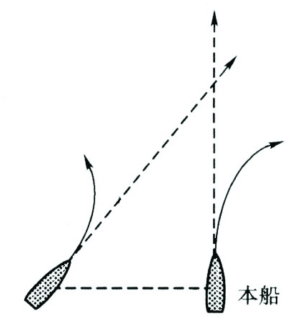

Slide 110
Rule 16
Action by
Give-way Vessel
(Rule 16 only including 1 item)

Slide 111
Every vessel which is directed to keep out of way of another shall, so far as possible, take early and substantial action to keep well clear.
须给他船让路的船舶, 应尽可能及早采取大幅度的行动，宽裕地让清他船。

Slide 112
Rule 17
Action by
Stand-on vessel
( Rule 17 including 4 items)

Slide 113
(a) (i) Where one of two vessels is to keep out of way the other shall keep her course and speed.
1.(1)两船中的一船应给另一船让路时，另一船应保持航向和航速。
(ii) The latter vessel may however take action to avoid collision by her manoeuve alone, as soon as it becomes apparent to her that the vessel required to keep out of way is not taking appropriate action in compliance with these Rules.
(2) 然而, 当保持航向航速的船一经发觉规定的让路船显然没有遵照本规则各条采崐取适当行动时，该船即可独自采取操纵行动，以避免碰撞。

Slide 114
(b) When, from any case, the vessel required to keep her course and speed finds herself so close that collision cannot be avoided by the give-way vessel alone, she shall take such action as will best aid to avoid collision.
2.当规定保持航向和航速的船,发觉本船不论由于何种原因逼近到单凭让路船的行动不能避免碰撞时，也应采取最有助于避碰的行动。

Slide 115
(c) A power-driven vessel which takes action in a crossing situation in accordance with sub-paragraph (a) (ii) of this Rules to avoid collision with another power-driven vessel shall, if the circumstances of the case admit, not alter course to port for a vessel on her port side.
3. 在交叉相遇局面下，机动船按照本条1款(2)项采取行动以避免与另一艘机动船碰撞时，如当时环境许可，不应对本船左侧的船采取向左转向

Slide 116
(d) This Rule does not relieve the give-way vessel of her obligation to keep out of the way.
4. 本条并不解除让路船的让路义务。

Slide 117
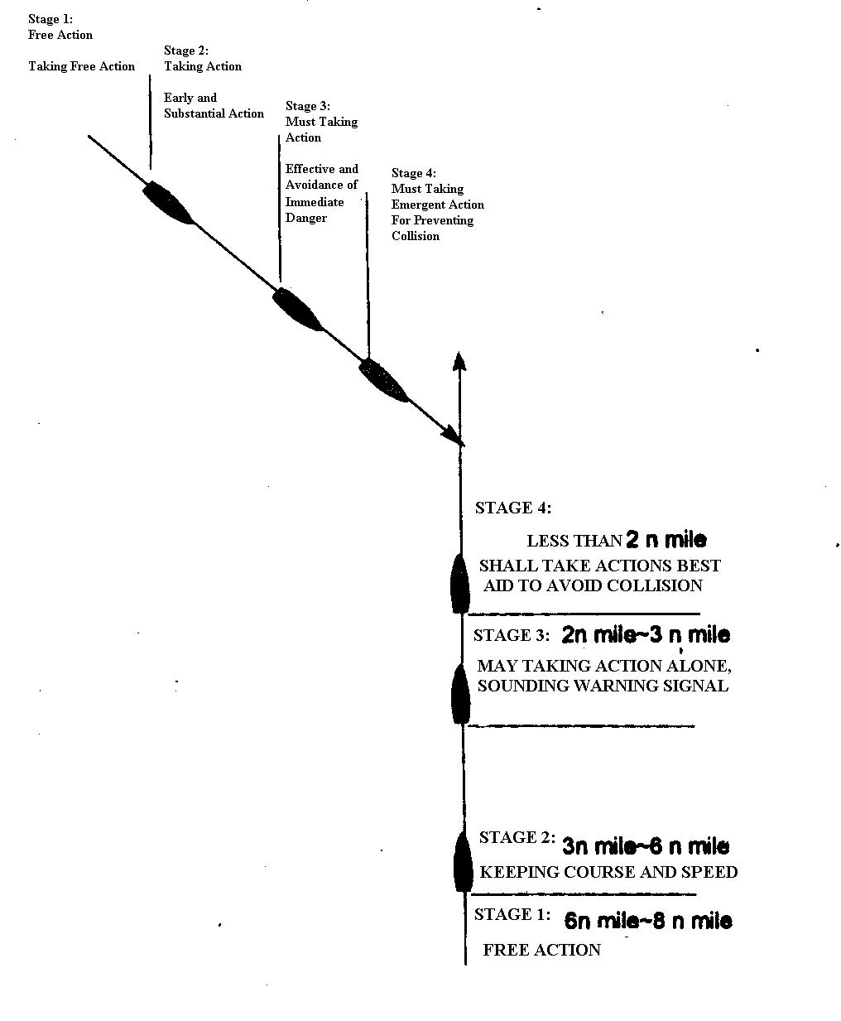

Slide 118
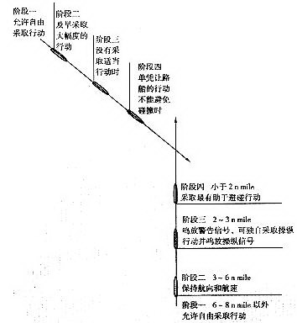

Slide 119
Rule 18
Responsibilities between
Vessels
船舶之间的责任

Slide 120
Except where rules 9, 10, and 13 otherwise require:
(a) A power-driven vessel underway shall keep out of the way of:
(i) a vessel not under command;
(ii) a vessel restricted in her ability to manoeuvre;
(iii) a vessel engaged in fishing;
(iv) a sailing vessel.
(除第九、十和十三条另有规定外):
1. 机动船在航时应给下述船舶让路：
(1) 失去控制的船舶；(2) 操纵能力受到限制的船舶；
(3) 从事捕鱼的船舶；(4) 帆船。

Slide 121
(b) A sailing vessel underway shall keep out of the way of:
(i) a vessel not under command;
(ii) a vessel restricted in her ability to manoeuvre;
(iii) a vessel engaged in fishing.
2. 帆船在航时应给下述船舶让路:
(1) 失去控制的船舶；
(2) 操纵能力受到限制的船舶；
(3) 从事捕鱼的船舶。

Slide 122
(c) A vessel engaged in fishing shall, as far as possible, keep out of way of:
(i) a vessel not under command;
(ii) a vessel restricted in her ability to manoeuvre;
3. 从事捕鱼的船舶在航时，应尽可能给下述船舶让路
(1) 失去控制的船舶；
(2) 操纵能力受到限制的船舶。

Slide 123
(d) (i) Any vessel other than a vessel not under command or a vessel restricted in her ability to manoeuvre shall, if the circumstances of case admit, avoid impeding the safe passage of a vessel constrained by her draft, exhibiting the signals in Rule 28.
(ii) A vessel constrained by her draught shall navigate with particular caution having full regard to her special condition.
4. (1)除失去控制的船舶或操纵能力受到限制的船舶外，任何船舶，如当时环境许可，应避免妨碍显示第二十八条信号的限于吃水的船舶安全通行。
(2)限于吃水的船舶应充分注意到其特殊条件，特别谨慎地驾驶。

Slide 124
(e) A seaplane on the water shall, in general, keep well clear of all vessel and avoid impeding their navigation. In circumstances, however, where risk of collision exists, shall comply with the Rules of this part.
5.在水面的水上飞机，通常应宽裕地让清所有船舶并避免妨碍其航行。然而在有碰撞危险的情况下，则应遵守本章各条规定

Slide 125
(f) (i) A WIG craft, when taking off, landing and in flight near the surface, shall keep well clear of all other vessels and avoid impeding their navigation;
6. (1) 地效船在贴近水面起飞、降落和飞行时应宽裕地让清所有其它船舶并避免妨碍它们的航行；
(ii) A WIG craft operating on the water surface shall comply with the Rules of this Part as a power-driven vessel.
(2) 在水面上操作的地效船应作为动力船舶遵守本章各条

Slide 126
Rule 19
Conduct of vessels in Restricted Visibility
船舶在能见度不良情况时的行动规则
(Rule 19 including 5 items)

Slide 127
(a) This rule applied to vessels not in sight of one another when navigating in or near an area of restricted visibility.
1.本条适用于能见度不良的水域中或在其附近航行时相互看不见的船舶。

Slide 128
(b) Every vessel shall proceed at a safe speed adapted to the prevailing circumstances and condition of restricted visibility. A power driven vessel shall have her engine ready for immediate manoeuvre.
2. 每一船舶应以适合当时能见度不良的环境和情况的安全航速行驶, 机动船应将机器作好随时操纵的准备。

Slide 129
(c) Every vessel shall have due regard to the prevailing circumstances and condition of restricted visibility when complying with the Rules of this section I of this part.
3. 在遵守本章第一节各条时，每一船舶应适当考虑到当时能见度不良的环境和情况。

Slide 130
(d) A vessel which detects by radar alone the presence of another vessel shall determine if a close-quarter situation is developing and/or risk of collision exists. If so, she shall take avoiding action in ample time, provide that when such action consists of an alteration of course, so far as possible the following shall be avoid:
(i) an alteration of course to port for a vessel forward of the beam, other than for a vessel being taken;
(ii) an alteration of course towards a vessel abeam or abaft the beam.

Slide 131
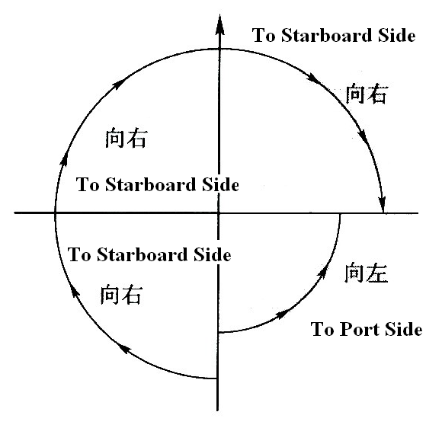

Slide 132
能见度不良时的转向避让时
应避免的事项
4. 一船仅凭雷达测到他船时，应判断是否正在形成碰撞局面和（或）存在着碰撞危险。若是如此，应及早地采取避让行动，这种行动如包括转向，则应尽可能避免如下各点：
(1) 除对被追越船外，对正横前的船舶采取向左转向;
(2) 对正横或正横后的船舶采取朝着它转向。

Slide 133
(e) Except where it has been determined that a risk of collision does not exist, every vessel which hears apparently forward of her beam the fog signal of another vessel, or which cannot avoid a close quarter-situation with another vessel forward of her beam, shall reduce her speed to the minimum at which she can be kept on her course. She shall if necessary take all her way off and even navigate with extreme caution until danger of collision is over.

Slide 134
能见度不良时的减速和停船
5. 除已断定不存在碰撞危险外, 每一船舶当听到他船的雾号显似在本船正横以前,或者与正横以前的他船不能避免紧迫局面时，应将航速减到能维持其航向的最小速度。必要时，应把船完全停住，而且，无论如何，应极其谨慎地驾驶，直到碰撞危险过去为止。

