Slide 1

“ Portfolio Website ”
Task - 1

Slide 2

Portfolio website
▪
ꢀProjectꢀIntroduction
A portfolio website is a curated, online space that showcases your best work. It's one of the most practical and memorable ways to share your work with press, potential collaborators or employers.
LMS Username
Name
Batch
E.Anitha
05
R.Deepika
05
V.Naveen kumar
05
S.Reshma
05

Slide 3
INTRODUCTION
The portfolio work aims to report the process of designing and developing a web portfolio for a graduating bachelor design student specializing in web design and development. It will define what a portfolio website is, it will also explain the basic theory and elements of an online portfolio design process. Further this work presents different ways and channels through which a design student can create And develop a personal online portfolio. By covering aspects such as: How to Integrate personal visual identity and what is required to build an effective portfolio. In order to carry out this process, it is essential to understand various strategies and Techniques that are used to today, while acquiring skill full understanding of modern tools and trends.It is not only a way to introduce yourself and your work but also a way to showcase your personality and voice. You want to sound authentic, engaging and confident, not boring, generic, or arrogant. Write in a conversational tone that reflects your brand identity and values.

Slide 4
Document Conventions
Entire document should be justified.
1.Convention for Main title
Font face:Times New Roman
Font style:Bold
Font Size: 14
2. Convention for Sub title
Font face:Times New Roman
Font style:Bold
Font Size: 12
3.Convention for body
Font face:Times New Roman
Font Size: 12

Slide 5
Scope of Development Project
The portfolio website should consists of our main parts such as personal
information,including short cv and professional skills, portfolio showcase, and
contact information including feedback Form . The Parallax effect possible can
be implemented in order to bring the visual depth and dynamics to graphical
objects.Parallax is a web design technique that allows components of a web page
to move at varying speeds when a user scrolls. In particular, the effect is created
when the background of a web page moves at a Different speed from the rest of
the elements when you scroll. The scope of a standard portfolio is defined by its
component projects and programmes whereas the scope of a structured portfolio
is defined by the strategic objectives it is designed to achieve.

Slide 6
Definitions, Acronyms and Abbreviations
JAVA -> platform independence
It is used to develop computer-based applications.
SQL -> Structured query Language
It is used to communicate with a database.
IDE -> Integrated Development Environment
It is used to develop software code efficiently.
SRS -> Software Requirement Specification
It is used to perform particular functions in a specific environment.

Slide 7
References
Books
○ Airey, D., 2010. Logo Design Love: A Guide to Creating Iconic Brand Identities
○ Berkeley, CA: New Riders
Websites
○ http://www.smashingmagazine.com/2013/06/workflow-design-develop-modern-portfolio-website/
○ http://business.tutsplus.com/articles/the-secret-to-getting-a-lot-of-web-design-work--fsw-390

Slide 8
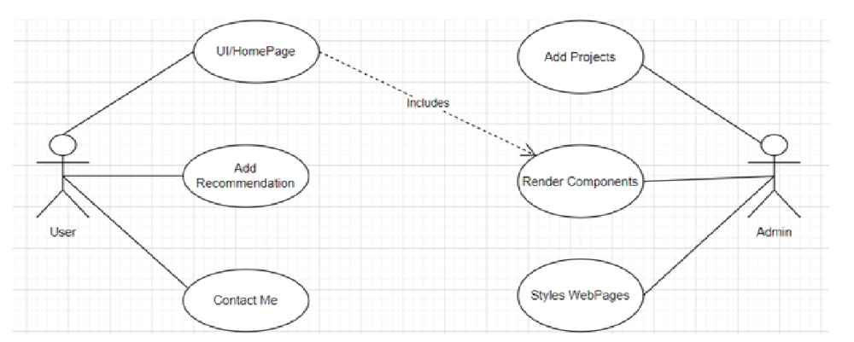
Overall description
Product perspective
Usecase diagram of portfolio website

Slide 9
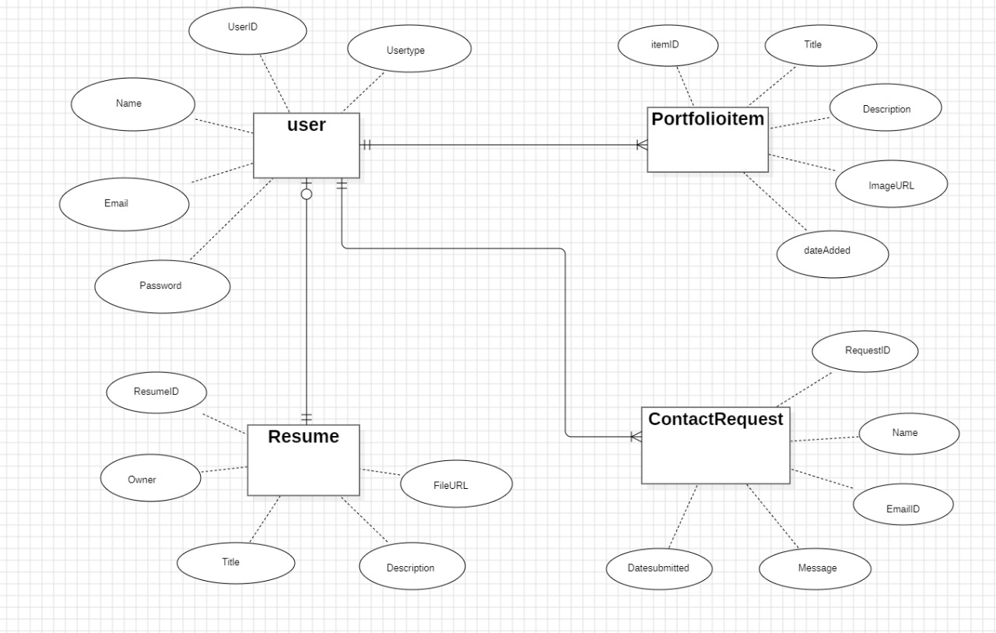
Product function
Entity Relationship Diagram of Portfolio

Slide 10
Class diagram
A class is an abstract, user-defined description of a type of data. It identifies the
attributes of the data and the operations that can be performed on instances
(i.e.objects) of the data. A class of data has a name, a set of attributes that describes
its characteristics, and a set of operations that can be performed on the objects of that
class. The classes’ structure and their relationships to each other frozen in time
represent the static model. In this project there are certain main classes which are
related to other classes required for their working. There are different kinds of
relationships between the classes as shown in the diagram like normal association,
aggregation,and generalization. The relationships are depicted using a role name and
multiplicities. Here ‘user’, ‘project’ , ‘Contact form’ and ‘about me’ are the most
important classes which are related to other classes.

Slide 11
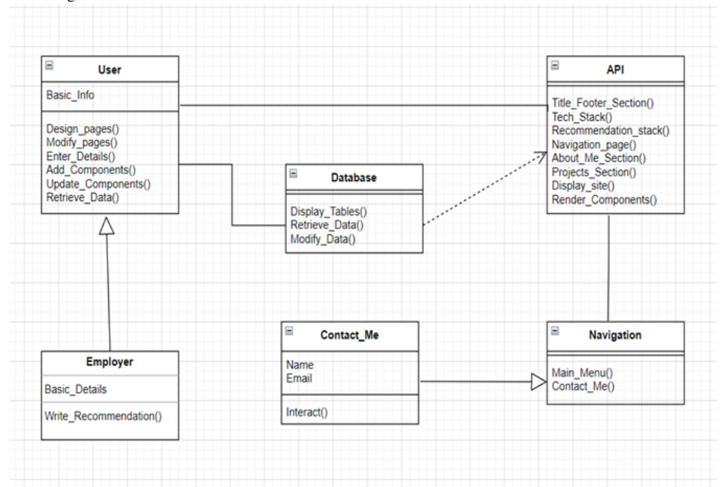

Slide 12
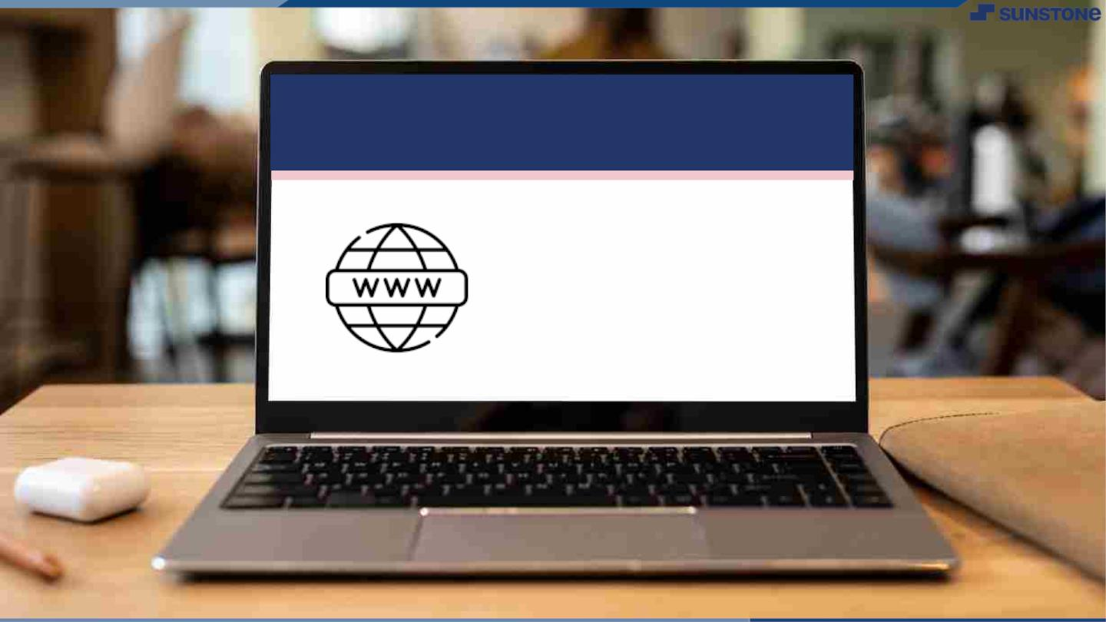
Submission Github
https://github.com/NAVI7708/NM-DSCET-GROUP-5.git

Slide 13


