Slide 1
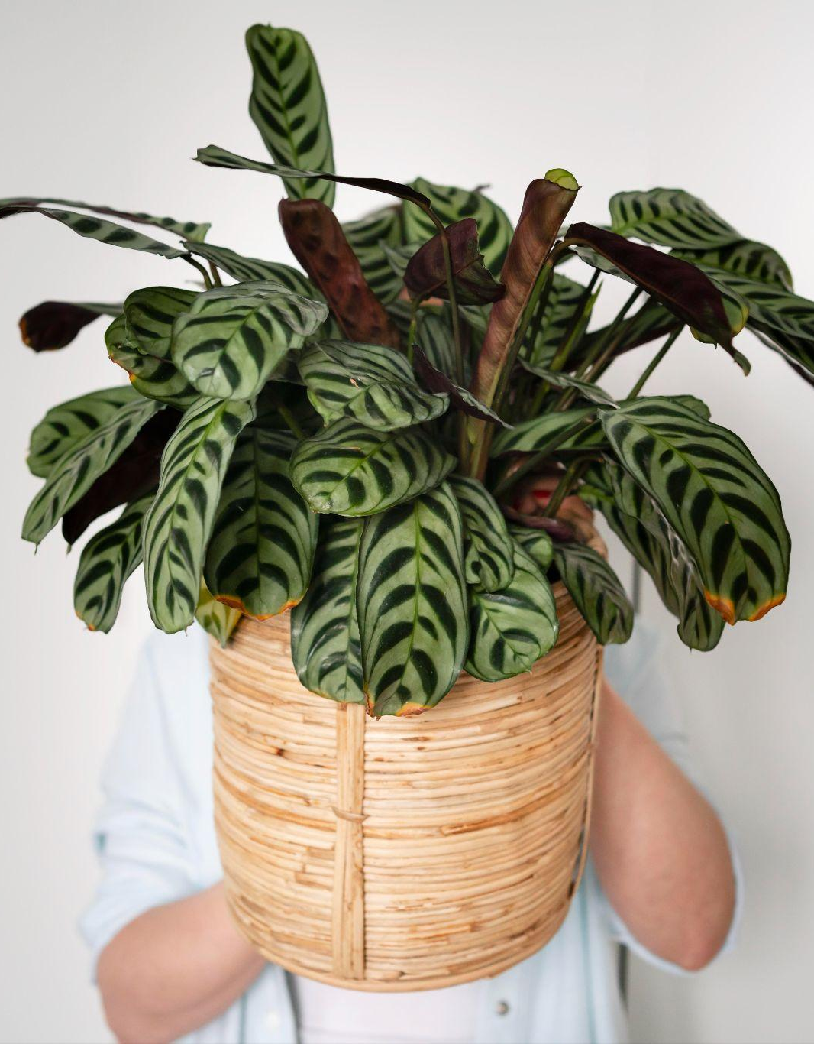
Nex Hack
Brewed
Brains
Project Title : Plant Health Diagnosis App
“Snap. Diagnose. Treat. Save your plant.”
Hackathon Theme: AI for Real-World Impact
Team Name: Brewed Brains
Team Members:
Navneet Pratap (Team Leader)( (AI models and AI integration)
Mudit Gupta (Frontend Developer)
Kavya Agarwal (Backend/Database Developer)
Rudra Pratap (Data collection and Data visualization)
Mayank Panwar(Backend/Database Developer)

Slide 2
Brewed
Brains
Problem Statement
Plant diseases are a growing concern for agriculture and urban gardening.
Farmers: Farmers often face unidentified crop diseases with no nearby expert help, leading to yield losses.
Urban plant owners: Urban plant owners also lack the knowledge to properly maintain their plants, resulting in high failure rates.
Lack of solution: No first AI tool for real-time disease detection and care guidance system .
~40% crop loss due to pests/diseases (FAO);
~65% of urban plants get abandoned by owners

Slide 3
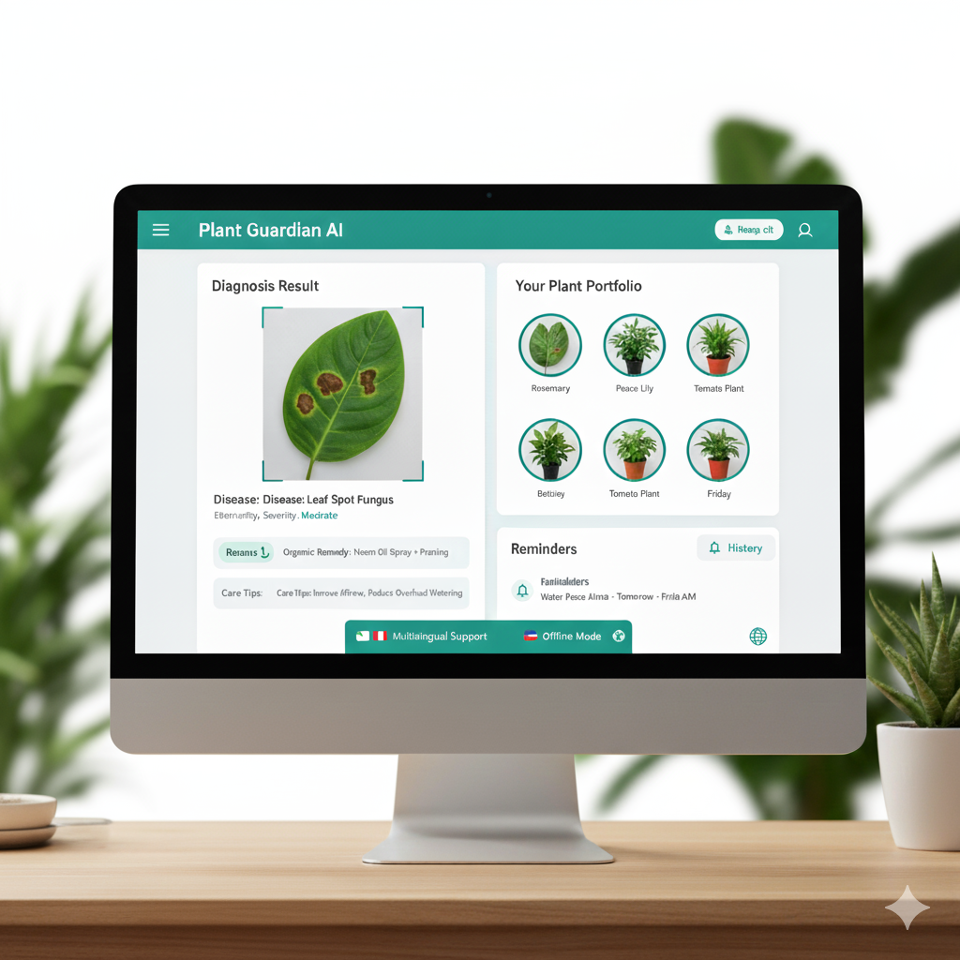
Brewed
Brains
Proposed Solution
Provides organic remedies and care tips tailored to the diagnosis.
Reminder notifications for watering, fertilization, and other care tasks.
History log of past diagnoses for each plant owner plants data.
Support for multiple languages and offline use for broader accessibility.

Slide 4
Objectives & Goals
Brewed
Brains
Inclusive platform
Build an website serving both rural farmers and urban gardeners.
Long-term vision
Develop a scalable mobile app with IoT integration (e.g. soil sensors) for comprehensive plant monitoring.
Education & support
Promote plant health via real-time AI guidance and educational content.
Smart features
Add intelligent functions like automated watering/fertilizer reminders and alerts.

Slide 5
Technology Stack
Brewed
Brains
Frontend | React.js + Tailwind CSS + (Library UI Components)
Backend | Node.js + Express.js(APIs) Image Upload: Multer (for file handling)
Integration | Connect Python ML model to Node.js via a REST API or a Python-shell bridge.
DataBase | FireBase | MongoDB (Cloud NoSQL DB)
AI Models | Plant Recognition and Plant Disease Recognition. Open CV ( Image processing ) Option : PyTorch
Deployment | Vercel / Netlify

Slide 6
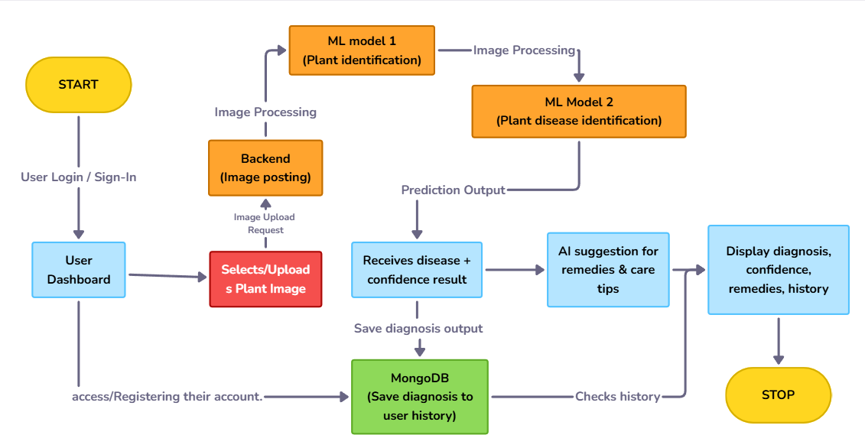
Project Workflow

Slide 7
Key Features & Innovation
Brewed
Brains
Real-time diagnosis: Instant plant disease identification from user photos.
Organic recommendations: Advice focuses on natural, chemical-free treatments.
Smart reminders: Alerts for watering, fertilizing, and other care tasks.
User history & multilingual: Past diagnosis logs; supports multiple Indian languages.
Unique offering: No direct competition in India currently, emphasizing rural/urban inclusivity and organic solutions.
Recommendation according to weather

Slide 8
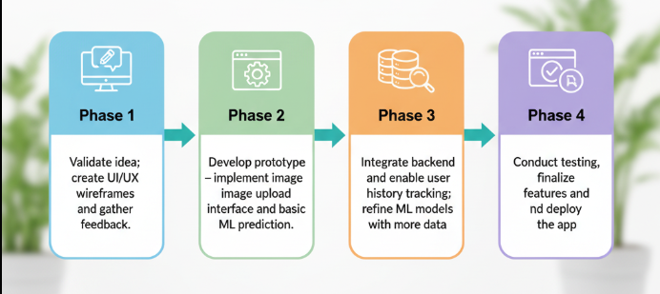
Brewed
Brains
Implementation Plan

Slide 9
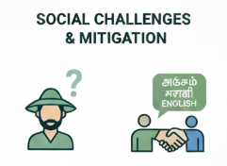
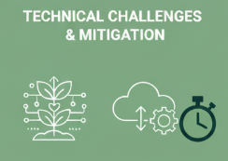
Challenges & Risk Management
Brewed
Brains
Adoption in rural areas, (language barriers)
Variability in image quality, ML accuracy, API delays.
MITIGATION:
Collaborate with local agri-extension services and helplines to build trust.
MITIGATION:
Use data augmentation, implement fallback rules for poor images, and use asynchronous API calls.

Slide 10
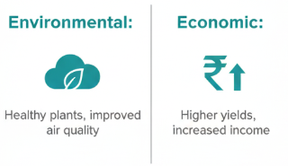
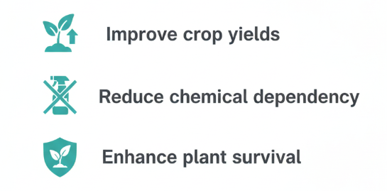
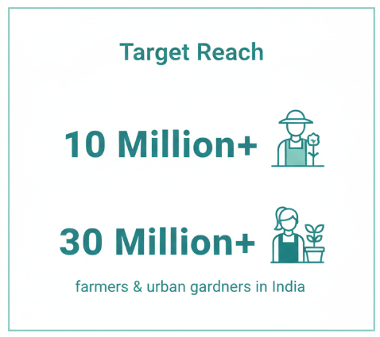

Impact & Conclusion
Brewed
Brains
Future Roadmap:
1) Build a scalable native mobile app,
2) Integrate more AI facilities and IOT Implementation (Soil Quality).
3) seek government/NGO partnerships to extend reach.

