Slide 1
Bringing logic 2 a gym

Slide 2
Whoami
Java developer, as good as no C/C++ knowledge
Very little exposure to electronics
Gymrat / meathead

Slide 3
The problem
Odd hours: 17-21h + ….....
Too many people having keys
Our Big Iron is disappearing
Even with very low rates, people are not paying

Slide 4
Requirements
Allow only access to paying members
Who was allowed access and when?
Who was denied access and when?
Still allow people to train outside of regular hours
Easily manageable
Low footprint, PC would be overkill

Slide 5
Solution?
Arduino (new toy to play with)
RFID (a lot of Arduino + RFID examples)
Data Logger Shield (storing log data + subscription information)
Existing solutions aren't that extensive or complicated

Slide 6
Limits?
Used resources (memory & pins)
Resource usage of existing solutions
Extra resources needed by data logger
Memory usage by logic for data management

Slide 7
Step 1: Simple RFID
(RFID hello world)
Get basic RFID working (Arduino playground example)
Memory usage: 3176 bytes (of 30720 bytes)
Pins used: dig pins 0 & 2 and the 5V & Gnd pin

Slide 8
Step 2: Data Logger Shield
Shield comes unassembled
2GB Max SD card with FAT16
Arduino has a timer not a clock
Data Logger Shield has an RTC
The RTC needs initialization
Added some connectors
            (http://www.adafruit.com/)

Slide 9
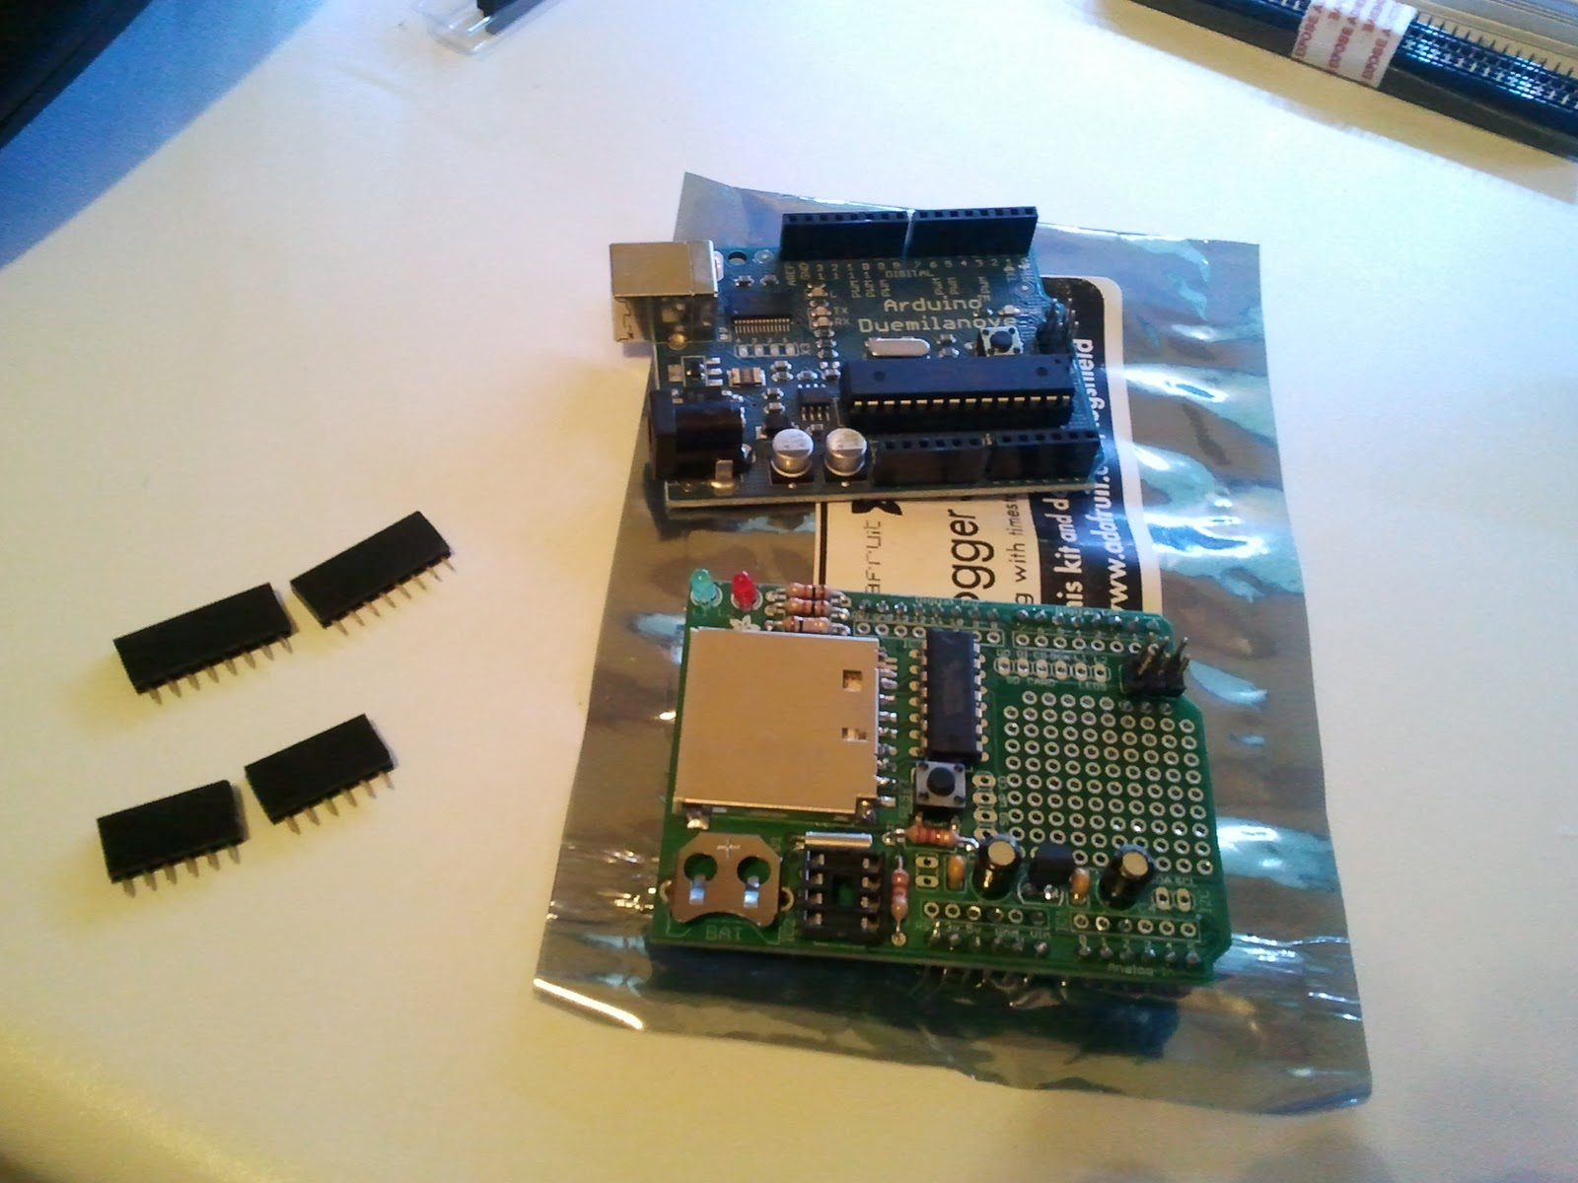

Slide 10
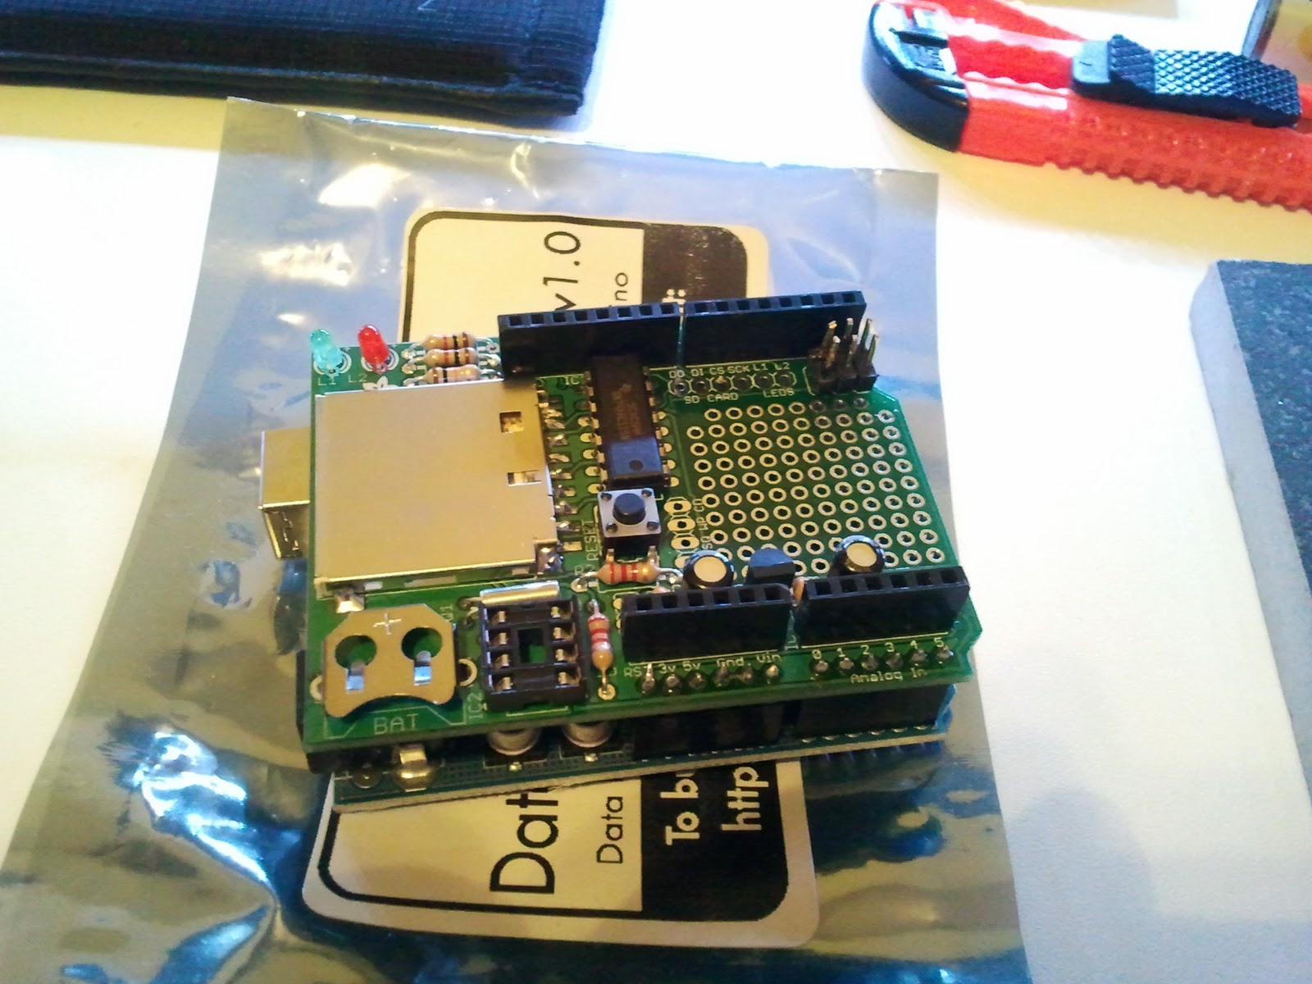

Slide 11
Step 2b: Add the DataLogger Shield
Check the RFID connections
(ShieldList.org)
logic for logging
logic for consulting subscription information
Memory used: 15736 bytes (of 30720 bytes)
pins used: 0, 2, 7, 10, 11, 12, 13; analog pins 4 and 5 and the 5V pin

Slide 12
Step 3: manage content
(the but slide)
Already working solution out there, but...
Existing solutions cool, but...
Can I manage data via USB, possibly, but...

Slide 13
Step 4: NewSoftSerial RFID
RFID uses Arduino RX pin
Annoying 4 flashing and serial comm
Emulate serial comm on digitial pins
Memory used: 20692 bytes (of 30720 bytes)
pins used: 2, 7, 8, (9), 10, 11, 12, 13; analog pins 4 and 5 and the 5V pin.

Slide 14
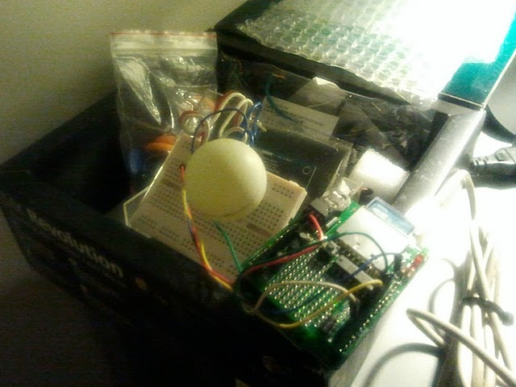

Slide 15
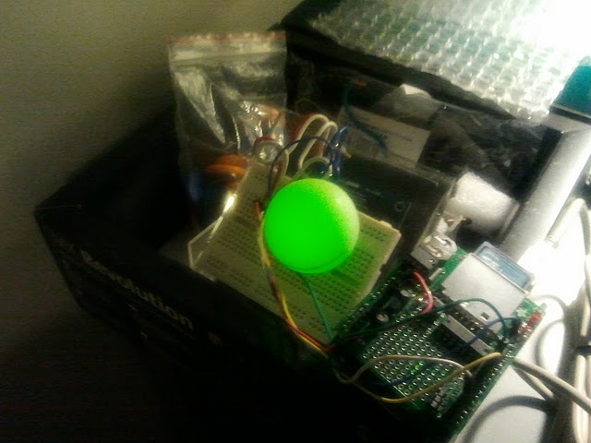

Slide 16
Step 5: PC-2-Arduino comm
List all log files
Show content log file
Cleanup log files
Add subscription for 1 month / 3 month / 1 year
Enable / disable RFID token
!!! FAIL !!!

Slide 17
Step 6: 2 sketches
Yeah I know, I'm cheating
Data management is still work in progress

Slide 18
TODO list
Can I still add some * bling *
Arduino Mega????
Physical security: SD card, sabotage
1 sketch solution
Nice GUI for users to manage the data

Slide 19
For the Procrastinators
Http://navni-stuff.blogspot.com
git://github.com/NAVNi-stuff/arduino-rfid-datalog.git

Slide 20
References
http://www.arduino.cc/playground/
http://arduiniana.org/libraries/newsoftserial/
Arduino Cookbook (http://oreilly.com/catalog/9780596802486)
Getting started with Arduino (http://oreilly.com/catalog/9780596155520)

Slide 21
Tokyohackerspace.org needs your help
http://www.tokyohackerspace.org/en/japan-in-crisis

