Slide 1
Exploring Semantic Segmentation: Dataset, Techniques, and Challenges
Mehadi Hasan
Reg. no.: 46341
Session: 2021-2022
Dr. Mohammad Shorif Uddin
Professor
Department of CSE
Sunday, 15 September, 2024

Slide 2
Slide Outline
Introduction
Objective
Basic Terminology
Popular Deep Network Architectures
Datasets
Challenges
Future Opportunities
Conclusion

Slide 3
Introduction
The main objective of this research is to conduct a detailed examination of semantic segmentation, with a focus on:
Investigating deep learning architectures and methodologies utilized for semantic segmentation.
Systematically reviewing and comparing prominent datasets used for training and evaluating segmentation models.
Assessing current challenges in the domain, and proposing potential avenues for future research and advancements.

Slide 4
Objective
The objective of this research is to comprehensively explore semantic segmentation by analyzing cutting-edge deep learning techniques, evaluating widely-used datasets, and identifying key challenges and opportunities for advancement in the field.

Slide 5
Basic Terminology
What is an image?
An image is defined as a two-dimensional function F(x, y) where x and y are spatial coordinates, and the amplitude of F at any pair of coordinates (x, y) is called the intensity of that image at that point. When x, y and amplitude values of F are finite, we call it a digital image.

Slide 6

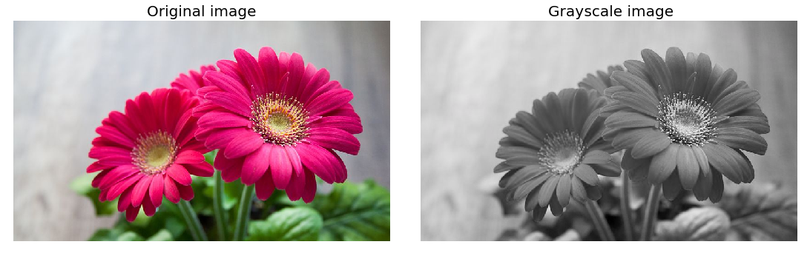
Basic Terminology (cont.)
Types of image
Binary Image Images that have only two unique values of pixel intensity- 0 (representing black) and 1 (representing white) are called binary images. | Grayscale Image Grayscale or 8-bit images are composed of 256 unique colors, where a pixel intensity of 0 represents the black color and pixel intensity of 255 represents the white color.

Slide 7
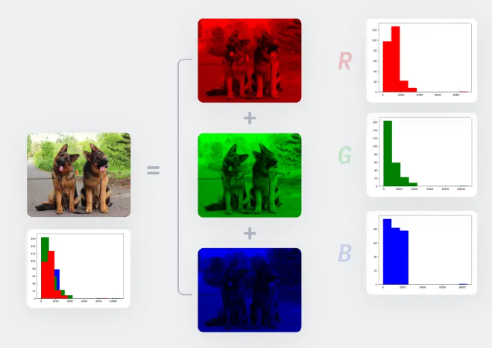
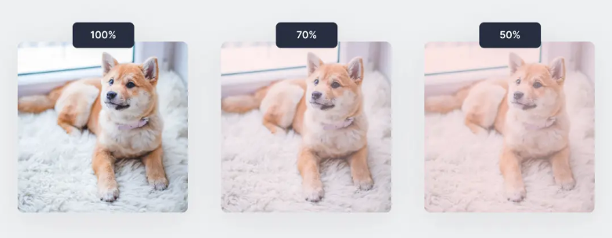
Basic Terminology (cont.)
Types of image
RGB Color Image The images we are used to in the modern world are RGB or colored images which are 16-bit matrices to computers. That is, 65,536 different colors are possible for each pixel. “RGB” represents the Red, Green, and Blue “channels” of an image. | RGBA Image RGBA images are colored RGB images with an extra channel known as “alpha” that depicts the opacity of the RGB image. Opacity ranges from a value of 0% to 100% and is essentially a “see-through” property.

Slide 8
Basic Terminology (cont.)
Digital Image Processing
Digital image processing is the use of algorithms and mathematical models to process and analyze digital images. The goal of digital image processing is to enhance the quality of images, extract meaningful information from images, and automate image-based tasks.

Slide 9
Basic Terminology (cont.)
Image Processing Techniques
Image Enhancement
Image Restoration
Image Segmentation
Object Detection
Image Compression
Image Manipulation
Image Generation
Image-to-Image Translation

Slide 10
Basic Terminology (cont.)
Image Segmentation
Image segmentation is a fundamental technique in digital image processing and computer vision. It involves partitioning a digital image into multiple segments (regions or objects) to simplify and analyze an image by separating it into meaningful components, which makes the image processing more efficient by focusing on specific regions of interest.
Segmentation Techniques
Semantic segmentation
Instance segmentation
Panoptic segmentation

Slide 11
Basic Terminology (cont.)
Semantic segmentation

Slide 12
Introduction

Slide 13
Introduction

Slide 14
Introduction

Slide 15
Thank You

