Slide 1
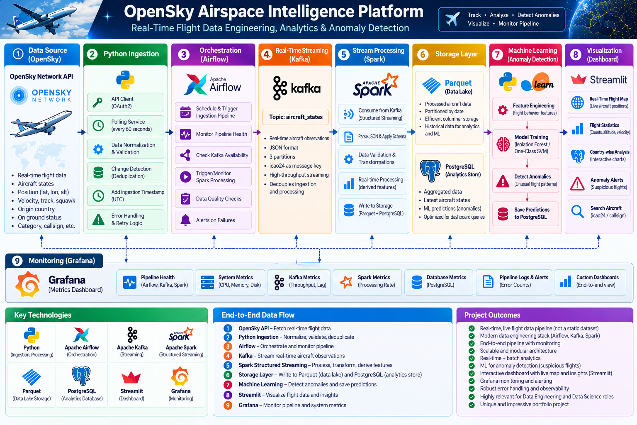


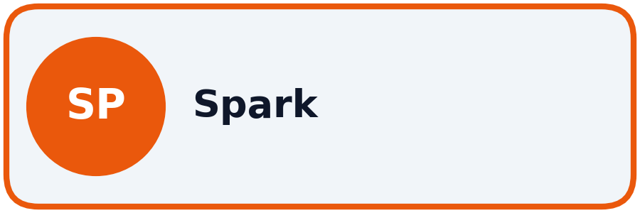




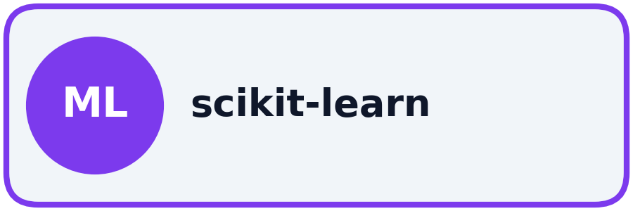
Airspace Intelligence
Platform
End-to-End Flight Data Engineering & Analytics
Containerized pipeline processing live OpenSky telemetry
Notes:
Hello. Today I will present the Airspace Intelligence Platform. I built this containerized pipeline to ingest live flight data, process it in real-time, store it reliably, and detect statistical anomalies using machine learning. It integrates a complete modern data engineering stack.

Slide 2
Project Overview & Goals
Why build a flight data pipeline?
02 / 08
The Data Challenges
• Messy Raw Data: OpenSky API returns raw arrays with missing fields, sensor noise, and occasional corrupt altitude/speed spikes (>400 m/s).
• Strict Rate Limits: Worldwide API calls cost 4 credits out of a strict 4,000/day budget. Blind retries lead to HTTP 429 bans.
• No Built-in History: The API gives point-in-time snapshots. Without persistence, flight tracks are permanently lost.
• Static Aircraft Bloat: Parked aircraft broadcast identical positions constantly, wasting downstream storage and processing.
Engineering Objectives
• Resilient Ingestion: Poll efficiently every 60s, respect API budgets, and handle network drops with exponential backoff.
• Decoupled Streaming: Use Kafka so the ingestion service never waits on heavy data processing or database locks.
• Zero Data Duplication: Use stateful change detection (only save aircraft that moved) and idempotent database inserts (ON CONFLICT DO NOTHING).
• Observability & Analytics: Add automated data quality checks, Grafana pipeline monitoring, and a Streamlit dashboard.
Notes:
The main challenge with live flight data is that it is noisy, ephemeral, and heavily rate-limited. My goal was to build a system that polls efficiently without hitting API limits, separates ingestion from processing using Kafka, and stores data cleanly without duplicates. The end result is a highly observable and reliable data foundation.

Slide 3
System Architecture
The path of data from API to Dashboard
03 / 08
Notes:
This is the complete end-to-end architecture. Data flows horizontally from Python ingestion into Kafka for buffering, then PySpark streams and cleans it. Processed data is saved to Parquet and bulk-loaded into PostgreSQL. Airflow sits on top to orchestrate batch tasks, and Grafana sits at the bottom to monitor pipeline health without interfering with the data flow.

Slide 4
Ingestion & Quality Gate
Polling the API and enforcing strict rules
04 / 08
Python Ingestion Service
• API Polling & Credit Guard: Fetches data every 60s via OAuth2. Computes credit costs to stay within the 4,000/day limit using 1s-300s exponential backoff.
• Schema Normalization: Transforms raw 18-element arrays into a canonical schema. Preserves both API snapshot time and pipeline ingestion time.
• Deduplication: An in-memory ChangeDetector compares 7 flight fields. If an aircraft hasn't moved (custom NaN-safe equality), it is skipped to save storage.
5-Rule Validation Gate
• Missing Data: Drops rows missing the core icao24 aircraft ID or observation timestamps.
• Physical Bounds: Filters out impossible latitudes (not between -90 and 90) or longitudes.
• Sensible Values: Drops any row reporting a negative velocity.
• Auditable Rejections: Invalid records are never silently dropped—each rejected aircraft row is explicitly logged with its rejection reason.
Notes:
In the ingestion stage, Python polls the API and applies strict validation rules. Crucially, it deduplicates the data in memory—if a plane hasn't moved, we don't process it further. All invalid rows are logged with clear rejection reasons, never silently dropped.

Slide 5
Real-Time Streaming
Decoupling with Kafka and PySpark
05 / 08
Apache Kafka Buffering
• Partition Ordering: Publishes to the aircraft_states topic. Using the aircraft ID as the key ensures updates for the same plane are ordered.
• Fault Isolation: If downstream processing crashes or restarts, Kafka safely retains incoming messages on disk.
• Multi-Consumer Extensibility: Allows test consumers and Grafana monitors to inspect the stream without interfering with Spark.
Spark Structured Streaming
• Permissive JSON Parsing: Applies an explicit 18-column schema. All fields are nullable to prevent Spark from dropping valid partial rows.
• Data Enrichment: Calculates km/h, km altitude, categorizes status as 'AIRBORNE' or 'ON_GROUND', and measures ingestion latency.
• Micro-batches: Uses a 30s trigger and writes final cleaned Parquet files. Protected by a POSIX file lock so only one stream runs.
Notes:
Kafka acts as a buffer. By keying messages by aircraft ID, we ensure ordered processing. PySpark then consumes this stream, parses the JSON safely, adds derived metrics like speed in km/h, and writes clean Parquet files every 30 seconds.

Slide 6
Storage & Orchestration
Idempotent loading and Airflow scheduling
06 / 08
Idempotent Loading to PostgreSQL
• Process: Airflow runs a Python loader that copies Parquet files into a PostgreSQL temp staging table.
• No Duplicates: Uses INSERT ... ON CONFLICT DO NOTHING with composite primary keys.
• Safety: Re-running the loader or overlapping files never duplicates data.
• Scale: Verified on a historical snapshot of ~286k observations across 24k aircraft.
Airflow Orchestration
• Hourly Batches: Schedules the DB loads and runs data-quality checks.
• Non-Intrusive Health Checks: Inspects Parquet file ages and Spark checkpoint commits without calling the OpenSky API.
• Resilient Rules: Uses TriggerRule.ALL_DONE so data already written by Spark still loads into Postgres even if an upstream check warns.
Notes:
For storage, Airflow bulk-loads the Spark Parquet files into PostgreSQL. This process is fully idempotent using ON CONFLICT rules, meaning we never get duplicates. Airflow monitors pipeline health through file timestamps rather than making redundant API calls.

Slide 7
Analytics & Machine Learning
From raw SQL to Anomaly Detection
07 / 08
SQL Analytics & UI
• Views: 8 analytical views (e.g., activity by country, current status) powered by PostgreSQL.
• Plausibility Limits: SQL views filter out sensor spikes (>400 m/s) before calculating averages.
• DQ Audits: 15 SQL data-quality checks run hourly, logging errors and warnings into a history table.
• Streamlit Dashboard: 6-page read-only UI for exploring live data and historical tracks.
Isolation Forest ML
• Purpose: Detects statistically unusual combinations of altitude, speed, and track using scikit-learn Isolation Forest.
• Features: Uses 12 inputs (6 kinematics + 6 missing value flags).
• Scoring: Airflow scores new data hourly. Predictions are written safely using DB locks and composite keys.
• Isolation: Runs in a dedicated virtualenv so ML dependencies never conflict with Airflow.
Notes:
Inside Postgres, 8 views power the analytics, and 15 automated checks monitor data quality. The Streamlit dashboard visualizes this cleanly. Finally, I added a machine learning layer using an Isolation Forest to flag statistically unusual flight behaviors based on speed, altitude, and heading.

Slide 8
Conclusion & Future Improvements
Platform outcomes and next steps
08 / 08
Platform Outcomes
• End-to-End Resilience: Built a fully containerized pipeline that survives restarts, API rate limits, and network drops.
• Data Integrity: Enforced explicit schemas, NaN-safe deduplication, and idempotent database writes.
• Observability: Monitored via 38 Grafana panels and a 6-page interactive Streamlit dashboard.
Future Roadmap
• Data Lakehouse: Migrate Parquet storage to Apache Iceberg or Delta Lake for ACID table management.
• Trajectory ML: Expand anomaly detection from single-point kinematics to full flight-path trajectories.
• CI/CD Testing: Automate the existing 34 Python unit and contract tests in GitHub Actions.
Through this project, I demonstrated how to take a noisy, rate-limited external feed and engineer a resilient data platform where every stage—from streaming to storage and ML—is built with explicit contracts and operational honesty.
Notes:
In conclusion, this platform successfully turns a noisy API feed into a clean, queryable, and monitored database. The key engineering takeaway was designing for failure—ensuring the system recovers cleanly without duplicating data. Future steps would include upgrading to Apache Iceberg and expanding the ML to track full flight paths. Thank you.

