Slide 1
Introduction to Java Programming
Unit-1

Slide 2
Characteristics of Java
Companion Website
Java Is Simple
Java Is Object-Oriented
Java Is Distributed
Java Is Interpreted
Java Is Robust
Java Is Secure
Java Is Architecture-Neutral
Java Is Portable
Java's Performance
Java Is Multithreaded
Java Is Dynamic

Slide 3
Characteristics of Java
Companion Website
Java Is Simple
Java Is Object-Oriented
Java Is Distributed
Java Is Interpreted
Java Is Robust
Java Is Secure
Java Is Architecture-Neutral
Java Is Portable
Java's Performance
Java Is Multithreaded
Java Is Dynamic
Java is partially modeled on C++, but greatly simplified and improved. Some people refer to Java as "C++--" because it is like C++ but with more functionality and fewer negative aspects.

Slide 4
Characteristics of Java
Companion Website
Java Is Simple
Java Is Object-Oriented
Java Is Distributed
Java Is Interpreted
Java Is Robust
Java Is Secure
Java Is Architecture-Neutral
Java Is Portable
Java's Performance
Java Is Multithreaded
Java Is Dynamic
Java is inherently object-oriented. Although many object-oriented languages began strictly as procedural languages, Java was designed from the start to be object-oriented. Object-oriented programming (OOP) is a popular programming approach that is replacing traditional procedural programming techniques.
One of the central issues in software development is how to reuse code. Object-oriented programming provides great flexibility, modularity, clarity, and reusability through encapsulation, inheritance, and polymorphism.

Slide 5
Characteristics of Java
Companion Website
Java Is Simple
Java Is Object-Oriented
Java Is Distributed
Java Is Interpreted
Java Is Robust
Java Is Secure
Java Is Architecture-Neutral
Java Is Portable
Java's Performance
Java Is Multithreaded
Java Is Dynamic
Distributed computing involves several computers working together on a network. Java is designed to make distributed computing easy. Since networking capability is inherently integrated into Java, writing network programs is like sending and receiving data to and from a file.

Slide 6
Characteristics of Java
Companion Website
Java Is Simple
Java Is Object-Oriented
Java Is Distributed
Java Is Interpreted
Java Is Robust
Java Is Secure
Java Is Architecture-Neutral
Java Is Portable
Java's Performance
Java Is Multithreaded
Java Is Dynamic
You need an interpreter to run Java programs. The programs are compiled into the Java Virtual Machine code called bytecode. The bytecode is machine-independent and can run on any machine that has a Java interpreter, which is part of the Java Virtual Machine (JVM).

Slide 7
Characteristics of Java
Companion Website
Java Is Simple
Java Is Object-Oriented
Java Is Distributed
Java Is Interpreted
Java Is Robust
Java Is Secure
Java Is Architecture-Neutral
Java Is Portable
Java's Performance
Java Is Multithreaded
Java Is Dynamic
Java compilers can detect many problems that would first show up at execution time in other languages.
Java has eliminated certain types of error-prone programming constructs found in other languages.
Java has a runtime exception-handling feature to provide programming support for robustness.

Slide 8
Characteristics of Java
Companion Website
Java Is Simple
Java Is Object-Oriented
Java Is Distributed
Java Is Interpreted
Java Is Robust
Java Is Secure
Java Is Architecture-Neutral
Java Is Portable
Java's Performance
Java Is Multithreaded
Java Is Dynamic
Java implements several security mechanisms to protect your system against harm caused by stray programs.

Slide 9
Characteristics of Java
Companion Website
Java Is Simple
Java Is Object-Oriented
Java Is Distributed
Java Is Interpreted
Java Is Robust
Java Is Secure
Java Is Architecture-Neutral
Java Is Portable
Java's Performance
Java Is Multithreaded
Java Is Dynamic
Write once, run anywhere
With a Java Virtual Machine (JVM), you can write one program that will run on any platform.

Slide 10
Characteristics of Java
Java Is Simple
Java Is Object-Oriented
Java Is Distributed
Java Is Interpreted
Java Is Robust
Java Is Secure
Java Is Architecture-Neutral
Java Is Portable
Java's Performance
Java Is Multithreaded
Java Is Dynamic
Because Java is architecture neutral, Java programs are portable. They can be run on any platform without being recompiled.

Slide 11
Characteristics of Java
Companion Website
Java Is Simple
Java Is Object-Oriented
Java Is Distributed
Java Is Interpreted
Java Is Robust
Java Is Secure
Java Is Architecture-Neutral
Java Is Portable
Java's Performance
Java Is Multithreaded
Java Is Dynamic
Java’s performance Because Java is architecture neutral, Java programs are portable. They can be run on any platform without being recompiled.

Slide 12
Characteristics of Java
Java Is Simple
Java Is Object-Oriented
Java Is Distributed
Java Is Interpreted
Java Is Robust
Java Is Secure
Java Is Architecture-Neutral
Java Is Portable
Java's Performance
Java Is Multithreaded
Java Is Dynamic
Multithread programming is smoothly integrated in Java, whereas in other languages you have to call procedures specific to the operating system to enable multithreading.

Slide 13
Characteristics of Java
Java Is Simple
Java Is Object-Oriented
Java Is Distributed
Java Is Interpreted
Java Is Robust
Java Is Secure
Java Is Architecture-Neutral
Java Is Portable
Java's Performance
Java Is Multithreaded
Java Is Dynamic
Java was designed to adapt to an evolving environment. New code can be loaded on the fly without recompilation. There is no need for developers to create, and for users to install, major new software versions. New features can be incorporated transparently as needed.

Slide 14
There are many devices where Java is currently used. Some of them are as follows:
Desktop Applications such as acrobat reader, media player, antivirus, etc.
Web Applications such as irctc.co.in, javatpoint.com, etc.
Enterprise Applications such as banking applications.
Mobile
Embedded System
Smart Card
Robotics
Games, etc.

Slide 15
Types of Java Applications: There are mainly 4 types of applications that can be created using Java programming:
1) Standalone Application
Standalone applications are also known as desktop applications or window-based applications. These are traditional software that we need to install on every machine. Examples of standalone application are Media player, antivirus, etc. AWT and Swing are used in Java for creating standalone applications.
2) Web Application
An application that runs on the server side and creates a dynamic page is called a web application. Currently, Servlet, JSP, Struts, Spring, Hibernate, JSF, etc. technologies are used for creating web applications in Java.
3) Enterprise Application
An application that is distributed in nature, such as banking applications, etc. is called enterprise application. It has advantages of the high-level security, load balancing, and clustering. In Java, EJB is used for creating enterprise applications.
4) Mobile Application
An application which is created for mobile devices is called a mobile application. Currently, Android and Java ME are used for creating mobile applications.

Slide 16
Java Platforms / Editions There are 4 platforms or editions of Java:
1) Java SE (Java Standard Edition)
It is a Java programming platform. It includes Java programming APIs such as java.lang, java.io, java.net, java.util, java.sql, java.math etc.
It includes core topics like OOPs, String, Regex, Exception, Inner classes, Multithreading, I/O Stream, Networking, AWT, Swing, Reflection, Collection, etc.
2) Java EE (Java Enterprise Edition)
It is an enterprise platform which is mainly used to develop web and enterprise applications. It is built on the top of the Java SE platform. It includes topics like Servlet, JSP, Web Services, EJB, JPA, etc.
3) Java ME (Java Micro Edition)
It is a micro platform which is mainly used to develop mobile applications.
4) JavaFX
It is used to develop rich internet applications. It uses a light-weight user interface API.

Slide 17
Java Version History: Many java versions have been released.
JDK Alpha and Beta (1995)
JDK 1.0 (23rd Jan 1996)
JDK 1.1 (19th Feb 1997)
J2SE 1.2 (8th Dec 1998)
J2SE 1.3 (8th May 2000)
J2SE 1.4 (6th Feb 2002)
J2SE 5.0 (30th Sep 2004)
Java SE 6 (11th Dec 2006)
Java SE 7 (28th July 2011)
Java SE 8 (18th March 2014)
Java SE 9 (21st Sep 2017)
Java SE 10 (20th March 2018)

Slide 18
Comparison Index | C++ | Java
Platform-independent | C++ is platform-dependent. | Java is platform-independent.
Mainly used for | C++ is mainly used for system programming. | Java is mainly used for application programming. It is widely used in window, web-based, enterprise and mobile applications.
Design Goal | C++ was designed for systems and applications programming. It was an extension of C programming language. | Java was designed and created as an interpreter for printing systems but later extended as a support network computing. It was designed with a goal of being easy to use and accessible to a broader audience.
Goto | C++ supports the goto statement. | Java doesn't support the goto statement.
Multiple inheritance | C++ supports multiple inheritance. | Java doesn't support multiple inheritance through class. It can be achieved by interfaces in java.
Operator Overloading | C++ supports operator overloading. | Java doesn't support operator overloading.
Pointers | C++ supports pointers. You can write pointer program in C++. | Java supports pointer internally. However, you can't write the pointer program in java. It means java has restricted pointer support in java.

Slide 19
Compiler and Interpreter | C++ uses compiler only. C++ is compiled and run using the compiler which converts source code into machine code so, C++ is platform dependent. | Java uses compiler and interpreter both. Java source code is converted into bytecode at compilation time. The interpreter executes this bytecode at runtime and produces output. Java is interpreted that is why it is platform independent.
Call by Value and Call by reference | C++ supports both call by value and call by reference. | Java supports call by value only. There is no call by reference in java.
Structure and Union | C++ supports structures and unions. | Java doesn't support structures and unions.
Thread Support | C++ doesn't have built-in support for threads. It relies on third-party libraries for thread support. | Java has built-in thread support.
Documentation comment | C++ doesn't support documentation comment. | Java supports documentation comment (/** ... */) to create documentation for java source code.
Virtual Keyword | C++ supports virtual keyword so that we can decide whether or not override a function. | Java has no virtual keyword. We can override all non-static methods by default. In other words, non-static methods are virtual by default.
unsigned right shift >>> | C++ doesn't support >>> operator. | Java supports unsigned right shift >>> operator that fills zero at the top for the negative numbers. For positive numbers, it works same like >> operator.

Slide 20
Inheritance Tree | C++ creates a new inheritance tree always. | Java uses a single inheritance tree always because all classes are the child of Object class in java. The object class is the root of the inheritance tree in java.
Hardware | C++ is nearer to hardware. | Java is not so interactive with hardware.
Object-oriented | C++ is an object-oriented language. However, in C language, single root hierarchy is not possible. | Java is also an object-oriented language. However, everything (except fundamental types) is an object in Java. It is a single root hierarchy as everything gets derived from java.lang.Object.

Slide 21
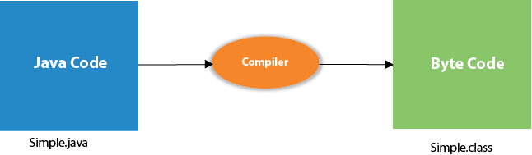
Sample Java Program
class Simple
{
public static void main(String args[])
{
System.out.println("Hello Java");
}
}
To compile: | javac Simple.java
To execute: | java Simple

Slide 22
Parameters used in First Java Program
Let's see what is the meaning of class, public, static, void, main, String[], System.out.println().
class keyword is used to declare a class in java.
public keyword is an access modifier which represents visibility. It means it is visible to all.
static is a keyword. If we declare any method as static, it is known as the static method. The core advantage of the static method is that there is no need to create an object to invoke the static method. The main method is executed by the JVM, so it doesn't require to create an object to invoke the main method. So it saves memory.
void is the return type of the method. It means it doesn't return any value.
main represents the starting point of the program.
String[] args is used for command line argument.
System.out.println() is used to print statement. Here, System is a class, out is the object of PrintStream class, println() is the method of PrintStream class. We will learn about the internal working of System.out.println statement later.

Slide 23
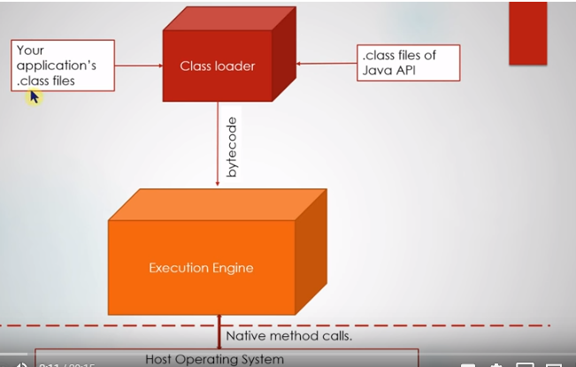
JVM: JVM (Java Virtual Machine) is an abstract machine.
It is called a virtual machine because it doesn't physically exist. It is a specification that provides a runtime environment in which Java bytecode can be executed. It can also run those programs which are written in other languages and compiled to Java bytecode.
JVMs are available for many hardware and software platforms. JVM, JRE, and JDK are platform dependent because the configuration of each OS is different from each other. However, Java is platform independent. There are three notions of the JVM: specification, implementation, and instance.
The JVM performs the following main tasks:
Loads code
Verifies code
Executes code
Provides runtime environment

Slide 24
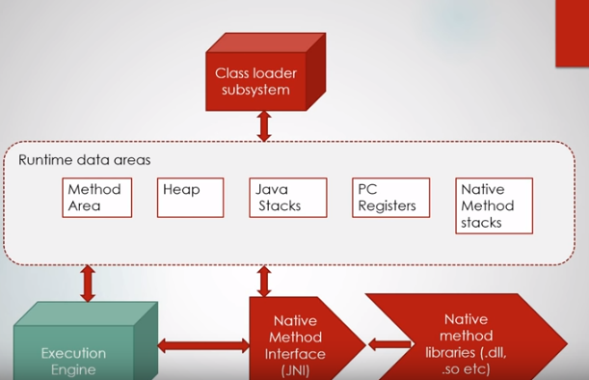

Slide 25
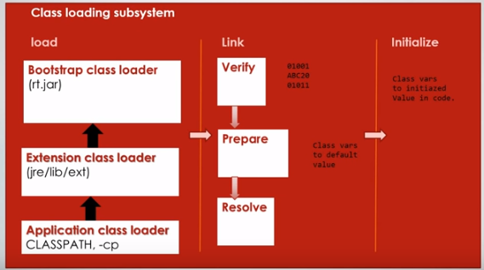

Slide 26
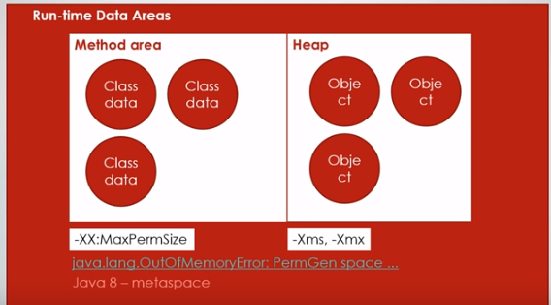

Slide 27
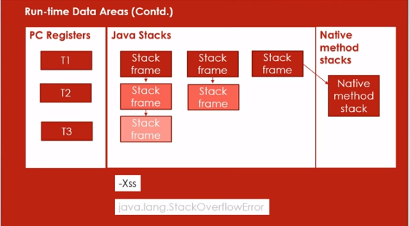

Slide 28
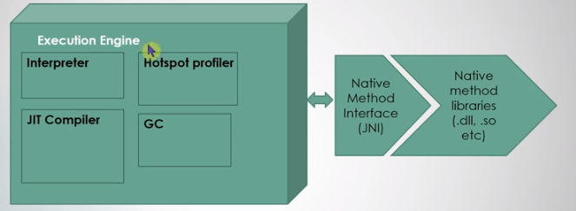

Slide 29
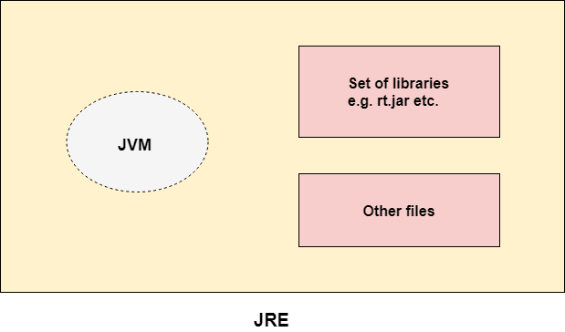
JRE: JRE is an acronym for Java Runtime Environment.
The Java Runtime Environment is a set of software tools which are used for developing Java applications. It is used to provide the runtime environment. It is the implementation of JVM. It physically exists.
It contains a set of libraries + other files that JVM uses at runtime.
The implementation of JVM is also actively released by other companies besides Sun Micro Systems.

Slide 30
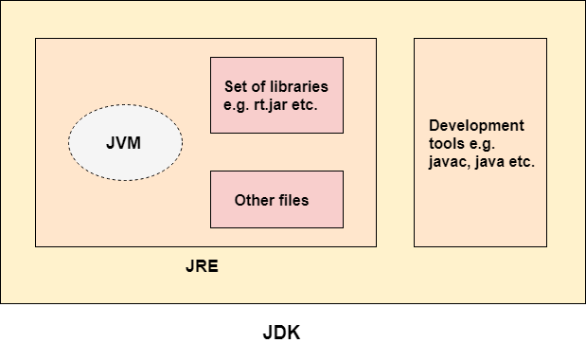
JDK: JDK is an acronym for Java Development Kit.
The Java Development Kit (JDK) is a software development environment which is used to develop Java applications and applets. It physically exists. It contains JRE + development tools.
JDK is an implementation of any one of the below given Java Platforms released by Oracle
Corporation:
Standard Edition Java Platform
Enterprise Edition Java Platform
Micro Edition Java Platform
The JDK contains a private Java Virtual Machine (JVM) and a few other resources such as an interpreter/loader (java), a compiler (javac), an archiver (jar), a documentation generator (Javadoc), etc. to complete the development of a Java Application.

Slide 31
JVM (Java Virtual Machine) Architecture
JVM (Java Virtual Machine) is an abstract machine. It is a specification that provides runtime environment in which java bytecode can be executed.
JVMs are available for many hardware and software platforms (i.e. JVM is platform dependent).
What is JVM It is:
A specification where working of Java Virtual Machine is specified. But implementation provider is independent to choose the algorithm. Its implementation has been provided by Oracle and other companies.
An implementation Its implementation is known as JRE (Java Runtime Environment).
Runtime Instance Whenever you write java command on the command prompt to run the java class, an instance of JVM is created.

Slide 32
The JVM performs following operation:
Loads code
Verifies code
Executes code
Provides runtime environment
JVM provides definitions for the:
Memory area
Class file format
Register set
Garbage-collected heap
Fatal error reporting etc.

Slide 33
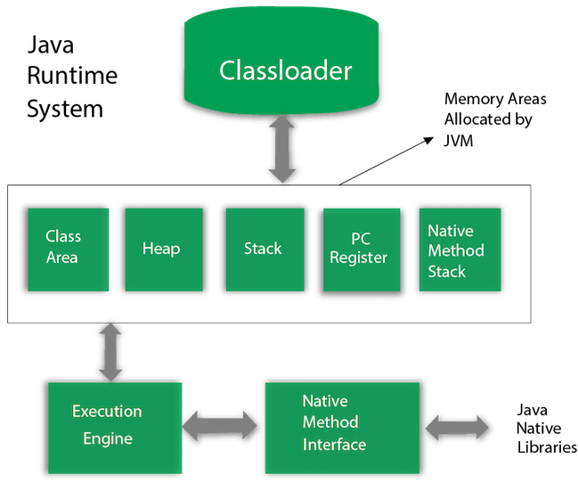

Slide 34
1) Classloader
Classloader is a subsystem of JVM which is used to load class files. Whenever we run the java program, it is loaded first by the classloader.
There are three built-in classloaders in Java.
Bootstrap ClassLoader: This is the first classloader which is the super class of Extension classloader. It loads the rt.jar file which contains all class files of Java Standard Edition like java.lang package classes, java.net package classes, java.util package classes, java.io package classes, java.sql package classes etc.
Extension ClassLoader: This is the child classloader of Bootstrap and parent classloader of System classloader. It loades the jar files located inside $JAVA_HOME/jre/lib/ext directory.
System/Application ClassLoader: This is the child classloader of Extension classloader. It loads the classfiles from classpath. By default, classpath is set to current directory. You can change the classpath using "-cp" or "-classpath" switch. It is also known as Application classloader.

Slide 35
2) Class(Method) Area
Class(Method) Area stores per-class structures such as the runtime constant pool, field and method data, the code for methods.
3) Heap
It is the runtime data area in which objects are allocated.
4) Stack
Java Stack stores frames. It holds local variables and partial results, and plays a part in method invocation and return.
each time a method is invoked. A frame is destroyed when its method invocation completes.
5) Program Counter Register
PC (program counter) register contains the address of the Java virtual machine instruction currently being executed.

Slide 36
6) Native Method Stack
It contains all the native methods used in the application.
7) Execution Engine
It contains:
A virtual processor
Interpreter: Read bytecode stream then execute the instructions.
Just-In-Time(JIT) compiler: It is used to improve the performance. JIT compiles parts of the byte code that have similar functionality at the same time, and hence reduces the amount of time needed for compilation. Here, the term "compiler" refers to a translator from the instruction set of a Java virtual machine (JVM) to the instruction set of a specific CPU.
8) Java Native Interface
Java Native Interface (JNI) is a framework which provides an interface to communicate with another application written in another language like C, C++, Assembly etc. Java uses JNI framework to send output to the Console or interact with OS libraries.

Slide 37
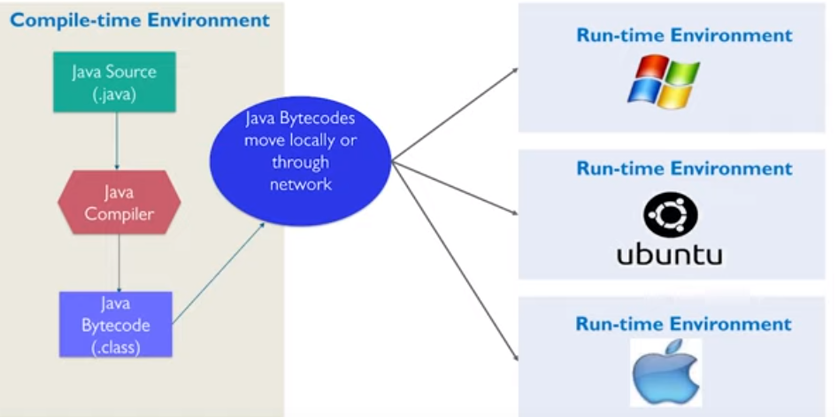

Slide 38
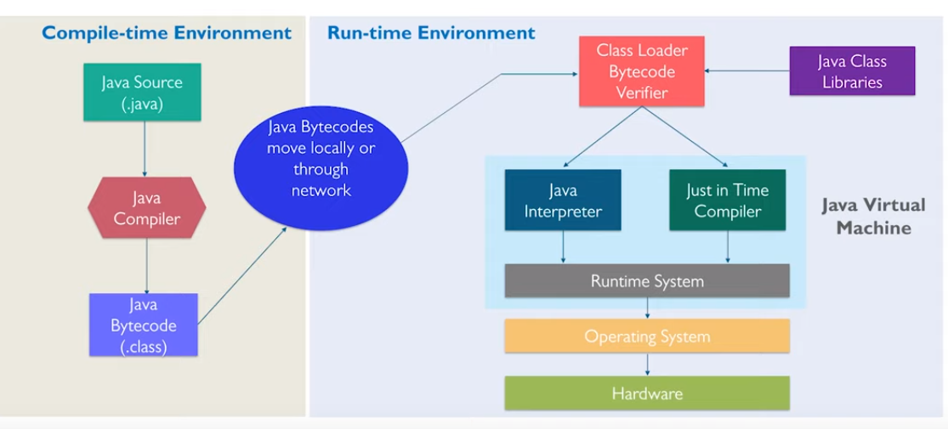

Slide 39
Popular Java IDEs
NetBeans Open Source by Sun
Eclipse Open Source by IBM

Slide 40
A Simple Java Program
Listing 1.1
//This program prints Welcome to Java!
public class Welcome {
public static void main(String[] args) {
System.out.println("Welcome to Java!");
}
}

Slide 41

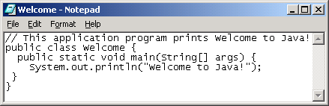
Creating and Editing Using NotePad
To use NotePad, type
notepad Welcome.java
from the DOS prompt.

Slide 42

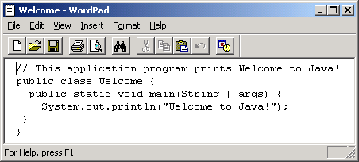
Creating and Editing Using WordPad
To use WordPad, type
write Welcome.java
from the DOS prompt.

Slide 43
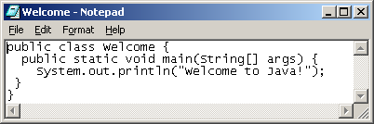
Creating, Compiling, and Running Programs

Slide 44
Compiling Java Source Code
You can port a source program to any machine with appropriate compilers. The source program must be recompiled, however, because the object program can only run on a specific machine. Nowadays computers are networked to work together. Java was designed to run object programs on any platform. With Java, you write the program once, and compile the source program into a special type of object code, known as bytecode. The bytecode can then run on any computer with a Java Virtual Machine, as shown below. Java Virtual Machine is a software that interprets Java bytecode.

Slide 45
Trace a Program Execution
animation
Execute statement
//This program prints Welcome to Java!
public class Welcome {
public static void main(String[] args) {
System.out.println("Welcome to Java!");
}
}

Slide 46
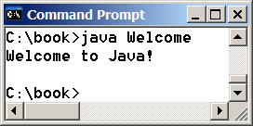
Trace a Program Execution
animation
//This program prints Welcome to Java!
public class Welcome {
public static void main(String[] args) {
System.out.println("Welcome to Java!");
}
}
print a message to the console

Slide 47
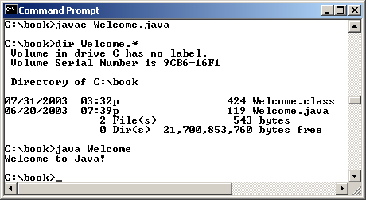
Compiling and Running Java from the Command Window
Companion Website
Set path to JDK bin directory
set path=c:\Program Files\java\jdk1.6.0\bin
Set classpath to include the current directory
set classpath=.
Compile
javac Welcome.java
Run
java Welcome

Slide 48
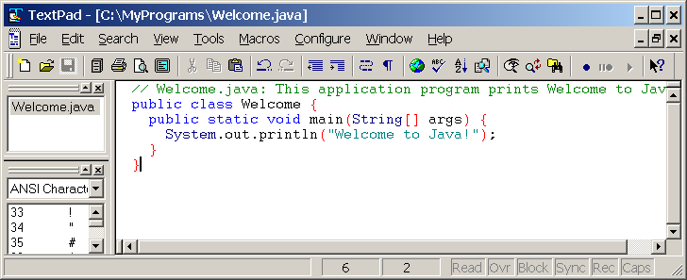
Compiling and Running Java from TextPad
See Supplement II.A on the Website for details

Slide 49
Anatomy of a Java Program
Comments
Reserved words
Modifiers
Statements
Blocks
Classes
Methods
The main method

Slide 50
Comments
Three types of comments in Java.
Line comment: A line comment is preceded by two slashes (//) in a line.
Paragraph comment: A paragraph comment is enclosed between /* and */ in one or multiple lines.
javadoc comment: javadoc comments begin with /** and end with */. They are used for documenting classes, data, and methods. They can be extracted into an HTML file using JDK's javadoc command.

Slide 51
Reserved Words
Reserved words or keywords are words that have a specific meaning to the compiler and cannot be used for other purposes in the program. For example, when the compiler sees the word class, it understands that the word after class is the name for the class. Other reserved words in Listing 1.1 are public, static, and void. Their use will be introduced later in the book.

Slide 52
Modifiers
Java uses certain reserved words called modifiers that specify the properties of the data, methods, and classes and how they can be used. Examples of modifiers are public and static. Other modifiers are private, final, abstract, and protected. A public datum, method, or class can be accessed by other programs. A private datum or method cannot be accessed by other programs. Modifiers are discussed in Chapter 6, “Objects and Classes.”

Slide 53
Statements
A statement represents an action or a sequence of actions. The statement System.out.println("Welcome to Java!") in the program in Listing 1.1 is a statement to display the greeting "Welcome to Java!" Every statement in Java ends with a semicolon (;).

Slide 54
Blocks
A pair of braces in a program forms a block that groups components of a program.

Slide 55
Classes
The class is the essential Java construct. A class is a template or blueprint for objects. To program in Java, you must understand classes and be able to write and use them. The mystery of the class will continue to be unveiled throughout this book. For now, though, understand that a program is defined by using one or more classes.

Slide 56
Methods
What is System.out.println? It is a method: a collection of statements that performs a sequence of operations to display a message on the console. It can be used even without fully understanding the details of how it works. It is used by invoking a statement with a string argument. The string argument is enclosed within parentheses. In this case, the argument is "Welcome to Java!" You can call the same println method with a different argument to print a different message.

Slide 57
main Method
The main method provides the control of program flow. The Java interpreter executes the application by invoking the main method.
The main method looks like this:
public static void main(String[] args) {
// Statements;
}

Slide 58
Variable
Variable is name of reserved area allocated in memory. In other words, it is a name of memory location. It is a combination of "vary + able" that means its value can be changed. There are three types of variables in java: local variable instance variable static variable 1) Local Variable: A variable declared inside the body of the method is called local variable. You can use this variable only within that method and the other methods in the class aren't even aware that the variable exists. A local variable cannot be defined with "static" keyword. 2) Instance Variable: A variable declared inside the class but outside the body of the method, is called instance variable. It is not declared as static. It is called instance variable because its value is instance specific and is not shared among instances. 3) Static variable: A variable which is declared as static is called static variable. It cannot be local. You can create a single copy of static variable and share among all the instances of the class. Memory allocation for static variable happens only once when the class is loaded in the memory.

Slide 59
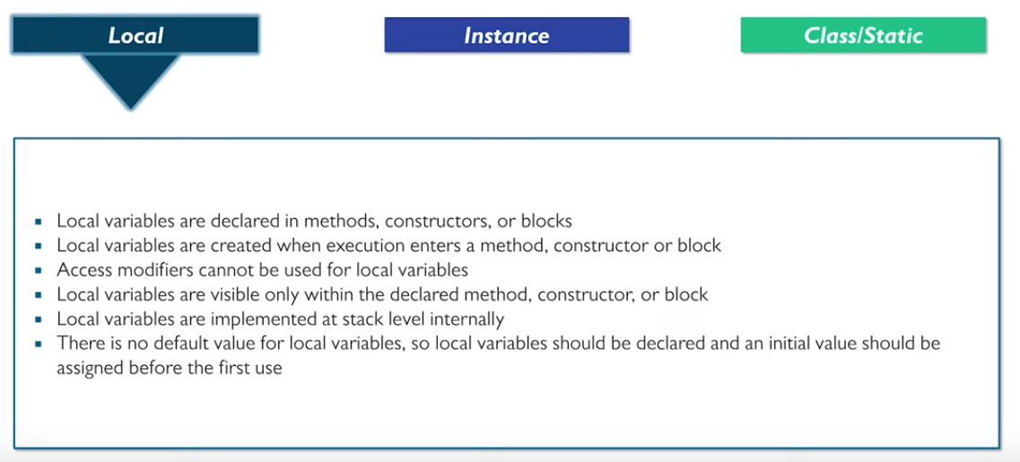

Slide 60
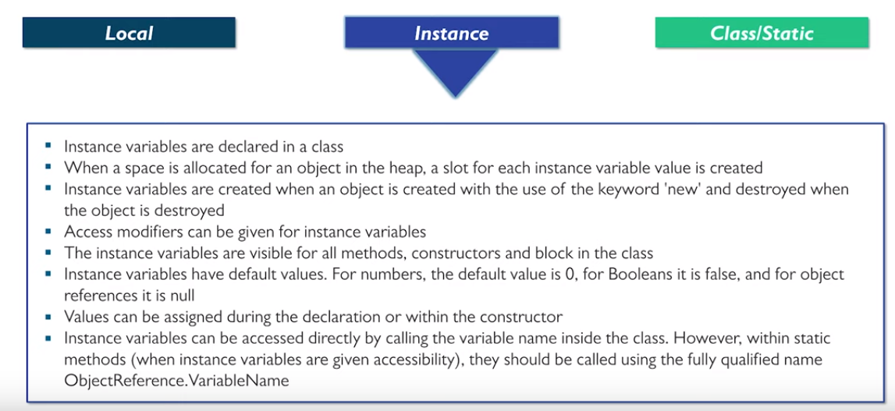

Slide 61
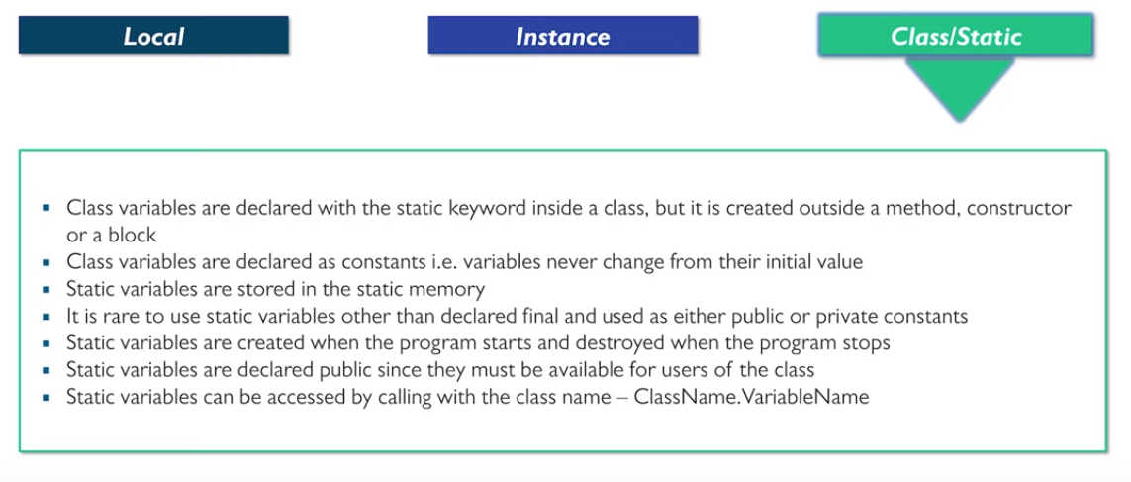

Slide 62
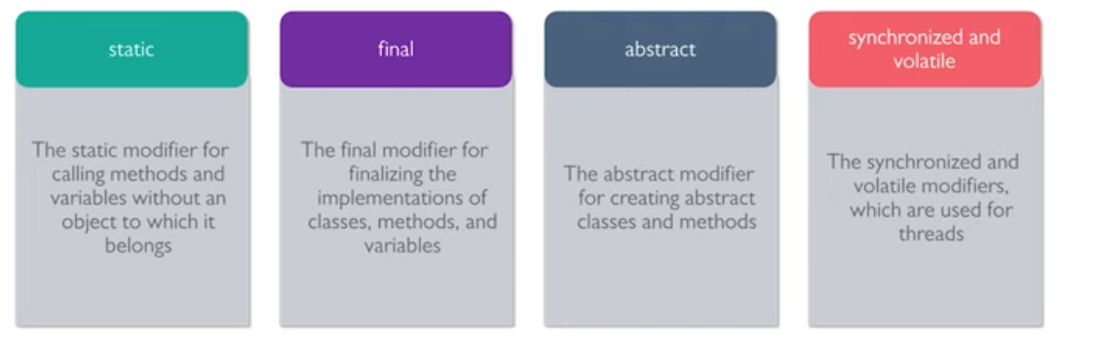
Modifiers

Slide 63
Example
class A{
int data=50;//instance variable
static int m=100;//static variable
void method(){
int n=90;//local variable
}
}//end of class

Slide 64
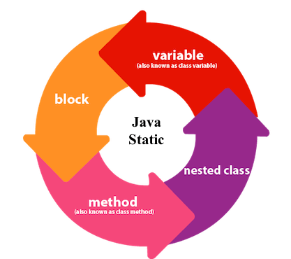
The static keyword in Java is used for memory management mainly. We can apply java static keyword with variables, methods, blocks and nested class. The static keyword belongs to the class than an instance of the class.
The static can be:
Variable (also known as a class variable)
Method (also known as a class method)
Block
Nested class

Slide 65
1) Java static variable
If you declare any variable as static, it is known as a static variable.
The static variable can be used to refer to the common property of all objects (which is not unique for each object), for example, the company name of employees, college name of students, etc.
The static variable gets memory only once in the class area at the time of class loading.
Advantages of static variable is to makes your program memory efficient (i.e., it saves memory).

Slide 66
//Java Program to demonstrate the use of static variable
class Student{
int rollno;//instance variable
String name;
static String college ="ITS";//static variable
//constructor
Student(int r, String n){
rollno = r;
name = n;
}
//method to display the values
void display (){
System.out.println(rollno+" "+name+" "+college);}
}
//Test class to show the values of objects
public class TestStaticVariable1{
public static void main(String args[]){
Student s1 = new Student(111,"Karan");
Student s2 = new Student(222,"Aryan");
//we can change the college of all objects by the single line of code
//Student.college="BBDIT";
s1.display();
s2.display();
}
}

Slide 67
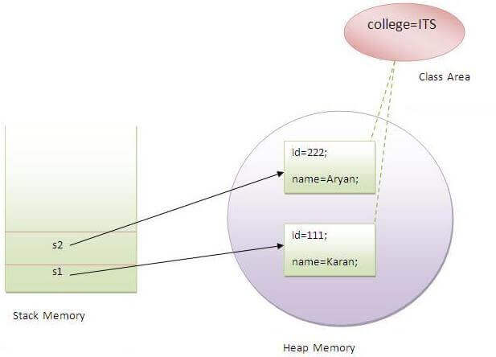

Slide 68
//Java Program to demonstrate the use of an instance variable
//which get memory each time when we create an object of the class.
class Counter{
int count=0;//will get memory each time when the instance is created
Counter(){
count++;//incrementing value
System.out.println(count);
}
public static void main(String args[]){
//Creating objects
Counter c1=new Counter();
Counter c2=new Counter();
Counter c3=new Counter();
}
}

Slide 69
static variable
//Java Program to illustrate the use of static variable which
//is shared with all objects.
class Counter2{
static int count=0;//will get memory only once and retain its value
Counter2(){
count++;//incrementing the value of static variable
System.out.println(count);
}
public static void main(String args[]){
//creating objects
Counter2 c1=new Counter2();
Counter2 c2=new Counter2();
Counter2 c3=new Counter2();
}
}

Slide 70
static method
//Java Program to demonstrate the use of a static method.
class Student{
int rollno;
String name;
static String college = "ITS";
//static method to change the value of static variable
static void change(){
college = "BBDIT";
}
//constructor to initialize the variable
Student(int r, String n){
rollno = r;
name = n;
}
//method to display values
void display(){System.out.println(rollno+" "+name+" "+college);}
}
//Test class to create and display the values of object
public class TestStaticMethod{
public static void main(String args[]){
Student.change();//calling change method
//creating objects
Student s1 = new Student(111,"Karan");
Student s2 = new Student(222,"Aryan");
Student s3 = new Student(333,"Sonoo");
//calling display method
s1.display();
s2.display();
s3.display();
}
}

Slide 71
class A{
int a=40;//non static
public static void main(String args[]){
System.out.println(a);
}
}

Slide 72
Java static block
Is used to initialize the static data member.
It is executed before the main method at the time of classloading.
class A2{
static{System.out.println("static block is invoked");}
public static void main(String args[]){
System.out.println("Hello main");
}
}

Slide 73
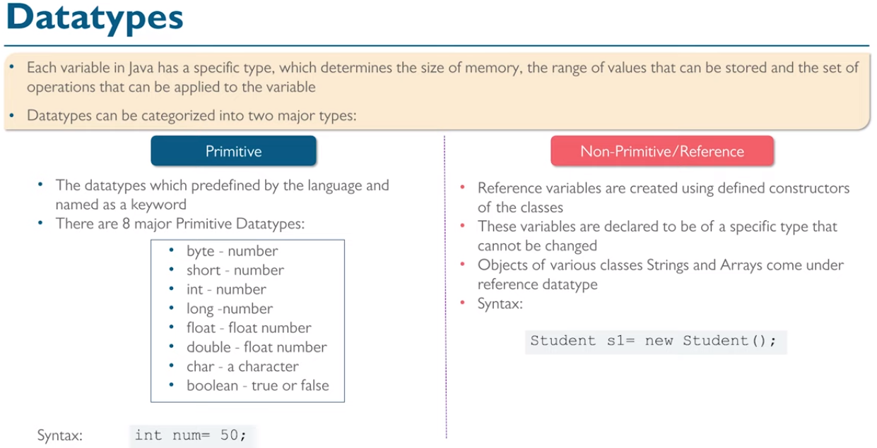

Slide 74
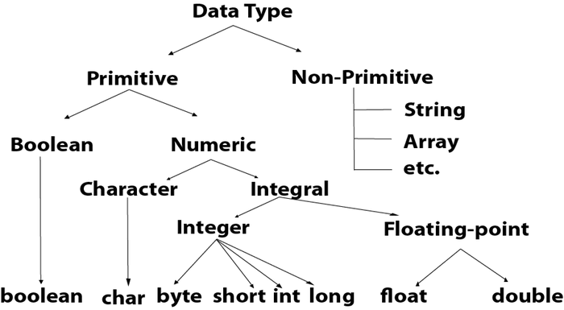
Data types in Java

Slide 75
Data types and it’s size
Data Type | Default Value | Default size
boolean | false | 1 bit
char | '\u0000' | 2 byte
byte | 0 | 1 byte
short | 0 | 2 byte
int | 0 | 4 byte
long | 0L | 8 byte
float | 0.0f | 4 byte
double | 0.0d | 8 byte

Slide 76
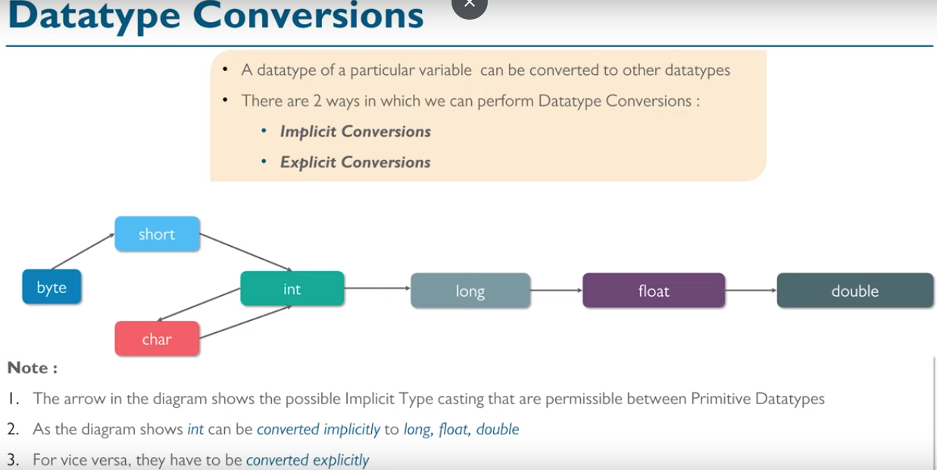

Slide 77
Java Operator Precedence
Operator Type | Category | Precedence
Unary | postfix | expr++ expr--
 | prefix | ++expr --expr +expr -expr ~ !
Arithmetic | multiplicative | * / %
 | additive | + -
Shift | shift | << >> >>>
Relational | comparison | < > <= >= instanceof
 | equality | == !=
Bitwise | bitwise AND | &
 | bitwise exclusive OR | ^
 | bitwise inclusive OR | |
Logical | logical AND | &&
 | logical OR | ||
Ternary | ternary | ? :
Assignment | assignment | = += -= *= /= %= &= ^= |= <<= >>= >>>=

Slide 78
List of Java Keywords
abstract: Java abstract keyword is used to declare abstract class. Abstract class can provide the implementation of interface. It can have abstract and non-abstract methods.
boolean: Java boolean keyword is used to declare a variable as a boolean type. It can hold True and False values only.
break: Java break keyword is used to break loop or switch statement. It breaks the current flow of the program at specified condition.
byte: Java byte keyword is used to declare a variable that can hold an 8-bit data values.
case: Java case keyword is used to with the switch statements to mark blocks of text.
catch: Java catch keyword is used to catch the exceptions generated by try statements. It must be used after the try block only.
char: Java char keyword is used to declare a variable that can hold unsigned 16-bit Unicode characters
class: Java class keyword is used to declare a class.
continue: Java continue keyword is used to continue the loop. It continues the current flow of the program and skips the remaining code at the specified condition.
default: Java default keyword is used to specify the default block of code in a switch statement.
do: Java do keyword is used in control statement to declare a loop. It can iterate a part of the program several times.
double: Java double keyword is used to declare a variable that can hold a 64-bit floating-point numbers.

Slide 79
else: Java else keyword is used to indicate the alternative branches in an if statement.
enum: Java enum keyword is used to define a fixed set of constants. Enum constructors are always private or default.
extends: Java extends keyword is used to indicate that a class is derived from another class or interface.
final: Java final keyword is used to indicate that a variable holds a constant value. It is applied with a variable. It is used to restrict the user.
finally: Java finally keyword indicates a block of code in a try-catch structure. This block is always executed whether exception is handled or not.
float: Java float keyword is used to declare a variable that can hold a 32-bit floating-point number.
for: Java for keyword is used to start a for loop. It is used to execute a set of instructions/functions repeatedly when some conditions become true. If the number of iteration is fixed, it is recommended to use for loop.
if: Java if keyword tests the condition. It executes the if block if condition is true.
implements: Java implements keyword is used to implement an interface.
import: Java import keyword makes classes and interfaces available and accessible to the current source code.
instanceof: Java instanceof keyword is used to test whether the object is an instance of the specified class or implements an interface.
int: Java int keyword is used to declare a variable that can hold a 32-bit signed integer.
interface: Java interface keyword is used to declare an interface. It can have only abstract methods.
long: Java long keyword is used to declare a variable that can hold a 64-bit integer.
native: Java native keyword is used to specify that a method is implemented in native code using JNI (Java Native Interface).
new: Java new keyword is used to create new objects.

Slide 80
null: Java null keyword is used to indicate that a reference does not refer to anything. It removes the garbage value.
package: Java package keyword is used to declare a Java package that includes the classes.
private: Java private keyword is an access modifier. It is used to indicate that a method or variable may be accessed only in the class in which it is declared.
protected: Java protected keyword is an access modifier. It can be accessible within package and outside the package but through inheritance only. It can't be applied on the class.
public: Java public keyword is an access modifier. It is used to indicate that an item is accessible anywhere. It has the widest scope among all other modifiers.
return: Java return keyword is used to return from a method when its execution is complete.
short: Java short keyword is used to declare a variable that can hold a 16-bit integer.
static: Java static keyword is used to indicate that a variable or method is a class method. The static keyword in Java is used for memory management mainly.
strictfp: Java strictfp is used to restrict the floating-point calculations to ensure portability.
super: Java super keyword is a reference variable that is used to refer parent class object. It can be used to invoke immediate parent class method.
switch: The Java switch keyword contains a switch statement that executes code based on test value. The switch statement tests the equality of a variable against multiple values.
synchronized: Java synchronized keyword is used to specify the critical sections or methods in multithreaded code.
this: Java this keyword can be used to refer the current object in a method or constructor.

Slide 81
throw: The Java throw keyword is used to explicitly throw an exception. The throw keyword is mainly used to throw custom exception. It is followed by an instance.
throws: The Java throws keyword is used to declare an exception. Checked exception can be propagated with throws.
transient: Java transient keyword is used in serialization. If you define any data member as transient, it will not be serialized.
try: Java try keyword is used to start a block of code that will be tested for exceptions. The try block must be followed by either catch or finally block.
void: Java void keyword is used to specify that a method does not have a return value.
volatile: Java volatile keyword is used to indicate that a variable may change asynchronously.
while: Java while keyword is used to start a while loop. This loop iterates a part of the program several times. If the number of iteration is not fixed, it is recommended to use while loop.

Slide 82
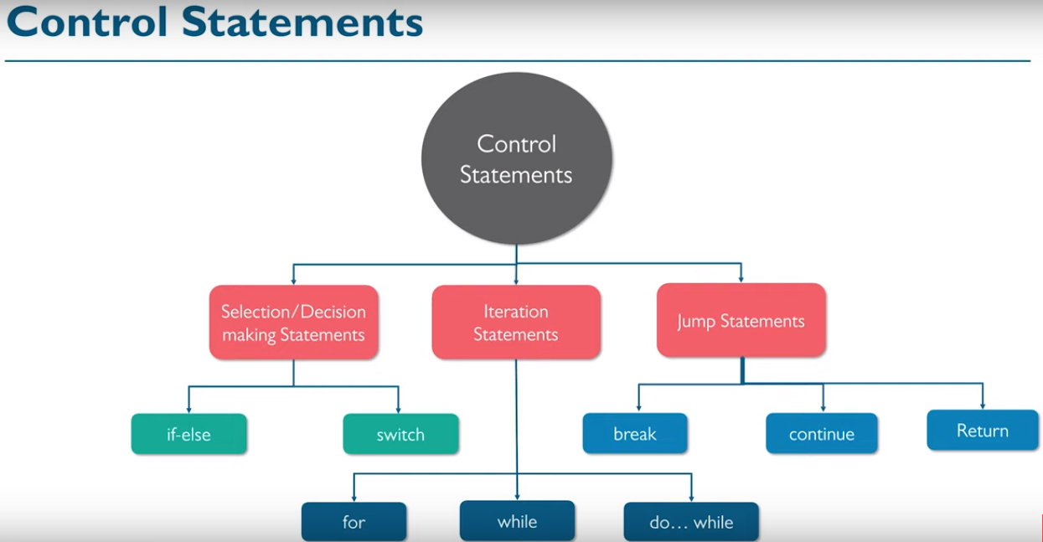

Slide 83
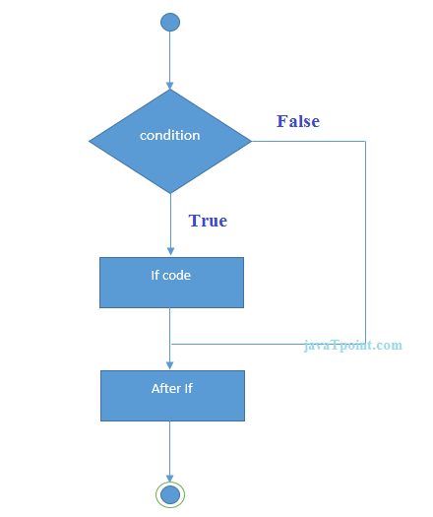
Java If-else Statement
The Java if statement is used to test the condition. It checks Boolean condition: true or false. There are various types of if statement in java. if statement if-else statement if-else-if ladder nested if statement

Slide 84
//Java Program to demonstate the use of if statement.
public class IfExample {
public static void main(String[] args) {
//defining an 'age' variable
int age=20;
//checking the age
if(age>18){
System.out.print("Age is greater than 18");
}
}
}
//Java Program to demonstate the use of if-else statement.
public class LeapYearExample {
public static void main(String[] args) {
int year=2020;
if(((year % 4 ==0) && (year % 100 !=0)) || (year % 400==0)){
System.out.println("LEAP YEAR");
}
else{
System.out.println("COMMON YEAR");
}
}
}

Slide 85
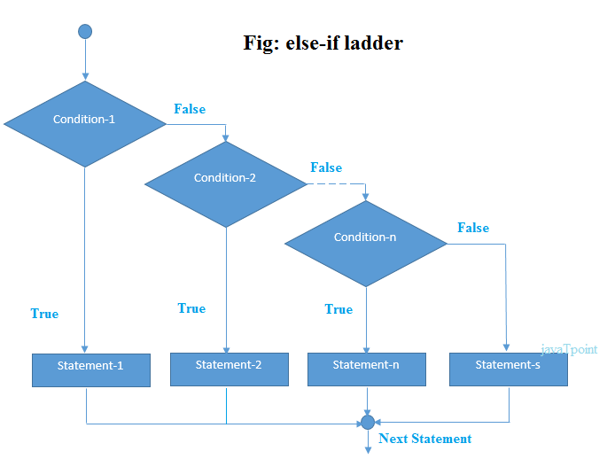

Slide 86
If-else-if statement
//Java Program to demonstrate the use of If else-if ladder.
//It is a program of grading system for fail, D grade, C grade, B grade, A grade and A+.
public class IfElseIfExample {
public static void main(String[] args) {
int marks=65;
if(marks<50){
System.out.println("fail");
}
else if(marks>=50 && marks<60){
System.out.println("D grade");
}
else if(marks>=60 && marks<70){
System.out.println("C grade");
}
else if(marks>=70 && marks<80){
System.out.println("B grade");
}
else if(marks>=80 && marks<90){
System.out.println("A grade");
}else if(marks>=90 && marks<100){
System.out.println("A+ grade");
}else{
System.out.println("Invalid!");
}
}
}

Slide 87
/Java Program to demonstrate the use of Nested If Statement.
public class JavaNestedIfExample2 {
public static void main(String[] args) {
//Creating two variables for age and weight
int age=25;
int weight=48;
//applying condition on age and weight
if(age>=18){
if(weight>50){
System.out.println("You are eligible to donate blood");
} else{
System.out.println("You are not eligible to donate blood");
}
} else{
System.out.println("Age must be greater than 18");
}
} }

Slide 88
Java Switch Statement
The Java switch statement executes one statement from multiple conditions. It is like if-else-if ladder statement. The switch statement works with byte, short, int, long, enum types, String and some wrapper types like Byte, Short, Int, and Long
In other words, the switch statement tests the equality of a variable against multiple values.
Points to Remember
There can be one or N number of case values for a switch expression.
The case value must be of switch expression type only. The case value must be literal or constant. It doesn't allow variables.
The case values must be unique. In case of duplicate value, it renders compile-time error.
The Java switch expression must be of byte, short, int, long (with its Wrapper type), enums and string.
Each case statement can have a break statement which is optional. When control reaches to the break statement, it jumps the control after the switch expression. If a break statement is not found, it executes the next case.
The case value can have a default label which is optional.

Slide 89
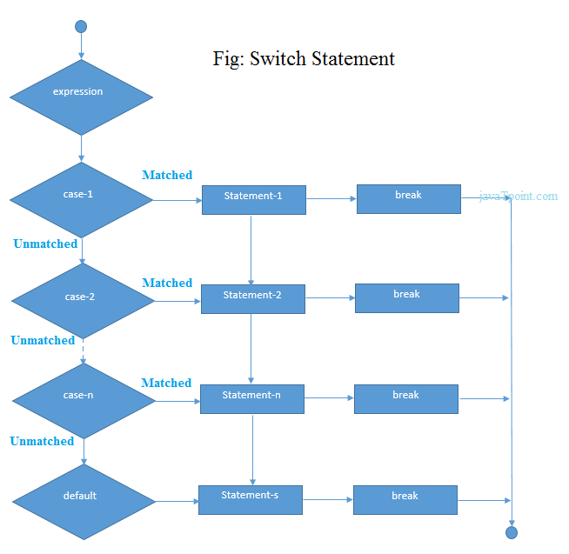

Slide 90
public class SwitchExample {
public static void main(String[] args) {
//Declaring a variable for switch expression
int number=20;
//Switch expression
switch(number){
//Case statements
case 10: System.out.println("10");
break;
case 20: System.out.println("20");
break;
case 30: System.out.println("30");
break;
//Default case statement
default:System.out.println("Not in 10, 20 or 30");
}
}
}

Slide 91
Loops in Java
In programming languages, loops are used to execute a set of instructions/functions repeatedly when some conditions become true. There are three types of loops in java. for loop while loop do-while loop

Slide 92
Java For Loop vs While Loop vs Do While Loop
Comparison | for loop | while loop | do while loop
Introduction | The Java for loop is a control flow statement that iterates a part of the programs multiple times. | The Java while loop is a control flow statement that executes a part of the programs repeatedly on the basis of given boolean condition. | The Java do while loop is a control flow statement that executes a part of the programs at least once and the further execution depends upon the given boolean condition.
When to use | If the number of iteration is fixed, it is recommended to use for loop. | If the number of iteration is not fixed, it is recommended to use while loop. | If the number of iteration is not fixed and you must have to execute the loop at least once, it is recommended to use the do-while loop.
Syntax | for(init;condition;incr/decr){ // code to be executed } | while(condition){ //code to be executed } | do{ //code to be executed }while(condition);
Example | //for loop for(int i=1;i<=10;i++){ System.out.println(i); } | //while loop int i=1; while(i<=10){ System.out.println(i); i++; } | //do-while loop int i=1; do{ System.out.println(i); i++; }while(i<=10);
Syntax for infinitive loop | for(;;){ //code to be executed } | while(true){ //code to be executed } | do{ //code to be executed }while(true);

Slide 93
For loops
Simple For Loop
For-each or Enhanced For Loop
Labeled For Loop
Java Simple For Loop
A simple for loop is the same as C/C++. We can initialize the variable, check condition and increment/decrement value. It consists of four parts:
Initialization: It is the initial condition which is executed once when the loop starts. Here, we can initialize the variable, or we can use an already initialized variable. It is an optional condition.
Condition: It is the second condition which is executed each time to test the condition of the loop. It continues execution until the condition is false. It must return boolean value either true or false. It is an optional condition.
Statement: The statement of the loop is executed each time until the second condition is false.
Increment/Decrement: It increments or decrements the variable value. It is an optional condition.
Syntax:
for(initialization;condition;incr/decr){
//statement or code to be executed
}

Slide 94
//Java Program to demonstrate the example of for loop
//which prints table of 1
public class ForExample {
public static void main(String[] args) {
//Code of Java for loop
for(int i=1;i<=10;i++){
System.out.println(i);
}
}
}

Slide 95
public class NestedForExample {
public static void main(String[] args) {
//loop of i
for(int i=1;i<=3;i++){
//loop of j
for(int j=1;j<=3;j++){
System.out.println(i+" "+j);
}//end of i
}//end of j
}
}

Slide 96
//Java For-each loop example which prints the
//elements of the array
public class ForEachExample {
public static void main(String[] args) {
//Declaring an array
int arr[]={12,23,44,56,78};
//Printing array using for-each loop
for(int i:arr){
System.out.println(i);
}
}
}

Slide 97
//A Java program to demonstrate the use of labeled for loop
public class LabeledForExample {
public static void main(String[] args) {
//Using Label for outer and for loop
aa:
for(int i=1;i<=3;i++){
bb:
for(int j=1;j<=3;j++){
if(i==2&&j==2){
break aa;
}
System.out.println(i+" "+j);
}
}
}
}

Slide 98
//Java program to demonstrate the use of infinite for loop
//which prints an statement
public class ForExample {
public static void main(String[] args) {
//Using no condition in for loop
for(;;){
System.out.println("infinitive loop");
}
}
}

Slide 99
public class WhileExample {
public static void main(String[] args) {
int i=1;
while(i<=10){
System.out.println(i);
i++;
}
}
}
public class DoWhileExample {
public static void main(String[] args) {
int i=1;
do{
System.out.println(i);
i++;
}while(i<=10);
}
}

Slide 100
//Java Program to illustrate the use of break statement
//inside an inner loop
public class BreakExample2 {
public static void main(String[] args) {
//outer loop
for(int i=1;i<=3;i++){
//inner loop
for(int j=1;j<=3;j++){
if(i==2&&j==2){
//using break statement inside the inner loop
break;
}
System.out.println(i+" "+j);
}
}
}
}

Slide 101
//Java Program to demonstrate the use of continue statement
//inside the for loop.
public class ContinueExample {
public static void main(String[] args) {
//for loop
for(int i=1;i<=10;i++){
if(i==5){
//using continue statement
continue;//it will skip the rest statement
}
System.out.println(i);
}
}
}

Slide 102
//Java Program to illustrate the use of continue statement
//inside an inner loop
public class ContinueExample2 {
public static void main(String[] args) {
//outer loop
for(int i=1;i<=3;i++){
//inner loop
for(int j=1;j<=3;j++){
if(i==2&&j==2){
//using continue statement inside inner loop
continue;
}
System.out.println(i+" "+j);
}
}
}
}

Slide 103
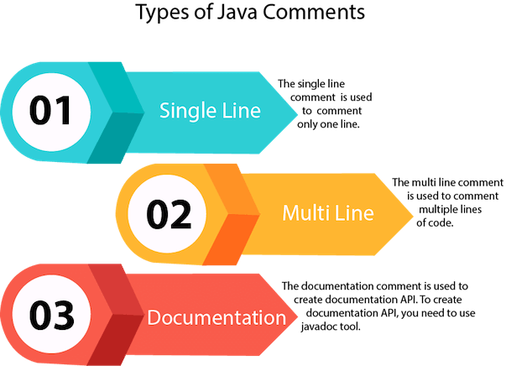

Slide 104
class BinarySearchExample{
public static void binarySearch(int arr[], int first, int last, int key){
int mid = (first + last)/2;
while( first <= last ){
if ( arr[mid] < key ){
first = mid + 1;
}else if ( arr[mid] == key ){
System.out.println("Element is found at index: " + mid);
break;
}else{
last = mid - 1;
}
mid = (first + last)/2;
}
if ( first > last ){
System.out.println("Element is not found!");
}
}
public static void main(String args[]){
int arr[] = {10,20,30,40,50};
int key = 30;
int last=arr.length-1;
binarySearch(arr,0,last,key);
}
}

Slide 105
public class SmallestElement_array {
public static void main(String[] args) {
//Initialize array
int [] arr = new int [] {25, 11, 7, 75, 56};
//Initialize min with first element of array.
int min = arr[0];
//Loop through the array
for (int i = 0; i < arr.length; i++) {
//Compare elements of array with min
if(arr[i] <min)
min = arr[i];
}
System.out.println("Smallest element present in given array: " + min);
}
}

