Slide 1
Introduction to Object and classes
Unit-2

Slide 2
Object
An entity that has state and behavior is known as an object
An object has three characteristics: State: represents the data (value) of an object. Behavior: represents the behavior (functionality) of an object such as deposit, withdraw, etc. Identity: An object identity is typically implemented via a unique ID. The value of the ID is not visible to the external user. However, it is used internally by the JVM to identify each object uniquely

Slide 3
//Java Program to illustrate how to define a class and fields
//Defining a Student class.
class Student{
//defining fields
int id;//field or data member or instance variable
String name;
//creating main method inside the Student class
public static void main(String args[]){
//Creating an object or instance
Student s1=new Student();//creating an object of Student
//Printing values of the object
System.out.println(s1.id);//accessing member through reference variable
System.out.println(s1.name);
}
}

Slide 4
//Java Program to demonstrate having the main method in
//another class
//Creating Student class.
class Student{
int id;
String name;
}
//Creating another class TestStudent1 which contains the main method
class TestStudent1{
public static void main(String args[]){
Student s1=new Student();
System.out.println(s1.id);
System.out.println(s1.name);
}
}

Slide 5
class Student{
int id;
String name;
}
class TestStudent2{
public static void main(String args[]){
Student s1=new Student();
s1.id=101;
s1.name="Sonoo";
System.out.println(s1.id+" "+s1.name);//printing members with a white space
}
}

Slide 6
class Student{
int rollno;
String name;
void insertRecord(int r, String n){
rollno=r;
name=n;
}
void displayInformation(){System.out.println(rollno+" "+name);}
}
class TestStudent4{
public static void main(String args[]){
Student s1=new Student();
Student s2=new Student();
s1.insertRecord(111,"Karan");
s2.insertRecord(222,"Aryan");
s1.displayInformation();
s2.displayInformation();
}
}

Slide 7
Anonymous object
class Calculation{
void fact(int n){
int fact=1;
for(int i=1;i<=n;i++){
fact=fact*i;
}
System.out.println("factorial is "+fact);
}
public static void main(String args[]){
new Calculation().fact(5);//calling method with anonymous object
}
}

Slide 8
//Java Program to illustrate the use of Rectangle class which
//has length and width data members
class Rectangle{
int length;
int width;
void insert(int l,int w){
length=l;
width=w;
}
void calculateArea(){System.out.println(length*width);}
}
class TestRectangle2{
public static void main(String args[]){
Rectangle r1=new Rectangle(),r2=new Rectangle();//creating two objects
r1.insert(11,5);
r2.insert(3,15);
r1.calculateArea();
r2.calculateArea();
}
}

Slide 9
constructor
In Java, a constructor is a block of codes similar to the method. It is called when an instance of the class is created. At the time of calling constructor, memory for the object is allocated in the memory.
It is a special type of method which is used to initialize the object.
Every time an object is created using the new() keyword, at least one constructor is called.
There are two rules defined for the constructor.
Constructor name must be the same as its class name
A Constructor must have no explicit return type
A Java constructor cannot be abstract, static, final, and synchronized
There are two types of constructors in Java:
Default constructor (no-arg constructor)
Parameterized constructor

Slide 10
//Java Program to create and call a default constructor
class Bike1{
//creating a default constructor
Bike1(){System.out.println("Bike is created");}
//main method
public static void main(String args[]){
//calling a default constructor
Bike1 b=new Bike1();
}
}

Slide 11
//Java Program to demonstrate the use of the parameterized constructor.
class Student4{
int id;
String name;
//creating a parameterized constructor
Student4(int i,String n){
id = i;
name = n;
}
//method to display the values
void display(){System.out.println(id+" "+name);}
public static void main(String args[]){
//creating objects and passing values
Student4 s1 = new Student4(111,"Karan");
Student4 s2 = new Student4(222,"Aryan");
//calling method to display the values of object
s1.display();
s2.display();
}
}

Slide 12
//Java program to overload constructors
class Student5{
int id;
String name;
int age;
//creating two arg constructor
Student5(int i,String n){
id = i;
name = n;
}
//creating three arg constructor
Student5(int i,String n,int a){
id = i;
name = n;
age=a;
}
void display(){
System.out.println(id+" "+name+" "+age);
}
public static void main(String args[]){
Student5 s1 = new Student5(111,"Karan");
Student5 s2 = new Student5(222,"Aryan",25);
s1.display();
s2.display();
}
}

Slide 13
There are many differences between constructors and methods.
Java Constructor | Java Method
A constructor is used to initialize the state of an object. | A method is used to expose the behavior of an object.
A constructor must not have a return type. | A method must have a return type.
The constructor is invoked implicitly. | The method is invoked explicitly.
The Java compiler provides a default constructor if you don't have any constructor in a class. | The method is not provided by the compiler in any case.
The constructor name must be same as the class name. | The method name may or may not be same as the class name.

Slide 14
//Java program to initialize the values from one object to another object.
class Student6{
int id;
String name;
//constructor to initialize integer and string
Student6(int i,String n){
id = i;
name = n;
}
//constructor to initialize another object
Student6(Student6 s){
id = s.id;
name =s.name;
}
void display(){System.out.println(id+" "+name);}
public static void main(String args[]){
Student6 s1 = new Student6(111,"Karan");
Student6 s2 = new Student6(s1);
s1.display();
s2.display();
}
}

Slide 15
Copy without constructor
class Student7{
int id;
String name;
Student7(int i,String n){
id = i;
name = n;
}
Student7(){}
void display(){System.out.println(id+" "+name);}
public static void main(String args[]){
Student7 s1 = new Student7(111,"Karan");
Student7 s2 = new Student7();
s2.id=s1.id;
s2.name=s1.name;
s1.display();
s2.display();
}
}

Slide 16
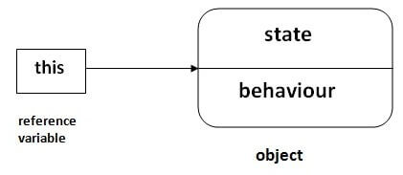
this keyword in java
There can be a lot of usage of java this keyword. In java, this is a reference variable that refers to the current object.
6 usage of java this keyword.
this can be used to refer current class instance variable.
this can be used to invoke current class method (implicitly)
this() can be used to invoke current class constructor.
this can be passed as an argument in the method call.
this can be passed as argument in the constructor call.
this can be used to return the current class instance from the method.

Slide 17
class Student{
int rollno;
String name;
float fee;
Student(int rollno,String name,float fee){
rollno=rollno;
name=name;
fee=fee;
}
void display(){System.out.println(rollno+" "+name+" "+fee);}
}
class TestThis1{
public static void main(String args[]){
Student s1=new Student(111,"ankit",5000f);
Student s2=new Student(112,"sumit",6000f);
s1.display();
s2.display();
}}

Slide 18
With this key word
class Student{
int rollno;
String name;
float fee;
Student(int rollno,String name,float fee){
this.rollno=rollno;
this.name=name;
this.fee=fee;
}
void display(){System.out.println(rollno+" "+name+" "+fee);}
}
class TestThis2{
public static void main(String args[]){
Student s1=new Student(111,"ankit",5000f);
Student s2=new Student(112,"sumit",6000f);
s1.display();
s2.display();
}}

Slide 19
Without this keyword
class Student{
int rollno;
String name;
float fee;
Student(int r,String n,float f){
rollno=r;
name=n;
fee=f;
}
void display(){System.out.println(rollno+" "+name+" "+fee);}
}
class TestThis3{
public static void main(String args[]){
Student s1=new Student(111,"ankit",5000f);
Student s2=new Student(112,"sumit",6000f);
s1.display();
s2.display();
}}

Slide 20
Calling default constructor from parameterized constructor:
class A{
A(){System.out.println("hello a");}
A(int x){
this();
System.out.println(x);
}
}
class TestThis5{
public static void main(String args[]){
A a=new A(10);
}}
Output:
hello a
10

Slide 21
Calling parameterized constructor from default constructor:
class A{
A(){
this(5);
System.out.println("hello a");
}
A(int x){
System.out.println(x);
}
}
class TestThis6{
public static void main(String args[]){
A a=new A();
}}

Slide 22
Passing this parameter
class A5{
void m(){
System.out.println(this);//prints same reference ID
}
public static void main(String args[]){
A5 obj=new A5();
System.out.println(obj);//prints the reference ID
obj.m();
}
}

Slide 23
Inheritance in Java
Inheritance in Java is a mechanism in which one object acquires all the properties and behaviors of a parent object. It is an important part of OOPs.
The idea behind inheritance in Java is that you can create new classes that are built upon existing classes. When you inherit from an existing class, you can reuse methods and fields of the parent class. Moreover, you can add new methods and fields in your current class also.
Inheritance represents the IS-A relationship which is also known as a parent-child relationship.
use of inheritance is for Method Overriding (so runtime polymorphism can be achieved) and For Code Reusability.

Slide 24
Terms used in Inheritance
Class: A class is a group of objects which have common properties. It is a template or blueprint from which objects are created.
Sub Class/Child Class: Subclass is a class which inherits the other class. It is also called a derived class, extended class, or child class.
Super Class/Parent Class: Superclass is the class from where a subclass inherits the features. It is also called a base class or a parent class.
Reusability: As the name specifies, reusability is a mechanism which facilitates you to reuse the fields and methods of the existing class when you create a new class. You can use the same fields and methods already defined in the previous class.
The syntax of Java Inheritance
class Subclass-name extends Superclass-name
{
//methods and fields
}
The extends keyword indicates that you are making a new class that derives from an existing class. The meaning of "extends" is to increase the functionality.

Slide 25
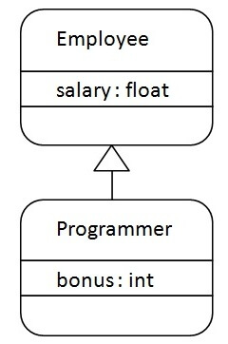
Example
class Employee{
float salary=40000;
}
class Programmer extends Employee{
int bonus=10000;
public static void main(String args[]){
Programmer p=new Programmer();
System.out.println("Programmer salary is:"+p.salary);
System.out.println("Bonus of Programmer is:"+p.bonus);
}
}

Slide 26
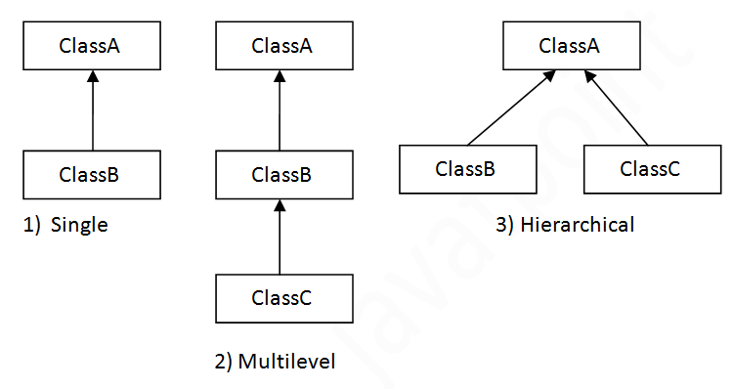
Types of inheritance in java
On the basis of class, there can be three types of inheritance in java: single, multilevel and hierarchical.
In java programming, multiple and hybrid inheritance is supported through interface only.

Slide 27
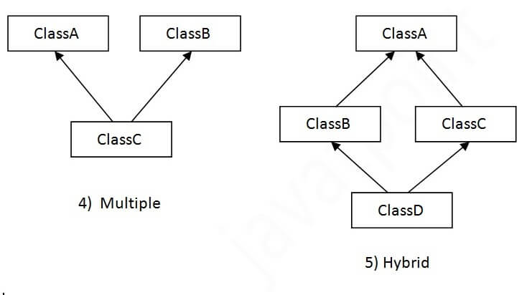

Slide 28
Single inheritance
class Animal{
void eat(){System.out.println("eating...");}
}
class Dog extends Animal{
void bark(){System.out.println("barking...");}
}
class TestInheritance{
public static void main(String args[]){
Dog d=new Dog();
d.bark();
d.eat();
}}

Slide 29
Multilevel inheritance
class Animal{
void eat(){System.out.println("eating...");}
}
class Dog extends Animal{
void bark(){System.out.println("barking...");}
}
class BabyDog extends Dog{
void weep(){System.out.println("weeping...");}
}
class TestInheritance2{
public static void main(String args[]){
BabyDog d=new BabyDog();
d.weep();
d.bark();
d.eat();
}}

Slide 30
Hierarchical Inheritance Example
class Animal{
void eat(){System.out.println("eating...");}
}
class Dog extends Animal{
void bark(){System.out.println("barking...");}
}
class Cat extends Animal{
void meow(){System.out.println("meowing...");}
}
class TestInheritance3{
public static void main(String args[]){
Cat c=new Cat();
c.meow();
c.eat();
//c.bark();//C.T.Error
}}

Slide 31
multiple inheritance is not supported in java
class A{
void msg(){System.out.println("Hello");}
}
class B{
void msg(){System.out.println("Welcome");}
}
class C extends A,B{//suppose if it were
public static void main(String args[]){
C obj=new C();
obj.msg();//Now which msg() method would be invoked?
}
}

Slide 32
Aggregation in Java
If a class have an entity reference, it is known as Aggregation. Aggregation represents HAS-A relationship.
Consider a situation, Employee object contains many informations such as id, name, emailId etc. It contains one more object named address, which contains its own informations such as city, state, country, zipcode etc. as given below.
class Employee{
int id;
String name;
Address address;//Address is a class
...
}
In such case, Employee has an entity reference address, so relationship is Employee HAS-A address.
it is used for Code Reusability.

Slide 33
public class Address {
String city,state,country;
public Address(String city, String state, String country) {
this.city = city;
this.state = state;
this.country = country;
}
}
public class Emp {
int id;
String name;
Address address;
public Emp(int id, String name,Address address) {
this.id = id;
this.name = name;
this.address=address;
}
void display(){
System.out.println(id+" "+name);
System.out.println(address.city+" "+address.state+" "+address.country);
}
public static void main(String[] args) {
Address address1=new Address("gzb","UP","india");
Address address2=new Address("gno","UP","india");
Emp e=new Emp(111,"varun",address1);
Emp e2=new Emp(112,"arun",address2);
e.display();
e2.display();
}
}

Slide 34
Method Overloading
If a class has multiple methods having same name but different in parameters, it is known as Method Overloading.
If we have to perform only one operation, having same name of the methods increases the readability of the program.
Suppose you have to perform addition of the given numbers but there can be any number of arguments, if you write the method such as
a(int,int) for two parameters, and
b(int,int,int) for three parameters then it may be difficult for you as well as other programmers to understand the behavior of the method because its name differs.
There are two ways to overload the method in java
By changing number of arguments
By changing the data type

Slide 35
Method Overloading: changing no. of arguments
class Adder{
static int add(int a,int b){return a+b;}
static int add(int a,int b,int c){return a+b+c;}
}
class TestOverloading1{
public static void main(String[] args){
System.out.println(Adder.add(11,11));
System.out.println(Adder.add(11,11,11));
}}

Slide 36
Method Overloading: changing data type of arguments
class Adder{
static int add(int a, int b){return a+b;}
static double add(double a, double b){return a+b;}
}
class TestOverloading2{
public static void main(String[] args){
System.out.println(Adder.add(11,11));
System.out.println(Adder.add(12.3,12.6));
}}

Slide 37
class TestOverloading4{
public static void main(String[] args){System.out.println("main with String[]");}
public static void main(String args){System.out.println("main with String");}
public static void main(){System.out.println("main without args");}
}

Slide 38
method overriding in Java
If subclass (child class) has the same method as declared in the parent class, it is known as method overriding in Java.
In other words, If a subclass provides the specific implementation of the method that has been declared by one of its parent class, it is known as method overriding.
Usage of Java Method Overriding
Method overriding is used to provide the specific implementation of a method which is already provided by its superclass.
Method overriding is used for runtime polymorphism
Rules for Java Method Overriding
The method must have the same name as in the parent class
The method must have the same parameter as in the parent class.
There must be an IS-A relationship (inheritance).

Slide 39
//Java Program to illustrate the use of Java Method Overriding
//Creating a parent class.
class Vehicle{
//defining a method
void run(){System.out.println("Vehicle is running");}
}
//Creating a child class
class Bike2 extends Vehicle{
//defining the same method as in the parent class
void run(){System.out.println("Bike is running safely");}
public static void main(String args[]){
Bike2 obj = new Bike2();//creating object
obj.run();//calling method
}
}

Slide 40
No. | Method Overloading | Method Overriding
1) | Method overloading is used to increase the readability of the program. | Method overriding is used to provide the specific implementation of the method that is already provided by its super class.
2) | Method overloading is performed within class. | Method overriding occurs in two classes that have IS-A (inheritance) relationship.
3) | In case of method overloading, parameter must be different. | In case of method overriding, parameter must be same.
4) | Method overloading is the example of compile time polymorphism. | Method overriding is the example of run time polymorphism.
5) | In java, method overloading can't be performed by changing return type of the method only. Return type can be same or different in method overloading. But you must have to change the parameter. | Return type must be same in method overriding.

Slide 41
super keyword
The super keyword in Java is a reference variable which is used to refer immediate parent class object.
Whenever you create the instance of subclass, an instance of parent class is created implicitly which is referred by super reference variable.
Usage of Java super Keyword
super can be used to refer immediate parent class instance variable.
super can be used to invoke immediate parent class method.
super() can be used to invoke immediate parent class constructor.

Slide 42
refer immediate parent class instance variable
class Animal{
String color="white";
}
class Dog extends Animal{
String color="black";
void printColor(){
System.out.println(color);//prints color of Dog class
System.out.println(super.color);//prints color of Animal class
}
}
class TestSuper1{
public static void main(String args[]){
Dog d=new Dog();
d.printColor();
}}

Slide 43
super can be used to invoke parent class method
class Animal{
void eat(){System.out.println("eating...");}
}
class Dog extends Animal{
void eat(){System.out.println("eating bread...");}
void bark(){System.out.println("barking...");}
void work(){
super.eat();
bark();
}
}
class TestSuper2{
public static void main(String args[]){
Dog d=new Dog();
d.work();
}}

Slide 44
super is used to invoke parent class constructor
class Animal{
Animal(){System.out.println("animal is created");}
}
class Dog extends Animal{
Dog(){
super();
System.out.println("dog is created");
}
}
class TestSuper3{
public static void main(String args[]){
Dog d=new Dog();
}}

Slide 45
Instance Initializer block
Instance Initializer block is used to initialize the instance data member. It run each time when object of the class is created.
The initialization of the instance variable can be done directly but there can be performed extra operations while initializing the instance variable in the instance initializer block. class Bike7{ int speed; Bike7(){System.out.println("speed is "+speed);} {speed=100;} public static void main(String args[]){ Bike7 b1=new Bike7(); Bike7 b2=new Bike7(); } }

Slide 46
class A{
A(){
System.out.println("parent class constructor invoked");
}
}
class B3 extends A{
B3(){
super();
System.out.println("child class constructor invoked");
}
B3(int a){
super();
System.out.println("child class constructor invoked "+a);
}
{System.out.println("instance initializer block is invoked");}
public static void main(String args[]){
B3 b1=new B3();
B3 b2=new B3(10);
}
}
Output:
parent class constructor invoked
instance initializer block is invoked
child class constructor invoked
parent class constructor invoked
instance initializer block is invoked
child class constructor invoked 10

Slide 47
There are mainly three rules for the instance initializer block. They are as follows:
The instance initializer block is created when instance of the class is created.
The instance initializer block is invoked after the parent class constructor is invoked (i.e. after super() constructor call).
The instance initializer block comes in the order in which they appear.

Slide 48
final keyword
The final keyword in java is used to restrict the user. The java final keyword can be used in many context. Final can be:
variable
method
Class
The final keyword can be applied with the variables, a final variable that have no value it is called blank final variable or uninitialized final variable.
It can be initialized in the constructor only. The blank final variable can be static also which will be initialized in the static block only.

Slide 49
final variable
class Bike9{
final int speedlimit=90;//final variable
void run(){
speedlimit=400;
}
public static void main(String args[]){
Bike9 obj=new Bike9();
obj.run();
}
}//end of class
Output: Compile time error

Slide 50
If you make any method as final, you cannot override it.
class Bike{
final void run(){System.out.println("running");}
}
class Honda extends Bike{
void run(){System.out.println("running safely with 100kmph");}
public static void main(String args[]){
Honda honda= new Honda();
honda.run();
}
}
Output: Error

Slide 51
If you make any class as final, you cannot extend it.
final class Bike{}
class Honda1 extends Bike{
void run(){System.out.println("running safely with 100kmph");}
public static void main(String args[]){
Honda1 honda= new Honda1();
honda.run();
}
}

Slide 52
initialize blank final variable
class Bike10{
final int speedlimit;//blank final variable
Bike10(){
speedlimit=70;
System.out.println(speedlimit);
}
public static void main(String args[]){
new Bike10();
}
}

Slide 53
static blank final variable
A static final variable that is not initialized at the time of declaration is known as static blank final variable. It can be initialized only in static block.
class A{
static final int data;//static blank final variable
static{ data=50;}
public static void main(String args[]){
System.out.println(A.data);
}
}

Slide 54
Polymorphism in Java
Polymorphism in Java is a concept by which we can perform a single action in different ways.
There are two types of polymorphism in Java:
compile-time polymorphism and
runtime polymorphism.
We can perform polymorphism in java by method overloading and method overriding.
If you overload a static method in Java, it is the example of compile time polymorphism

Slide 55
Java Runtime Polymorphism
class Bike{
void run(){System.out.println("running");}
}
class Splendor extends Bike{
void run(){System.out.println("running safely with 60km");}
public static void main(String args[]){
Bike b = new Splendor();//upcasting
b.run();
}
}

Slide 56
class Bank{
float getRateOfInterest(){return 0;}
}
class SBI extends Bank{
float getRateOfInterest(){return 8.4f;}
}
class ICICI extends Bank{
float getRateOfInterest(){return 7.3f;}
}
class AXIS extends Bank{
float getRateOfInterest(){return 9.7f;}
}
class TestPolymorphism{
public static void main(String args[]){
Bank b;
b=new SBI();
System.out.println("SBI Rate of Interest: "+b.getRateOfInterest());
b=new ICICI();
System.out.println("ICICI Rate of Interest: "+b.getRateOfInterest());
b=new AXIS();
System.out.println("AXIS Rate of Interest: "+b.getRateOfInterest());
}
}

Slide 57
Runtime polymorphism can't be achieved by data members.
class Bike{
int speedlimit=90;
}
class Honda3 extends Bike{
int speedlimit=150;
}
public static void main(String args[]){
Bike obj=new Honda3();
System.out.println(obj.speedlimit);//90
}

Slide 58
Runtime Polymorphism with Multilevel Inheritance
class Animal{
void eat(){System.out.println("eating");}
}
class Dog extends Animal{
void eat(){System.out.println("eating fruits");}
}
class BabyDog extends Dog{
void eat(){System.out.println("drinking milk");}
public static void main(String args[]){
Animal a1,a2,a3;
a1=new Animal();
a2=new Dog();
a3=new BabyDog();
a1.eat();
a2.eat();
a3.eat();
}
}
Eating
Eating fruits
Drinking milk

Slide 59
Static Binding and Dynamic Binding
Connecting a method call to the method body is known as binding.
There are two types of binding
Static Binding (also known as Early Binding).
Dynamic Binding (also known as Late Binding).
When type of the object is determined at compiled time(by the compiler), it is known as static binding.
If there is any private, final or static method in a class, there is static binding.

Slide 60
Example for static binding
class Dog{
private void eat(){System.out.println("dog is eating...");}
public static void main(String args[]){
Dog d1=new Dog();
d1.eat();
}
}

Slide 61
When type of the object is determined at run-time, it is known as dynamic binding.
class Animal{
void eat(){System.out.println("animal is eating...");}
}
class Dog extends Animal{
void eat(){System.out.println("dog is eating...");}
public static void main(String args[]){
Animal a=new Dog();
a.eat();
}
}

Slide 62
downcasting with instanceof
class Animal { }
class Dog3 extends Animal {
static void method(Animal a) {
if(a instanceof Dog3){
Dog3 d=(Dog3)a;//downcasting float x=3.4; int y=(int)x;//typecasting *a here is animal type instance of Dog3*
System.out.println("ok downcasting performed");
}
}
public static void main (String [] args) {
Animal a=new Dog3();
Dog3.method(a);
}
}

Slide 63
Compile time Polymorphism
class Overload
{
void demo (int a)
{
System.out.println ("a: " + a);
}
void demo (int a, int b)
{
System.out.println ("a and b: " + a + "," + b);
}
double demo(double a) {
System.out.println("double a: " + a);
return a*a;
}
}
class MethodOverloading
{
public static void main (String args [])
{
Overload Obj = new Overload();
double result;
Obj .demo(10);
Obj .demo(10, 20);
result = Obj .demo(5.5);
System.out.println("O/P : " + result);
}
}

Slide 64
Runtime Polymorphism
public class Animal{
public void sound(){
System.out.println("Animal is making a sound");
}
}
class Horse extends Animal{
public void sound(){
System.out.println("Neigh");
}
public static void main(String args[]){
Animal obj = new Horse();
obj.sound();
}
}

Slide 65
abstract class
A class which is declared as abstract is known as an abstract class. It can have abstract and non-abstract methods. It needs to be extended and its method implemented. It cannot be instantiated.
An abstract class must be declared with an abstract keyword.
It can have abstract and non-abstract methods.
It cannot be instantiated.
It can have constructors and static methods also.
It can have final methods which will force the subclass not to change the body of the method.
abstract class A{}
A method which is declared as abstract and does not have implementation is known as an abstract method.
abstract void printStatus();

Slide 66
Abstract class that has an abstract method
abstract class Bike{
abstract void run();
}
class Honda4 extends Bike{
void run(){System.out.println("running safely");}
public static void main(String args[]){
Bike obj = new Honda4();
obj.run();
}
}

Slide 67
interface A{
void a();
void b();
void c();
void d();
}
abstract class B implements A{
public void c(){System.out.println("I am c");}
}
class M extends B{
public void a(){System.out.println("I am a");}
public void b(){System.out.println("I am b");}
public void d(){System.out.println("I am d");}
}
class Test5{
public static void main(String args[]){
A a=new M();
a.a();
a.b();
a.c();
a.d();
}}

Slide 68
//Example of an abstract class that has abstract and non-abstract methods
abstract class Bike{
Bike(){System.out.println("bike is created");}
abstract void run();
void changeGear(){System.out.println("gear changed");}
}
//Creating a Child class which inherits Abstract class
class Honda extends Bike{
void run(){System.out.println("running safely..");}
}
//Creating a Test class which calls abstract and non-abstract methods
class TestAbstraction2{
public static void main(String args[]){
Bike obj = new Honda();
obj.run();
obj.changeGear();
}
}

Slide 69
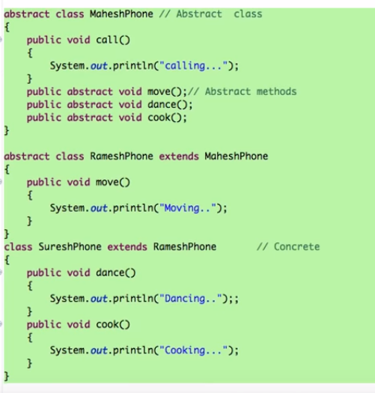
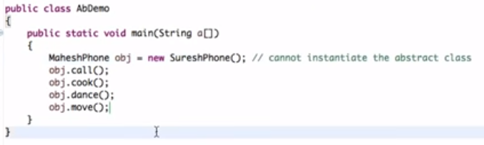

Slide 70
interface in java
An interface in java is a blueprint of a class. It has static constants and abstract methods.
The interface in Java is a mechanism to achieve abstraction. There can be only abstract methods in the Java interface, not method body. It is used to achieve abstraction and multiple inheritance in Java.
interface <interface_name>{
// declare constant fields
// declare methods that abstract
// by default.
}

Slide 71
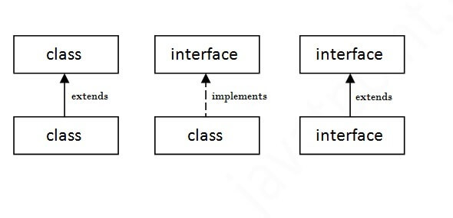
The relationship between classes and interfaces
interface printable{
void print();
}
class A6 implements printable{
public void print(){System.out.println("Hello");}
public static void main(String args[]){
A6 obj = new A6();
obj.print();
}
}
Types of Interface
Marker Interface(Blank Interface),
Single Abstract interface(Functional Interface)
Normal Interface

Slide 72
//Interface declaration: by first user
interface Drawable{
void draw();
}
//Implementation: by second user
class Rectangle implements Drawable{
public void draw(){System.out.println("drawing rectangle");}
}
class Circle implements Drawable{
public void draw(){System.out.println("drawing circle");}
}
//Using interface: by third user
class TestInterface1{
public static void main(String args[]){
Drawable d=new Circle();//In real scenario, object is provided by method e.g. getDrawable()
d.draw();
}}

Slide 73
Interface inheritance
interface Printable{
void print();
}
interface Showable extends Printable{
void show();
}
class TestInterface4 implements Showable{
public void print(){System.out.println("Hello");}
public void show(){System.out.println("Welcome");}
public static void main(String args[]){
TestInterface4 obj = new TestInterface4();
obj.print();
obj.show();
}
}

Slide 74
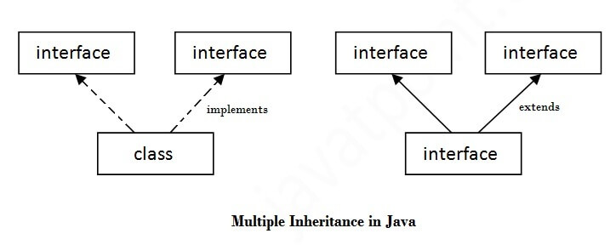
Multiple inheritance in Java by interface
If a class implements multiple interfaces, or an interface extends multiple interfaces, it is known as multiple inheritance.

Slide 75
Multiple inheritance
interface Printable{
void print();
}
interface Showable{
void show();
}
class A7 implements Printable,Showable{
public void print(){System.out.println("Hello");}
public void show(){System.out.println("Welcome");}
public static void main(String args[]){
A7 obj = new A7();
obj.print();
obj.show();
}
}

Slide 76
A class implements an interface, but one interface extends another interface.
interface Printable{
void print();
}
interface Showable extends Printable{
void show();
}
class TestInterface4 implements Showable{
public void print(){System.out.println("Hello");}
public void show(){System.out.println("Welcome");}
public static void main(String args[]){
TestInterface4 obj = new TestInterface4();
obj.print();
obj.show();
}
}

Slide 77
Abstract class | Interface
1) Abstract class can have abstract and non-abstractmethods. | Interface can have only abstract methods. Since Java 8, it can have default and static methods also.
2) Abstract class doesn't support multiple inheritance. | Interface supports multiple inheritance.
3) Abstract class can have final, non-final, static and non-static variables. | Interface has only static and final variables.
4) Abstract class can provide the implementation of interface. | Interface can't provide the implementation of abstract class.
5) The abstract keyword is used to declare abstract class. | The interface keyword is used to declare interface.
6) An abstract class can extend another Java class and implement multiple Java interfaces. | An interface can extend another Java interface only.
7) An abstract class can be extended using keyword "extends". | An interface can be implemented using keyword "implements".
8) A Java abstract class can have class members like private, protected, etc. | Members of a Java interface are public by default.
9)Example: public abstract class Shape{ public abstract void draw(); } | Example: public interface Drawable{ void draw(); }

Slide 78
Wrapper class

Slide 79
object cloning
The object cloning is a way to create exact copy of an object. The clone() method of Object class is used to clone an object.
The java.lang.Cloneable interface must be implemented by the class whose object clone we want to create. If we don't implement Cloneable interface, clone() method generates CloneNotSupportedException.
The clone() method is defined in the Object class. Syntax of the clone() method is
protected Object clone() throws CloneNotSupportedException
The clone() method saves the extra processing task for creating the exact copy of an object.
If we perform it by using the new keyword, it will take a lot of processing time to be performed that is why we use object cloning.

Slide 80
Example
class Student18 implements Cloneable{
int rollno;
String name;
Student18(int rollno,String name){
this.rollno=rollno;
this.name=name;
}
public Object clone()throws CloneNotSupportedException{
return super.clone();
}
public static void main(String args[]){
try{
Student18 s1=new Student18(101,"amit");
Student18 s2=(Student18)s1.clone();
System.out.println(s1.rollno+" "+s1.name);
System.out.println(s2.rollno+" "+s2.name);
}catch(CloneNotSupportedException c){}
}
}

Slide 81
java package
A java package is a group of similar types of classes, interfaces and sub-packages.
Package in java can be categorized in two form,
built-in package and
user-defined package.
There are many built-in packages such as java, lang, awt, javax, swing, net, io, util, sql etc.
Advantage of Java Package
1) Java package is used to categorize the classes and interfaces so that they can be easily maintained.
2) Java package provides access protection.
3) Java package removes naming collision.

Slide 82
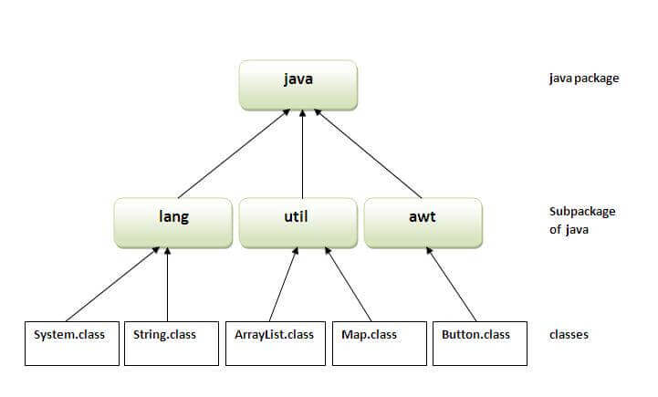
There are three ways to access the package from outside the package.
import package.*;
import package.classname;
fully qualified name.

Slide 83
1. import package.*;
//save by A.java
package pack;
public class A{
public void msg(){System.out.println("Hello");}
}
//save by B.java
package mypack;
import pack.*;
class B{
public static void main(String args[]){
A obj = new A();
obj.msg();
}
}

Slide 84
2. import package.classname;
/save by A.java
package pack;
public class A{
public void msg(){System.out.println("Hello");}
}
//save by B.java
package mypack;
import pack.A;
class B{
public static void main(String args[]){
A obj = new A();
obj.msg();
}
}

Slide 85
3. fully qualified name
//save by A.java
package pack;
public class A{
public void msg(){System.out.println("Hello");}
}
//save by B.java
package mypack;
class B{
public static void main(String args[]){
pack.A obj = new pack.A();//using fully qualified name
obj.msg();
}
}

