Slide 1
Introduction to JDBC-ODBC

Slide 2
JDBC
JDBC stands for Java Database Connectivity.
JDBC is a Java API to connect and execute the query with the database.
It is a part of JavaSE (Java Standard Edition). JDBC API uses JDBC drivers to connect with the database.
There are four types of JDBC drivers:
JDBC-ODBC Bridge Driver,
Native Driver,
Network Protocol Driver, and
Thin Driver
We can use JDBC API to access tabular data stored in any relational database. By the help of JDBC API, we can save, update, delete and fetch data from the database. It is like Open Database Connectivity (ODBC) provided by Microsoft.

Slide 3
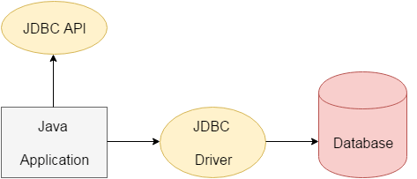

Slide 4
The java.sql package contains classes and interfaces for JDBC API.
A list of popular interfaces of JDBC API are given below:
Driver interface
Connection interface
Statement interface
PreparedStatement interface
CallableStatement interface
ResultSet interface
ResultSetMetaData interface
DatabaseMetaData interface
RowSet interface

Slide 5
JDBC Driver
JDBC Driver is a software component that enables java application to interact with the database.
There are 4 types of JDBC drivers:
JDBC-ODBC bridge driver
Native-API driver (partially java driver)
Network Protocol driver (fully java driver)
Thin driver (fully java driver)

Slide 6
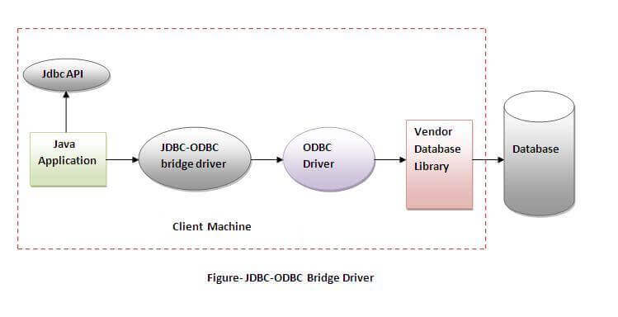
JDBC-ODBC bridge driver
The JDBC-ODBC bridge driver uses ODBC driver to connect to the database. The JDBC-ODBC bridge driver converts JDBC method calls into the ODBC function calls
Advantages:
easy to use.
can be easily connected to any database.
Disadvantages:
Performance degraded because JDBC method call is converted into the ODBC function calls.
The ODBC driver needs to be installed on the client machine.

Slide 7
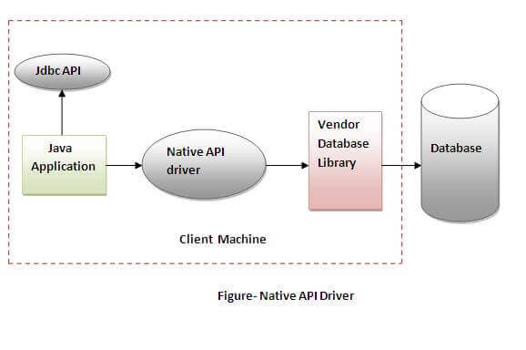
2) Native-API driver The Native API driver uses the client-side libraries of the database. The driver converts JDBC method calls into native calls of the database API. It is not written entirely in java.
Advantage:
performance upgraded than JDBC-ODBC bridge driver.
Disadvantage:
The Native driver needs to be installed on the each client machine.
The Vendor client library needs to be installed on client machine.

Slide 8
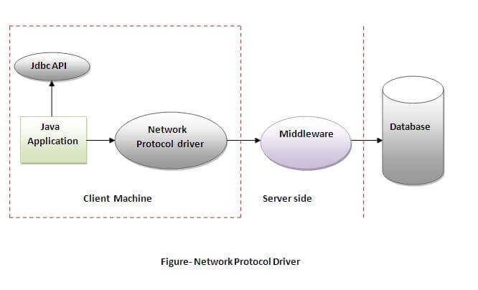
3) Network Protocol driver
The Network Protocol driver uses middleware (application server) that converts JDBC calls directly or indirectly into the vendor-specific database protocol. It is fully written in java.
Advantage:
No client side library is required because of application server that can perform many tasks like auditing, load balancing, logging etc.
Disadvantages:
Network support is required on client machine.
Requires database-specific coding to be done in the middle tier.
Maintenance of Network Protocol driver becomes costly because it requires database-specific coding to be done in the middle tier.

Slide 9
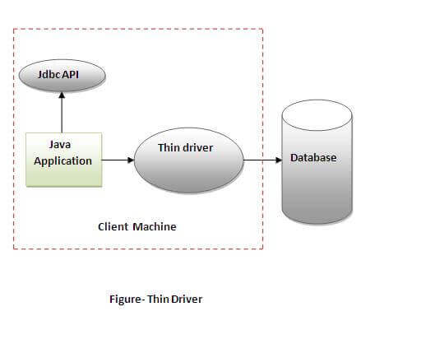
4) Thin driver
The thin driver converts JDBC calls directly into the vendor-specific database protocol. That is why it is known as thin driver. It is fully written in Java language.
Advantage:
Better performance than all other drivers.
No software is required at client side or server side.
Disadvantage:
Drivers depend on the Database.

Slide 10
Fundamental Steps in JDBC
The fundamental steps involved in the process of connecting to a database and executing a query consist of the following:
Import JDBC packages.
Load and register the JDBC driver.
Open a connection to the database.
Create a statement object to perform a query.
Execute the statement object and return a query resultset.
Process the resultset.
Close the resultset and statement objects.
Close the connection.

Slide 11
Java Database Connectivity with Oracle
In this example, we are using Oracle 10g as the database. So we need to know following information for the oracle database: Driver class: The driver class for the oracle database is oracle.jdbc.driver.OracleDriver. Connection URL: The connection URL for the oracle10G database is jdbc:oracle:thin:@localhost:1521:xe where jdbc is the API, oracle is the database, thin is the driver, localhost is the server name on which oracle is running, we may also use IP address, 1521 is the port number and XE is the Oracle service name. Username: The default username for the oracle database is system. Password: It is the password given by the user at the time of installing the oracle database.

Slide 12
Create a Table
Before establishing connection, let's first create a table in oracle database.
Following is the SQL query to create a table.
create table emp(id number(10),name varchar2(40),age number(3));

Slide 13
import java.sql.*;
class OracleCon{
public static void main(String args[]){
try{
//step1 load the driver class
Class.forName("oracle.jdbc.driver.OracleDriver");
//step2 create the connection object
Connection con=DriverManager.getConnection(
"jdbc:oracle:thin:@localhost:1521:xe","system","oracle");
//step3 create the statement object
Statement stmt=con.createStatement();
//step4 execute query
ResultSet rs=stmt.executeQuery("select * from emp");
while(rs.next())
System.out.println(rs.getInt(1)+" "+rs.getString(2)+" "+rs.getString(3));
//step5 close the connection object
con.close();
}catch(Exception e){ System.out.println(e);}
}
}

Slide 14
Java Database Connectivity with MySQL
In this example we are using MySql as the database. So we need to know following informations for the mysql database:
Driver class: The driver class for the mysql database is com.mysql.jdbc.Driver.
Connection URL: The connection URL for the mysql database
is jdbc:mysql://localhost:3306/sonoo where jdbc is the API, mysql is the database, localhost is the server name on which mysql is running, we may also use IP address, 3306 is the port number and sonoo is the database name. We may use any database, in such case, we need to replace the sonoo with our database name.
Username: The default username for the mysql database is root.
Password: It is the password given by the user at the time of installing the mysql database. In this example, we are going to use root as the password.
create a table in the mysql database, but before creating table, we need to create database first.
create database sonoo;
use sonoo;
create table emp(id int(10),name varchar(40),age int(3));

Slide 15
import java.sql.*;
class MysqlCon{
public static void main(String args[]){
try{
Class.forName("com.mysql.jdbc.Driver");
Connection con=DriverManager.getConnection(
"jdbc:mysql://localhost:3306/sonoo","root","root");
//here sonoo is database name, root is username and password
Statement stmt=con.createStatement();
ResultSet rs=stmt.executeQuery("select * from emp");
while(rs.next())
System.out.println(rs.getInt(1)+" "+rs.getString(2)+" "+rs.getString(3));
con.close();
}catch(Exception e){ System.out.println(e);}
}
}

Slide 16
Connectivity with Access without Data Source Name
import java.sql.*;
class Test{
public static void main(String ar[]){
try{
String database="student.mdb";//Here database exists in the current directory
String url="jdbc:odbc:Driver={Microsoft Access Driver (*.mdb)};
DBQ=" + database + ";DriverID=22;READONLY=true";
Class.forName("sun.jdbc.odbc.JdbcOdbcDriver");
Connection c=DriverManager.getConnection(url);
Statement st=c.createStatement();
ResultSet rs=st.executeQuery("select * from login");
while(rs.next()){
System.out.println(rs.getString(1));
}
}catch(Exception ee){System.out.println(ee);}
}}

Slide 17
Connect Java Application with access with DSN
import java.sql.*;
class Test{
public static void main(String ar[]){
try{
String url="jdbc:odbc:mydsn";
Class.forName("sun.jdbc.odbc.JdbcOdbcDriver");
Connection c=DriverManager.getConnection(url);
Statement st=c.createStatement();
ResultSet rs=st.executeQuery("select * from login");
while(rs.next()){
System.out.println(rs.getString(1));
}
}catch(Exception ee){System.out.println(ee);}
}}

Slide 18
DriverManager class
The DriverManager class acts as an interface between user and drivers.
It keeps track of the drivers that are available and handles establishing a connection between a database and the appropriate driver.
The DriverManager class maintains a list of Driver classes that have registered themselves by calling the method
DriverManager.registerDriver().

Slide 19
methods of DriverManager class
Method | Description
1) public static void registerDriver(Driver driver): | is used to register the given driver with DriverManager.
2) public static void deregisterDriver(Driver driver): | is used to deregister the given driver (drop the driver from the list) with DriverManager.
3) public static Connection getConnection(String url): | is used to establish the connection with the specified url.
4) public static Connection getConnection(String url,String userName,String password): | is used to establish the connection with the specified url, username and password.

Slide 20
Connection
A Connection is the session between java application and database.
The object of Connection can be used to get the object of Statement and DatabaseMetaData.
The Connection interface provide many methods for transaction management like commit(), rollback() etc.

Slide 21
Methods
1) public Statement createStatement(): creates a statement object that can be used to execute SQL queries.
2) public Statement createStatement(int resultSetType,int resultSetConcurrency): Creates a Statement object that will generate ResultSet objects with the given type and concurrency.
3) public void setAutoCommit(boolean status): is used to set the commit status.By default it is true.
4) public void commit(): saves the changes made since the previous commit/rollback permanent.
5) public void rollback(): Drops all changes made since the previous commit/rollback.
6) public void close(): closes the connection and Releases a JDBC resources immediately.

Slide 22
Statement interface
The Statement interface provides methods to execute queries with the database.
It provide method to get the object of ResultSet.
methods of Statement interface:
public ResultSet executeQuery(String sql): is used to execute SELECT query. It returns the object of ResultSet.
2) public int executeUpdate(String sql): is used to execute specified query, it may be create, drop, insert, update, delete etc.
3) public boolean execute(String sql): is used to execute queries that may return multiple results.
4) public int[] executeBatch(): is used to execute batch of commands.

Slide 23
ResultSet Interface
he object of ResultSet maintains a cursor pointing to a row of a table. Initially, cursor points to before the first row.
1) public boolean next(): | is used to move the cursor to the one row next from the current position.
2) public boolean previous(): | is used to move the cursor to the one row previous from the current position.
3) public boolean first(): | is used to move the cursor to the first row in result set object.
4) public boolean last(): | is used to move the cursor to the last row in result set object.
5) public boolean absolute(int row): | is used to move the cursor to the specified row number in the ResultSet object.
6) public boolean relative(int row): | is used to move the cursor to the relative row number in the ResultSet object, it may be positive or negative.
7) public int getInt(int columnIndex): | is used to return the data of specified column index of the current row as int.
8) public int getInt(String columnName): | is used to return the data of specified column name of the current row as int.
9) public String getString(int columnIndex): | is used to return the data of specified column index of the current row as String.
10) public String getString(String columnName): | is used to return the data of specified column name of the current row as String.

Slide 24
PreparedStatement interface
The PreparedStatement interface is a subinterface of Statement. It is used to execute parameterized query.
String sql="insert into emp values(?,?,?)";
Method | Description
public void setInt(int paramIndex, int value) | sets the integer value to the given parameter index.
public void setString(int paramIndex, String value) | sets the String value to the given parameter index.
public void setFloat(int paramIndex, float value) | sets the float value to the given parameter index.
public void setDouble(int paramIndex, double value) | sets the double value to the given parameter index.
public int executeUpdate() | executes the query. It is used for create, drop, insert, update, delete etc.
public ResultSet executeQuery() | executes the select query. It returns an instance of ResultSet.

Slide 25
PreparedStatement interface that inserts the record
import java.sql.*;
class InsertPrepared{
public static void main(String args[]){
try{
Class.forName("oracle.jdbc.driver.OracleDriver");
Connection con=DriverManager.getConnection("jdbc:oracle:thin:@localhost:1521:xe","system","oracle");
PreparedStatement stmt=con.prepareStatement("insert into Emp values(?,?)");
stmt.setInt(1,101);//1 specifies the first parameter in the query
stmt.setString(2,"Ratan");
int i=stmt.executeUpdate();
System.out.println(i+" records inserted");
con.close();
}catch(Exception e){ System.out.println(e);}
} }

