Slide 1
Java collections Framework
Unit-5

Slide 2
Collection in Java
The Collection in Java is a framework that provides an architecture to store and manipulate the group of objects.
Java Collections can achieve all the operations that you perform on a data such as searching, sorting, insertion, manipulation, and deletion.
Java Collection means a single unit of objects. Java Collection framework provides many interfaces (Set, List, Queue, Deque) and classes (ArrayList, Vector, LinkedList, PriorityQueue, HashSet, LinkedHashSet, TreeSet)
A Collection represents a single unit of objects, i.e., a group.
It provides readymade architecture.
It represents a set of classes and interfaces.
It is optional.
The Collection framework represents a unified architecture for storing and manipulating a group of objects. It has:
Interfaces and its implementations, i.e., classes
Algorithm

Slide 3
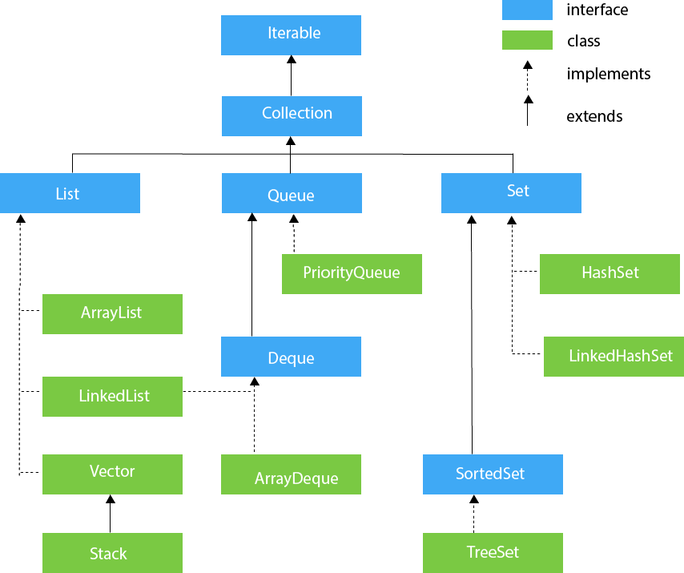
Hierarchy of Collection Framework

Slide 4
List interface
List interface is the child interface of Collection interface. It inhibits a list type data structure in which we can store the ordered collection of objects. It can have duplicate values.
List interface is implemented by the classes ArrayList, LinkedList, Vector, and Stack.
To instantiate the List interface
List <data-type> list1= new ArrayList();
List <data-type> list2 = new LinkedList();
List <data-type> list3 = new Vector();
List <data-type> list4 = new Stack();
The methods in List interface that can be used to insert, delete, and access the elements from the list.

Slide 5
ArrayList class
The ArrayList class implements the List interface.
It uses a dynamic array to store the duplicate element of different data types.
The ArrayList class maintains the insertion order and is non-synchronized.
The elements stored in the ArrayList class can be randomly accessed.
import java.util.*;
class TestJavaCollection1{
public static void main(String args[]){
ArrayList<String> list=new ArrayList<String>();//Creating arraylist
list.add("Ravi");//Adding object in arraylist
list.add("Vijay");
list.add("Ravi");
list.add("Ajay");
//Traversing list through Iterator
Iterator itr=list.iterator();
while(itr.hasNext()){
System.out.println(itr.next());
}
}
}

Slide 6
LinkedList
LinkedList implements the Collection interface.
It uses a doubly linked list internally to store the elements.
It can store the duplicate elements. It maintains the insertion order and is not synchronized.
In LinkedList, the manipulation is fast because no shifting is required.
import java.util.*;
public class TestJavaCollection2{
public static void main(String args[]){
List<String> al=new LinkedList<String>();
al.add("Ravi");
al.add("Vijay");
al.add("Ravi");
al.add("Ajay");
Iterator<String> itr=al.iterator();
while(itr.hasNext()){
System.out.println(itr.next());
}
}
}

Slide 7
ArrayList | LinkedList
1) ArrayList internally uses a dynamic array to store the elements. | LinkedList internally uses a doubly linked list to store the elements.
2) Manipulation with ArrayList is slow because it internally uses an array. If any element is removed from the array, all the bits are shifted in memory. | Manipulation with LinkedList is faster than ArrayList because it uses a doubly linked list, so no bit shifting is required in memory.
3) An ArrayList class can act as a list only because it implements List only. | LinkedList class can act as a list and queue both because it implements List and Deque interfaces.
4) ArrayList is better for storing and accessing data. | LinkedList is better for manipulating data.

Slide 8
import java.util.*;
class TestArrayLinked{
public static void main(String args[]){
List<String> al=new ArrayList<String>();//creating arraylist
al.add("Ravi");//adding object in arraylist
al.add("Vijay");
al.add("Ravi");
al.add("Ajay");
List<String> al2=new LinkedList<String>();//creating linkedlist
al2.add("James");//adding object in linkedlist
al2.add("Serena");
al2.add("Swati");
al2.add("Junaid");
System.out.println("arraylist: "+al);
System.out.println("linkedlist: "+al2);
}
}
//output
arraylist:? [Ravi, Vijay, Ravi, Ajay]
linkedlist:? [James, Serena, Swati, Junaid]

Slide 9
List methods
Method | Description
void add(int index, E element) | It is used to insert the specified element at the specified position in a list.
boolean add(E e) | It is used to append the specified element at the end of a list.
boolean addAll(Collection<? extends E> c) | It is used to append all of the elements in the specified collection to the end of a list.
boolean addAll(int index, Collection<? extends E> c) | It is used to append all the elements in the specified collection, starting at the specified position of the list.
void clear() | It is used to remove all of the elements from this list.
boolean equals(Object o) | It is used to compare the specified object with the elements of a list.

Slide 10
int hashcode() | It is used to return the hash code value for a list.
E get(int index) | It is used to fetch the element from the particular position of the list.
boolean isEmpty() | It returns true if the list is empty, otherwise false.
int lastIndexOf(Object o) | It is used to return the index in this list of the last occurrence of the specified element, or -1 if the list does not contain this element.
Object[] toArray() | It is used to return an array containing all of the elements in this list in the correct order.
T[] toArray(T[] a) | It is used to return an array containing all of the elements in this list in the correct order.
boolean contains(Object o) | It returns true if the list contains the specified element
boolean containsAll(Collection<?> c) | It returns true if the list contains all the specified element
int indexOf(Object o) | It is used to return the index in this list of the first occurrence of the specified element, or -1 if the List does not contain this element.

Slide 11
E remove(int index) | It is used to remove the element present at the specified position in the list.
boolean remove(Object o) | It is used to remove the first occurrence of the specified element.
boolean removeAll(Collection<?> c) | It is used to remove all the elements from the list.
void replaceAll(UnaryOperator operator) | It is used to replace all the elements from the list with the specified element.
void retainAll(Collection<?> c) | It is used to retain all the elements in the list that are present in the specified collection.
E set(int index, E element) | It is used to replace the specified element in the list, present at the specified position.
void sort(Comparator<? super E> c) | It is used to sort the elements of the list on the basis of specified comparator.
Spliterator spliterator() | It is used to create spliterator over the elements in a list.
List<E> subList(int fromIndex, int toIndex) | It is used to fetch all the elements lies within the given range.
int size() | It is used to return the number of elements present in the list.

Slide 12
import java.util.*;
public class ListExample{
public static void main(String args[]){
List<String> al=new ArrayList<String>();
al.add("Amit");
al.add("Vijay");
al.add("Kumar");
al.add(1,"Sachin");
System.out.println("An element at 2nd position: "+al.get(2));
for(String s:al){
System.out.println(s);
}
}
}

Slide 13
ListIterator methods
Method | Description
void add(E e) | This method inserts the specified element into the list.
boolean hasNext() | This method returns true if the list iterator has more elements while traversing the list in the forward direction.
E next() | This method returns the next element in the list and advances the cursor position.
int nextIndex() | This method returns the index of the element that would be returned by a subsequent call to next()
boolean hasPrevious() | This method returns true if this list iterator has more elements while traversing the list in the reverse direction.
E previous() | This method returns the previous element in the list and moves the cursor position backward.
E previousIndex() | This method returns the index of the element that would be returned by a subsequent call to previous().
void remove() | This method removes the last element from the list that was returned by next() or previous() methods
void set(E e) | This method replaces the last element returned by next() or previous() methods with the specified element.

Slide 14
import java.util.*;
public class ListIteratorExample1{
public static void main(String args[]){
List<String> al=new ArrayList<String>();
al.add("Amit");
al.add("Vijay");
al.add("Kumar");
al.add(1,"Sachin");
ListIterator<String> itr=al.listIterator();
System.out.println("Traversing elements in forward direction");
while(itr.hasNext()){
System.out.println("index:"+itr.nextIndex()+" value:"+itr.next());
}
System.out.println("Traversing elements in backward direction");
while(itr.hasPrevious()){
System.out.println("index:"+itr.previousIndex()+" value:"+itr.previous());
}
}
}
Traversing elements in forward direction
index:0 value:Amit
index:1 value:Sachin
index:2 value:Vijay
index:3 value:Kumar
Traversing elements in backward direction
index:3 value:Kumar
index:2 value:Vijay
index:1 value:Sachin
index:0 value:Amit

Slide 15
import java.util.*;
class Book {
int id;
String name,author,publisher;
int quantity;
public Book(int id, String name, String author, String publisher, int quantity) {
this.id = id;
this.name = name;
this.author = author;
this.publisher = publisher;
this.quantity = quantity;
}
}
public class ListIteratorExample2 {
public static void main(String[] args) {
//Creating list of Books
List<Book> list=new ArrayList<Book>();
//Creating Books
Book b1=new Book(101,"Let us C","Yashwant Kanetkar","BPB",8);
Book b2=new Book(102,"Data Communications & Networking","Forouzan","Mc Graw Hill",4);
Book b3=new Book(103,"Operating System","Galvin","Wiley",6);
//Adding Books to list
list.add(b1);
list.add(b2);
list.add(b3);
//Traversing list
for(Book b:list){
System.out.println(b.id+" "+b.name+" "+b.author+" "+b.publisher+" "+b.quantity);
}
}
}
//output
101? Let? us? C? Yashwant? Kanetkar? BPB? 8
102? Data? Communications? &? Networking? Forouzan? Mc? Graw? Hill? 4
103? Operating? System? Galvin? Wiley? 6

Slide 16
HashSet class
Java HashSet class is used to create a collection that uses a hash table for storage. It inherits the AbstractSet class and implements Set interface.
HashSet stores the elements by using a mechanism called hashing.
HashSet contains unique elements only.
HashSet allows null value.
HashSet doesn't maintain the insertion order. Here, elements are inserted on the basis of their hashcode.
HashSet is the best approach for search operations.
The initial default capacity of HashSet is 16, and the load factor is 0.75.
Initial Capacity: The initial capacity means the number of buckets when hashtable (HashSet internally uses hashtable data structure) is created. The number of buckets will be automatically increased if the current size gets full. Load Factor: The load factor is a measure of how full the HashSet is allowed to get before its capacity is automatically increased. When the number of entries in the hash table exceeds the product of the load factor and the current capacity, the hash table is rehashed (that is, internal data structures are rebuilt) so that the hash table has approximately twice the number of buckets.

Slide 17
constructors
SN | Constructor | Description
1) | HashSet() | It is used to construct a default HashSet.
2) | HashSet(int capacity) | It is used to initialize the capacity of the hash set to the given integer value capacity. The capacity grows automatically as elements are added to the HashSet.
3) | HashSet(int capacity, float loadFactor) | It is used to initialize the capacity of the hash set to the given integer value capacity and the specified load factor.
4) | HashSet(Collection<? extends E> c) | It is used to initialize the hash set by using the elements of the collection c.

Slide 18
SN | Modifier & Type | Method | Description
1) | boolean | add(E e) | It is used to add the specified element to this set if it is not already present.
2) | void | clear() | It is used to remove all of the elements from the set.
3) | object | clone() | It is used to return a shallow copy of this HashSet instance: the elements themselves are not cloned.
4) | boolean | contains(Object o) | It is used to return true if this set contains the specified element.
5) | boolean | isEmpty() | It is used to return true if this set contains no elements.
6) | Iterator<E> | iterator() | It is used to return an iterator over the elements in this set.
7) | boolean | remove(Object o) | It is used to remove the specified element from this set if it is present.
8) | int | size() | It is used to return the number of elements in the set.
9) | Spliterator<E> | spliterator() | It is used to create a late-binding and fail-fast Spliterator over the elements in the set.

Slide 19
import java.util.*;
class HashSet1{
public static void main(String args[]){
//Creating HashSet and adding elements
HashSet<String> set=new HashSet();
set.add("One");
set.add("Two");
set.add("Three");
set.add("Four");
set.add("Five");
Iterator<String> i=set.iterator();
while(i.hasNext())
{
System.out.println(i.next());
}
}
}
//random order
Five
One
Four
Two
Three

Slide 20
import java.util.*;
class HashSet3{
public static void main(String args[]){
HashSet<String> set=new HashSet<String>();
set.add("Ravi");
set.add("Vijay");
set.add("Arun");
set.add("Sumit");
System.out.println("An initial list of elements: "+set);
//Removing specific element from HashSet
set.remove("Ravi");
System.out.println("After invoking remove(object) method: "+set);
HashSet<String> set1=new HashSet<String>();
set1.add("Ajay");
set1.add("Gaurav");
set.addAll(set1);
System.out.println("Updated List: "+set);
//Removing all the new elements from HashSet
set.removeAll(set1);
System.out.println("After invoking removeAll() method: "+set);
//Removing elements on the basis of specified condition
set.removeIf(str->str.contains("Vijay"));
System.out.println("After invoking removeIf() method: "+set);
//Removing all the elements available in the set
set.clear();
System.out.println("After invoking clear() method: "+set);
}
}
An? initial? list? of? elements:? [Vijay, Ravi, Arun, Sumit]
After? invoking? remove(object)? method:? [Vijay, Arun, Sumit]
Updated? List:? [Vijay, Arun, Gaurav, Sumit, Ajay]
After? invoking? removeAll()? method:? [Vijay, Arun, Sumit]
After? invoking? removeIf()? method:? [Arun, Sumit]
After? invoking? clear()? method:? []

Slide 21
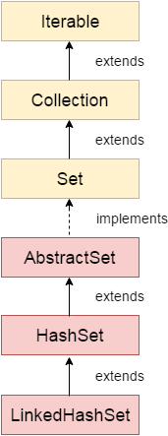
LinkedHashSet class
Java LinkedHashSet class is a Hashtable and Linked list implementation of the set interface.
It inherits HashSet class and implements Set interface.
Java LinkedHashSet class contains unique elements only like HashSet.
Java LinkedHashSet class provides all optional set operation and permits null elements.
Java LinkedHashSet class maintains insertion order.

Slide 22
Constructor | Description
HashSet() | It is used to construct a default HashSet.
HashSet(Collection c) | It is used to initialize the hash set by using the elements of the collection c.
LinkedHashSet(int capacity) | It is used initialize the capacity of the linked hash set to the given integer value capacity.
LinkedHashSet(int capacity, float fillRatio) | It is used to initialize both the capacity and the fill ratio (also called load capacity) of the hash set from its argument.

Slide 23
import java.util.*;
class LinkedHashSet1{
public static void main(String args[]){
//Creating HashSet and adding elements
LinkedHashSet<String> set=new LinkedHashSet();
set.add("One");
set.add("Two");
set.add("Three");
set.add("Four");
set.add("Five");
Iterator<String> i=set.iterator();
while(i.hasNext())
{
System.out.println(i.next());
}
}
}

Slide 24
ignoring duplicate Elements
import java.util.*;
class LinkedHashSet2{
public static void main(String args[]){
LinkedHashSet<String> al=new LinkedHashSet<String>();
al.add("Ravi");
al.add("Vijay");
al.add("Ravi");
al.add("Ajay");
Iterator<String> itr=al.iterator();
while(itr.hasNext()){
System.out.println(itr.next());
}
}
}

Slide 25
import java.util.*;
class Book {
int id;
String name,author,publisher;
int quantity;
public Book(int id, String name, String author, String publisher, int quantity) {
this.id = id;
this.name = name;
this.author = author;
this.publisher = publisher;
this.quantity = quantity;
}
}
public class LinkedHashSetExample {
public static void main(String[] args) {
LinkedHashSet<Book> hs=new LinkedHashSet<Book>();
//Creating Books
Book b1=new Book(101,"Let us C","Yashwant Kanetkar","BPB",8);
Book b2=new Book(102,"Data Communications & Networking","Forouzan","Mc Graw Hill",4);
Book b3=new Book(103,"Operating System","Galvin","Wiley",6);
//Adding Books to hash table
hs.add(b1);
hs.add(b2);
hs.add(b3);
//Traversing hash table
for(Book b:hs){
System.out.println(b.id+" "+b.name+" "+b.author+" "+b.publisher+" "+b.quantity);
}
}
}

Slide 26
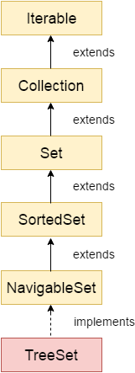
TreeSet class
Java TreeSet class implements the Set interface that uses a tree for storage. It inherits AbstractSet class and implements the NavigableSet interface.
The objects of the TreeSet class are stored in ascending order.
Java TreeSet class contains unique elements only like HashSet.
Java TreeSet class access and retrieval times are quiet fast.
Java TreeSet class doesn't allow null element.

Slide 27
Constructor | Description
TreeSet() | It is used to construct an empty tree set that will be sorted in ascending order according to the natural order of the tree set.
TreeSet(Collection<? extends E> c) | It is used to build a new tree set that contains the elements of the collection c.
TreeSet(Comparator<? super E> comparator) | It is used to construct an empty tree set that will be sorted according to given comparator.
TreeSet(SortedSet<E> s) | It is used to build a TreeSet that contains the elements of the given SortedSet.

Slide 28
Method | Description
boolean add(E e) | It is used to add the specified element to this set if it is not already present.
boolean addAll(Collection<? extends E> c) | It is used to add all of the elements in the specified collection to this set.
E ceiling(E e) | It returns the equal or closest greatest element of the specified element from the set, or null there is no such element.
Comparator<? super E> comparator() | It returns comparator that arranged elements in order.
Iterator descendingIterator() | It is used iterate the elements in descending order.
NavigableSet descendingSet() | It returns the elements in reverse order.
E floor(E e) | It returns the equal or closest least element of the specified element from the set, or null there is no such element.
SortedSet headSet(E toElement) | It returns the group of elements that are less than the specified element.

Slide 29
NavigableSet headSet(E toElement, boolean inclusive) | It returns the group of elements that are less than or equal to(if, inclusive is true) the specified element.
E higher(E e) | It returns the closest greatest element of the specified element from the set, or null there is no such element.
Iterator iterator() | It is used to iterate the elements in ascending order.
E lower(E e) | It returns the closest least element of the specified element from the set, or null there is no such element.
E pollFirst() | It is used to retrieve and remove the lowest(first) element.
E pollLast() | It is used to retrieve and remove the highest(last) element.
Spliterator spliterator() | It is used to create a late-binding and fail-fast spliterator over the elements.

Slide 30
import java.util.*;
class TreeSet1{
public static void main(String args[]){
//Creating and adding elements
TreeSet<String> al=new TreeSet<String>();
al.add("Ravi");
al.add("Vijay");
al.add("Ravi");
al.add("Ajay");
//Traversing elements
Iterator<String> itr=al.iterator();
while(itr.hasNext()){
System.out.println(itr.next());
}
}
}
//
Ajay
Ravi
Vijay

Slide 31
import java.util.*;
class TreeSet2{
public static void main(String args[]){
TreeSet<String> set=new TreeSet<String>();
set.add("Ravi");
set.add("Vijay");
set.add("Ajay");
System.out.println("Traversing element through Iterator in descending order");
Iterator i=set.descendingIterator();
while(i.hasNext())
{
System.out.println(i.next());
}
}
}

Slide 32
Vector
Vector uses a dynamic array to store the data elements. It is similar to ArrayList. However, It is synchronized and contains many methods that are not the part of Collection framework.
import java.util.*;
public class TestJavaCollection3{
public static void main(String args[]){
Vector<String> v=new Vector<String>();
v.add("Ayush");
v.add("Amit");
v.add("Ashish");
v.add("Garima");
Iterator<String> itr=v.iterator();
while(itr.hasNext()){
System.out.println(itr.next());
}
}
}

Slide 33
stack
The stack is the subclass of Vector. It implements the last-in-first-out data structure, i.e., Stack.
The stack contains all of the methods of Vector class and also provides its methods like boolean push(), boolean peek(), boolean push(object o), which defines its properties.
import java.util.*;
public class TestJavaCollection4{
public static void main(String args[]){
Stack<String> stack = new Stack<String>();
stack.push("Ayush");
stack.push("Garvit");
stack.push("Amit");
stack.push("Ashish");
stack.push("Garima");
stack.pop();
Iterator<String> itr=stack.iterator();
while(itr.hasNext()){
System.out.println(itr.next());
}
}
}

