Slide 1
Introduction to Multi-threading
Unit-4

Slide 2
Multithreading in java
Multithreading in java is a process of executing multiple threads simultaneously.
A thread is a lightweight sub-process, the smallest unit of processing.
Multiprocessing and multithreading, both are used to achieve multitasking.
However, we use multithreading than multiprocessing because threads use a shared memory area. They don't allocate separate memory area so saves memory, and context-switching between the threads takes less time than process.
Java Multithreading is mostly used in games, animation, etc.
Advantages of Java Multithreading
1) It doesn't block the user because threads are independent and you can perform multiple operations at the same time.
2) You can perform many operations together, so it saves time.
3) Threads are independent, so it doesn't affect other threads if an exception occurs in a single thread.

Slide 3
Multitasking
Multitasking is a process of executing multiple tasks simultaneously. We use multitasking to utilize the CPU.
Multitasking can be achieved in two ways:
Process-based Multitasking (Multiprocessing)
Thread-based Multitasking (Multithreading)
1) Process-based Multitasking (Multiprocessing)
Each process has an address in memory. In other words, each process allocates a separate memory area.
A process is heavyweight.
Cost of communication between the process is high.
Switching from one process to another requires some time for saving and loading registers, memory maps, updating lists, etc.
2) Thread-based Multitasking (Multithreading)
Threads share the same address space.
A thread is lightweight.
Cost of communication between the thread is low.

Slide 4
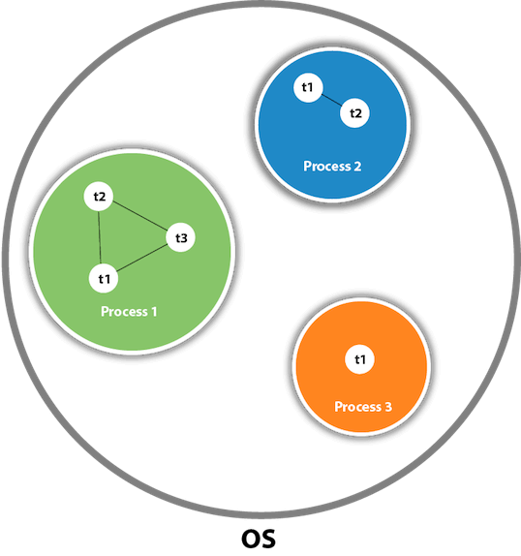
What is Thread in java
A thread is a lightweight subprocess, the smallest unit of processing. It is a separate path of execution.
Java Thread class
Java provides Thread class to achieve thread programming. Thread class provides constructors and methods to create and perform operations on a thread.
Thread class extends Object class and implements Runnable interface.

Slide 5
JDBC
S.N. | Modifier and Type | Method | Description
1) | void | start() | It is used to start the execution of the thread.
2) | void | run() | It is used to do an action for a thread.
3) | static void | sleep() | It sleeps a thread for the specified amount of time.
4) | static Thread | currentThread() | It returns a reference to the currently executing thread object.
5) | void | join() | It waits for a thread to die.
6) | int | getPriority() | It returns the priority of the thread.
7) | void | setPriority() | It changes the priority of the thread.
8) | String | getName() | It returns the name of the thread.
9) | void | setName() | It changes the name of the thread.
10) | long | getId() | It returns the id of the thread.

Slide 6
JDBC
11) | boolean | isAlive() | It tests if the thread is alive.
12) | static void | yield() | It causes the currently executing thread object to pause and allow other threads to execute temporarily.
13) | void | suspend() | It is used to suspend the thread.
14) | void | resume() | It is used to resume the suspended thread.
15) | void | stop() | It is used to stop the thread.
16) | void | destroy() | It is used to destroy the thread group and all of its subgroups.
17) | boolean | isDaemon() | It tests if the thread is a daemon thread.
18) | void | setDaemon() | It marks the thread as daemon or user thread.
19) | void | interrupt() | It interrupts the thread.
20) | boolean | isinterrupted() | It tests whether the thread has been interrupted.

Slide 7
21) | static boolean | interrupted() | It tests whether the current thread has been interrupted.
22) | static int | activeCount() | It returns the number of active threads in the current thread's thread group.
23) | void | checkAccess() | It determines if the currently running thread has permission to modify the thread.
24) | static boolean | holdLock() | It returns true if and only if the current thread holds the monitor lock on the specified object.
25) | static void | dumpStack() | It is used to print a stack trace of the current thread to the standard error stream.
26) | StackTraceElement[] | getStackTrace() | It returns an array of stack trace elements representing the stack dump of the thread.
27) | static int | enumerate() | It is used to copy every active thread's thread group and its subgroup into the specified array.
28) | Thread.State | getState() | It is used to return the state of the thread.
29) | ThreadGroup | getThreadGroup() | It is used to return the thread group to which this thread belongs
30) | String | toString() | It is used to return a string representation of this thread, including the thread's name, priority, and thread group.

Slide 8
31) | void | notify() | It is used to give the notification for only one thread which is waiting for a particular object.
32) | void | notifyAll() | It is used to give the notification to all waiting threads of a particular object.
33) | void | setContextClassLoader() | It sets the context ClassLoader for the Thread.
34) | ClassLoader | getContextClassLoader() | It returns the context ClassLoader for the thread.
35) | static Thread.UncaughtExceptionHandler | getDefaultUncaughtExceptionHandler() | It returns the default handler invoked when a thread abruptly terminates due to an uncaught exception.
36) | static void | setDefaultUncaughtExceptionHandler() | It sets the default handler invoked when a thread abruptly terminates due to an uncaught exception.

Slide 9
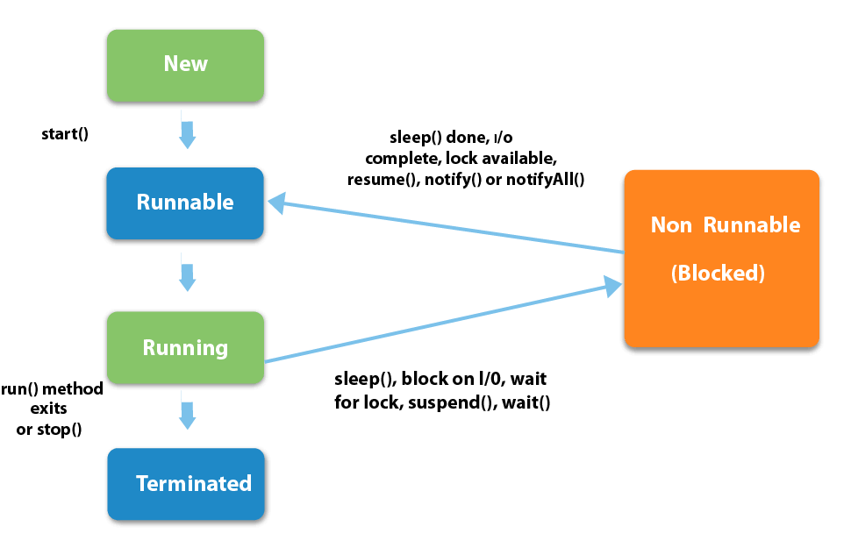
thread life cycle in java
A thread can be in one of the five states.
The life cycle of the thread in java is controlled by JVM.
The java thread states are as follows:
New
Runnable
Running
Non-Runnable (Blocked)
Terminated

Slide 10
1) New
The thread is in new state if you create an instance of Thread class but before the invocation of start() method.
2) Runnable
The thread is in runnable state after invocation of start() method, but the thread scheduler has not selected it to be the running thread.
3) Running
The thread is in running state if the thread scheduler has selected it.
4) Non-Runnable (Blocked)
This is the state when the thread is still alive, but is currently not eligible to run.
5) Terminated
A thread is in terminated or dead state when its run() method exits.

Slide 11
How to create thread There are two ways to create a thread: By extending Thread class By implementing Runnable interface
Thread class:
Thread class provide constructors and methods to create and perform operations on a thread.Thread class extends Object class and implements Runnable interface.
Commonly used Constructors of Thread class:
Thread()
Thread(String name)
Thread(Runnable r)
Thread(Runnable r,String name)

Slide 12
methods of Thread class:
public void run(): is used to perform action for a thread. public void start(): starts the execution of the thread.JVM calls the run() method on the thread. public void sleep(long miliseconds): Causes the currently executing thread to sleep (temporarily cease execution) for the specified number of milliseconds. public void join(): waits for a thread to die. public void join(long miliseconds): waits for a thread to die for the specified miliseconds. public int getPriority(): returns the priority of the thread. public int setPriority(int priority): changes the priority of the thread. public String getName(): returns the name of the thread. public void setName(String name): changes the name of the thread. public Thread currentThread(): returns the reference of currently executing thread. public int getId(): returns the id of the thread. public Thread.State getState(): returns the state of the thread. public boolean isAlive(): tests if the thread is alive.

Slide 13
public void yield(): causes the currently executing thread object to temporarily pause and allow other threads to execute.
public void suspend(): is used to suspend the thread(depricated).
public void resume(): is used to resume the suspended thread(depricated).
public void stop(): is used to stop the thread(depricated).
public boolean isDaemon(): tests if the thread is a daemon thread.
public void setDaemon(boolean b): marks the thread as daemon or user thread.
public void interrupt(): interrupts the thread.
public boolean isInterrupted(): tests if the thread has been interrupted.
public static boolean interrupted(): tests if the current thread has been interrupted.

Slide 14
Java Thread Example by extending Thread class
class Multi extends Thread{
public void run(){
System.out.println("thread is running...");
}
public static void main(String args[]){
Multi t1=new Multi();
t1.start();
}
}

Slide 15
Java Thread Example by implementing Runnable interface
class Multi3 implements Runnable{
public void run(){
System.out.println("thread is running...");
}
public static void main(String args[]){
Multi3 m1=new Multi3();
Thread t1 =new Thread(m1);
t1.start();
}
}

Slide 16
Thread scheduler in java is the part of the JVM that decides which thread should run.
There is no guarantee that which runnable thread will be chosen to run by the thread scheduler.
Only one thread at a time can run in a single process.
The thread scheduler mainly uses preemptive or time slicing scheduling to schedule the threads.

Slide 17
sleep() method
The sleep() method of Thread class is used to sleep a thread for the specified amount of time.
Syntax of sleep() method in java
The Thread class provides two methods for sleeping a thread:
public static void sleep(long miliseconds)throws InterruptedException
public static void sleep(long miliseconds, int nanos)throws InterruptedException

Slide 18
class TestSleepMethod1 extends Thread{
public void run(){
for(int i=1;i<5;i++){
try{Thread.sleep(500);}catch(InterruptedException e){System.out.println(e);}
System.out.println(i);
}
}
public static void main(String args[]){
TestSleepMethod1 t1=new TestSleepMethod1();
TestSleepMethod1 t2=new TestSleepMethod1();
t1.start();
t2.start();
}
}

Slide 19
What if we call run() method directly instead start() method?
Each thread starts in a separate call stack.
Invoking the run() method from main thread, the run() method goes onto the current call stack rather than at the beginning of a new call stack.
class TestCallRun1 extends Thread{
public void run(){
System.out.println("running...");
}
public static void main(String args[]){
TestCallRun1 t1=new TestCallRun1();
t1.run();//fine, but does not start a separate call stack
}
}

Slide 20
Normal objects not Threads
class TestCallRun2 extends Thread{
public void run(){
for(int i=1;i<5;i++){
try{Thread.sleep(500);}catch(InterruptedException e){System.out.println(e);}
System.out.println(i);
}
}
public static void main(String args[]){
TestCallRun2 t1=new TestCallRun2();
TestCallRun2 t2=new TestCallRun2();
t1.run();
t2.run();
}
}

Slide 21
join() method
The join() method waits for a thread to die. In other words, it causes the currently running threads to stop executing until the thread it joins with completes its task.
public void join()throws InterruptedException
public void join(long milliseconds)throws InterruptedException

Slide 22
class TestJoinMethod1 extends Thread{
public void run(){
for(int i=1;i<=5;i++){
try{
Thread.sleep(500);
}catch(Exception e){System.out.println(e);}
System.out.println(i);
}
}
public static void main(String args[]){
TestJoinMethod1 t1=new TestJoinMethod1();
TestJoinMethod1 t2=new TestJoinMethod1();
TestJoinMethod1 t3=new TestJoinMethod1();
t1.start();
try{
t1.join();
}catch(Exception e){System.out.println(e);}
t2.start();
t3.start();
}
}

Slide 23
getName(),setName(String) and getId() method:
class TestJoinMethod3 extends Thread{
public void run(){
System.out.println("running...");
}
public static void main(String args[]){
TestJoinMethod3 t1=new TestJoinMethod3();
TestJoinMethod3 t2=new TestJoinMethod3();
System.out.println("Name of t1:"+t1.getName());
System.out.println("Name of t2:"+t2.getName());
System.out.println("id of t1:"+t1.getId());
t1.start();
t2.start();
t1.setName("Sonoo Jaiswal");
System.out.println("After changing name of t1:"+t1.getName());
}
}
Output:Name of t1:Thread-0
Name of t2:Thread-1
id of t1:8
running...
After changling name of t1:Sonoo Jaiswal
running...

Slide 24
Naming Thread
The Thread class provides methods to change and get the name of a thread. By default, each thread has a name i.e. thread-0, thread-1 and so on.
we can change the name of the thread by using setName() method.
The syntax of setName() and getName() methods are given below:
public String getName(): is used to return the name of a thread.
public void setName(String name): is used to change the name of a thread.

Slide 25
class TestMultiNaming1 extends Thread{
public void run(){
System.out.println("running...");
}
public static void main(String args[]){
TestMultiNaming1 t1=new TestMultiNaming1();
TestMultiNaming1 t2=new TestMultiNaming1();
System.out.println("Name of t1:"+t1.getName());
System.out.println("Name of t2:"+t2.getName());
t1.start();
t2.start();
t1.setName("Sonoo Jaiswal");
System.out.println("After changing name of t1:"+t1.getName());
}
}
Test it Now
Output:Name of t1:Thread-0
Name of t2:Thread-1
id of t1:8
running... After changeling name of t1:Sonoo Jaiswal running...

Slide 26
class MyThread implements Runnable {
String name;
Thread t;
MyThread (String thread){
name = thread;
t = new Thread(this, name);
System.out.println("New thread: " + t);
t.start();
}
public void run() {
try {
for(int i = 5; i > 0; i--) {
System.out.println(name + ": " + i);
Thread.sleep(1000);
}
}catch (InterruptedException e) {
System.out.println(name + "Interrupted");
}
System.out.println(name + " exiting.");
}
}
class MultiThread {
public static void main(String args[]) {
new MyThread("One");
new MyThread("Two");
new MyThread("Three");
try {
Thread.sleep(10000);
} catch (InterruptedException e) {
System.out.println("Main thread Interrupted");
}
System.out.println("Main thread exiting.");
}
}

Slide 27
class TestMultiPriority1 extends Thread{
public void run(){
System.out.println("running thread name is:"+Thread.currentThread().getName());
System.out.println("running thread priority is:"+Thread.currentThread().getPriority());
}
public static void main(String args[]){
TestMultiPriority1 m1=new TestMultiPriority1();
TestMultiPriority1 m2=new TestMultiPriority1();
m1.setPriority(Thread.MIN_PRIORITY);
m2.setPriority(Thread.MAX_PRIORITY);
m1.start();
m2.start();
}
}

Slide 28
public class ThreadDemo {
public static void main(String[] args) {
Thread t = Thread.currentThread();
t.setName("Admin Thread");
// set thread priority to 1
t.setPriority(1);
// prints the current thread
System.out.println("Thread = " + t);
int priority= t.getPriority();
System.out.println("Thread priority= " + priority);
int count = Thread.activeCount();
System.out.println("currently active threads = " + count);
}
}
Output:
Thread = Thread[Admin Thread,1,main]
Thread priority= 1
currently active threads = 1

Slide 29
Daemon thread in java
Daemon thread in java is a service provider thread that provides services to the user thread. JVM terminates this thread automatically.
There are many java daemon threads running automatically e.g. gc, finalizer etc.
It provides services to user threads for background supporting tasks. It has no role in life than to serve user threads.
Its life depends on user threads.
It is a low priority thread.

Slide 30
 | Method | Description
1) | public void setDaemon(boolean status) | is used to mark the current thread as daemon thread or user thread.
2) | public boolean isDaemon() | is used to check that current is daemon.

Slide 31
public class TestDaemonThread1 extends Thread{
public void run(){
if(Thread.currentThread().isDaemon()){//checking for daemon thread
System.out.println("daemon thread work");
}
else{
System.out.println("user thread work");
}
}
public static void main(String[] args){
TestDaemonThread1 t1=new TestDaemonThread1();//creating thread
TestDaemonThread1 t2=new TestDaemonThread1();
TestDaemonThread1 t3=new TestDaemonThread1();
t1.setDaemon(true);//now t1 is daemon thread
t1.start();//starting threads
t2.start();
t3.start();
}
}

Slide 32
class TestDaemonThread2 extends Thread{
public void run(){
System.out.println("Name: "+Thread.currentThread().getName());
System.out.println("Daemon: "+Thread.currentThread().isDaemon());
}
public static void main(String[] args){
TestDaemonThread2 t1=new TestDaemonThread2();
TestDaemonThread2 t2=new TestDaemonThread2();
t1.start();
t1.setDaemon(true);//will throw exception here
t2.start();
}
}

Slide 33
Garbage Collection
In java, garbage means unreferenced objects.
Garbage Collection is process of reclaiming the runtime unused memory automatically. In other words, it is a way to destroy the unused objects.
It makes java memory efficient because garbage collector removes the unreferenced objects from heap memory.
It is automatically done by the garbage collector(a part of JVM) so we don't need to make extra efforts.

Slide 34
1) By nulling a reference:
Employee e=new Employee();
e=null;
2) By assigning a reference to another
Employee e1=new Employee();
Employee e2=new Employee();
e1=e2;//now the first object referred by e1 is available for garbage collection
3) By anonymous object:
new Employee();

Slide 35
garbage collection
public class TestGarbage1{
public void finalize(){System.out.println("object is garbage collected");}
public static void main(String args[]){
TestGarbage1 s1=new TestGarbage1();
TestGarbage1 s2=new TestGarbage1();
s1=null;
s2=null;
System.gc();
}
}

