Slide 1
Application of
Transport Optimization Codes to Groundwater Pump and Treat Systems
Internet Training Seminar
September 24, 2003

Slide 2
Today’s Presenters
Dave Becker
  U.S. Army Corps of Engineers Hazardous, Toxic and Radioactive Waste Center of Expertise (dave.J.becker@usace.army.mil)
Karla Harre
  Naval Facilities Engineering Service Center (karla.harre@navy.mil)
Dr. Barbara Minsker
  University of Illinois (minsker@uiuc.edu)
Rob Greenwald
  GeoTrans, Inc. (rgreenwald@geotransinc.com)
Dr. Chunmiao Zheng
  University of Alabama (czheng@wgs.geo.ua.edu)
Dr. Richard Peralta
  Utah State University (richard.peralta@usurf.usu.edu)

Slide 3
Remedial Optimization
For P&T Systems
Remediation System Evaluation (RSE) or Remedial Process Optimization (RPO) provides a broad assessment of…
    Goals and exit strategy
    Below-ground performance
    Above-ground performance
    Monitoring and reporting
    Potential for alternate technologies
Pumpage optimization is a subset or a component of these more general optimization evaluations
    Trying to determine the “best” extraction/injection strategy assuming P&T is the most appropriate technology

Slide 4
Presentation Outline
What is “transport optimization”?
Why perform transport optimization?
General optimization process
  Formulating problems
  Solving problems
Recent DOD “ESTCP” groundwater remediation optimization study
  Project Background
  Example: Umatilla
  Example: Blaine
  Lessons Learned
Further Information

Slide 5
What is “Transport Optimization”?
Optimization algorithms coupled with existing groundwater flow and transport models that determine an “optimal” set of pumping/injection well rates & locations
wells
PLUME
Regional Flow
Source
Area
Extraction well
Injection well
Example: Minimize total pumping rate subject to:
- TCE < 5 ppb at each cell within current plume extent after 5 yr.
- TCE < 1 ppb at each cell outside current plume extent (all times)
- extraction volume equals injection volume

Slide 6
Why Perform Transport Optimization?
“Hydraulic Optimization” can be too limiting for many sites (1999 EPA Demonstration project)
  Optimization based only on ground water FLOW model
  Focus is on containment, cannot optimize based on concentration or cleanup times
Hydraulic Optimization

Slide 7
Hydraulic Optimization
wells
Plume
Regional Flow
Extraction well
Injection well
Inward flow constraint
Example: Minimize total pumping rate subject to:
- inward flow at plume boundary = plume containment
- extraction volume equals injection volume

Slide 8
Why Perform Transport Optimization?
“Hydraulic Optimization” can be too limiting for many sites (1999 EPA Demonstration project)
  Optimization based only on ground water FLOW model
  Focus is on containment, cannot optimize based on concentration or cleanup times
Transport Optimization
  Optimization based on ground water FLOW and TRANSPORT model
  Not just containment…considers concentrations and cleanup times

Slide 9
Why Perform Transport Optimization?
Assuming a model is being used to evaluate pumping alternatives…the optimization algorithms will yield improved strategies relative to strategies determined by trial & error model simulations
Potential benefits of improved strategies include
  Faster cleanup
  Lower life-cycle cost
Notes:
The DoD has ~ 200 operating pump-and-treat systems for containment or containment and treatment. The total O&M cost of those sites is about 100M/yr. The optimization codes are expected to be cost effective at 25%-30% of those sites.
Studies completed by EPA and Navy indicate the majority of the p&t systems are not operating as designed, have unachievable or undefined goals, and have not been optimized since installation.

Slide 10
General Optimization Process
Start with a real-life problem for which you are seeking the “best” or “optimal” solution
Formulate the Problem. Develop an “optimization formulation” that describes the essential elements of the real world problem in mathematical terms to establish…
  The parameters for which optimal values are to be determined
  The criteria for determining that one solution is better than another
  The rules for allowing some solutions and disallowing others
Solve the Problem. Select and apply an appropriate methodology to search possible and allowable combinations of pumping strategies for an “optimal” solution

Slide 11
Formulation Components (Terminology)
Decision Variables
  What we are determining optimal values for
Objective Function
  The mathematical equation being minimized or maximized
  Value can be computed once the value of each decision variable is specified
  Serves as the basis for comparing one solution to another
Constraints
  Limits on values of the decision variables, or limits on other values that can be calculated once the value of each decision variable is specified

Slide 12
Formulation Components Example
Max x²+y²
Subject to:
-4 ≤ y ≤ 4
-2 ≤ x ≤ 2
2x + 3y ≤ 12
Objective Function
Decision Variables
Constraints

Slide 13
Example of Formulation Process for a Real-Life Situation
Real-Life Problem
  What is the optimal driving route between home to work?
 Office

One-way

Home


Slide 14
Example of Formulation Process for a Real-Life Situation
Formulation must establish…
  The decision variables
    Combinations of roads/turns between my house and work
  The objective function (some possibilities)
    Minimize distance traveled
    Minimize travel time
    Minimize number of traffic lights
  The constraints (some examples)
    Must travel on paved roads
    No more than four traffic lights allowed
    Cannot go wrong way on a one-way street

Slide 15
Mathematical Descriptions are Often Difficult…
Example: Minimize Travel Time
  How do you mathematically account for traffic when calculating time of travel for a selected route of travel?
    How do you estimate speed on the interstate?
    Does it depend on time of day?
    Does it depend on day of the week?
Simplifications are invariably required in the formulation process
Many alternative formulations are generally possible, each may have a different optimal solution

Slide 16
Solve the Formulation
Global optimization algorithms use “heuristic” approaches to find the highest peak or lowest valley
  Genetic algorithm
  Simulated annealing
  Tabu search
  Artificial neural network
Peaks and Valleys
“Heuristic” refers to methods that work based on “rules of thumb” but there is no specific mathematical proof that it does work and no guarantee of optimality

Slide 17
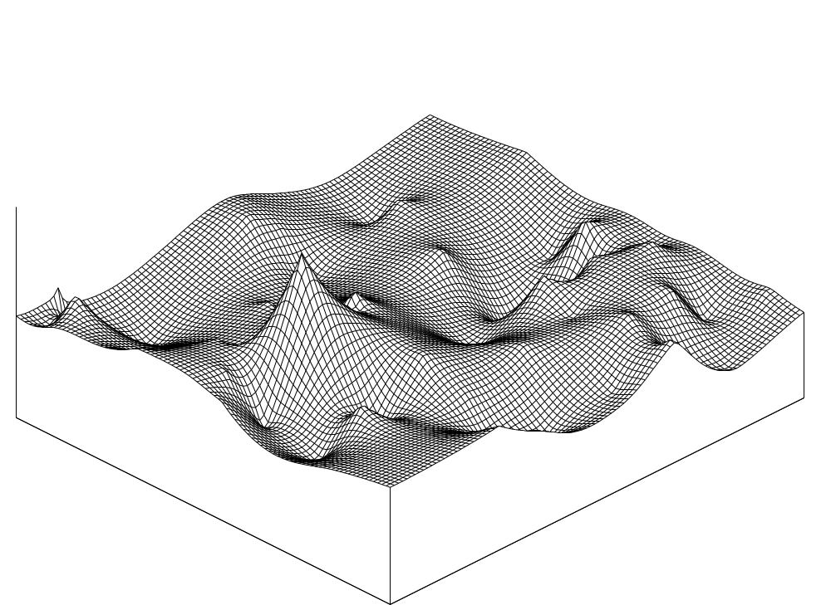
Real-World Problem:
Peaks and Valleys
Highest Peak
Lowest Valley

Slide 18
Optimization Process:
Ground Water Remediation Problems
Preliminary Tasks
  Understand site-specific goals and constraints
  Verify/update flow & transport model until it is considered valid for design purposes
  Obtain detailed information required to develop the formulations
State formulation(s) in mathematical terms
  Objective function
  Constraints
Select optimization codes/algorithms & solve formulations
Revise formulations and solve as needed

Slide 19
Types of Information Collected:
Ground Water Remediation Problems
Cost components
  One-time “capital” costs (now or in the future)
  Annual costs
Point of exposure, point of compliance
Schematic

Slide 20
Point of Exposure and Point of Compliance
Point of Exposure must have concentrations below a specified limit to protect receptors at or near this location
Property Boundary
Point of Compliance must have concentrations below a specified limit to protect potential receptors downgradient
Plume
Extraction wells
Regional Flow

Slide 21
Types of Information Collected:
Ground Water Remediation Problems
Cost components
  One-time “capital” costs (now or in the future)
  Annual costs
Point of exposure, point of compliance
Containment zones
Schematic

Slide 22
Containment Zone Schematic
Containment Zone
Regional Flow
Plume
Containment Zone defined to prevent the plume from spreading

Slide 23
Types of Information Collected:
Ground Water Remediation Problems
Cost components
  One-time “capital” costs (now or in the future)
  Annual costs
Point of exposure, point of compliance
Containment zones
Cleanup criteria and time period
System capacity
Pumping/injection limits
Drawdown/water level limits
Schematic

Slide 24
Water Level Limit
Private Well
Land Surface
Lowest water level allowed to protect private well
Well Screen

Slide 25
Types of Information Collected:
Ground Water Remediation Problems
Cost components
  One-time “capital” costs (now or in the future)
  Annual costs
Point of exposure, point of compliance
Containment zones
Cleanup criteria and time period
System capacity
Pumping/injection limits
Drawdown/water level limits
Limit on capital cost, etc.
Other planned actions (such as source removal) that may impact future remedy performance

Slide 26
Formulation Components:
Ground Water Remediation Problems
  Decision Variables
    Locations of extraction/injection wells
    Rates at each extraction/injection well over time
  Potential objective functions (select only one unless using a multi-objective algorithm)
    Total life-cycle cost {minimize}
    Cleanup time {minimize}
    Contaminant mass remaining in aquifer {minimize}
    Contaminant mass removed from aquifer {maximize}
  Potential constraints (as many as you want…here are some examples)
    Limits on pumping rates at specific wells or total pumping rate
    Limits on concentrations (at specific locations/times)
    Restrictions on well locations
    Limits on aquifer drawdown at specific locations
    Financial constraints such as limits on capital costs

Slide 27
Optimization Codes:
Ground Water Remediation Problems
Dr. Chunmiao Zheng (University of Alabama), Modular Groundwater Optimizer (MGO)
  Genetic algorithms
  Simulated annealing
  Tabu search
Dr. Richard Peralta (Utah State Univeristy), Simulation Optimization Modeling Systems (SOMOS)
  Genetic algorithms
  Simulated annealing
  Tabu search
  Genetic algorithms coupled with artificial neural network

Slide 28
Modular Groundwater Optimizer (MGO)
Simulation Components
  MODFLOW for groundwater flow
  MT3DMS for multi-species contaminant transport
Optimization Components
  Global optimization (heuristic search) techniques
    Genetic algorithms (GA)
    Simulated annealing (SA)
    Tabu search (TS)
  Integrated techniques
    Global optimization techniques + response functions for greater computational efficiency

Slide 29
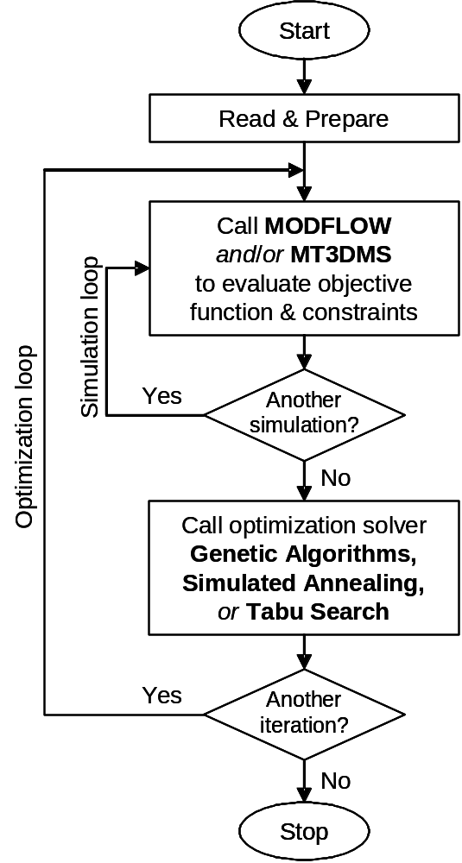
MGO
Program Structure

Slide 30
MGO: Setup of Optimization Modeling
Input files for MODFLOW (no modification)
Input files for MT3DMS (no modification)
An optimization input file specifying
  Optimization Solver (GA, SA, TS)
  Output options
  Decision variables (flow rates, well locations)
  Objective function
  Constraints

Slide 31
MGO: Additional Information
Code Compatibility
  MODFLOW
  MT3DMS
Platforms that incorporates MGO
  Groundwater Vistas

Slide 32
Simulation / Optimization
Modeling System (SOMOS)
Copyright August 2003
Optimization Software for Managing:
  Groundwater Flow
  Solute Transport
  Conjunctive Use
SOMOS is easy-to-use Windows-based S/O modeling software
SOMOS has a comprehensive set of heavy-duty optimizers to most efficiently address the spectrum of management optimization problems
SOMOS significantly improves planning and management and can help optimally manage water resources systems of unlimited size
SOMOS results from twenty years experience developing optimization models and applying them to real-world problems, including 11 pump-and-treat (PAT) systems and many large and small scale water supply problems
SOMOS has detailed documentation, tutorials, and error checking
Developed by:
Systems Simulation /Optimization Laboratory
Department of Biological and Irrigation Engineering
Utah State University, Logan, UT 84322 – 4105
Contact: richard.peralta@usurf.usu.edu

Slide 33
Applications
SOMOS handles large and complex problems and has been applied to many real-world problems. Some examples are:
Minimizing cost of TCE plume containment at Norton AFB:
  Optimization yielded 23% cost reduction from base strategy
  System was built, strategy was implemented and successful
TCE contaminant plume management: Minimizing TCE mass remaining at Massachusetts Military Reservation, CS-10 plume, while preventing plume expansion
  Optimization yielded 6% improvement from base strategy, at less cost
  Constructed system is operating successfully
Cache Valley sustained yield optimization problem: Maximizing sustained yield of stream-aquifer system
  Optimal strategy showed sustainable pumping could increase 40%
  causing management change
Applications performed at three sites for this ESTCP project
For more applications: http://www.usurf.org/units/wdl

Slide 34
SOMOS Features
Windows-based SOMOS runs in background, while user employs other programs.
SOMOS’ spread-sheet based pre-processor, SOMOIN, simplifies input file preparation (availability depends on version).
SOMOS’ professional design has detailed input error-checking and error messages.
Buttons on SOMOS’ user-friendly interface speed accessing/editing I/O files, and optimizations.
SOMOS’ flexibility allows run restarts, result merges, stepwise, sequential, and simultaneous optimization, full control over constraints and bounds in time and space.
SOMOS’ automation allows considering multitudinous candidate wells in a run and speeds sequential running of multiple optimization actions.
SOMOS includes a 2-D spreadsheet-based tool for mapping layered aquifer parameters, well locations and hypothetical capture zones (availability depends on version).
SOMOS is being included within groundwater modeling packages such as Visual MODFLOW and Groundwater Vistas

Slide 35
SOMOS Features (vary with version)
Applicability: Any confined or unconfined aquifer system that can be modeled.
Simulators: MODFLOW, MT3DMS, SEAWAT, Response Matrix, Response Surface, Artificial Neural Networks, Others.
12 Optimizers: Including Simplex, Gradient Search, Branch & Bound, Outer Approximation, Genetic Algorithm (GA) linked with Tabu Search (GA-TS) and Simulated Annealing (SA) linked with Tabu Search (SA-TS).
Optimization Problem Types: linear, quadratic, nonlinear, mixed integer, mixed integer nonlinear, multi-objective, stochastic (i.e. under uncertainty).
Controllable Variables: ground-water pumping, gradient, cell-head, head at well casing; surface water diversion, flow, & head; aquifer/surface body seepage; contaminant concentration, mass remaining & removal; user-definable variables.
Management Goals: Can optimize for 90+ distinct objective functions plus user-defined objective and multi-objective optimization.

Slide 36
Questions

Slide 37
DOD Groundwater Remediation Optimization Study

Slide 38
ESTCP Demonstration Project
Goal of project
  Demonstrate application of “transport optimization” at real world sites
  Evaluate the benefits and costs of using optimization algorithms versus the traditional trial-and-error modeling approach
  Make transport optimization technology more accessible
    Training
    Code availability

Slide 39
Project Setup
“Transport optimization” applied at 3 sites
  Umatilla Chemical Depot, Oregon
  Tooele Army Depot, Utah
  Former Blaine Naval Ammunition Depot, Nebraska
At each site, three different optimization formulations were developed
Each formulation was solved (over a fixed time period) by…
  two groups applying the coupled simulation-optimization approach
  one group running the contaminant transport model using trial-&-error (to serve as a scientific control)
Use of two groups provided greater confidence in results, a comparison of code performance, and more insight into the “beyond the code” efforts required to solve the problems

Slide 40
Project Team
ESTCP and EPA provided funding, USACE also provided support
Diverse project management team
  NFESC - Karla Harre, Laura Yeh
  EPA-TIO - Kathy Yager
  USACE - Dave Becker
  GeoTrans, Inc. - Rob Greenwald, Yan Zhang
  University of Illinois - Dr. Barbara Minsker
Transport optimization modelers
  Utah State University - Dr. Richard Peralta (SOMOS)
  University of Alabama - Dr. Chunmiao Zheng (MGO)

Slide 41
Demonstration Sites
Site Name | Pump rate (gpm) and Cost ($/yr) | # Existing Wells | Contam-inants | Groundwater Model Info.
Umatilla Army Depot | 1300/$430K (operating) | 3 ext. 3 inj. | RDX/ TNT | 5 layers 10 min runs
Tooele Army Depot | 5000/$1M (operating) | 15 ext. 13 inj. | TCE | 4 layers 10 min runs
Former Blaine NAD | 4000/$2M (in preliminary design) | 17 ext. (planned) | TCE*/ TNT | 6 layers 2 hr runs
* TCE simulated is combined plume of TCE, PCE, TCA, DCE, and RDX

Slide 42
Formulation Process For Each Site
Perform site visit and review site data
  Understand the real-life situation
  Explore real-life objectives and constraints with the installations
  Initial discussion of how to convert real life situation into mathematical description
Review site groundwater flow and transport model
  Receive assurance from installation that they consider the model predictions acceptable for use for remediation design purposes
  Important because the transport model provides the mathematical relationship between the decision variable values (the pumping locations/rates) and terms in the constraints/objective function

Slide 43
Formulation Process For Each Site
Develop 3 “optimization formulations” based on further interaction with the installations
  Select an “objective function” to be minimized (or maximized)
  Specify a set of constraints to be satisfied
Worked with installation to establish final mathematical representations of key problem components, such as…
  Cost coefficients (e.g., cost of new well, cost to treat each gpm, etc.)
  Nature of the relationships between the decision variables and other terms in the objective function and/or constraints (e.g., is the cost to treat each gpm constant, or does it change based on flow rate and/or contaminant concentrations?)

Slide 44
Optimization Formulations
Site Name |  | Objective Function | Major Constraints
Umatilla | Form. 1 | Min life-cycle cost | Current treatment capacity Cleanup of RDX and TNT
 | Form. 2 | Min life-cycle cost | Increased treatment capacity Cleanup of RDX and TNT
 | Form. 3 | Min total mass remaining in layer 1 | Cleanup of RDX and TNT
Tooele | Form. 1 | Min total cost | POE concentration limit
 | Form. 2 | Min total cost | POE/POC concentration limits
 | Form. 3 | Min total cost | POE/POC concentration Limits Declining source term Cleanup (< 50ppb)
Blaine | Form. 1 | Min life-cycle cost | Plume containment Cleanup of TCE and TNT
 | Form. 2 | Min life-cycle cost w/ 2400gpm extracted water diversion | Plume containment Cleanup of TCE and TNT
 | Form. 3 | Min maximum total pumping | Plume containment
POE = Point of Exposure; POC = Point of Compliance

Slide 45
Example: Umatilla
Goal: cleanup 2 constituents
  RDX: 2.1 ug/L
  TNT: 2.8 ug/L
Current system
  System capacity: 2 GAC units @ 1300 gpm
    3 extraction wells
    3 infiltration basins
  Expect cleanup in 17 years
Site Location
Current System &
Plume Distribution

Slide 46
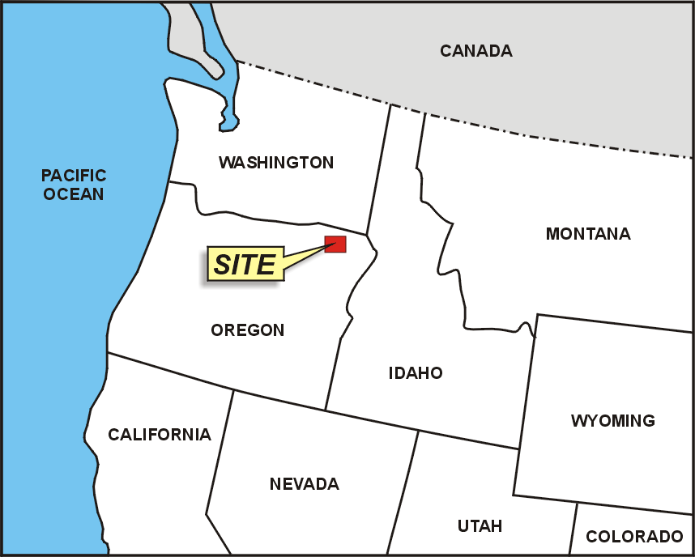
SITE LOCATION MAP

Slide 47
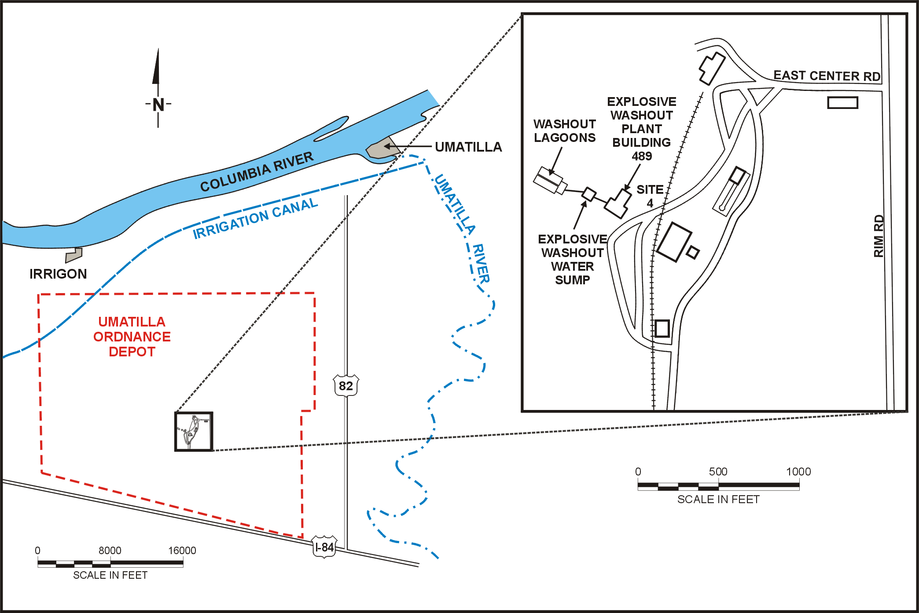
FACILITY AND SITE LOCATION MAP

Slide 48
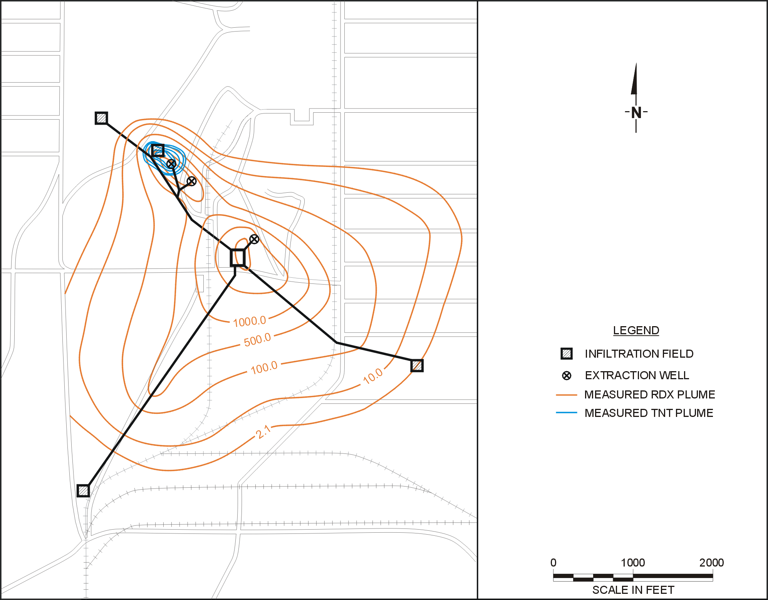
CURRENT SYSTEM
IF1
IFL
EW-3
EW-1
EW-4
Treatment Plant
IF2
IF3

Slide 49
Umatilla Objective Function:
Formulation 1
Minimize Total Cost Until Cleanup
Total Cost = CCW + CCB + CCG + FCL + FCE + VCE + VCG + VCS
    CCW: Capital Costs of new Wells
    CCB: Capital Costs of new Recharge Basins
    CCG: Capital Costs of new GAC units
    FCL: Fixed Costs of Labor
    FCE: Fixed Costs of Electricity
    VCE: Variable Costs of Electricity
    VCG: Variable Costs of changing GAC units
    VCS: Variable Costs of Sampling
    future costs are discounted to yield Net Present Value

Slide 50
Umatilla: Cost Terms
Up-Front costs
  New well and piping: $75K
  Put EW-2 in service: $25K
  New recharge basin: $25K
  New GAC unit (325 gpm): $150K
Fixed Annual Costs (each year until cleanup)
  Labor (fixed): $237K/yr
  Electric (fixed): $3.6k/yr
Variable Costs Depending on Solution (complicated)
  Electric based on pump rate at specific wells
  GAC changeout based on influent concentration
  Sampling costs due to plume area
Details:
Variable Electric Costs

Slide 51
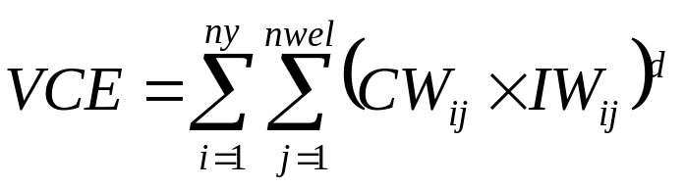
Example of Actual Details –
Cost Term VCE
VCE: Variable Cost of Electricity over system life-cycle
Where
ny is the elapsed time when cleanup occurs
nwel is the total number of extraction wells
CW_{ij} is the electrical cost of well j in year i. Costs differ for wells depending on the extraction rates Q_{ij}
IW_{ij} is a flag indicator; 1 if the well j is on in year i, 0 otherwise
d indicates application of the discount function to yield Net Present Value (NPV)

Slide 52
Umatilla Constraints: Formulation 1
Cleanup must be achieved within 20 years
Current treatment capacity, 1300 gpm
Limits on extraction rates imposed by hydrogeology of the site
  Zone 1, maximum rate at well ≤ 400 gpm
  Zone 2, maximum rate at well ≤ 1000 gpm
Concentration buffer zone
  Prohibits concentrations from exceeding the cleanup levels outside a specified area
Balance of extraction and injection rates

Slide 53
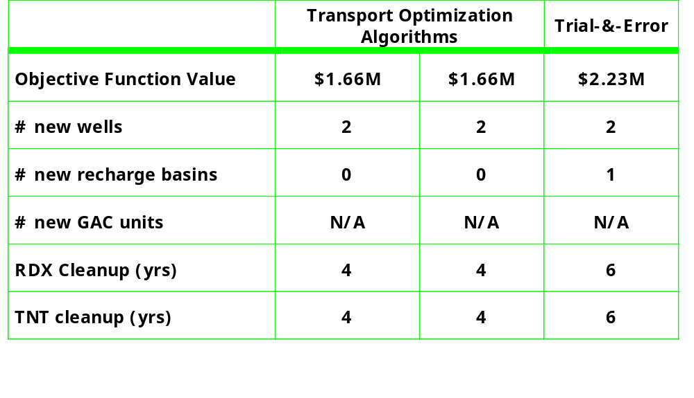
Umatilla Results: Formulation 1
Improvement using transport optimization: ~26%
Results Summary

Slide 54
Umatilla – Formulation 1 Results
All groups added new wells in this region…
USU & UA used wells only in this region.
IF1
IFL
EW-3
EW-1
Existing well EW-4 Only selected by the trial & error group
EW-4
Treatment Plant
IF2
IF3

Slide 55
Umatilla Results: Formulation 1
RDX results for an “optimal solution”
Result w/optimization:
RDX

Slide 56
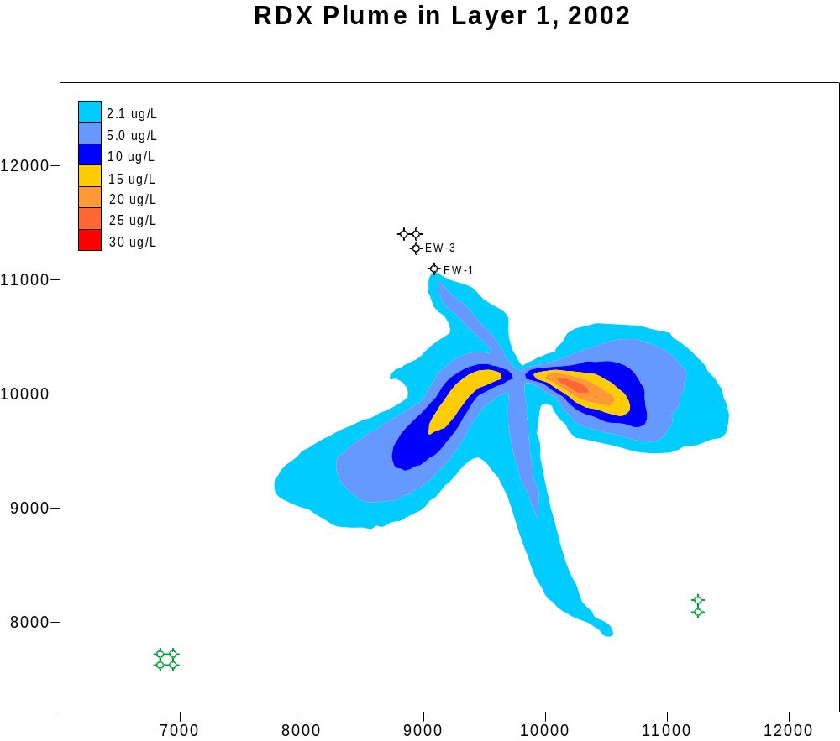

Slide 57
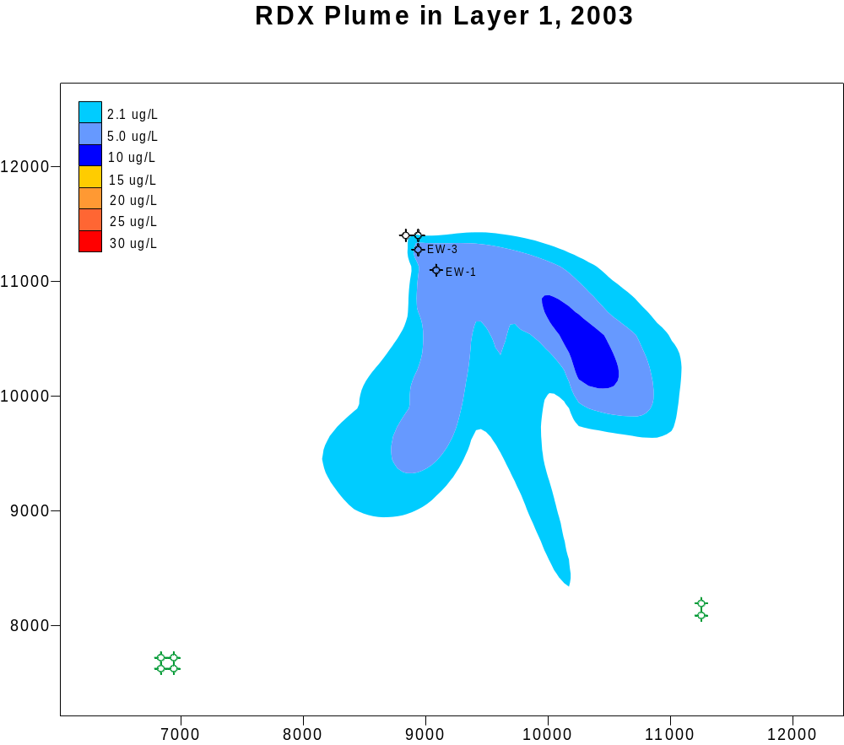

Slide 58
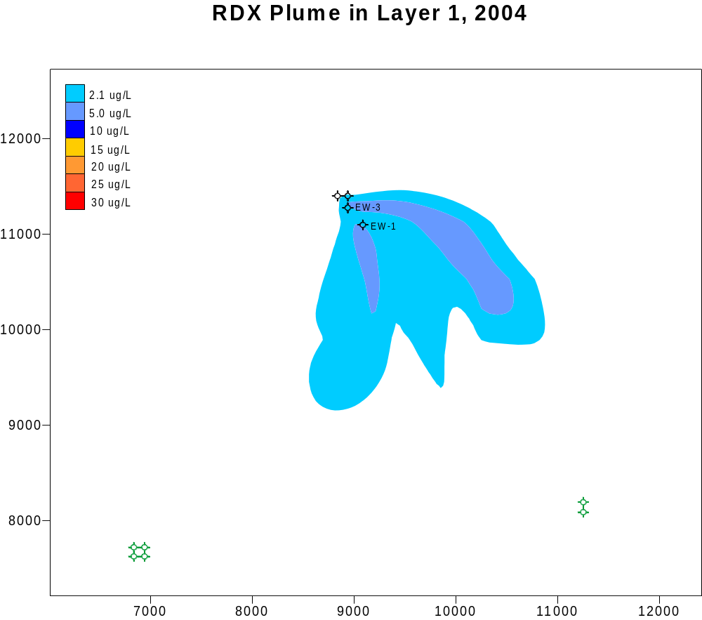

Slide 59
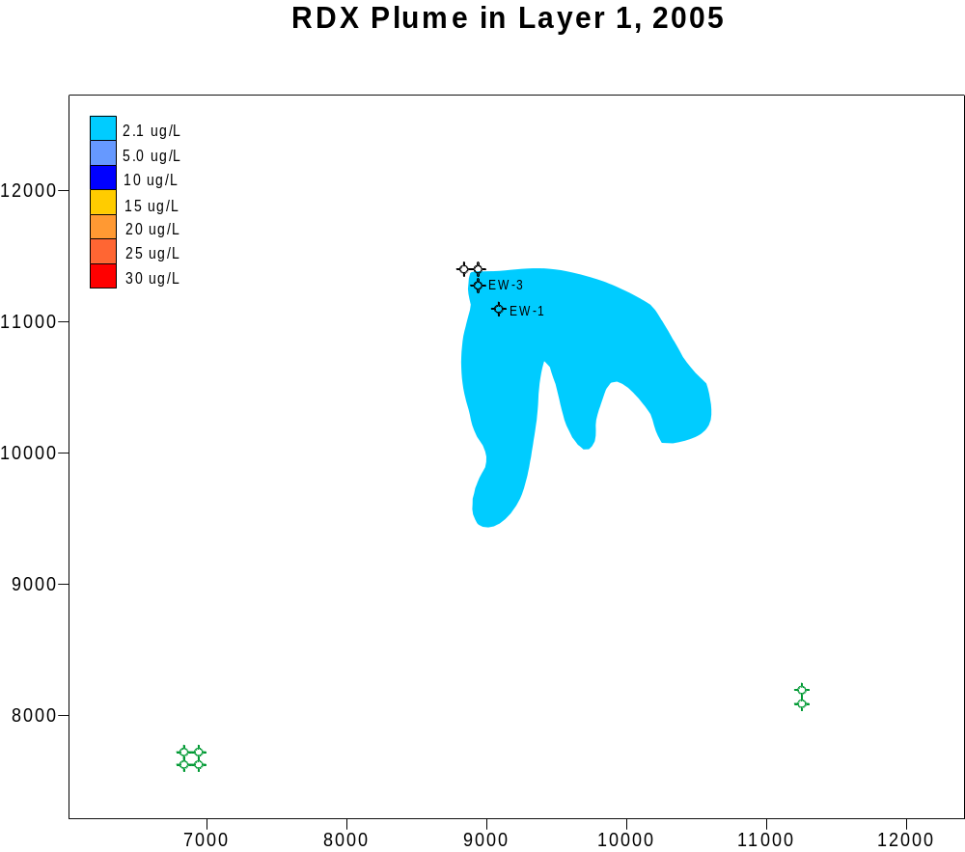

Slide 60
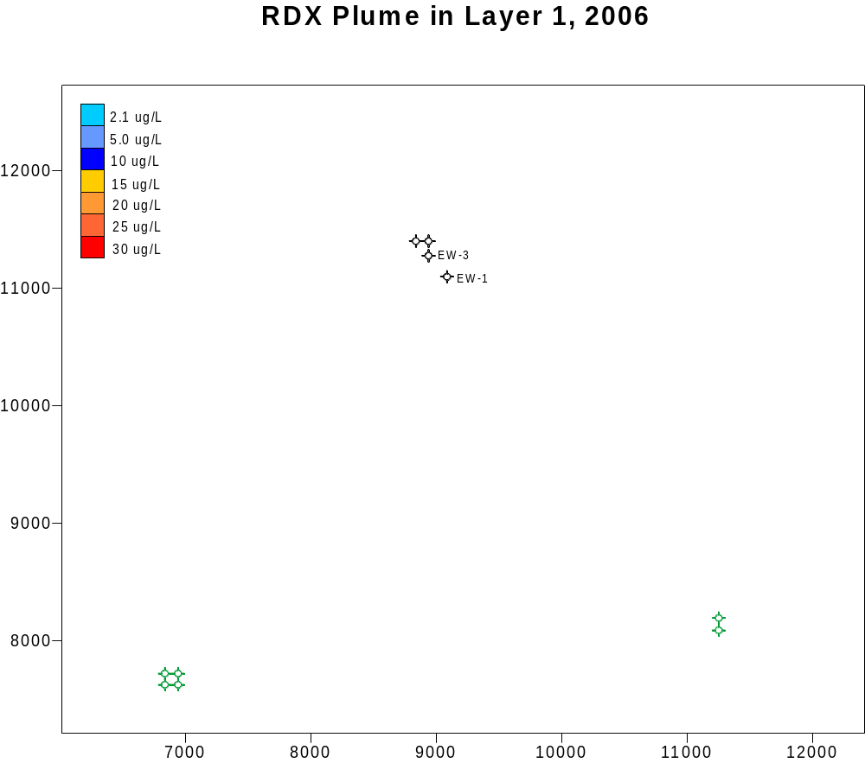

Slide 61
Umatilla Results: Formulation 1
TNT results for an “optimal solution”
Result w/optimization:
TN9T

Slide 62
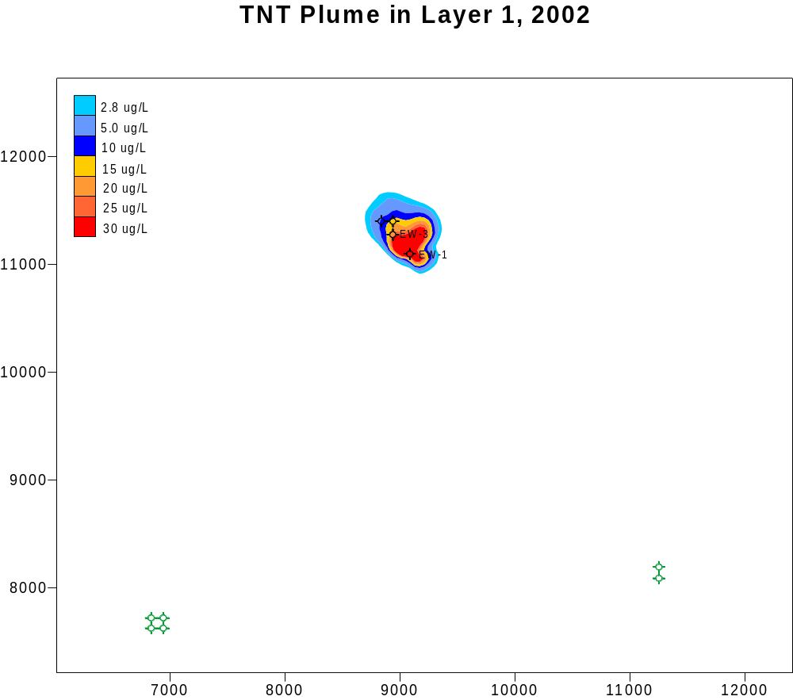

Slide 63
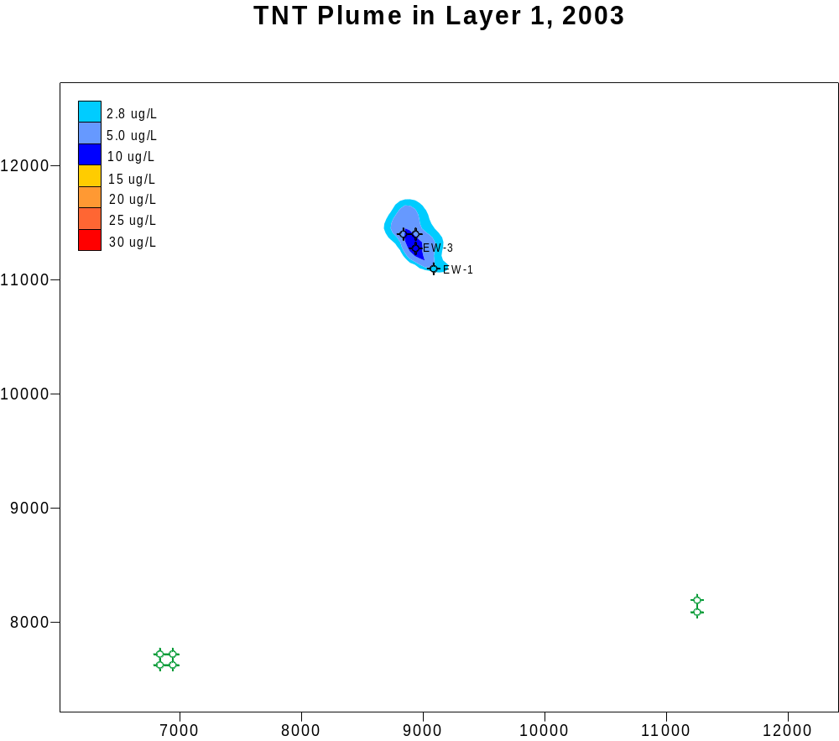

Slide 64
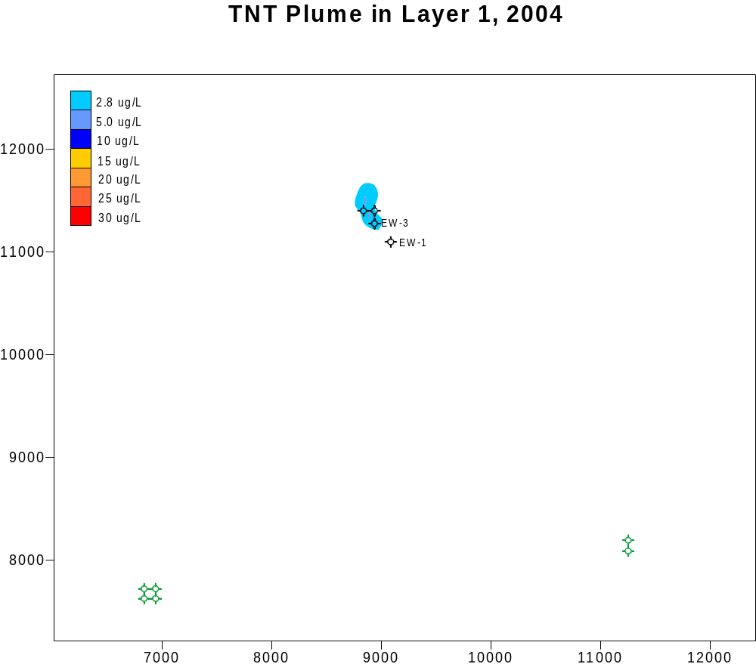

Slide 65


Slide 66
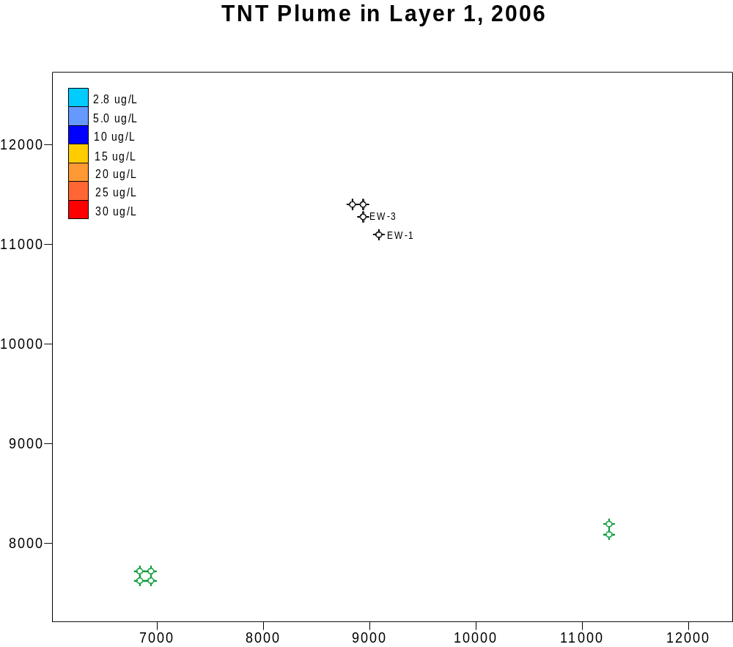

Slide 67
Example: Blaine
Primary Contaminants:
  VOCs
    TCE
    1,1,1-TCA
    PCE
    1,1-DCE
  Explosives
    TNT
    RDX
FS Recommended Design (Hydraulic Containment)
  12 deep wells @ 4,050 gpm
  5 shallow wells @ 18 gpm
  Expect cleanup up to 60 years
Only 2 constituents simulated for optimization:
TNT
TCE (represents TCE, TCA, PCE, DCE, and RDX)
Site Location
Pre-Remedy Plumes

Slide 68
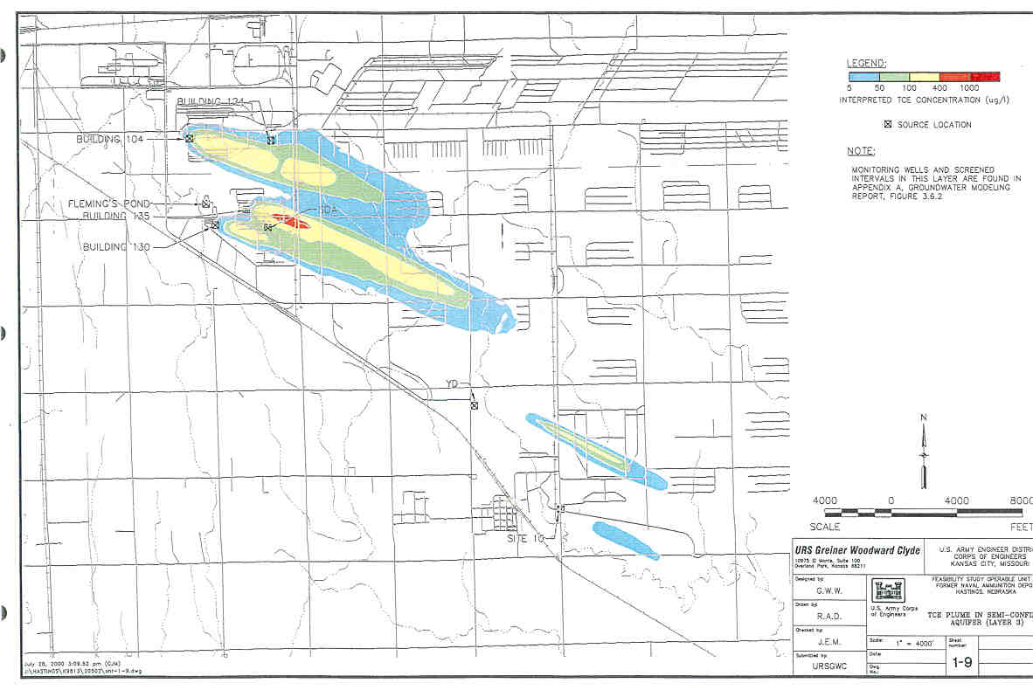

Site Location With TCE Distribution in Upper Semi-Confined Aquifer
HASTINGS
Hastings East
Industrial Park
Yard Dump
Bomb And
Mine Complex
NEBRASKA
Explosives
Disposal Area

Slide 69
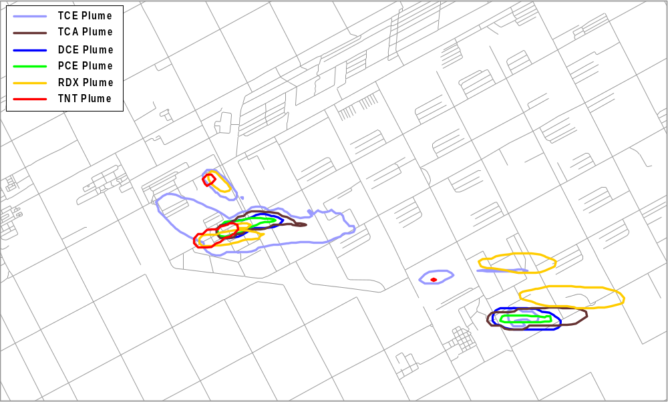
Commingled Plumes in Model Layer 1, 8/30/2002

Slide 70
Blaine Objective Function: Formulation 1
Minimize Total Cost Until Cleanup
Total Cost = CCE + CCT + CCD + FCM + FCS + VCE + VCT + VCD
    CCE: Capital cost of new extraction wells
    CCT: Capital cost of treatment
    CCD: Capital cost of discharge
    FCM: Fixed cost of management
    FCS: Fixed cost of sampling
    VCE: Variable cost of electricity
    VCT: Variable cost of treatment
    VCD: Variable cost of discharge
    future costs are discounted to yield Net Present Value

Slide 71
Blaine: Cost Terms
Up-Front Costs
  New extraction well: $400K
  Capital Treatment: $1.0K/gpm
  Capital Discharge: $1.5K/gpm
Fixed Annual Costs (each year until cleanup)
  Fixed O&M: $115K/yr
  Sampling: $300K/yr
Variable Costs
  Electric: $0.046K/gpm/yr
  Treatment: $0.283K/gpm/yr
  Discharge: $0.066K/gpm/yr

Slide 72
Blaine Constraints: Formulation 1
Cleanup within 30 years
Containment limits to prevent plume spreading
Limits on extraction well rates
  Well screens one model layer: 350 gpm
  Well screens two model layers: 700 gpm
  Well screens three model layers: 1050 gpm
Restricted areas where no wells allowed
Remediation wells not allowed in same cells as irrigation wells
No dry cells allowed

Slide 73
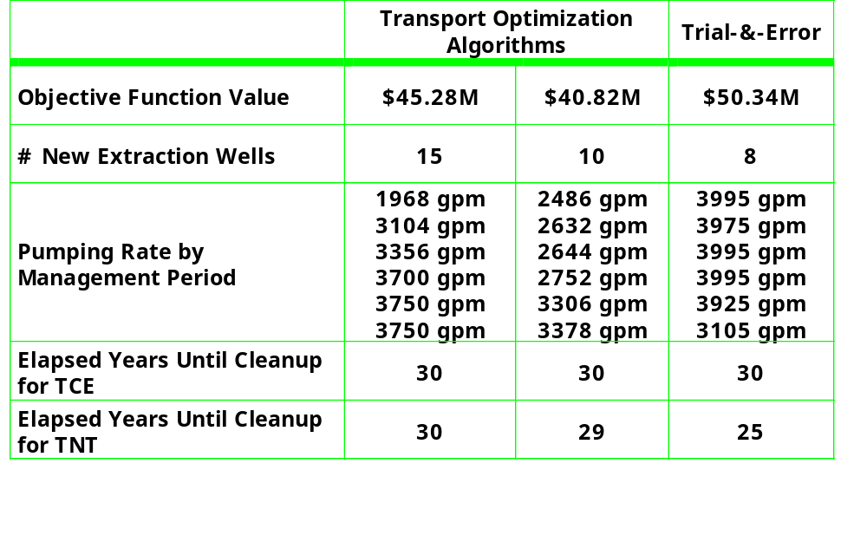
Blaine Results: Formulation 1
Improvement using transport optimization: ~10 - 20%

Slide 74
Blaine Results: Formulation 1
Optimization result from all three groups
Optimization Results:
TCE Layer 3

Slide 75
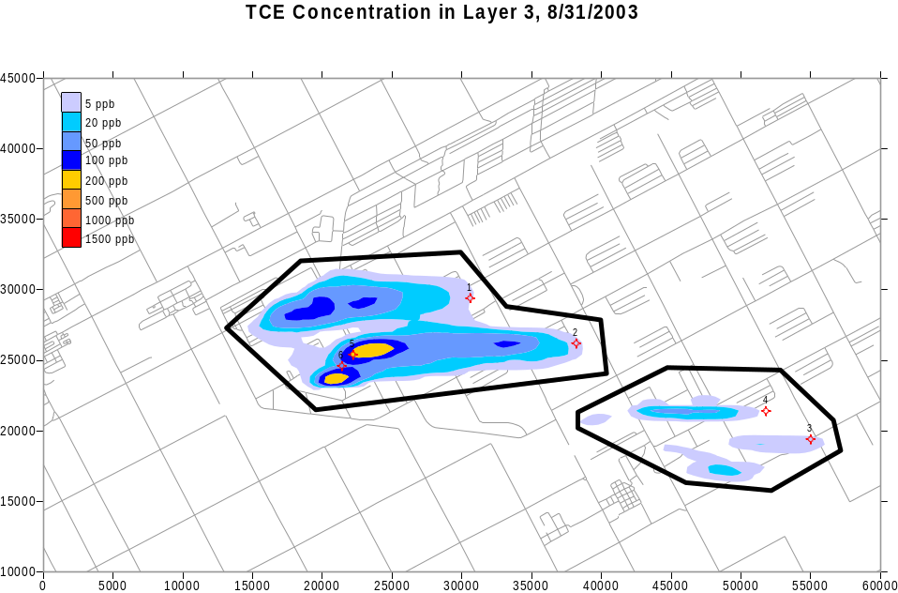

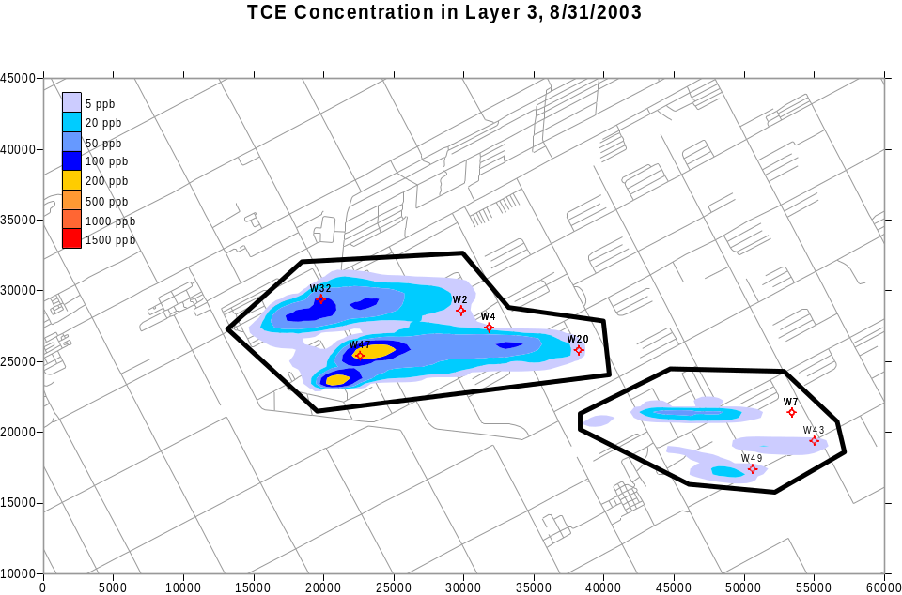
Transport Optimization Group 1
Transport Optimization Group 2
Trial-and-Error Group

Slide 76
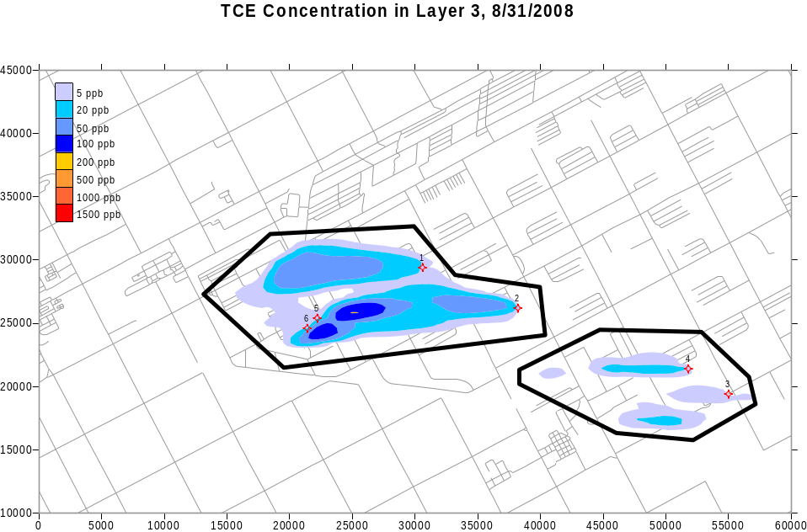
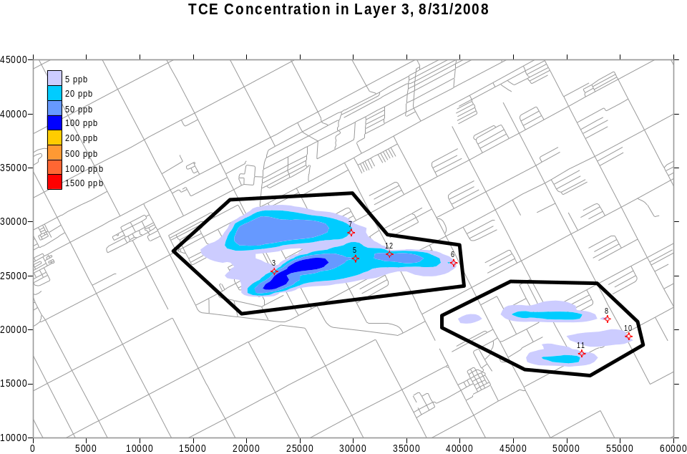
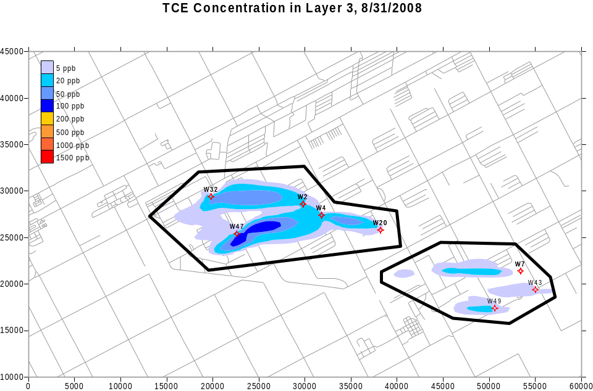
Transport Optimization Group 1
Transport Optimization Group 2
Trial-and-Error Group

Slide 77
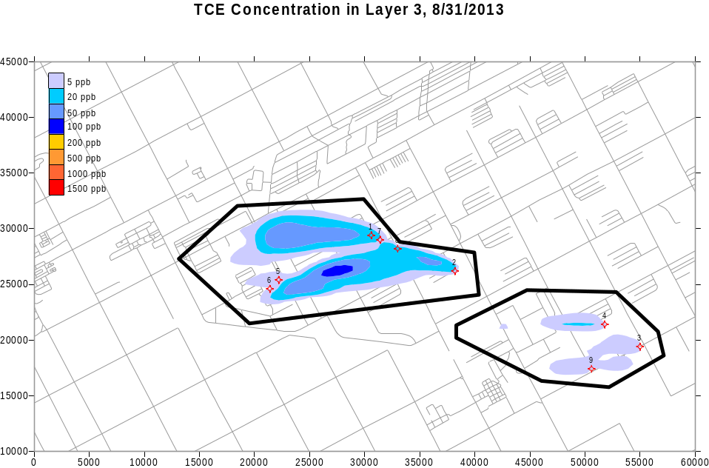
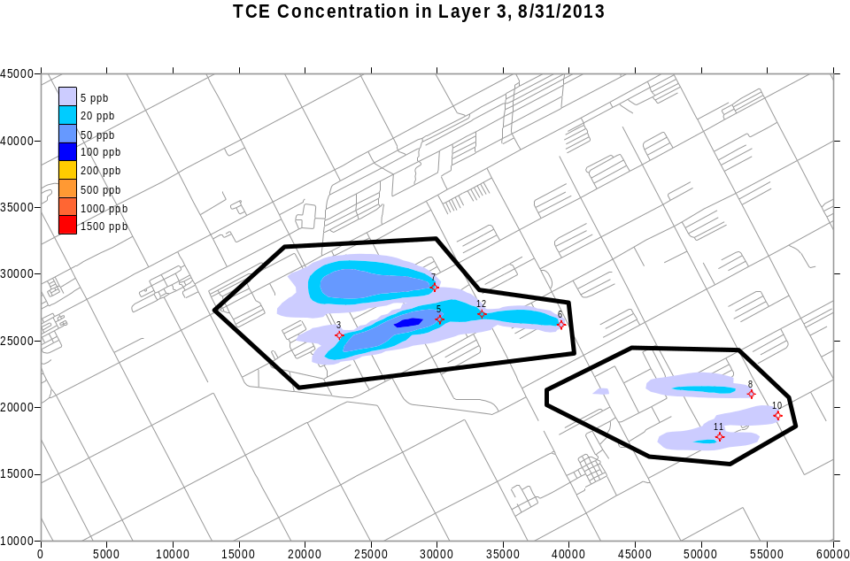
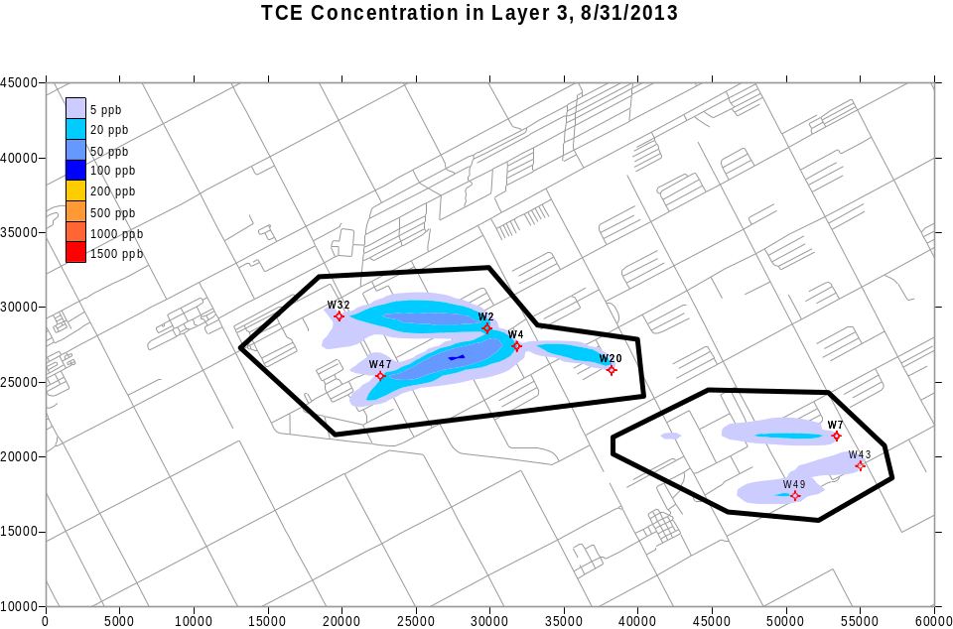
Transport Optimization Group 1
Transport Optimization Group 2
Trial-and-Error Group

Slide 78
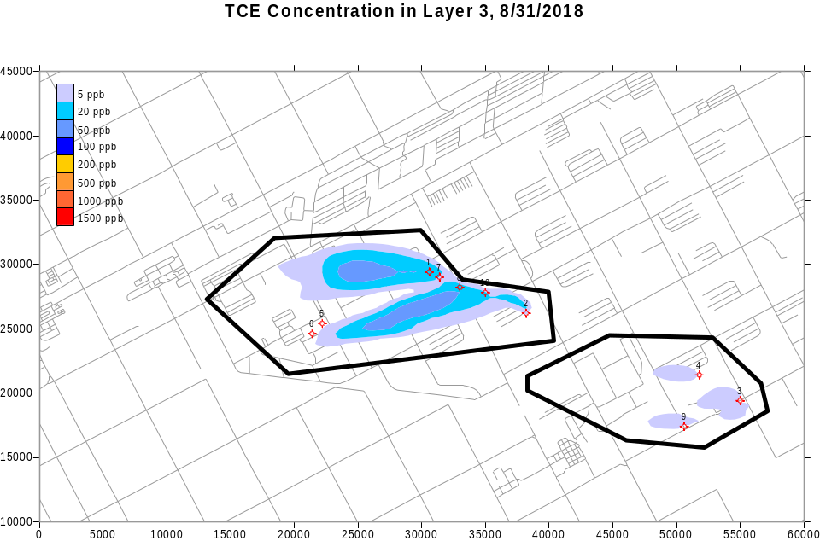
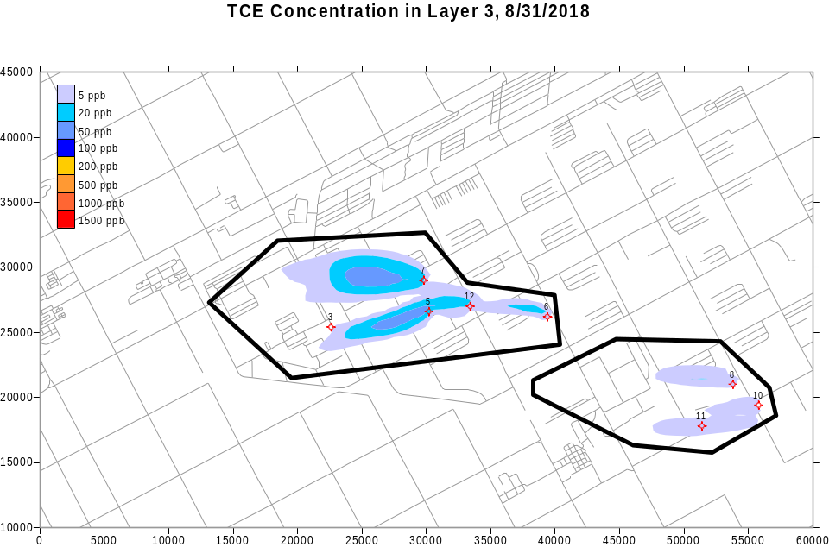
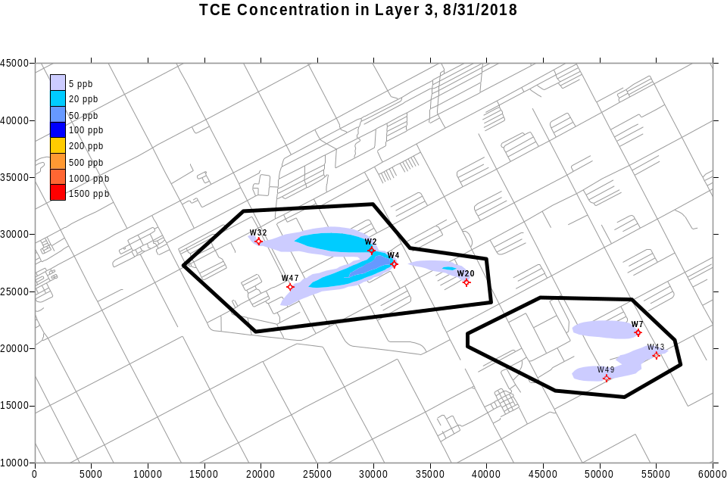
Transport Optimization Group 1
Transport Optimization Group 2
Trial-and-Error Group

Slide 79
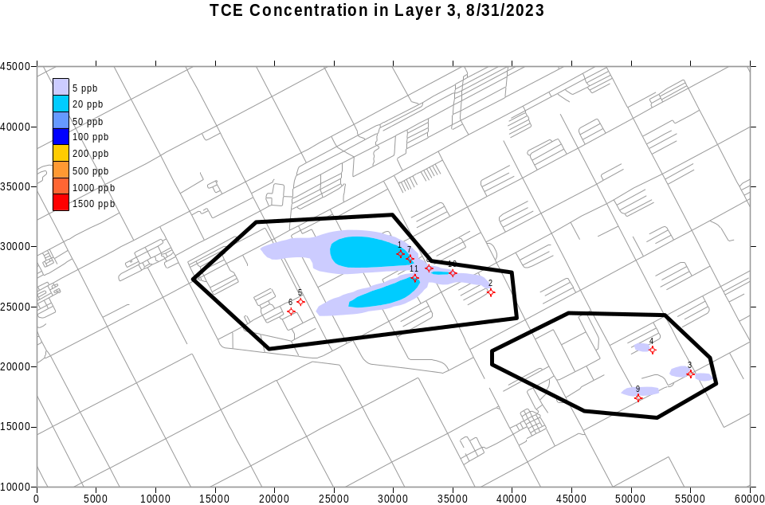
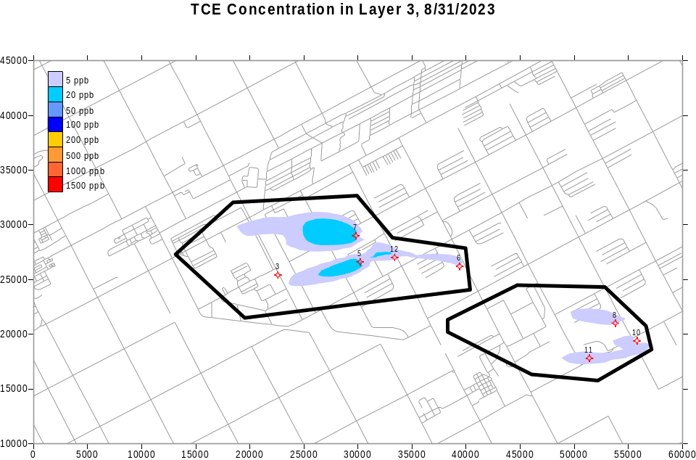
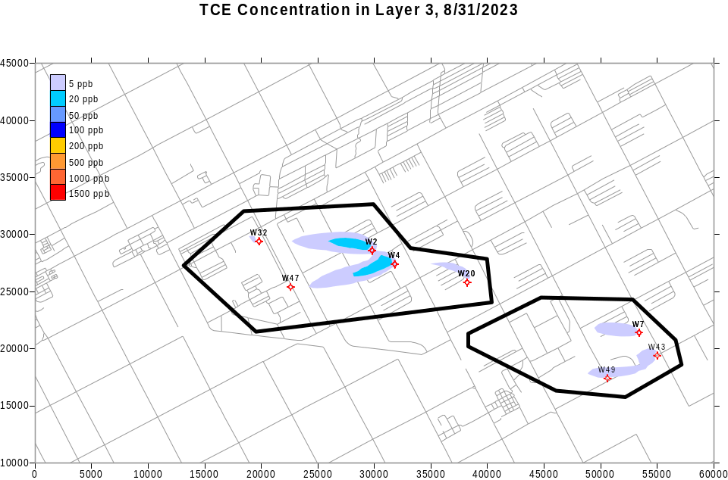
Transport Optimization Group 1
Transport Optimization Group 2
Trial-and-Error Group

Slide 80
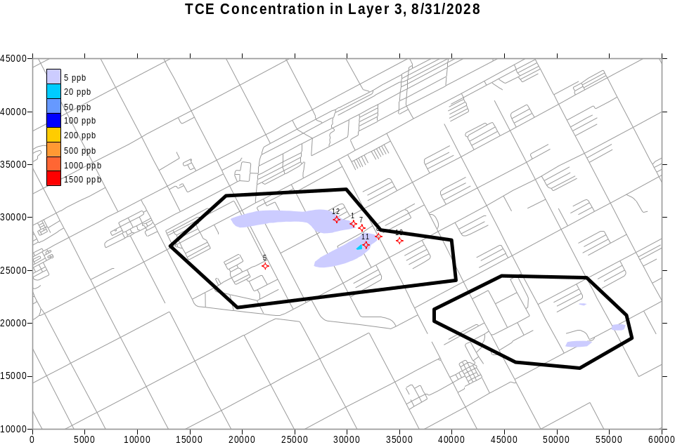
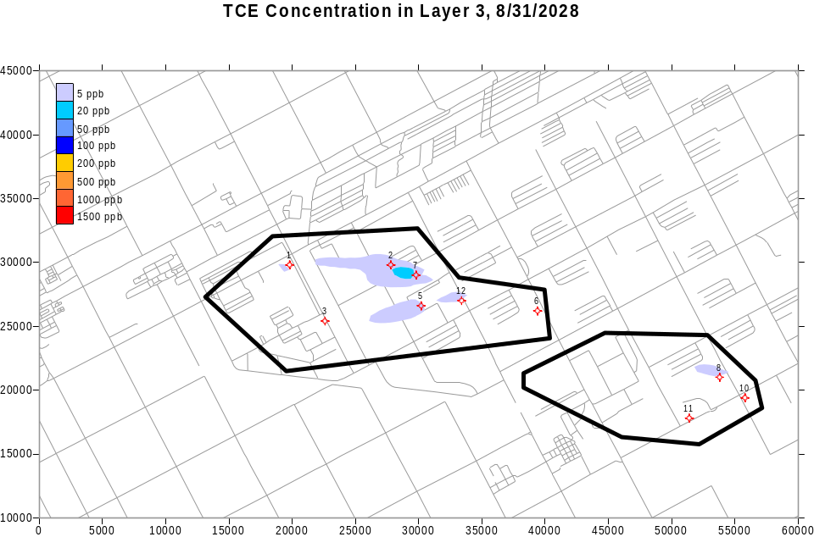
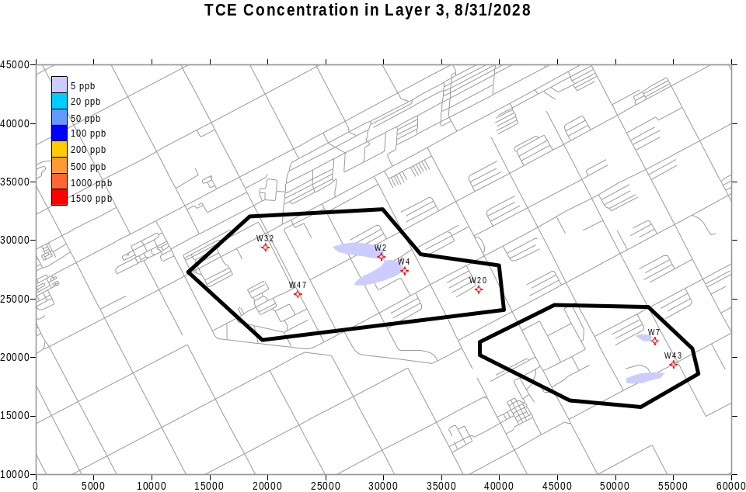
Transport Optimization Group 1
Transport Optimization Group 2
Trial-and-Error Group

Slide 81
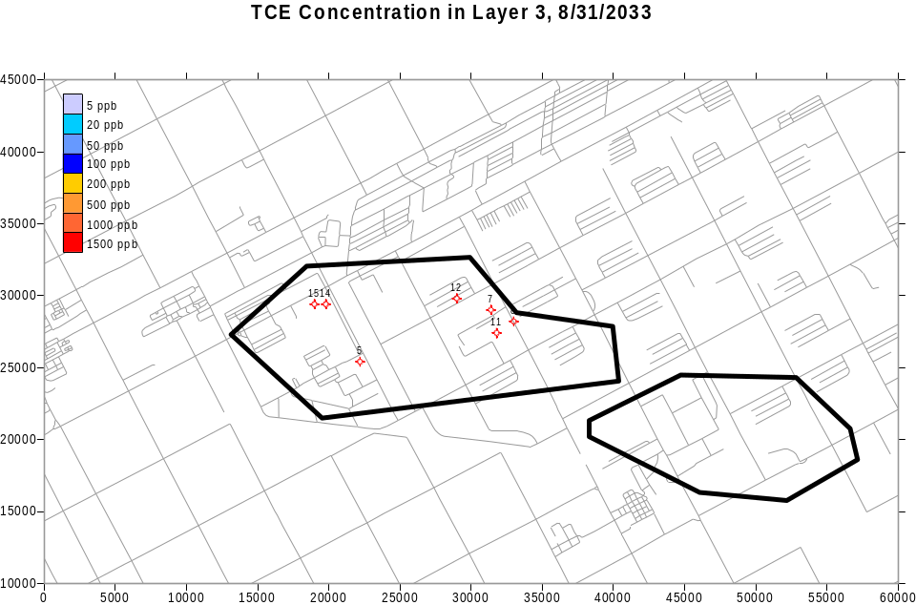


Transport Optimization Group 1
Transport Optimization Group 2
Trial-and-Error Group

Slide 82
Findings/Lessons Learned
Transport optimization algorithms
  Can be applied at real-world sites
  Provided improved solutions compared to trial-&-error (representative improvement was 20%)
  Found “outside of the box” solutions
    Pumping only within TNT plume at Umatilla
    Pumping less in early time periods and installed new wells later at Blaine
  Are estimated to cost $40-120K per site to apply ($0-40K more than trial-&-error design)
    Range varies with site complexity, model size, and number of contaminants

Slide 83
Typical Costs Estimated for A Transport Optimization Analysis
Costs Associated With Basic Items*
 | Low Cost | Typical Cost | High Cost | Expected Duration
Site visit and/or transfer information | $2,500 | $5,000 | $10,000 | 1-2 months
Develop 3 optimization formulations | $5,000 | $10,000 | $15,000 | 1-2 months
Solve optimization formulations | $25,000 | $40,000 | $60,000 | 2-4 months
Prepare report and/or present results | $5,000 | $15,000 | $25,000 | 1 month
Project management | $2,500 | $5,000 | $10,000 | NA
Total | $40,000 | $75,000 | $120,000 | 5-9 months
Costs Associated With Optional Items
 | Low Cost | Typical Cost | High Cost | Expected Duration
Update and improve simulation models | 0 | $20,000 | $50,000 | Add 1-3 months
Up to 3 additional formulations | $15,000 | $25,000 | $40,000 | Add 2-3 months
Additional constituent simulated | $10,000 | $20,000 | $30,000 | Add 1-2 months
Transport simulation 1 hr longer | $10,000 | $20,000 | $30,000 | Add 1-2 months
* Assumes 1-2 constituents, and simulation time of 2 hours or less

Slide 84
Findings/Lessons Learned
Transport optimization algorithms
  Allow thousands more simulations
    For example, 39 trial-&-error runs vs. ~5000 runs with the MGO transport optimization code for one formulation
  Can assist sites in screening alternative strategies (e.g., aggressive pumping vs. containment only)
  Have potential application during both the design and operation of P&T systems
  Require development of optimization formulations, which helps the project team understand and quantify objectives and constraints

Slide 85
Technology Transfer Activities
Project Website (http://www.frtr.gov/optimization/simulation/transport/general.html)
  Optimization codes and documentations
  Final project report
  Modeling files for each demonstration site
  Sample optimization code input and output files for Blaine
  Powerpoint animations illustrating results for Each group
Training
  2-day workshop - 2004
Case Study / Site Follow-Up
  Through summer 2004

Slide 86
Questions

Slide 87

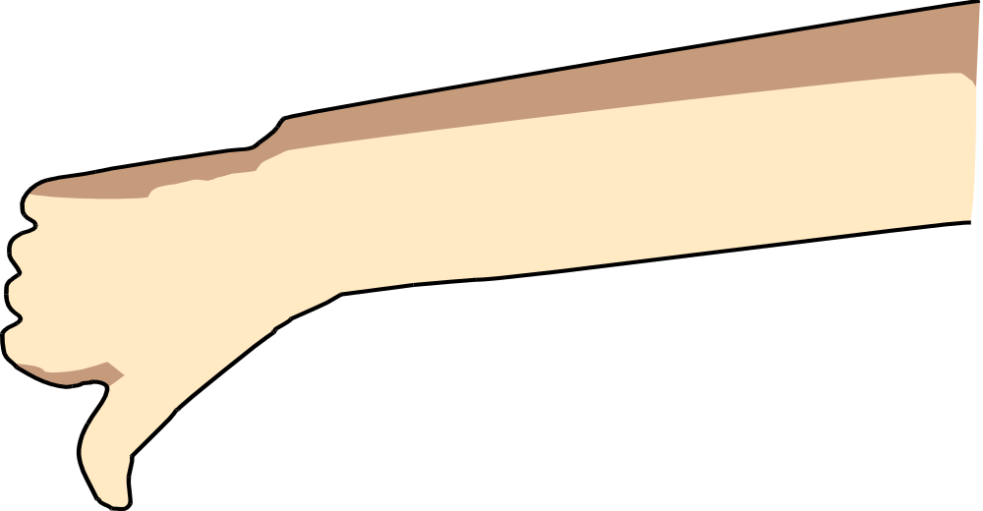
Thank You
After viewing the links to additional resources, please complete our online feedback form.
Thank You
Links to Additional Resources

