Slide 1
Ascent Performance of the Rockot/Breeze-KM Launch Vehicle from Plesetsk
AeroSim technical note · October 2026
Abstract. A three-degree-of-freedom ascent model is calibrated against the User's Guide reference mission [1]: 1,570 kg to a 650 km circular orbit at 86.58°. Stage-1 and stage-2 burnout speeds agree within 0.2 % and 0.5 %. Maximum dynamic pressure is 64.8 kPa and peak axial load 7.2 g. The upper stage inserts into a 643 × 666 km orbit at 86.34° with 235 kg of propellant remaining.

Slide 2
Stage parameters
 | Stage 1 | Stage 2 | Breeze-KM
Engines | RD-0233 ×3, RD-0234 | RD-0235, RD-0236 ×4 | S5.98M
Thrust, vacuum (kN) | 2,178 | 248 | 20
Isp, vacuum (s) | 310.0 | 320.0 | 325.5
Isp, sea level (s) | 285.0 | – | –
Burn time (s) | 121 | 183 | ≤ 794
Propellant (kg) | 86,691 | 14,475 | 4,975
Dry mass (kg) | 5,695 | 1,485 | 1,320
Ideal Δv, vacuum (m/s) | 4,109 | 2,790 | 3,161
Ideal Δv totals 10,061 m/s (fairing carried to stage-2 burnout). Lift-off mass 117.0 t; thrust-to-weight 1.75. Engine and Isp data [1]; dry masses [2]; stage-1/2 propellant fitted (slide 6).

Slide 3
Mission performance
 | Model | User's Guide [1]
Payload (kg) | 1,570 | 1,570
Lift-off mass (t) | 117.0 | 107
Max. dynamic pressure (kPa) | 64.8 at 51 s | 61.3 at 50 s
Peak axial load, stage 1 (g) | 7.2 | 6.2–8.0
Peak axial load, stage 2 (g) | 2.7 | ≤ 3.0
Peak axial load, Breeze-KM (g) | 0.64 | –
Transfer orbit (km) | 160 × 635 | 160 × 635
Final orbit (km) | 643 × 666 | 650 × 650
Inclination (deg) | 86.34 | 86.58
Lift-off to transfer orbit (s) | 1,038 | 882
Breeze-KM propellant remaining (kg) | 235 | –
Reference mission from Plesetsk (62.8° N, 40.3° E).

Slide 4
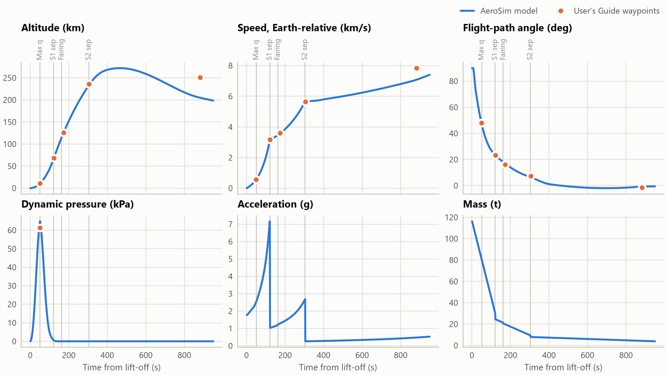
Ascent trajectory
Line: model; points: waypoints of [1, fig. 3-6]. Vertical lines: max. q, stage-1 separation, fairing jettison, stage-2 separation.

Slide 5
State at flight events
 | t (s) |  | h (km) |  | v (m/s) |  | γ (deg)
Event | Model | Guide | Model | Guide | Model | Guide | Model | Guide
Max. q | 51 | 50 | 10.9 | 10.7 | 591 | 567 | 46.9 | 47.9
Stage-1 sep. | 121 | 122 | 65.9 | 68.3 | 3,156 | 3,163 | 23.3 | 23.3
Fairing jettison | 162 | 173 | 114.2 | 125.6 | 3,464 | 3,599 | 18.0 | 16.0
Stage-2 sep. | 304 | 305 | 233.0 | 235.7 | 5,663 | 5,634 | 6.5 | 7.3
Burn-1 cutoff | 1,038 | 882 | 189.9 | 250.7 | 7,902 | 7,832 | −0.6 | −1.5
Model against [1, fig. 3-6]. v: Earth-relative speed; γ: flight-path angle.

Slide 6
Calibration and limitations
Fitted by least squares to ten waypoints of [1]: stage-1/2 propellant, pitch kick, stage-2 pitch rate, Breeze-KM climb-rate law. Eight of ten met.
Misses: lift-off mass +9.3 %, burn-1 cutoff +156 s. The model needs more energy than the flight vehicle.
Point mass, constant thrust per stage, J2 gravity, generic drag, exponential upper atmosphere [3].
References
[1] Eurockot Launch Services, Rockot User's Guide, EHB0003, Issue 5, Rev. 0, 2011.
[2] M. Wade, “Rokot,” Encyclopedia Astronautica, astronautix.com.
[3] D. A. Vallado, Fundamentals of Astrodynamics and Applications, table 8-4.

