Slide 1
Laziness...
Made by Ádám Ancsin

Slide 2
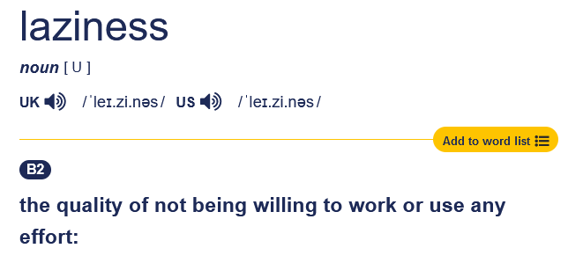
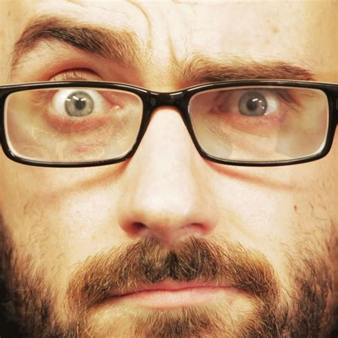
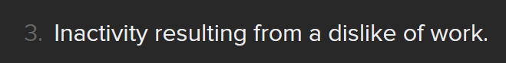
In the Dictionary.
Or is it?
Camebridge dictionary
DuckDuckGo

Slide 3
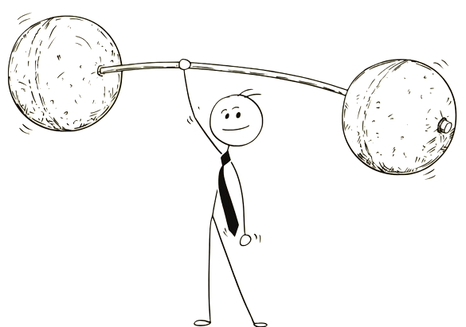
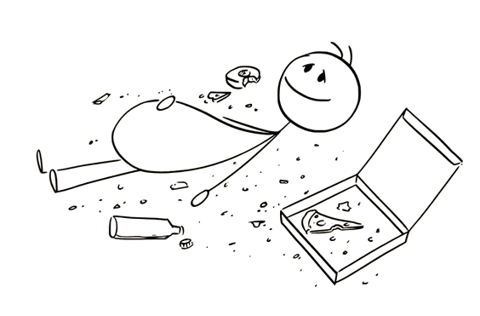
What it really is.
When you know what you should
be doing to reach a certain goal,
but aren’t actually doing it.
theblurb @Youtube

Slide 4


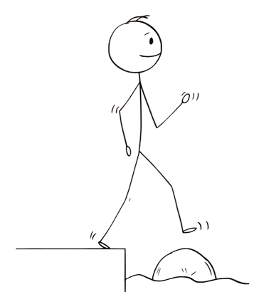
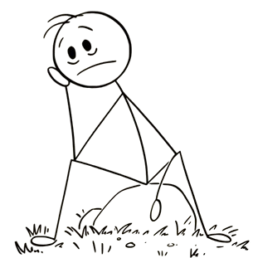

A big Reason.
Procrastination

Slide 5
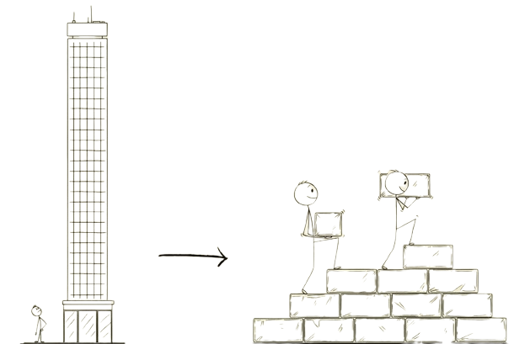
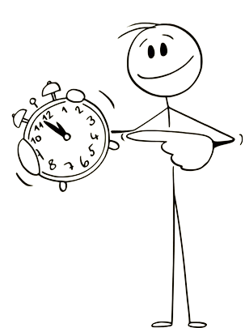
When Knowing’s not enough.
the 2 minute
rule
breaking it down

Slide 6
So What are You waiting for?
Make the first step small
and
take
it.

Slide 7
Thank You for your Attention.
“You don’t have to see the
whole staircase, just take
the first step.”
- Martin Luther King Jr.

