Slide 1
ROCKBUSTER STEALH
Moving Our Film Rentals from In-Person
to Online Streaming

Slide 2
HISTORY
FUTURE
Rockbuster was once a video rental giant, the biggest in the world.
However, streaming video services have long surpassed Rockbuster, and nearly all of our stores have shuttered their doors.
Now it’s time to bring Rockbuster Stealth into the world of streaming video-on-demand. We’ll use our existing movie licenses, and analyze our previous rental performances, to open the door for launching our new services.

Slide 3
Rockbuster’s General Movie Facts:
# of Movies in Inventory: 4,581
# of different film licenses: 1,000
Average Rental Duration: 5 days
Max Rental Rate: $4.99
Minimum Rental Rate: $0.99
Average Rental Rate: $2.98

Slide 4
Rockbuster’s Best Performing Movies
Rockbuster’s Poorest Performing Movies
Rockbuster’s Top Performing Actors
Telegraph Voyage | $215.75
Zorro Ark | $199.72
Wife Turn | $198.73
Innocent Usual | $191.74
Hustler Party | $190.78
Saturday Lambs | $190.74
Titans Jerk | $186.73
Harry Idaho | $177.73
Torque Bound | $169.76
Dogma Family | $168.72
Pelican Comforts | $165.77
Goodfellas Salute | $164.75
Fool Mockingbird | $162.79
Apache Divine | $160.72
Enemy Odds | $159.75
Cat Coneheads | $159.73
Scorpion Apollo | $158.79
Range Moonwalker | $158.77
Scalawag Duck | $157.71
Sunrise League | $155.78
Zhivago Core | $10.93
Maude Mod | $10.93
Jawbreaker Brooklyn | $10.91
Towers Hurricane | $10.91
Comancheros Enemy | $9.94
Ballroom Mockingbird | $9.93
Connection Microcosmos | $8.95
Harold French | $8.93
Ghostbusters Elf | $8.93
Japanese Run | $7.94
Stallion Sundance | $7.94
Lights Deer | $7.93
Treatment Jekyll | $6.94
Cruelty Unforgiven | $6.94
Young Language | $6.93
Rebel Airport | $6.93
Freedom Cleopatra | $5.95
Oklahoma Jumanji | $5.94
Texas Watch | $5.94
Duffel Apocalypse | $5.94
Susan | Davis | $3,193.49
Gina | Degeneres | $3,129.17
Matthew | Carrey | $2,543.78
Mary | Keitel | $2,426.92
Scarlett | Damon | $2,403.81
Walter | Torn | $2,403.18
Henry | Berry | $2,392.36
Christian | Akroyd | $2,378.97
Angela | Witherspoon | $2,357.11
Cameron | Zellweger | $2,322.94
Woody | Hoffman | $2,315.92
Sandra | Kilmer | $2,271.44
Ben | Willis | $2,239.97
Jayne | Nolte | $2,231.33
Michael | Bolger | $2,201.97
Sean | Guiness | $2,173.61
Kevin | Garland | $2,161.90
Whoopi | Hurt | $2,156.16
Ed | Mansfield | $2,146.56
Helen | Voight | $2,144.92

Slide 5
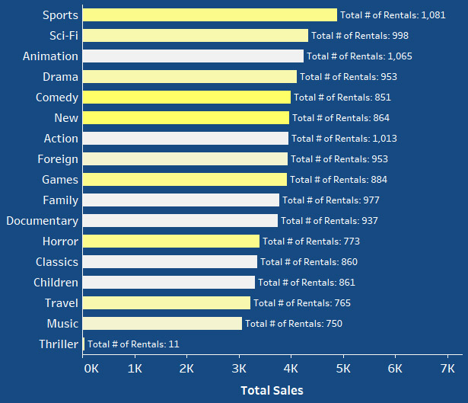
Which Types of Movies Perform Best?
Movie Rental Sales Performance by Genre
With this information, we can see that some movies produce lower overall sales even though they have higher numbers of rentals. We can see this is because their average rental cost is lower than some other movie genres. We can possibly increase our overall sales by increasing the average rental cost of our most popular movie genres.

Slide 6
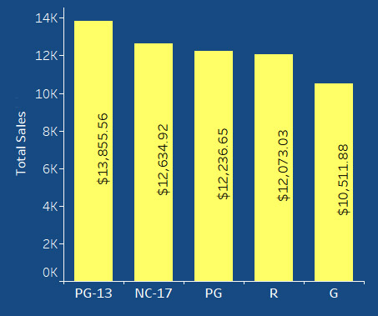
Which Types of Movies Perform Best?
Movie Rental Sales Performance by Rating
PG-13 and NC-17 movies produce the most income for Rockbuster. However, only G movies produce significantly less income than the other ratings. When sorted by rating, all categories have little variation in average rental price, and overall sales performance is based more on how many rental transactions happened for each genre.

Slide 7
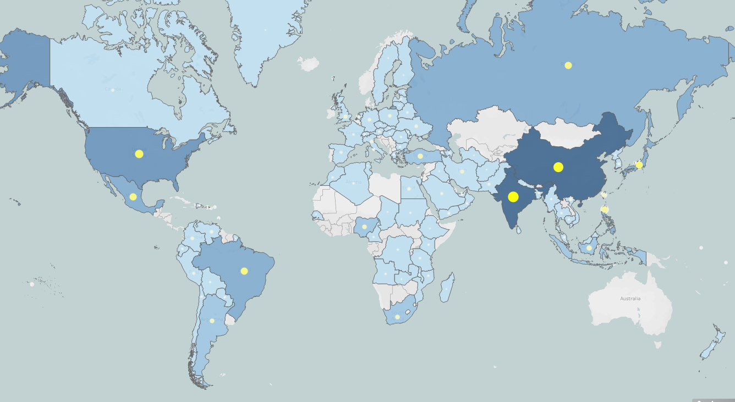
Where are Rockbuster Customers Located?
This map shows where Rockbuster’s customers are located and which countries have had the most sales.
Asia represents the largest sales and greatest number of customers.
North America also has a large customer base and substantial sales.
South America is the third largest region for Rockbuster customers.

Slide 8
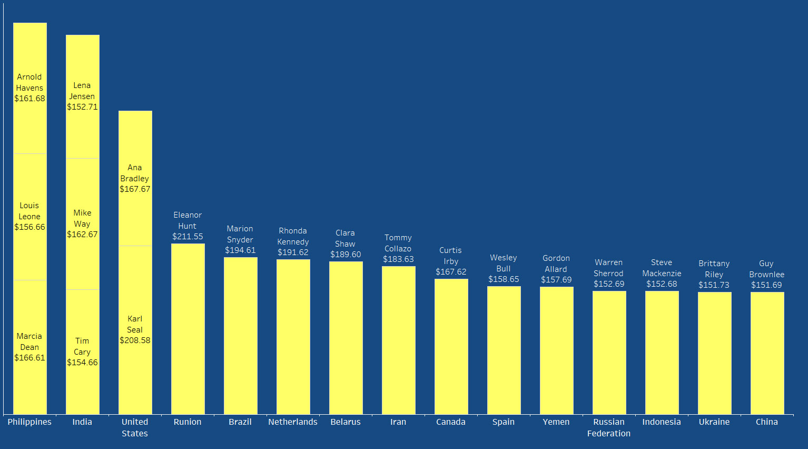
Rockbuster’s Top Lifetime-Valued Customers by Country

Slide 9
Next Steps
Asia and North America should be the two primary target markets for the launch of Rockbuster Stealth’s online streaming platform.
The most customers will be looking for PG-13, NC-17, or PG movies.
Sports, Sci-Fi, Animation, and Action movies all have the most rentals and if higher rental prices are charged (particularly for action movies), greater revenue can be expected.
For marketing the launch of the new service, it will be best to choose movies that highlight actors from the top-performing actors list, such as Susan Davis or Gina Degeneres.
Tableau Public Interactive Graphs

