Slide 1


CSCI 1304: Programming I Chapter 1 Introduction Part 2 A Sip of Java
Dr. Nour Almadhoun Alserr
Lecture 5
Week 3
Notes:
Overcome Challenges

Slide 2
Objectives
Introduce program design and errors.
Overview of the Java programming language.

Slide 3
History of Java
In 1991, James Gosling and Sun Microsystems began designing a language for home appliances (controlled by many different chips ”processors”)).
Intermediate language
Machine language
Program
common to all appliance processors
For a particular appliance’s processor

Slide 4
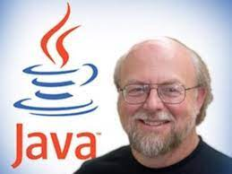
History of Java
Appliance manufacturers weren’t impressed ….
In 1994, Gosling realized that his language would be ideal for a Web browser (over the Internet).
Notes:
Sun produced the browser known today as HotJava.

Slide 5
Applications and Applets
Two kinds of java programs: applications and applets
Applications
Regular programs
Meant to be run on your computer
Applets
Little applications
Meant to be sent to another location on the internet and run there (e.g., included with the HTML web document)

Slide 6
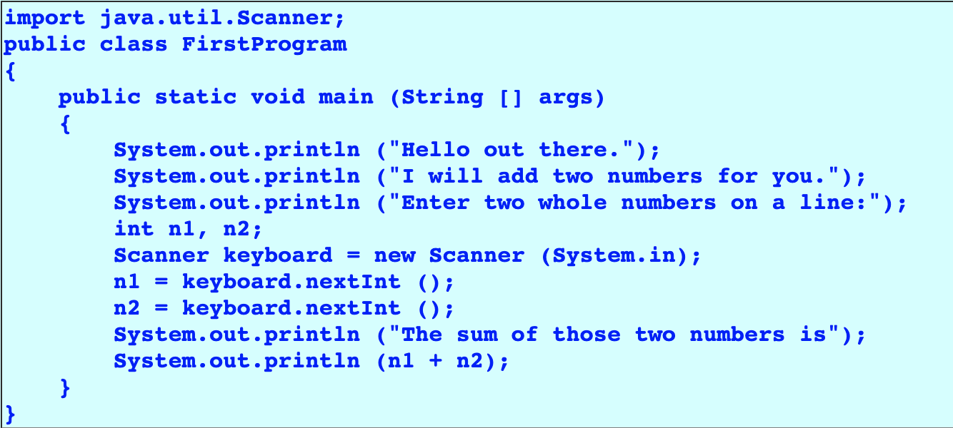
First Java Application

Slide 7

Some Terminology
The person who writes a program is called the programmer.
The person who interacts with the program is called the user.
https://medium.com/swlh/10-things-every-programmer-should-know-26ba37cfcaf4

Slide 8

Some Terminology
A package is a library of classes that have been defined already.
import java.util.Scanner; //Explicit import.
Scanner class is used to get user input.
import java.util.*; //Wildcard import.
Notes:
Wildcard imports refer to importing a package instead of declaring specific class names being used from a package.

Slide 9
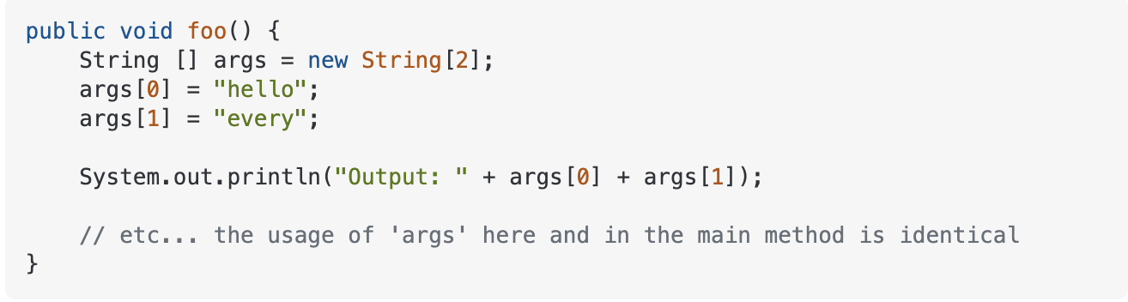
Some Terminology
A Java program can involve any number of classes.
The class to run (main method) will contain the words
public static void main(String args[]) { }
Notes:
Wildcard imports refer to importing a package instead of declaring specific class names being used from a package.

Slide 10
Some Terminology
The item(s) inside parentheses are called argument(s) and provide the information needed by methods.
A variable is something that can store data.
int n1, n2;
An instruction to the computer is called a statement; it ends with a semicolon.
System.out.println ("Hello out there.");
System.out.println ("I will add two numbers for you.");
The grammar rules for a programming language are called the syntax of the language.

Slide 11
Printing to the Screen
System.out.println ("Hello out there.");
System.out is an object for sending output to the screen.
println is a method to print whatever is in parentheses to the screen.
https://www.quora.com/What-is-the-difference-between-println-and-printLn-in-Java-Where-do-we-use-output-command-line-printLn-with-uppercase-L
Notes:
Add a real example

Slide 12
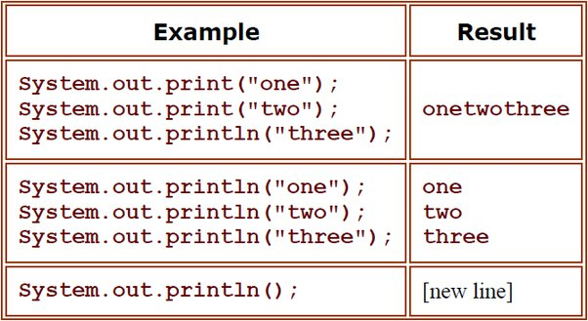
Printing to the Screen
Print() and println()
https://www.quora.com/What-is-the-difference-between-println-and-printLn-in-Java-Where-do-we-use-output-command-line-printLn-with-uppercase-L
Notes:
Add a real example

Slide 13

RECALL: First Java Application

Slide 14
Printing to the Screen
The object performs an action when you invoke or call one of its methods.
Scanner keyboard = new Scanner (System.in);
n1 = keyboard.nextInt ();
objectName.methodName(argumentsTheMethodNeeds);
Notes:
Add a real example

Slide 15
Compiling a Java Program or Class
A Java program consists of one or more classes, which must be compiled before running the program.
You need not compile classes that accompany Java (e.g. System and Scanner).
Notes:
The name of the file should be the same as the name of the class, which is the way to tell the JVM that this is an entry point

Slide 16
Compiling a Java Program or Class
Each class should be in a separate file.
The name of the file should be the same as the name of the class.
Notes:
The name of the file should be the same as the name of the class, which is the way to tell the JVM that this is an entry point

Slide 17
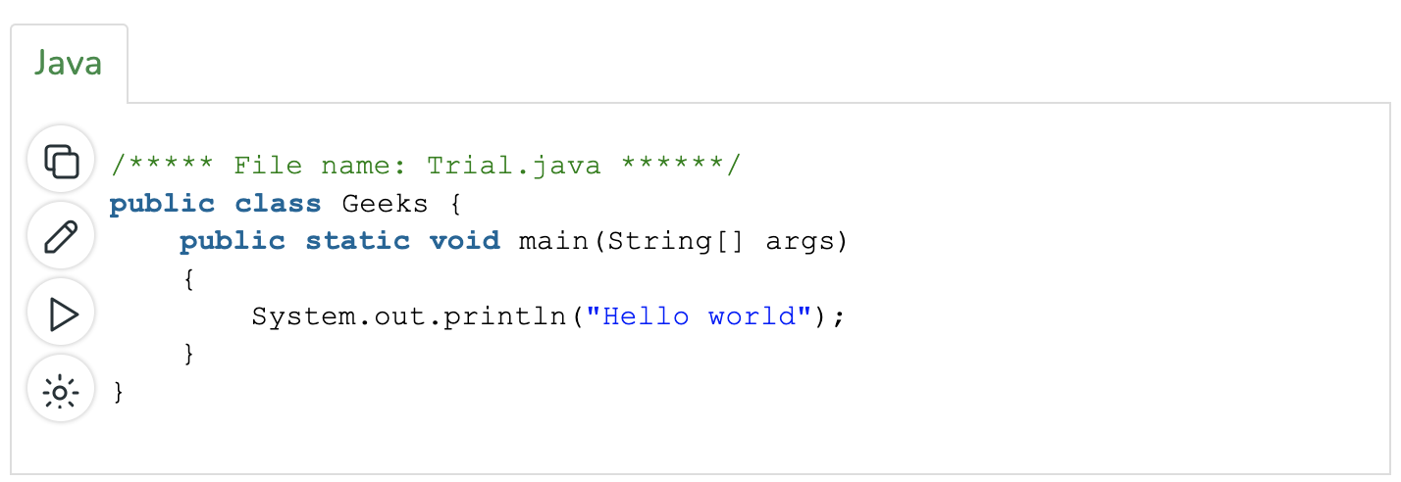
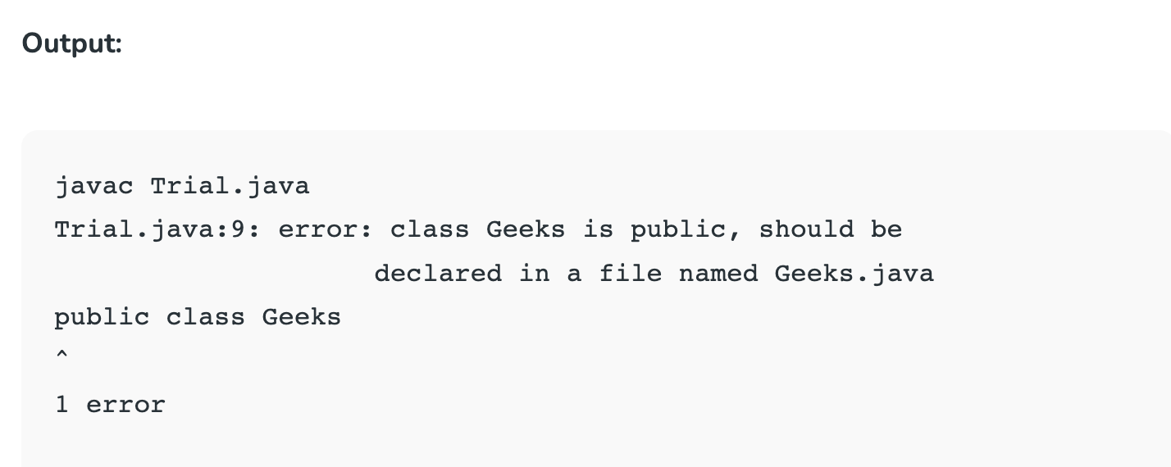
Compiling a Java Program or Class
https://www.geeksforgeeks.org/myth-file-name-class-name-java/
Notes:
The name of the file should be the same as the name of the class, which is the way to tell the JVM that this is an entry point

Slide 18
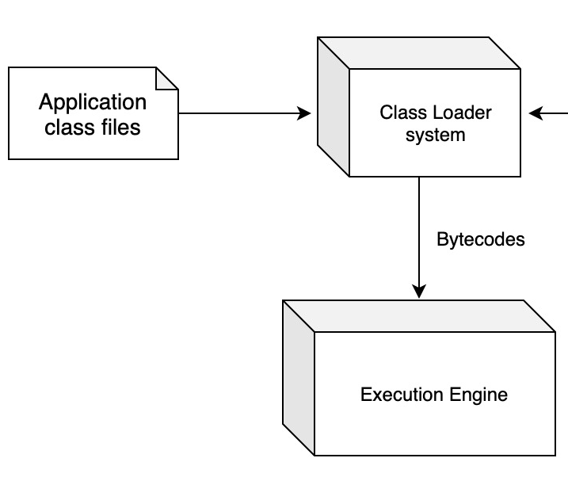
RECALL: Class Loader
A Java program typically consists of several pieces called classes.
Each class may have a separate author and each is compiled (translated into byte-code) separately.
A class loader (called a linker in other programming languages) automatically connects the classes together.
https://dzone.com/articles/java-virtual-machine-internals-class-loader

Slide 19
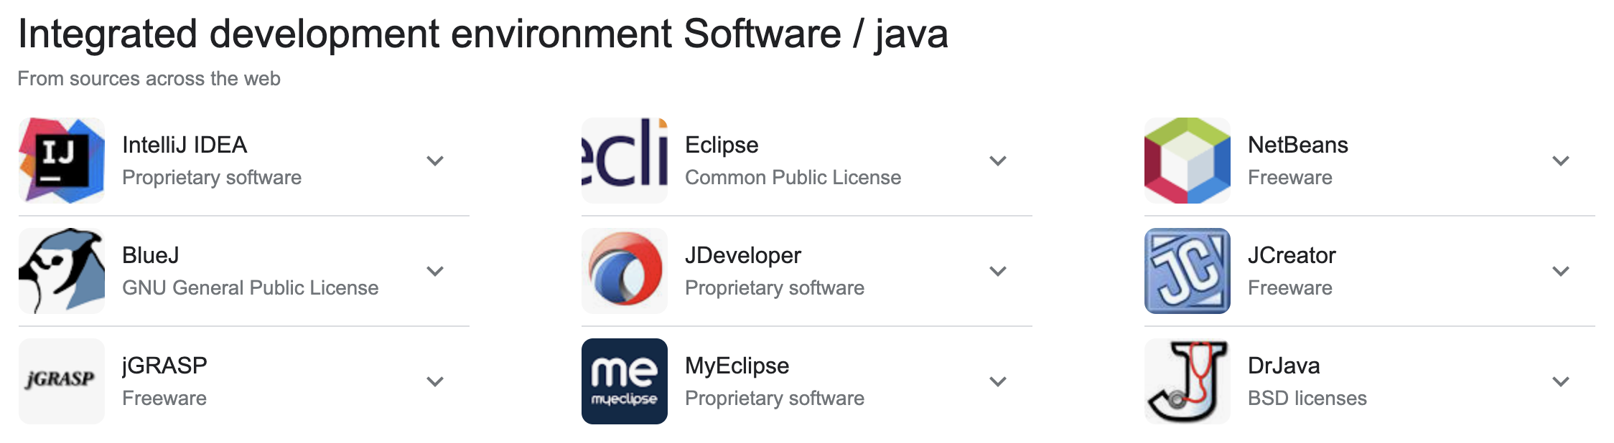
Compiling and Running
Use an IDE (integrated development environment) which combines a text editor with commands for compiling and running Java programs.
When a Java program is compiled, the byte-code version of the program has the same name, but the ending is changed from .java to .class.

Slide 20
RECALL: Java Compilers
High-Level Language
Java Compiler
(Translation)
Low-Level Language
Java Program
(.java)
Java language
Machine language for Java Virtual Machine (JVM)
Byte-code
(.class)
Byte-code: easy to translate into machine language for any particular computer (Java is platform independent).
Notes:
Instead, it translates a Java program into byte-code.
Byte-code is the machine language for a hypothetical computer (or interpreter) called the Java Virtual Machine.

Slide 21
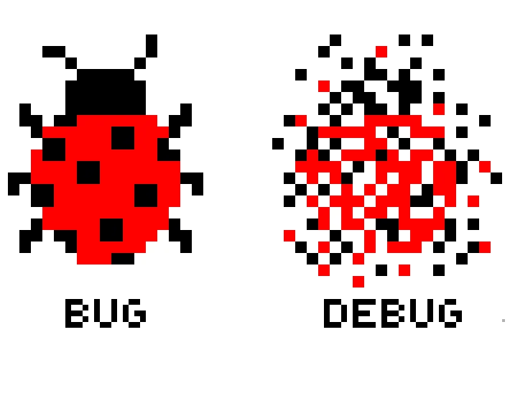
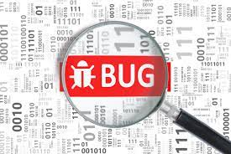
Errors
An error in a program is called a bug.
Eliminating errors is called debugging.
https://www.beningo.com/embedded-basics-classifying-software-bugs/
https://medium.com/@imAkash25/bug-debug-3445497d4daf

Slide 22
Errors
Three kinds or errors
Syntax errors
Runtime errors
Logic errors

Slide 23
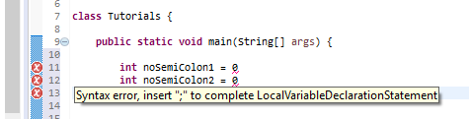
Syntax Error
Grammatical mistakes in a program.
The grammatical rules for writing a program are very strict.
The compiler catches syntax errors and prints an error message.
Example 1:
https://www.quora.com/What-error-comes-if-a-semicolon-is-not-given-in-Java

Slide 24
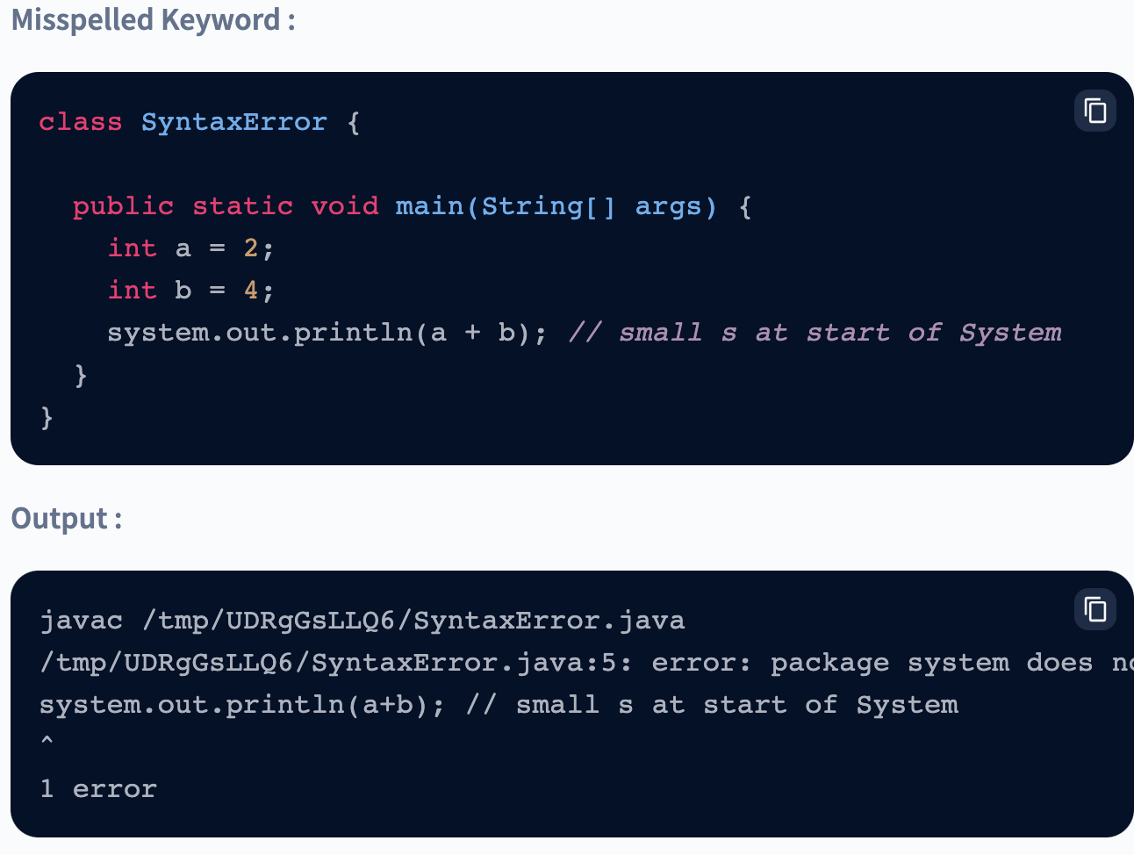
Syntax Error
Example 2:
Example 1:
https://www.scaler.com/topics/types-of-errors-in-java/

Slide 25
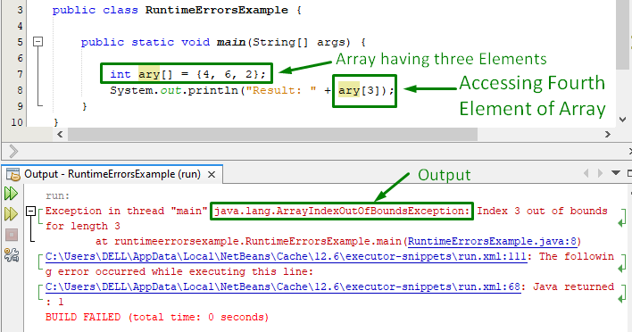
Runtime Errors
Errors that are detected when your program is running, but not during compilation.
When the computer detects an error, it terminates the program and prints an error message.
Example 1:
https://linuxhint.com/java-runtime-errors/

Slide 26
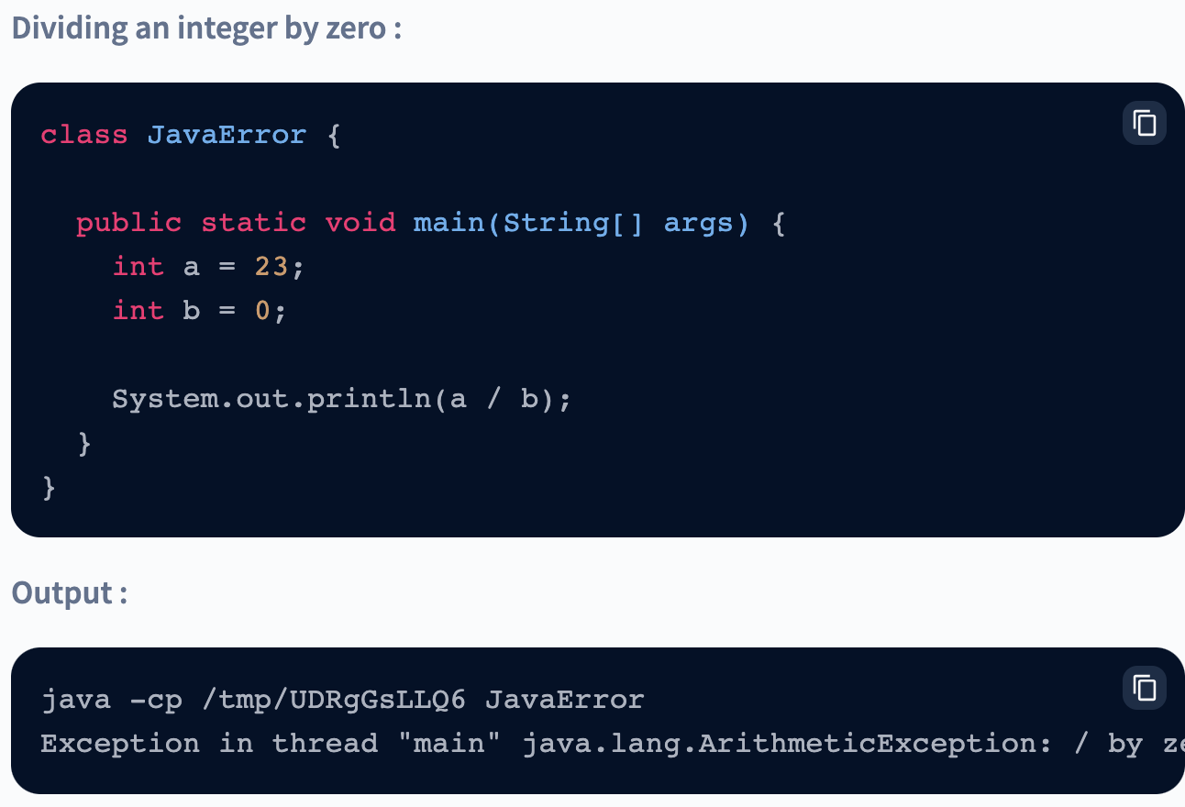
Runtime Errors
Example 2:
https://www.scaler.com/topics/types-of-errors-in-java/

Slide 27
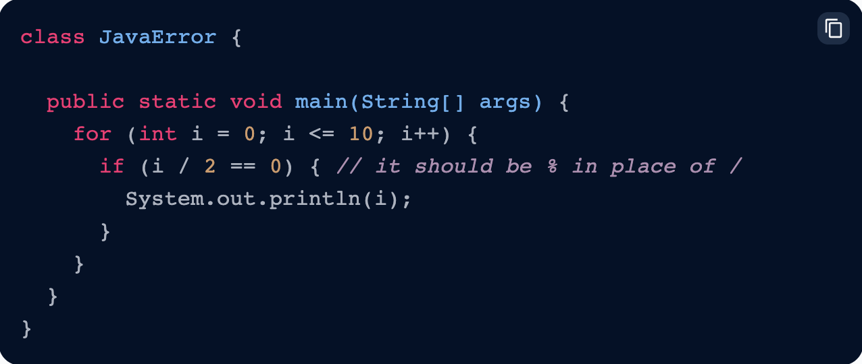
Logic errors
Errors that are not detected during compilation or while running, but which cause the program to produce incorrect results.
Example: program to print even numbers.
https://www.scaler.com/topics/types-of-errors-in-java/

Slide 28
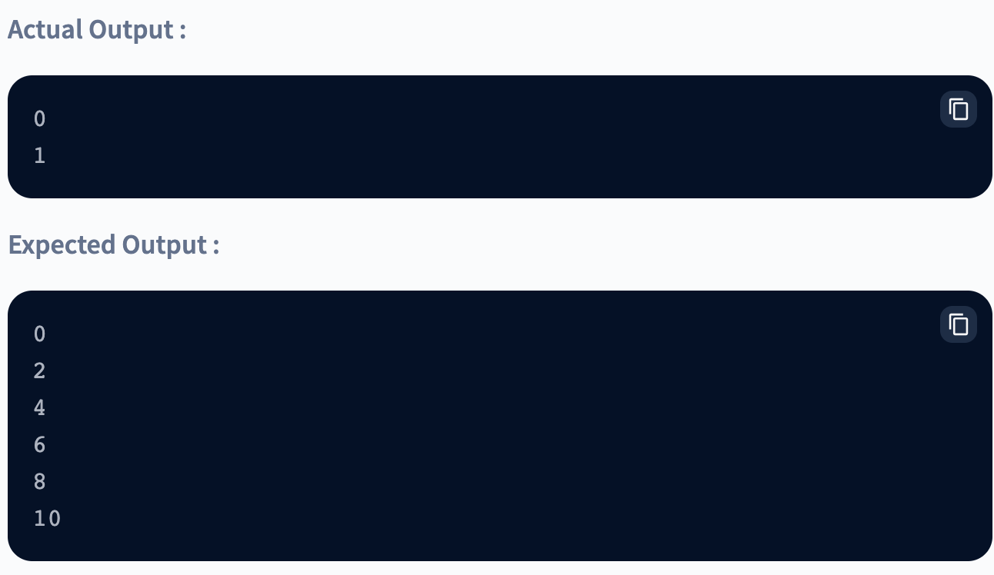
Logic errors
https://www.scaler.com/topics/types-of-errors-in-java/

Slide 29

Do you have
any QUESTIONS??
Notes:
Do you have any Questions?

