Slide 1


CSCI 1304: Programming I Chapter 2 Basic Computation Part 1 Variables and Data Types
Dr. Nour Almadhoun Alserr
Lecture 6
Week 3
Notes:
Overcome Challenges

Slide 2
Objectives
Describe the Java data types used for simple data .
Write Java statements to declare variables.

Slide 3
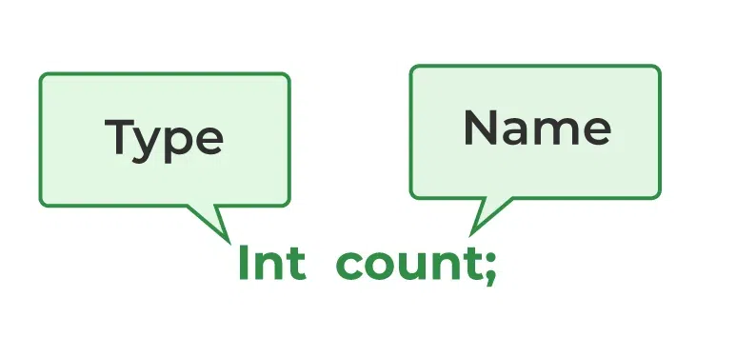
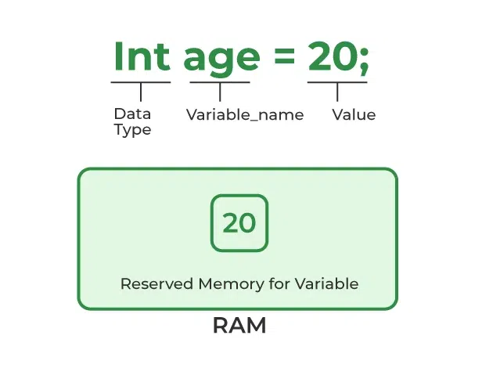
Variables
Variables store data such as numbers and letters.
Places to store data.
They are implemented as memory locations.
Syntax
i
i
kinds of values
https://www.geeksforgeeks.org/variables-in-java/
Notes:
In Java, all variables must be declared before use.
The data stored by a variable is called its value.
The value is stored in the memory location.
Its value can be changed.
Syntax بناء الجملة
i

Slide 4
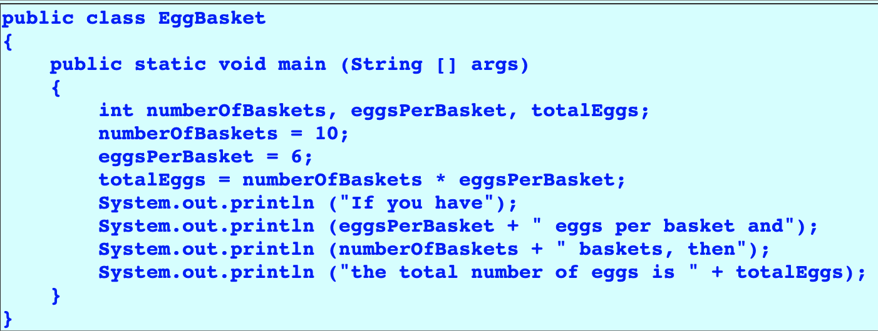
Variables
Class EggBasket.
Variables
Assigning values

Slide 5
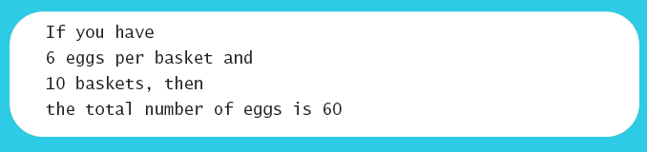
Variables
Class EggBasket (Output)

Slide 6
Naming and Declaring Variables
Choose names that are helpful such as count or speed, but not c or s.
Example: numberOfBaskets, eggsPerBasket , studentAge, universityName.
A variable's type determines what kinds of values it can hold (int, double, char, etc.).
A variable must be declared before it is used.

Slide 7
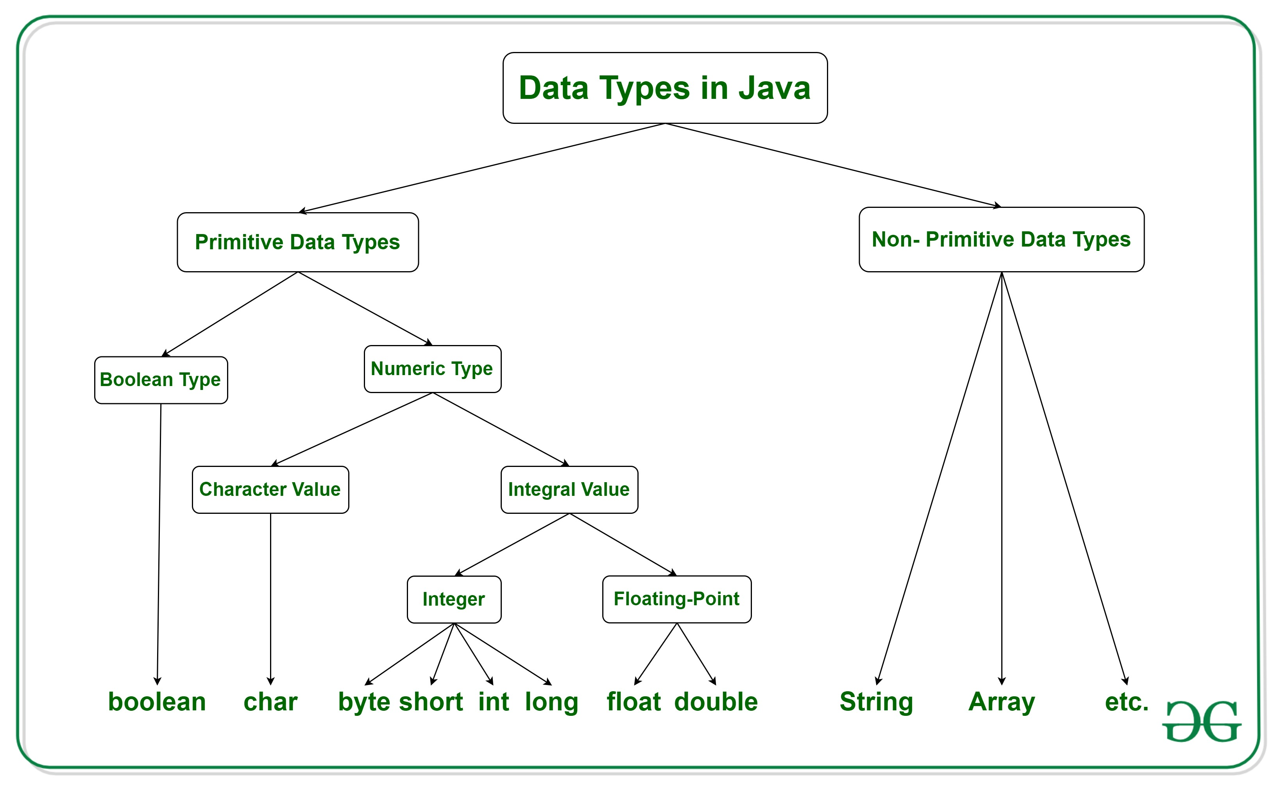
Data Types
Class types
simple
non decomposable
https://www.geeksforgeeks.org/data-types-in-java/
Notes:
"primitive "بدائية"" in the sense that they cannot be decomposed غير قابلة للتحللinto simpler components. From these basic types you can define new types - pointer types, array types, struct types, union types, etc.

Slide 8
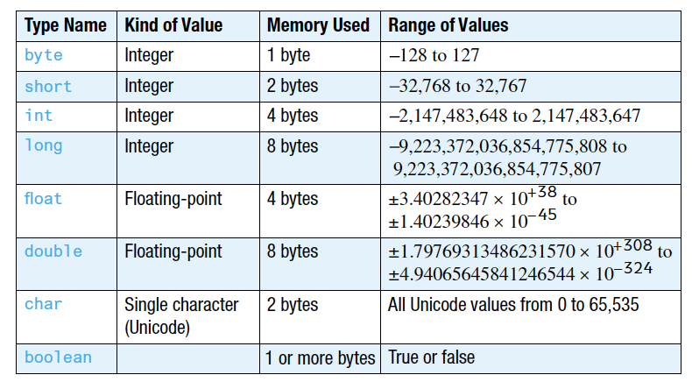
Data Types

Slide 9
Data Types
Four integer types (byte, short, int, and long)
int is most common
Example: 0 -1 365 12000
Two floating-point types (float and double)
double is more common
Example: 0.99 -22.8 3.14159 5.0
One character type (char)
Example: 'a' 'A' '#' ' '
One boolean type (boolean)
Example: true false

Slide 10
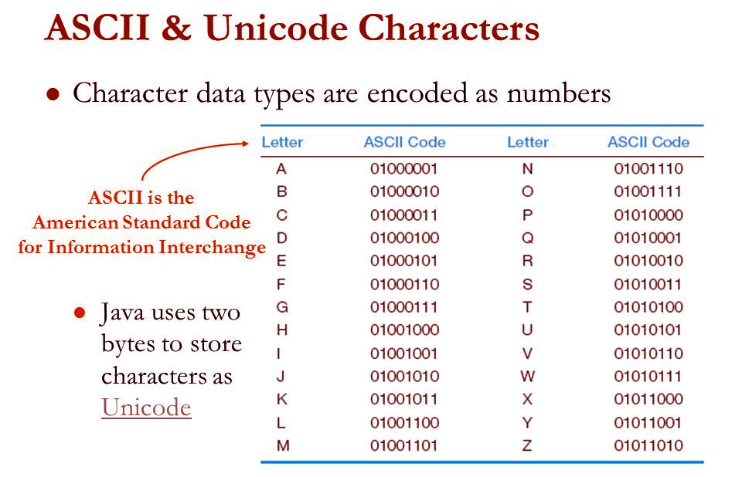
Data Types (Char ' ')
Unicode is a 16-bit character encoding established by the Unicode Consortium.
https://tutorials.freshersnow.com/java-category/java-unicode-system/
Notes:
مشفرةencoded

