Slide 1
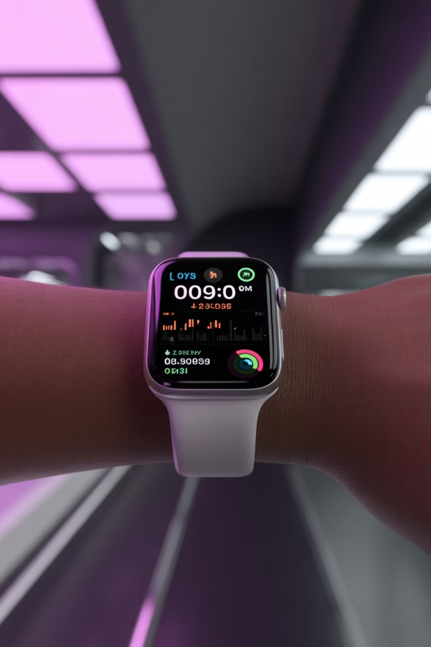
Smart+: Monitoring Student Well-being.

Slide 2

Smart+ Using Apple Watch Data
Supervisors: Dr Tariq Soussan, Dr Khalid Tarmissi
Project Members: Naif Aba Alrous, Bader Alforij, Mohammed NourAldin, Ziyad Bin Juwayid, Abdullah Babkeer, Saud Alqadhib.
CS499, SE499.

Slide 3
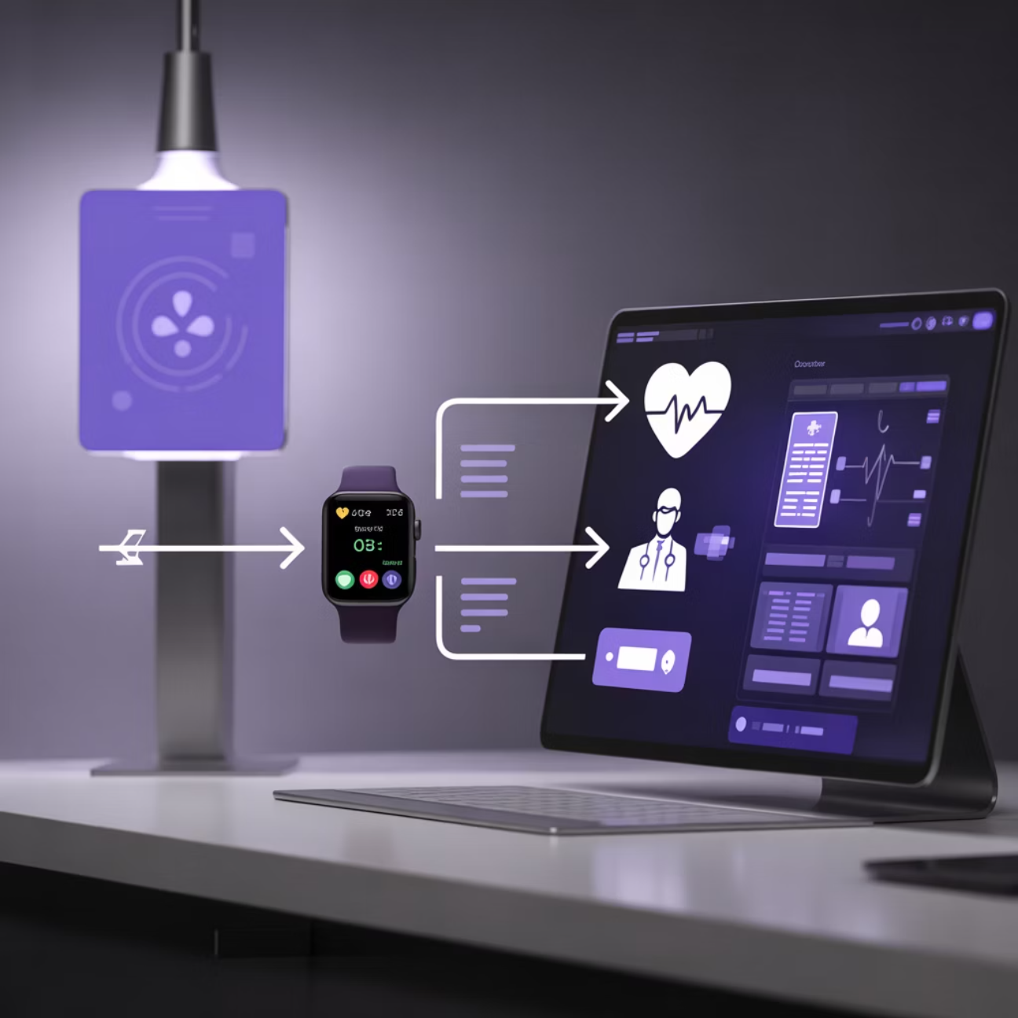
Project Overview
Our Smart Health Alert and Monitoring System uses Apple Watch data for proactive health management in academic settings, ensuring early detection and timely intervention for student well-being.
Collects continuous student health data (heart rate, activity, sleep, blood oxygen) from Apple Watch sensors.
Advanced algorithms analyze vitals to identify deviations and generate immediate, actionable alerts.
Medical professionals review alerts via a secure dashboard to assess severity and determine appropriate interventions.
This proactive system significantly improves early detection of health risks, providing timely support and fostering a healthier campus community.

Slide 4




Identified Problem
Manual Monitoring Impractical
Missed Warning Signs
Manual monitoring of student health is impractical and inconsistent.
Early warning signs are often missed during normal classroom operations.
No Real Time Oversight
Lack of Structured Escalation
Real time health oversight is missing in learning environments.
Existing systems lack structured alert escalation and medical validation.

Slide 5





Agile Development Approach
The system was developed using iterative sprints where each sprint delivered a complete functional module ready for integration and testing.
Initialization
Processing
Defining project scope and initial requirements.
Iterative development, testing, and integration of features.
Optimization
Deployment
Refining functionality and improving performance based on feedback.
Releasing the module for use and continuous monitoring.

Slide 6
Main Objectives
1
Collect vital signs using Apple Watch and HealthKit integration.
2
Detect sustained abnormal health patterns automatically.
3
Generate structured medical alerts for doctors.
4
Support decision making through dashboards and notifications.
5
Ensure system readiness for pilot deployment in real classrooms.

Slide 7
Sprint Planning and Achieved Outputs
1
2
Sprint 1 Core Data Integration and System Setup
Sprint 2 Alert Engine and Doctor Workflow
Output bullets:
Output bullets:
iOS HealthKit data collection and backend infrastructure established
Alert evaluation logic and severity classification developed
Doctor authentication and role based access portal implemented
Doctor case review, acceptance, and decision logging enabled
3
4
Sprint 3 Notification System and KPI Dashboard
Sprint 4 Simulation Testing and Pilot Readiness
Output bullets:
Output bullets:
Email notification system with templates integrated
Synthetic alert simulations and performance testing completed
Real time KPI dashboard with filtering and export features deployed
Pilot deployment readiness and system validation finalized

Slide 8
System Operational Stages
Stage 1 Data Monitoring and Alert Generation
Stage 2 Doctor Review and Compliance Decision
Stage 1 focuses on collecting vitals and generating alerts.
Stage 2 focuses on doctor evaluation, response, and decision recording.
Stage 1 focuses on collecting vitals and generating alerts. Stage 2 focuses on doctor evaluation, response, and decision recording.

Slide 9
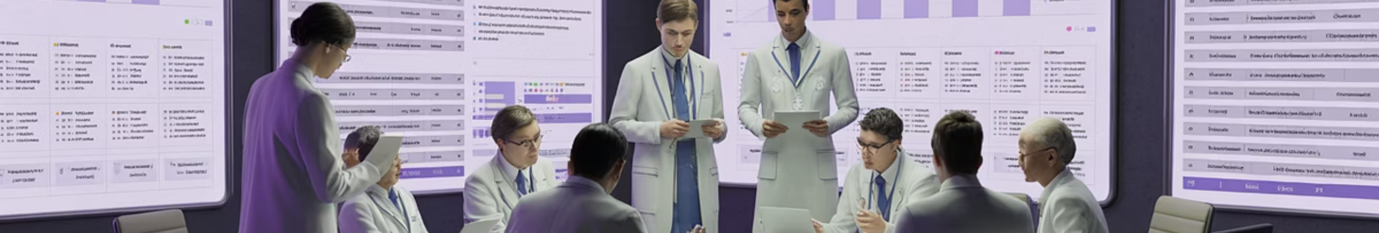
Requirements Phase
Survey conducted among students and medical professionals.
Focus on usability, privacy, medical accuracy, and system reliability.
Feedback guided system feature prioritization and interface design.
Data privacy and secure access were rated as critical requirements.

Slide 10
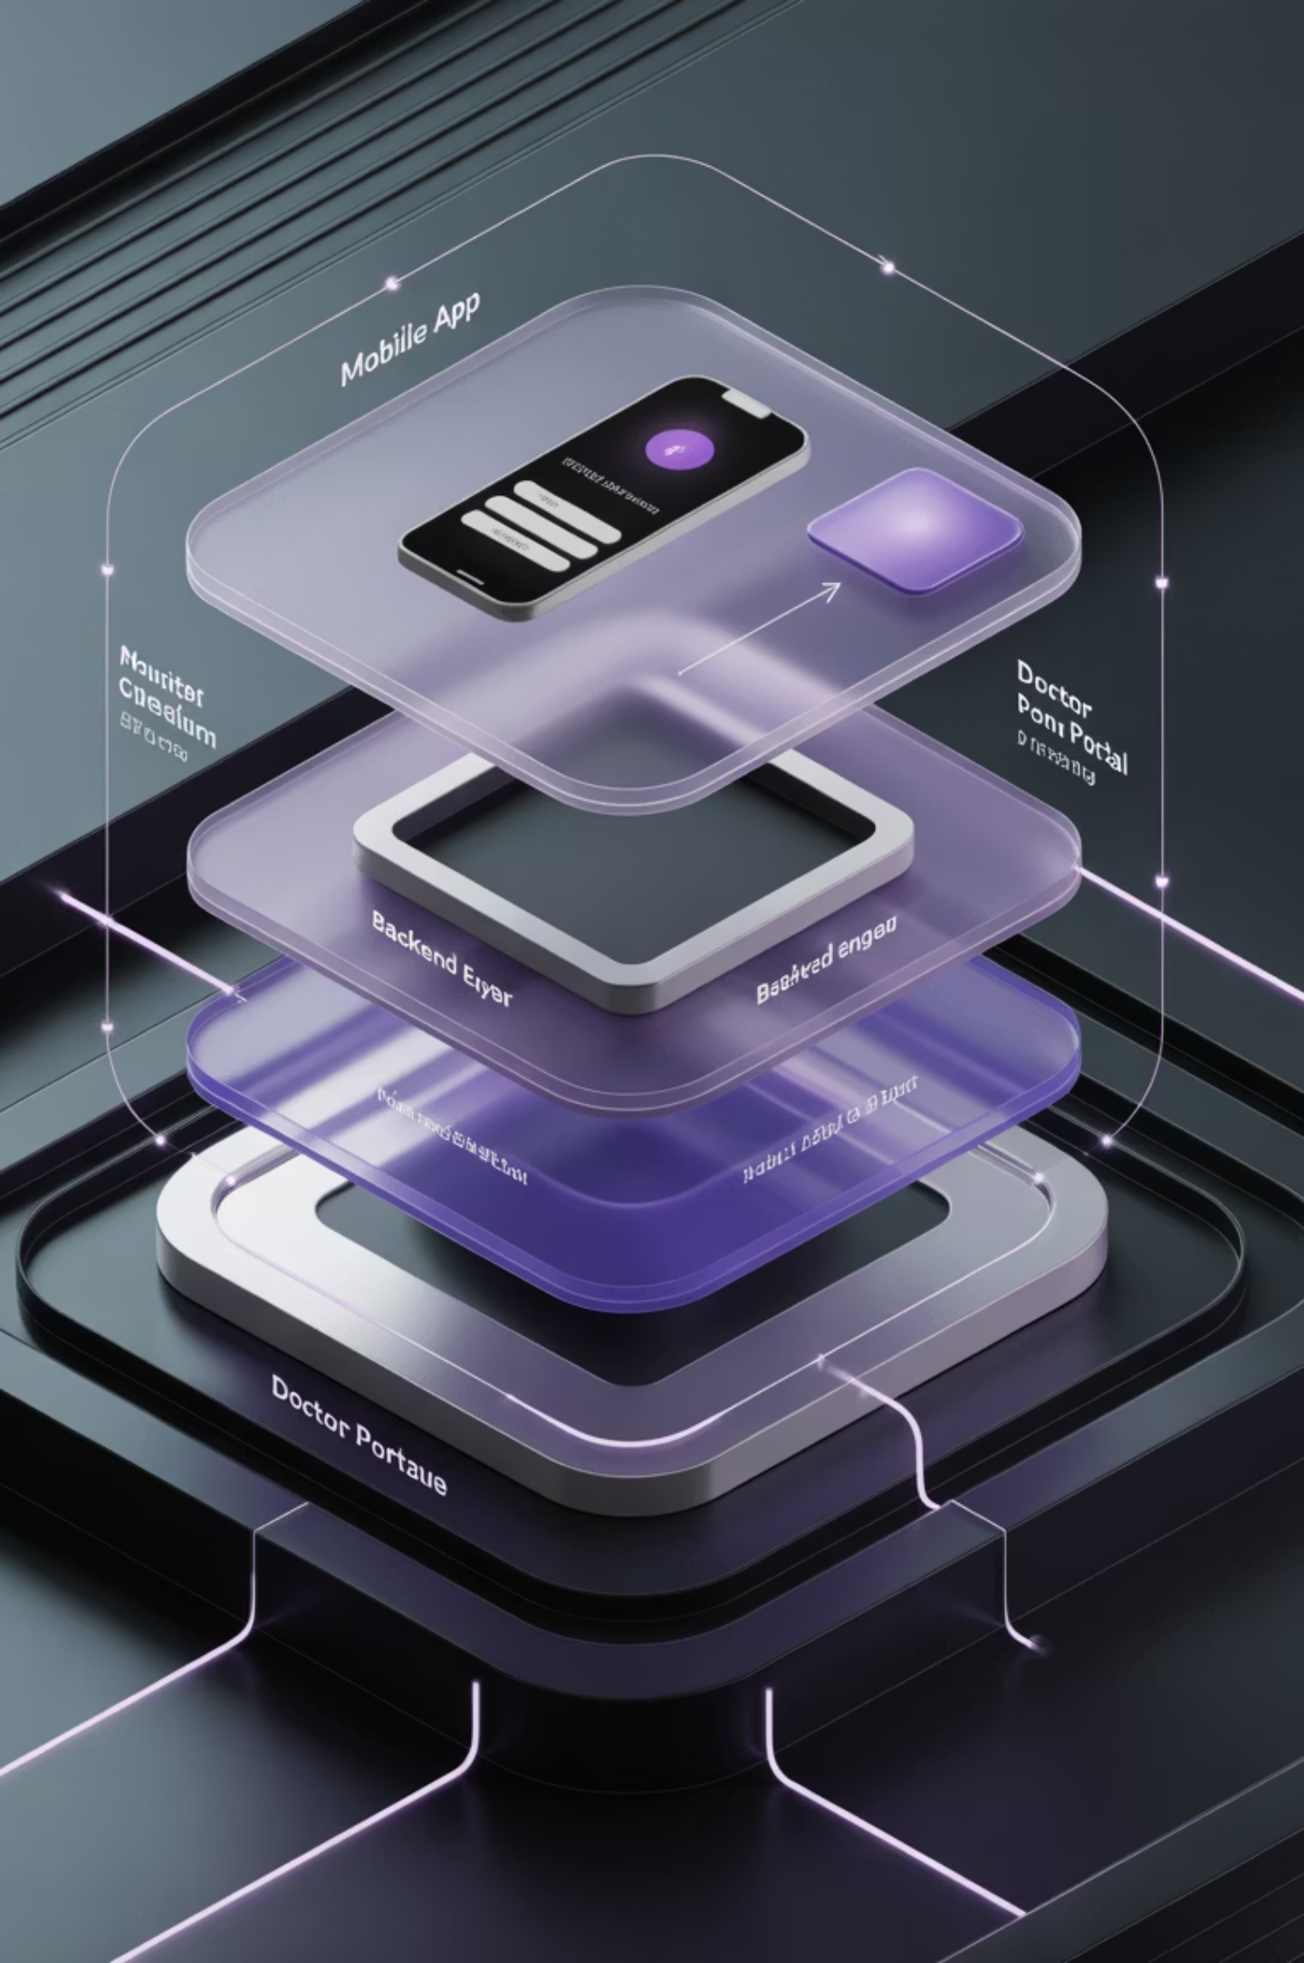
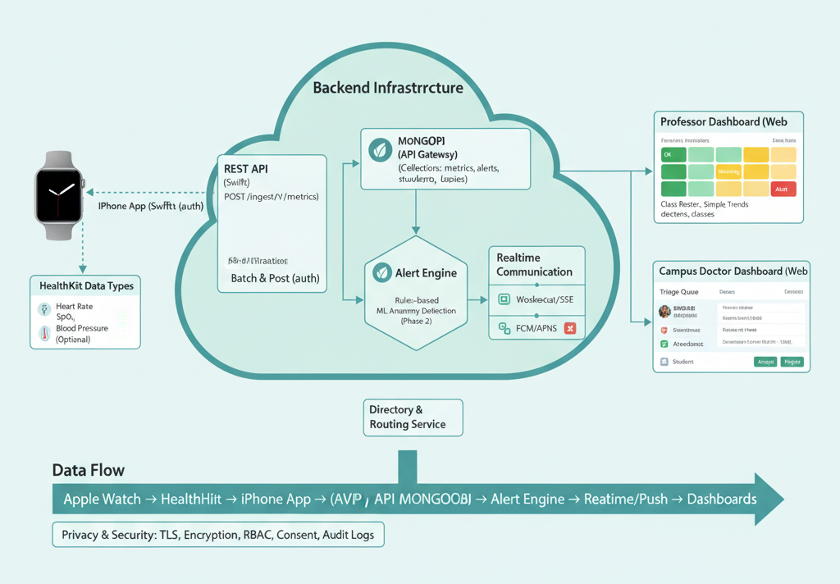
System Design Architecture
01
02
Layered design separating mobile app, backend engine, and doctor portal.
Data pipeline structure ensures secure handling of health information.
03
Scalable architecture supports real time processing and alert generation.

Slide 11
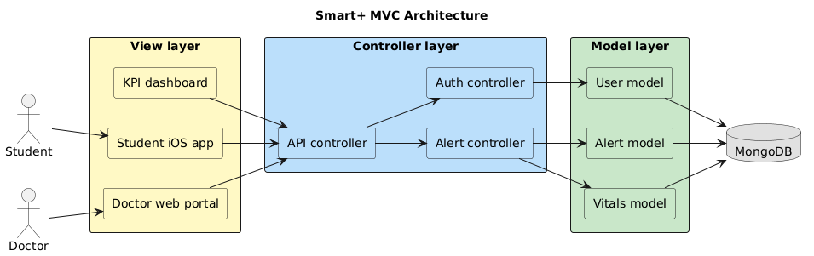
Data Flow Design
View Layer
Controller Layer
Mobile interface displays health data and user interactions
Handles input, manages navigation, and coordinates data flow
Model Layer
Database
Processes health data, manages business logic, and database operations
Stores health records, alerts, and system data

Slide 12
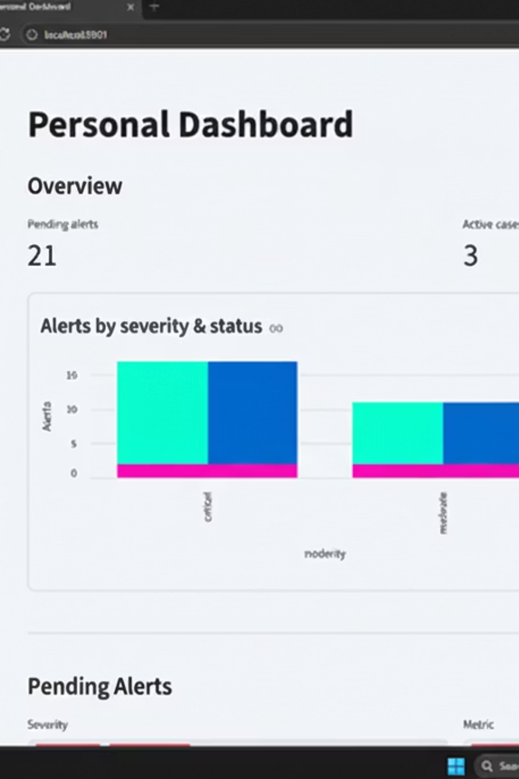
Alert Evaluation Logic
Technical content:
Threshold based rules applied on vitals such as heart rate and oxygen levels.
Trend analysis applied to detect sustained abnormal patterns.
Alert score formula example: Alert Score = weighted sum of deviation multiplied by duration factor

Slide 13
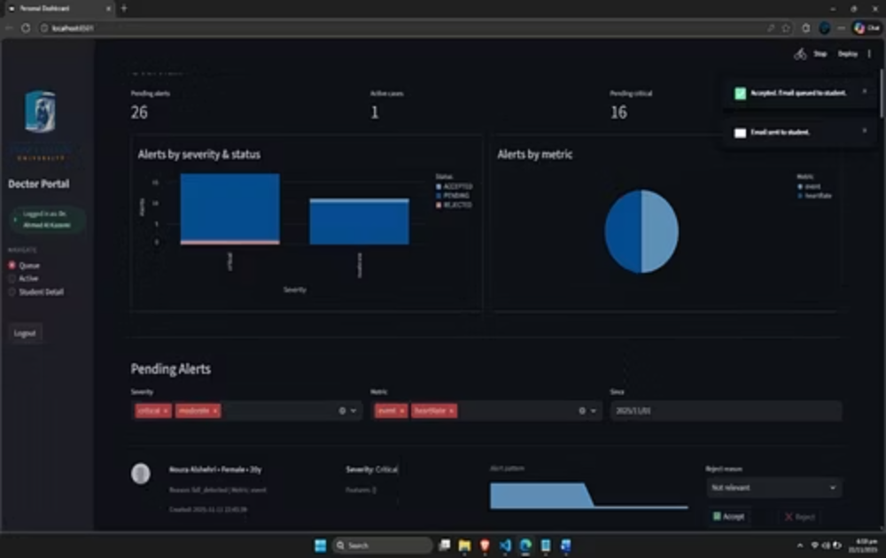
Notification Strategy
Content points:
Notifications include vital summaries and severity classification.
Graphs guides clinical decision making.
Design instructions: Add mockup space for sample email template

Slide 14
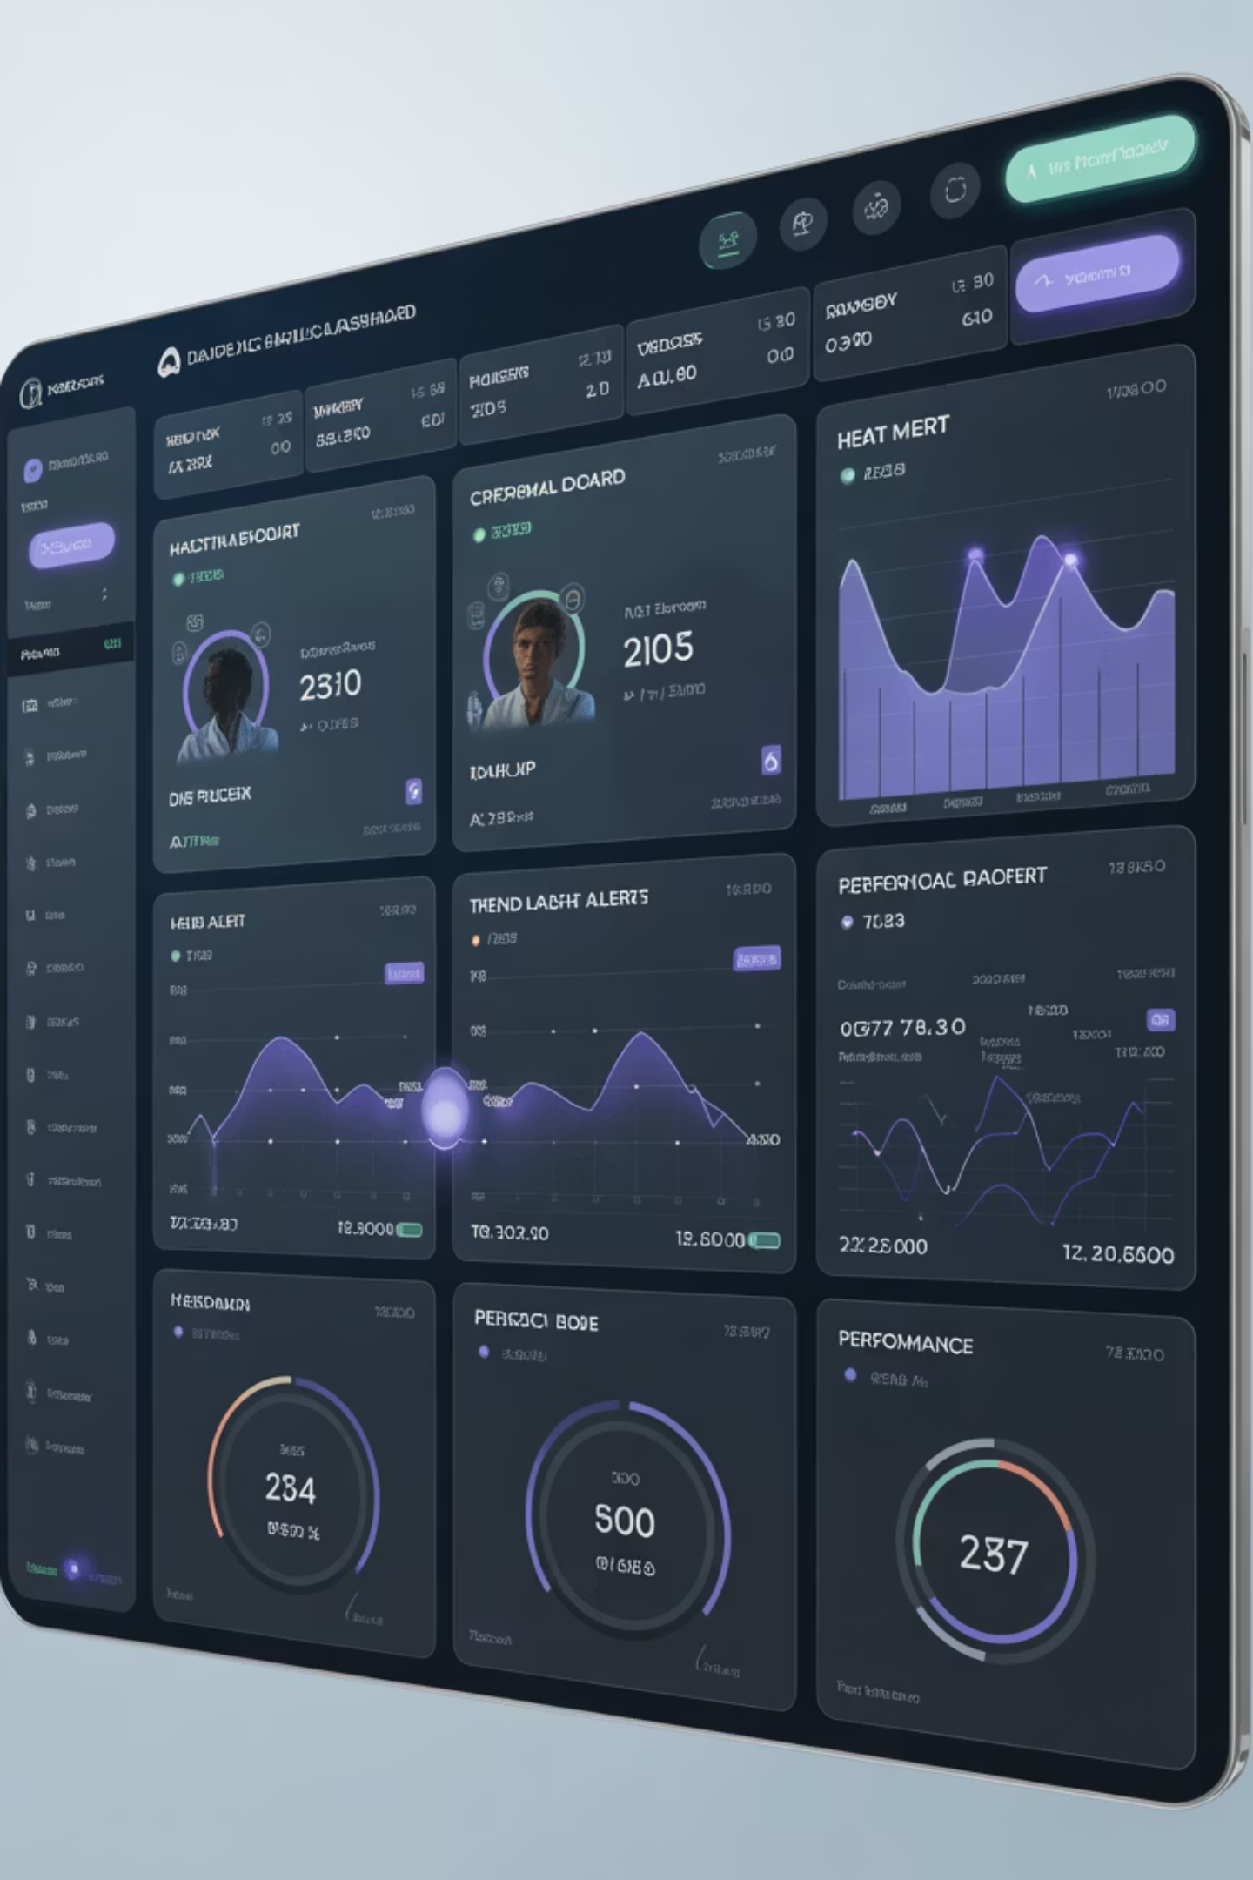
KPI Dashboard Structure
Content points:
Displays active alerts, resolved alerts, and system performance metrics.
Includes trend graphs and response time analytics.
Supports filtering, sorting, and export functionality.
Design instructions: Reserve area for dashboard screenshot or layout wireframe

Slide 15
Testing Approach
Multiple Testing Layers
Functional Testing
Multiple testing layers applied across all modules.
Functional testing for alert logic.
Integration Testing
Usability Testing
Integration testing between app and backend.
Usability testing for doctor portal.

Slide 16
Sample Test Case
Content format:
Test Case Name
High heart rate alert detection
Input
Simulated heart rate above configured threshold for 10 minutes
Expected Output
Alert generated with high severity
Actual Result
Pass

Slide 17
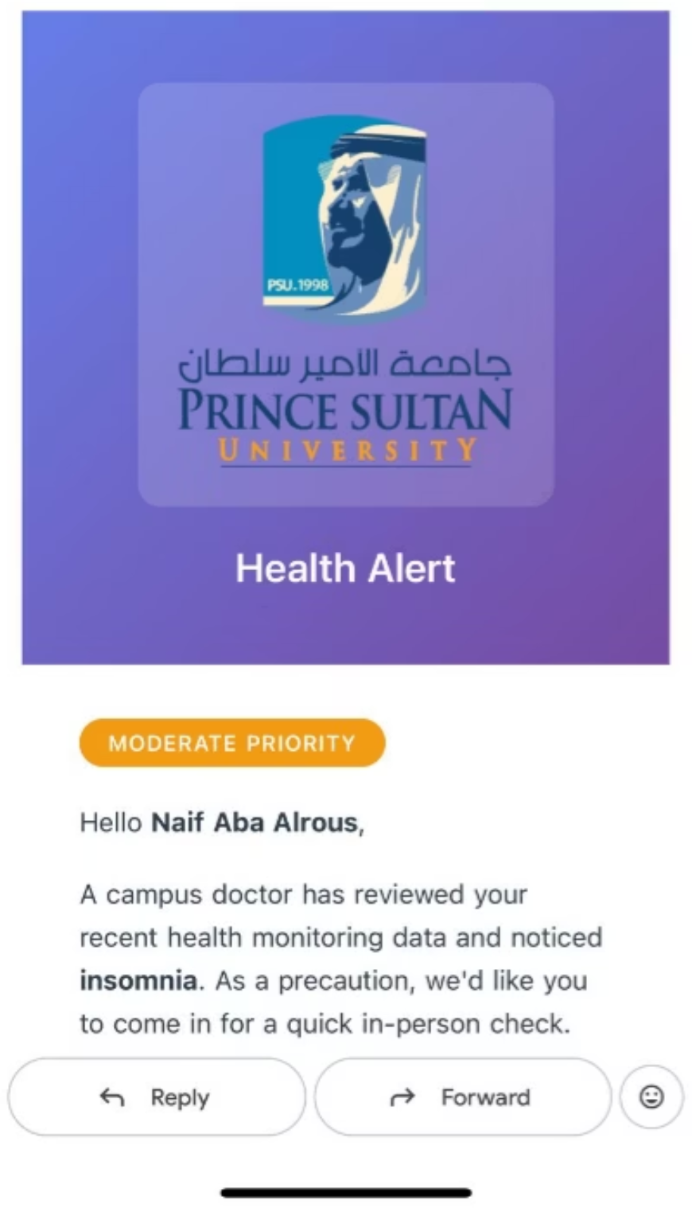
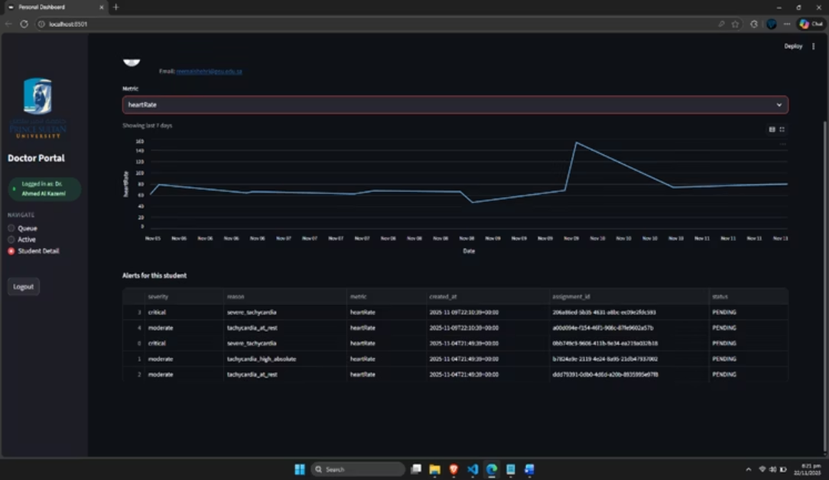
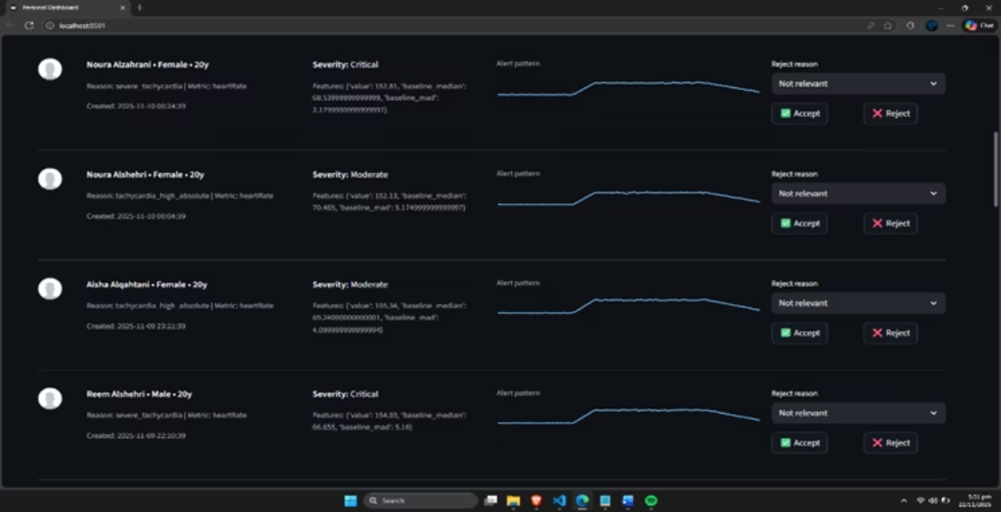
System Output Samples
Alert Review Interface - Doctors can accept or reject alerts with severity classification and patient details
Doctor Portal Dashboard - Real-time monitoring of patient vitals with trend analysis and alert history
Email Alert Notification

Slide 18




Project Outcomes
Reliable Real Time System
Accurate Detection
Reliable real time health alert system achieved
Accurate detection of abnormal health patterns
Improved Decision Making
Pilot Ready
Improved decision making workflow for doctors
System ready for controlled pilot testing
Design instructions: Use four clean blocks with icons

Slide 19
Conclusion and Future Work
Content points:
Future enhancements:
System demonstrates effective smart health monitoring in academic environments.
Integration with additional wearable devices
Advanced predictive analytics
Supports proactive medical intervention through automation.
Mobile doctor application
Expanded deployment to multiple campuses

Slide 20
Thank You
Smart+
Any questions

