Slide 1
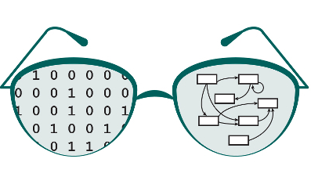


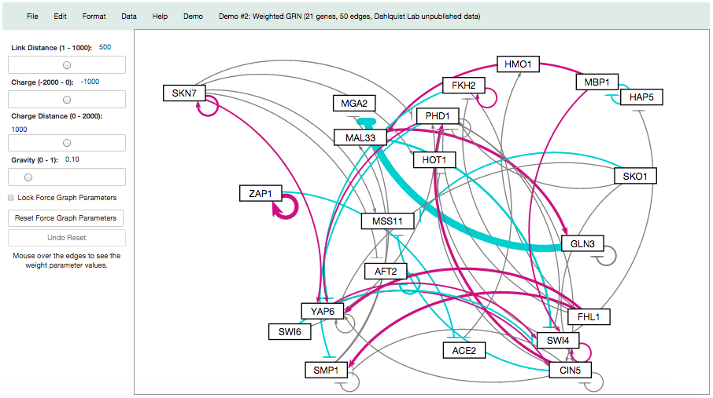
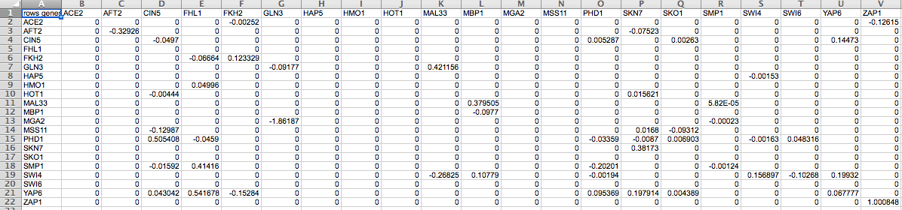

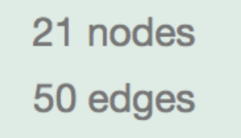
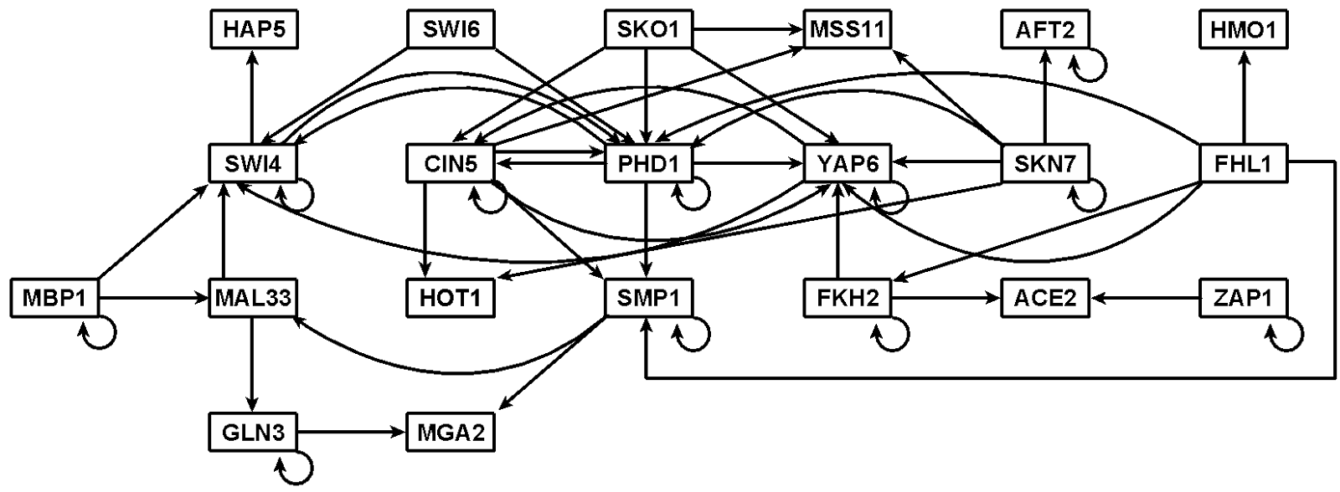
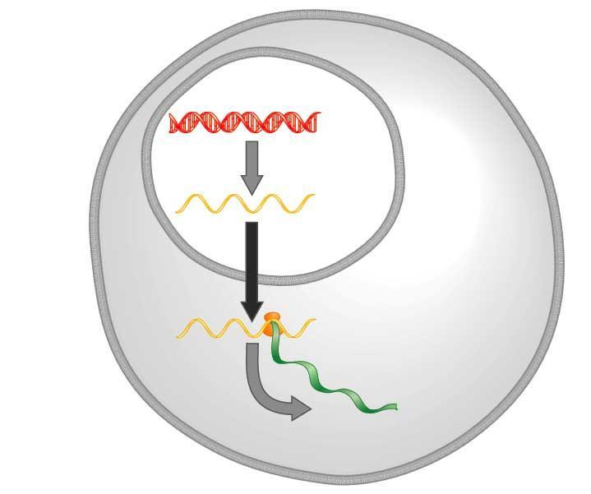
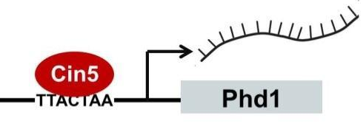
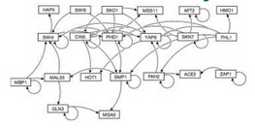
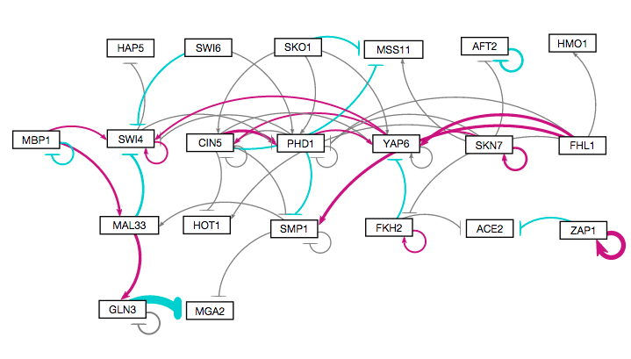
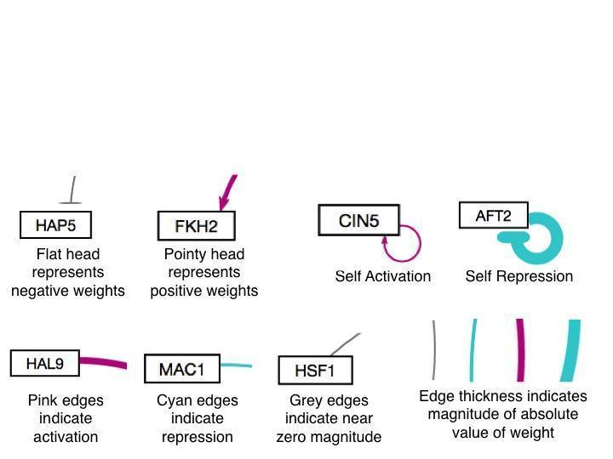
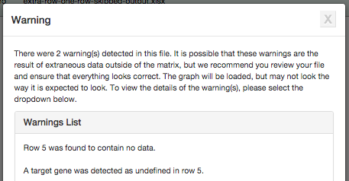
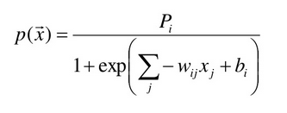
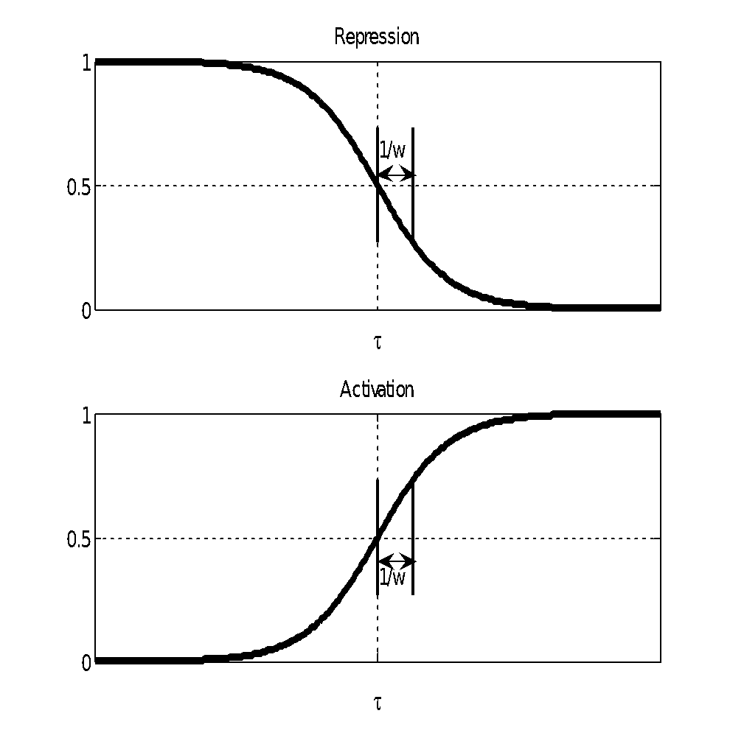
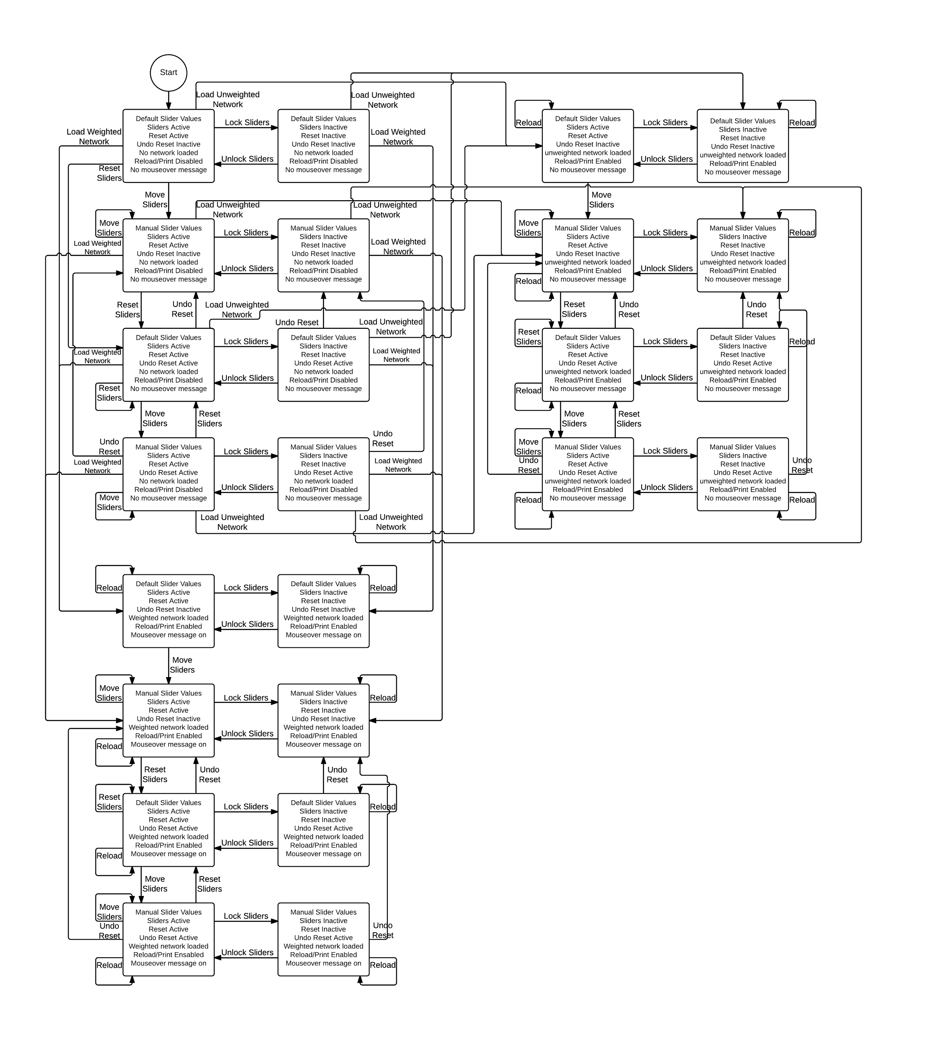
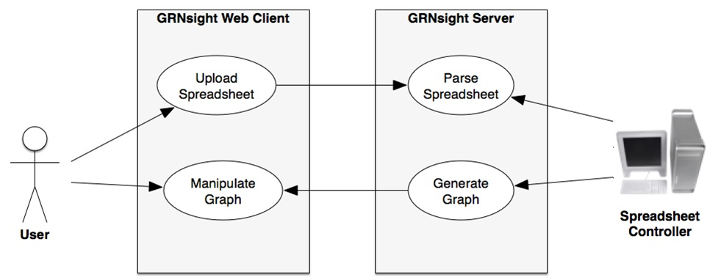
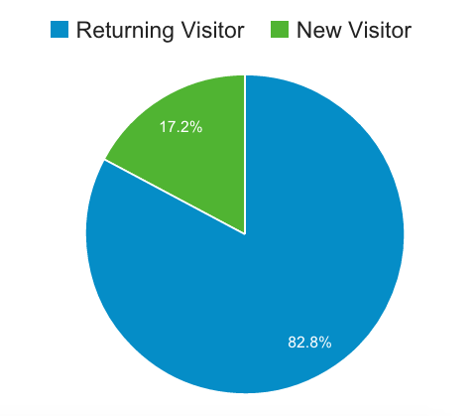
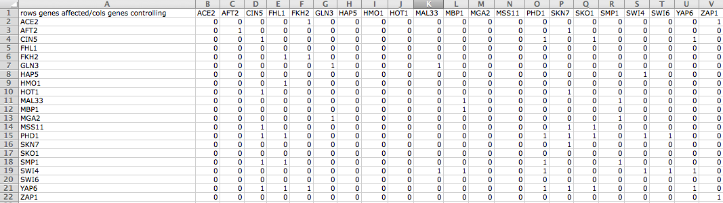
Test-driven development improves GRNsight: a web
application for visualizing models of gene regulatory networks
Anindita Varshneya*, Nicole A. Anguiano**, Mihir Samdarshi*, Yeon-Soo Shin**, Kam D. Dahlquist*, John David N. Dionisio**, and Ben G. Fitzpatrick***
*Department of Biology, **Department of Electrical Engineering and Computer Science, ***Department of Mathematics, Loyola Marymount University, 1 LMU Drive, Los Angeles, CA 90045
http://dondi.github.io/GRNsight/
Gene Regulatory Networks Can Be Illustrated by Directed Graphs
GRNsight Automatically Lays Out Unweighted and Weighted Networks
Implemented Mocha Unit Testing Framework
The central dogma of molecular biology describes the flow of information in a cell during gene expression from DNA to RNA to protein.
Transcription factors control gene expression by binding to regulatory DNA sequences.
Activators increase gene expression.
Repressors decrease gene expression.
Transcription factors are themselves proteins encoded by genes.
Freeman (2002)
A gene regulatory network (GRN) consists of genes, transcription factors, and the regulatory connections between them, which govern the level of expression of mRNA and proteins from those genes.
Each node represents the gene, the mRNA, and the protein expressed from the gene.
Each edge represents a regulatory relationship.
All the nodes are transcription factors themselves.
Excel Spreadsheet
1
4
Unweighted graph drawn manually with Adobe Illustrator
Beta Version Allows for Testing of New Features
A beta version of GRNsight was created to allow for testing of new features and catching any potential new errors before releasing to the master set of code.
New Unit Testing Framework Implemented
In order to follow Test Driven Development (TDD) practices, a unit testing framework was created with 161 passing tests covering over 500 test files.
Unit testing is now executed through Mocha, a JavaScript test framework running on node.js and are written in Chai, an assertion library for node.js.
3. Weighted graph laid out automatically
1. Menu Bar
Four demo files can be found in the “Demo” menu for users who do not have their own data.
Print functionality is accessed from the “File” menu option.
“File > Reload” reloads the current graph with the active settings.
In the “Edit > Preferences” menu, the user can select for weighted graphs to be displayed as unweighted graphs.
2
Produced in several hours
DNA
Unweighted graph laid out automatically by GRNsight and adjusted by hand
RNA
Test Coverage Statistics
Statements: | 72% (124/172)
Branches: | 86% (60/70)
Functions: | 64% (18/28)
Lines: | 73% (124/171)
Write test for new functionality
Write Code
Refactor Code
Protein
Test Passes
Test Fails
Produced in ~5 minutes
Test Passes
2. Force Graph Parameter Sliders
Link distance determines the minimum distance between nodes.
Nodes have a charge, which repels or attracts other nodes.
The charge distance determines at what range a node’s charge will affect other nodes.
Gravity determines the strength of the force holding the nodes to the center of the graph.
Reset functionality sets all parameters to default settings
Locking the parameters prevents any further changes
Produced in ~10 milliseconds
Weighted graph laid out automatically by GRNsight and adjusted by hand
Error Catching was Greatly Improved
Robustness was greatly extended.
Instead of crashing when given an improperly formatted or incorrect file, GRNsight returns an error in a modal window.
3. Nodes, Edges, and Arrows
The absolute values of each weight parameter are normalized to a value between 0 and 1. The thicknesses of the lines are adjusted to vary continuously from the minimum thickness (for normalized weights near zero) to the maximum thickness (normalized weights of 1).
Edges with negative weights (repression) are colored cyan; edges with positive weights (activation) are colored magenta; edges with normalized weight values between -0.05 and 0.05 are colored grey to signify a weak influence on the target gene.
Warnings Are Returned In Cases of Non-Fatal Improper Spreadsheets
In cases where non-fatal errors exist in the format or data of an uploaded spreadsheet, the adjacency matrix is graphed, and a warning box appears.
Warnings clearly state which row(s) or cell(s) may have incorrect data.
The warning box can be closed and reopened at any time via a hyperlink underneath Force Graph Parameter sliders.
GRNmap: Gene Regulatory Network Modeling and Parameter Estimation
Produced in ~5 minutes
4. Status Bar
The name of the uploaded file is displayed.
The number of nodes and edges of the graph are displayed in the far right hand side.
The MATLAB model is available at http://kdahlquist.github.io/GRNmap/
GRNmap is a differential equations model of the changes in gene expression over time for a gene regulatory network (Dahlquist et al. 2015).
Each gene (node) in the network has an equation.
The parameters in the model are estimated from laboratory data.
The weight parameter, w, gives the direction (activation or repression) and magnitude of the regulatory relationship.
GRNmap produces an Excel spreadsheet with an adjacency matrix representing the network.
Future Directions
GRNsight Has Sophisticated Architecture and Follows Open Source Development Practices
Further expand and refine the unit testing framework.
Calculate and present other graph statistics.
Add node coloring based on expression data.
Availability
GRNsight is free and open to all users and there is no login requirement.
Web site content is available under the Creative Commons Attribution Non-Commercial Share Alike license.
GRNsight code is available under the open source BSD license.
Usage is being tracked through Google Analytics.
2048 total visitors and
1440 files uploaded as of
8 March 2016
GRNsight has a service-oriented architecture
GRNsight has two pieces: a server and a web client.
The server uses the node.js framework to receive and parse the Excel spreadsheet uploaded by the user.
The web client receives the data from the server and generates the graph visualization.
0 represents no relationship.
Initially, 1 represents a regulatory relationship where the gene specified by the column controls the gene specified by the rows.
After the parameters have been estimated, a positive weight value indicates activation and a negative weight value indicates repression.
The magnitude of the weight defines the strength of the relationship.
However, GRNmap does not generate a visual representation of GRNs.
Acknowledgments
The User Interface is Compatible with Firefox and Chrome Browsers
GRNsight has been tested with and confirmed to be working in Chrome version 43.0.2357.65 or higher and Firefox version 38.0.1 or higher on Windows 7 and Mac OS X operating systems.
File upload is through a simple HTML form element.
Nodes are displayed as interactive HTML elements, and can be clicked and moved.
GRNsight implementation takes advantage of other open source tools
GRNsight uses the Data-Driven Documents (D3) JavaScript library to generate a graph derived from input network data.
D3 dynamically manipulates HTML and Scalable Vector Graphics (SVG) to form the elements of the graph.
GRNsight implements D3’s force layout algorithm which applies a physics-based simulation to the graph.
D3 also allows for the fine tuning of Cascading Style Sheets (CSS), the code that styles web pages.
GRNsight follows an open development model using an open source github.com code repository and issue tracking.
This work is partially supported by NSF award 0921038 (K.D.D., B.G.F.), a Kadner-Pitts Research Grant (K.D.D.), the Loyola Marymount University Rains Research Assistant Program (N.A.A.), and the Loyola Marymount University Summer Undergraduate Research Program (A.V.).
GRNsight Accepts Microsoft Excel, SIF, and GraphML Files in the Proper Format
References
Excel workbooks need a “network” sheet (for unweighted graphs) or a “network_optimized_weights” sheet (for weighted graphs).
The adjacency matrix can be symmetrical or asymmetrical.
GRNmap input and output workbooks are accepted without adjustment.
Adjacency matrices generated from other databases, such as YEASTRACT (Miguel et al., 2014), can be used with some modification.
Chai: http://chaijs.com/
Dahlquist, K.D., Fitzpatrick, B.G., Camacho, E.T., Entzminger, S.D., and Wanner, N.C. (2015) Parameter Estimation for Gene Regulatory Networks from Microarray Data: Cold Shock Response in Saccharomyces cerevisiae. Bulletin of Mathematical Biology, 77(8), 1457-1492, DOI: 10.1007/s11538-015-0092-6
D3.js: http://d3js.org/
Express Framework: http://expressjs.com/
Freeman, S. (2002) Biological Science. Upper Saddle River, New Jersey: Prentice Hall.
GRNmap: http://kdahlquist.github.io/GRNmap/
node.js: http://nodejs.org/
Mocha: http://mochajs.org/
Teixeira, M. C., Monteiro, P. T., Guerreiro, J. F., Gonçalves, J. P., Mira, N. P., dos Santos, S. C., ... & Madeira, S. C. (2014). The YEASTRACT database: an upgraded information system for the analysis of gene and genomic transcription regulation in Saccharomyces cerevisiae. Nucleic Acids Research, 42(D1), D161-D166, DOI: 10.1093/nar/gkt1015
Notes:
Kill abstract
Change to sans serif font
Make title bigger
Make title background white
Use full names
Super script to associate names with correct department
Background color: make it dark green, make writing on white background and writing in black/dark green
4 columns!!!
Smaller pictures
Bold titles
References can be 12pt
Acknowledgements can be 16pt
Everything else is 18-24pt
Titles don’t need to be bigger than 36pt
Remove circles from the arrowhead diagram, group the related labels together
Include menu bar
Testing/error handling – sample error (we don’t crash with errors!)
Mouseovers for edges screenshot

