Slide 1
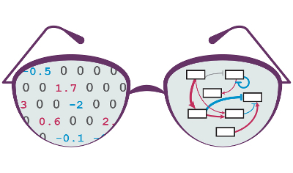

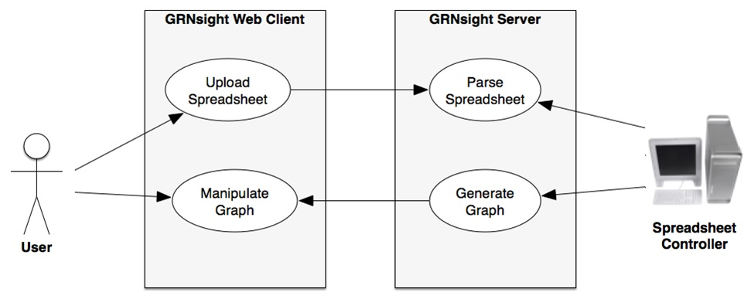
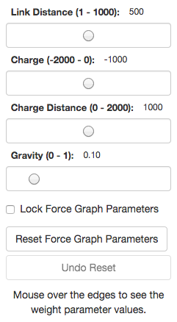
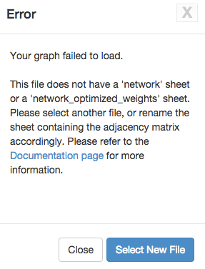
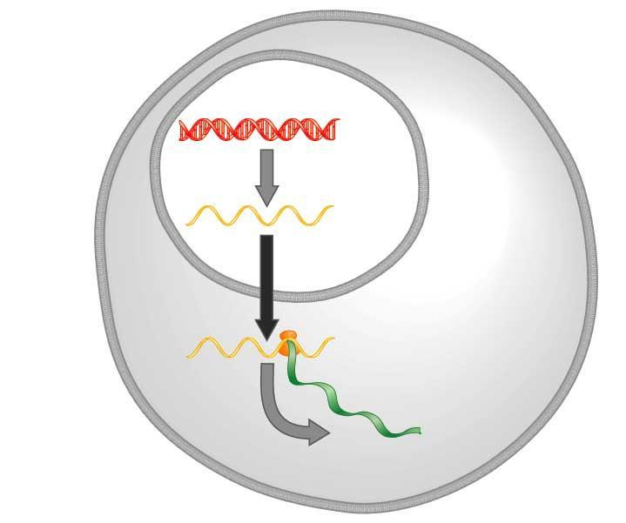
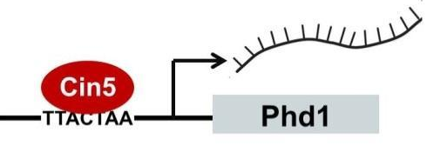
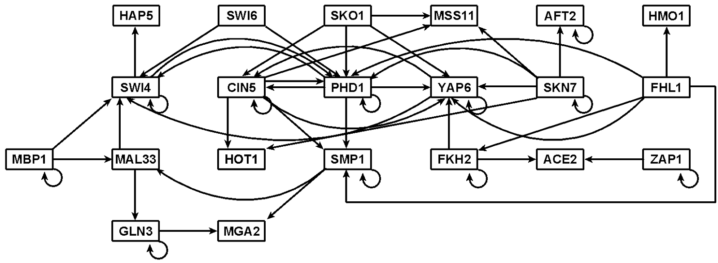
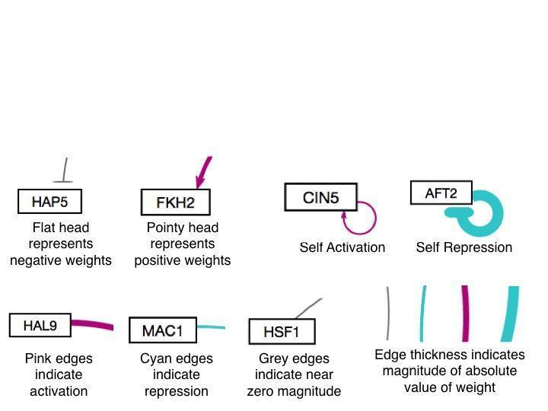
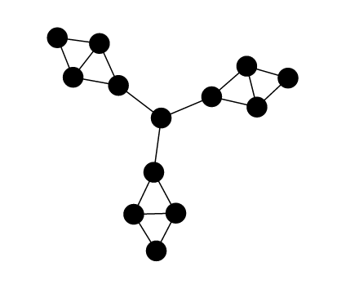
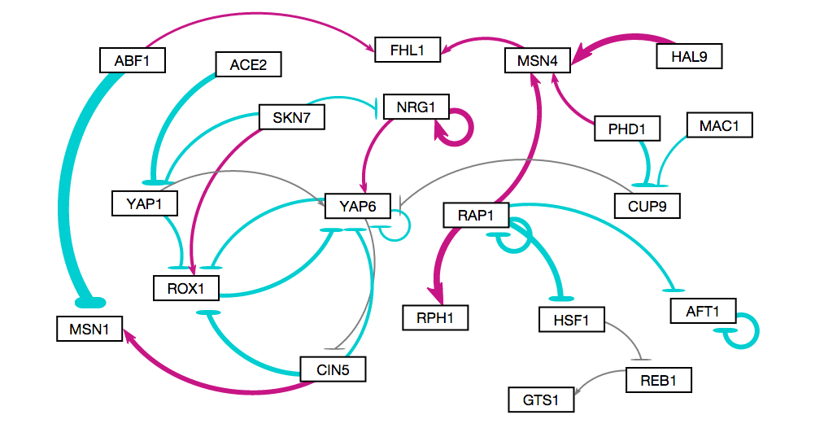
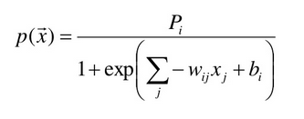
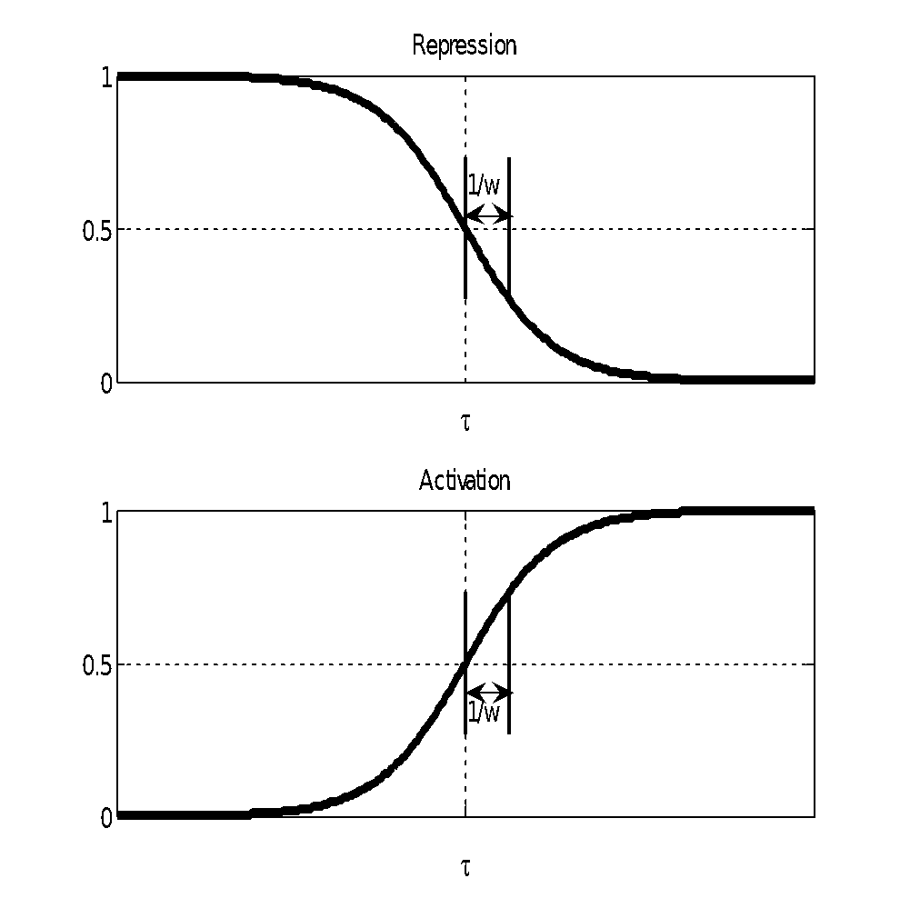
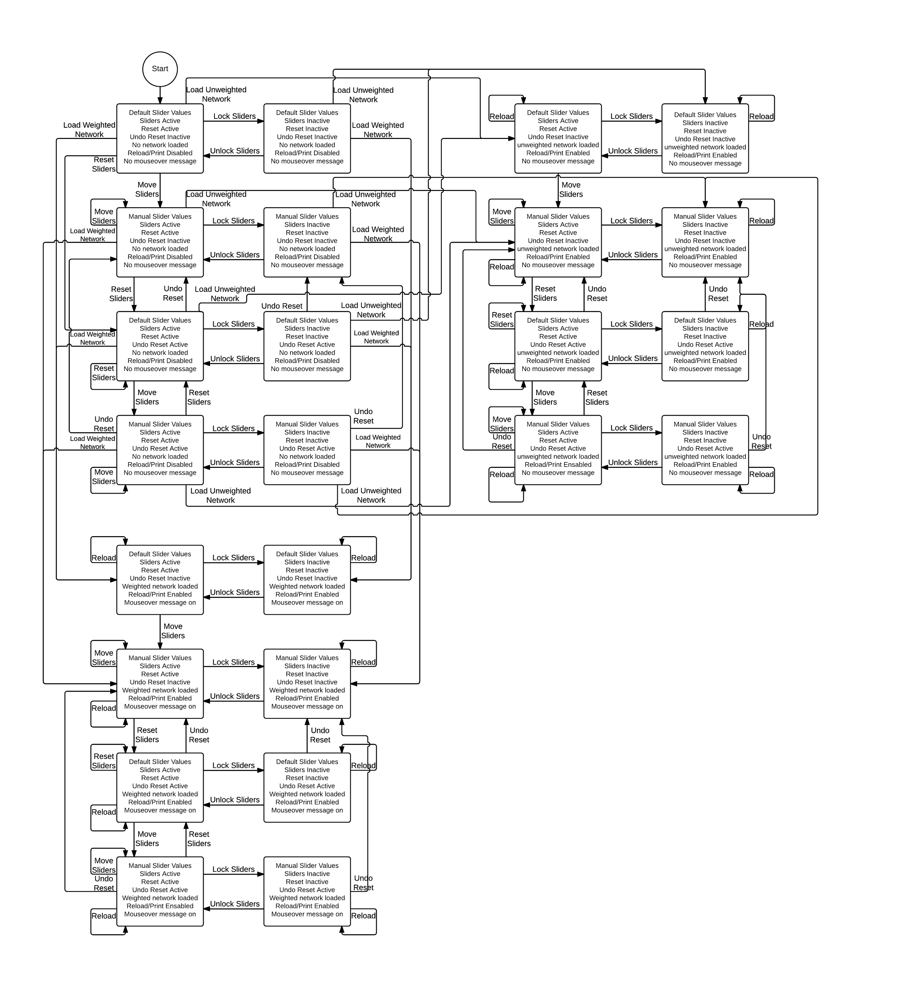
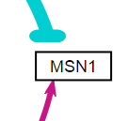
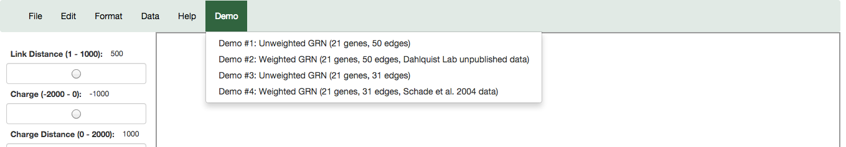
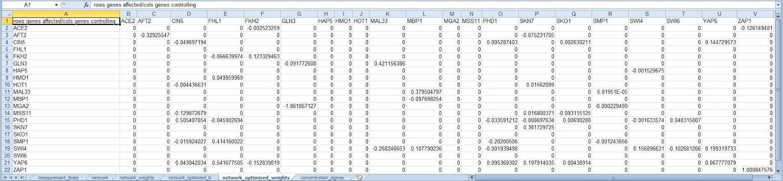
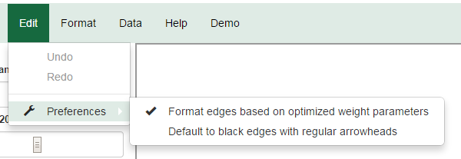
MATLAB model available at http://kdahlquist.github.io/GRNmap/
Improvements to GRNsight: a Web Application for
Visualizing Models of Gene Regulatory Networks
Nicole Anguiano*, Anindita Varshneya**, Kam D. Dahlquist**, John David N. Dionisio*, and Ben G. Fitzpatrick***
*Department of Electrical Engineering and Computer Science, **Department of Biology, ***Department of Mathematics, Loyola Marymount University, 1 LMU Drive, Los Angeles, CA 90045
http://dondi.github.io/GRNsight/
Gene Regulatory Networks Can Be Illustrated By Directed Graphs
Architecture and Open Development
User Interface
Implemented Mocha Unit-testing Framework
The central dogma of molecular biology describes the flow of information in a cell during gene expression from DNA to RNA to protein.
Transcription factors control gene expression by binding to regulatory DNA sequences.
Activators increase gene expression.
Repressors decrease gene expression.
Transcription factors are themselves proteins encoded by genes.
Freeman (2002)
A gene regulatory network (GRN) consists of genes, transcription factors, and the regulatory connections between them, which govern the level of expression of mRNA and proteins from those genes.
Each node represents the gene, the mRNA, and the protein expressed from the gene.
Each edge represents a regulatory relationship.
All the nodes are transcription factors themselves.
GRNsight has a service-oriented architecture
GRNsight has two pieces: a server and a web client.
The server uses the Node.js framework to receive and parse the Excel spreadsheet uploaded by the user.
The web client receives the data from the server and generates the graph visualization.
GRNsight implementation takes advantage of other open source tools
GRNsight uses the Data-Driven Documents (D3) JavaScript library to generate a graph derived from input network data.
D3 dynamically manipulates HTML and Scalable Vector Graphics (SVG) to form the elements of the graph.
GRNsight implements D3’s force layout which applies a physics-based simulation to the graph.
D3 also allows for the fine tuning of Cascading Style Sheets (CSS), the code that styles web pages.
The default implementation simply had nodes and edges. We added several features including:
GRNsight follows an open development model using an open source github.com code repository and issue tracking.
The User Interface is compatible with Firefox and Chrome browsers
File upload is via simple HTML form element.
Nodes are displayed as interactive HTML elements, and can be clicked and moved.
Users can utilize force graph parameter sliders to refine the automatic layout.
Nodes have a charge, which repels or attracts other nodes.
The charge distance determines at what range a node’s charge will affect other nodes.
The link distance determines the minimum distance maintained between nodes.
Sliders can be locked to prevent changes.
Error Catching was Greatly Improved
Robustness was greatly extended.
Instead of crashing when given an improperly formatted or incorrect file, GRNsight returns an error.
Information about the error is returned in a modal without crashing the server.
Beta Version Allows for Testing of New Features
A beta version was created to allow for testing of new features and catching any potential new errors before releasing to master.
Edges were customized to show activation, repression, and self-regulation
Multiple arrowheads were created as to represent the different types of edges depicted by the graph (activation, repression, and self-regulation).
A special case was added to add a looping edge if a node regulated itself.
New Unit Testing Framework Implemented
Unit testing executed through Mocha, a JavaScript test framework running on node.js
All tests are written in Chai, a BDD/TDD assertion library for node
Labels on nodes | Rectangular nodes | Variant node size | Edge thickness based on weight
Edge color based on type of relation | Tooltips to display the value of an edge on hover | Curved edges that remain on screen
GRNmap: Gene Regulatory Network Modeling and Parameter Estimation
Aesthetic Improvements Focused Primarily on the Edges and Arrows
Edge thickness was changed to be based on a linear scale instead of four quartiles.
The weight values are normalized to between 0 and 1, then the thicknesses of the lines are adjusted to vary continuously from the minimum thickness (for normalized weights near zero) to the maximum thickness (weights of 1).
Edges were changed to curves with control points to prevent the curves from going outside the bounding box.
The size of the arrowheads was matched to the size of the new edge
thicknesses.
Repressor bars were changed to have rounded ends.
Arrowheads were given a bezel.
Edges were centered in the arrowheads and repressor bars.
The MATLAB model is available at http://kdahlquist.github.io/GRNmap/
GRNmap is a differential equations model of the changes in gene expression over time for a gene regulatory network.
Each gene (node) in the network has an equation.
The parameters in the model are estimated from laboratory data.
The weight parameter, w, gives the direction (activation or repression) and magnitude of the regulatory relationship.
GRNmap produces an Excel spreadsheet with an adjacency matrix representing the network
0 represents no relationship.
A positive weight value indicates activation.
A negative weight value indicates repression.
The magnitude of the weight defines the strength of the relationship.
However, GRNmap does not generate a visual representation of the GRN.
Future Directions
Further expand and refine the unit testing framework.
Add node coloring based on expression data.
Implement different sizes for the graph drawing area.
Implement draggable edges to allow further graph customization.
State Diagram
A Menu Bar was Introduced
A menu bar with multiple options was added.
Four demo files were added to the “Demo” menu.
Print functionality was enabled in the “File” menu option.
Force graph parameter sliders are active before a graph is loaded.
Availability
GRNsight is free and open to all users and there is no login requirement. Web site content is available under the Creative Commons Attribution Non-Commercial Share Alike license. GRNsight code is available under the open source BSD license.
Acknowledgments
Weighted Graphs can be Drawn as Unweighted Graphs
In the Edit > Preferences menu,
the user can select for weighted
graphs to be displayed as
unweighted graphs.
Reload Functionality Enables Graph Reload
The reload menu option under “File” reloads the current graph with the active settings.
Changes made in the Edit > Preferences menu become visible on reload.
More Expansive Requirements for Valid Adjacency Matrix
Asymmetric matrices are valid; there can be more columns vs. rows or vis versa of gene names
Gene names along top and side do not need to be in the same order or have same capitalization
This work is partially supported by NSF award 0921038 (Kam D. Dahlquist, Ben G. Fitzpatrick) and by the Loyola Marymount University Rains Research Assistant Program (Nicole Anguiano).
GRNsight Requirements
References
GRNsight Accepts .xlsx Files in the Proper Format
Spreadsheets need a “network” or “network_optimized_weights” sheet containing a symmetrical or asymmetrical adjacency matrix. GRNsight should then automatically lay out the graph based on the adjacency matrix.
GRNmap input and output spreadsheets are accepted without adjustment.
Spreadsheets from databases such as YEASTRACT can be used with some modification.
D3.js: http://d3js.org/
Express Framework: http://expressjs.com/
Freeman, S. (2002) Biological Science. Upper Saddle River, New Jersey: Prentice Hall.
GRNmap: http://kdahlquist.github.io/GRNmap/
Node.js: http://nodejs.org/
Notes:
Kill abstract
Change to sans serif font
Make title bigger
Make title background white
Use full names
Super script to associate names with correct department
Background color: make it dark green, make writing on white background and writing in black/dark green
4 columns!!!
Smaller pictures
Bold titles
References can be 12pt
Acknowledgements can be 16pt
Everything else is 18-24pt
Titles don’t need to be bigger than 36pt
Remove circles from the arrowhead diagram, group the related labels together
Include menu bar
Testing/error handling – sample error (we don’t crash with errors!)
Mouseovers for edges screenshot

Slide 2
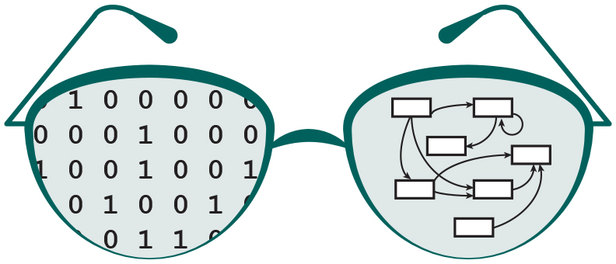
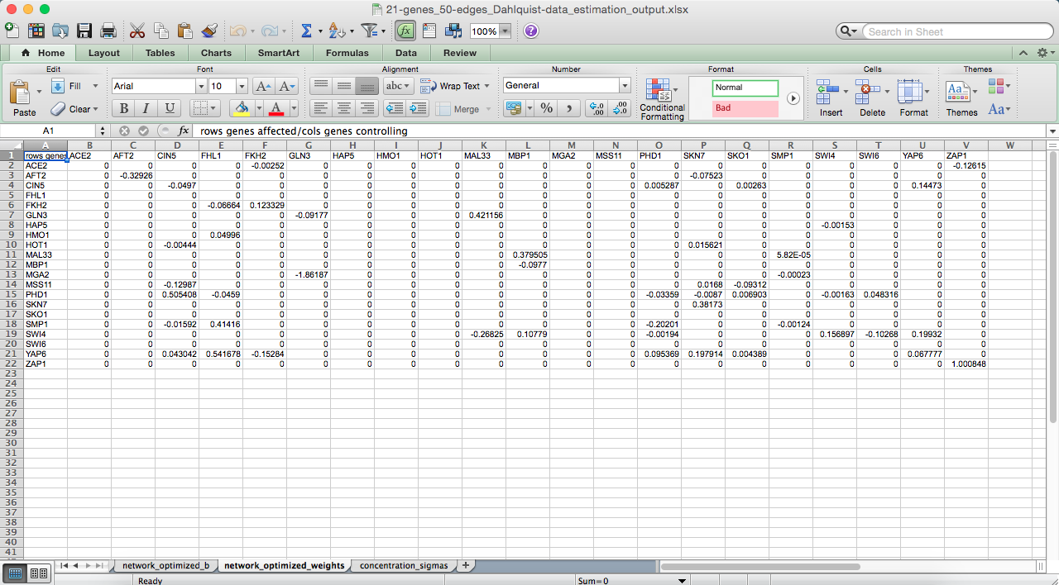
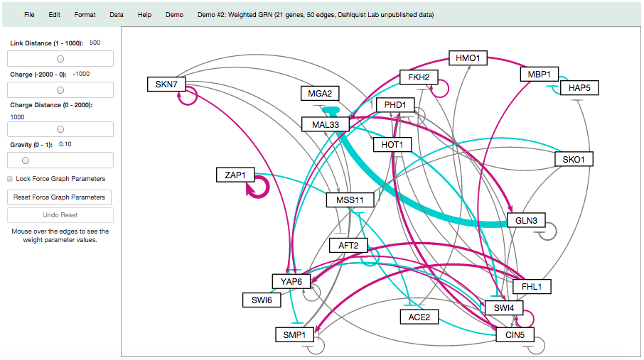
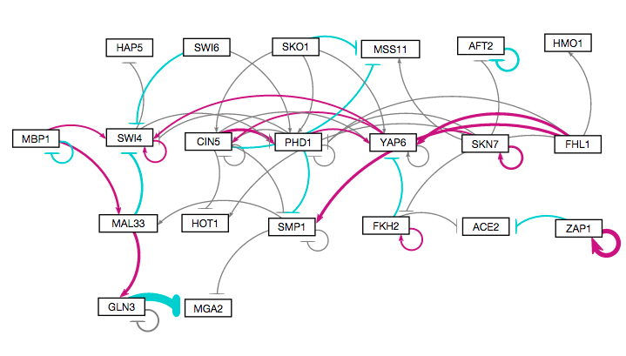
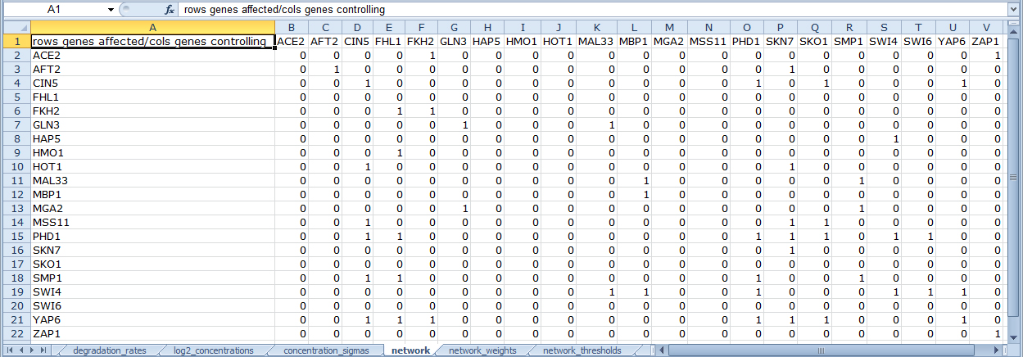
Improvements to GRNsight: a Web Application for
Visualizing Models of Gene Regulatory Networks
Nicole Anguiano*, Anindita Varshneya**, Kam D. Dahlquist**, John David N. Dionisio*, and Ben G. Fitzpatrick***
*Department of Electrical Engineering and Computer Science, **Department of Biology, ***Department of Mathematics, Loyola Marymount University, 1 LMU Drive, Los Angeles, CA 90045
http://dondi.github.io/GRNsight/
Gene Regulatory Networks Can Be Illustrated By Directed Graphs
Key Features
Implemented Mocha Unit-testing Framework
The central dogma of molecular biology describes the flow of information in a cell during gene expression from DNA to RNA to protein.
Transcription factors control gene expression by binding to regulatory DNA sequences.
Activators increase gene expression.
Repressors decrease gene expression.
Transcription factors are themselves proteins encoded by genes.
Freeman (2002)
A gene regulatory network (GRN) consists of genes, transcription factors, and the regulatory connections between them, which govern the level of expression of mRNA and proteins from those genes.
Each node represents the gene, the mRNA, and the protein expressed from the gene.
Each edge represents a regulatory relationship.
All the nodes are transcription factors themselves.
GRNsight Automatic Network Graph
GRNsight Adjusted Network Graph
Error Catching was Greatly Improved
Robustness was greatly extended.
Instead of crashing when given an improperly formatted or incorrect file, GRNsight returns an error.
Information about the error is returned in a modal without crashing the server.
Excel Spreadsheet
1
Beta Version Allows for Testing of New Features
A beta version was created to allow for testing of new features and catching any potential new errors before releasing to master.
1. Menu Bar
Four demo files are contained in the “Demo” menu.
Print functionality is enabled in the “File” menu option.
The reload menu option under “File” reloads the current graph with the active settings.
In the Edit > Preferences menu,
the user can select for weighted
graphs to be displayed as
unweighted graphs.
Produced in ~5 min
Manual Network Graph via Adobe Illustrator
New Unit Testing Framework Implemented
Unit testing executed through Mocha, a JavaScript test framework running on node.js
All tests are written in Chai, a BDD/TDD assertion library for node
2
Produced in ~10 milliseconds
Produced in several hours
2. Force Graph Parameter
Sliders
The link distance determines the minimum distance maintained between nodes.
Nodes have a charge, which repels or attracts other nodes.
The charge distance determines at what range a node’s charge will affect other nodes.
The force graph parameters can be locked or reset.
Aesthetic Improvements Focused Primarily on the Edges and Arrows
Edge thickness is based on a linear scale.
The weight values are normalized to between 0 and 1, then the thicknesses of the lines are adjusted to vary continuously from the minimum thickness (normalized weights near zero) to the maximum thickness (weights of 1).
Edges with normalized weight values from 0.05 to 1 are colored magenta; edges with normalized weight values from -0.05 to -1 are colored cyan. Edges with normalized weight values between -0.05 and 0.05 are colored grey.
GRNmap: Gene Regulatory Network Modeling and Parameter Estimation
The MATLAB model is available at http://kdahlquist.github.io/GRNmap/
GRNmap is a differential equations model of the
changes in gene expression over time for a gene regulatory network.
Each gene (node) in the network has an equation.
The parameters in the model are estimated from laboratory data.
The weight parameter, w, gives the direction (activation or repression) and magnitude of the regulatory relationship.
GRNmap produces an Excel spreadsheet with an adjacency matrix representing the network
The magnitude of the weight defines the strength of the relationship.
However, GRNmap does not generate a visual representation of the GRN.
Architecture and Development
Future Directions
Further expand and refine the unit testing framework.
Add node coloring based on expression data.
Implement different sizes for the graph drawing area.
Implement draggable edges to allow further graph customization.
Availability
GRNsight is free and open to all users and there is no login requirement.
Web site content is available under the Creative Commons Attribution Non-Commercial Share Alike license.
GRNsight code is available under the open source BSD license.
GRNsight Accepts .xlsx Files in the Proper Format
GRNsight has a service-oriented architecture
GRNsight has two pieces: a server and a web client.
The server uses the Node.js framework to receive and parse the Excel spreadsheet uploaded by the user.
The web client receives the data from the server and generates the graph visualization.
The user interface is compatible with Firefox and Chrome browsers.
Acknowledgments
GRNsight Accepts .xlsx Files in the Proper Format
Spreadsheets need a “network” or “network_optimized_weights” sheet containing a symmetrical or asymmetrical adjacency matrix.
0 represents no relationship.
A positive weight value indicates activation.
A negative weight value indicates repression.
GRNmap input and output spreadsheets are accepted without adjustment.
Spreadsheets from databases such as YEASTRACT can be used with some modification.
This work is partially supported by NSF award 0921038 (Kam D. Dahlquist, Ben G. Fitzpatrick) and by the Loyola Marymount University Rains Research Assistant Program (Nicole Anguiano).
GRNsight implementation takes advantage of other open source tools
GRNsight uses the Data-Driven Documents (D3) JavaScript library to generate a graph derived from input network data.
D3 dynamically manipulates HTML and Scalable Vector Graphics (SVG) to form the elements of the graph.
GRNsight implements D3’s force layout which applies a physics-based simulation to the graph.
D3 also allows for the fine tuning of Cascading Style Sheets (CSS), the code that styles web pages.
GRNsight follows an open development model using an open source github.com code repository and issue tracking.
References
D3.js: http://d3js.org/
Express Framework: http://expressjs.com/
Freeman, S. (2002) Biological Science. Upper Saddle River, New Jersey: Prentice Hall.
GRNmap: http://kdahlquist.github.io/GRNmap/
Node.js: http://nodejs.org/
Notes:
Kill abstract
Change to sans serif font
Make title bigger
Make title background white
Use full names
Super script to associate names with correct department
Background color: make it dark green, make writing on white background and writing in black/dark green
4 columns!!!
Smaller pictures
Bold titles
References can be 12pt
Acknowledgements can be 16pt
Everything else is 18-24pt
Titles don’t need to be bigger than 36pt
Remove circles from the arrowhead diagram, group the related labels together
Include menu bar
Testing/error handling – sample error (we don’t crash with errors!)
Mouseovers for edges screenshot

