Slide 1
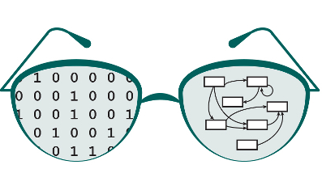

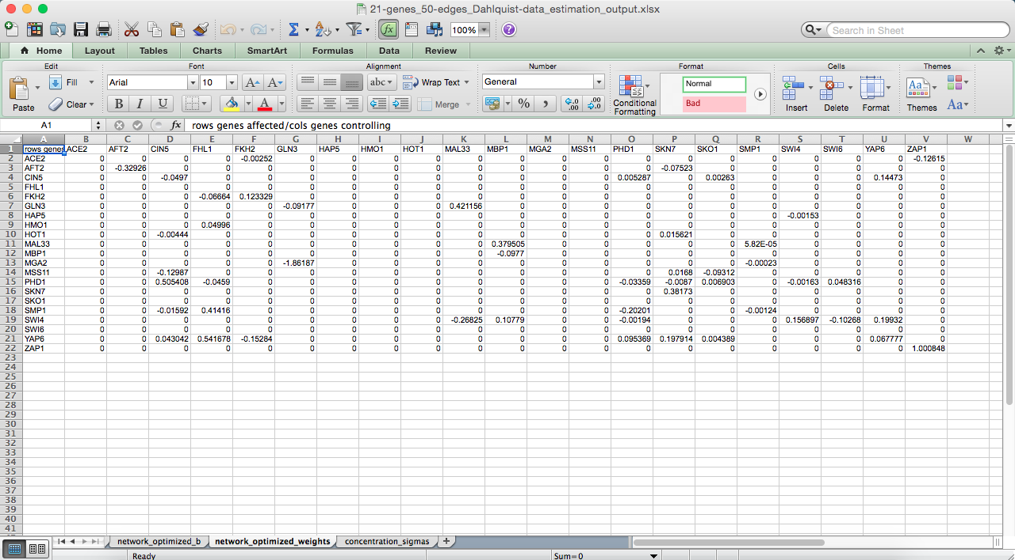

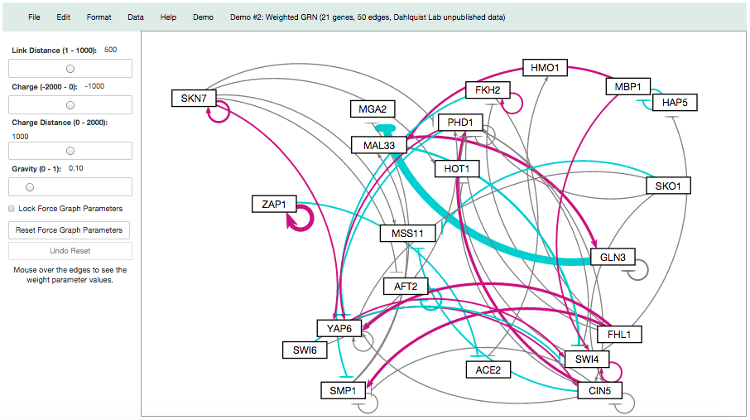

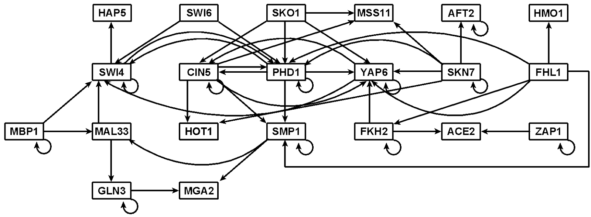
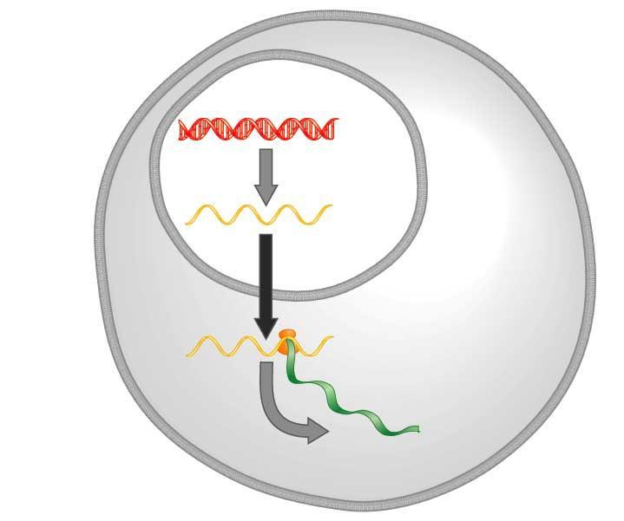
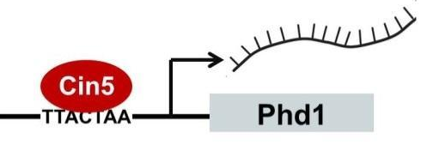
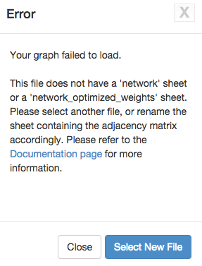
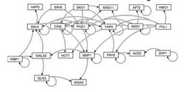
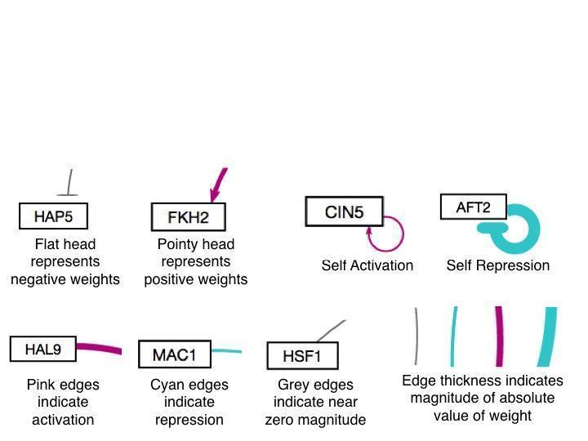
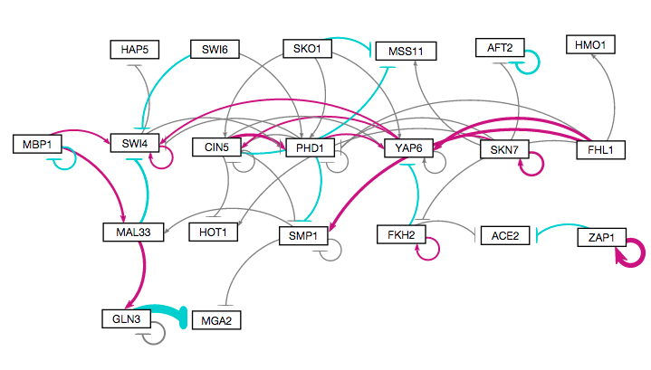

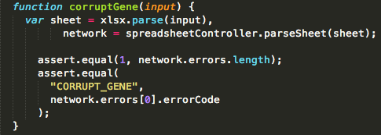
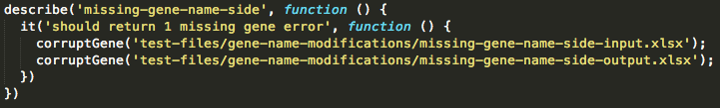
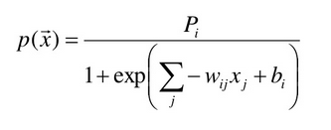
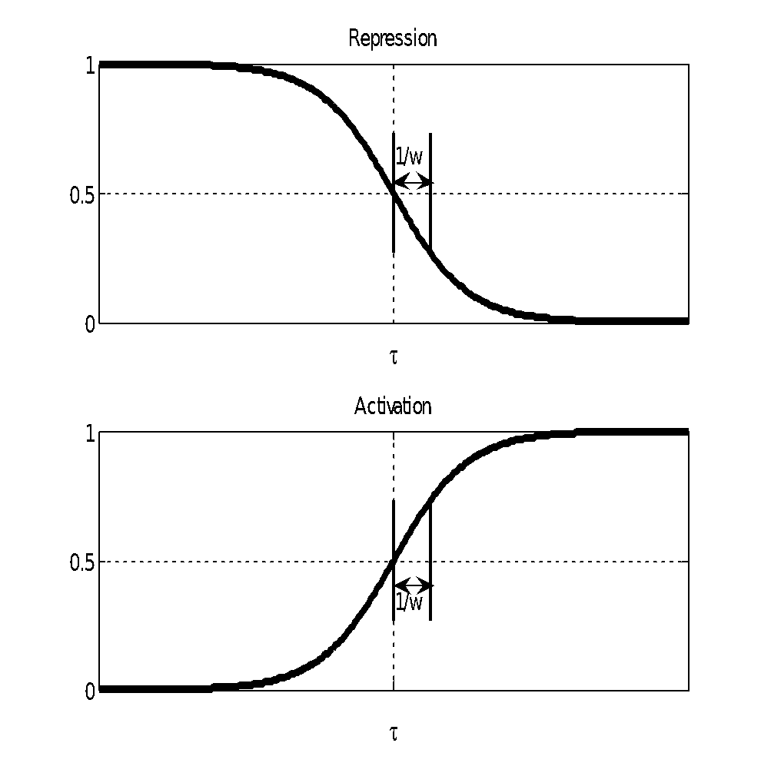
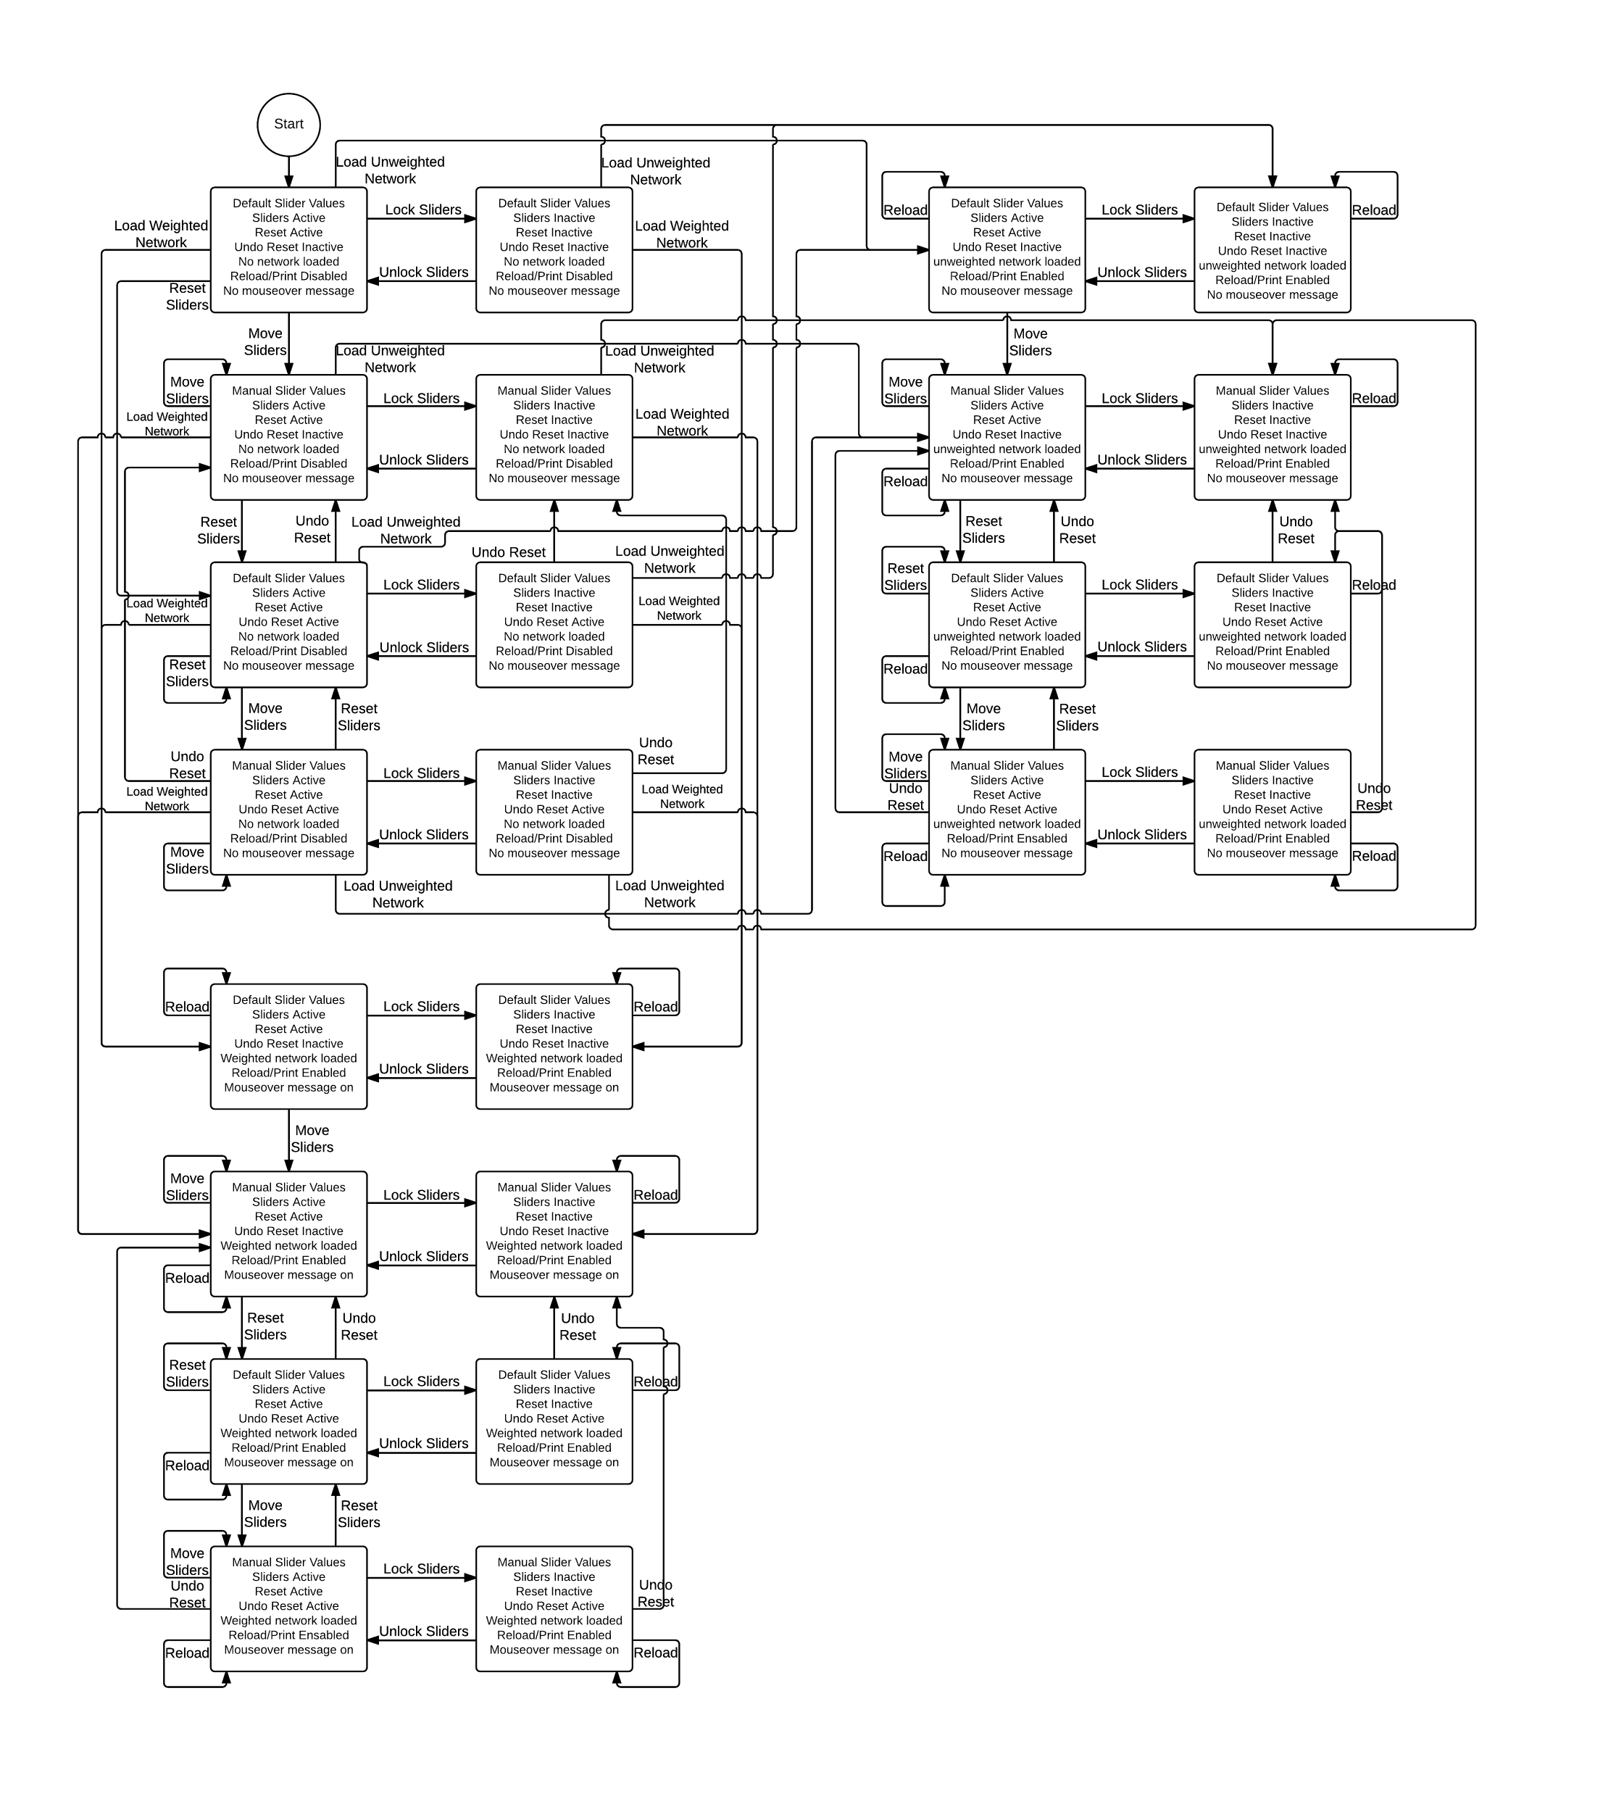
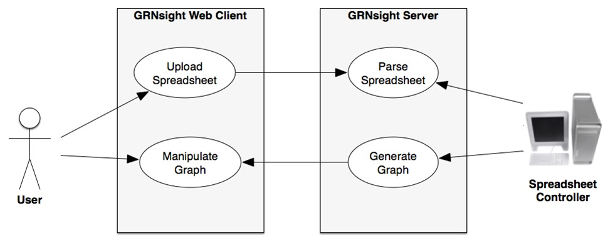
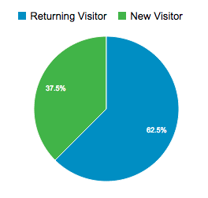
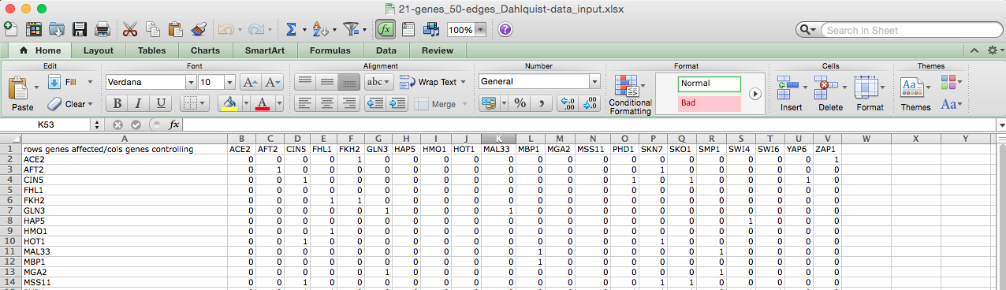
Improvements to GRNsight: a Web Application for
Visualizing Models of Gene Regulatory Networks
Nicole Anguiano*, Anindita Varshneya**, Kam D. Dahlquist**, John David N. Dionisio*, and Ben G. Fitzpatrick***
*Department of Electrical Engineering and Computer Science, **Department of Biology, ***Department of Mathematics, Loyola Marymount University, 1 LMU Drive, Los Angeles, CA 90045
http://dondi.github.io/GRNsight/
Gene Regulatory Networks Can Be Illustrated by Directed Graphs
GRNsight Automatically Lays Out Weighted and Unweighted Networks
Implemented Mocha Unit-testing Framework
The central dogma of molecular biology describes the flow of information in a cell during gene expression from DNA to RNA to protein.
Transcription factors control gene expression by binding to regulatory DNA sequences.
Activators increase gene expression.
Repressors decrease gene expression.
Transcription factors are themselves proteins encoded by genes.
Freeman (2002)
A gene regulatory network (GRN) consists of genes, transcription factors, and the regulatory connections between them, which govern the level of expression of mRNA and proteins from those genes.
Each node represents the gene, the mRNA, and the protein expressed from the gene.
Each edge represents a regulatory relationship.
All the nodes are transcription factors themselves.
Unit testing is a software testing method where source code can be tested through a unit interface to ensure that it is error free, and fit for use.
Error Catching was Greatly Improved
Robustness was greatly extended.
Instead of crashing when given an improperly formatted or incorrect file, GRNsight returns an error.
Information about the error is returned in a modal without crashing the server.
Sample Code
Excel Spreadsheet
1
Manual Network Graph via Adobe Illustrator
1. Menu Bar
Four demos in the “Demo” menu.
Print functionality in the “File” menu option.
The “Reload” option under “File” reloads the current graph with the active settings.
In the Edit > Preferences menu,
the user can select for weighted
graphs to be displayed as
unweighted graphs.
Produced in several hours
Beta Version Allows for Testing of New Features
A beta version was created to allow for testing of new features and catching any potential new errors before releasing to master.
GRNsight Adjusted Unweighted Network Graph
New Unit Testing Framework Implemented
Unit testing executed through Mocha, a JavaScript test framework running on node.js.
All tests are written in Chai, a behavior-driven development/test-driven development assertion library for node.
2
3
Produced in ~10 milliseconds
Prior to unit testing framework, each unit test was manually uploaded onto the website to test for errors.
2. Force Graph Parameter Sliders
Link distance determines the minimum distance between nodes.
Nodes have a charge, which repels or attracts other nodes.
The charge distance determines at what range a node’s charge will affect other nodes.
Reset functionality sets all parameters to default settings
Locking the parameters prevents any further changes
Produced in ~10 milliseconds
GRNsight Adjusted Weighted Network Graph
3. Nodes, Edges, and Arrows
Edge thickness is based on a linear scale.
The weight values are normalized to between 0 and 1, then the thicknesses of the lines are adjusted to vary continuously from the minimum thickness (for normalized weights near zero) to the maximum thickness (weights of 1).
Green edges indicate negative relationships, pink edges signify positive relationships, and grey edges signify near 0 relationships.
GRNmap: Gene Regulatory Network Modeling and Parameter Estimation
Produced in ~5 min
The MATLAB model is available at http://kdahlquist.github.io/GRNmap/
GRNmap is a differential equations model of the changes in gene expression over time for a gene regulatory network.
Each gene (node) in the network has an equation.
The parameters in the model are estimated from laboratory data.
The weight parameter, w, gives the direction (activation or repression) and magnitude of the regulatory relationship.
GRNmap produces an Excel spreadsheet with an adjacency matrix representing the network
However, GRNmap does not generate a visual representation of GRNs
0 represents no relationship.
A positive weight value indicates activation.
A negative weight value indicates repression.
The magnitude of the weight defines the strength of the relationship.
Future Directions
GRNsight Has Sophisticated Architecture and Follows Open Development Practices
Further expand and refine the unit testing framework.
Add node coloring based on expression data.
Implement different sizes for the graph drawing area.
Implement draggable edges to allow further graph customization.
Availability
GRNsight is free and open to all users and there is no login requirement.
Web site content is available under the Creative Commons Attribution Non-Commercial Share Alike license.
GRNsight code is available under the open source BSD license.
Usage is being tracked through Google Analytics
GRNsight has a service-oriented architecture
GRNsight has two pieces: a server and a web client.
The server uses the Node.js framework to receive and parse the Excel spreadsheet uploaded by the user.
The web client receives the data from the server and generates the graph visualization.
Acknowledgments
GRNsight implementation takes advantage of other open source tools
GRNsight uses the Data-Driven Documents (D3) JavaScript library to generate a graph derived from input network data.
D3 dynamically manipulates HTML and Scalable Vector Graphics (SVG) to form the elements of the graph.
GRNsight implements D3’s force layout which applies a physics-based simulation to the graph.
D3 also allows for the fine tuning of Cascading Style Sheets (CSS), the code that styles web pages.
GRNsight follows an open development model using an open source github.com code repository and issue tracking.
The User Interface is Compatible with Firefox and Chrome Browsers
File upload is through simple HTML form element.
Nodes are displayed as interactive HTML elements, and can be clicked and moved.
This work is partially supported by NSF award 0921038 (Kam D. Dahlquist, Ben G. Fitzpatrick) and by the Loyola Marymount University Rains Research Assistant Program (Nicole Anguiano).
GRNsight Accpets .xlsx Files in the Proper Format
References
Spreadsheets need a “network” or “network_optimized_weights” sheet containing a symmetrical or asymmetrical adjacency matrix.
GRNmap input and output spreadsheets are accepted without adjustment.
Spreadsheets from databases such as YEASTRACT can be used with some modification.
Gene names are arranged along the top and side of the matrix
Chai: http://chaijs.com/
D3.js: http://d3js.org/
Express Framework: http://expressjs.com/
Freeman, S. (2002) Biological Science. Upper Saddle River, New Jersey: Prentice Hall.
GRNmap: http://kdahlquist.github.io/GRNmap/
Node.js: http://nodejs.org/
Mocha: http://mochajs.org/
Notes:
Kill abstract
Change to sans serif font
Make title bigger
Make title background white
Use full names
Super script to associate names with correct department
Background color: make it dark green, make writing on white background and writing in black/dark green
4 columns!!!
Smaller pictures
Bold titles
References can be 12pt
Acknowledgements can be 16pt
Everything else is 18-24pt
Titles don’t need to be bigger than 36pt
Remove circles from the arrowhead diagram, group the related labels together
Include menu bar
Testing/error handling – sample error (we don’t crash with errors!)
Mouseovers for edges screenshot

