Slide 1
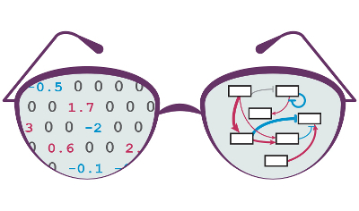

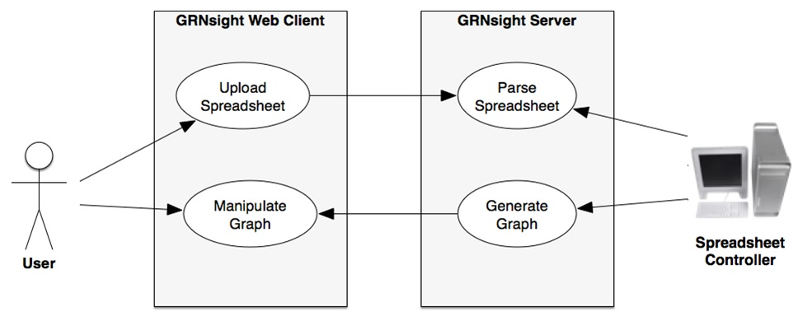
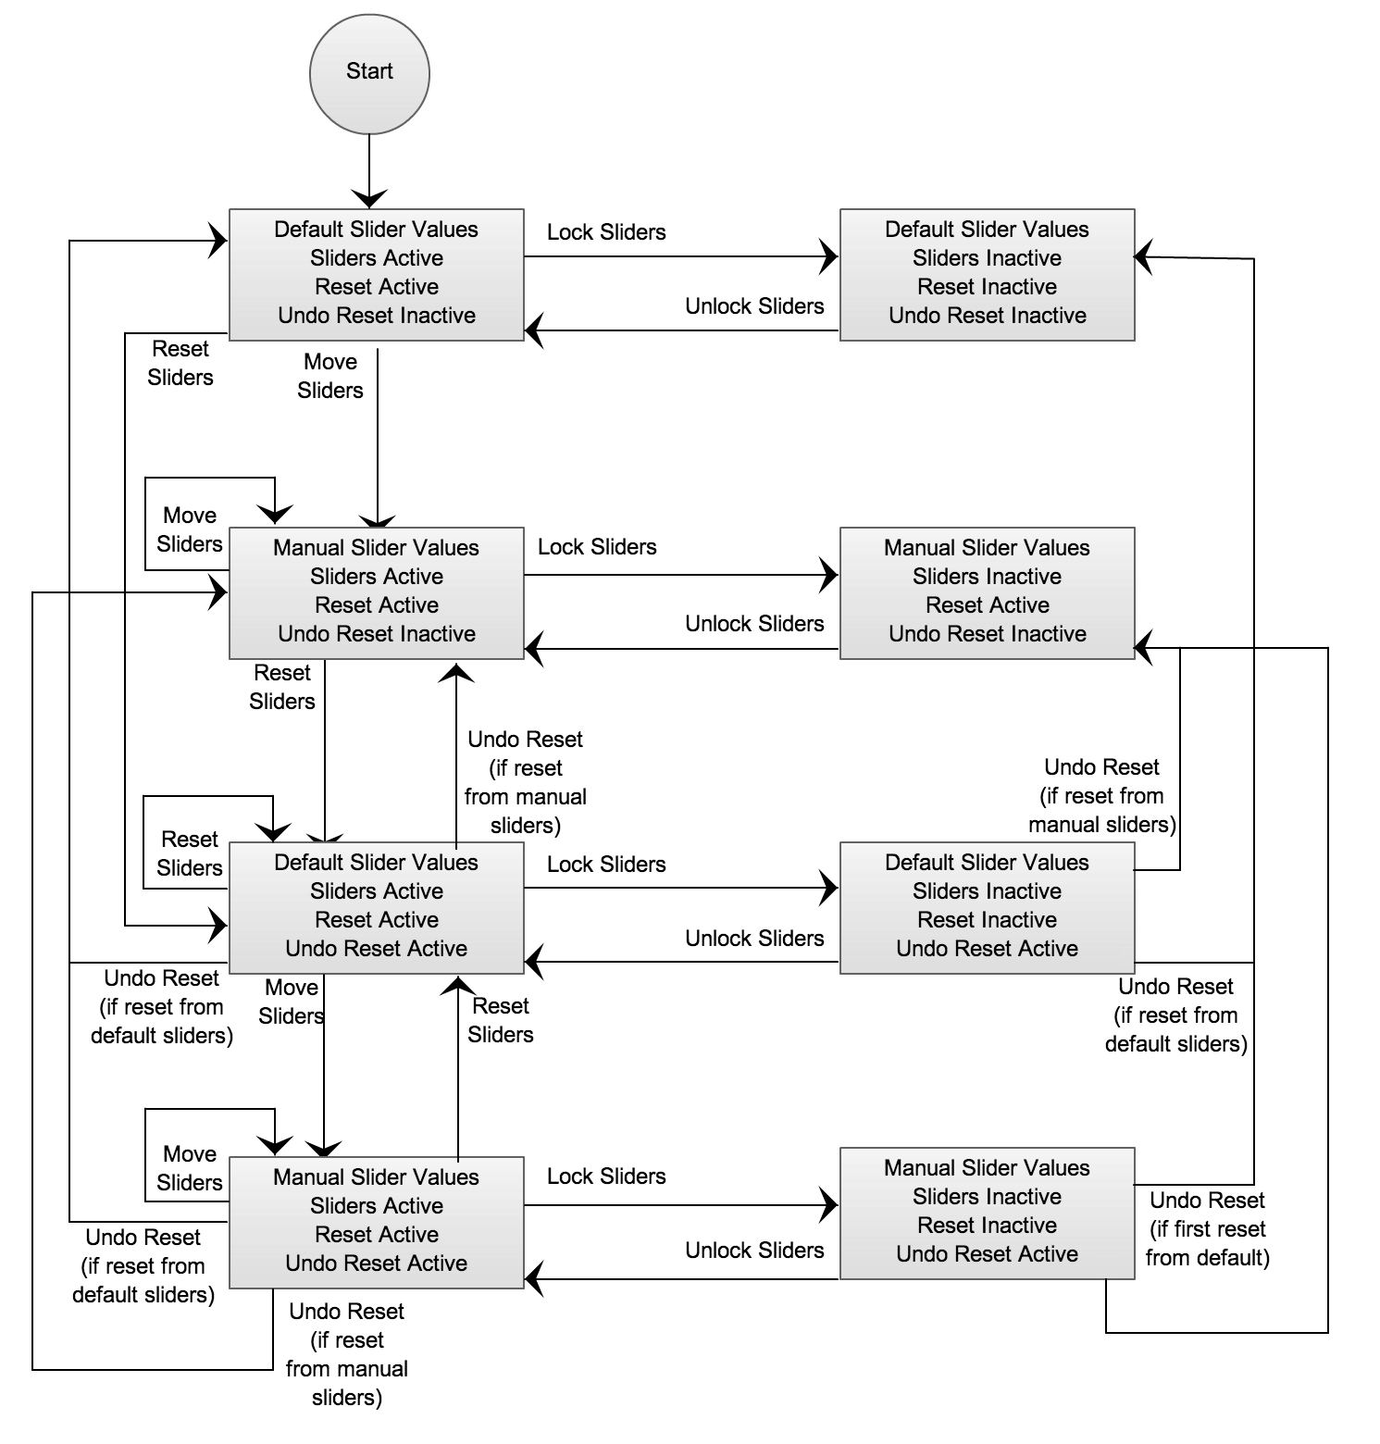
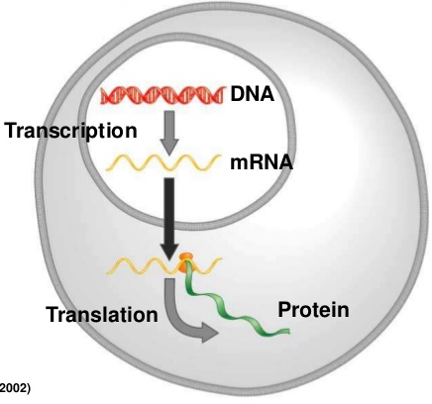
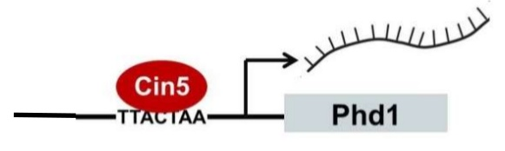
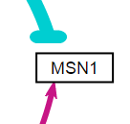
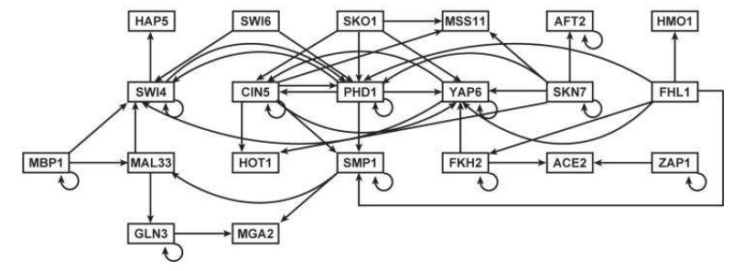
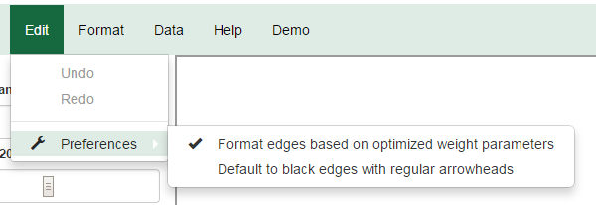
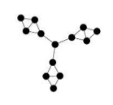
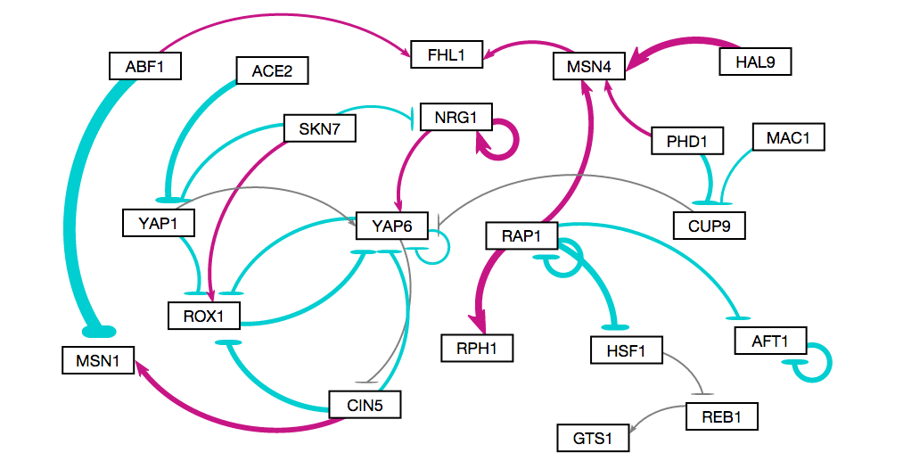
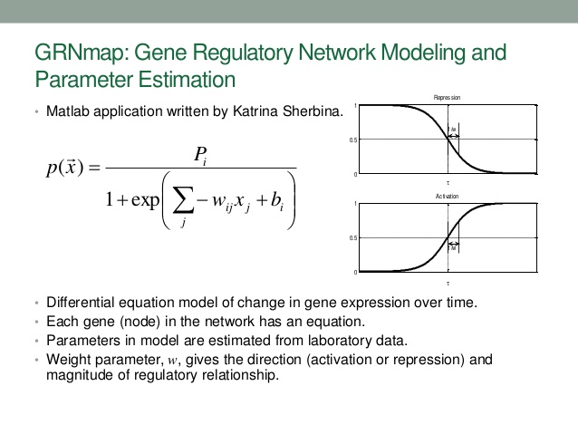
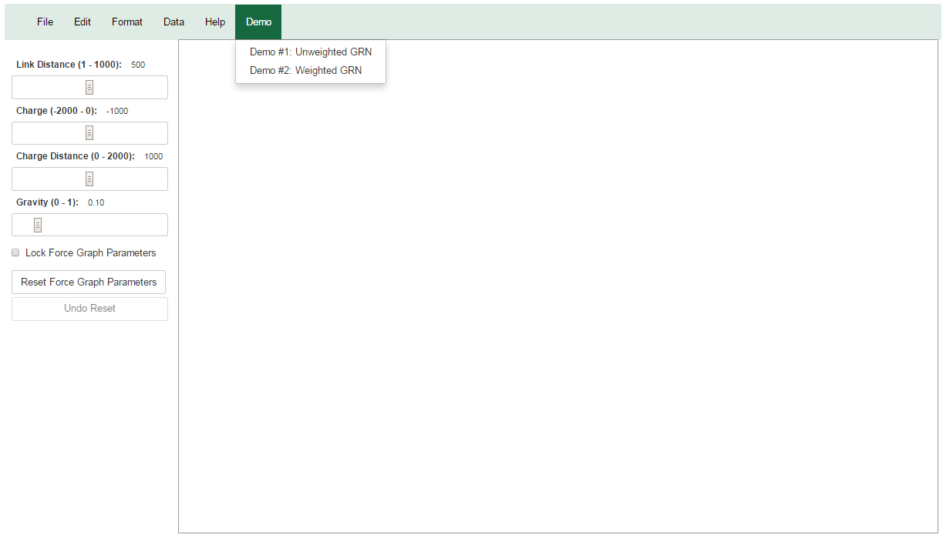
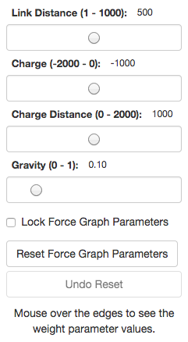
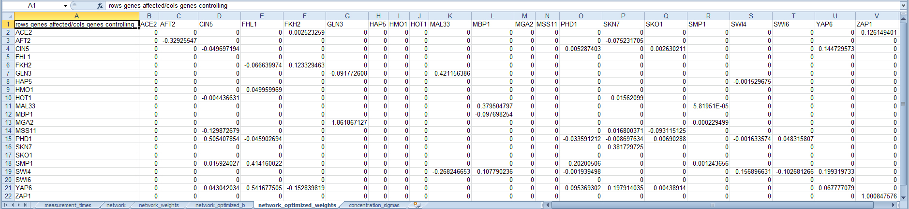
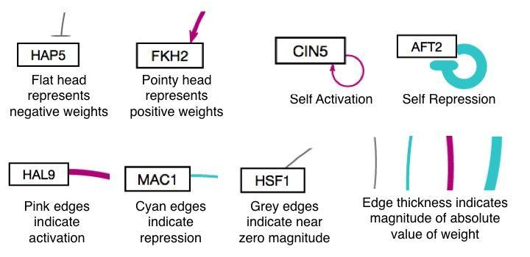
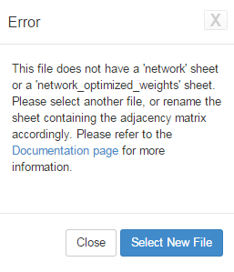
Improvements to GRNsight: a Web Application for
Visualizing Models of Gene Regulatory Networks
Nicole Anguiano*, Anindita Varshneya**, Kam Dahlquist**, John David Dionisio*, and Ben Fitzpatrick***
*Department of Electrical Engineering and Computer Science, **Department of Biology, ***Department of Mathematics, Loyola Marymount University, 1 LMU Drive, Los Angeles, CA 90045
URL: http://dondi.github.io/GRNsight/
Introduction
Architecture
State Diagram
Aesthetic Improvements
Central dogma of molecular biology
Transcription factors control gene expression by binding to regulatory DNA sequences.
Activators increase gene expression.
Repressors decrease gene expression.
Transcription factors are themselves proteins encoded by the gene.
Gene Regulatory Networks Can Be Illustrated By Directed Graphs
A gene regulatory network (GRN) consists of genes, transcription factors, and the regulatory connections between them, which govern the level of expression of mRNA and proteins from those genes.
Each node represents the gene, the mRNA, and the protein expressed from the gene
Each edge represents a regulatory relationship
All the nodes are transcription factors themselves
GRNsight has a service-oriented architecture
GRNsight has two pieces: a server and a web client
Server uses Node.js framework to receive and parse an excel spreadsheet uploaded by the user.
Web client receives data from the server and generates the graph visualization
GRNsight implementation takes advantage of other open source tools
Uses the Data-Driven Documents (D3) JavaScript library to generate a graph derived from input network data
D3 dynamically manipulates HTML and Sector Vector Graphics (SVG) to form the elements of the graph.
GRNsight implements D3’s force layout which applies a physics-based simulation to the graph
D3 also allows for the fine tuning of Cascading Style Sheets (CSS), the code that styles web pages
Default implementation simply had nodes and edges. We added several features including:
Aesthetic Improvements Focused Primarily on the Edges and Arrows
Edge thickness changed to be based on a linear scale instead of four quartiles
Edges were changed to curves with control points to prevent the curves from going outside the bounding box
Arrowheads were matched to the size of the new edge
thicknesses
Repressor bars changed to have rounded ends
Arrowheads were given a bezel
Edges were centered in the arrowheads and repressor bars
Other General Improvements
Weighted Graphs can be Drawn as Unweighted Graphs
In the Edit > Preferences menu,
the user can select for weighted
graphs to be displayed as
unweighted graphs
Reload Functionality Enables Graph Reload
Reload menu option under “File” reloads the current graph with the active settings
Changes made in the Edit > Preferences menu become visible on reload
Labels on nodes | Rectangular nodes | Variant node size | Edge thickness based on weight
Edge color based on type of relation | Tooltips to display the value of an edge on hover | Edges were given an outline to better distinguish them | Curved edges that remain on screen
GRNmap
User Interface Improvements
Summary
GRNmap: Gene Regulatory Network Modeling and Parameter Equation
Matlab equation written by Katrina Sherbina
Differential equation model of change in gene expression over time.
Each gene (node) in the network has an equation.
Parameters in model are estimated from laboratory data.
Weight parameter, w, gives the direction (activation or repression) and magnitude of regulatory relationship
GRNmap produces an Excel spreadsheet with an adjacency matrix representing the network
0 represents no relationship
A positive number indicates activation
A negative number indicates repression
Magnitude of weight defines strength of relationship
However, GRNmap does not generate any visual representation of the Gene Regulatory Network
A Menu Bar was Introduced
A menu bar with multiple options was added
Two demo files were added to the “Demo” menu, with more to be added
Print functionality was enabled in the “File” menu option
Force parameter sliders are active before a graph is loaded
GRNsight is an open source application that displays a graphical view of an adjacency matrix representation of a gene regulatory network
GRNsight utilizes a service-oriented architecture and open source tools, and is compatible with Firefox and Chrome
A beta version was created to thoroughly test new features before being released in the main master version, with beta currently at version 1.7 and master at 1.6.
Since version one, general improvements have been made as well as improvements in the user interface design, error catching and handling, testing, and aesthetics.
User Interface
The User Interface is compatible with Firefox and Chrome browsers
File upload via sample HTML form element
Nodes displayed as interactive HTML elements
Advanced users can utilize setting sliders to refine the visualization
Nodes have a charge, which repels or attracts other nodes
The charge distance determines at what range a node’s charge will affect other nodes
The link distance determines the minimum distance maintained between nodes
Sliders can be locked to prevent changes
Future Directions
Prevent self referential edges from being able to go outside the bounding box
Node coloring based off of expression data
Implement different sizes for the graph drawing area
Availability
Edges were customized to show activation, repression, and self-regulation
Multiple arrowheads were created as to represent the different types of edges depicted by the graph (activation, repression, and self-regulation)
A special case was added to add a looping edge if a node regulated itself
Testing and Error Handling
GRNsight is free and open to all users and there is no login requirement. Web site content is available under the Creative Commons Attribution Non-Commercial Share Alike. GRNsight code is available under the open source BSD license.
Error Catching was Greatly Improved
Robustness greatly extended
Instead of crashing when given an improperly formatted or incorrect file, GRNsight returns an error
The error caused is returned in a modal without crashing the server
Acknowledgments
Requirements
Beta Version Allows for Testing of New Features
Beta version was created to allow for testing of new features and catching any potential new errors before releasing to master
Currently, a new spreadsheet controller is being bug tested on beta that would accept asymmetrical matrices
This work is partially supported by NSF award 0921038 (Kam D. Dahlquist, Ben G. Fitzpatrick) and by the Loyola Marymount University Rains Research Assistant Program (Nicole Anguiano).
GRNsight Accepts xlsx Files in the Proper Format
Spreadsheets need a “network” or “network_optimized_weights” sheet containing a matrix
GRNmap input and output spreadsheets are accepted without adjustment
Spreadsheets from databases such as YEASTRACT can be used with some modification
Asymmetrical matrices are currently not accepted by the master version
References
Notes:
Kill abstract
Change to sans serif font
Make title bigger
Make title background white
Use full names
Super script to associate names with correct department
Background color: make it dark green, make writing on white background and writing in black/dark green
4 columns!!!
Smaller pictures
Bold titles
References can be 12pt
Acknowledgements can be 16pt
Everything else is 18-24pt
Titles don’t need to be bigger than 36pt
Remove circles from the arrowhead diagram, group the related labels together
Include menu bar
Testing/error handling – sample error (we don’t crash with errors!)
Mouseovers for edges screenshot

