Slide 1
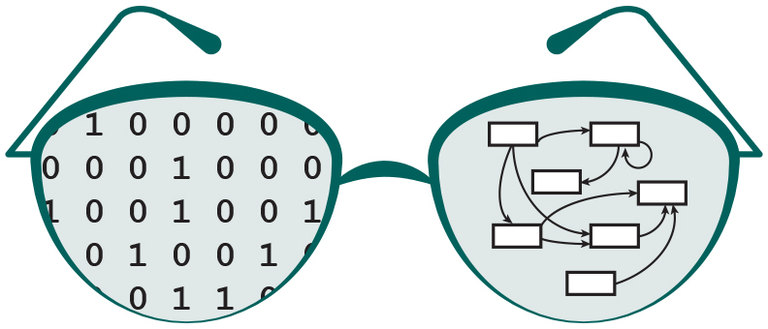

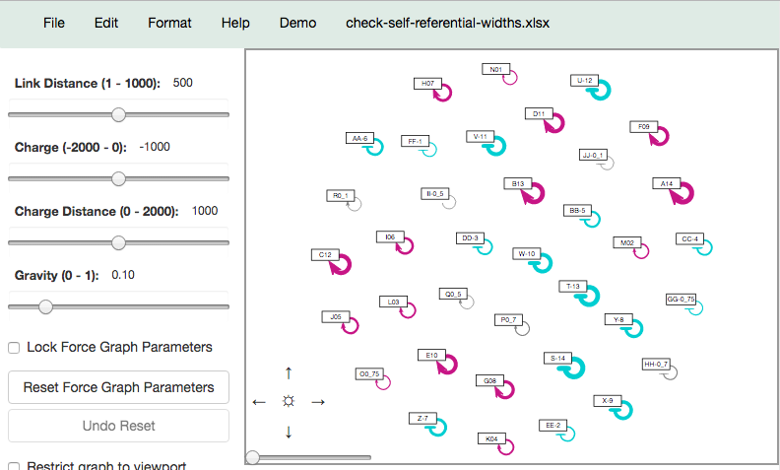
GRNsight
Nicole Anguiano
CMSI 402
5/5/17
http://dondi.github.io/GRNsight/
About
Snapshot of User Interface
The menu bar provides options for loading GRNs, formatting them, and exporting to SIF/GraphML.
GRNsight is a web application and service for visualizing models of small- to medium-scale gene regulatory networks (GRNs).
It also provides sample files for users to test GRNsight, and links to resources if they want to know how to format their data for upload.
It accepts a representation of a GRN in XLSX, SIF, or GraphML format and outputs them as a directed graph.
It displays the current graph name when a graph is loaded, as well as the number of nodes and edges in the graph.
Transcription factors are displayed as nodes, with edges representing the relationships between them.
Acknowledgements
Motivation
The viewport is where the graph is drawn.
GRNsight Team
Jen Shin
Eileen Choe
Anu Varshneya
Eddie Bachoura
Mihir Samdarshi
Dr. Kam D. Dahlquist
Dr. John David N. Dionisio
The side bar contains options for changing how the graph is drawn, with elements such as the force graph parameter sliders, viewport size toggle, and edge weight toggle, among others.
We wanted to create a web-based, intuitive, open-source application for visualizing GRNs that is simple and easy to use.
Users can adjust their view of the graph using the mouse to click-to-drag and mouse wheel to zoom, or by using the on-screen controls.
Technologies
D3.js: Graph engine
Mocha & Chai: Testing
Node.js & Express: Server
Jade & Stylus: Website

