Slide 1
Abusive Content Detection
Nitesh Choudhary
Fall 17
nxc170730@utdallas.edu
(469) 929-4528

Slide 2


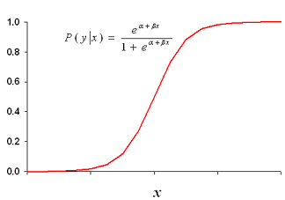
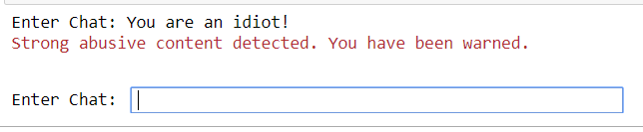
ABUSIVE CONTENT DETECTION
USE CASE
Insulting comments are increasing over social media sites and content sharing platforms. An intelligent application is required that can identify these comments and flag them to control social abuse.
Data Cleaning
APPLICATION FLOW
Tokenization
Stop Words Removal Bad-words Synonyms Mapping
Punctuation Removal Abbreviation Treatment
you | dad | come | stupid | ……
0.23 | 0.12 | 0.1 | 0.56 | …
0 | 0.24 | 0.3 | 0.33 | …
0.23 | 0.11 | 0.24 | 0.13 | …
0.11 | 0.09 | 0.18 | 0.06 | ..
TF-IDF Transformation
Chi Square Feature Selection
Modelling
Classification
RESULT

Slide 3
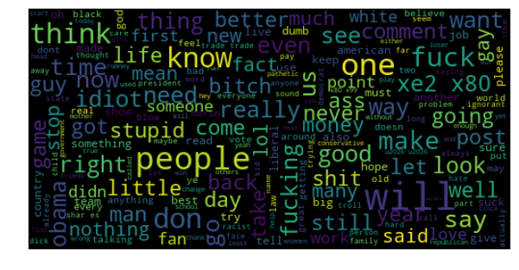
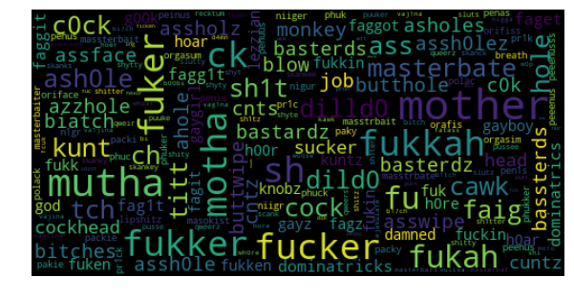
SUMMARY AND INSIGHTS
Model Summary
Model has an accuracy of 91.2% on training data and 81% on cross validation
Area under the curve is found to be 0.77
Logistic Regression is found to be the best suitable model in comparison to popularly used Naïve Bayes and SVM
1500 relevant features are selected using Chi square test
Common Chat Words
Abusive Word Variants
Insights
53% of comments which have abusive words are not actually abusive
For every one in five comments, abusive word variants are used to insult rather than direct abusive words
Typing errors are a common part of chat but are penalized heavily by model in case of a resemblance with abusive words

