Slide 1

CAP
Cryptographic Analysis Program
Column Transposition Cipher Help Presentation
Press Enter or click on your mouse button to continue

Slide 2

Column Transposition
Write the plaintext into a matrix by rows, then generate the ciphertext by selecting the columns in a given order
For example, given the plaintext “encryption algorithms” and a 5x4 matrix
KEY
1
2
3
4
E
Select the columns in the order 4 - 2 - 1 - 3
E
N
N
C
C
R
R
Y
P
T
I
Y
P
T
I
O
N
A
L
O
N
A
L
G
O
R
I
R
I
L
I
S
N
P
N
O
H
E
Y
O
G
T
C
T
A
R
M
G
O
R
I
T
H
M
S
T
H
M
S

Slide 3
Column Key
The key for a column transposition is the number of columns and the order in which they are selected
Both can be specified by a keyword:
the length of the keyword is the number of columns
the order of the letters in the keyword determines
the order in which the columns are selected

Slide 4
Example Key
For example, the keyword “general” defines a column transposition with 7 columns
To define the order of columns assign each letter a number based on its order in the alphabet
g e n e r a l
4
2
6
3
7
1
5

Slide 5
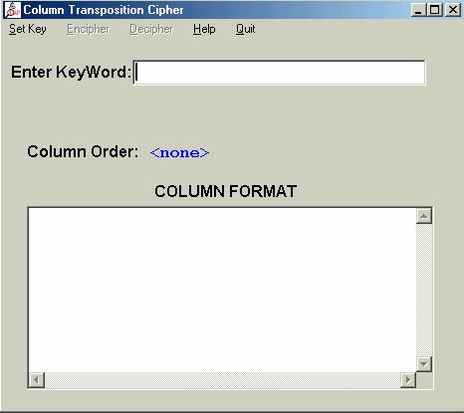
Using CAP
When you select Column Transposition, CAP presents a key window:

