Slide 1

CAP
Cryptographic Analysis Program
Affine Analysis Help Presentation
Press Enter or click on your mouse button to continue

Slide 2

Breaking the Affine Cipher
To break the Affine cipher all that is necessary is to find the substitution for two letters
  For example, say plaintext “e” is represented in the ciphertext by “c” and plaintext “t” is represented in the ciphertext by “f”
  These two substitutions define to affine equations:
2 = a*4 + b mod 26 (since e – character 4 is replaced by c – character 2)
5 = a*19 + b mod 26 (since t – character 19 is replaced by f – character 5)
Solving the two equations for a and b results in the affine key (21,22)
Or the affine equation:
c = 21*p + 22 mod 26

Slide 3
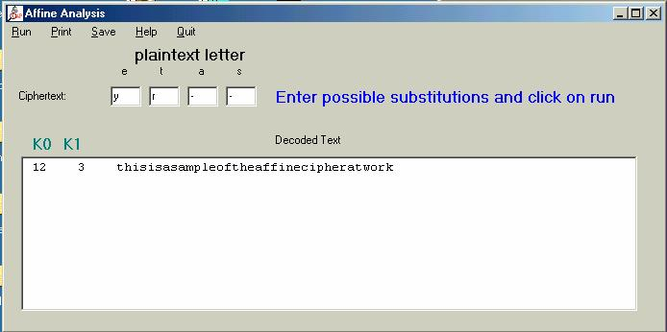
Using CAP
CAP will solve the equations provided you find at least two correct substitutions
Click on Run
Enter
possible
substitutions
If this appears to be plaintext then you were correct
Otherwise try another substitution

