Slide 1

CAP
Cryptographic Analysis Program
Keyword Cipher Help Presentation
Press Enter or click on your mouse button to continue

Slide 2

The Keyword Cipher System
Keyword cipher Process:
1. select a keyword - if any letters are repeated drop the second
and all other occurrences from the keyword
2. write the keyword below the alphabet, fill in the rest of the
space with the remaining letters in the alphabet in their
standard order

Slide 3
Example
If the keyword is COUNT:
plaintext
A
B
C
D
E
F
G
H
I
J
K
L
M
N
O
P
Q
R
S
T
U
V
W
X
Y
Z
ciphertext
C
O
U
N
T
A
B
D
E
F
G
H
I
J
K
L
M
P
Q
R
S
V
W
X
Y
Z
So a goes to c, b goes to o, . . .

Slide 4
Keyword Starting Position
The keyword does not have to start at the beginning of the plaintext alphabet
  it could start at any letter
  for example, “count” could start at “k”
plaintext
A
B
C
D
E
F
G
H
I
J
K
L
M
N
O
P
Q
R
S
T
U
V
W
X
Y
Z
ciphertext
M
P
Q
R
S
V
W
X
Y
Z
C
O
U
N
T
A
B
D
E
F
G
H
I
J
K
L

Slide 5
Example
If the keyword is “visit” (note, the second “i” in visit is dropped below) starting at “a” and the plaintext is “next”, the application is:
N E X T
plaintext
A
B
C
D
E
F
G
H
I
J
K
L
M
N
O
P
Q
R
S
T
U
V
W
X
Y
Z
ciphertext
V
I
S
T
A
B
C
D
E
F
G
H
J
K
L
M
N
O
P
Q
R
U
W
X
Y
Z
K
A
X
Q

Slide 6
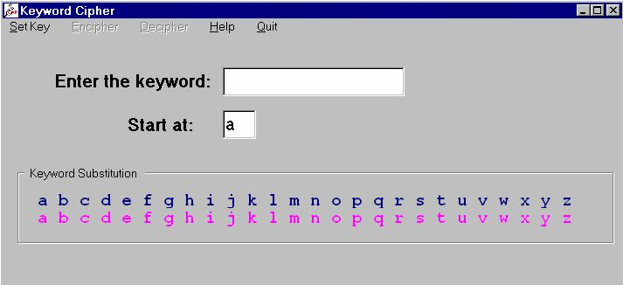
CAP Implementation
When you select the KeyWord cipher, CAP presents you with a KeyWord window
Select
Set Key
Encipher
Or
Decipher
Enter
Keyword

